Slide 1
Computational reproducibility
For R users

Slide 2
What’s that??
Definition
Data
Code
Should give the same results as the original paper
Access to
+
=
Isn’t it always the case when the code is shared??

Slide 3
Some studies
Hardwicke et al. 2021:
36% of computational reproducible when the code and data are shared
Cruwell et al 2023:
1 article out of 14 reproducible (and 3 others with minor deviations)
Stodden et al 2018:
32% reproducible with minimal effort/minor difficulty
That’s not a lot :/

Slide 4
How to become reproducible?
2 ways to improve it:
Making the results section computationnally reproducible
Having a virtual environment

Slide 5
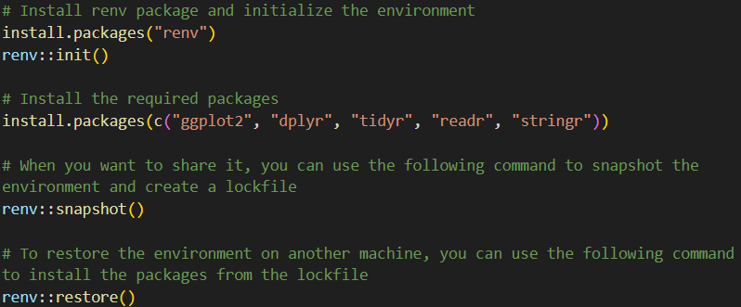
Virtual environment
Many different ways to do it, just an ex ample

Slide 6
Results section reproducible?
Quarto: Basically a pretty R markdown with more features and more friendly. https://quarto.org/
In Rstudio, File > New project > existing directory > Quarto manuscript
In Positron,
New > New File > Quarto Project > Manuscript project

Slide 7
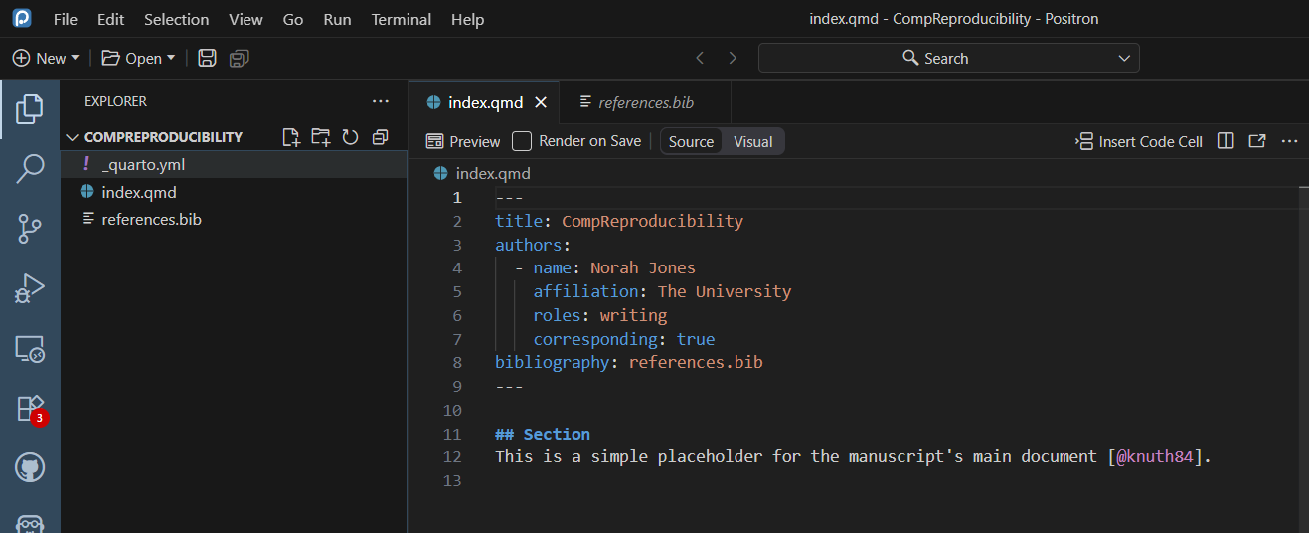
Quarto
Header

Slide 8
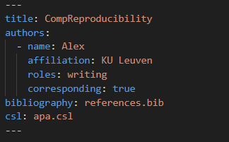
Final example
Specify the csl file (bibliography format)

Slide 9
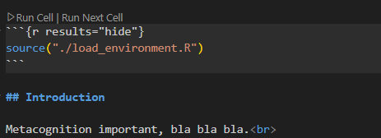
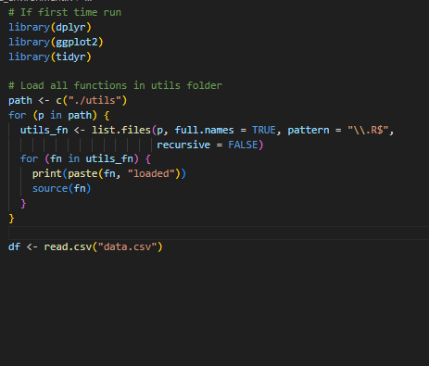
Final example
Cell: normal R script
Markdown text
Load every useful packages/dataframe

Slide 10
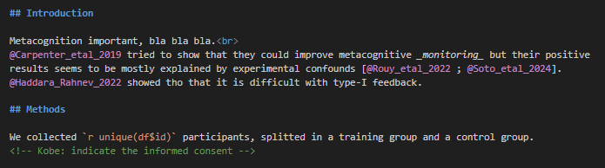
Final example
Possibility of HTML
Here it’s break line.
Header
In-text citation
Citation with bracket
Comments hidden from the final document
Inline R code
Will execute during the rendering
Keys are contained in the bibliography file, with extension .bib
Can be obtained by the export of your bibliography on Zotero/Mendeley

Slide 11
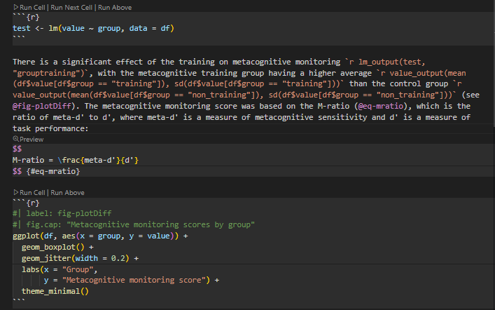
Results
Show linear regression output
Definition of the model
Inline r code for the results
Plot
Show formatted mean and standard deviation of the group

Slide 12
function_APA.R
lm_output <- function(model, effect_name = -1, to_round = options()$to_round)
ANOVA_output <- function(model, effect_name, to_round = options()$to_round)
glmmtmb_output <- function(model, effect_name, to_round = 2, IC)
lmer_output <- function(model, effect_name, to_round = 2, IC)
glmer_output <- function(model, effect_name, to_round = 2, IC)
value_output <- function(mean, sd, to_round = 2)

Slide 13
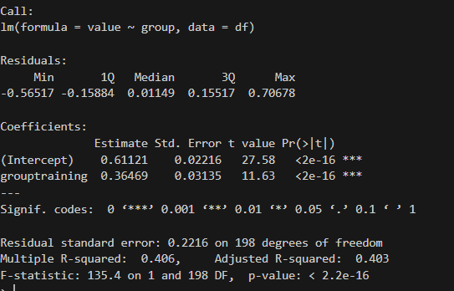
lm_output
lm_output(model, effect_name, to_round = options()$to_round)
Default based on global options
Number of digit to show after the comma
The name of your effect
Linear model
1
2
return: b = coefficient, t(ddf) = t_value, p-value, CI95%

Slide 14
value_output
value_output(mean, sd)
return: (M = value, SD = value)

Slide 15
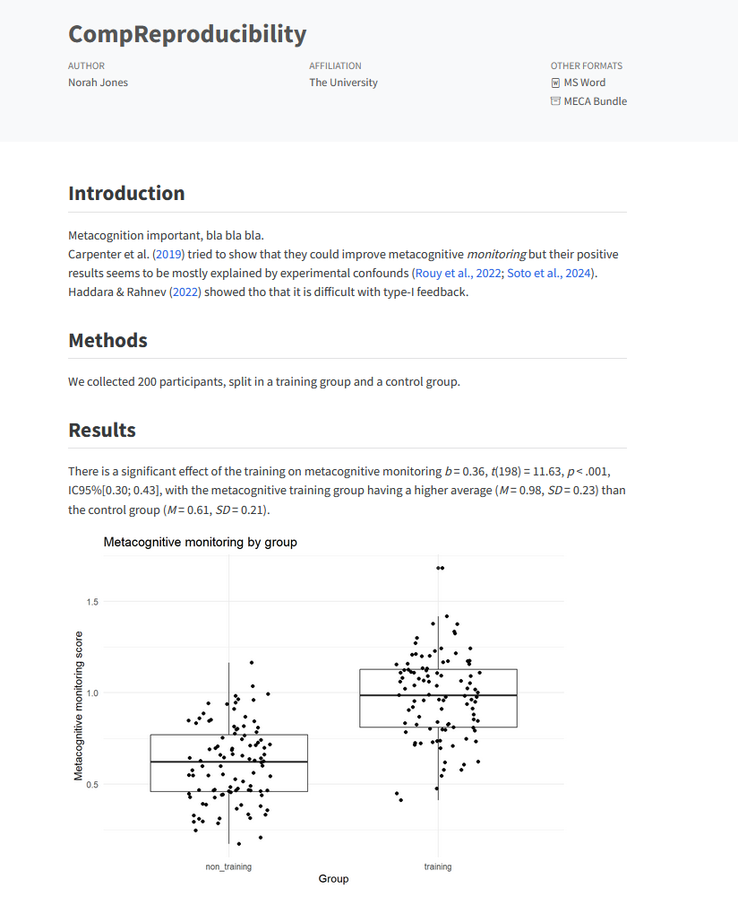
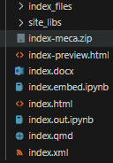
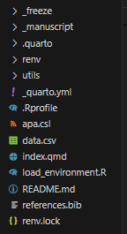
After rendering
quarto render index.qmd

Slide 16

Referencing figures
code
In the code chunk, label your plot and indicate the caption of the figure with “fig.cap”
fig key word is important: it designates the fact that it’s a figure
Avoid underscore in the name of the figure
Forward references work
In _quarto.yml, you can specify how you call your figure title:
crossref:
fig-title: "Figure"
In the text
(see @fig-plotDiff)

Slide 17

Referencing equations
code
Label the equation after the content
In the text
(see @eq-mratio)

Slide 18

Pros and cons
Cool because:
Computationnaly reproducible
Way more flexible: addition or remove of participant doesn’t matter
Standardized way to report
Less burden with the copy paste of results/referencing
Cons:
Collaboration a bit tedious, notably for the comment/writing suggestion (github?)
Can’t write your results section on your phone during your flight
Can take time to render the file
Possibility of using a save_or_load() function
Or, save the .Rdata

