Slide 1
Graph-based Multi-view Object Counting
via VGGT + SAM3

Slide 2
CCGS vs. Ours
CCGS
Ours
Input: RGB images, instance masks, pointmaps
For each adjacent image pair (t → t+1):
For each pixel (i,j) in image t:
Find closest pixel in t+1 by minimizing pointmap distance
→ correspondence mapping φ : (i,j) → (k,l)
For instances a ∈ mask_t and b ∈ mask_t+1:
Overlap = pixels of a whose φ lands inside b
Cost(a,b) = 1 − overlap / min(|a|,|b|)
Hungarian algorithm → optimal 1-to-1 match
Input: RGB images, instance masks, pointmaps optional: VGGT confidence, camera poses
For each instance: generate Graph node (image_index, instance_id)
For all image pairs (t1 → t2):
Optional: discard image pairs with large camera distance
restrict to instance pixels (mask > 0)
For each pixel (i,j) in image t1:
Find closest pixel in t2 by minimizing pointmap distance
Discard distant pixels
→ correspondence mapping φ : (i,j) → (k,l)
For instances a ∈ mask_t1 and b ∈ mask_t2:
Overlap = pixels of a whose φ lands inside b
Cost(a,b) = 1 − overlap / min(|a|,|b|)
Discard low percentage matches
Hungarian algorithm → optimal 1-to-1 match
Add graph edge between matched instances
count connected components in the graph → each is one instance

Slide 3
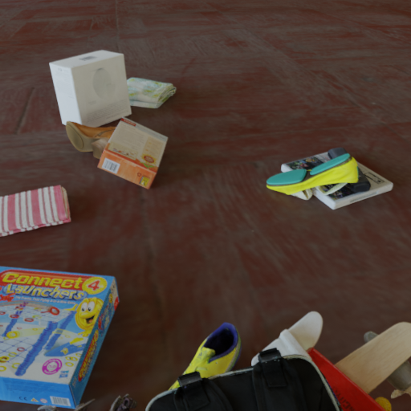
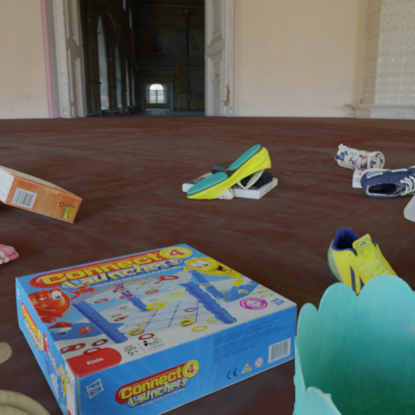
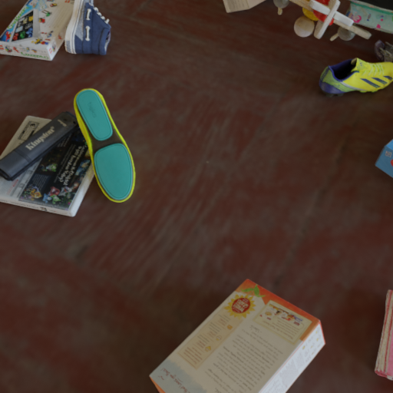
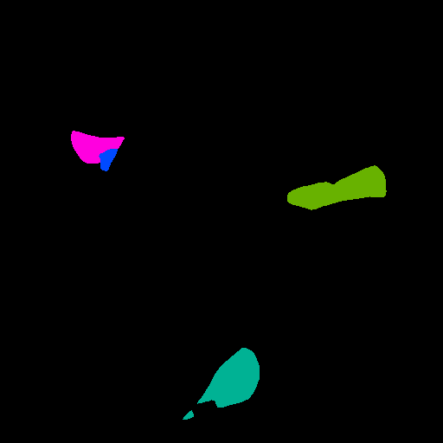
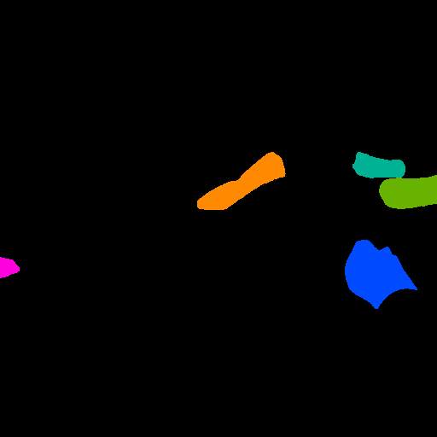
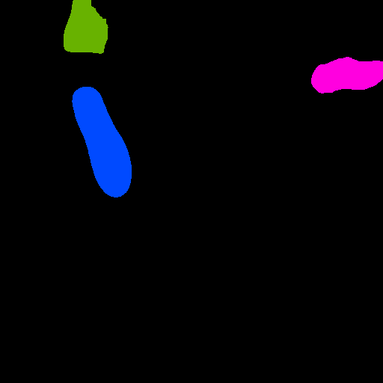
Walkthrough
3 input images + SAM3 instance masks (prompt: "shoe")
RGB: 00001.png
RGB: 00002.png
RGB: 00008.png
3
SAM3 mask - 4 instances
SAM3 mask - 5 instances
SAM3 mask - 3 instances

Slide 4
Walkthrough
For all instances: Generate graph nodes
RGB: 00001.png
RGB: 00002.png
RGB: 00008.png
2
3
3
5
4
3
1
2
1
2
3
1
4
SAM3 mask - 4 instances
SAM3 mask - 5 instances
SAM3 mask - 3 instances

Slide 5
Walkthrough
For all image pairs: Compute instance matching cost
Img1/ img2 | inst. 1 | inst. 2 | inst. 3 | inst. 4 | inst. 5
inst. 1 | - | - | - | - | -
inst. 2 | - | - | - | - | 100%
inst. 3 | - | - | - | - | -
inst. 4 | 95.8% | - | - | - | -
RGB: 00001.png
RGB: 00002.png
3
3
5
4
1
2
2
3
1
4
SAM3 mask - 4 instances
SAM3 mask - 5 instances

Slide 6
Walkthrough
For all image pairs: Compute instance matching cost
Img1/ img0 | inst. 1 | inst. 2 | inst. 3 | inst. 4 | inst. 5
inst. 1 | - | - | - | - | -
inst. 2 | - | - | - | - | 100%
inst. 3 | - | - | - | - | -
inst. 4 | 95.8% | - | - | - | -
Img0/Img2 | Inst1 | Inst2 | inst3
Ints1 | - | - | -
Itns2 | 95,4% | - | -
Inst3 | - | - | -
inst4 | - | - | 95,2%
Img1/Img2 | Inst1 | Inst2 | inst3
Inst1 | - | - | 100%
Inst2 | - | 85,2% | -
Inst3 | - | - | -
Inst4 | - | - | -
Inst5 | 92,9% | - | -

Slide 7
Walkthrough
For all instance pairs: Find optimal match
Img1/ img0 | inst. 1 | inst. 2 | inst. 3 | inst. 4 | inst. 5
inst. 1 | - | - | - | - | -
inst. 2 | - | - | - | - | 100%
inst. 3 | - | - | - | - | -
inst. 4 | 95.8% | - | - | - | -
Img0/Img2 | Inst1 | Inst2 | inst3
Ints1 | - | - | -
Itns2 | 95,4% | - | -
Inst3 | - | - | -
inst4 | - | - | 95,2%
Img1/Img2 | Inst1 | Inst2 | inst3
Inst1 | - | - | 100%
Inst2 | - | 85,2% | -
Inst3 | - | - | -
Inst4 | - | - | -
Inst5 | 92,9% | - | -

Slide 8
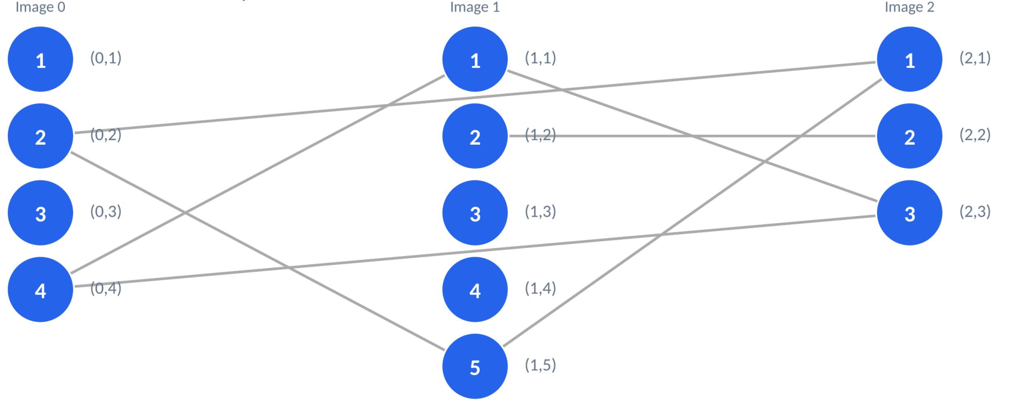
Walkthrough
For all matching instances: Add edges to the graph
Img1/ img0 | inst. 1 | inst. 2 | inst. 3 | inst. 4 | inst. 5
inst. 1 | - | - | - | - | -
inst. 2 | - | - | - | - | 100%
inst. 3 | - | - | - | - | -
inst. 4 | 95.8% | - | - | - | -
Img0/Img2 | Inst1 | Inst2 | inst3
Ints1 | - | - | -
Itns2 | 95,4% | - | -
Inst3 | - | - | -
inst4 | - | - | 95,2%
Img1/Img2 | Inst1 | Inst2 | inst3
Inst1 | - | - | 100%
Inst2 | - | 85,2% | -
Inst3 | - | - | -
Inst4 | - | - | -
Inst5 | 92,9% | - | -

Slide 9
Walkthrough
Count components: 3 connected components, 4 singletons → 7 counted shoes

