Slide 1
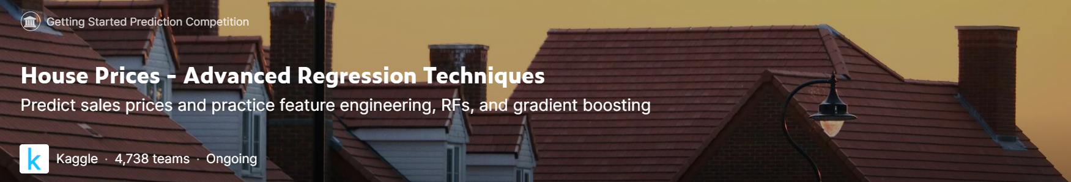
COMP4433 Competition
House Price Prediction
AllSidesChecker
LI Tong​ 21101988D
LIU Yuzhou 21100602D
LU Zhoudao​ 21099695D​
YANG Yifan 20075243D​

Slide 2
1
Data Visualization
2
Feature Engineering
CONTENTS
3
Modelling
4
Conclusion

Slide 3
Data Visualization
PART 1
Notes:
Intuitive analysis data

Slide 4
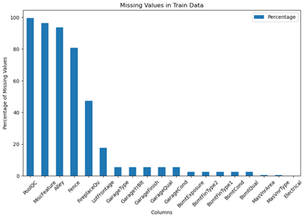
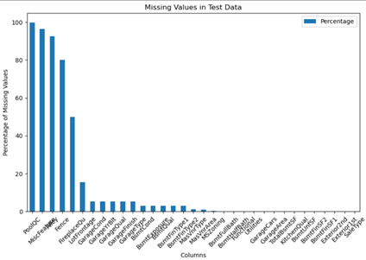
Missing Value
Notes:
Missing Values may lead to confusion to the analysis and processing in the following prediction. We first analysis the missing values in both training and testing data sets, by using the bar plots built in the library matplotlib.

Slide 5
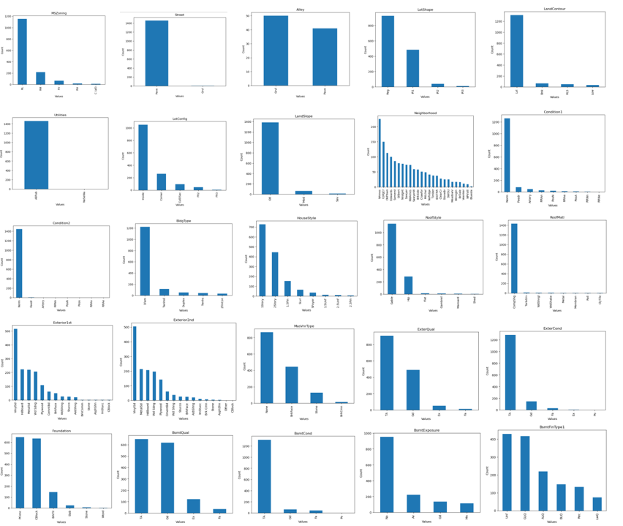
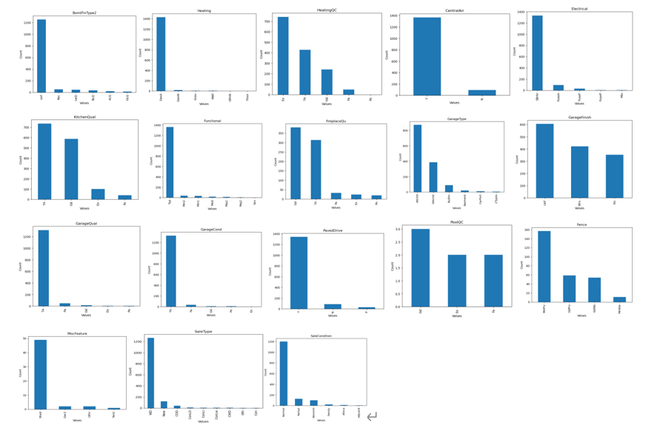
Categorical columns attribute
Notes:
For the categorical columns, there may be only two attributes in a single categorical with which one attribute has the most percentage and the other appears few times for example the categorical “Street”. We can see clearly from these bar plots and know that some of the features are not that useful

Slide 6
Feature Engineering
PART 2

Slide 7
Null values Handling
Encoding
combination
Data Transformation

Slide 8
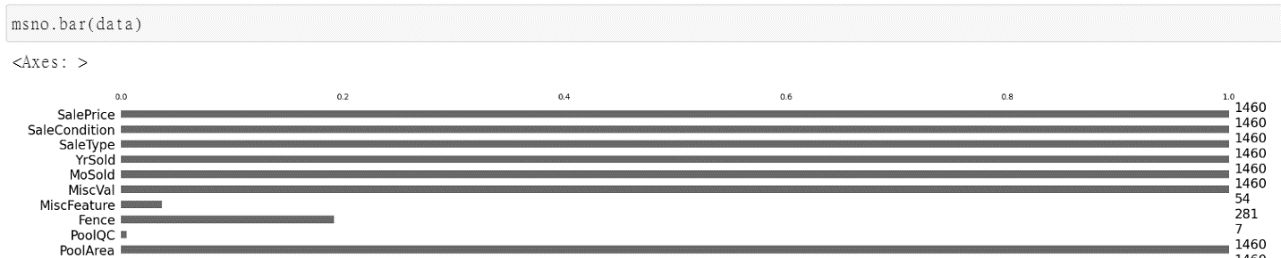
Null values Handling
Try using a picture to display the missing value.
This images can only show the general situation (or the trend of the data) and are not conducive to us setting the value of the defined percentage.

Slide 9
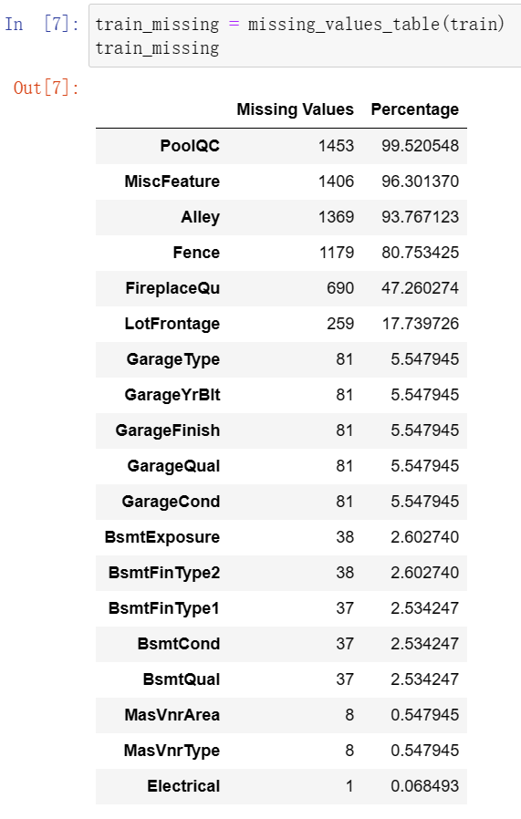
Null values Handling
15%
For attributes with missing value > 15%
Directly delete these kinds attributes. Excessively high data missing ratio will reduce the completeness and reliability of the data set.
For attributes with missing value <= 15%
Try to fill the missing values with appropriate values and then retain the attribute.

Slide 10
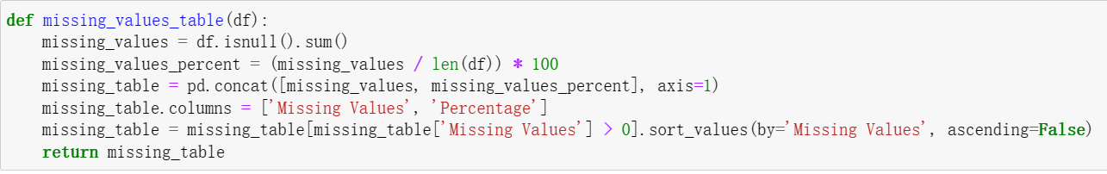
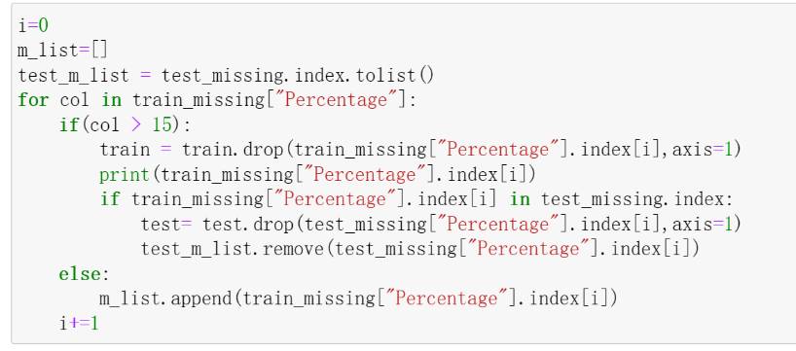
Null values Handling
15%
Find from the list, find the percentage > 15% and use the column name to drop those attributes in data.

Slide 11
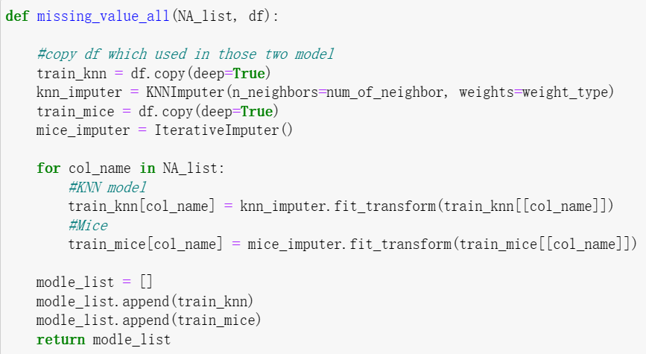
Null values Handling
Three methods to fit in missing value
KNN
Mice
Both

Slide 12
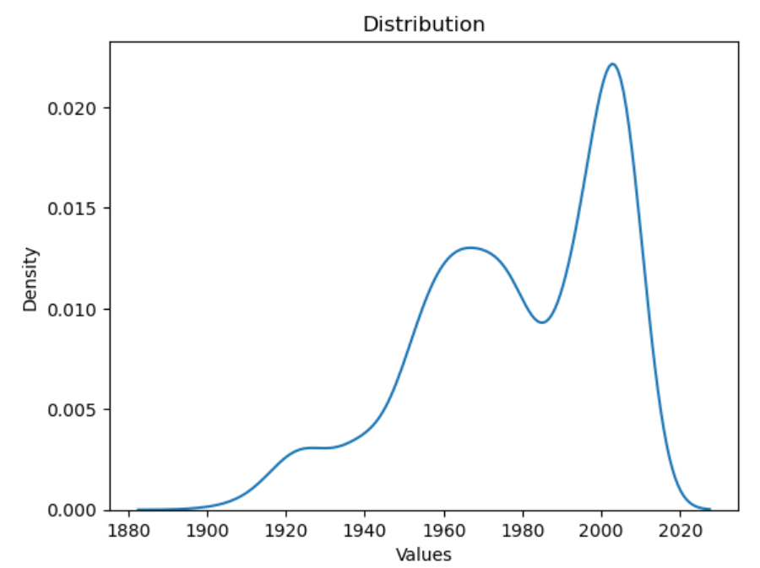
Null values Handling
The thought process
Previous view: 1. Use mean to fit in
For “GarageYrBlt”
The mean value here is around 1978.
Fit in with mean value will cause negative impact on prediction!

Slide 13
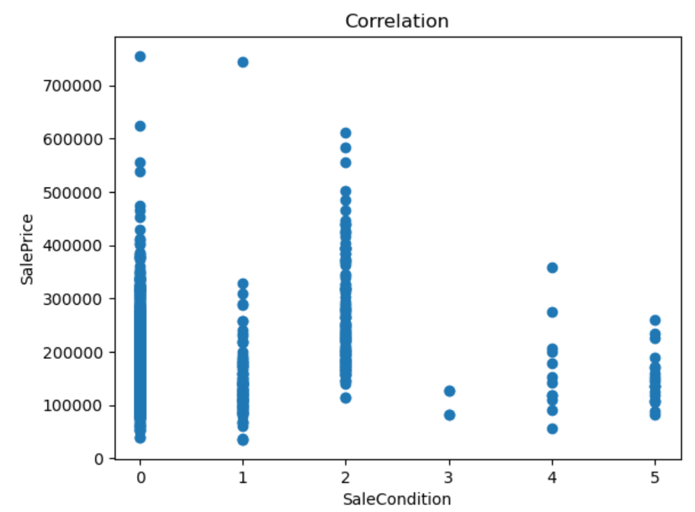
Null values Handling
The thought process
Previous view: 2. ignore the text attributes
For “SaleCondition”
Image data shows that it has a strong correlation with housing prices.

Slide 14
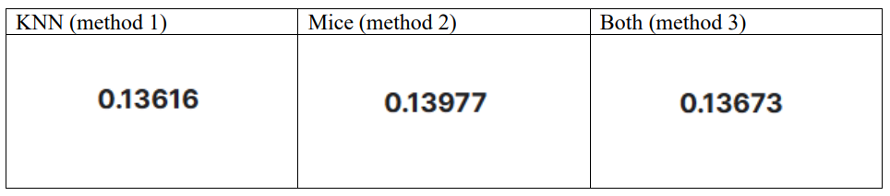
Null values Handling
Result display
May still consider the meaning of take mean of KNN and Mice.
Based on the prediction results of the three methods, method one often has the most ideal results.

Slide 15
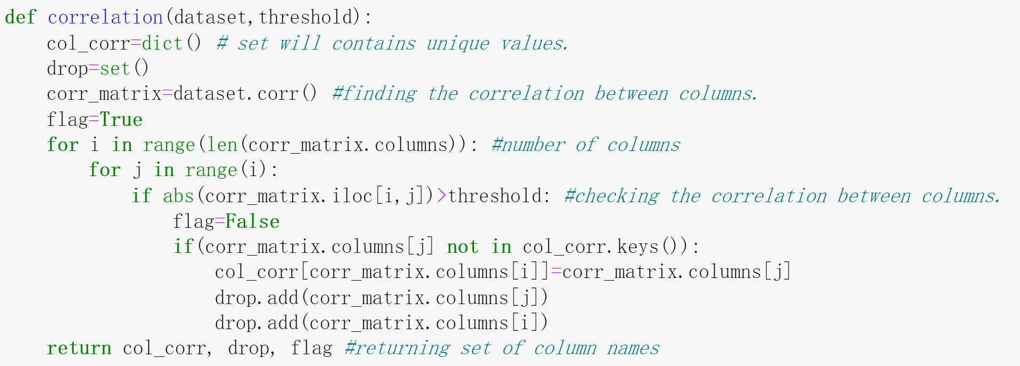
Combination
Select similar columns:
Find similar columns based on their correlation coefficient.
Return fields:
Col_corr: The columns have strong correlation ship.
Drops: The name of the columns we need to drop those columns.
Flag: tell the program that there is no any pair of columns have correlation coefficient greater than the threshold.

Slide 16
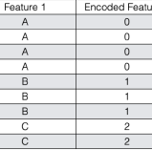
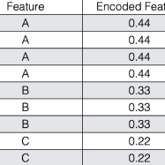
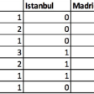
Or other methods?
Encoding
01
03
One-hot Encoding
02
Labeled Encoding
Frequency Encoding

Slide 17
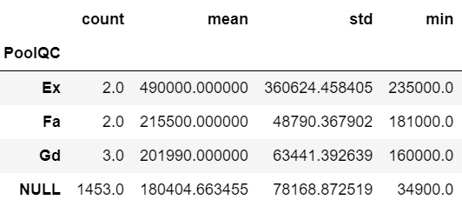

Encoding
These encoding ways are universal, are there any methods just focus on regression task?
We can create a new method!
some specific categorical features may lead to higher prices overall.
For example, no matter if the pool quality is excellent or not, houses with pools are more expensive on average
How to handle this kind of NULL?
P.S.: ‘PoolQC’ is deleted when handling NULL, we just want to show this situation exists

Slide 18
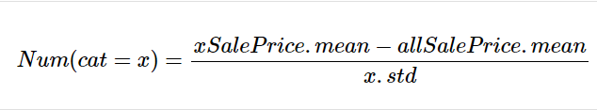
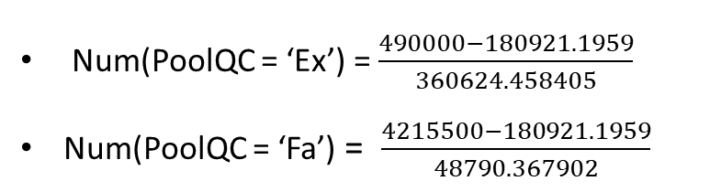
Encoding
Num(PoolQC = ‘Ex’) = $\frac{490000−180921.1959}{360624.458405}$
Num(PoolQC = ‘Fa’) = $\frac{4215500−180921.1959}{48790.367902}$

Slide 19
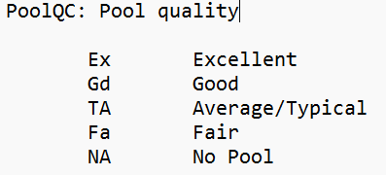
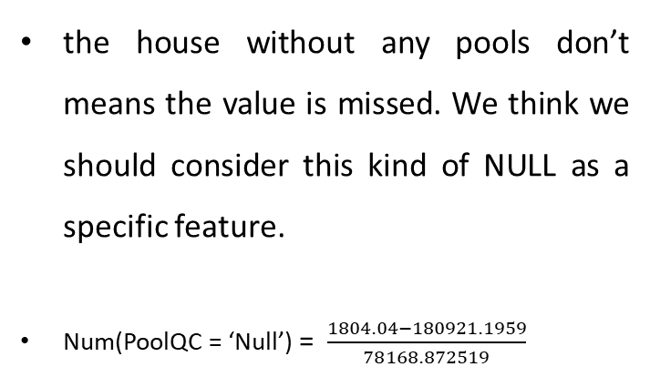
Encoding
the house without any pools don’t means the value is missed. We think we should consider this kind of NULL as a specific feature.
Num(PoolQC = ‘Null’) = $\frac{1804.04−180921.1959}{78168.872519}$

Slide 20
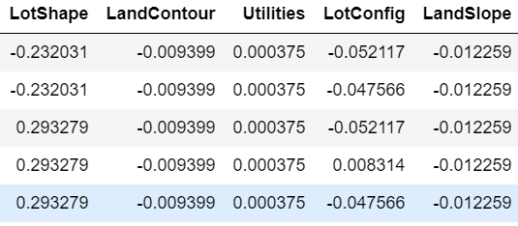
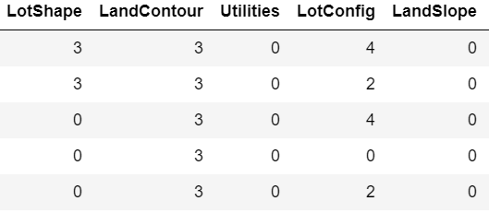
Good performance!!
Encoding
0.13673
Our encoding
0.1515
Labelled encoding

Slide 21
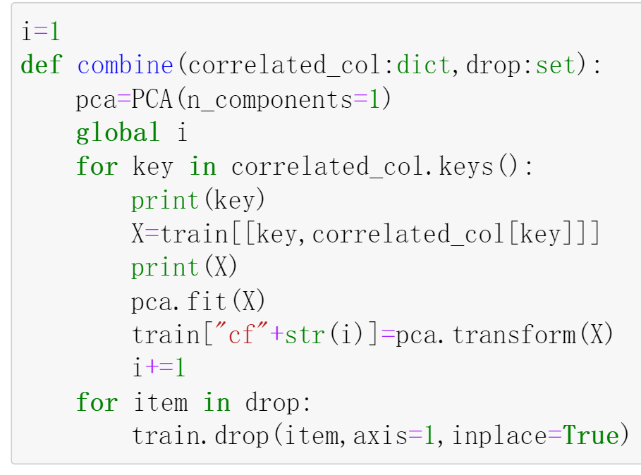
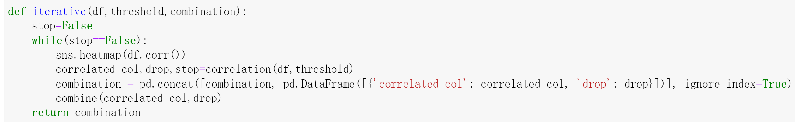
Combination
Working procedure:
Simply drop 1column? -> ….
Combine:
To combine columns with high correlation ship. And drop the original columns which are used to be combined.
Iterative:
To generate heat matrix each time, and do combination based on the matrix. Stop when there is no any pairs of columns have correlation coefficient greater than the threshold.

Slide 22
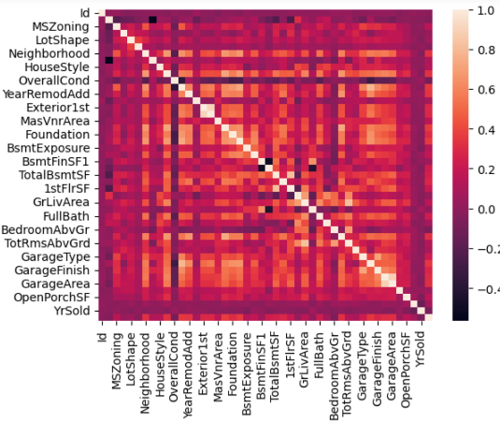
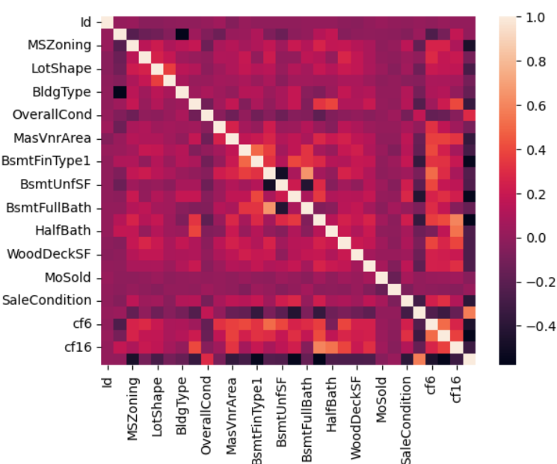
Combination
To
Result:
[1] columns have been reduced a lot.
[2] The correlation coefficient has been decreased under the threshold.
Notes:
When we combine different columns, information from different columns will be fused. This is a double-edged sword. As there could be redundant information be eliminated (The good thing). There could also be some useful information that could be ignored.
As threshold increases, the performance decreases (More columns could be remained). That might be because some redundant information is included which could affect the result.
As threshold decreases, the performance decreases (Less columns could be remained). That might be because some useful information has been eliminated, which is useful to improve the final result.

Slide 23
Combination
Threshold | Performance
0.75 | 0.14231
0.65 | 0.13616
0.60 | 0.13977
0.55 | 0.14032
Performance under different threshold:
We tried 4 different thresholds, and we found that the best value is attained at 0.65.

Slide 24
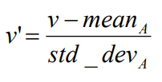
Data Transformation
Data transformation is used to remove noise from data, scaled to fall within a small, specified range. We choose z-score normalization as our function

Slide 25
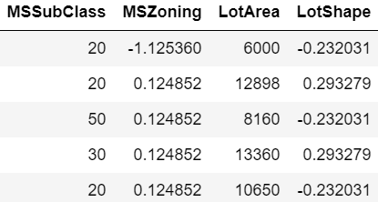
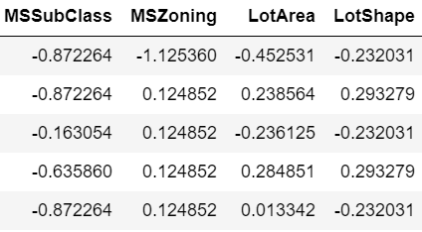
Data Transformation
Without transformation
With transformation
VS
0.13187
0.12986

Slide 26
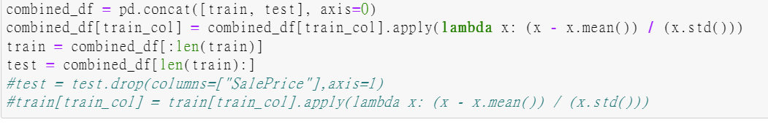
Good performance!!
Data Transformation
0.12741
Use train and test to calculate mean / std together
0.12745
Use train/ test to calculate mean /std separately
using the attributes for all samples belonging to
the same class to fill the missing value is smarter!!!

Slide 27
Modelling
PART 3

Slide 28
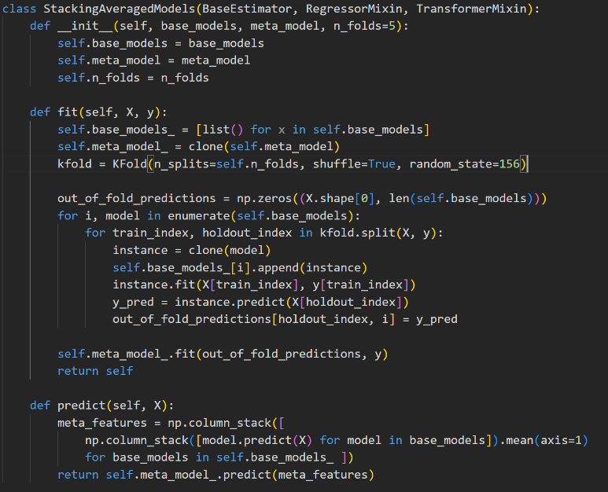
Stack Regressor
RandomForest
XGBoosting
etc
Notes:
we try to build a new class which called StackingAveragedModels which is based on the basic models such as RandomForest and XGBoosting. The basic idea of creating this model is to use stack which could combine different basic individual models to make a new meta model as input so that the meta model could learn from the collective knowledge of the base models and might make more accurate predictions.

Slide 29
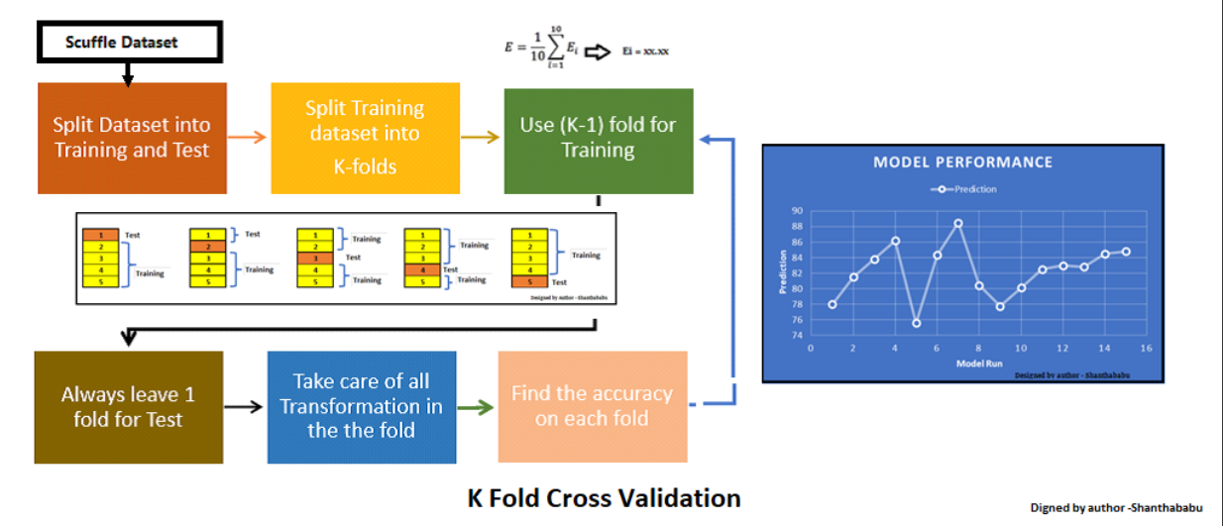
K-fold Cross Validation
Notes:
K-fold cross-validation has also been used in every single model we try to train. Since it is folded as equally sized subsets and could train the model in many times which could reduce dependence on a single partition. It also helps keep the stability and generalization capabilities of each model. We try to use this method to make the predictions more accurate in each training model.

Slide 30
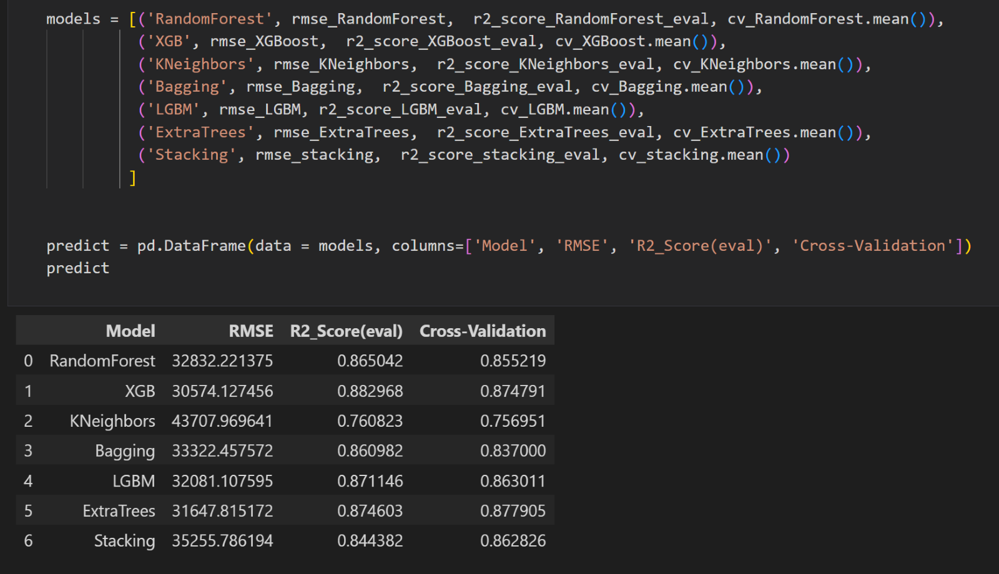
Compare models
root mean
squared error
R-squared score
Notes:
we check the scores they get based on cross_val_score which cross validation is used in models that help mitigate the potential issues of overfitting or underfitting, R-squared score (r2_score) and root mean squared error (RMSE). Since we have split the training data as train one and evaluation one, we compare the prediction saleprice and the evaluation data actual price could get the scores
XGBoost’s RMSE and r2 score is the best, cross-validation is a little less than ExtraTrees but not too much. We can conclude that XGBoost is the best model. It seems that our integrated model is not good enough, but we believe this is a good try.

Slide 31
How to improve?
1
How to make the single model better?
Optimizing the hyperparameters
2
How to combine models better?
stackingRegressor
3
More?

Slide 32
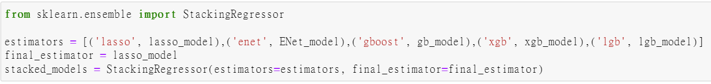
How to combine models better?
Stacking regression is an ensemble learning technique to combine multiple regression models via a meta-regressor.

Slide 33
Good performance!!
More?
Because of the outstanding performance of XGboost, we want to combine StackingRegressor and XGBoost for prediction. For example, we assign 0.6 weights to StackingRegressor and 0.4 to XGBoost.
StackingRegressor | XGBoost | score
0 | 1 | 0.12785
0.6 | 0.4 | 0.12732
0.5 | 0.5 | 0.12728
0.8 | 0.2 | 0.12741
1 | 0 | 0.12803

Slide 34
Conclusion
PART 4

Slide 35
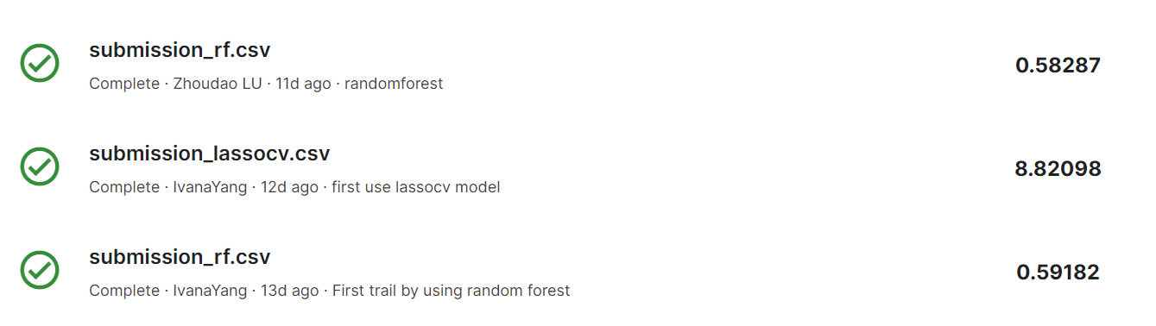
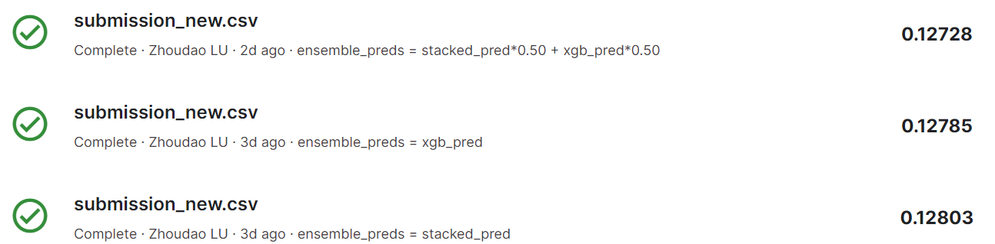
55 entries in total
Conclusion

Slide 36
THANKS

