Slide 1
TADaaM Talks
IMPROVING I/O PERFORMANCES OF GYSELA
Lou-Poueyou Alexandre
Inria Bordeaux
24/03/2026
<numéro>
Next

Slide 2
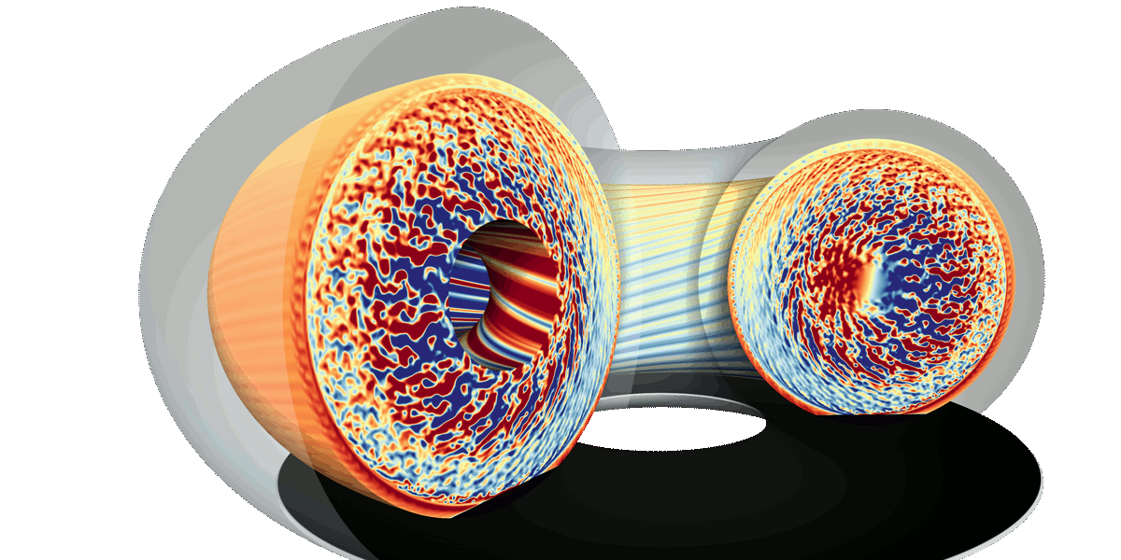
Introduction : Gysela
What is gysela ?
C++ / Fortran library & application
Gyrokinetic semi-lagrangian code
Used for simulation of plasma’s turbulence in tokamac
Previous
<numéro>
Next

Slide 3
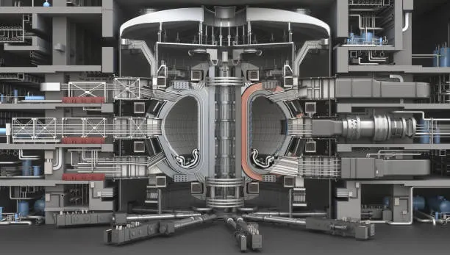
Introduction : Gysela
What is gysela ?
Tokamak fusion’s reactor
Previous
<numéro>
Next

Slide 4
Introduction : Gysela main problem for I/O
Regular checkpoints
  Save full simulation state
  Dominate runtime
Large data output
  Many processes writing simultaneously
Slows down the simulation
Previous
<numéro>
Next

Slide 5
Introduction : objectives
Optimize gysela I/O operations
Focus on checkpoint performance
Use various HPC libraries to explore I/O strategies for checkpointing
  PDI
  HDF5
  MPI-IO
Previous
<numéro>
Next

Slide 6
What has been explored ?
Gysela configurations
  Yaml for gysela
  Yaml for PDI
Striping on BeeGFS
  Benchmark for multiple stripe count
Subfiling with PDI
  New version of PDI who support subfiling
Previous
<numéro>
Next

Slide 7
Gysela configurations
2 yaml files
Gysela yaml config
  Deciding the size of each dimension for the simulation
PDI yaml config
  Declaration of datas and types
  I/O events and strategies
Previous
<numéro>
Next

Slide 8
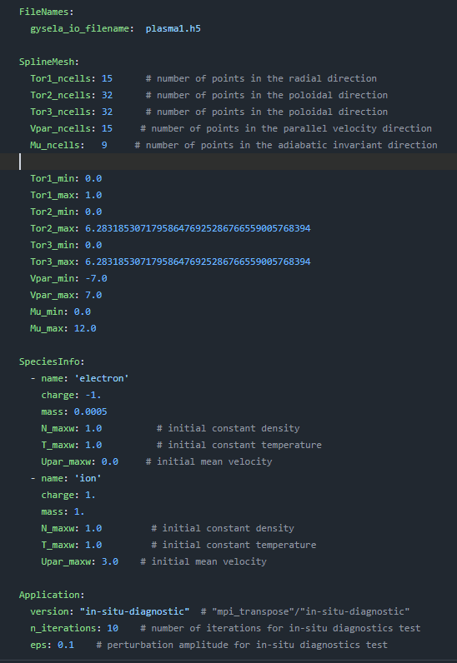
Gysela configurations
Gysela yaml config
Previous
<numéro>
Next

Slide 9
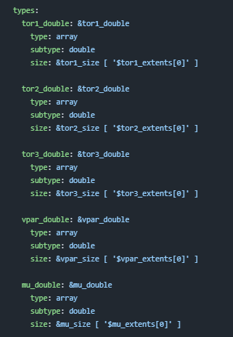
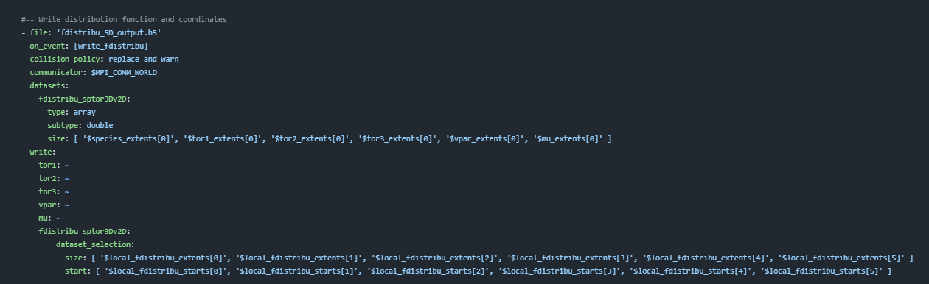
Gysela configurations
PDI yaml config
Previous
<numéro>
Next

Slide 10
Striping on BeeGFS
Splitting file into multiple chunks
Each stripe is stored on a different storage target
  Parallel writes across multiple servers
Stripes count = number of storage targets
Previous
<numéro>
Next

Slide 11
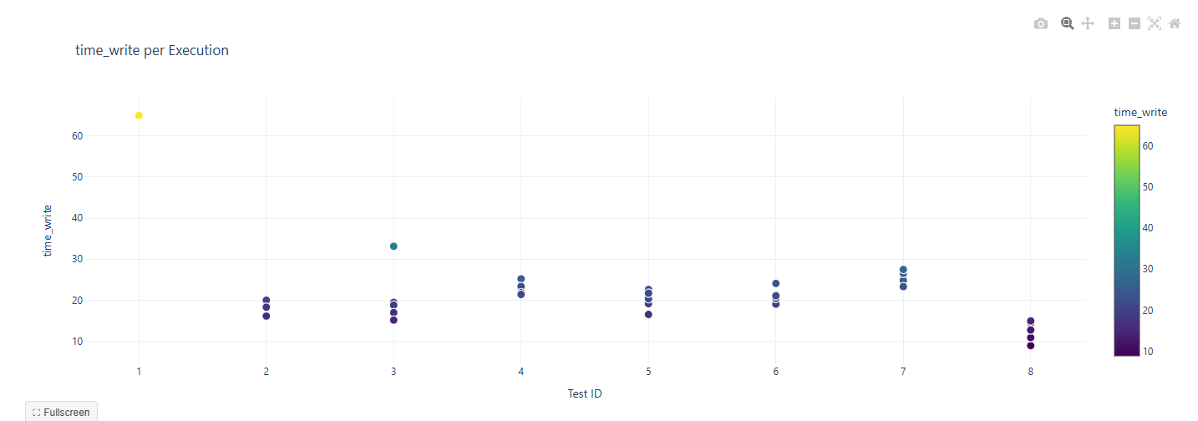
Striping on BeeGFS
Experiment run on Bora ( 2x 18-core Cascade Lake Intel Xeon Skylake Gold 6240 @ 2.6 GHz ) with stripe count variation with fixed chunksize (512K)
Previous
<numéro>
Next

Slide 12
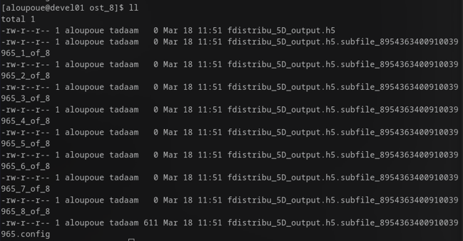
Subfiling with PDI
Divide file into multiples files
  Managed by a config file
Subfiling avaible with HDF5
  Version 1.14
PDI now support subfiling
  Flag `subfiling: <number>`
Previous
<numéro>
Next

Slide 13
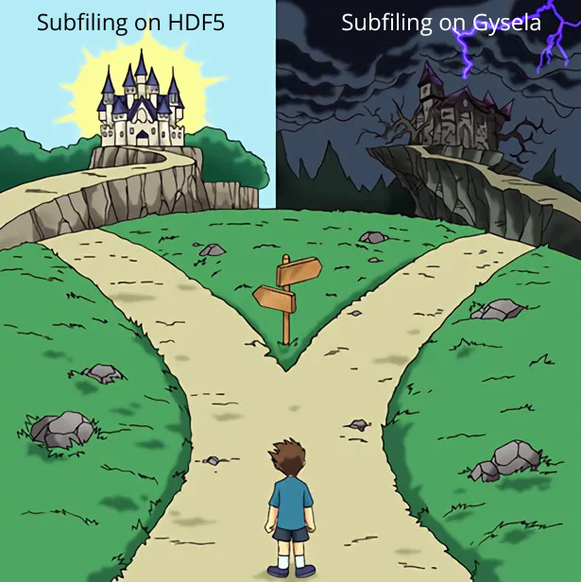
Subfiling with PDI
Subfiling on PDI is new
  09/03/2026
Gysela not being tested with
  Multiple problems
Leads to find a patch
Previous
<numéro>
Next

Slide 14
Conclusion
Making some experiment for subfiling
Explore other I/O strategies
  MPI-IO parameters
Thanks
Previous
<numéro>

