Slide 1
Mobile Robotics
Team Members:
Alex Lundin, Geet Babaria, Justin Horak

Slide 2
Overview of Architecture
Main program
Communicates with control loop
Receives data from sensors
Subroutines
Connect hardware and main
Layered (Strick)
Each layer provides functionality directly above
Tri-hybrid
Mobile robotic system
hybrid system
combines three patterns
Control loop
Top decision piece
receives the environmental data from the main program
Listens for interrupts

Slide 3
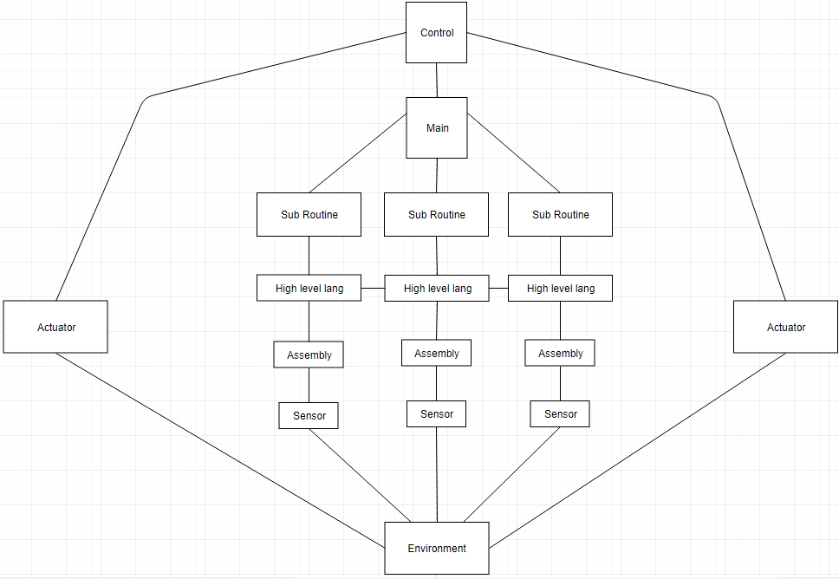
Architecture Graphical Diagram

Slide 4
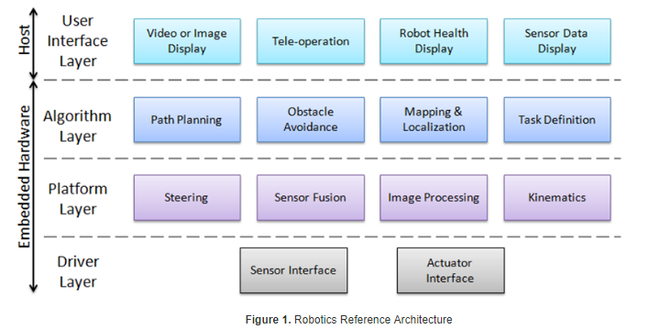
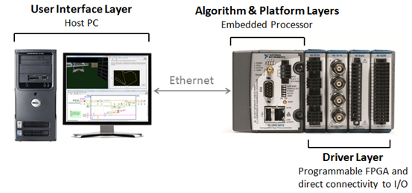
Additional information (optional)
Example of layered robotics system found online
Left shows visualization of layers
Right shows physical implementation
[1]
[1]
We anticipate extending our system would be difficult
“Sharing sensor data across different layers of the software stack is a good idea, but comes with considerable integration pain[1]”

Slide 5
How 4 requirements are handled
Req1, accommodate deliberative and reactive behavior
Control Loop (improved from layers)
Simplicity captures basic interaction between robot and outside
Layers
Provides control loop with way to decompose into components
More components available for delegation and abstraction to guide design
Req2, allow for uncertainty
Control loop
reduces the unknowns through trial and error
Layers
more knowledge as you move up layers, handling uncertainty
Req3, must account for dangers
Interrupt handler
Breaks out of control loop for dangers
Provides layers with immediate reset and task prioritization
Req4, must give the designer flexibility
Control loop,
Major components are separated and can be replaced independently
Layers
Strict layering for simple relationships
Red shows how our hybrid differs from the class lecture slides
Indicates an improvement
Indicates staying the same
[2]

Slide 6
Textual Discussion of Architecture
Scenarios
Boot up:
Control
sets up all the necessary processes
Including an interrupt handler
has the ability to stop the loop
handles immediate needs
Starts the infinite loop
Contains decision logic
Main
Retrieves data from subroutines
Sends data to control
Subroutines
Retrieves data from actuators
Sends data to main
Danger:
Actuator
Detects threat
Has a interrupt signaler built directly into hardware
Subroutines
Retrieve data from actuator
Sends data to main
Main
Retrieves data from actuators
Sends data to control
Control
Stops loop
Handles threat

Slide 7
Assessment comparison features
 | Control Loop | Layers | Implicit Invocation | Blackboard | Tri-hybrid Robotic System
Task Coordination | +- | - | ++ | + | +
Dealing with Uncertainty | - | +- | +- | + | +
Fault Tolerance | +- | +- | ++ | + | +
Safety | +- | +- | ++ | + | +
Performance | +- | +- | ++ | + | -
Flexibility | +- | - | + | + | +
Simple loop
More knowledge at higher layers
Control loop, trial and error
Hardware Interrupts
Layered communication
Strick Layers, simple relationships
[2]
Main and control independent, easy rework

Slide 8
4 requirements
Req1 –Architecture must accommodate deliberative and reactive behavior. Robot must coordinate the actions it undertakes to achieve its designated objective with the reactions forced on it by the environment
Req2 --The architecture must allow for uncertainty. The circumstances of a robot’s operation are never fully predictable. The architecture must provide a framework in which the robot can act even when faced with incomplete or unreliable information
Req3 –The architecture must account for dangers inherent in the robot’s operation and its environment. By considering fault tolerance, safety, and performance the architecture must help maintain the integrity of the robot, its operators, and its environment. Problems like reduced power supply, dangerous vapors, or unexpectedly opening doors should not lead to disaster
Req4 –The architecture must give the designer flexibility. Application development for mobile robots frequently requires experimentation and reconfiguration. More over, changes in tasks may require regular modification.
[2]

Slide 9
References
[1] Ni.com. (2018). A Layered Approach to Designing Robot Software - National Instruments. [online] Available at: http://www.ni.com/white-paper/13929/en/ [Accessed 3 Oct. 2018].
[2] Dr. Pushpa Kumar, Lecture 11, Topic: "Module5-extra”, SE-4352.001, Software Engineering, University of Texas at Dallas, ECSS, 09/25/2018

Slide 10
Contact Slide
Alex Lundin
Sr, Software Engineering
aml140830@utdallas.edu
Geet Babaria
Sr, Software Engineering
gxb120730@utdallas.edu
Justin Horak
Sr, Software Engineering
jmh161030@utdallas.edu

