Slide 1
CS6361 Project, Part 2
Fall 2006
The Design Firm of
  Bouchier, Fischer, Herschbach, & Nina

Slide 2
Agenda
Team Organization
Tasks Completed
  Previous requirements issues resolved
  Dependency graph refinements (with security added)
Tasks in progress
  New requirement integration (security)
  UML & SIG graphing
  Implementation (Iteration 2)

Slide 3
Team Organization
Paul Bouchier: Dynamic Content Dev.
JSP/TomCat on Linux, Requirements analysis
Jon Fischer: User rep & DB expert
Conflict resolution, mySQL
Shaun Herschbach: Domain rep, Requirements analysis, Presentation organizer
Chris Nina: User Interface Dev.
FrontPage

Slide 4
Requirement issue resolutions
Issue: How to solve conflicts?
  Resolution: Conflict resolution policy order
Issue: Admin functionality?
  Resolution: Admin functionality included
Issue: External interfacing?
  Resolution: Email interface for notification
Issue: Meeting monitoring?
  Resolution: Dropped meeting monitoring

Slide 5
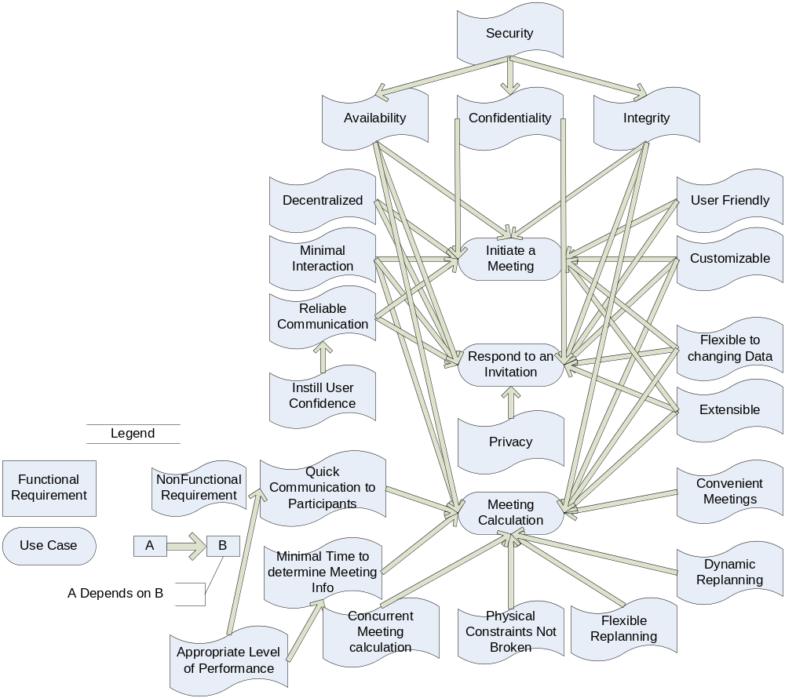
NFR Dependency Graph Refinement

Slide 6
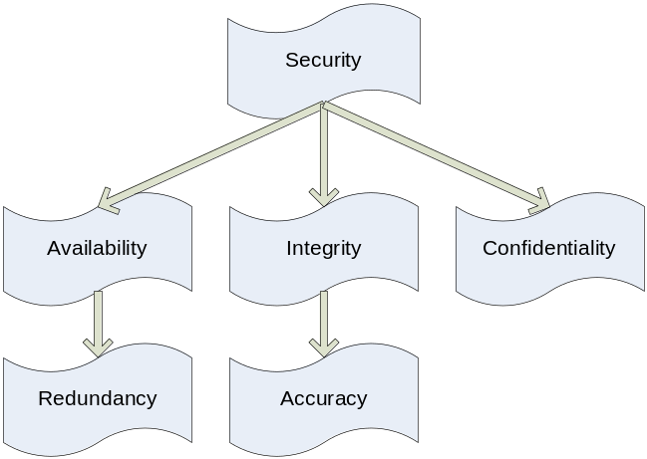
Security Requirement
Issues
  “Absolute security” not possible
  Not possible to foresee the future
Resolution: Offer best currently available

Slide 7
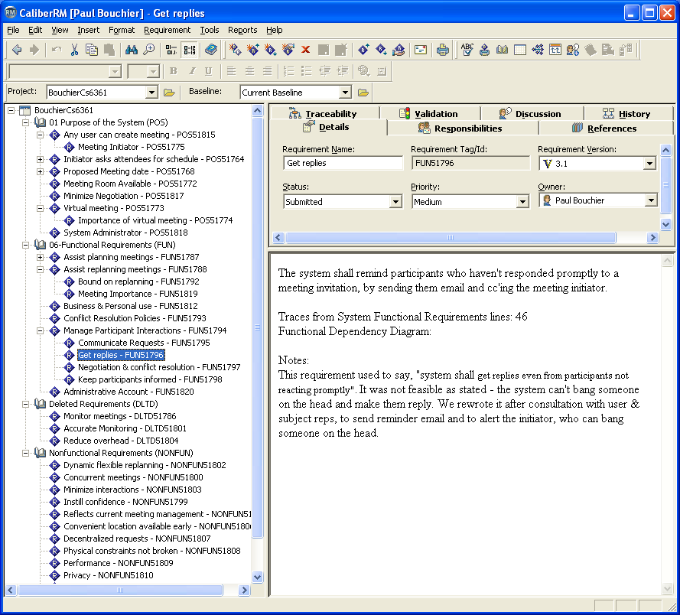

Slide 8
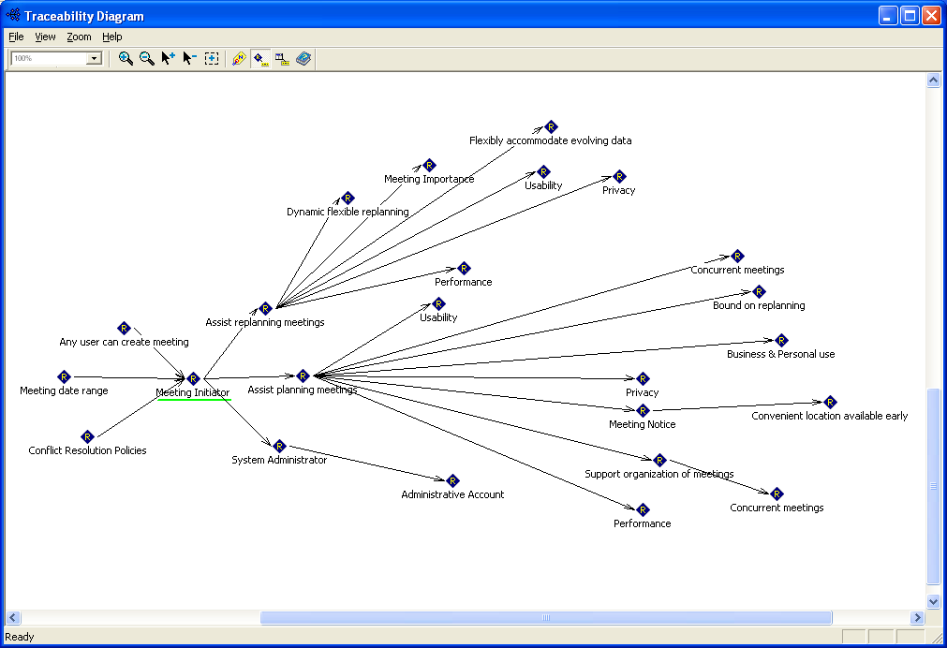

Slide 9
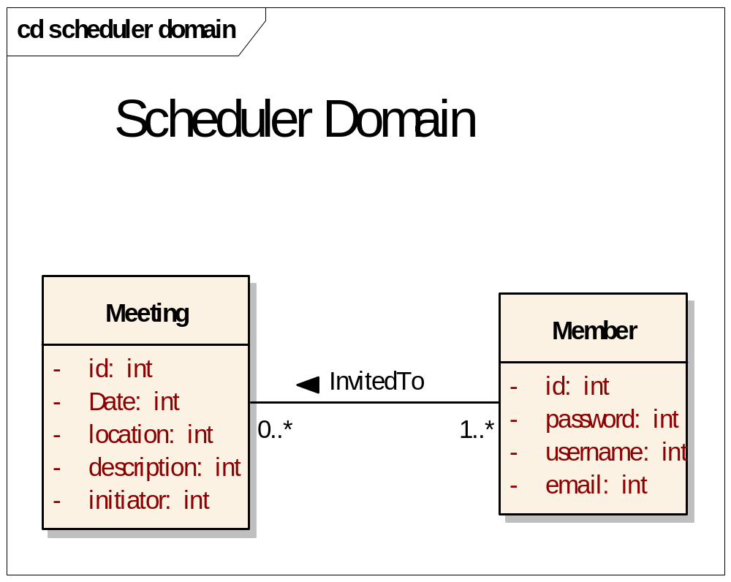

Slide 10
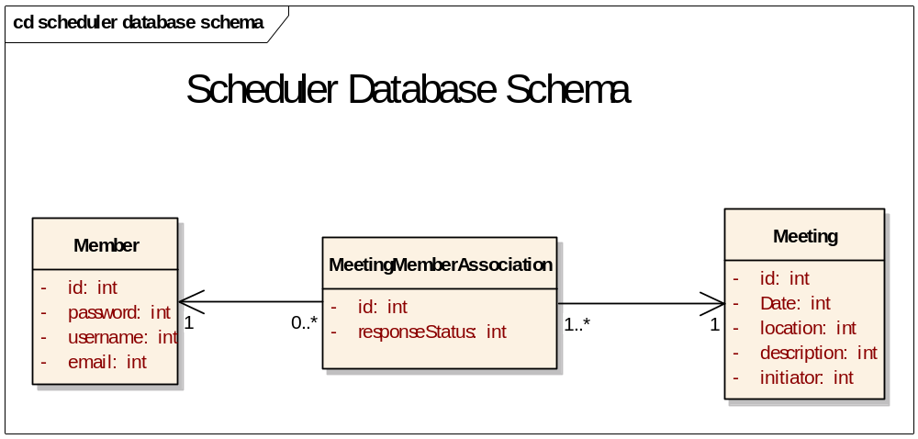

Slide 11
Reuse
Reuse of various code segments from CS 6354 semester project
  Database management class
  Member and MemberList classes

