Slide 1
Synergy Meeting Scheduler System
Geetanjali
Jeff
Yogita

Slide 2
Agenda
Overview :Why , What , How?
Project Goals
Requirement Sources
Project Process
Enterprise/System Functional Requirements
Issues
Prototype

Slide 3
SDMS Overview
SDMS is a web-based meeting scheduler system used to efficiently schedule meetings.
It accelerates the communication process and supports negotiation mechanism.
It helps the scheduler to resolve the conflicts and also supports virtual meetings/teleconferencing.

Slide 4
Why a Scheduling System?
Problems
  Lot of time spent in scheduling meetings
    Too much work for the Initiator: inviting participants, resolving conflicts, rescheduling, sending reminders, awaiting responses, etc.
  Manage interactions between the team participants.
  Traveling costs
    Participants in different geographical locations

Slide 5
Why a Scheduling System?
Reduces time in scheduling meetings
  Less time spent in scheduling meetings locations , dates, resources.
Manage interactions between the participants effectively
  Automation of typical tasks: invitations, responses, etc.
Increasing employee productivity
  Initiator can schedule more meetings in less time.
Reduce traveling costs
Virtual meetings

Slide 6
What to build?
Functional requirements
  Plan meeting
    Meeting scheduling
    Date selection
    Re-plan, cancel meetings
  Schedule Conflict resolution
  Manage Interactions
  Monitor Meeting

Slide 7
How to build ?
Non-Functional Requirements
  Minimal Interaction
  Fast Scheduling
    Through electronic messaging
  Compliance
    All the manual processes must be available
  Convenient Dates and Locations
  Decentralized
    Meetings can be scheduled independent of initiator location.

Slide 8
How?
Uniqueness
  Locations, Participants and Resources
Performance
  Constraints in responses and communications
Privacy
User-friendliness
Customizable
  Private and Professional
Flexibility
  Meeting updates
Extensible
  Support of different date formats and timezones.

Slide 9
Projects Goals
To identify the requirements of customers
To provide and help the team participants to schedule the meeting time, date and location efficiently.
Provides a prototype for customer feedback.

Slide 10
Requirement Sources
Previous Projects
Customer interviews
Group domain experiences
Internet

Slide 11
Project Process
Identify Stakeholders and sources
Model Enterprise and System Functional requirements
Model Non-functional reqs with dependency graph
Specify constraints
Document all issues
Further develop the system with resolving issues.
Develop the prototype

Slide 12
Enterprise Requirements
Domain level Questions
Identify stakeholders
Environment for meetings
How will they take place
Issues to set up the meeting agenda

Slide 13
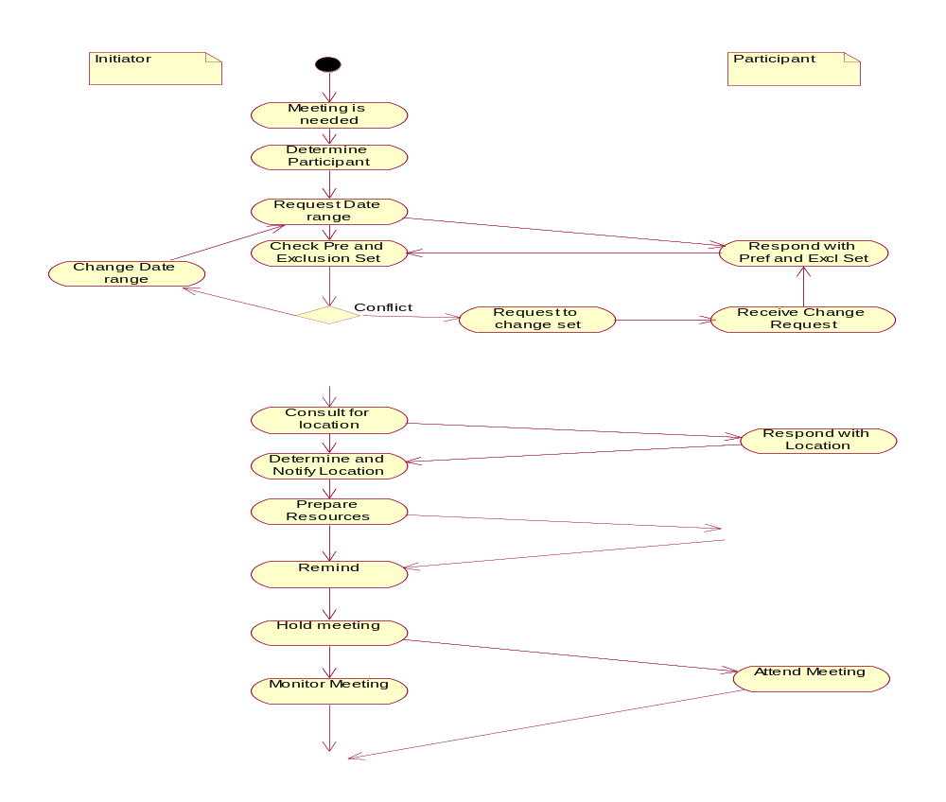

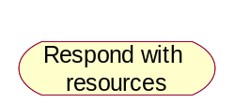

Enterprise Reqs

Slide 14
Enterprise Non-functional Reqs
Negotiations should be minimal
Availability of equipments should be updated
All conflicts should be quickly resolved
The system should be flexible

Slide 15
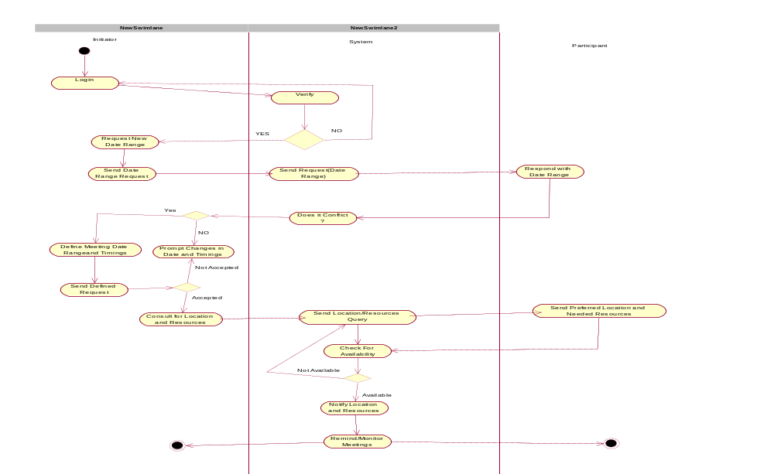
System Functional Requirements

Slide 16
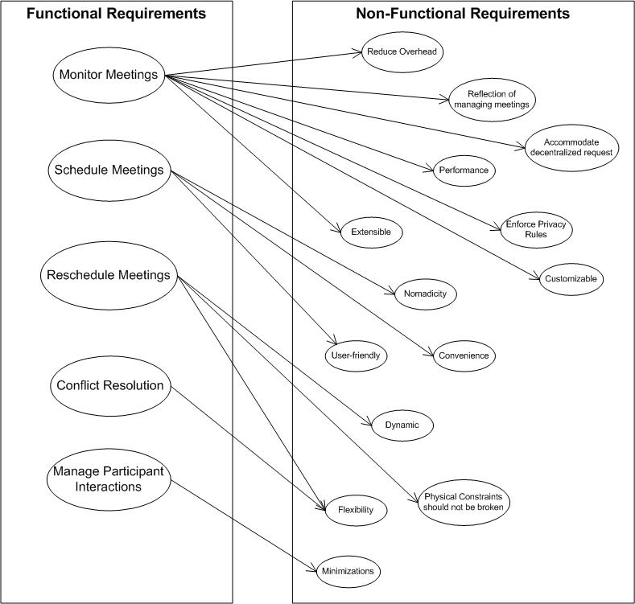
Non-Functional Req Dependency Graph

Slide 17
Issues
Incompleteness
The system extensibility can be enhanced additionally by allowing a participant to attend only part of the meeting.
It [meeting room] should ideally belong to one of the locations preferred by as many important participants as possible.
The amount of interaction among participants should be kept minimal.
Ambiguous
A meeting should be accurately monitored, especially when it is held in a virtual place. Here, nomadicity will then be important to consider.

Slide 18
Issues
Difference between potential meeting attendees and participants.
Clarification of criteria for expanding date range.
Misclassified
To make them confident about the reliability of the communications.
Physical constraints should not be broken.
Missing
Missing Login and Logout requirements.
The system doesn't specify how many participants at the most can be there in a meeting.
Redundancy
‘Make participants aware of what is going on’ and ‘Keep participants informed about schedules and changes’.

Slide 19
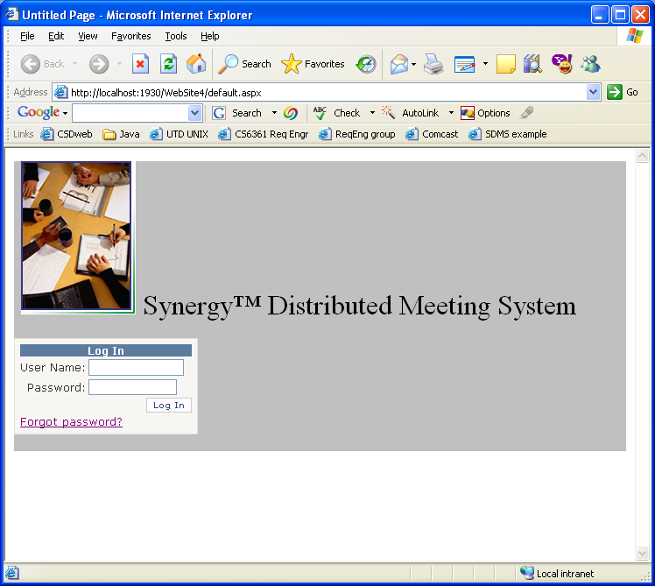
Prototype
Login Screen

Slide 20
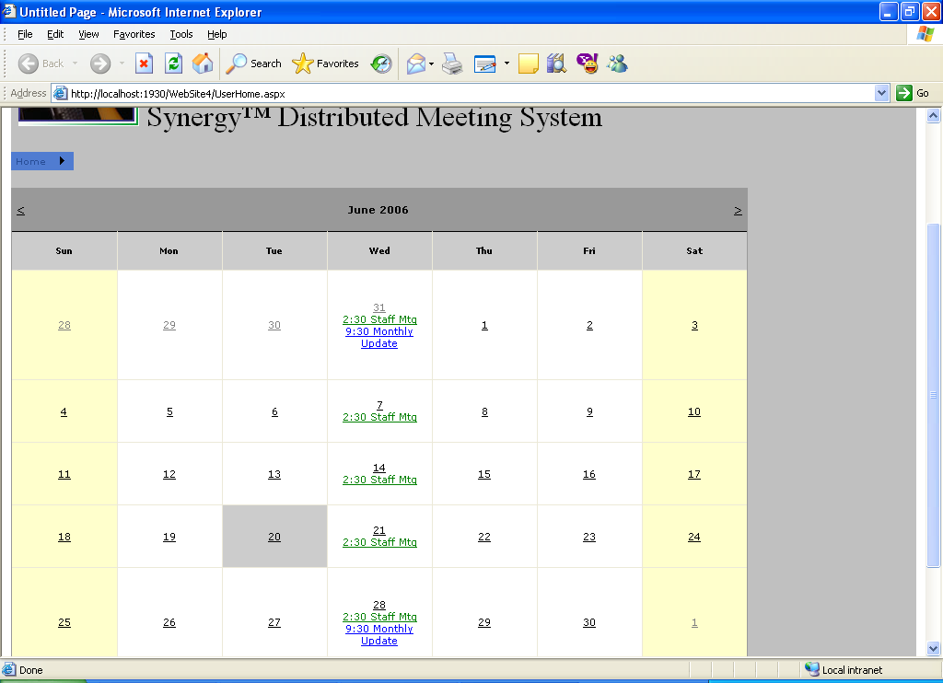
Main Page

Slide 21
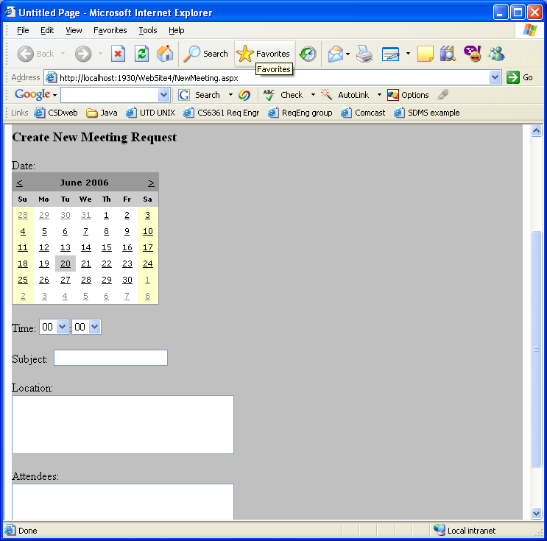
New Meeting

Slide 22
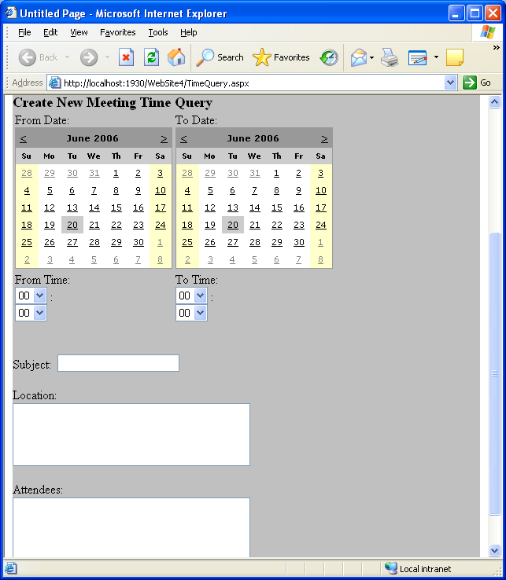
New Meeting Time Query

Slide 23
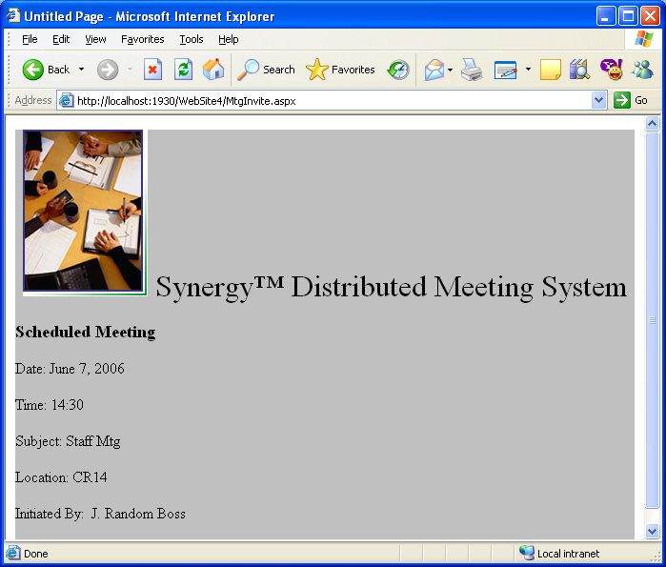
Meeting Notice (attendee)

Slide 24
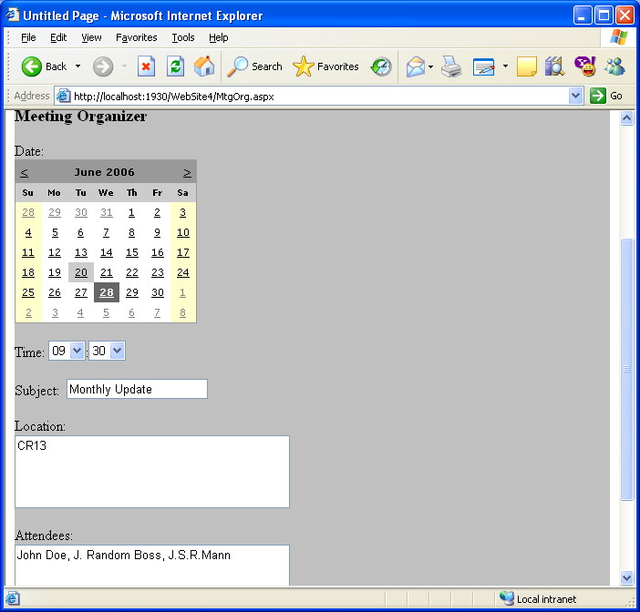
Meeting Planning (Initiator)

Slide 25
Thanks!!!

