Slide 1
REQUIREMENTS ENGINEERING
SynergySoft Disrtibured Meeting Scheduler System
Siddharth Phadkar
Pratyush Chandra. M
Deepak V Shenoy

Slide 2
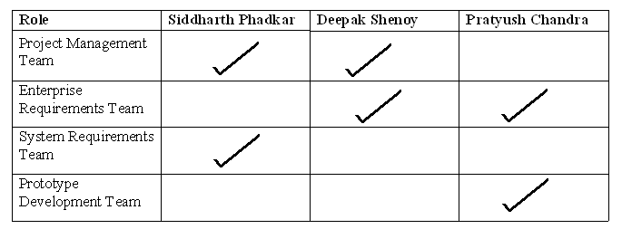
Roles

Slide 3
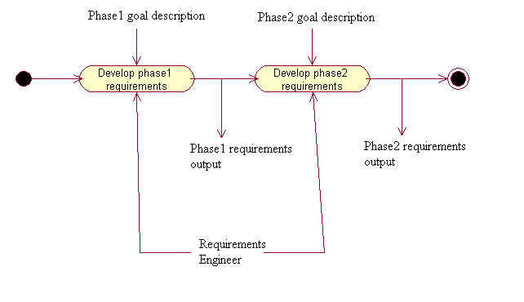
Process cycle

Slide 4
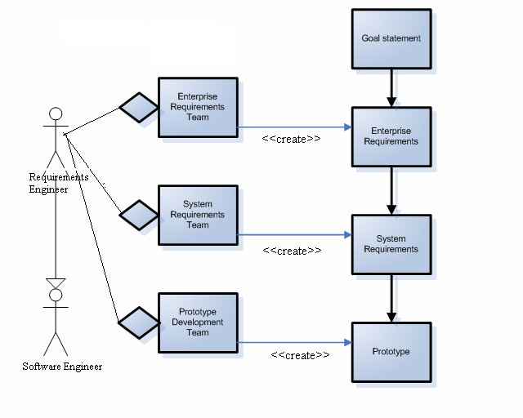
Process-data relationship

Slide 5
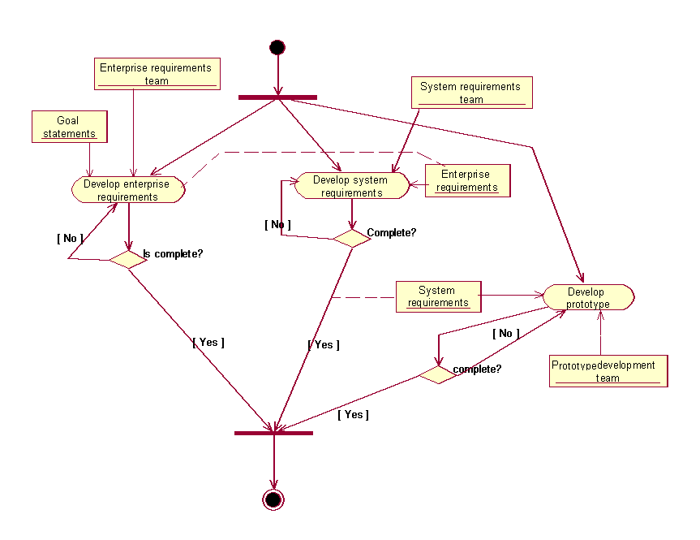
Process activity diagram

Slide 6
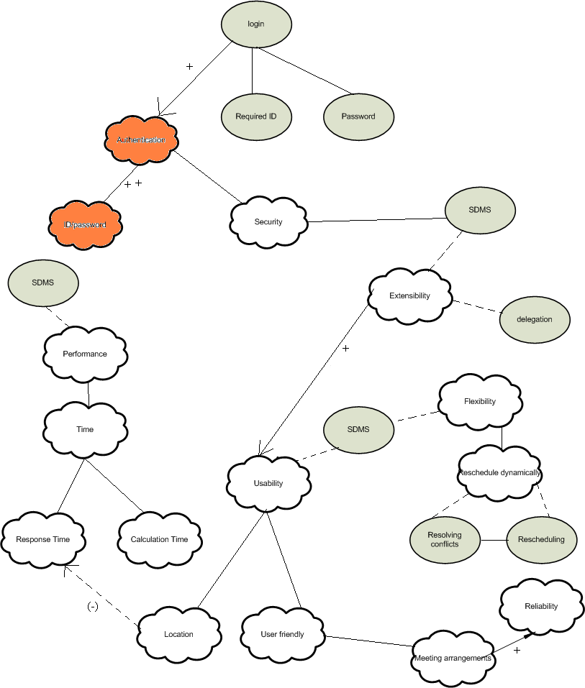
Non functional requirements

Slide 7
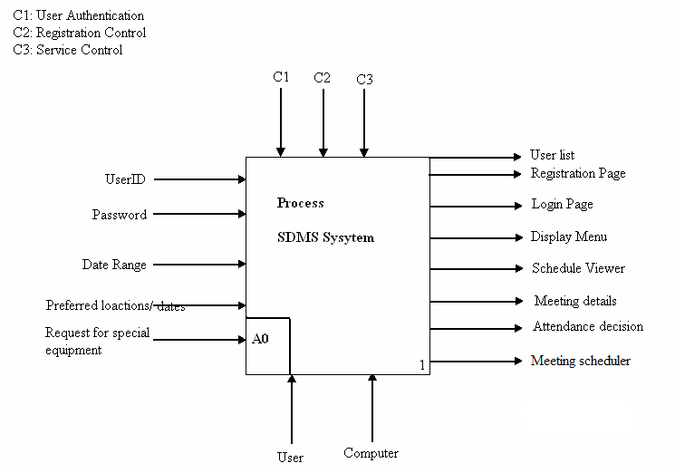
SADT: Top level diagram

Slide 8
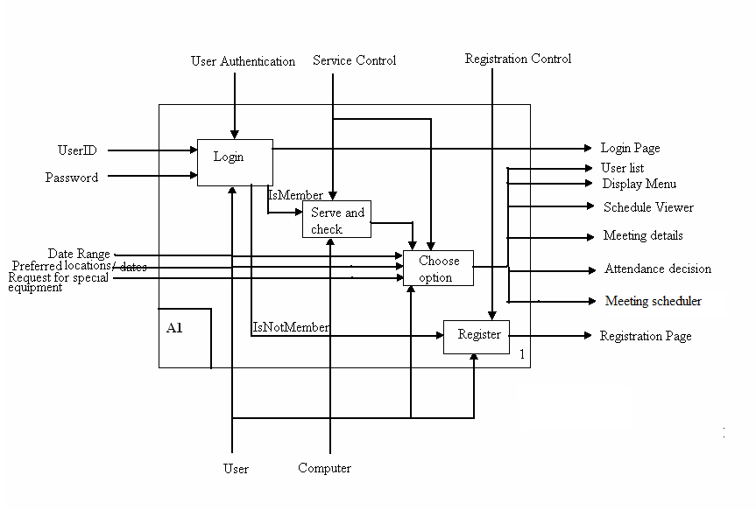
SADT: Top level detailed diagram

Slide 9
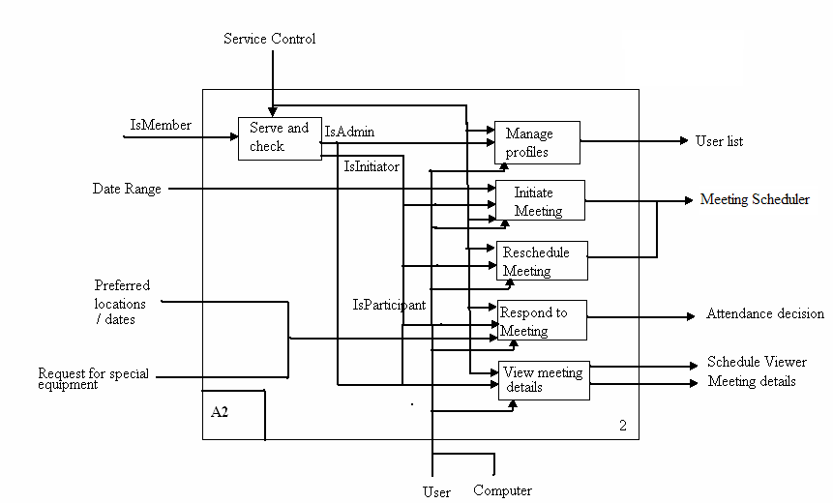
SADT: Second level diagram:
Choose option

Slide 10
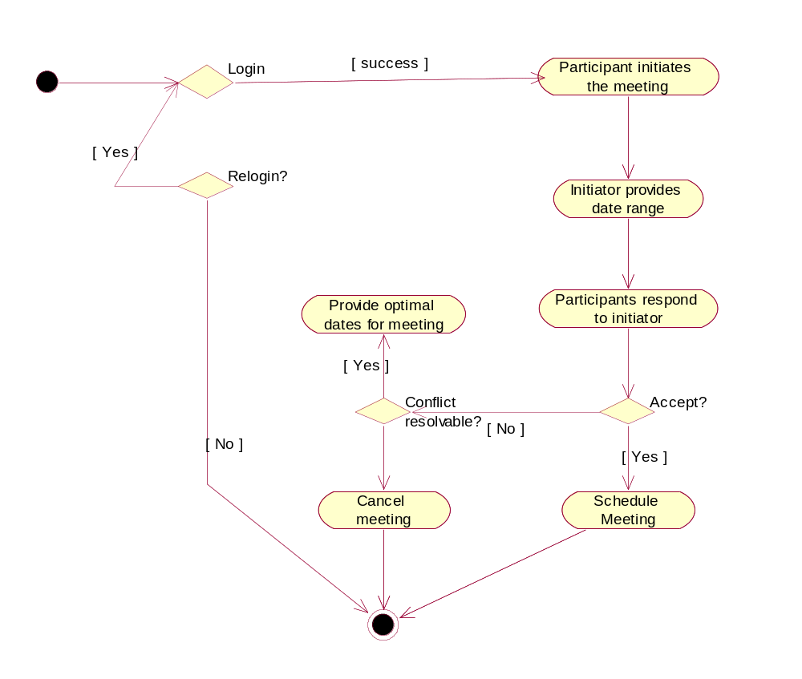
Activity Diagram: Product Specification

Slide 11
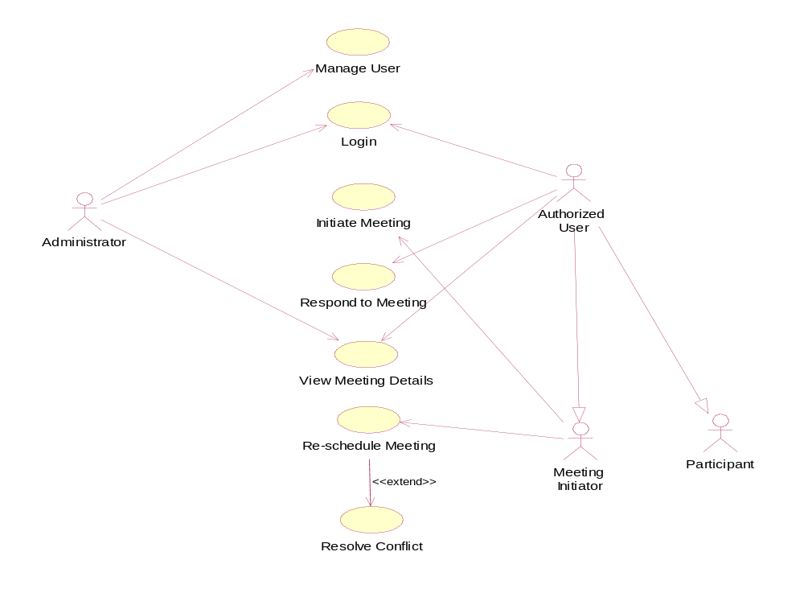
Use Case Diagram

Slide 12
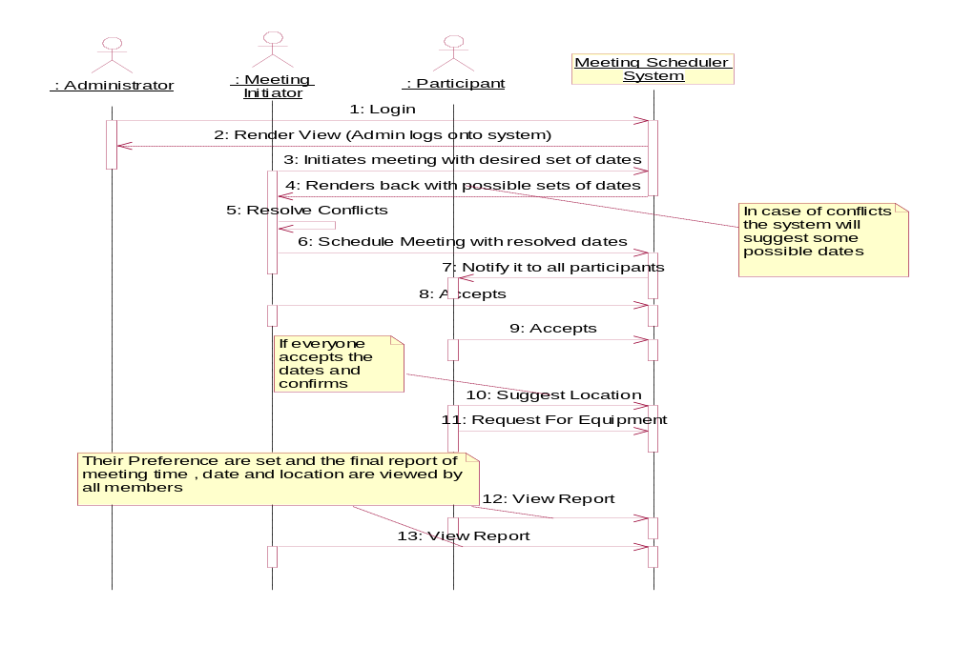
Sequence Diagram: Initiate meeting

Slide 13
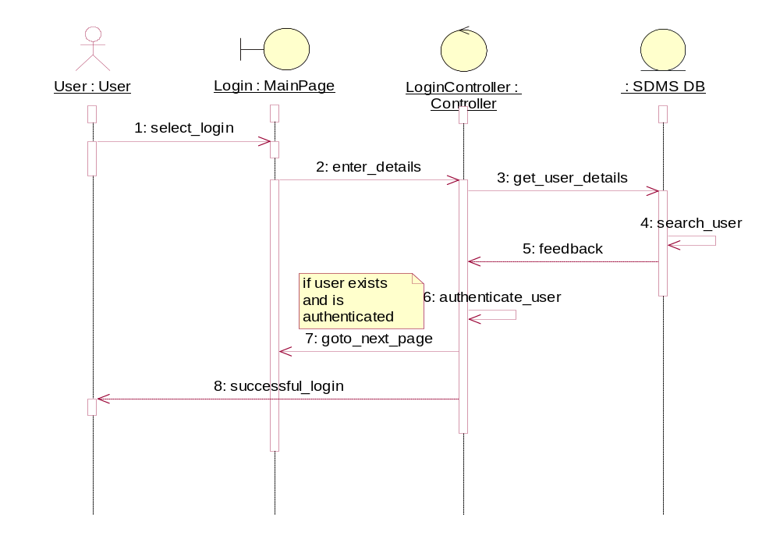
Sequence Diagram: Login

Slide 14
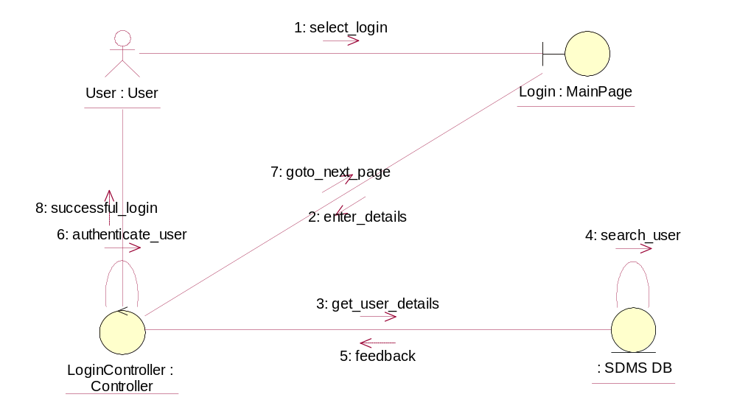
VOPC: Login

Slide 15
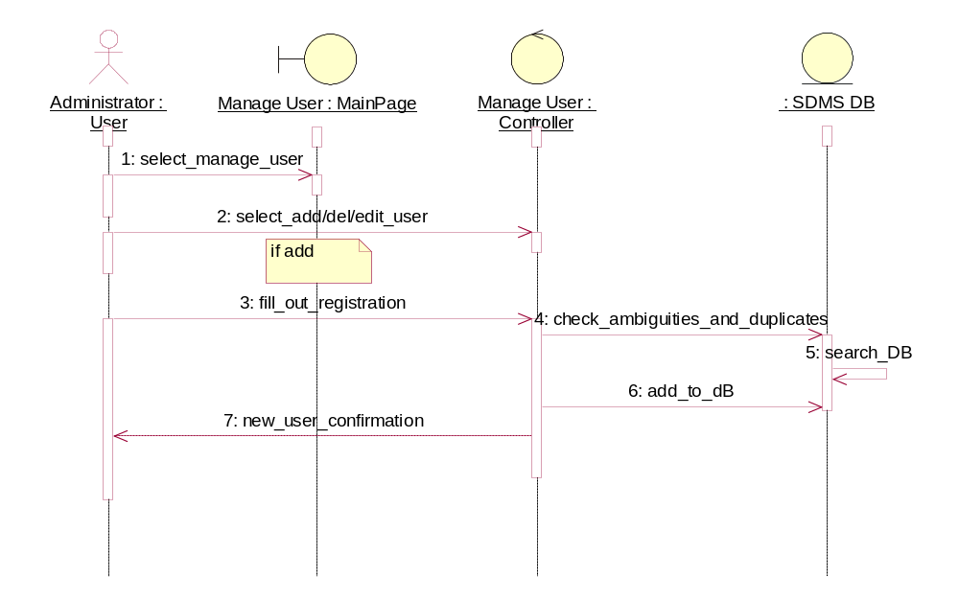
Sequence Diagram: Manage User

Slide 16
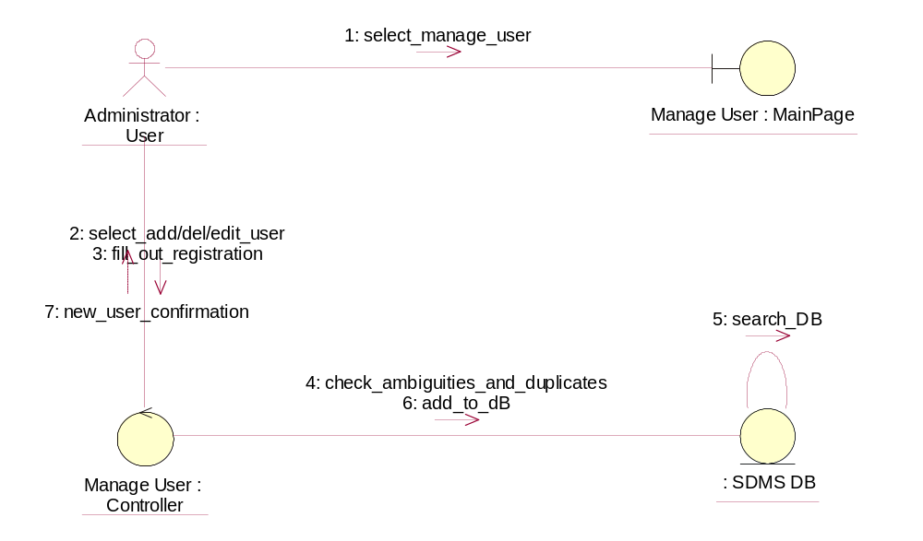
VOPC: Manage User

Slide 17
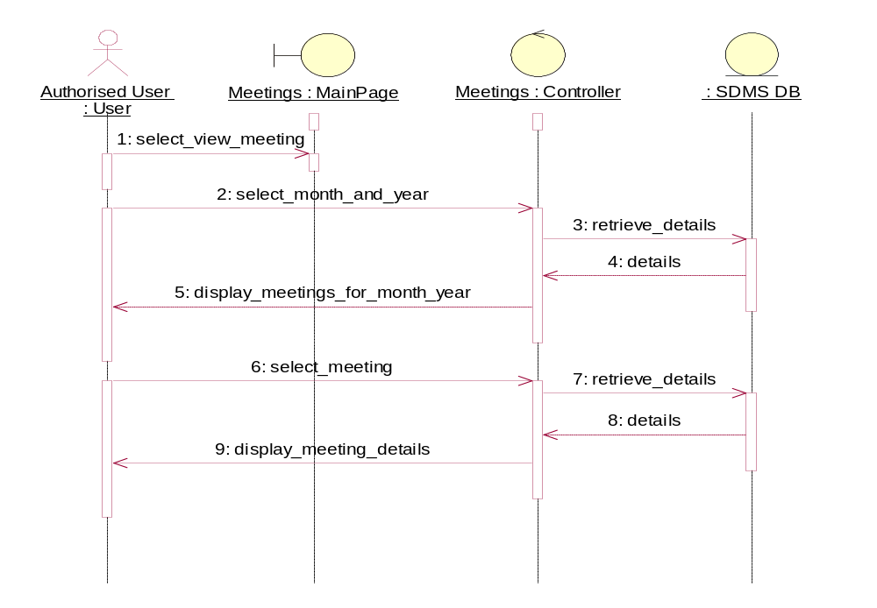
Sequence Diagram: View meeting details

Slide 18
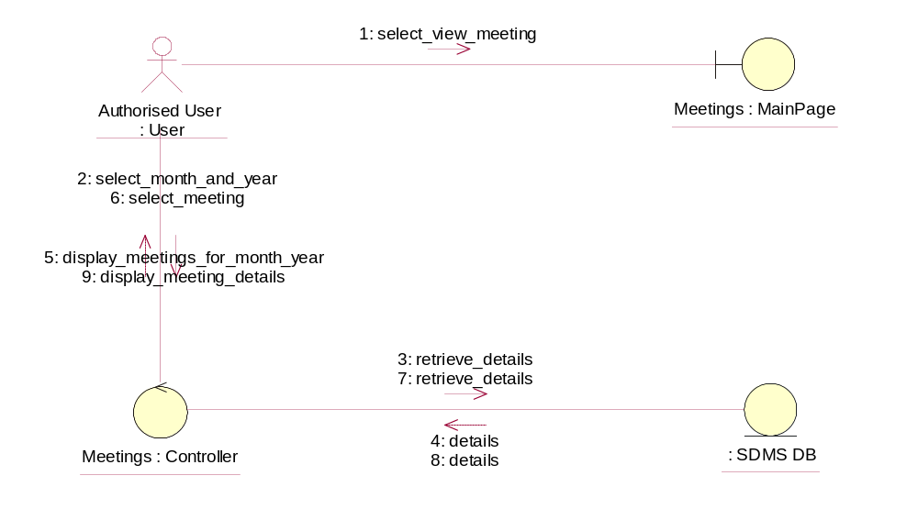
VOPC: View meeting details

Slide 19
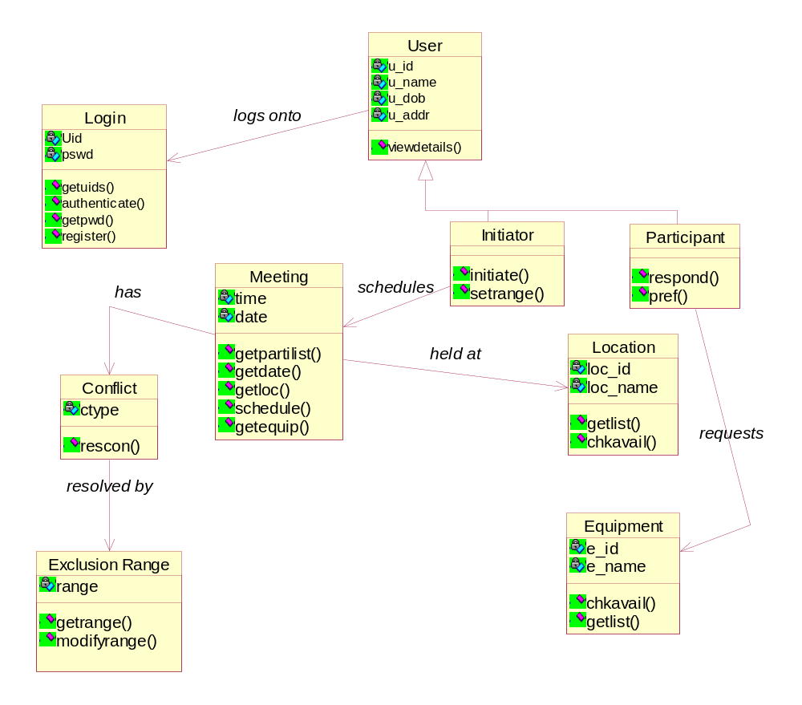
Class Diagram

Slide 20
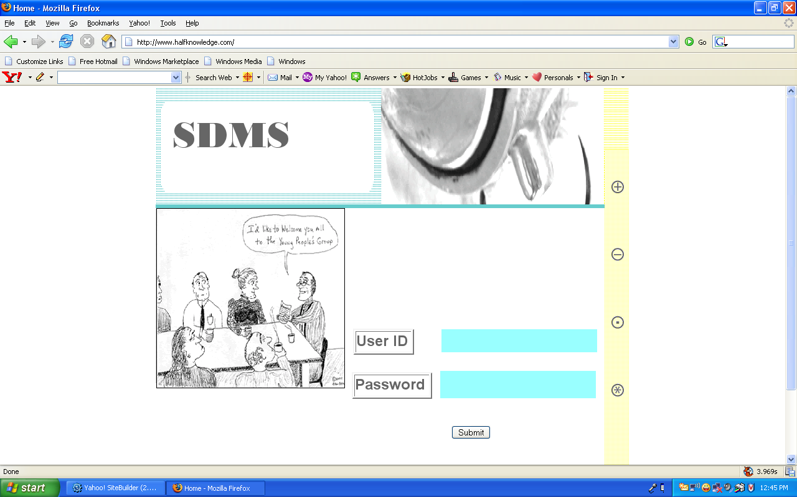
Screen Shots --- Login Page

Slide 21
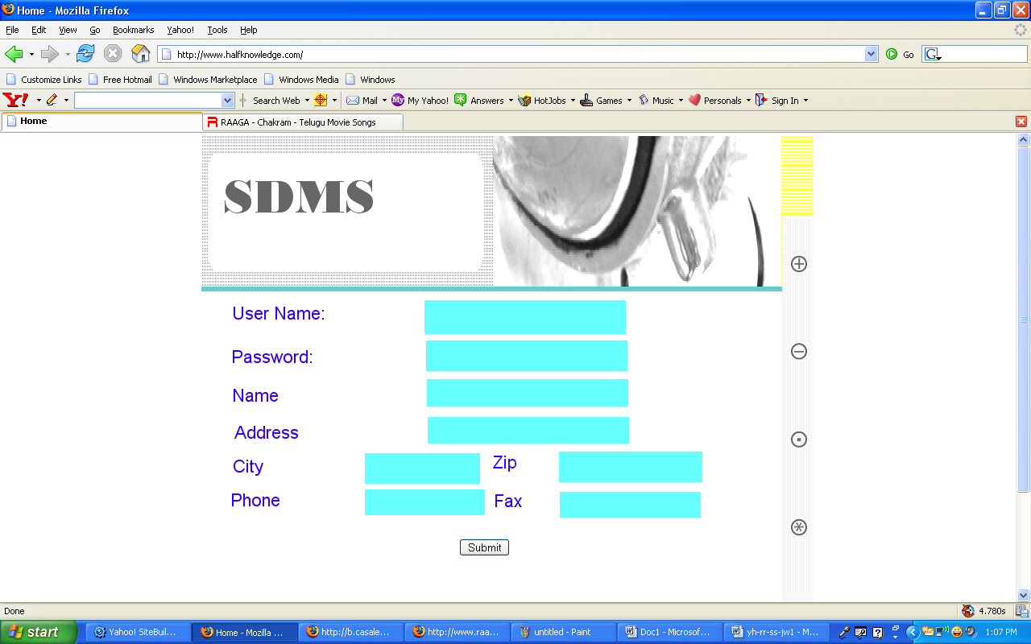
Registration Page

Slide 22
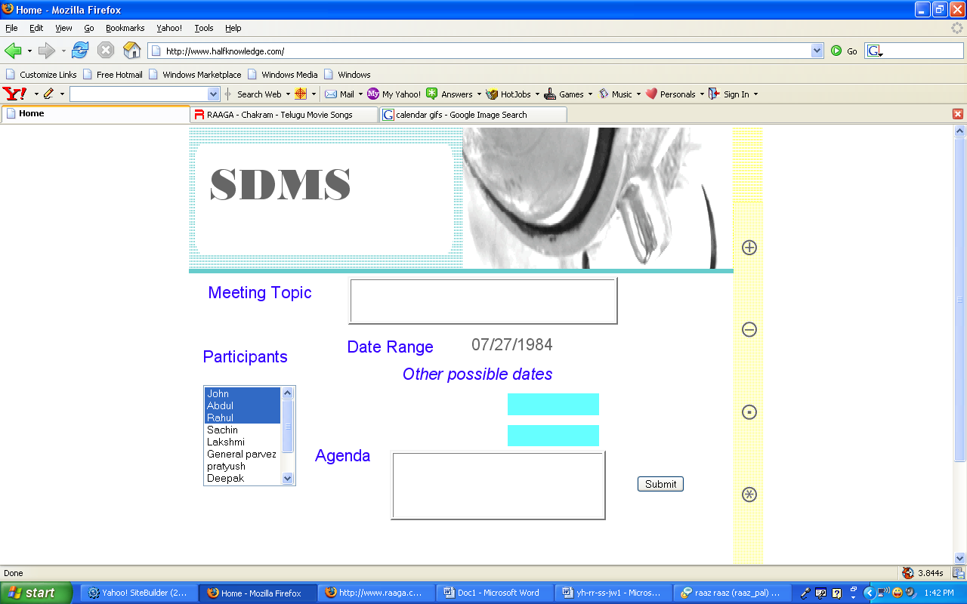
Schedule Meeting
+/- 6 days

Slide 23
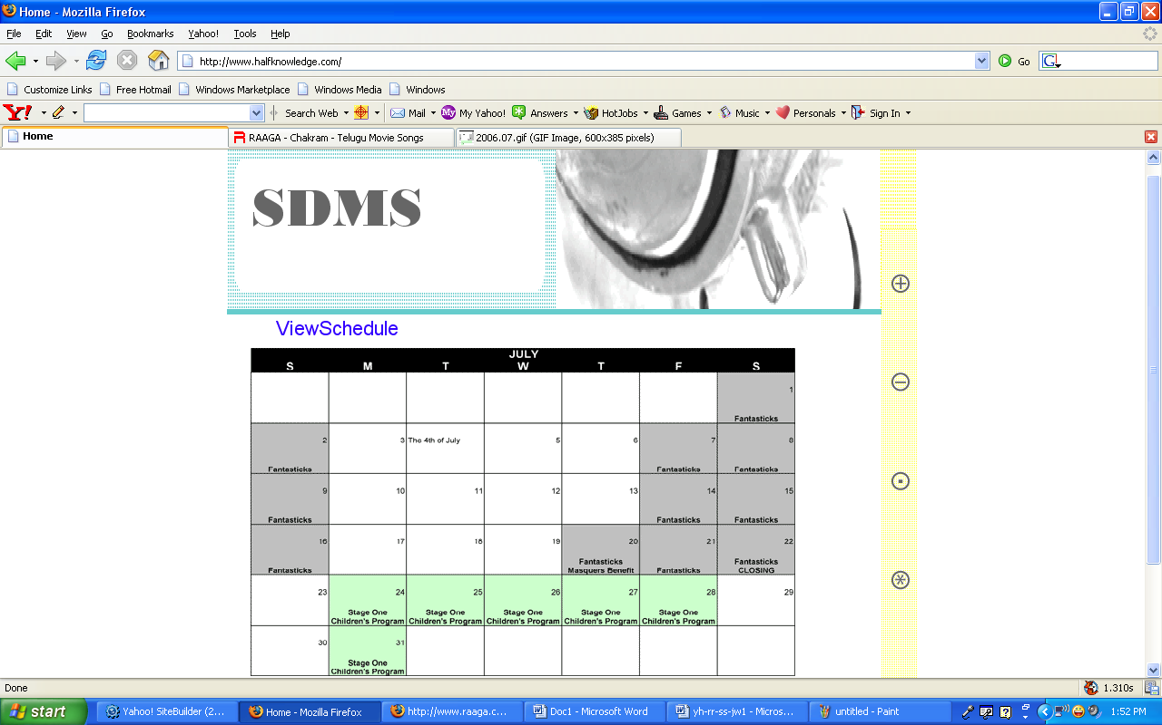
View Schedule

Slide 24
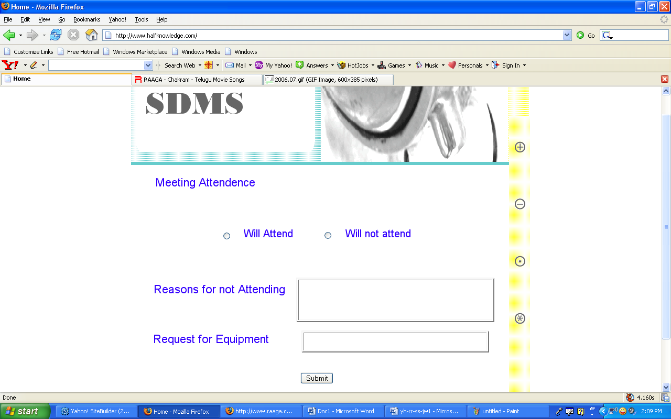
Meeting Attendance

Slide 25
Questions?
Comments?
Suggestions?

