Slide 1
CS6361 Project, Part 1
Fall 2006
The Design Firm of
  Bouchier, Fischer, Herschbach, & Nina

Slide 2
Agenda
Vision & Scope
Requirements Process
Use Cases
Requirements Dependency Analysis
Example Requirements Tracing
UI Design
Next Steps

Slide 3
Team Roles
Paul Bouchier: System World rep
Jon Fischer: User World rep
Shaun Herschbach: Domain rep
Chris Nina: Developer rep

Slide 4
Vision & Scope
A web-based tool that eases meeting scheduling activities between participants who have previously entered their availability data
Usability goal: effort for each user to maintain availability is substantially less than effort to schedule meetings without this system
System is self-contained – no external calendar, email or other interfaces

Slide 5
Process
Incremental lifecycle
Each increment goes through phases:
  Visioning based on customer requirements
  Elicitation with “World” representatives
  Use case analysis
  UI design
  Requirements specification
  Validation (with class)
  Software design

Slide 6
Use Case Analysis
Goal: Understand the functional aspects of the enterprise requirements in order to understand the stated requirements (the “why”)
1st Iteration: analyzed 2 use cases
  Respond to meeting invitations
  Create meeting invitation

Slide 7
Respond to meeting invitation
Most common use case described by fully-dressed use case description:
User goal: respond to meeting notification by accepting or denying an invitation (if one has been sent) and potentially to update their preference and/or exclusion-set
  System shows outstanding invitations + calendar
  User accepts/declines outstanding invitations
  System shows calendar & allows modifying exclusion/prefs
  User updates exclusion/prefs. System returns to step 3

Slide 8
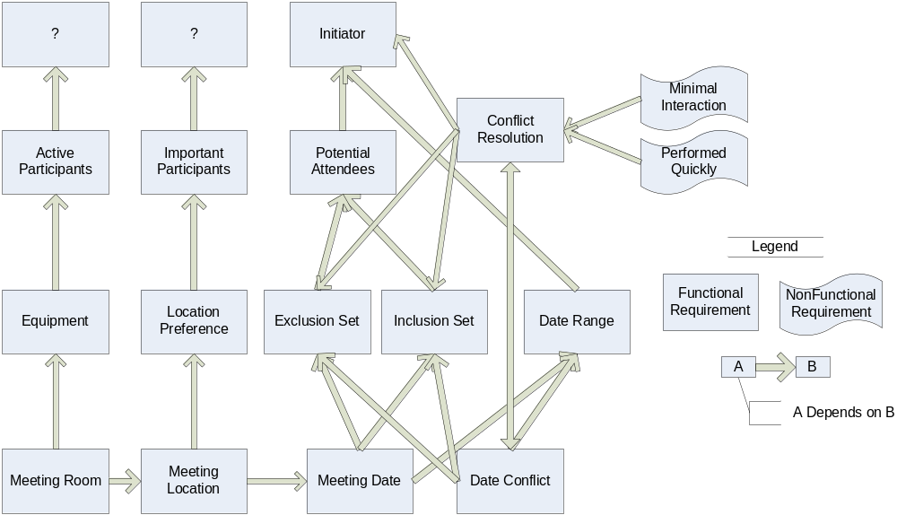
Preliminary Semiformal Definition
Enterprise Requirements

Slide 9
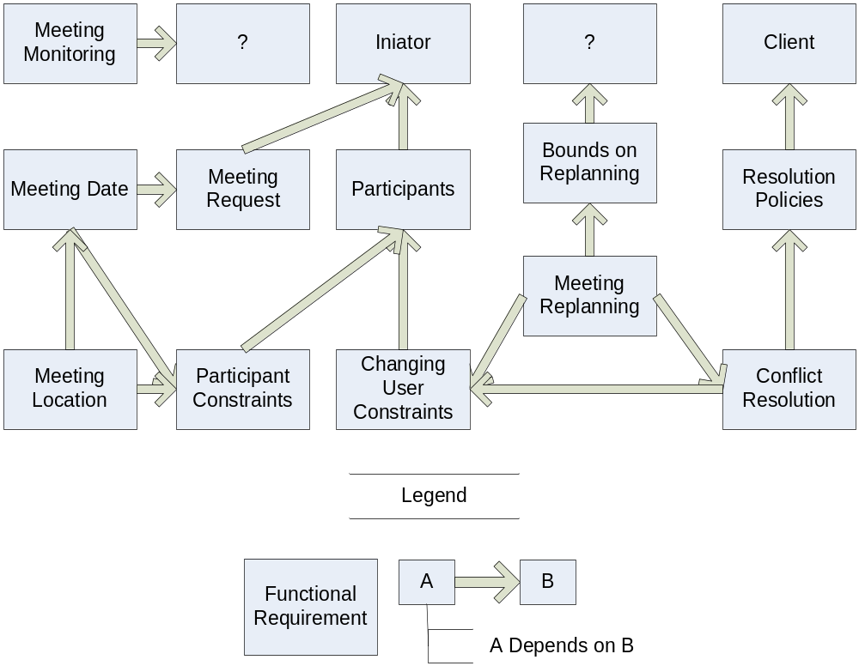
Preliminary Semiformal Definition
Functional Requirements

Slide 10
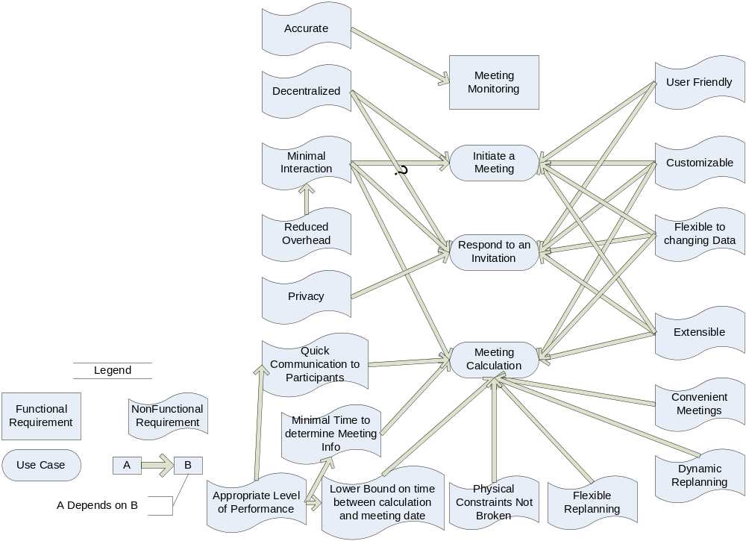
Preliminary Semiformal Definition
Non-Functional Requirements

Slide 11
Issues - Preliminary Requirements
Conflicts and Resolutions
Admin Functionality
Distribution
Interaction and Interfacing

Slide 12
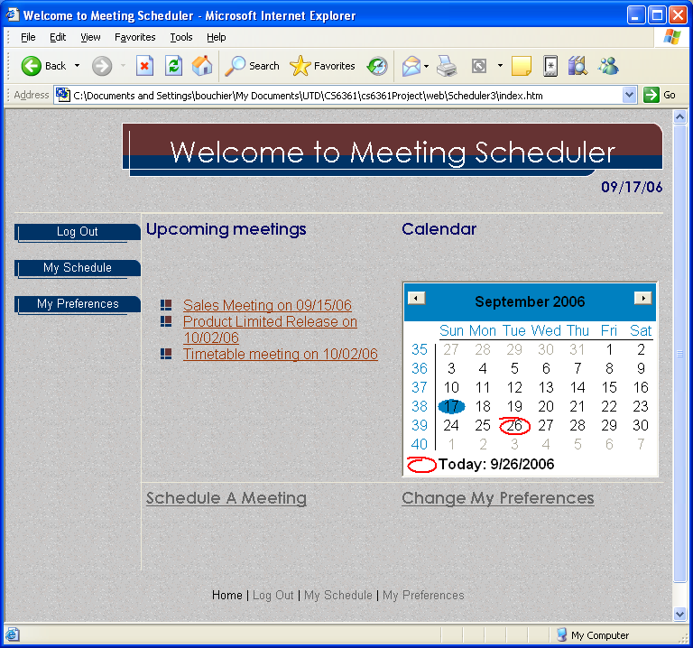
Scheduler Home

Slide 13
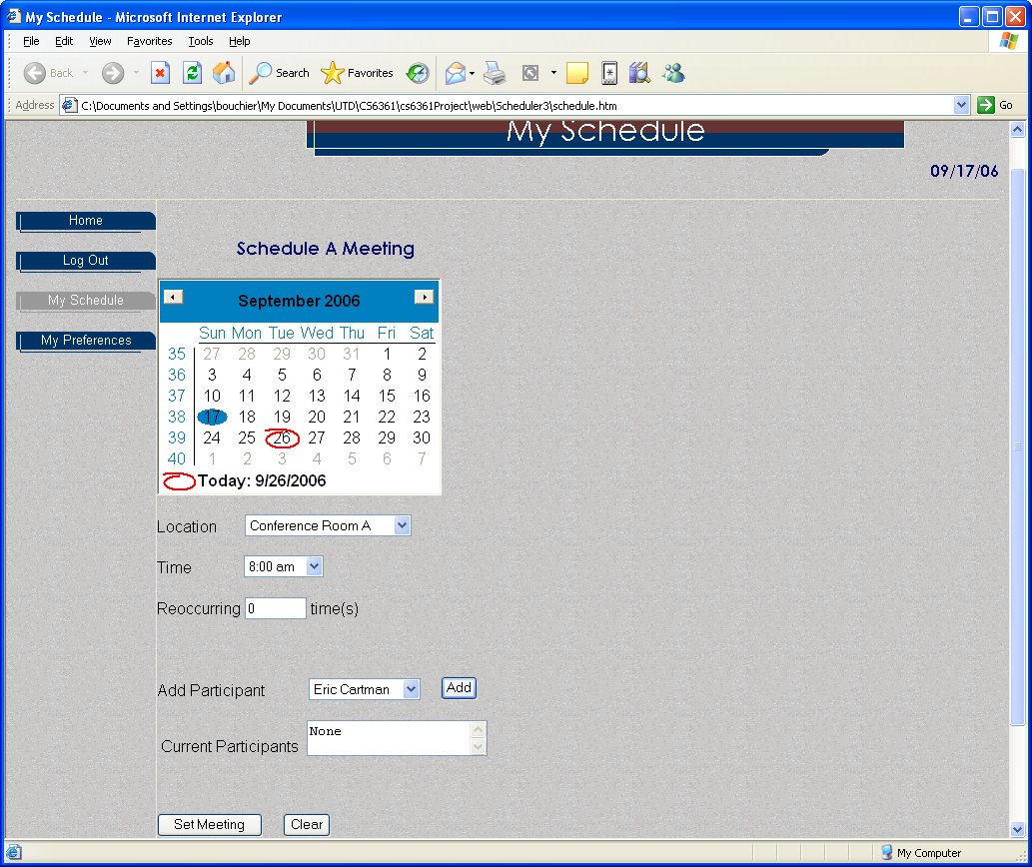
My Schedule

Slide 14
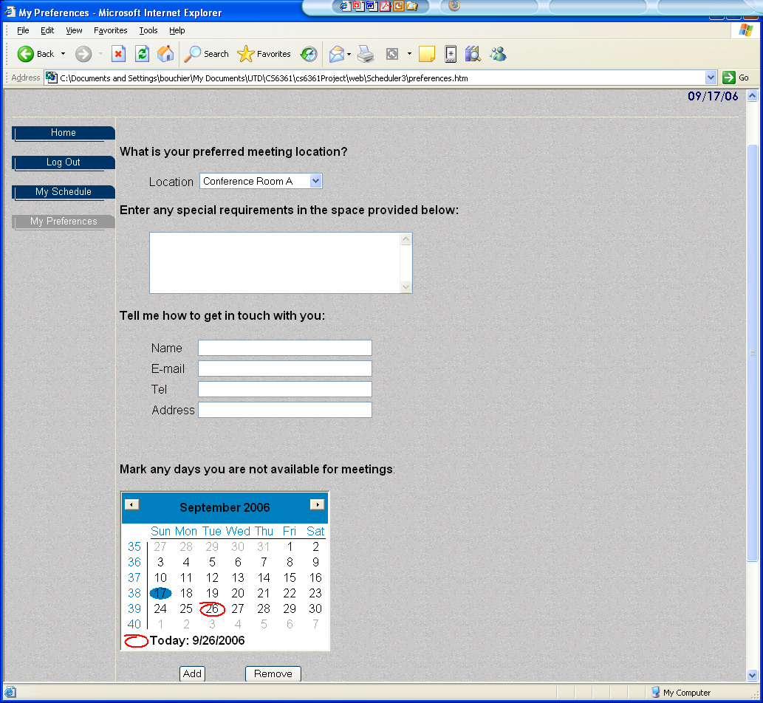
My Preferences

Slide 15
Next Steps
Analyze requirements for inconsistencies & resolve. Update requirements database.

Slide 16
References
Alistair Cockburn – Writing effective use cases
Summer project: pk-wp-iw.ppt

