Slide 1
REQUIREMENTS ENGINEERING
SynergySoft Distributed Meeting Scheduler System
Siddharth Phadkar
Pratyush Chandra. M
Deepak V Shenoy
Rahul Kotian

Slide 2
Project Overview
The system aims to coordinate referred meeting dates and venues obtained from all the participating individuals and come up with the best meeting schedule possible.

Slide 3
Requirement Sources
Existing ‘Meeting Scheduler’ softwares
Internet
Interviews
Personal Experiences

Slide 4
Objectives
Outperform existing systems by Microsoft, IBM etc.
Efficient and Usable Meeting Scheduler.
A huge target audience (user group).
Development within given time frame (November 28, 2006)(2 months).

Slide 5
Team Involved
Deepak Shenoy: User World
Rahul Kotian: Subject World
Siddharth Phadkar: System World
Pratyush Chandra: Developer World

Slide 6
Functional Requirements
Plan meetings under constraints stated by participants.
Replan meetings to account for changing user constraints.
Support conflict resolution.
Manage interactions among participants.
Manage concurrency

Slide 7
Issues
Ambiguous:
Issue: A meeting should be accurately monitored, especially when it is held in a virtual place.
Resolution: Here Monitoring will include the various events taken place till the meeting is scheduled and conveying the various events to the concerned people.
Issue: Who decides who the potential meeting attendees are?
Resolution: The Meeting Initiator will decide this.
Issue: To make them confident about the reliability of the communications.
Resolution: The System will have to send timely and accurate updates about the various events in the scheduling of meetings.

Slide 8
Issues
Redundancy:
Issues: ‘Make participants aware of what is going on’ and ‘Keep participants informed about schedules and changes’.

Slide 9
Issues
Incomplete:
Issues: “The intended system should considerably reduce the amount of overhead usually incurred in organizing meetings…..”
Resolution : The system will be using the email system which the user uses and not have email service of its own.
Issue: No criteria for expanding date range is specified.

Slide 10
Functional Requirements
External Constraint
Modify Preference Set/exclusion set
Monitor Meetings
Accommodate Important Meeting
Plan Meetings
Replan Meetings
Cancel Meeting
Change Date& Location
SDMS
Manage Interactions
Support Conflict Resolution
Manage Concurrency
Updates
Support Negotiations
Policies by Client

Slide 11
Non Functional Requirements
Flexibility
Minimal interaction among participants
Convenient to users
Dynamic
Performance
Usable by non experts
Customizable
Maintain privacy
Within physical constraints

Slide 12
Mapping functional to non functional requirements
Accommodate decentralized meetings
Maintain privacy
Monitor meetings
Reduce overhead
Plan meetings
Convenient date and locations
Usable???
Replan meetings
Dynamic
Manage
concurrency
Customizable???
Manage physical
constraints
Improved Performance???
Support conflict
resolution
Flexible
Manage Interactions
Minimal

Slide 13
Non-Functional Requirements
Usable
Customizable
Flexible
SDMS
Improved Performance
Extensible

Slide 14
System inputs
The inputs to the system can be listed as:
Available participants
A roster consisting of available dates for each participant
Meeting date range ( provided by Initiator )
Preferred Locations ( provided by Initiator )

Slide 15
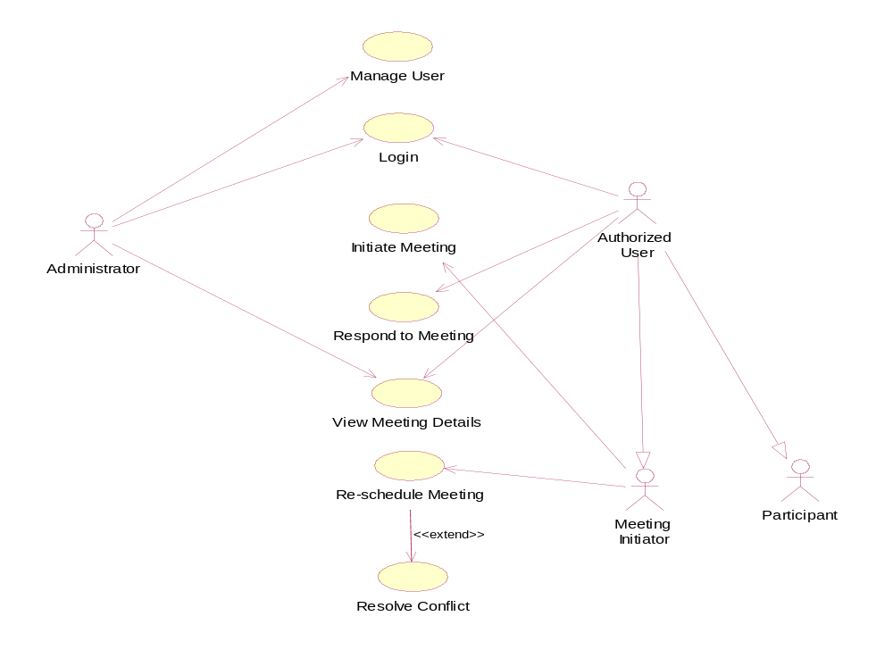
Use Case Diagram

Slide 16
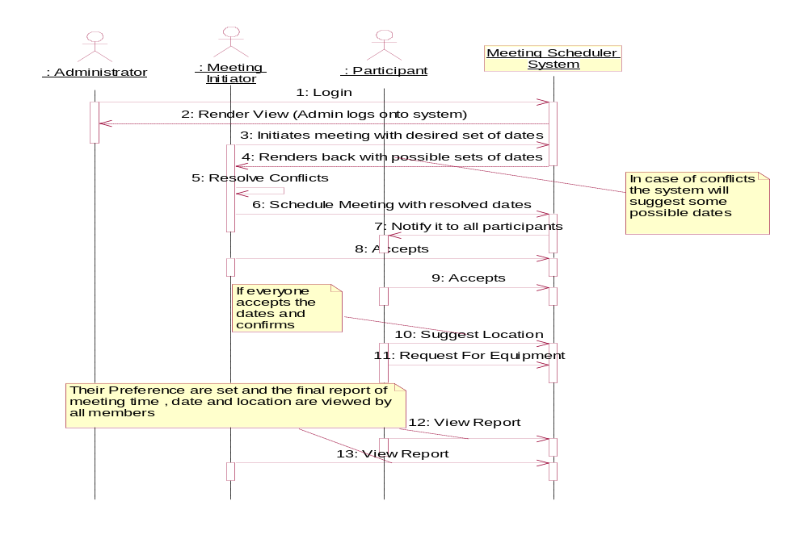
Sequence Diagram

Slide 17
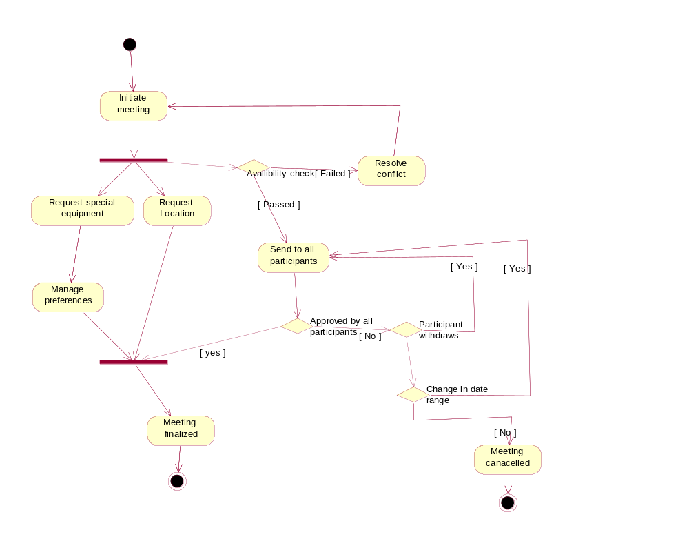
Activity Diagram

Slide 18
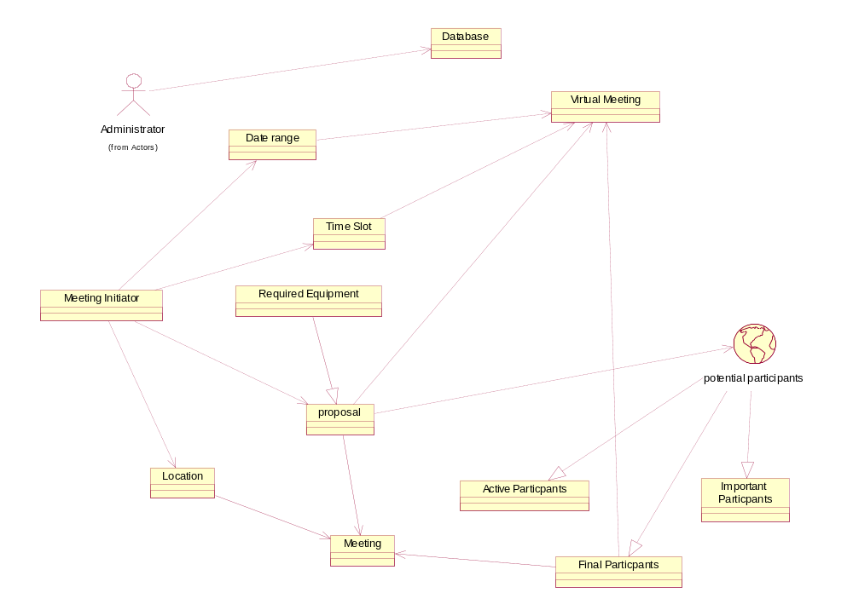
Domain Model

Slide 19
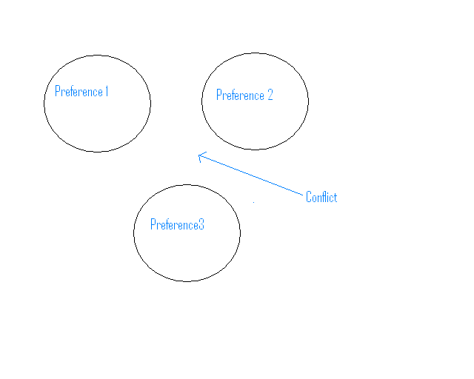
Conflict

Slide 20
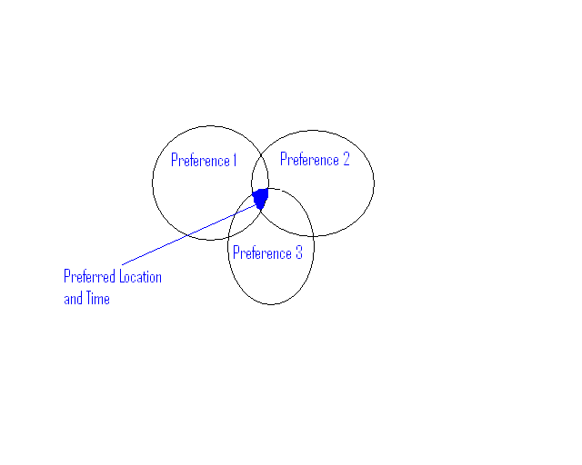
Conflict Resolution

Slide 21
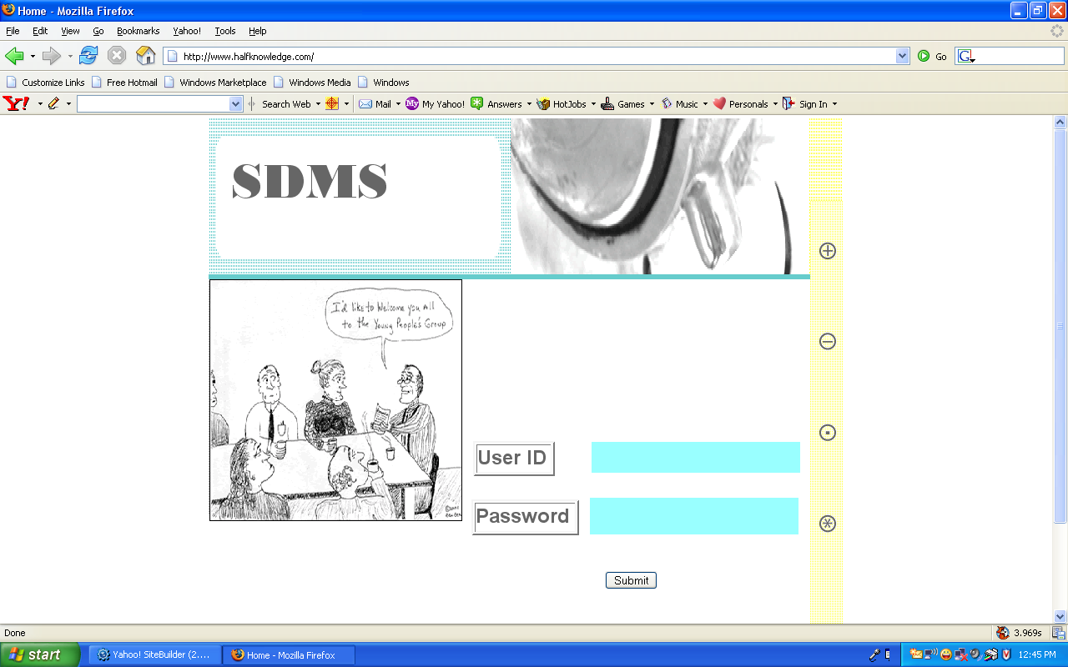
Screen Shots --- Login Page

Slide 22
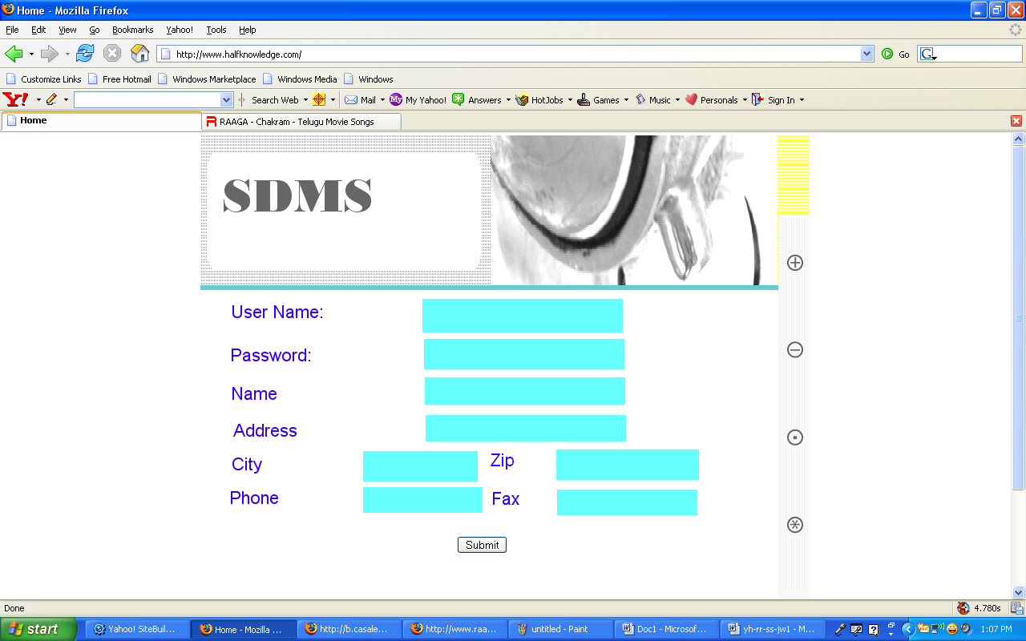
Registration Page

Slide 23
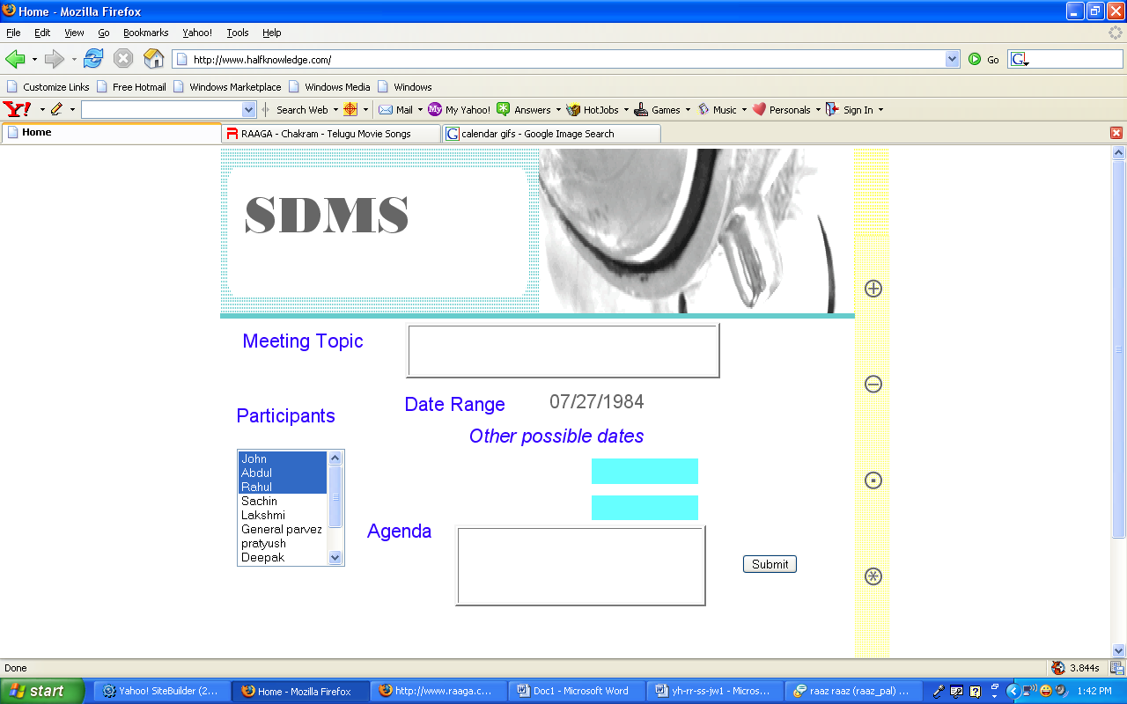
Schedule Meeting

Slide 24
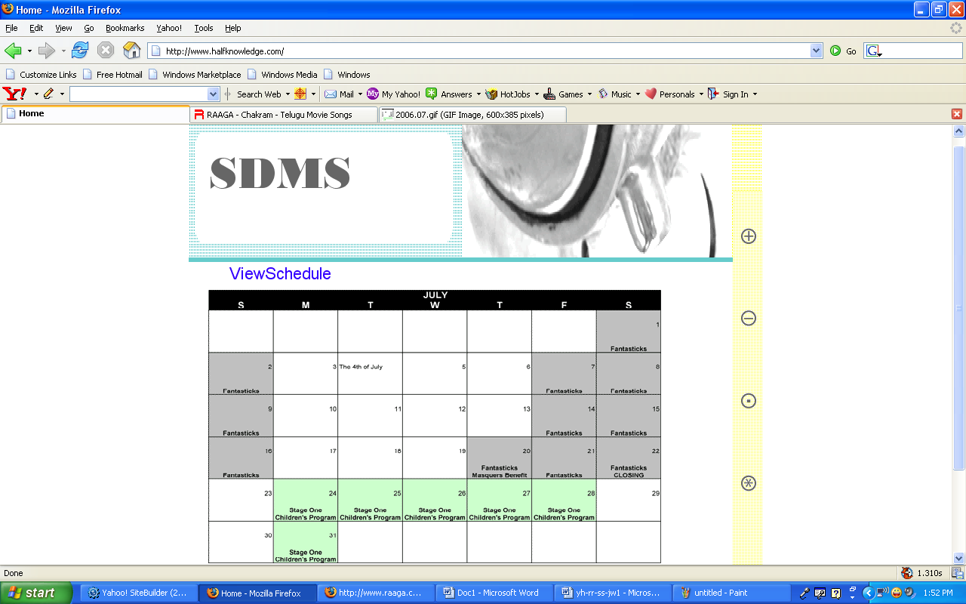
View Schedule

Slide 25
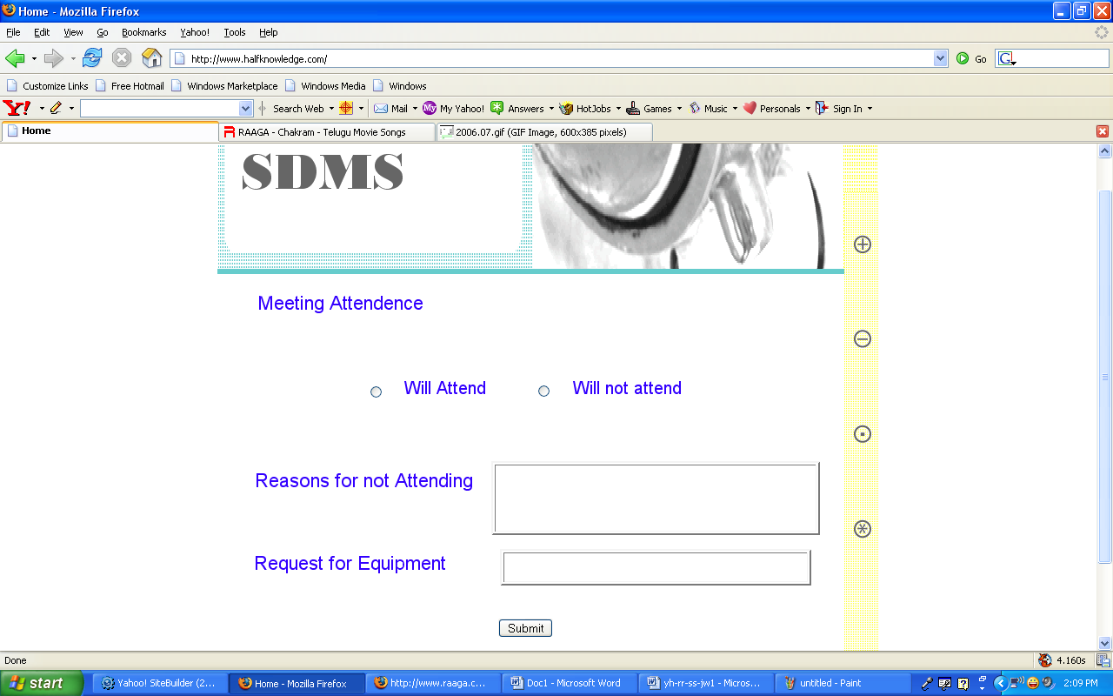
Meeting Attendance

Slide 26
Bibliography
Presentaion 1 Summer 2006
Presentaion 2 Summer 2006

Slide 27
Questions?
Comments?
Suggestions?

