Slide 1
Mobile Robotics
Alex Lundin, Geet Babaria, Justin Horak

Slide 2
Overview of Architecture
Trihybrid robotic system is a hybrid system that combines the main and subroutine architectural pattern with layered, the combination makes the sensor to environment components of the system. The control loop is the main decision piece of the mobile robotic system, followed by the procedure calls which are the connectors used in the system. The control or brain receives the environmental data from the main program, the program then decides based on the data received and then passes the decision to the actuator which then commands the hardware.

Slide 3
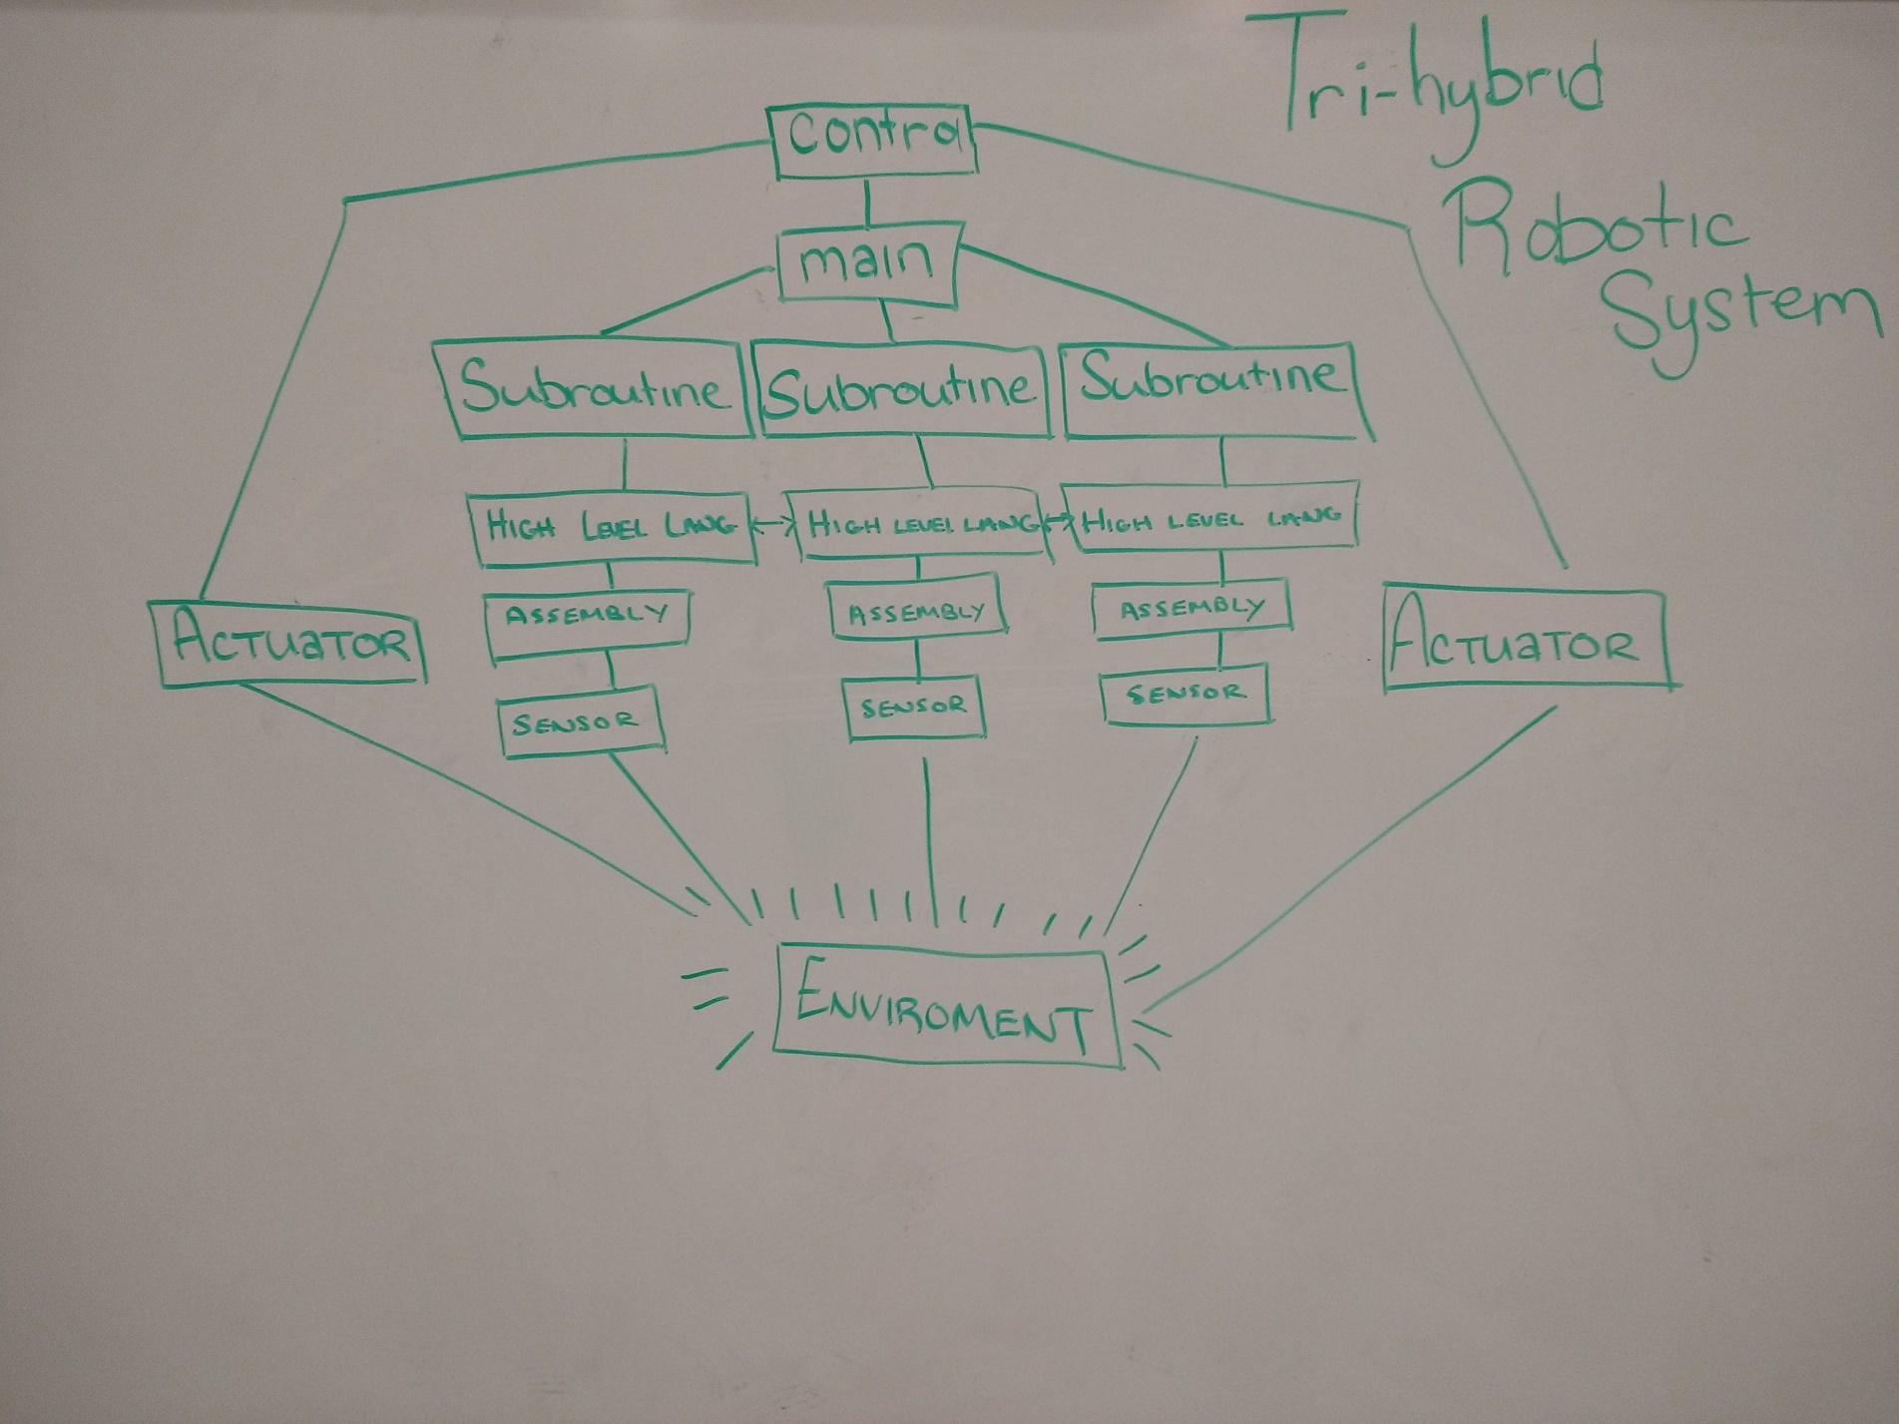
Architecture Graphical Diagram

Slide 4
Additional information (optional)
Control
Main / Subroutine
Layer Services
Level 1 –High level Language
Level 2 –Assembly
Level 3 –Sensor
Actuators

Slide 5
4 requirements
Req1 –Architecture must accommodate deliberative and reactive behavior. Robot must coordinate the actions it undertakes to achieve its designated objective with the reactions forced on it by the environment
Req2 --The architecture must allow for uncertainty. The circumstances of a robot’s operation are never fully predictable. The architecture must provide a framework in which the robot can act even when faced with incomplete or unreliable information
Req3 –The architecture must account for dangers inherent in the robot’s operation and its environment. By considering fault tolerance, safety, and performance the architecture must help maintain the integrity of the robot, its operators, and its environment. Problems like reduced power supply, dangerous vapors, or unexpectedly opening doors should not lead to disaster
Req4 –The architecture must give the designer flexibility. Application development for mobile robots frequently requires experimentation and reconfiguration. More over, changes in tasks may require regular modification.

Slide 6
How 4 requirements are handled
Req1
Control loop - Closed loop simplicity captures basic interaction between robot and outside. Drawback is unpredictability. No way to leverage ability to decompose into cooperating components.
Layers -More components available for delegation and abstraction to guide design
Req2
Control loop - Biased towards reducing the unknowns through integration (trial and error with action and reaction)
Layers - Existence of abstraction layers addresses the need for managing uncertainty (more knowledge as you move up layers)
Req3
Control loop - Simplicity enables easy duplication and reduces error brought forth by complexity
Layers - Abstraction enables but communication will need to be short circuited to be usable
Req4
Control loop - Major components are separated and can be replaced independently. Refinement handled by designers and not architects.
Layers - Complex relationships difficult to decipher

Slide 7
Textual Discussion of Architecture
Scenarios
Use Case Diagrams

Slide 8
Assessment comparison features
 | Control Loop | Layers | Implicit Invocation | Blackboard | Tri-hybrid Robotic System
Task Coordination | +- | - | ++ | + | +--
Dealing with Uncertainty | - | +- | +- | + | +--
Fault Tolerance | +- | +- | ++ | + | ++--
Safety | +- | +- | ++ | + | ++--
Performance | +- | +- | ++ | + | ++--
Flexibility | +- | - | + | + | +--

Slide 9
References
[1] Utdallas.edu. (2018). Requirements Engineering. [online] Available at: https://www.utdallas.edu/~chung/CS4351/syllabus.htm [Accessed 27 Sep. 2018].

Slide 10
Contact Information
Alex Lundin
Sr, Software Engineering
aml140830@utdallas.edu
Geet Babaria
Sr, Software Engineering
gxb120730@utdallas.edu
Justin Horak
Sr, Software Engineering
jmh161030@utdallas.edu

