Slide 1
Point-to-point links
Modulation
Bit Encoding
Framing
Error Detection
Reliable Transmission
Media Sharing (broadcast channels)

Slide 2
Building Blocks
CPU
Cache
Network
(T
o network)
adaptor
Memory
I/O bus
General-purpose computers (e.g., workstation) or special purpose hardware (switches/routers)
Finite memory (limited buffer space)
Connect to the network using a network adapter (aka Network Interface Card – NIC)
Fast Processor, slow memory
Slow I/O bus

Slide 3
Links
Local area network (within your building or campus) is usually built from:
  Copper Cable
  Unshielded Category 5 Twisted Pair (UTP)
  Thin-net co-ax
  Thick-net co-ax
  Optical Fiber
  Multimode optical fiber
  Single-mode optical fiber

Slide 4
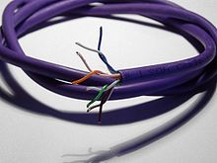
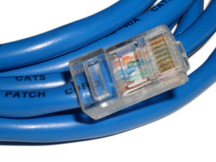
UTP
Consists of four pairs of cables
Each pair transmits a signal
Pairs are “twisted” together, to minimize interference from/to other pairs and other cables

Slide 5
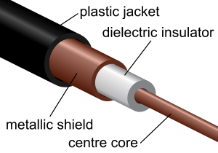
Thick-Net Co-ax
It has two conductors (the center core and the metallic shield)
It was designed to transmit high-frequency signals
An ordinary cable acts like an antenna, and high frequency signals radiate away from the wire (power loss)
To prevent this, one of the conductors is formed into a tube and encloses the other conductor. This confines the radio waves from the central conductor to the space inside the tube.

Slide 6
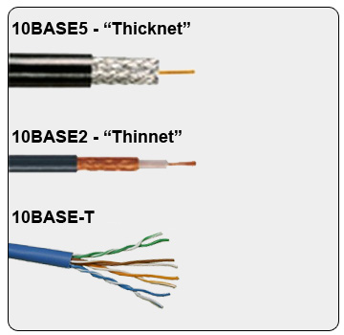
Thin-net Co-ax
Similar to thick-net, just thinner ☺

Slide 7
Links - Optical
Advantages of optical communication
  Higher bandwidths
  Superior attenuation properties
  Immune from electromagnetic interference
  No crosstalk between fibers
  Thin, lightweight, and cheap (the fiber, not the optical-electrical interfaces)
glass core (the fiber)
glas cladding
plastic jacket
optical
fiber
CS/ECE 338

Slide 8
Links - Optical
Single mode
  Lower attenuation (longer distances)
  Lower dispersion (higher data rates)
Multimode fiber
  Cheap to drive (LED’s) vs. lasers for single mode
  Easier to terminate
core of single mode fiber
~1 wavelength thick = ~1 micron
core of multimode fiber (same frequency; colors for clarity)
O(100 microns) thick

Slide 9
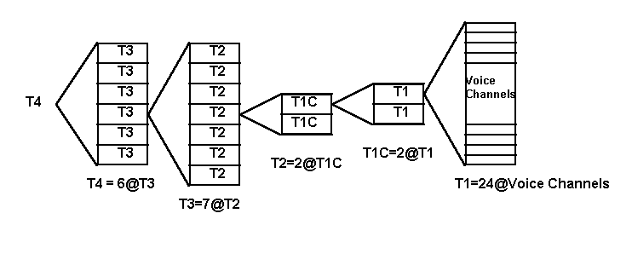
Connecting to the network core (businesses and universities)
  T1 is a high speed digital network (1.544 mbps) developed by AT&T in 1957.
  The primary innovation of T1 was to introduce "digitized" voice
  It later started being used to transmit digital data (Internet traffic)

Slide 10
Continued..
Chart 1 - T1 Hierarchy
DS0 | 64Kbps | 1/24 of T-1 | 1 Channel
DS1 | 1.544Mbps | 1 T-1 | 24 Channels
DS1C | 3.152 Mbps | 2 T-1 | 48 Channels
DS2 | 6.312 Mbps | 4 T-1 | 96 Channels
DS3 | 44.736 Mbps | 28 T-1 | 672 Channels
DS3C | 89.472 Mbps | 56 T-1 | 1344 Channels
DS4 | 274.176 Mbps | 168 T-1 | 4032 Channels

Slide 11
Carrier Optical Links
Optical Carrier (OC) transmission rates are a standardized set of specifications of transmission bandwidth for digital signals that can be carried on Synchronous Optical Networking (SONET) networks.[
Transmission rates are defined by rate of the bitstream of the digital signal, and are designated as OC-n, with a bandwidth of n × 51.84 Mbit/s.

Slide 12
Last-Mile Links: Residential Access
  Service Bandwidth
  POTS 28.8–56 Kbps
  ISDN 64–128 Kbps
  DSL 128 Kbps – 100 Mbps
  CATV 1–40 Mbps
  FTTH (fiber to the home) 50Mbps – 1 Gbps
Plain Old Telephone System (POTS) modem over 3KHz “voice” channel
ISDN: digital modem over 3KHz channel
xDSL/ADSL: Telephone company providing more bandwidth
CATV: use the co-ax cable provided by the cable TV company

Slide 13
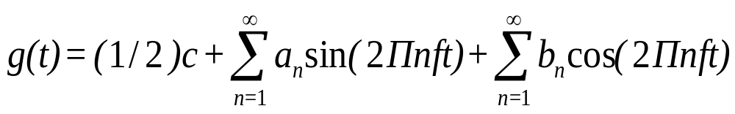
Sums of Sines and Cosines
All signals through a medium are electromagnetic waves.
Each signal can be decomposed into (represented as) an infinite sum of sines and cosines.
The more terms above are added, the closer the sum of sines and cosines becomes to the original signal.

Slide 14
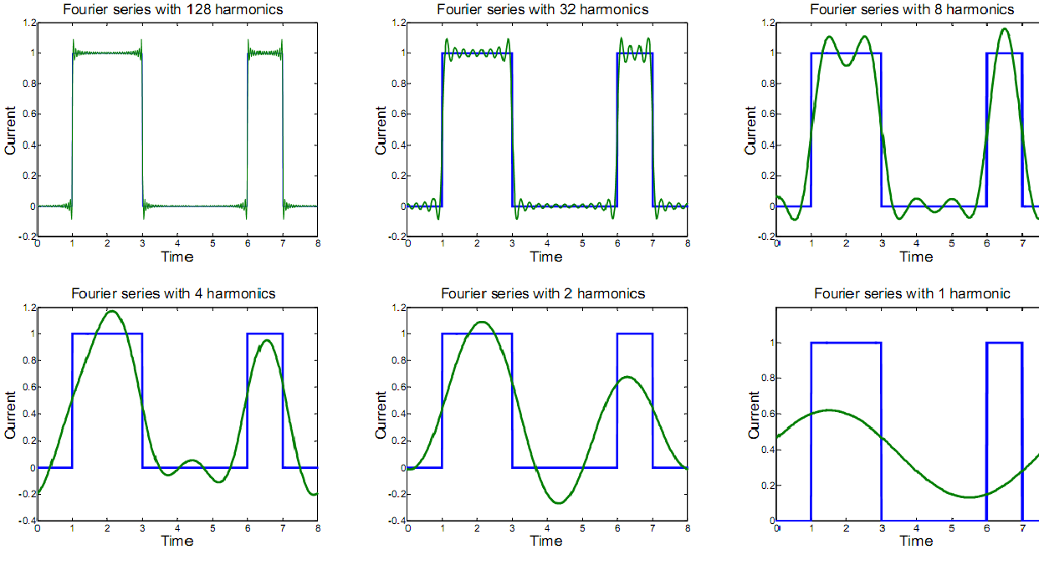

Slide 15
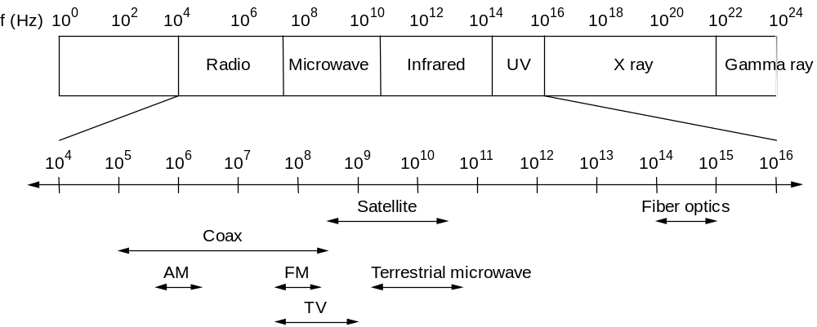
Electromagnetic Spectrum
Each medium has a finite range of frequencies it can transmit

Slide 16
Square Waves
What if we send our data (bits) as square waves?
I.e., two voltages, high for 1 and low for 0?
Problem: a square wave has an infinite number of frequency components.
Thus many components will be lost and the signal distorted
You also can’t do frequency division multiplexing (why?)
1
0
1
1
0

Slide 17
Modulation
Encode the signal as a sine wave: A*cos(wt + p)
  A is the amplitude
  w is the frequency
  p is the phase
Use modulation to encode the data, i.e.,
  change the amplitude
  change the frequency
  change the phase
  change all of the above.

Slide 18
1
0
Amplitude modulation
Frequency Modulation
Phase Modulation

Slide 19
Baud vs Bit Rate
Baud rate: number of transitions in the signal per second (e.g. how often can you change the amplitude?)
Bit rate: how many binary bits can you transmit per second.
Assume: 3 amplitudes, 3 frequencies and 2 phases
I.e., 18 different “symbols” (combinations) if all of these can change at each transition.
Then: bit rate = floor(log₂(18)) * baud rate = 4* baud rate
  Two symbols go unused.

Slide 20
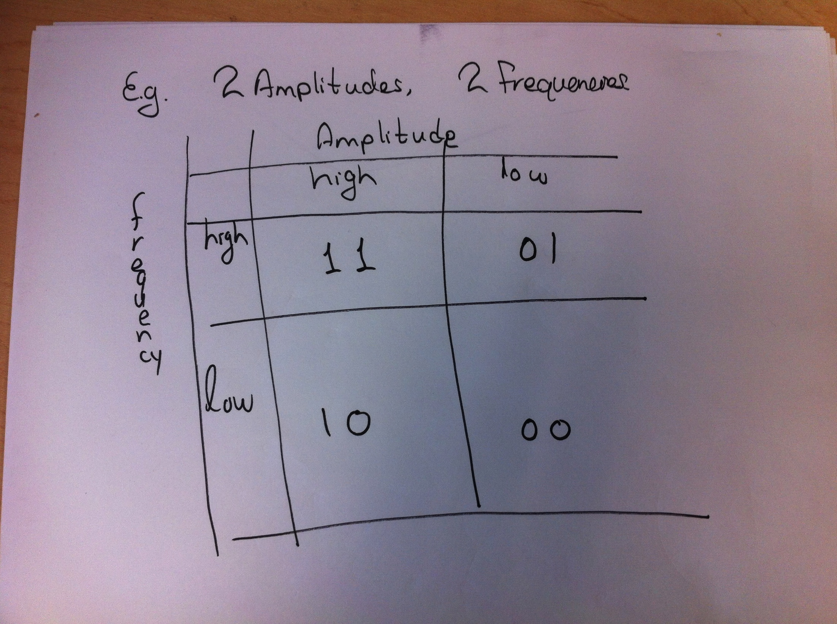

Slide 21
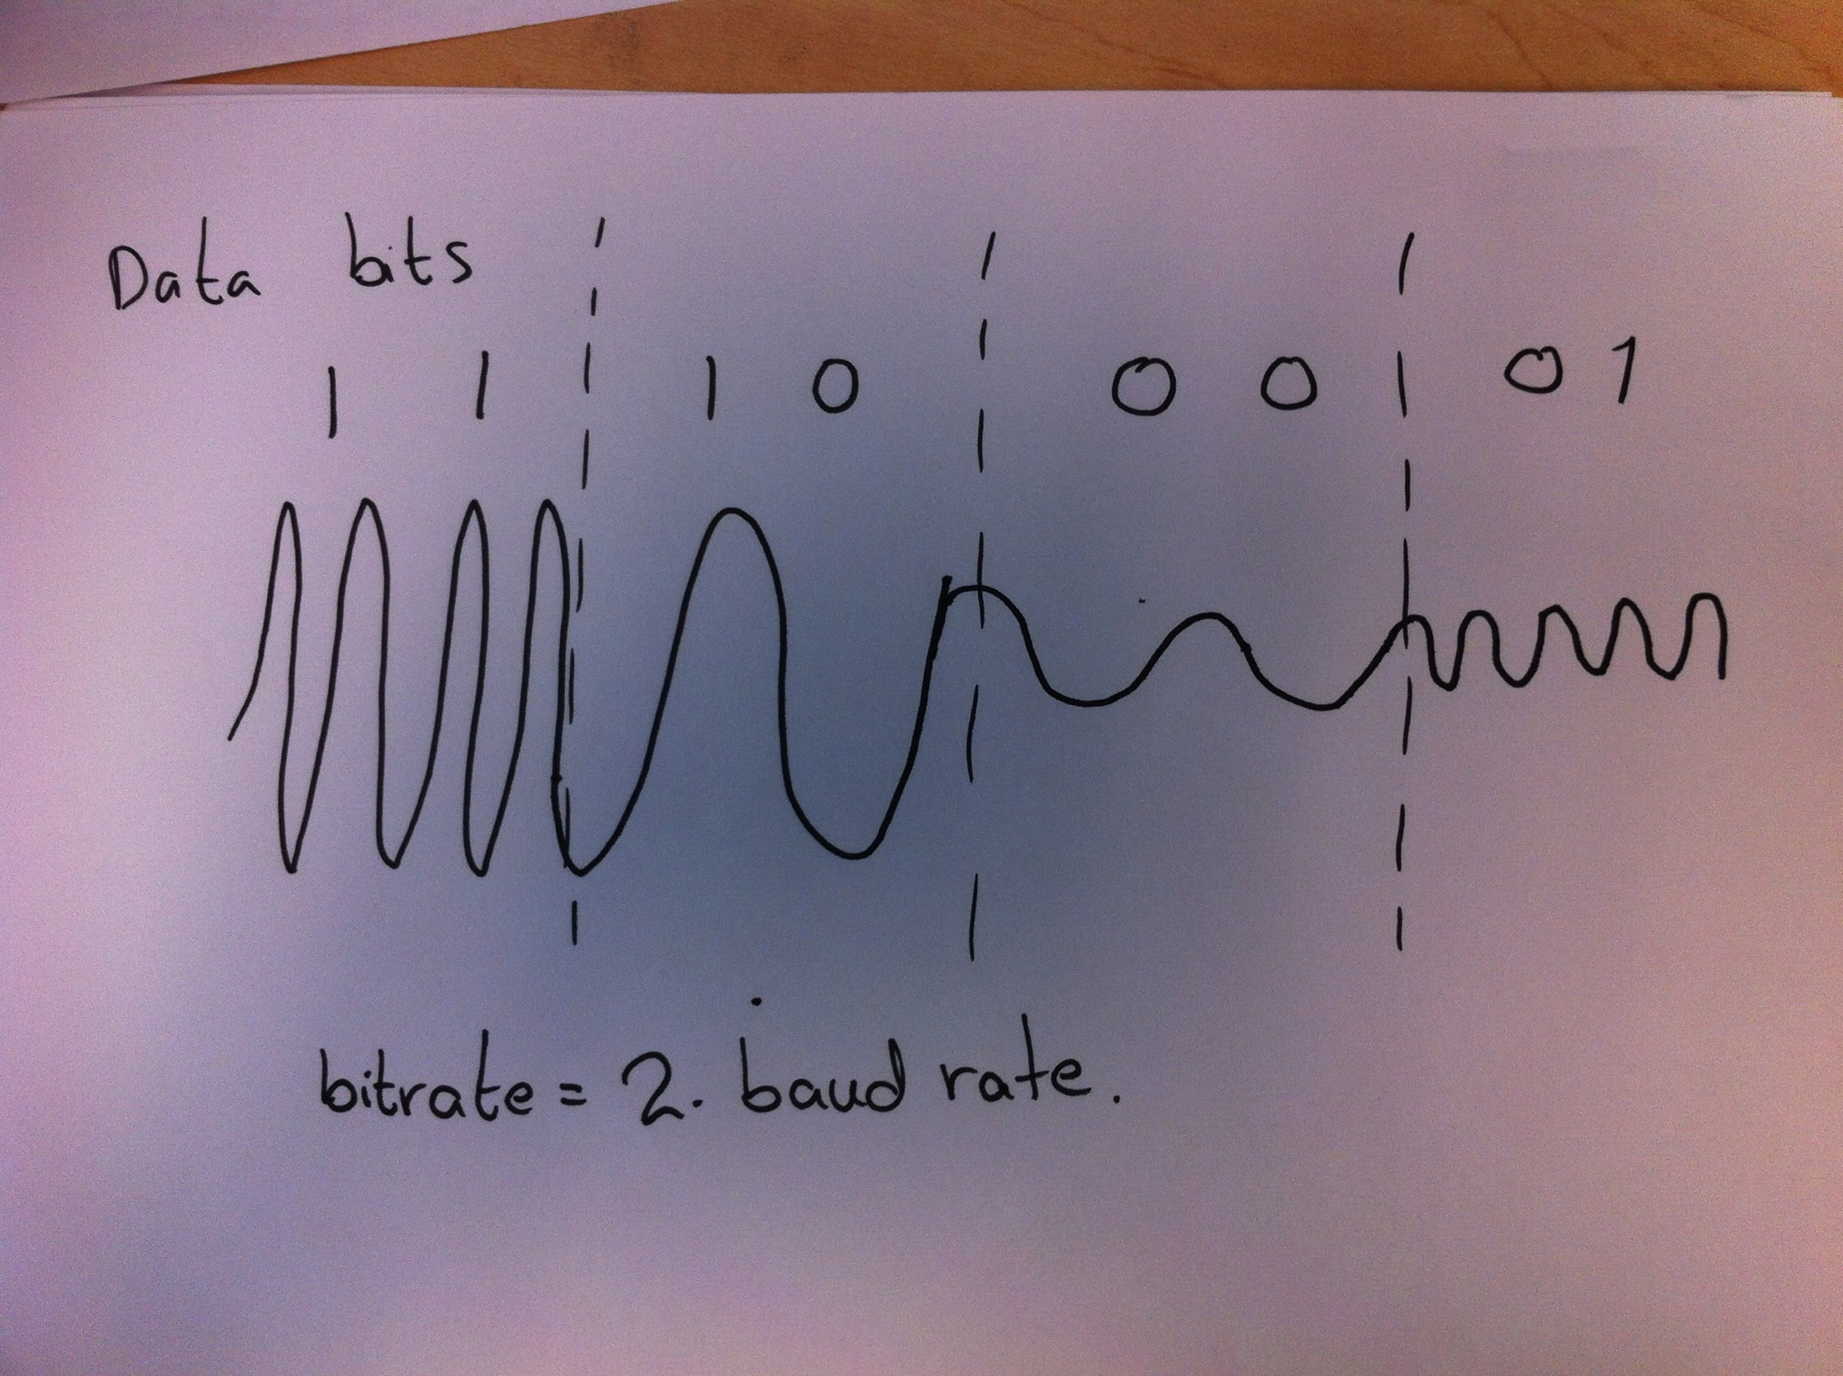

Slide 22
Baseband vs Broadband
Broadband
  Only a range of the frequencies of the medium are available for transmission by the user
  Data is modulated (frequency, shift, amplitude, etc)
    This allows the data to only use a small range of frequencies of the medium
    The remaining frequencies are used by other users.
Baseband
  All the frequencies of the medium are available for transmission by the user
  This allows the user to send a “square wave”
    Square waves use all the frequencies of the medium
    No problem, since no one else is also sharing the medium

Slide 23
Communication using a direct link – Issues
Signalling component
Signal
Node
Adaptor
Adaptor
Node
Bits
Encoding: should we just pass the 1’s and 0’s as is?
Synchronization: where does the data begin and where does it end?
  Bit synchronization
  Byte synchronization
  Frame synchronization
Error Detection (and, possibly, correction)
Medium Access Control (if not point to point)

Slide 24
Physical Bits
We will assume for simplicity :
  one bit per baud if we use modulation
  or a square wave if we use baseband
Each signal encodes a physical bit (may be different from data bit, see later why)
Thus, every time period of a baud encodes one bit.
What if the signal does not change? (e.g., data has many consecutive 0’s?
  More on this later . . .

Slide 25
Non-Return to Zero (NRZ)
Bits are sent “as is”
If bits do not change, then the signal does not change
Problem: receiver keeps an average of the power level (e.g. in amplitude modulation)
When a new bit is received, its signal value is compared to the average to determine its value.
What if we have 10,000 consecutive zeroes (or 10,000 ones)?
Bits
0
0
1
0
1
1
1
1
0
1
0
0
0
0
1
0
NRZ

Slide 26
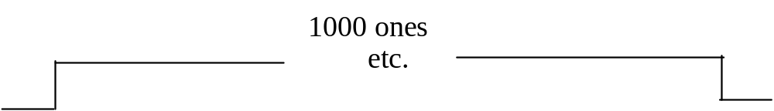
Clock Drift
Consider sending 1000 consecutive one's:
Sender and receiver's clocks aren't perfect: cannot run at exactly same speed.
Let Ts = time duration of a sender’s bit as measured by “true” clock
Tr = time duration of a receiver’s bit as measured by “true” clock
If Ts ≥ 1.001 Tr (sender slower than receiver) then
1000*Ts ≥ 1001*Tr
(receiver "sees" 1001 one's, rather than 1000)
If Ts ≤ 0.999 Tr (sender faster than receiver) then
1000*Ts ≤ 999*Tr
(receiver "sees" only 999 ones)
Thus, this poses a big problem: long signals with no change cause more or less bits to be received.

Slide 27
Bit Synchronization
Asynchronous
  Synchronize frequently
    send a short burst of bits (8-bits) followed by a synchronization sequence
    Mostly for low bandwidth inexpensive networks
Synchronous
  Synchronize after every bit
    Transmit many bits at a time (thousands if desired)
    Uses codes that allow the clock to be recovered (self-synchronizing codes)
    Receiver derives sender’s clock from the received bits and adjusts itself accordingly.

Slide 28
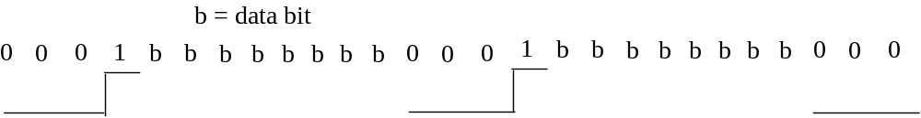
Asynchronous Bit Synchronization
The technique accomplishes bit and byte synchronization.
Each byte transmitted is surrounded by
  a start bit (usually 1),
  one or more stop bits (usually 0's, must be different from start bit)
When the sender is idle, it sends a continuous stream of zeroes.
Periodically, the sender should send at least 10 bits of consecutive zeroes, in case the receiver loses track of which bit corresponds to the start bit.
This technique is usually slow, because
  clock's not synchronized
  start-stop bit overhead.

Slide 29
Synchronous Transmission using Bit Encoding
Accomplishes bit synchronization at high speeds.
The whole frame is sent continuously without space between bytes.
The sender's and receiver's clock need to be running at exactly the same speed.
To do so, clocks are synchronized by encoding the sender's clock in the signal.
There are several encoding techniques.

Slide 30
Encodings
Data Bits
0
0
1
0
1
1
1
1
0
1
0
0
0
0
1
0
Clock
NRZ
Manchester
NRZI
Manchester: XOR of NRZ and Clock (always a transition in the middle of a bit)
NRZI: transition in the middle of bit indicates a one (does not solve the
problem of consecutive zeroes.

Slide 31
Manchester More Detailed
Let a "physical bit" be either a high (1) or a low (0) signal.
Let a "data bit" be a real bit of information to be transferred.
Each data bit is encoded as follows.
data bit physical bits
0 01
1 10
There is always a signal transition in the middle of each data bit.
Receiver uses these transitions to synchronize its clock to the sender's. This synchronization is what allows faster transmission speeds.
0
1
1
0
1
0
Data bits
0
1
1
0
1
0
0
1
1
0
0
1
Physical bits
Transitions in the
middle of each
data
bit
Clock signal of sender
extracted from the bits

Slide 32
Recovery
What if the receiver loses track?
  I.e., assume that the receiver loses track of which is the first physical bit of the two bits of each data bit.
    For example, if a physical bit received is a 0, is this the first physical bit of a 0 data bit, or is it the second physical bit of a 1 data bit?
E.g. 01010101010101010101 . . . (physical bits)
  Is the above a sequence of 0 data bits or a sequence of 1 data bits?

Slide 33
Recover (continued)
Notice the following
  data bit physical bits
  00 0101
  01 0110
  10 1001
  11 1010
Thus, two consecutive equal physical bits indicate a transition between data bits
Receiver re-synchronizes when it receives two consecutive equal physical bits

Slide 34
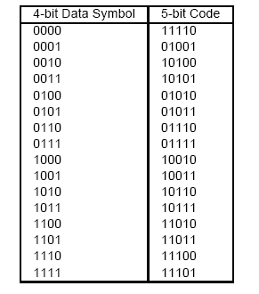
4B/5B
4B/5B
  every 4 bits of data encoded in a 5-bit code
  5-bit codes selected to have no more than one leading 0 and no more than two trailing 0s
  thus, never get more than three consecutive 0s
  resulting 5-bit codes are transmitted using NRZI
  achieves 80% efficiency! (vs. 50% of manchester)

Slide 35
Example of Used Encoding Approaches
4B/5B combined with NRZI used in
  FDDI (fiber token ring)
  100 Mbit Ethernet
Manchester encoding used in 10 Mbit Ethernet
8B/10B used in Gigabit Ethernet

Slide 36
Framing
We have achieved bit-synchronization
  In the case of asynchronous, also byte synchronization
Next, we need frame synchronization
  Typically implemented by the network adaptor (network card)
A large sequence of bits needs to be delineated.
  This sequence is a message (a.k.a. frame) from the data link layer.
Note: if we assume the sequence of bits is a sequence of bytes, then we also have byte synchronization.

Slide 37
Bit-Oriented Approaches
Use a few bits to delineate the begin and end of a frame.
We cover two approaches:
  Bit insertion (used in the HDLC data link protocol)
  Code violations (briefly)

Slide 38
Bit Insertion (a.k.a. bit stuffing)
Assume the sender always (continuously) sends data bits.
Why? to maintain bit synchronization using manchester encoding in a synchronous system.
From now on we ignore physical bits, and consider only data bits.
  I.e., the physical bits received are decoded using manchester and the result is an infinite stream of data bits.
But, what if the sender is "idle", i.e., which data bits are "idle" bits and which are "true" data bits?
To determine this, one common technique is bit stuffing

Slide 39
Idleness vs. Data
Idleness consists of k consecutive ones or more
  Sender and receiver must agree on k in advance, of course
E.g., if k = 6, then 111111 is idleness,
and so is 1111111,
and also 11111111111.
In general, the bit sequence looks like this, where x = data bit
11111110xxxxxxxxxxx011111111111110xxxxxxxxx01111111
idleness data bits idleness data bits idleness
k consecutive one's should not appear in your data bits, i.e., inside xxxxxx.
But what if your data does have k or more consecutive ones?

Slide 40
Inserting a "0"
The sender "inserts" an additional zero every time there are (k-1) consecutive data bits equal to one.
  The receiver will remove this extra zero
  If your data has k-1 ones followed by a zero, you still insert a zero.
For example, let k = 6, and you want to transmit as follows:
      data (ten ones)
      idleness 11111111110 idleness
Then, your output is as follows:
1111111110 111110 111110 0 0111111111

Slide 41
More examples
Next example,
      data
      idleness 11111011 idleness
output:
1111111110 111110 011 01111111
Final example,
        data
        idleness 11111 idleness
output:
11111110 111110 0111111111

Slide 42
Receiver Operation
How does the receiver determine if a bit is data or idleness?
One bits
  For a sequence of ones (surrounded by a zero on each side) the receiver simply counts the number of ones.
  If they are less than k, they are data bits,
  E.g.: input: 0111110
    The ones have to be data, since #1's = 5 < 6 = k = 6
  E.g.: input: 01111110
    The ones have to be idleness, since #1's = 6 ≥ k = 6

Slide 43
Zero Bits
Consider a zero bit, is it data or not?
Must count the number of ones that occur before and after the zero.
0 111...1111 0 1111...1111 0
B ones z A ones
Is the z bit (the zero with B ones before and A ones after) data or idleness?
If B ≥ k then z is not data, since the B bits are the idle flag
If B = k - 1 then z is not data, z is an inserted zero
If B < k-1 ∧ A ≥ k then z is not data, since z is
the beginning of an idle
If B < k-1 ∧ A < k then (and only then) z is data

Slide 44
Remarks
In practice, k = 6, hence 01111110 is a byte, and the pattern used is a little different:
idleness flag data flag idleness
11111111111111 01111110 xxxxxxxxx 01111110 111111111111111
I.e., 01111110 is at the beginning and end of a message,
  to fill the idle space between messages, a sequence of at least 8 consecutive ones is used.
Bit stuffing allows both character and frame synchronization (a frame is between idleness periods, each frame is a sequence of bytes)

Slide 45
Coding Violations
Manchester allows only 01 and 10 for a 1 data bit and a 0 data bit
Codes 00 and 11 are not used.
You can transmit data this way (physical bits)
00 (data bits with manchester encoding) 11
Note that in doing so our earlier recovery scheme does not work
What if we begin a frame with (physical bits) 0000 and end it with 1111? Will that work?

Slide 46
Initial Bit Synchronization in Synchronous Xmission
Assume we are doing Synchronous xmission (transmitting many bits, thousands, without stopping)
Assume, however, that the sender does not always transmit and the line is left with no signal (no voltage, nothing ...)
  Consider the case of Ethernet, many nodes share the line
  Thus, when idle, a node cannot xmit any signal otherwise it would interfere with other potential xmissions.
  If no nodes xmit, the wire has no voltage
How do we perform our initial bit synchronization?

Slide 47
Preamble
. . . idle . . .
01010101 . . . 01011
Data frame
. . . idle . . .
preamble
block of data bytes
Begin transmiting a “preamble”: a sequence of bits to aid in bit synchronization
  In Ethernet, it is 7 bytes of 10101010 (“data” bits, NOT physical bits)
  What do they look like in Manchester encoding?
Finish preamble with one special byte: 10101011
  Note: receiver does not count # of pairs 01
  Why? at the beginning, while synchronizing, it may miss a few
  It is the “11” that determines the end of the preamble
The next bit is the first bit of the frame.

Slide 48
Byte Oriented Approaches
Assume you have a method that has achieved already byte-synchronization (e.g. the asynchronous bit synchronization we saw earlier, the output is a sequence of bytes)
Thus, you receive as input an infinite sequence of bytes.
Which is the first byte of the frame and which is the last?
  separate frames from each other in the input sequence of bytes

Slide 49
Character Insertion Approach
(a.k.a. Sentinel Approach or Byte Stuffing)
Use special control characters to delineate the begin/end of the frame (and or sections of the frame)
What if the special control characters appear in the data? (Remember: users can xmit anything they want!)
Insert an “escape” character (often called DLE data link escape) before every special control character in the data.
What if “escape” exists in the data?
  Send two “escapes” back to back
  Two consecutive “escapes” are treated as a regular data byte whose value is equal to that of one “escape”

Slide 50
PPP
Point-to-point protocol
  Used heavily in the internet in point-to-point links (especially modems)
  Flag: 01111110
  Address field (constant value) 11111111
  Control Field (constant value) 00000011
  Protocol: which upper level protocol (e.g. IP) should receive data
  Data: the data itself of the upper level protocol
  CRC: error detection bits
8
8
8
16
32
8
Flag
Address
Control
Protocol
data
CRC
Flag

Slide 51
PPP Continued
PPP uses byte stuffing
  If 01111110 appears inside the data,
  it is escaped with the character 01111101
  If 01111101 appears in the data,
  then send 01111101 01111101
  receiver deletes one of these

Slide 52
Byte Count
Include a byte count in the message.
E.g., DECNET’s DDCMP protocol (1980's)
SOH (start of header, actually it is the message type)
COUNT (# bytes in message)
CRC-h (error detection on the header)
CRC-d (error detection on the data)
8
16
16
16
SOH
Count
CRC-h
Body
CRC-d

Slide 53
Error in Count
What if the count becomes corrupted?
  Read as many bytes as the count indicates
  CRC will detect corruption (hopefully) and frame is thrown away
  Then scan for the next SOH byte.
What if a data byte has a value equal to a SOH byte?
  We can keep getting error upon error
  Unlikely but possible

Slide 54
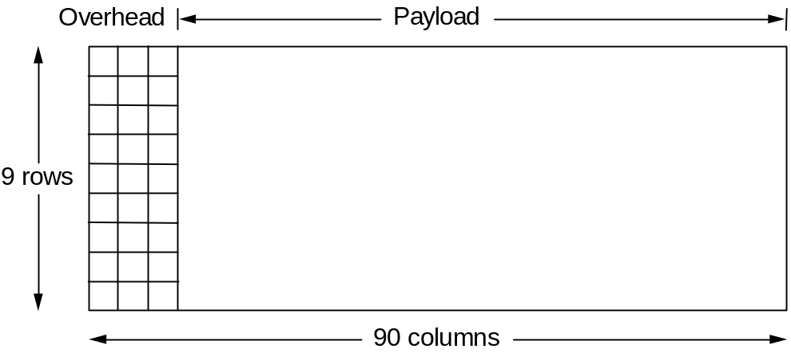
Clock-Based Framing (SONET)
Frame is always of the same size.
  STS-1 frame (above) 810 bytes
No need for bit-insertion or character insertion (well, sort of)
Does not use encoding (manchester, etc), i.e. uses NRZ (sort of)
First two bytes have special begin-of-frame pattern

Slide 55
Synchronization
What if you lose track of the beginning of frame?
  The begin-of-frame pattern may occur in the data!
  The receiver looks for this pattern
  If it occurs every 810 bytes often enough, it assumes it is ok (probabilistic)
What about bit synchronization?
  The payload could be all 0’s or all 1’s
  To ensure enough transitions, the data is scrambled
    XOR’ed with a fixed 128 bit pattern
    This ensure enough 0 to 1 and 1 to 0 transitions exist to allow clock synchronization.

Slide 56
STS-N/STS-Nc
STS-3 = byte interleaving of 3 STS1 frames
ALL frames last 125 microsec
  Hence, bandwidth of STS-3 (155.52 Mbps) is 3 times that of STS1 (51.84 Mbps)
  STS-N = N times bandwidth of STS-1
An STS-3 frame could carry a large data packet (say IP packet)
  The first part of the IP packet would be in first STS-1 frame, the second in the second STS-1 frame, etc.
  This is known as “concatenated” STS-3c
  Thus, the client gets a single large pipe (155.52 Mbps) rather than three independent small pipes (51.84 Mbps)

Slide 57
Example – Gigabit Ethernet Cables
Multiple Physical cable standards
  1000 Base-SX
    fiber, short wave, multi-mode fiber
      Short wave laser costs less (Same as CD Laser), but does not travel as well as long wave laser
  1000 Base-LX
    fiber, long wave, multi-mode or single-mode fiber
  1000 Base-CX
    Shielded 150 ohm matched cable, limited to 25 meters
  1000 Base-T
    Twisted-pair cabling (CAT-5, CAT-5e, CAT-6, or CAT-7), 100m
  1000 Base-TX
    Twisted-pair cabling (CAT-6. CAT-7), 100m

