Slide 1
Congestion Control
Notes:
1

Slide 2
Outline
Reacting to Congestion
Avoiding Congestion
Queuing Discipline
2
Notes:
2

Slide 3
Issues
Congestion Avoidance vs Control:
pre-allocate resources so as to avoid congestion (avoidance)
control congestion if (and when) it occurs (control)
Underlying service model
best-effort (assume for now)
multiple qualities of service (later in CS 6390)
Source
1
10-Mbps Ethernet
Router
Destination
1.5-Mbps T1 link
Source
100-Mbps FDDI
2
3
Notes:
3

Slide 4
Evaluation
Fairness – allocate resources fairly among flows.
Power (ratio of throughput to delay)
If you increase load too much
Packet losses increase
Queuing delay increases
Throughput/delay
Optimal
Load
load
4
Notes:
4

Slide 5
Taxonomy of schemes
Point of implementation
router-centric versus host-centric (TCP)
Resource allocation scheme
reservation-based
feedback-based
explicit
implicit (TCP)
Rate control Method
window-based (TCP)
rate-based
5
Notes:
5

Slide 6
TCP Congestion Control
Idea:
assumes best-effort network (FIFO or FQ routers)
each source determines network capacity by itself
uses implicit feedback
ACKs pace transmission (self-clocking sliding window)
Challenges:
determining the available capacity in the first place
adjusting to changes in the available capacity
6
Notes:
6

Slide 7
Self-clocking or ACK Clock (picture of bottleneck router link)
P_{b}
P_{r}
Sender
Receiver
A_{b}
A_{s}
A_{r}
Self-clocking systems tend to be very stable under a wide range of bandwidths and delays.
The principal issue with self-clocking systems is getting them started.
Notes:
7
Implications of ack-clocking:
More batching of acks => bursty traffic
Less batching leads to a large fraction of Internet traffic being just acks (overhead)

Slide 8
Throughput
If the window is W
And if the round-trip delay is D
What is the throughput of TCP?
(assuming the “bottleneck” link is not the first link of the host)
Source
Router
Router
Router
Router
Dest
One of these routers is the “bottleneck” router, whose link is the slowest (or busiest)
8
Notes:
8

Slide 9
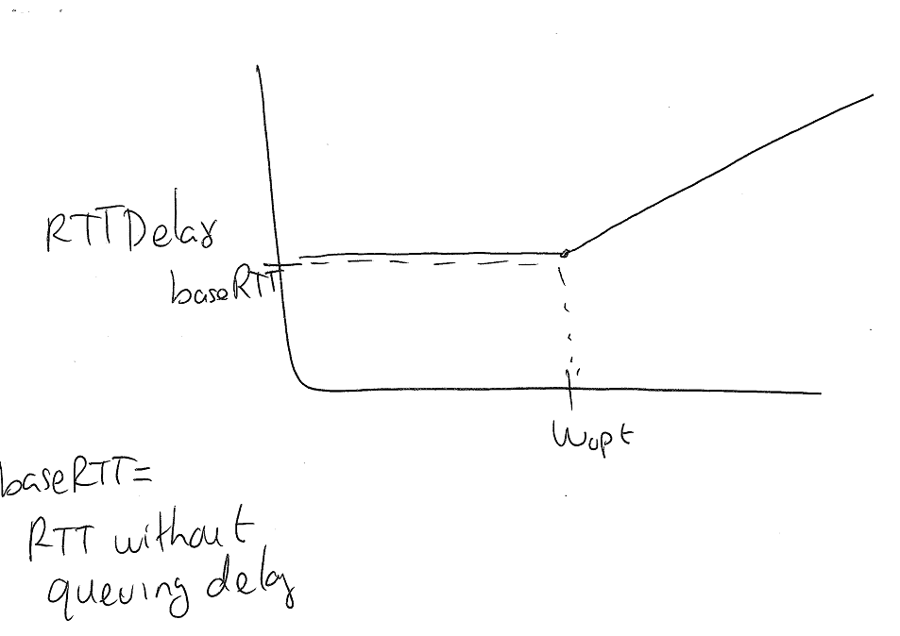
Window vs Round-Trip-Time
How would you adjust the window?
Wopt = optimum window = baseRTT * Bandwidth
9
Notes:
9

Slide 10
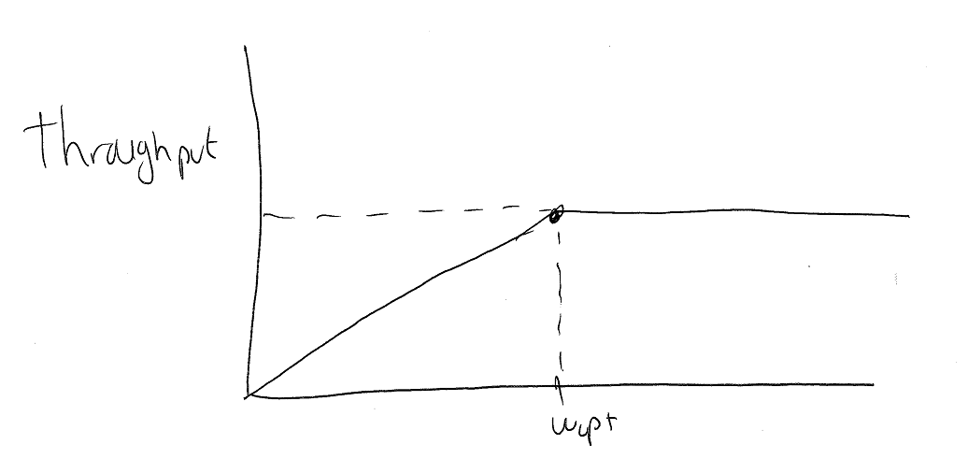
Window vs Throughput
How would you adjust the window?
10
Notes:
10

Slide 11
TCP
TCP does NOT know what baseRTT is (the network does not tell it) nor the bandwidth!
So, it CAN’t compute Wopt!
It must therefore act “blind”
11

Slide 12
AIMD (cont)
Question: how does the source determine if the network is congested?
12
Notes:
12

Slide 13
AIMD (cont)
Question: how does the source determine if the network is congested?
Answer: a timeout occurs (or a fast retransmit)
timeout signals that a packet was lost
packets are seldom lost due to transmission error
lost packet implies congestion
13
Notes:
13

Slide 14
AIMD (cont)
How does the source determine the network is NOT congested?
14
Notes:
14

Slide 15
AIMD (cont)
How does the source determine the network is NOT congested?
You can’t, you just assume it is !!!
15
Notes:
15

Slide 16
Additive Increase/Multiplicative Decrease
Objective: adjust to changes in the available capacity
New state variable per connection: CongestionWindow
limits how much data source has in transit
MaxWin = MIN(CongestionWindow, AdvertisedWindow)
(LastByteSent - LastByteAcked) ≤ MaxWin
Idea:
increase CongestionWindow when congestion goes down
decrease CongestionWindow when congestion goes up
16
Notes:
16

Slide 17
AIMD (cont)
Source
Destination
Algorithm
increment CongestionWindow by one packet per RTT (additive increase)
divide CongestionWindow by two whenever a timeout occurs (multiplicative decrease)
…
In practice: increment a little for each ACK
Increment = MSS * (MSS/CongestionWindow)
CongestionWindow = CongestionWindow + Increment
17
Notes:
17

Slide 18
AIMD (cont)
Trace: sawtooth behavior
70
60
50
KB
40
30
20
10
1.0
2.0
3.0
4.0
5.0
6.0
7.0
8.0
9.0
10.0
T
ime (seconds)
18
Notes:
18

Slide 19
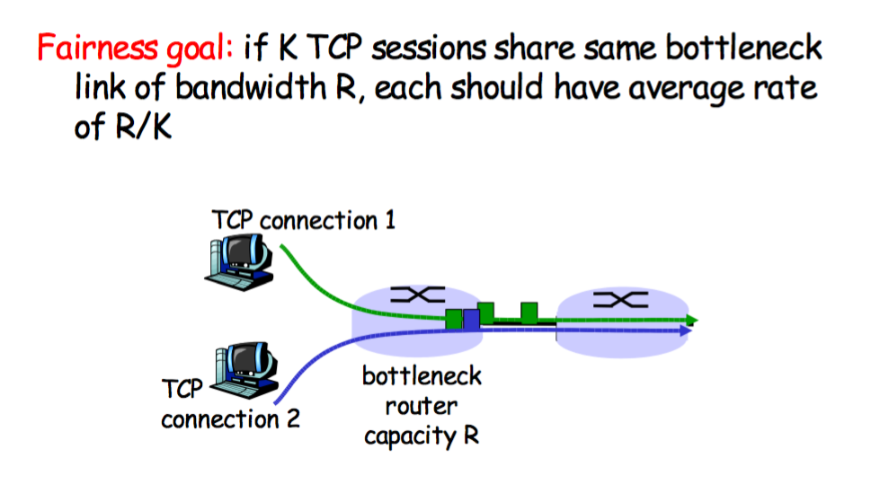
Why AIMD?
Think fairness
19

Slide 20
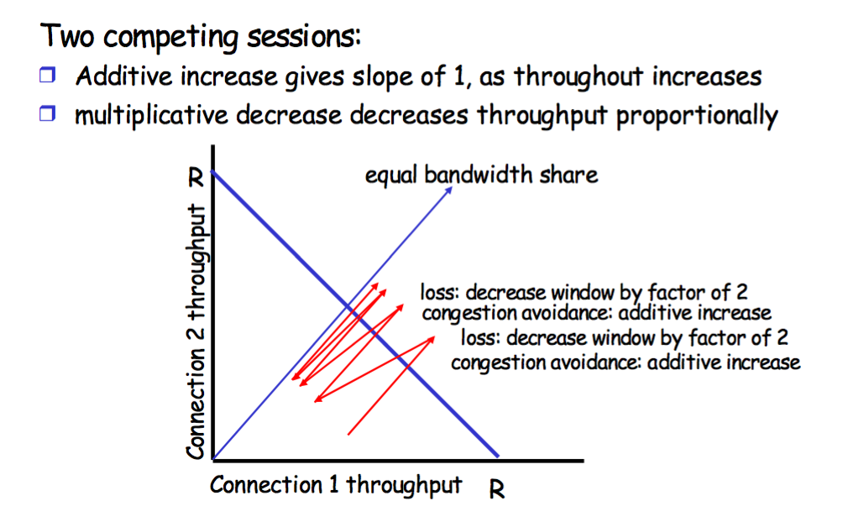
AIMD is sensibly fair
20

Slide 21
Initial window value
Initially, you don’t know the network capacity
What then should be the value of congwin?
Perhaps a value hard-coded in the program:
E.g., always start W = 20KB
Problems:
If congwin is too small, we waste bandwith
Takes a long time for congwin to grow using cong. avoidance
If congwin is too big we cause congestion
Dumping congwin bytes in the network, at once, even if W is the right value, may cause congestion.
21
Notes:
21

Slide 22
Slow Start
Source
Destination
Objective: determine the available capacity in the first place
Idea:
begin with CongestionWindow = 1 packet
double CongestionWindow each RTT (increment by 1 packet for each ACK)
…
22
Notes:
22

Slide 23
When to switch to linear? There is no good answer when you startup a connection
cwnd
time
23

Slide 24
Slow Start (cont)
Exponential growth, but slower than all at once
Used…
when first starting connection
when connection goes dead waiting for timeout and we go into congestion control (see next slides)
By the way, how many of your packets are in the network after you receive an ack for a retransmitted packet?
24
Notes:
24

Slide 25
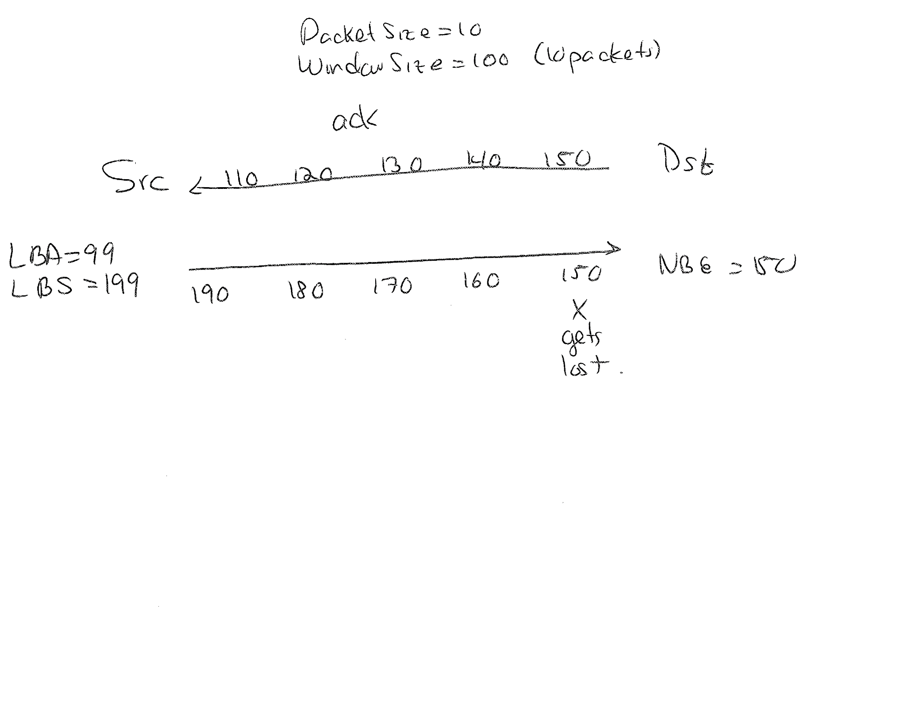
25

Slide 26
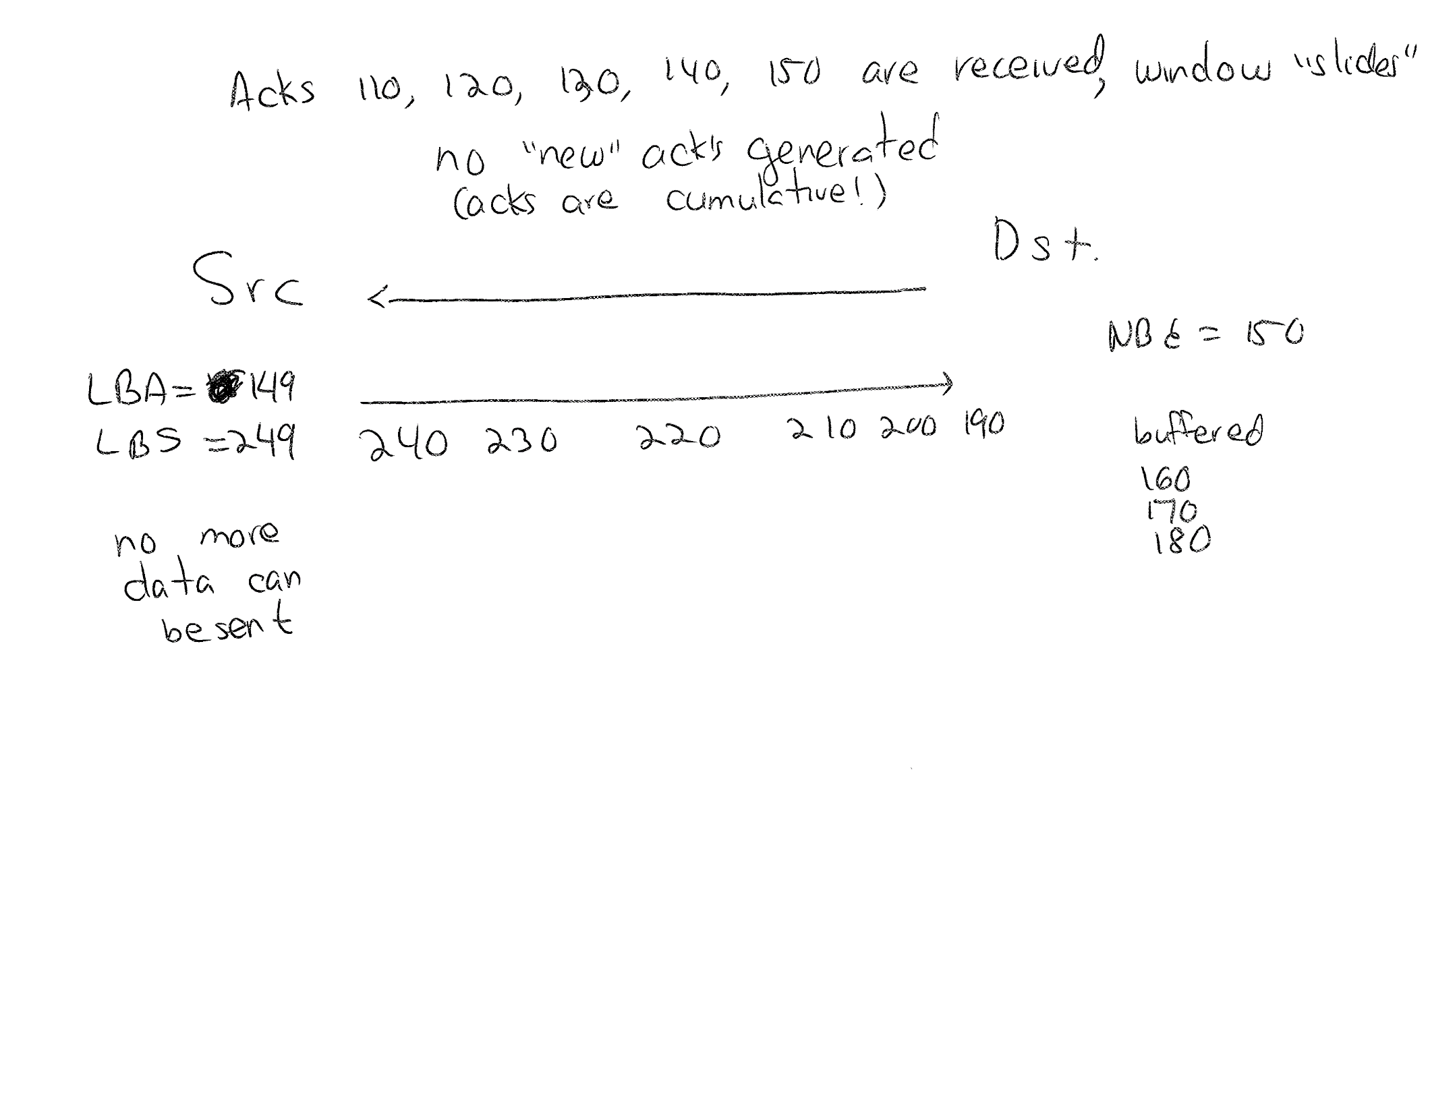
26

Slide 27
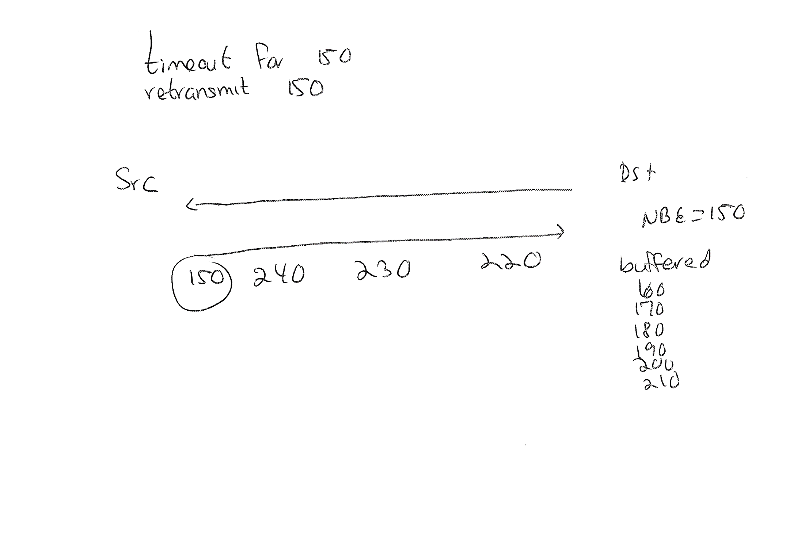
27

Slide 28
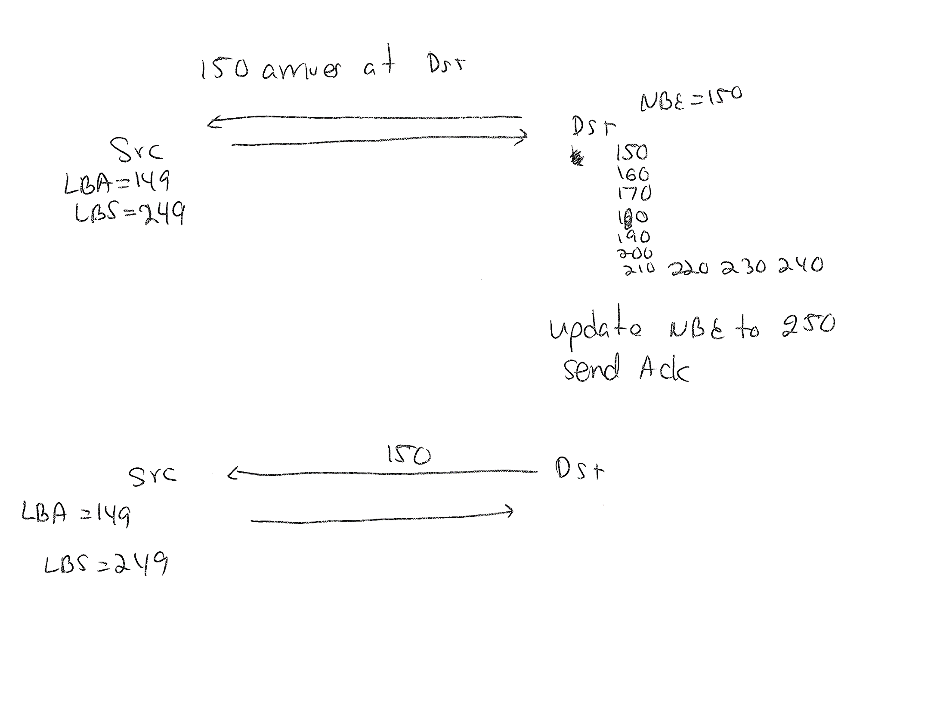
250
28

Slide 29
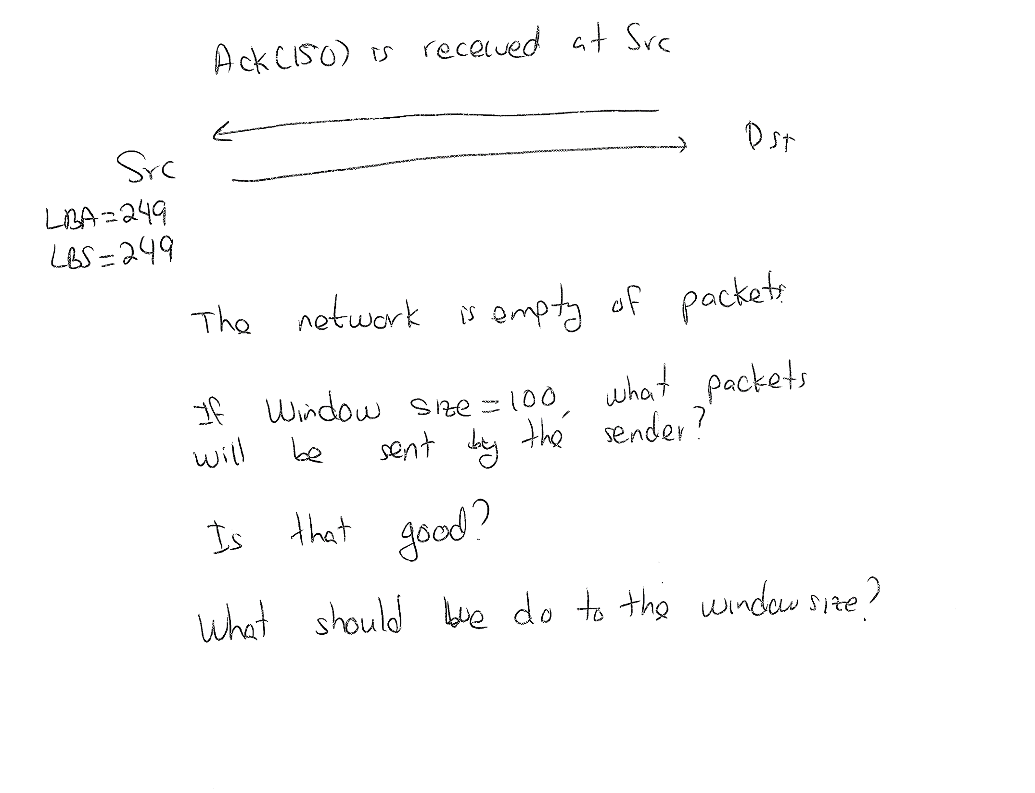
29

Slide 30
Congestion Control
After a timeout, we are in “congestion control” mode
set slow-start threshold SSThresh to CongestionWindow/2
set CongestionWindow to 1
Allow CongestionWindow to grow exponentially using “slow start” until it reaches the SSThresh
Then, continue with additive increase of CongestionWindow (i.e., back to congestion avoidance)
30
Notes:
30

Slide 31
Window size over time
14
12
10
8
congestion window size
(segments)
6
4
2
0
1
2
3
4
5
6
7
8
9
10
11
12
13
14
15
Transmission round
cwnd
time
31

Slide 32
Fast Retransmit
Problem: coarse-grain TCP timeouts lead to idle periods
Fast retransmit: use duplicate ACKs to trigger retransmission (3 of them in case there is reorder)
Sender
Receiver
Packet 10
Packet 20
Packet 30
ACK 20
Packet 40
ACK 30
Packet 50
ACK 30
Packet 60
ACK 30
Retransmit
ACK 30
packet 30
ACK 70
32
Notes:
32

Slide 33
Slow start or not?
After a fast retransmission –
Do a slow start? (set the CongestionWindow to 1 and increase exponentially up to Thresh)
(again, how many packets are in the network after we receive an ack for the retransmitted packet?)
Or not? (Fast Recovery, details later…)
Go “directly” to half the previous congestion window
Avoid the slow start
More details on this later …
The above depends on the version of TCP
33
Notes:
33

Slide 34
TCP Tahoe and TCP Reno (for single segment losses)
cwnd
Tahoe
Does slow start
time
Reno
cwnd
Does “fast recovery”
time
Notes:
34

Slide 35
Summary: TCP Congestion Control
When CongWin is above SShreshold, sender is in congestion-avoidance phase, window grows linearly.
When timeout occurs (i.e., congestion), SSThreshold set to CongWin/2 and CongWin is set to 1 MSS (i.e. slow-start)
When CongWin is below SSThreshold, sender in slow-start phase, window grows exponentially.
When a fast retransmission (i.e., congestion) occurs,
If fast recovery not implemented, then slow the same as a timeout.
if fast recovery, then we stay in congestion-avoidance (details follow)
35
Notes:
35

Slide 36
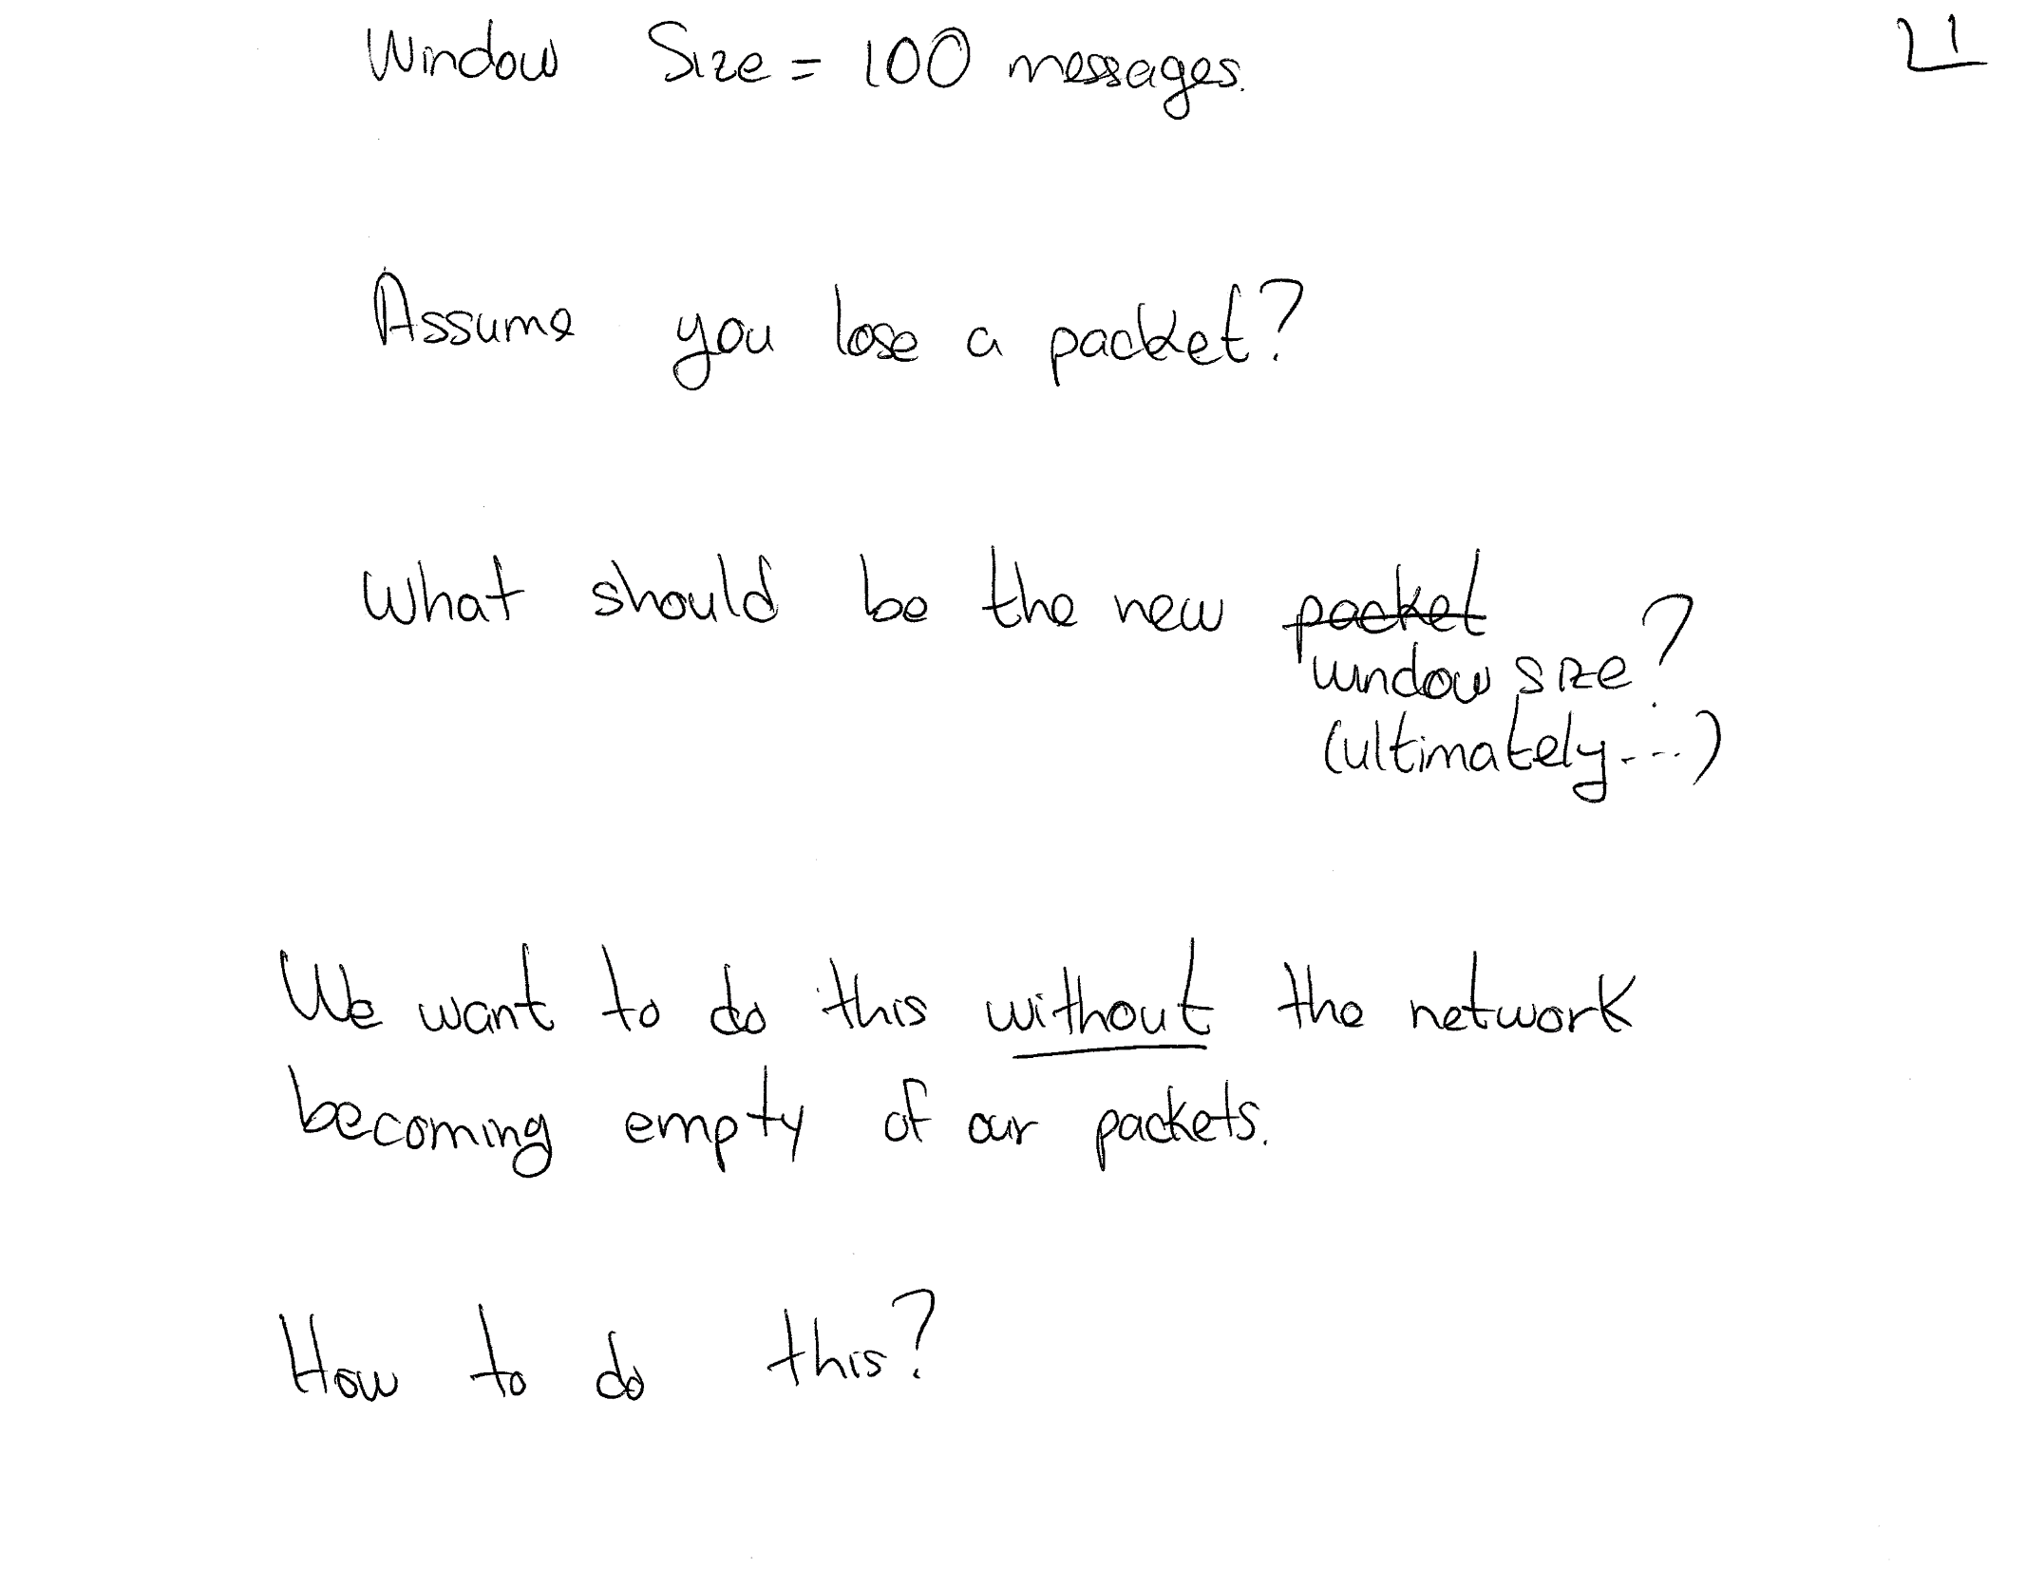
36

Slide 37
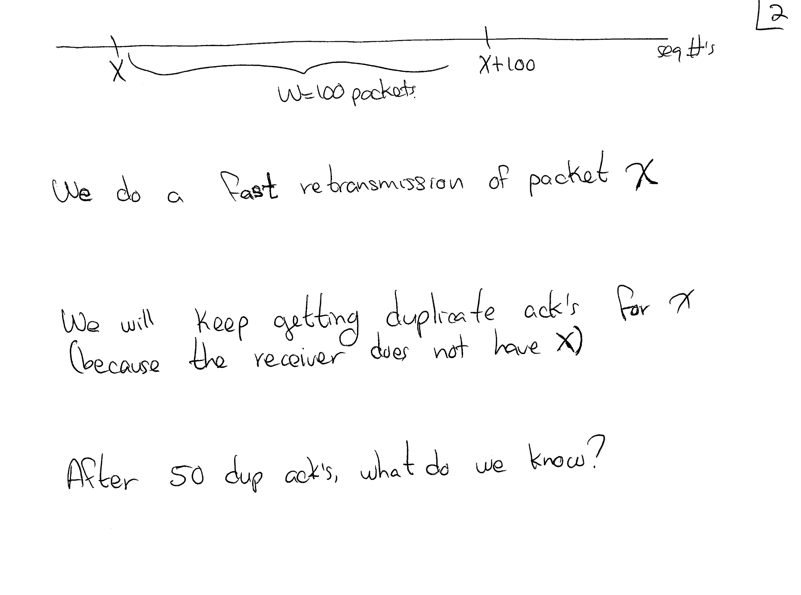
37

Slide 38
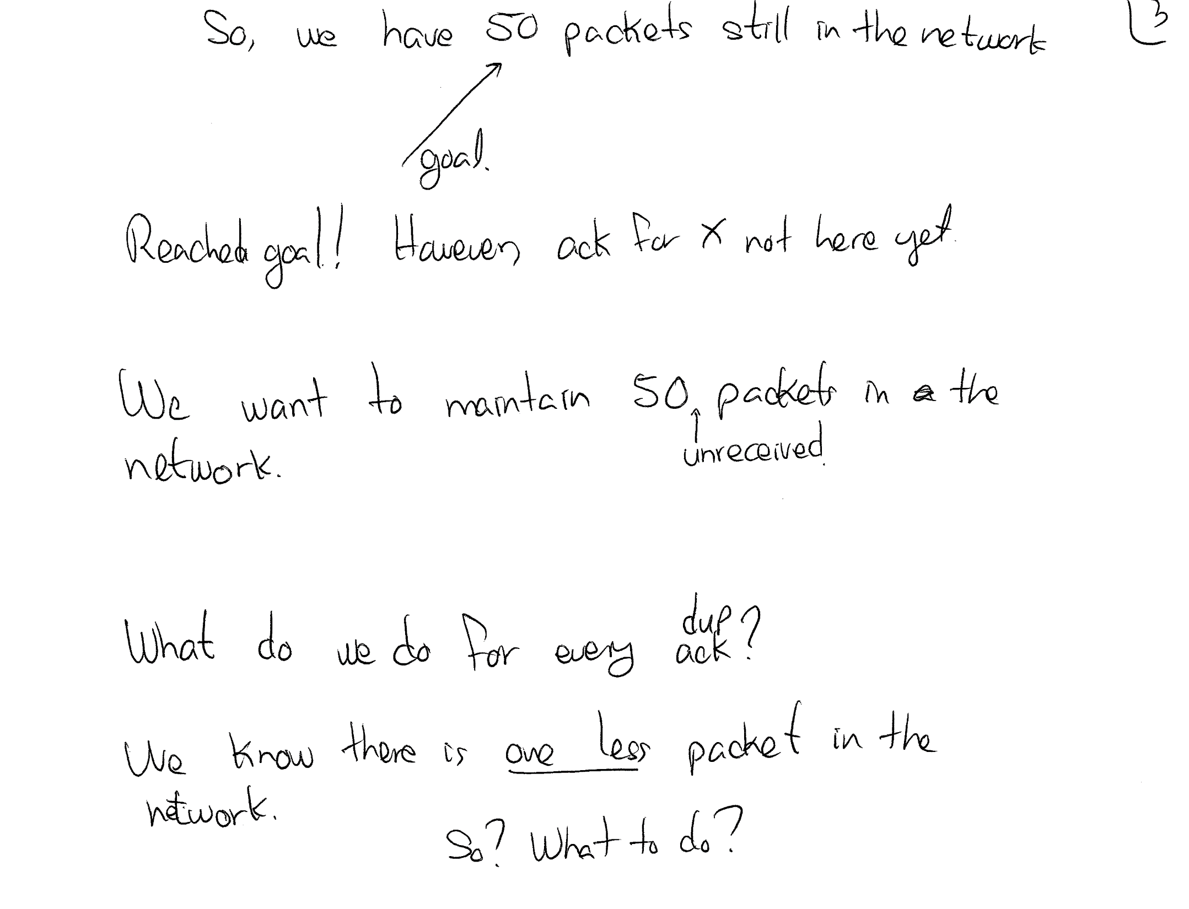
38

Slide 39
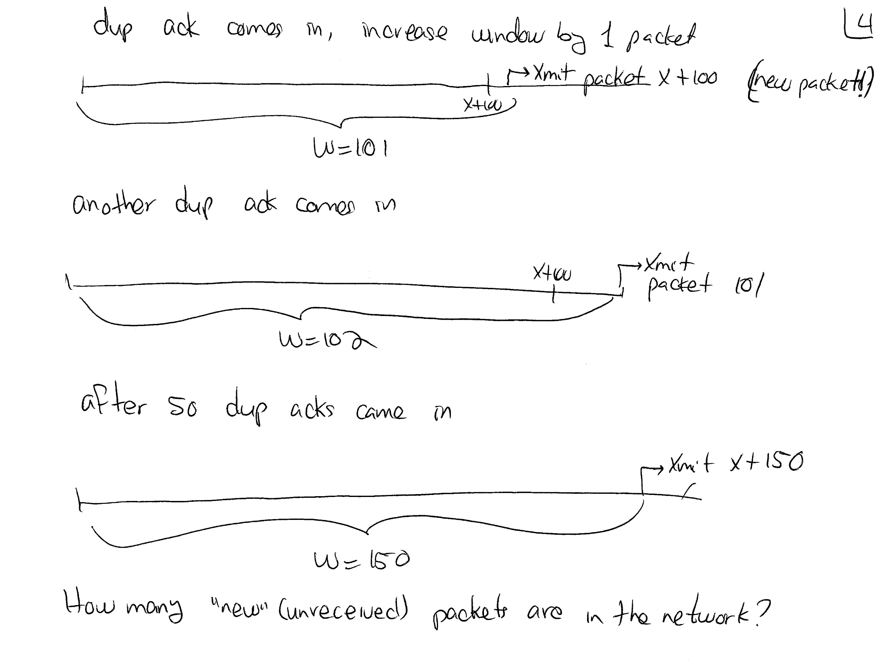
39

Slide 40
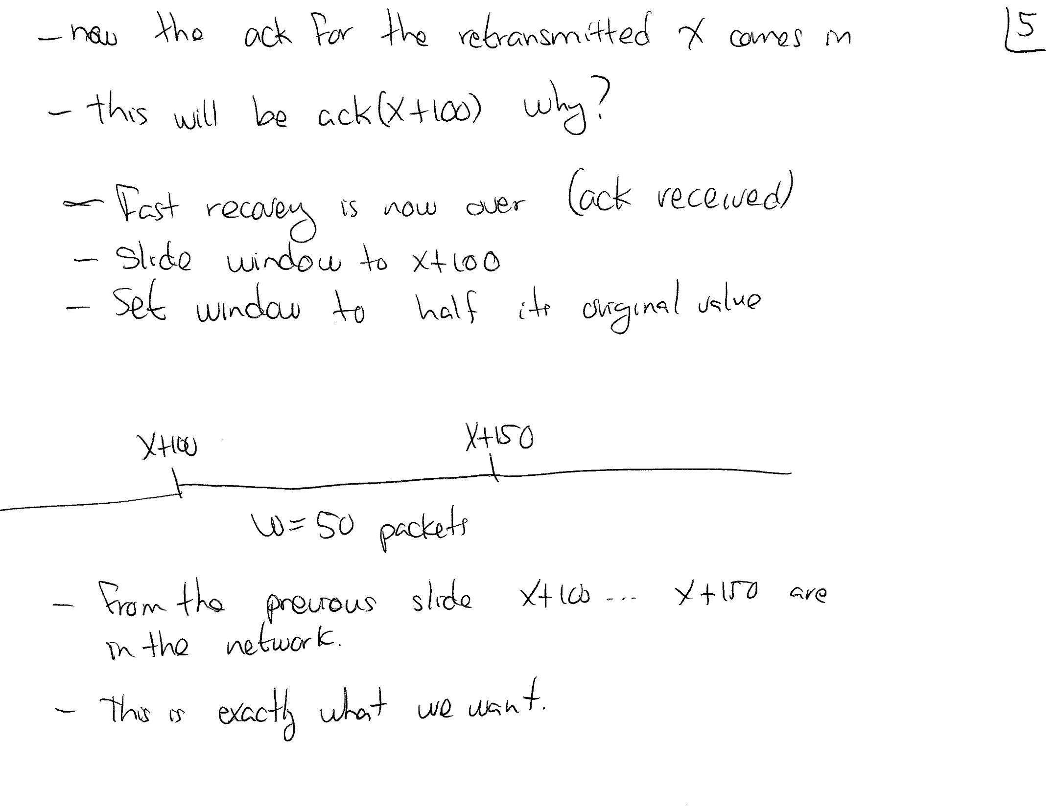
40

Slide 41
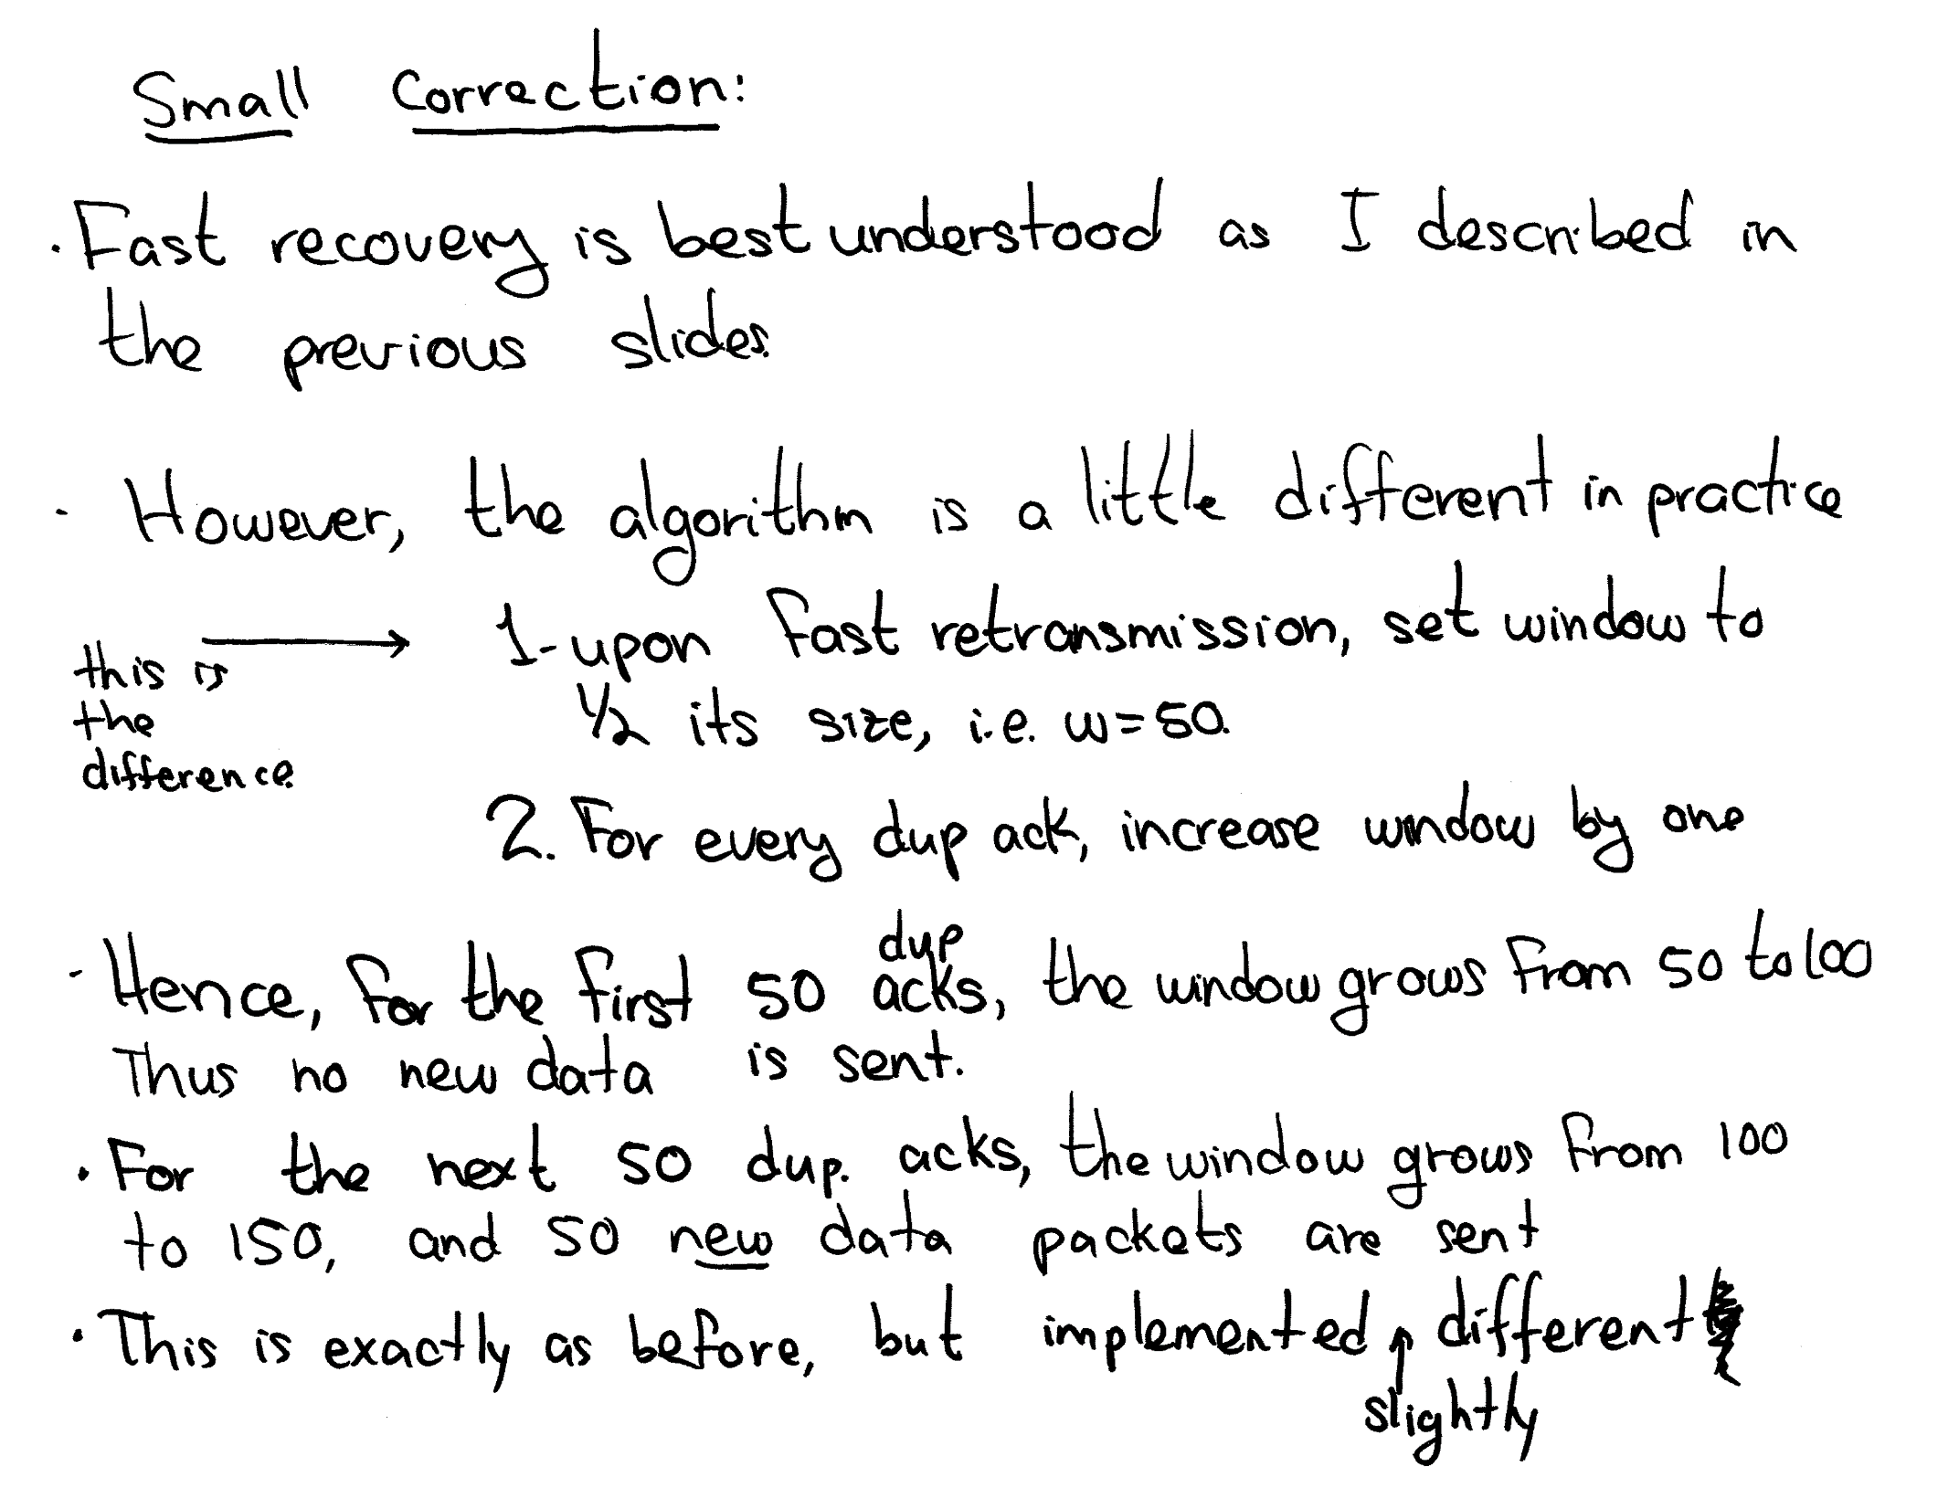
41

Slide 42
Fast Recovery, more details
Assume we have the following scenario (10 byte packets)
100 segments 10, 20, 30, … 990, 1000 have been sent,
cwnd = 1000, ssthr ≤ 1000 (congestion avoidance) thus, 100 segments (10 bytes each) are “flying” in the channel
Assume segment 10 is lost
Thus, when segments 20, 30, and 40 are received, the receiver will send 3 duplicate ack(10)
42
Notes:
42

Slide 43
Fast Recovery (more details)
When the third duplicate ACK(10) in a row is received:
set ssthreshold to one-half the current congestion window, congwin, but no less than two segments.
i.e., set ssthreshold = 500
congwin remains at 1000 (for the moment)
Retransmit the missing segment.
Rxmit segment 10
Notice, “new” 10 is now “behind” segments 1000, 990, 980, … , 50
43
Notes:
43

Slide 44
Fast Recovery (more details)
NOTE:
congwin does not allow you to send any more packets (the window is “closed”)
If you wait for the retransmitted segment 10 to reach the receiver and the ack (which will ack all 1000 bytes) to arrive at the sender, the network will be empty of packets and a slow-start must be performed
we don’t want this. You want to continue to send data and prevent the network from being empty (recall self-clocking)
You would need a window of size 1010 before you can send another new packet.
44
Notes:
44

Slide 45
Fast recovery (contd)
We thus temporarily increase congwin
Set congwin to threshold plus 3 times the segment size.
congwin = 500 + 30 = 530
This inflates the congestion window by the number of segments that have left the network and which the other end has received and stored (3).
It is not big enough yet to transmit new data
Each time another duplicate ACK arrives
Increment congwin by the segment size.
This inflates the congestion window for the additional segment that has left the network.
Transmit a packet, if allowed by the new value of congwin.
Note that congwin needs to grow to at least 1010 for this to happen.
45
Notes:
45

Slide 46
Fast recovery (back to the example)
We have congwin = 530, and 96 old segments flying (1000 … 50)
When receiver rcvs segments 510 .. 50 the rcvr sends back duplicate ack(10), i.e., 47 duplicate ack’s.
Each of these will increase the window by 10 at sender
New congwin = 1000 (as big as before!)
Still have 1000 … 520 outstanding (about ½ old window)
Note, we can now send new data if more acks come in (because the window will grow)
46
Notes:
46

Slide 47
Fast recovery (contd)
When segments 1000 … 520 are rcvd, receiver sends 49 duplicate ack(10)
Thus, congwin increases by 490: congwin = 1490
congwin grows from 1000 to 1490
Thus, we can now send segments 1010 … 1490 as the window increases (i.e. 1490, … ,1010, 10, …)
These are 49 new packets, not retransmissions
These packets are behind the retransmitted packet 10
47
Notes:
47

Slide 48
Fast recovery (more details)
When segment 10 arrives at the receiver:
the send an ack for ALL the data – ack(1010)
segments still flying: 1490 ..1010
these are the new packets sent after the retransmission
When ack(1010) arrives at the sender
Fast retransmit is over at this point.
set congwin to threshold (the value set in step 1).
congwin = 500
We can now send segment 1500
We now have congestion avoidance (congwin = thresh) at one-half the rate it was at when the packet was lost (congwin = 500)
48
Notes:
48

Slide 49
TCP New Reno
When multiple packets are dropped, Reno has problems
Partial ACK:
Occurs when multiple packets are lost
A partial ACK acknowledges some, but not all packets that are outstanding at the start of a fast recovery,
It takes sender out of fast recovery
Sender has to wait until timeout occurs (then slowstart)
New Reno:
Partial ACK does not take sender out of fast recovery (basically, don’t slide the window).
Partial ACK causes retransmission of the segment following the acknowledged segment
New Reno can deal with multiple lost segments without going to slow start
Notes:
49

Slide 50
Congestion Avoidance
TCP’s strategy
control congestion once it happens
repeatedly increase load in an effort to find the point at which congestion occurs, and then back off
Alternative strategy
predict when congestion is about to happen
reduce rate before packets start being discarded
call this congestion avoidance, instead of congestion control
Two possibilities
router-centric: DECbit and RED Gateways
host-centric: TCP Vegas
50
Notes:
50

Slide 51
Random Early Detection (RED)
Notification is implicit
just drop the packet (TCP will timeout)
could be made explicit by marking the packet
Early random drop
rather than wait for queue to become full, drop each arriving packet with some drop probability whenever the average queue length exceeds some drop level
51
Notes:
51

Slide 52
RED Details
Compute average queue length
AvgLen = (1 - Weight) * AvgLen +
Weight * SampleLen
0 < Weight < 1 (usually 0.002)
SampleLen is queue length each time a packet arrives
MaxThreshold
MinThreshold
A
vgLen
52
Notes:
52

Slide 53
RED Details (cont)
Two queue length thresholds
if AvgLen ≤ MinThreshold then
enqueue the packet
if MinThreshold < AvgLen < MaxThreshold then
calculate probability P
drop arriving packet with probability P
if MaxThreshold ≤ AvgLen then
drop arriving packet
53
Notes:
53

Slide 54
RED Details (cont)
Computing probability P
TempP = MaxP * (AvgLen - MinThreshold)/ (MaxThreshold - MinThreshold)
P = TempP/(1 - count * TempP)
count = number of new packets NOT dropped while within MinThresh and MaxThresh
TempP
1.0
TempP
MaxP
A
vgLen
MinThresh
MaxThresh
54
Notes:
54

Slide 55
Final P
P = TempP/(1 - count * TempP)
count = number of consecutive packets NOT dropped while within MinThresh and MaxThresh
This spreads the losses more over time
E.g., assume:
MaxP = 0.02, count = 0, AvgLen = (MaxThreshold + MinThreshold)/2 TempP = 0.01
Assume AvgLen remains where it is
After 50 packets arrive without dropping
P = 0.01/(1 – 50*0.01) = 0.02
After 99 packets arrive without dropping
P = 0.01/(1 – 99*0.01) = 1 !!!
Packet will be dropped
Prevents long periods without dropping
55
Notes:
55

Slide 56
Why RED
Probability of dropping a particular flow’s packet(s) is roughly proportional to the share of the bandwidth that flow is currently getting
It is fair (or sensibly so)
It keeps the queue size small
TCP tries to do the opposite, make it big
Big queue sizes lead to “buffer bloat”
RED helps to prevent this
56
Notes:
56

Slide 57
Tuning RED
MaxP is typically set to 0.02, meaning that when the average queue size is halfway between the two thresholds, the gateway drops roughly one out of 100 packets.
If traffic is bursty, then MinThreshold should be sufficiently large to allow link utilization to be maintained at an acceptably high level
57
Notes:
57

Slide 58
Tuning Red (cont)
Difference between two thresholds should be larger than the typical increase in the calculated average queue length in one RTT;
I.e., in one RTT windows (throughput) increase, and the drop prob should not jump from 0 to 1.
setting MaxThreshold to twice MinThreshold is reasonable for traffic on today’s Internet
MaxThreshold should be smaller than the entire buffer size
We want P = 1 when the average queue size is greater than MaxThreshold ,
A burst may increase queue size above MaxThreshold,
This causes all arriving packets to be dropped
But P != 1, so this is not our intended effect.
58
Notes:
58

Slide 59
Source-Based Congestion Avoidance
Perhaps the source can detect that congestion is starting to occur (rather than just react when it occurs)
When congestion begins to occur
Buffers begin to fill up at intermediate routers
Queuing delays (hence RTT) increases
Throughput does not increase regardless of how fast we send or how big the window is
The network cannot send any faster
59
Notes:
59

Slide 60
TCP plot
70
Idea: source watches for some sign that router’s queue is building up and congestion will happen too; e.g.,
RTT grows
sending rate flattens
60
50
KB
40
30
20
10
0.5
1.0
1.5
2.0
2.5
3.0
3.5
4.0
4.5
5.0
5.5
6.0
6.5
7.0
7.5
8.0
8.5
Time (seconds)
1100
900
700
Sending KBps
500
300
100
0.5
1.0
1.5
2.0
2.5
3.0
3.5
4.0
4.5
5.0
5.5
6.0
6.5
7.0
7.5
8.0
8.5
Time (seconds)
10
5
Queue size in router
0.5
1.0
1.5
2.0
2.5
3.0
3.5
4.0
4.5
5.0
5.5
6.0
6.5
7.0
7.5
8.0
8.5
Time (seconds)
60
Notes:
60

Slide 61
TCP Vegas Algorithm
Let BaseRTT be the minimum of all measured RTTs (commonly the RTT of the first packet)
If not overflowing the connection, then
ExpectRate = CongestionWindow/BaseRTT
Source calculates sending rate (ActualRate) once per RTT
Send a distinguished packet
Compute the RTT of this distinguished packet (when its ACK arrives)
Divide number of bytes transmitted while waiting for the ACK by the RTT measured.
61
Notes:
61

Slide 62
Algorithm (cont)
Source compares ActualRate with ExpectRate (note: ExpectRate > ActualRate by definition!)
Diff = ExpectRate - ActualRate
if Diff < α
increase CongestionWindow linearly
else if Diff > β
decrease CongestionWindow linearly
else
leave CongestionWindow unchanged
62
Notes:
62

Slide 63
α and β as “packets”
α and β are defined as rate, i.e., in bytes/sec.
Typically, the throughput varies widely from one connection (destination) to another
Thus we need a α and β to be related to the throughput of the current connection
They are usually expressed as # of MSS’s divided by baseRTT
Thus, you can think of α and β as the number of “extra” packets in the network beyond the bandwidth-delay product.
More on this later
63
Notes:
63

Slide 64
Algorithm (cont)
Parameters
α = 1 packet
β = 3 packets
Even faster retransmit
keep fine-grained timestamps for each packet
check for timeout on first duplicate ACK
70
60
50
KB
40
30
20
10
0.5
1.0
1.5
2.0
2.5
3.0
3.5
4.0
4.5
5.0
5.5
6.0
6.5
7.0
7.5
8.0
T
ime (seconds)
Actual rate
240
200
Expected rate
160
CAM KBps
120
80
40
0.5
1.0
1.5
2.0
2.5
3.0
3.5
4.0
4.5
5.0
5.5
6.0
6.5
7.0
7.5
8.0
T
ime (seconds)
64
Notes:
64

Slide 65
Modified Slow Start
Instead of doubling every RTT, double every other RTT
Keep window the same for one RTT after doubling
Then check for congestion (αβ test as above)
If congestion, go to additive increase
65
Notes:
65

Slide 66
α and β as packets/base_rtt
basertt = minimum rtt seen thus far (probably equal to the minimum possible rtt with little or no queuing delay)
actualrtt = the actual rtt being experienced at this moment
actualrate = W/actualrtt
expectedrate = W/basertt
optimumW = bandwidth delay product = basertt * C, where C is the share of the bandwidth of the network available to the flow.
66
Notes:
66

Slide 67
α and β as packets/base_rtt
During early stages of congestion, we can claim that C = actualrate
because if the flow attempts to transmit faster than C, the network will only xmit its packets at a rate of C, all the other packets beyond this will be queued at the router.
actualrate = C
optimumW = basertt * C = basertt * actualrate = basertt * W / actualrtt
rearranging: W/actualrtt = optimumW/basertt
67
Notes:
67

Slide 68
α and β as packets/base_rtt
expectedrate - actualrate = W/basertt - W/actualrtt {by definition} = W/basertt - optimumW/basertt {from previous slide} = (W - optimumW)/basertt
Thus, α and β are bounds on (expectedrate - actualrate), and hence, they are bounds on
(W - optimumW)/basertt
Hence, you can express these bounds in terms of "packets per basertt“
and, they correspond to the number of extra packets in W compared to the optimum window.
68
Notes:
68

Slide 69
DECbit : end host behavior
Add binary congestion bit to each packet header
Source sets bit to 0
If congestion, the router will flip the bit to 1
Destination echoes bit back to source in the ack’s
Source records how many packets resulted in set bit
If less than 50% of last window’s worth had bit set
increase CongestionWindow by 1 packet
If 50% or more of last window’s worth had bit set
Multiply CongestionWindow by 0.875
69
Notes:
69

Slide 70
DECbit : router behavior
Router monitors average queue length over last busy+idle cycle
set congestion bit if average queue length > 1
attempts to balance throughput against delay
Queue length
Current
time
Previous
Current
T
ime
cycle
cycle
A
veraging
interval
70
Notes:
70

Slide 71
Queuing Discipline (Scheduling)
First-In-First-Out (FIFO)
does not discriminate between traffic sources (one queue for all)
Fair Queuing (FQ)
explicitly segregates traffic based on flows (how?)
ensures no flow captures more than its share of capacity
variation: weighted fair queuing (WFQ)
FQ problems:
How to differentiate between flows
Must consider variable packet size
Flow 1
Flow 2
Round-robin
service
Flow 3
Flow 4
71
Notes:
71

Slide 72
Fair Queuing Algorithm
In FQ, there are two “servers” (or systems)
The real system
This is the real router with a real output link and the real flows arriving into the router
The “fake” system
It does not exist (only used as reference by real system)
Has the same output link capacity as the real system
Has the same input flows (with the same packets) as the real system
However, it is a “bit-by-bit” server (actually, a fluid server), not a packet server.
72
Notes:
72

Slide 73
The “fake” system
Bit-by-bit round-robin server
not real service!, i.e. fake!
Suppose a fake clock ticks each time a bit is transmitted from every active flow (i.e., after each round)
i.e., it is not a real-time clock
Let L_{f,i} denote the length of (f,i), i.e., i^{th} packet of flow f
Let S_{f,i} denote the fake time when start to transmit packet i in the fake system
Let F_{f,i} denote the fake time when finish transmitting packet i in the fake system (regardless of other flows)
F_{f,i} = S_{f,i} + L_{f,i}
73
Notes:
73

Slide 74
Computing S_{f,i}
When does the (fake) server start to transmit first bit of packet (f,i) ? i.e., what is S_{f,i}?
if when f,i arrives, server has not finished packet f,(i -1) from f, then immediately after last bit of (f,i–1), i.e., S_{f,i} = F_{f,i-1}
if no current packets queued for this flow, then start transmitting (f,i) when it arrives, i.e., S_{f,i} = V_{f,i}
where V_{f,i} is the fake time when the packet arrives
Thus: F_{f,i} = S_{f,i} + L_{f,i} = MAX (F_{f,i - 1}, V_{f,i}) + L_{f,i}
74

Slide 75
Calculating V
V is not “real-time”
It grows depending on the number of backlogged flows (flows whose queue is not empty) in the fake server
Output channel rate is constant
We tick after transmitting one bit of each flow
If more flows, then it takes more time to transmit one bit of each flow (the round takes more time)
Hence, the number of queued flows dictates how fast (with respect to real-time) V grows.
75
Notes:
75

Slide 76
Virtual time rate changes with backlogged flows
V(t)
Virtual time of real time t
Real time
Backlogged flows at fake server increased
Backlogged flows at fake server decreased
76
Notes:
76

Slide 77
Calculating V (continued)
Actually, the rate of growth of V “changes” when the set of backlogged flows (i.e. with non-empty queue) changes.
The rate of growth increases when a flow is no longer queued
The rate of growth decreases when the queue of a flow becomes non-empty
It is somewhat of a mess to compute it
We will cover all the gory details later when we discuss weighted fair queuing (WFQ)
77
Notes:
77

Slide 78
“Real” FQ Server
Packets are sent out according to which one would exit the fake server first. (try to mimic the fake server)
Note: we don’t know the real-time of when a packet exits the fake server, but we know the fake time.
Thus, if F_{f,i} > F_{g,j}, we know (g,j) exits the fake server before (f,i), and thus is given higher priority
78
Notes:
78

Slide 79
“Real” FQ Server (continued …)
When a packet P_{f,i} is received
Compute the value F_{f,i} (this depends on V)
Insert packet into a priority queue, ordered by F value
When the output channel becomes idle
Retrieve the packet from the priority queue with least F value
I.e. the one that would exit first from the fake server.
Transmit this packet.
79

Slide 80
FQ Algorithm limitations
Want to emulate the behavior of the bit-by-bit server as much as possible
We want each packet to exit from the real server no later than it exits from the bit-by-bit server
However, not perfect: can’t preempt current packet, so exit time may be greater (but only by one packet!)
Example
Flow 1
Flow 2
Flow 1
Flow 2
Output
(arriving)
(transmitting)
Output
F = 8
F = 10
F = 10
F = 5
F = 5
(a) What you want
(b) What you may get instead
80
Notes:
80

