Slide 1
Compare and Contrast Critical Chain vs Traditional Project Management
Presented by: Patrick Hale, Adam Goodman, Akib Hossain, Alexander Lundin

Slide 2
Introduction
Critical Chain solves some very clear issues that Traditional Project Management presents.
The first major issue Traditional Projects run into is student syndrome [1].
Second is multitasking and the third is delays [1].
Looking at the pitfalls of Traditional Project Management gives clear insight into why Critical Chain chooses to implement certain concepts.

Slide 3

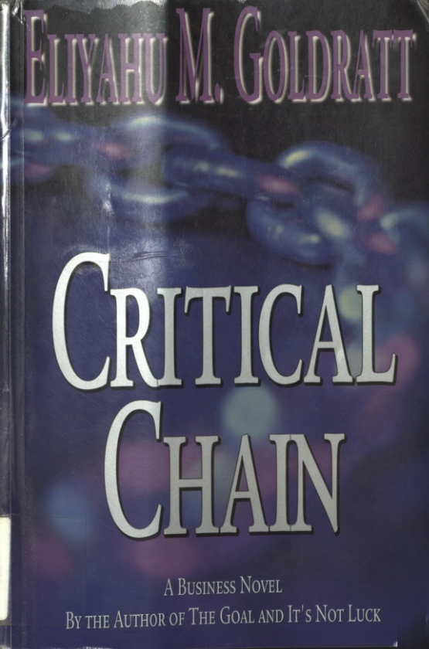
Critical Chain [1]
Uses stories to show the critical chain project management method
Initially follows a University professor at a failing business school as he tries to get tenure
Discusses the theory of constraints

Slide 4
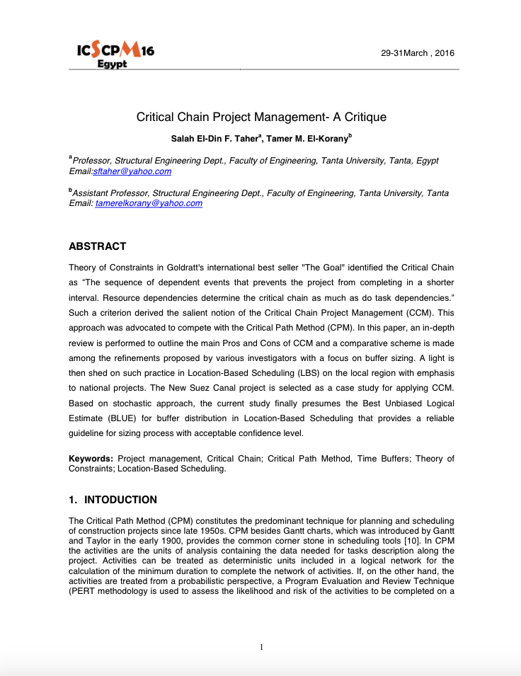
Critical Chain Project Management- A Critique [2]
Compares critical chain project management and critical path management
Uses a real world construction example: the Suez Canal to show effectiveness
CCPM was superior to the other options for the Egyptian government

Slide 5
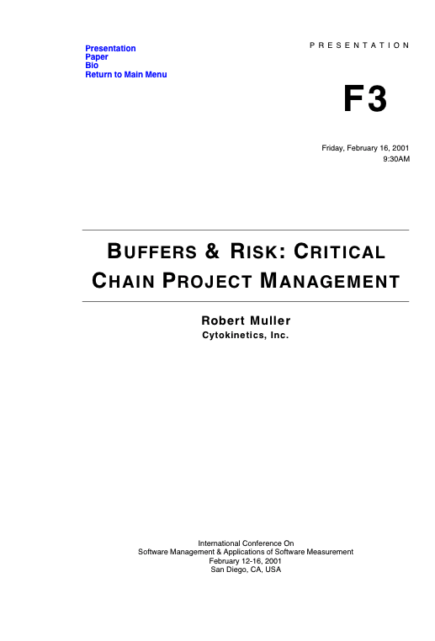
BUFFERS & RISK: CRITICAL CHAIN PROJECT MANAGEMENT [3]
Discusses use of Statistical Process Control for buffer management
SPC is highly effective in identifying the causes during planning the buffers and creating a critical chain
SPC is helpful in distinguishing causes which leads to buffering techniques for managing and controlling project budget and time

Slide 6
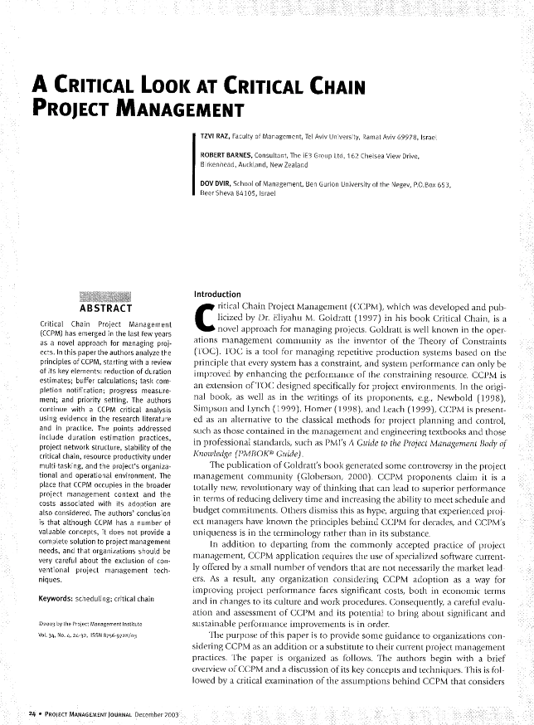
A Critical Look at Critical Chain Project Management [4]
Doesn’t focus on making critical chain look like a better option
Clearly states several benefits as well as disadvantages of CCPM
Notes:
Doesn’t focus on making critical chain look like a better option than the traditional method, but it clearly states several benefits as well as disadvantages of CCPM
If there was a project where the schedule and budget were of the top priority, then CCPM would be a suitable option, however it lacks in project planning in development for the organization

Slide 7
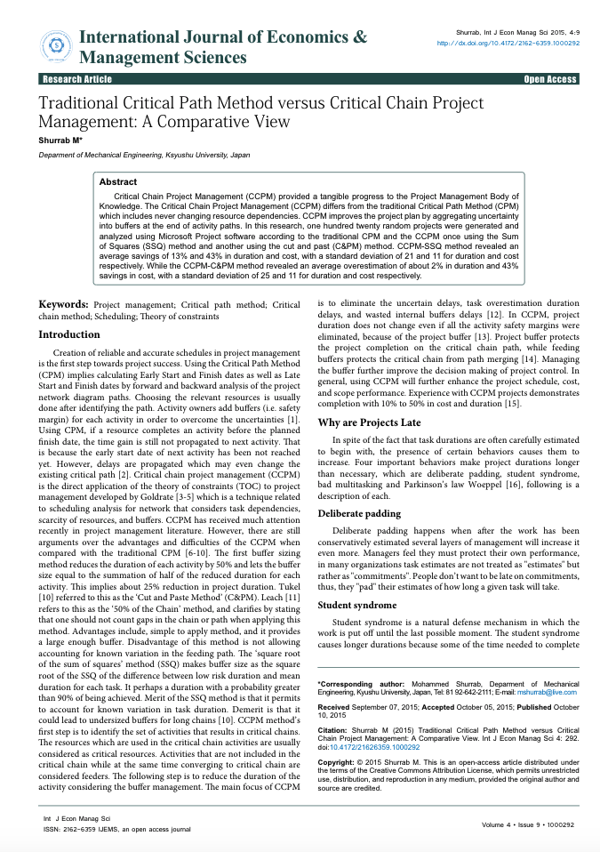
Traditional Critical Path Method versus Critical Chain Project Management: A Comparative View [5]
Critical chain project management tries to keep efficient by removing complications
Similarities: projects are almost always late in some manner
Notes:
The premise behind critical chain project management is to eliminate as much uncertainty delays, task overestimation and wasted internal buffer delays
When looking at both traditional critical path and critical chain project management one of the essential factors we are hoping to gain a footing in from these methods is that the projects are almost always late in some manner

Slide 8
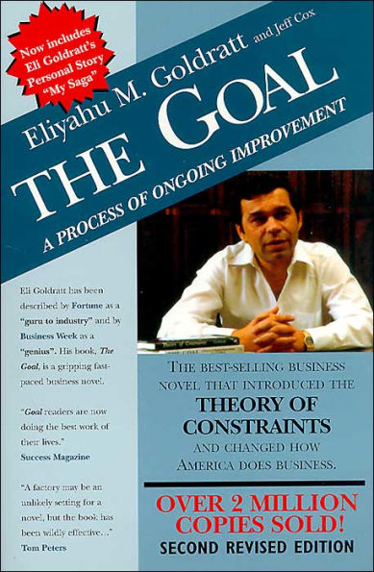
The Goal [6]
Follows a narrative of a failing manufacturing plant and its employees attempt to turn around production.
Uses this method of narrative to show how to improve throughput and address bottlenecks
Makes sure that everything marches to the tune of the constraints.
Notes:
Step 1 - Identify the bottleneck
Step 2 – Decide how to exploit the bottleneck
Step 3 – Subordinate everything else to reach the above decision.
Step 4 – Elevate the systems bottlenecks.
Step 5 – If in a previous step a bottleneck has been broken go back to step 1.

Slide 9

The Usual Causes of Delays
First, the issue is deliberate padding and the fact that often a developer would potentially state that the project should take a certain time which will be padded by the manager.
Secondly, the student syndrome which is essentially procrastination.
Thirdly, the inability to effectively multitask.
Finally, there is Parkinson’s law
Notes:
First-to make the team seem better than it is, due to either being able to deliver on the new time generated by padding or by delivering early.
Second - this causes longer durations due to time needed to complete a task is wasted due to the procrastination.
Thirdly - Often when multitasking it leads to “working on a single task before it is finished so as to start another.”
Finally - will have “the amount of work rise to fill the time available to complete it.”.

Slide 10
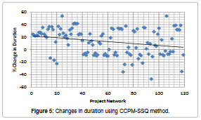
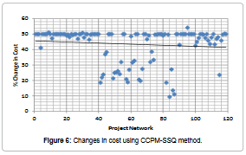
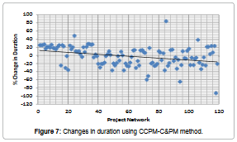
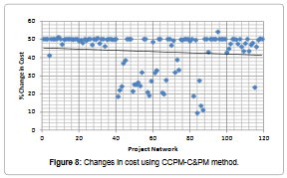

Comparison of Both CCPM Methods
[5]
Notes:
To analyze the data, it was input into Microsoft Project software this allowed CPM to be compared vs both versions of CCPM.
As the data shows the change in duration and the cost are decidedly lower with change in duration averaging around 12.72% savings and cost savings being averaged to around 40.38% in order to reach these figures the author used a standard deviation of 20.99 and 11.05 for duration and cost respectively.

Slide 11
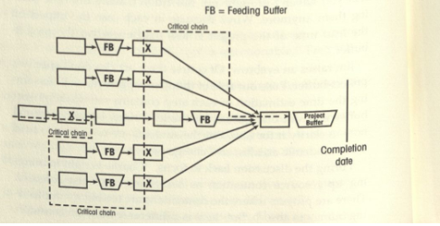
How does estimating differ?
Traditional
Safety on each task
Safety added by managers
Safety cut by executives
Critical Chain
Large buffer at the end
No safety per task
Feeding buffers for the critical steps
Reduce the final estimate by 33%
[1]

Slide 12
How does planning differ?
Critical chain project management
Creating a project buffer at the end instead of between tasks
Can use Statistical Process Control to manage buffers and plan the schedule [3]
Rely on the theory of constraints for project planning [2]
Traditional
Pad for delays, if schedule shortens then shrink padding, taking too long on a task will consume other task padding

Slide 13
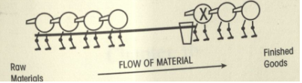
How does risk management differ?
Traditional
Assign priorities to tasks
High, medium, low
Red, yellow, green
Results in a lot of tasks as red
Critical Chain
Your fastest resources become your risks
Constraints
Tie throughput to the bottleneck
This means only tie your first step to the bottleneck
The chain follows the first
[1]

Slide 14
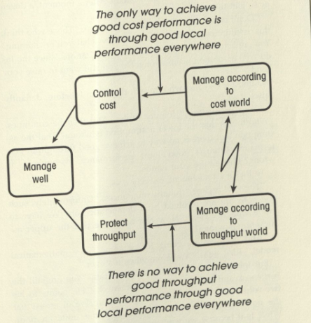
How does monitoring progress differ?
Critical Chain
make assumptions based on the project
Measure, based on the assumptions
If conflicts arise, then evaporate the cloud
Redefine how you measure progress after
Traditional
alternate between throughput and cost
During conflicting wants:
Looks for a compromise
Won't do a good job meeting either criteria
Because there is no compromise
[1]

Slide 15
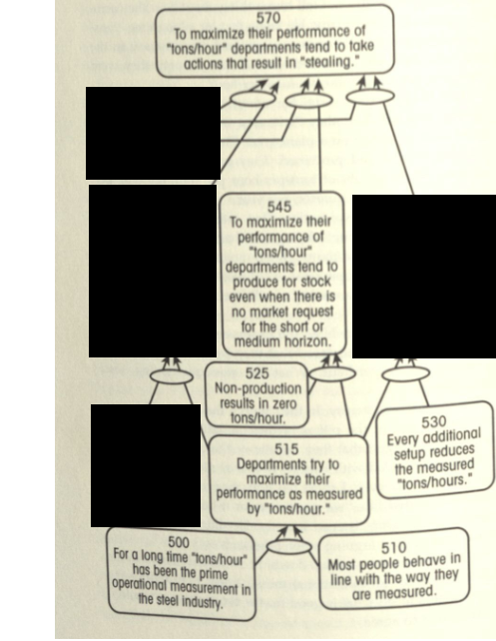
How does monitoring progress differ?
Critical Chain
People behave differently depending how you measure them
Don, a new CEO of a steel mill [1]
Turned his company around in 1 month
By simply changing how they measured progress
[1]

Slide 16
Conclusion
Critical chain project management uses a large buffer at the end rather than pad each individual task
Theory of constraints [2]
1. "identify" the system constraint
2. "exploit" the system constraint
3. "subordinate" everything else to the system constraint
4. "elevate" the system constraint
5. if, in the previous step, a new constraint has been uncovered, repeat the process. "do not let inertia become" the system constraint.

Slide 17
Key Questions Answered
What is the relation between throughput and bottlenecks?
A bottleneck will restrict throughput of the entire system
How to solve student syndrome?
Place the safety net at the end of the project
Reduce the visibility of safety in each task
How to solve multitasking?
Identify the critical path
Whoever is working on that, is only allowed to work on that

Slide 18
What we've learned
Critical chain project management simplifies the estimating process and leads to more truthful estimates for how long task will take
Our group definitely suffered from the student syndrome when it came to this project, more rigorously following a project plan and finishing key tasks earlier on would have been beneficial

Slide 19
References
[1] Eliyahu M. Goldratt, CRITICAL CHAIN: a business novel. S.l.: ROUTLEDGE, 2017.
[2] T. Korany and S. Taher, "Critical Chain Project Management- A Critique", researchgate, 2016.
[3] R. Muller, “BUFFERS & RISK: CRITICAL CHAIN PROJECT MANAGEMENT,” in International Conference on Software Management & Applications of Software Measurement, 16-Feb-2001.
[4] R. Barnes, T. Raz, and D. Dvir, “A Critical Look at Critical Chain Project Management,” researchgate, 2004.
[5] Shurrab M (2015) Traditional Critical Path Method versus Critical Chain Project Management:
A Comparative View. Int J Econ Manag Sci4:292. doi:10.4172/21626359.1000292
[6] E. M. Goldratt and J. Cox, The goal: a process of ongoing improvement. Great Barrington, MA: North River Press, 2004.

