Slide 1
feature engineering
Machine Learning

Slide 2
real-world data
may have hundreds of features
hundreds of thousands of rows
most of the time in a real-world ML project is spent on data cleaning and feature engineering
too many predictors can be a problem for some algorithms so we need a principled way to select the important ones

Slide 3
features
feature engineering – selecting features from the set of all features and/or creating features
feature extraction – finding features in raw data

Slide 4
feature selection
some algorithms have embedded methods that tell us which features were helpful
features that were good for one algorithm may not be good for others

Slide 5
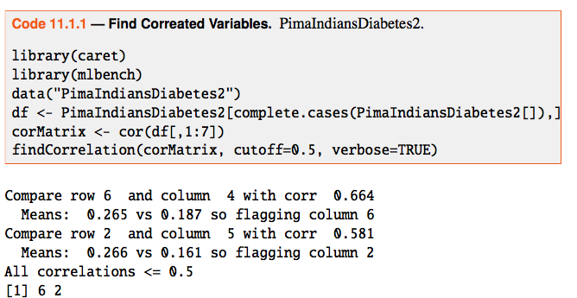
feature extraction

Slide 6
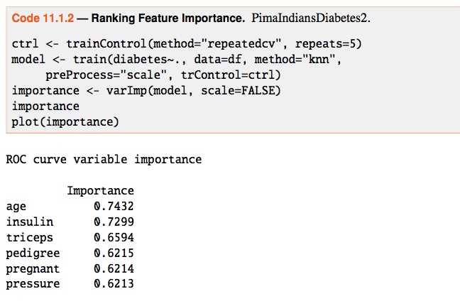
rank feature importance

Slide 7
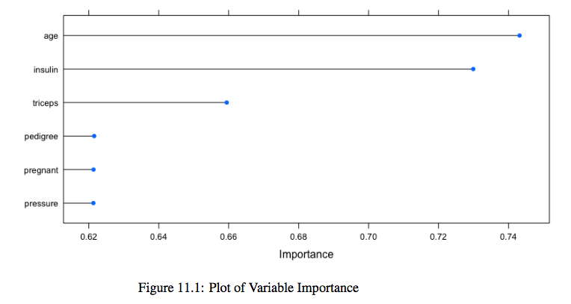
plot

Slide 8
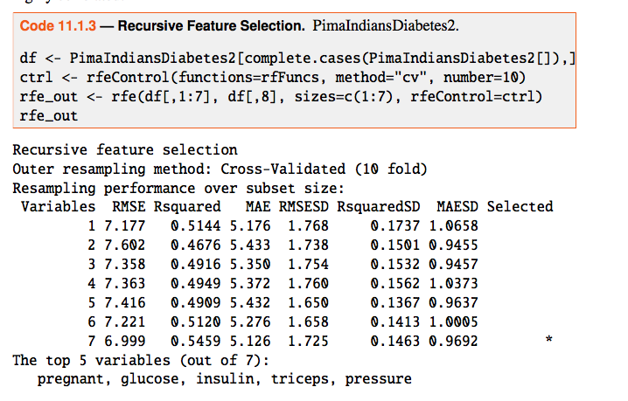
recursive feature selection

