Slide 1
Logistic Regression
Machine Learning

Slide 2
Regression v. Classification
Linear Regression
Logistic Regression
target is a quantitative variable
model creates a regression line that can be used to predict y values from new predictors
metrics on test set:
cor(prediction, actual)
mse (mean squared error)
rmse (root mse)
target is a qualitative variable (factor), usually binary
model creates a decision boundary for classifying as positive or negative class
metrics on test set:
accuracy – percentage of correctly classified observations

Slide 3
Example
First we look at the plasma data set in package HSAUR. The data measures the erythrocyte sedimentation rate and measurements for 2 plasma proteins. Higher ESR can indicate some health problems.
the data has 32 rows and 3 variables:
fibrinogen – levels in blood sample
globulin – levels in blood sample
ESR – factor with 2 levels
1 = ESR < 20
2 = ESR > 20

Slide 4
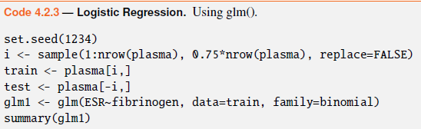
logistic regression
divide data into train/test
create a logistic regression model
look at the summary of the model

Slide 5
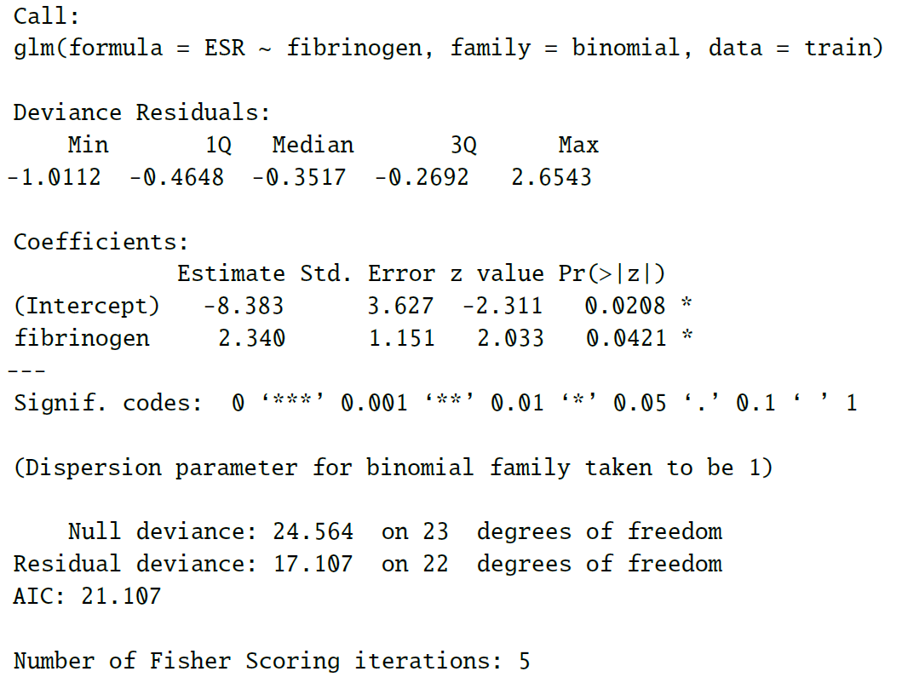
summary output

Slide 6
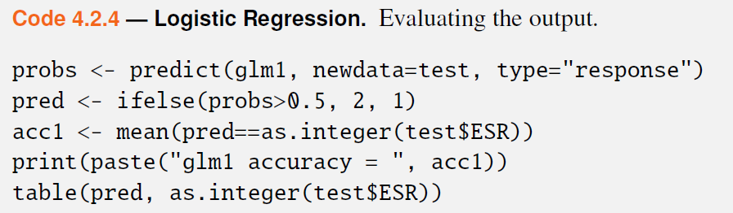
evaluate on test set
extract probabilities
convert these to binary predictions
compute accuracy

Slide 7
Practice
Load the PimaIndiansDiabetes2 data set from package mlbench.
Examine the data and convert to factor or numeric as needed.
Divide the data into 80/20 train/test.
Build a logistic regression model predicting diabetes from glucose.
If your accuracy is NA, add na.rm=TRUE to the mean().

Slide 8
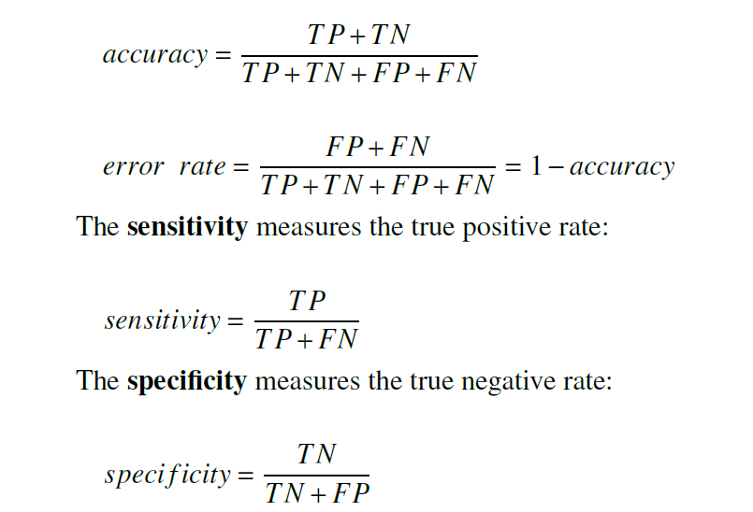
metrics for classification

Slide 9
metrics for classification
kappa – adjusts for correct predictions by chance
<2.0 poor agreement
0.2 to 0.4 fair agreement
0.4 to 0.6 moderate agreement
0.6 to 0.8 good agreement
0.8 to 1.0 very good agreement

Slide 10
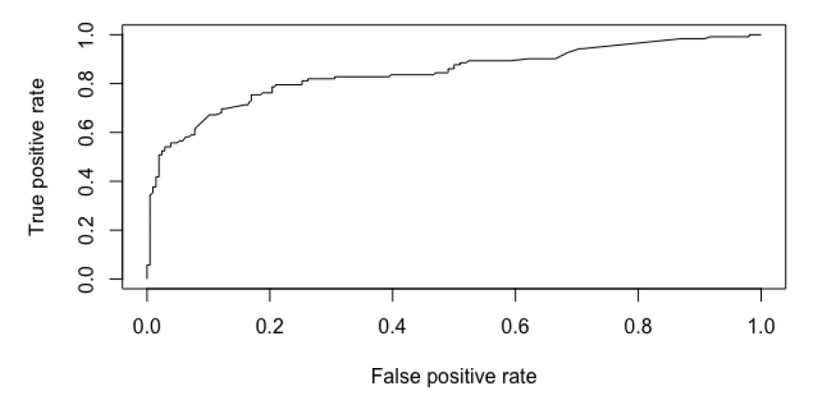
metrics for classification
ROC curve and AUC (area under curve)

Slide 11
practice
for the Pima Indian Diabetes model you created earlier, use R to calculate:
TP, TN, FP, FN
accuracy using TP, TN, FP, FN
error rate using accuracy
sensitivity
specificity
then use confusionMatirx() in package caret to verify your results

Slide 12
odds probability log odds

Slide 13

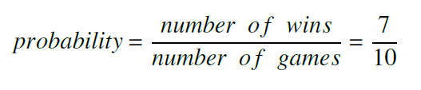

probability, odds, log odds
Let’s say you played 10 games and won 7

Slide 14
Logistic Regression
y = B₁*x + B₀
in a linear regression model, the coefficient B₁ represents the change in y for a one-unit change in x
in logistic regression, the coefficient represents the change in the log odds of y for a one-unit change in x

Slide 15
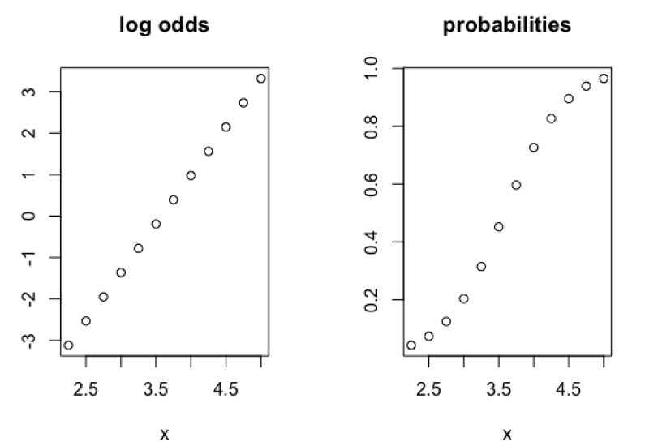
log odds
just as it sounds, log odds is log(odds)
the coefficients of logistic regression represent a change in the log odds

Slide 16
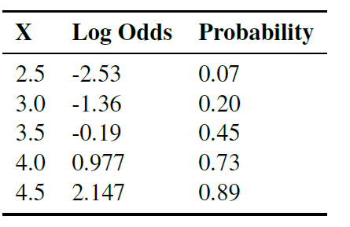
plasma model
x = fibrinogen
graphs on previous slide illustrate that the log odds are linear in the parameters

Slide 17
plasma model
the coefficient for fibrinogen is 2.34
For every one-unit change in fibrinogen, the log odds changes by:
exp(2.34) / [1 + exp(2.34)]
the log odds are linear in the parameters
probability is not

Slide 18
the algorithm

Slide 19
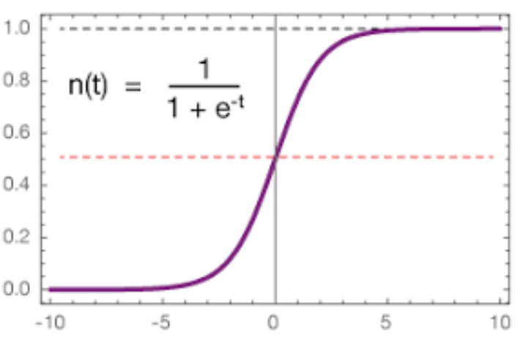
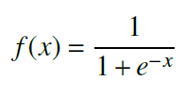
logistic runction
the output of linear regression prediction is a quantitative value that ranges over all real numbers
what we need for logistic regression is a function that will output probabilities in the range [0, 1]
the sigmoid, or logistic function, can map real values to the range [0, 1]

Slide 20


logistic function
the logistic regression algorithm computes the log odds from the estimated parameters
the odds are the probability of the positive class p(x) over the negative class: 1 – p(x)

Slide 21
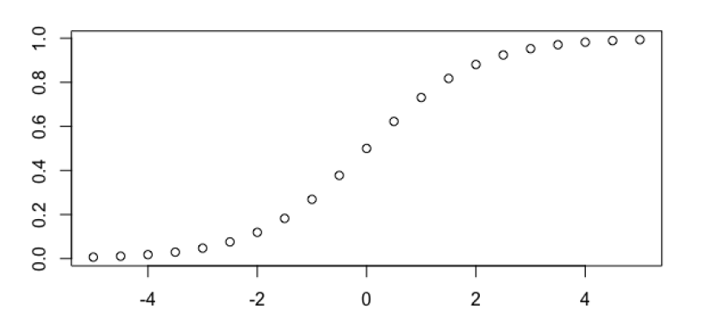
predictions
threshold is typically 0.5
probabilities > 0.5 are positive, else negative

Slide 22
practice
Using the coefficients and data from the diabetes model created earlier:
Compute the probabilities in R using coefficients and glucose
Compare these to the output of predict()
Create a plot with test glucose on the x axis and your probabilities on the y axis. What do you observe?
Create a vector of “test” values for glucose: 60, 100, 140, 180, 220
Compute the probabilities for these using your formulas. Are they consistent with your graph?

Slide 23
mathematical foundations

Slide 24
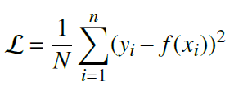
loss functions
loss function for linear regression:
this won’t work for logistic regression because it won’t be a convex function

Slide 25

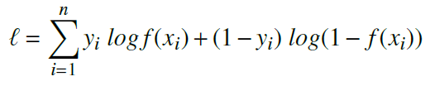

loss functions
start with the likelihood: (one term always=1)
take the log to get log-likelihood:
the log-likelihood for each instance: (one term always=0)

Slide 26
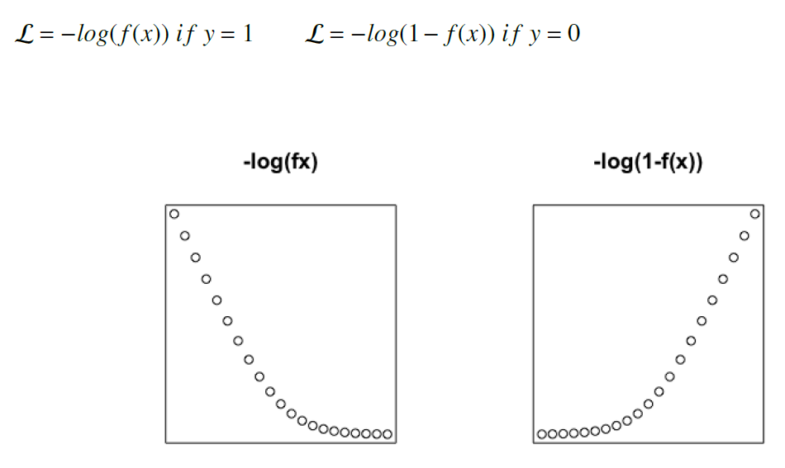
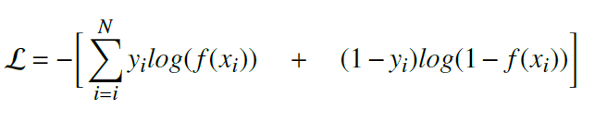
loss function
high penalty for wrong classification
put them together, it is a convex function

Slide 27
using multiple predictors

Slide 28
Handling NAs
NAs can cause problems for some algorithms so we need to know how to first detect them and then remove them
We can use sapply() as shown on the next slide to find the NA values
We can either replace NA values with the mean or median, or remove rows with NA values with complete.cases():
df <- df[complete.cases(),]

Slide 29
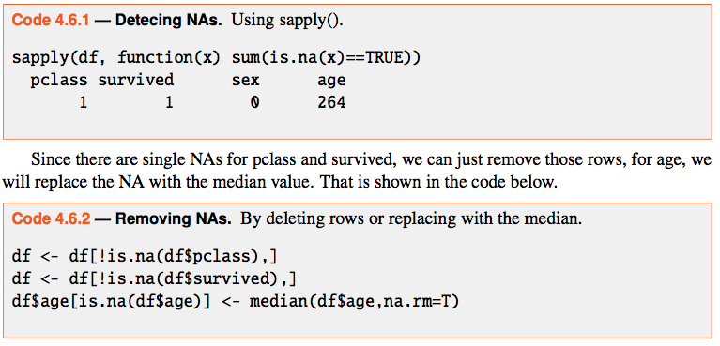
Find NAs
Example using Titanic data:

Slide 30
Titanic Demo
select 4 columns: class, survived, pclass, sex, age
deal with NAs
divide into 75/25 train/test
create logistic regression model of survived ~ the 3 predictors

Slide 31
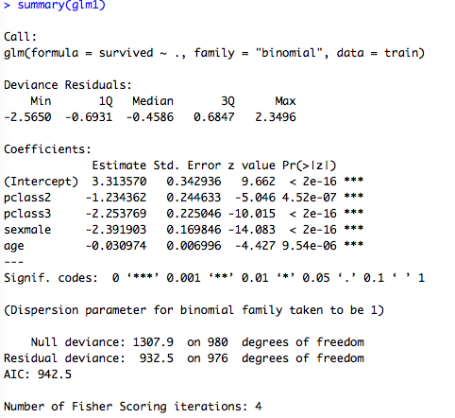
summary()
Note: dummy variables,
null vs. residual deviance

Slide 32
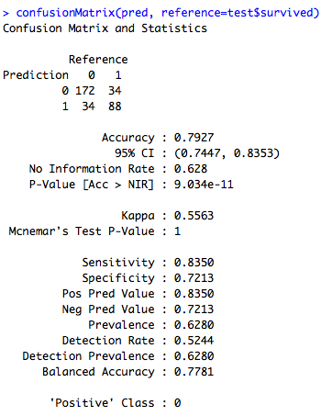
evaluate on test data

Slide 33
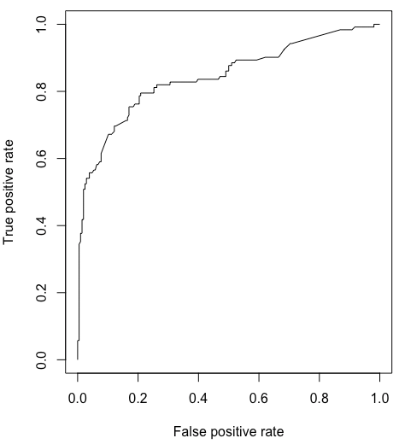
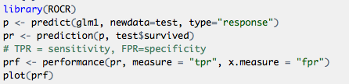

ROC

Slide 34
Practice
Using the Pima Indian diabetes data:
Build a logistic regression model with all predictors, using the same train/test data as before; compare accuracy of the 2 models
Use R functions to count how many NAs are in each column.
Replace NAs in the triceps and insulin columns with the mean of each column in both train and test. Now replace train and test with rows that have complete data using complete.cases().
Build a second model with all predictors on the train and test that have been cleaned up.
Can you run anova() on these two models? Why or why not?
Compare the accuracies of the two models.
Compare the residual deviance and degrees of freedom for each model. Which model do you think is best, and why?

Slide 35
advanced topic: optimization

Slide 36
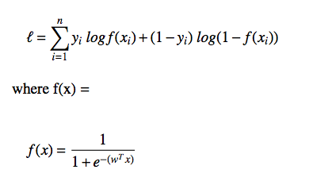
log-loss function

Slide 37



gradient and Hessian
gradient using first derivative is the X matrix times how wrong f(x) is in predicting y
Hessian (second partial derivatives) is needed for optimization methods as it gives local curvature of a function

Slide 38

optimization
many methods:
gradient descent, at each step the parameters theta get closer to optimal values, eta is step size
stochastic gradient descent – process data in small batches; this improves computation time
Newton’s method – uses Hessian and often converges faster

Slide 39
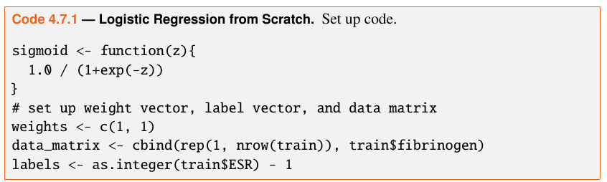
optimization from scratch
using plasma data
first create a sigmoid function
set up initial weights
set up data

Slide 40
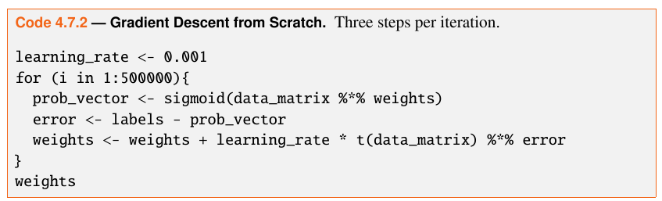
iterate
iterate 500,000 times, each iteration:
multiplies weights by log likelihood, runs these values through sigmoid function to get a vector of probabilities
computes the error
updates the weights by: weights + learning rate * gradient

Slide 41
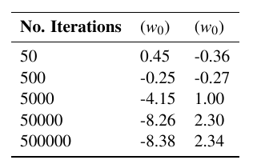
weights
table shows the change in weights at various numbers of iterations
After 500,000 iterations we have the same coefficients as glm() gave us.

Slide 42
multiclass classification

Slide 43
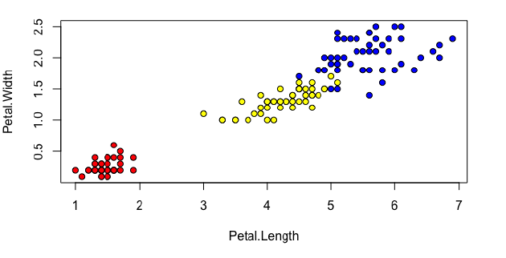
iris data

Slide 44
one-versus-all
code in book and online, idea:
make 3 data sets where each set has Species=1 for that species and Species=0 for the two other
then run 3 logistic regression models
this gave accuracies of 0.98, 1, and 0.62
average of 87%

Slide 45
warnings in glm()
the algorithm will work even with these warnings which can occur if the data is too easily separated

Slide 46
generalized linear models
for logistic regression:
the link function is logit
other families include Gaussian, Gamma, Poisson and more, each with its own link function
the link function links the mean of the target to the linear term
the logit link functions links the mean of the target to the linear combination of the predictors

Slide 47
classification metrics
accuracy
error rate
sensitivity
specificity
Kappa
ROC
AUC

Slide 48
summary
strengths:
separates classes well if they are linearly separable
computationally inexpensive
nice probabilistic output
weaknesses:
prone to underfitting; not flexible enough to capture complex non-linear decision boundaries

