Slide 1
kNN k Nearest Neighbors
Machine Learning

Slide 2
kNN
supervised learning
regression or classification
does not form a model of the data
“training” involves reading in the training data
when a new observation needs to be evaluated, the algorithm compares it to the nearest k neighbors stored in memory
aka instance-based learning

Slide 3
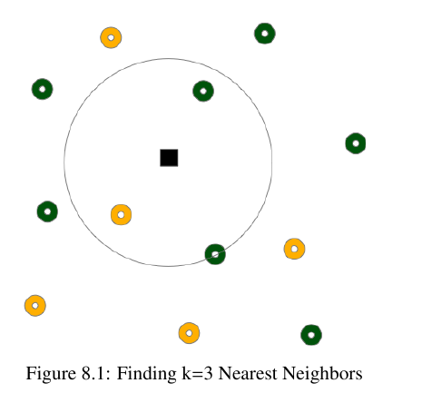
kNN
regression: average neighbors
classification: determine majority class

Slide 4
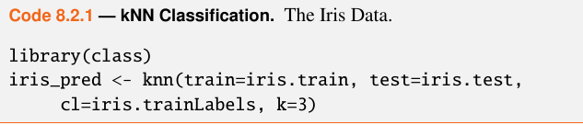
kNN on iris data
after randomly sampling 67/33 train and test
knn() arguments: training columns, test columns, training labels, k

Slide 5
kNN on iris data
the knn() outputs a vector of class predictions: setosa, virginica, versicolor
parameter prob=TRUE will cause it to return probabilities instead of predictions
to compute accuracy of our predictions:
accuracy was 98%

Slide 6
practice with wine data
Download wine_all.csv from the github site. It is a 6497x13 data set of the chemical composition of red and white wines. This data set was edited from the wine data set on the UCI ML Repository. Your task is to use kNN to classify red/white wine.
Divide the data into train and test sets, setting a seed first for reproducibility.
Use R commands to make sure that the train and test sets have distributions of white and red types similar to the overall data.
For comparison, first build a logistic regression model predicting wine type (red or white) based on all other columns. What is your acccuracy?
Run knn() with k=2 on the data and compare the accuracies of the two algorithms.

Slide 7
the algorithm

Slide 8


nearest neighbors
for a test observation, the algorithm searches for the k closest neighbors
for classification:
for regression:

Slide 9
choosing k
the choice of k is critical
a small k will result in low bias, high variance
as k grows, the algorithm becomes less flexible and bias increases while variance decreases
the optimal value for k is often found by cross validation
if k is too small it will be susceptible to noise
if k is too large, computation time increases
an oft-reaped but unproven heuristic is to set k=sqrt(number of observations)

Slide 10
curse of dimensionality
the more predictors we have, the larger the space
searching for a “near” neighbor in 3-dimensional space is quite a different thing from search in 20-dimensional space
kNN may bog down in high dimensions

Slide 11
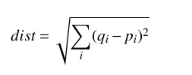
nearness
nearness can use a distance metric like Euclidean distance
this means that we need numeric features, not factors
you should convert factors to integers

Slide 12
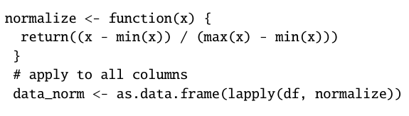
scaling
normalizing data reshapes data into a normal distribution
scaling transforms the data but may or may not result in a normal distribution
scale() using the default settings will transform data to have mean=0 and sd=1
if the data is skewed you might want to manually normalize:

Slide 13
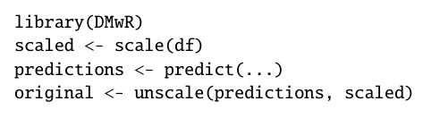
un-
after you scale or normalize, you need to be able to reverse it to get results in the original units
package DMwR has an unscale() function

Slide 14
scaling
if data is in the same scale already, like the iris data, you won’t need to scale it
otherwise, scaling usually improves performance

Slide 15
practice
Using the same wine data
scale the data and see if performance improves
try reducing the number of predictors and see how it changes either results or execution time

Slide 16
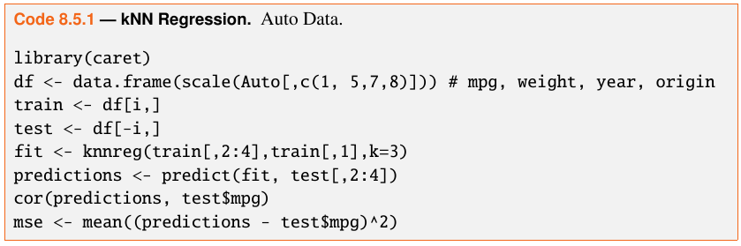
kNN regression
Auto data in package ISLR
linear regression cor=.9, mse=9.88
unscaled knn cor=.8, mse=19.29
scaled knn cor=.92, mse=0.138

Slide 17
practice
Using the same wine data, try to predict quality
remove the red/white column from scaled train and test sets
run knnreg() on the data
what is cor and mse?
create a linear regression model
compare the model performance

Slide 18
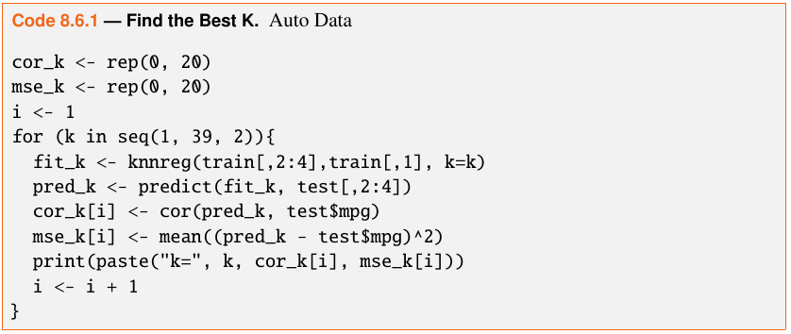

finding the best k

Slide 19
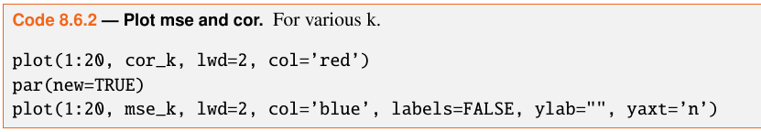
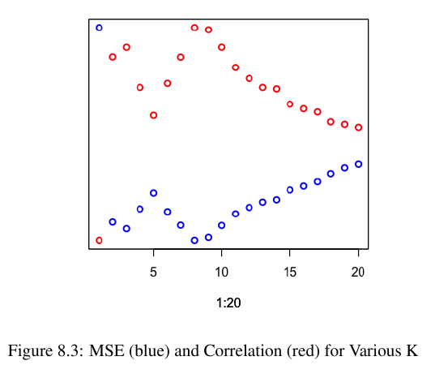
plot results
index 8 corresponds to k=15

Slide 20
practice
on the wine data, find the best k
what is cor and mse?
how does this compare to the linear regression model?

Slide 21
k-fold cross validation

Slide 22
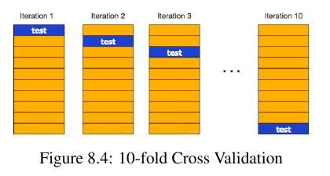
k-fold cross validation
useful if you have a small amount of data
also useful to help set model parameters
idea: divide data into k folds, run k times, selecting one of the k sections for testing

Slide 23
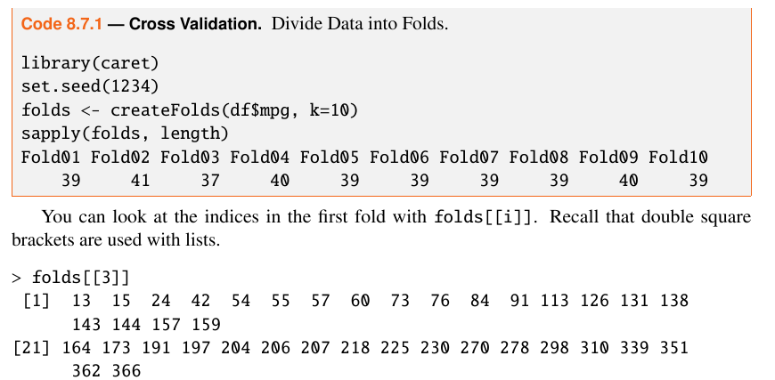
divide data

Slide 24
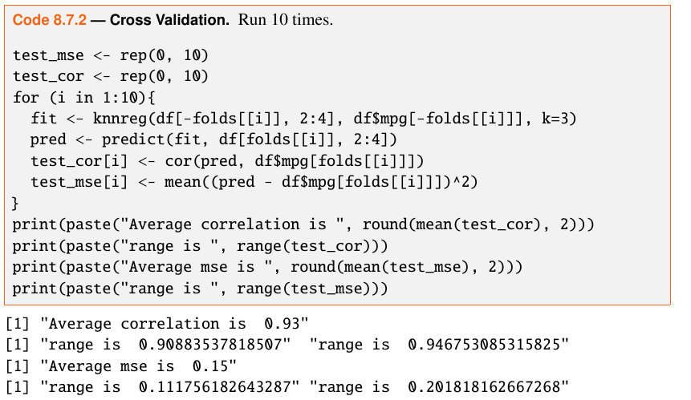
run k times

Slide 25
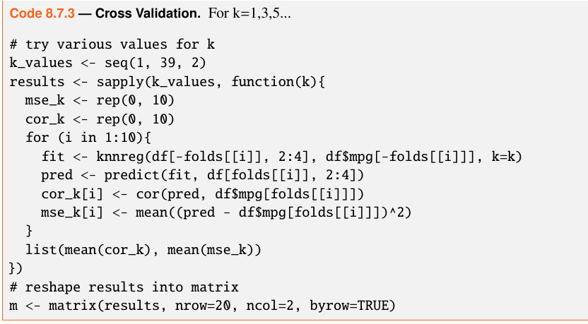
cross validation for various k

Slide 26
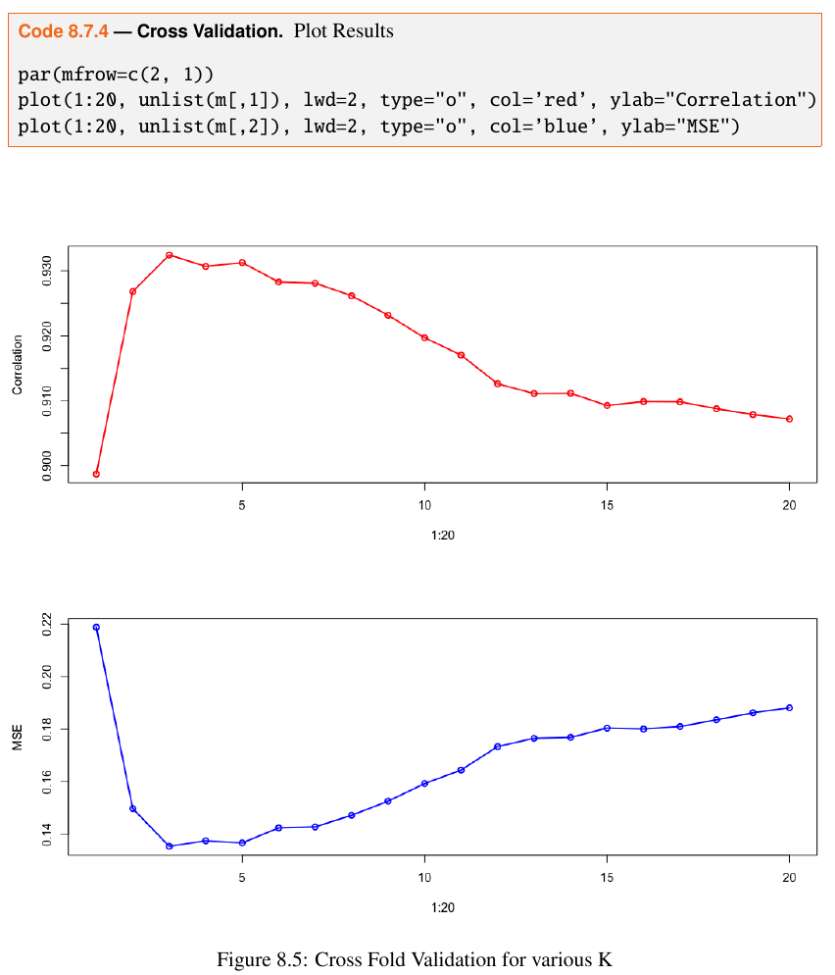

Slide 27
summary
knn
does not create a model of the data
therefore, is non-parametric
is instance-based learning

Slide 28
kNN
advantages
makes no assumptions about the shape of the data
performs well in low dimensions
disadvantages
bogs down in high dimensions
k must be chosen
data should be scaled
difficult to interpret

