Slide 1
Clustering
Machine Learning

Slide 2
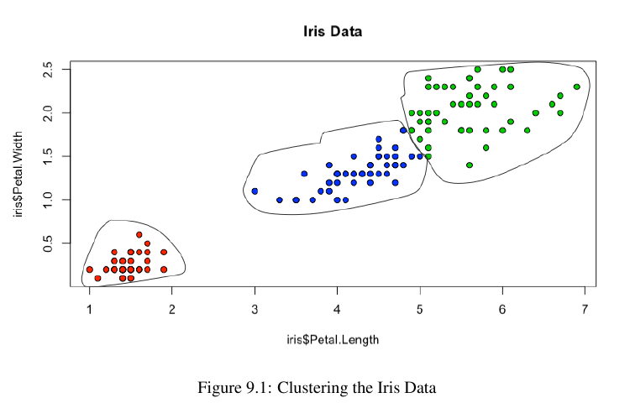
Clustering
unsupervised learning
no target/label column
goal: find similar observations and put them together in clusters

Slide 3
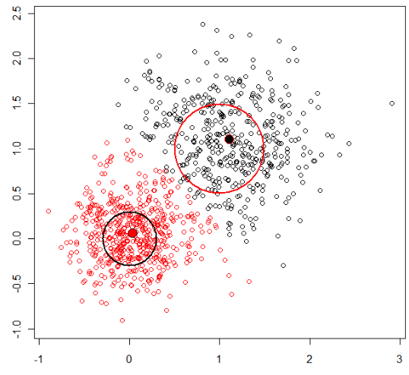
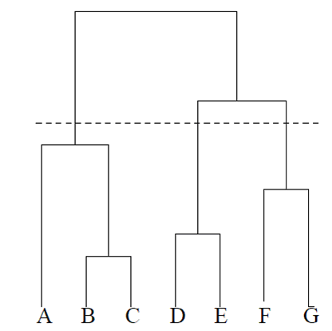
popular algorithms
k-means clustering
identifies k centroids
cluster = nearest centroid
hierarchical clustering
combines observations
in a hierarchy (dendogram)

Slide 4
Clustering
Typical workflow:
preprocess data (including scaling)
determine a similarity measure
cluster the observations
analyze the results
repeat from 2 until the clusters are meaningful

Slide 5
k-means

Slide 6
k-means algorithm
random assignment
assign each observation to the closest centroid
recalculate the centroid
repeat from 2 until convergence
many variations of the algorithm
step 1: randomly choose k observations to be centroids
step 1: randomly assign observations to k clusters

Slide 7
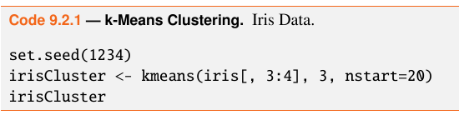
kmeans()
set seed for random starts
algorithm will pick best of these 20 starts
set k=3
the variable irisCluster holds the results
why didn’t we scale the data?

Slide 8
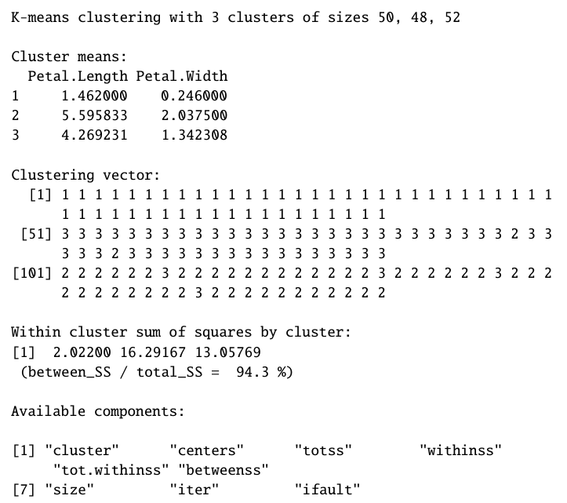
irisCluster
Notice cluster 1
is compact, it has a
small within-ss

Slide 9
What is a cluster?
A cluster is a set of observations that satisfies these two properties:

Slide 10


What is a good clustering?
observations within the cluster are homogenous
we want their features to be similar, or close, by some metric like distance
or variance
We want to minimize the within sum of squares

Slide 11
within-ss, between-ss
if a cluster is compact, its within-ss is small
ideally, all clusters will be compact
between-ss indicates how well separated the clusters are
ideally, clusters are well separated

Slide 12
EM
k-means is an example of the Expectation-Maximization algorithm
an algorithm that lets us estimate parameters from data when they can’t be directly computed
Two steps:
Expectation step: each observation is assigned to the closest centroid, the most likely cluster
Maximization step: recompute the centroids

Slide 13
finding k
k must be found experimentally
next slide shows k-means results on synthetic data that has 3 “true” clusters
top plot shows k=3
bottom plot shows k=4

Slide 14
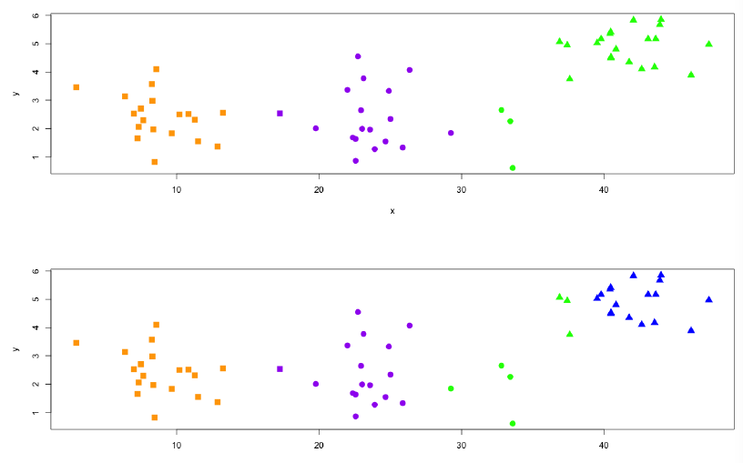
k-means
color shows cluster
shape shows “true” cluster

Slide 15
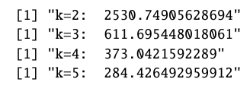
within-ss for various k
sharp drop from k=2 to k=3, then gradual
keep in mind that as k approaches n, within-ss will naturally drop

Slide 16
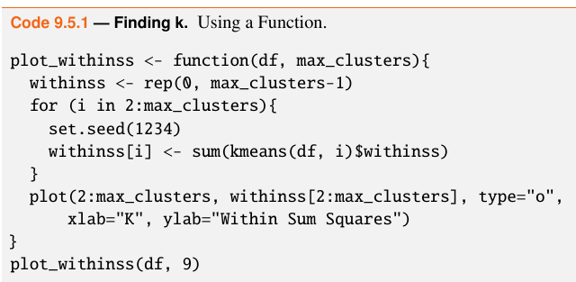
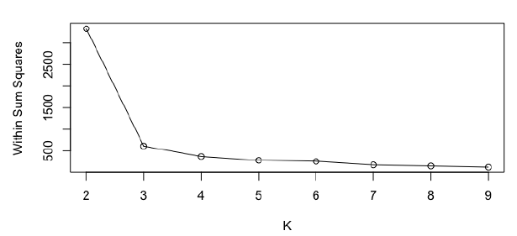
finding k
look for
the “elbow”
at k=3

Slide 17
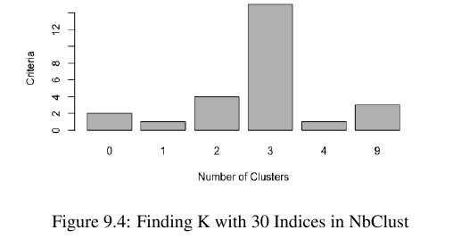
package NbClust
NbClust() combines over 30 indices
k=3 seems best

Slide 18
parametric v. non-parametric
in k-means or kNN we have to find k experimentally
sometime we call k a parameter
more accurate to call it a hyperparameter
a parameter refers to the data
a hyperparameter refers to the model
linear/logistic regression are parametric algorithms because we learn the coefficient parameters
parametric algorithms have a fixed number of parameters
kNN and k-means are non-parametric algorithms

Slide 19
hierarchical clustering

Slide 20
clustering
a disadvantage of k-means is that we have to find the best k
in hierarchical clustering, we don’t specify beforehand how many clusters we want
it creates a dendogram of clustering

Slide 21
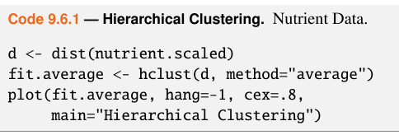
hierarchical
data nutrient in package flexclust

Slide 22
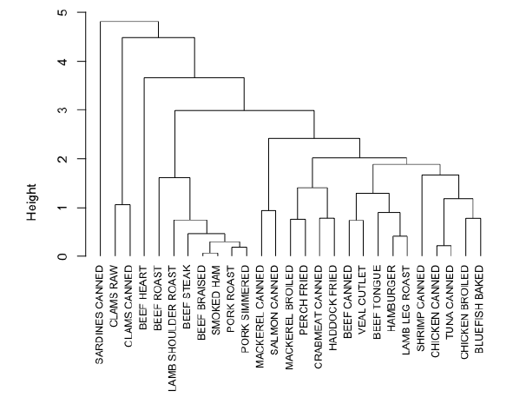
dendogram

Slide 23
the algorithm
many variations, the “bottom-up” version:
place each observation in its own cluster
calculate the distance between each cluster and every other cluster
combine the two closest clusters
repeat 2 and 3 until all clusters are merged into one big cluster

Slide 24
distance
3 types of measurement:
single linkage – shortest distance between any points in the cluster; tends to create elongated clusters
complete linkage – longest distance; more compact but sensitive to outliers
average linkage – average distance

Slide 25
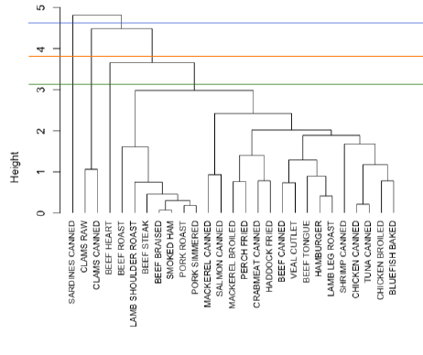
cut the dendogram

Slide 26
cutree()
cutree(fit.average, 3)
returns a vector of indices of the cluster to which each observation belongs

Slide 27
evaluating clusters
there are dozens of metrics that can be used to evaluate how good the clustering is:
how homogenous, or pure, are the clusters
how distinct are the clusters
the Rand Index is a metric that ranges from -1 to +1 where 0 indicates a random clustering
github notebooks have examples

Slide 28
hierarchical clustering
tends to bog down with a lot of data
is a greedy algorithm: once an observation is in a cluster it is stuck there, no restarts like k-means
can find structure in data that other algorithms would miss

Slide 29
summary
unsupervised learning
useful when we have a lot of unlabeled data and we want to learn something about it
we don’t know the “true” or “best” clustering
use cases:
market segmentation
neighborhood analysis for city planning
clustering species in biology
virtually unlimited applications

