Slide 1
Naïve Bayes
and discussion of probability distributions

Slide 2
Naïve Bayes
supervised learning
classification
often a baseline
works well with small data
simple algorithm
high bias, low variance
random fact: Alan Turing applied Bayesian methods in decoding the German enigma code in WW2

Slide 3
Naïve Bayes
called “naïve” because it assumes all the predictors X are independent
for example a fruit may be classified as an apple if:
it is red
it is roundish
it is about 10 cm in diameter
naïve Bayes will consider all these predictors to contribute independently to the probability that a fruit is an apple

Slide 4

Bayes Theoreom
Named for Thomas Bayes, 18th C mathematician and minister
You want to know the probability of event Y given evidence/data X.

Slide 5
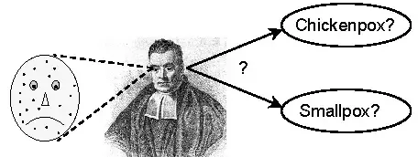
pox example
90% of people with small pox have spots
p(spots|smallpox)=.9
Do you have a 90% chance of having smallpox if you have spots?
Notes:
from: https://www.quora.com/What-is-an-intuitive-explanation-of-Bayes-Rule

Slide 6

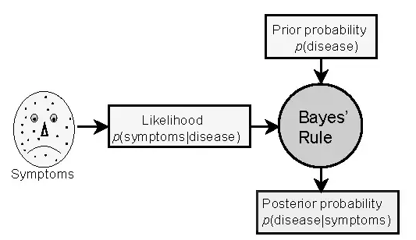
pox example
likelihoods:
p(spots|smallpox)=.9
p(spots|chpox) =.8
priors:
p(smallpox)=0.001
p(chickenpox)=0.1
posterior:
p(smallpox|spots)=.011
p(chpox|spots)=.988
p(smallpox|spots)=(.9*.001)/.081 = 0.011
p(chpox|spots)=(.8*.1)/.081 = .988
marginal: .9*.001 + .8*.1 = .081
Notes:
from: https://www.quora.com/What-is-an-intuitive-explanation-of-Bayes-Rule

Slide 7
naïve Bayes
Let A be the categorical outcome (class) and B be a set of predictors, which are naively assumed to be independent
since the predictors are independent:
P(B|A) = P(b1|A)*P(b2|A)*…*P(bn|A)
this makes calculations easier

Slide 8

Titanic example
P(data|survived) aka likelihood – calculated from joint probabilities of Survived and the data
P(survived) aka prior – also learned from training data
P(data) aka marginal – needed to normalize posterior to a probability in [0, 1]

Slide 9
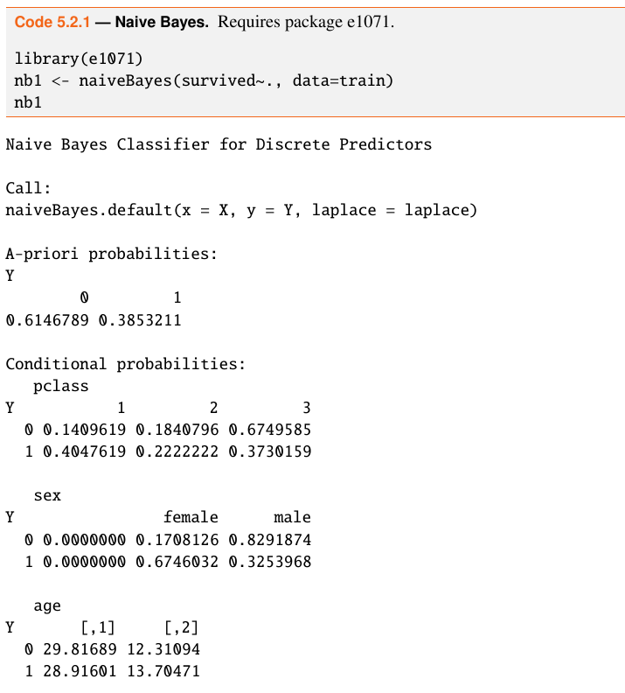
NB in R

Slide 10
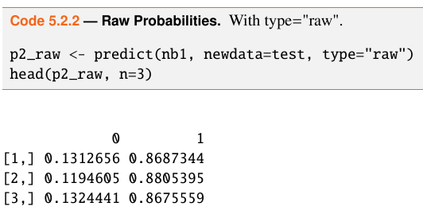
NB in R
predict() can yield class or raw probabilities

Slide 11
practice
Compare logistic regression and naïve Bayes on the Pima Indians Diabetes 2 data in package mlbench

Slide 12
function approximation
compare the ways that algorithms “learn”
clustering methods don’t learn any “big picture” relationship between X and Y
parametric methods learn a deterministic function: f: wX -> Y
Naïve Bayes will learn probability distributions: P(Y|X), specifically, it will learn the joint distribution of X and Y from the training data, as well as the prior, then calculate the conditional probability P(Y|X)

Slide 13
Probability Foundations

Slide 14

random variables
X, Y are random variables
discrete or continuous
joint distribution: P(X,Y)
conditional distribution:

Slide 15


rules
product rule: find the joint probability by multiplying the conditional by p(b)
sum rule: find p(A) by summing the joint probability over all values of B

Slide 16

chain rule
find the joint probability of many variables

Slide 17


expectation (discrete RV)
Expectation of a random variable aka mean aka first moment
Variance aka second moment
taking sqrt() gives us standard deviation

Slide 18
log trick
multiplying probabilities can result in underflow
also: what if one probability is 0?
instead of multiplying we can add the log of the probabilities

Slide 19
probability distribution families

Slide 20
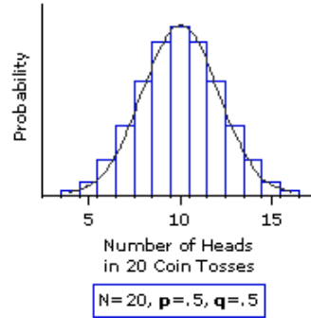
Bernoulli, Binomial, Beta
concern binary outcomes like heads/tails

Slide 21

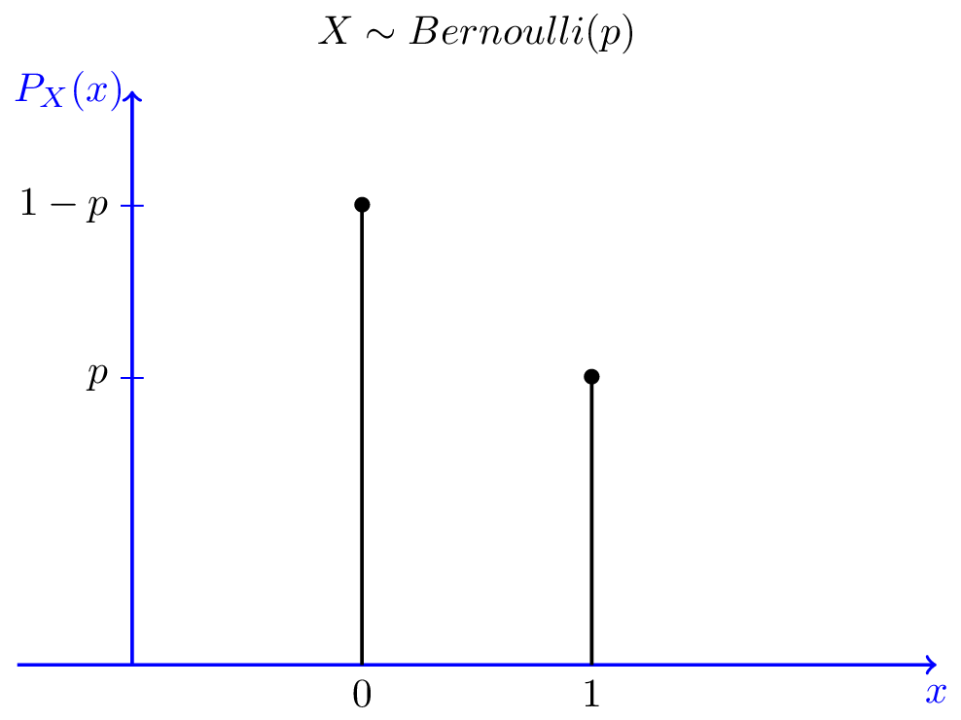
Bernoulli
concerns binary outcomes like heads/tails
where mu=avg probability of the positive class

Slide 22

Bernoulli
newby shooting hoops
probability of making basket is 20%
p(1) = .2^1 * .8^0 = .2
p(0) = .2^0 * .8^1 = .8
we have to know parameter mu
This is a special case of the binomial distribution where N = 1

Slide 23
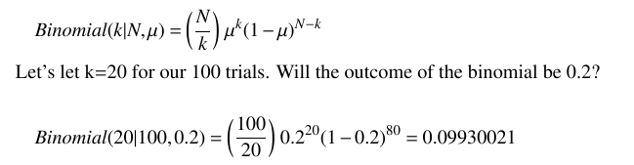
Binomial
X is a discrete random variable representing the number of baskets made
actually, there are 100 choose 20 ways to make 20 baskets out of 100 tries
E(X) = Nμ = 100 * .2 = 20

Slide 24
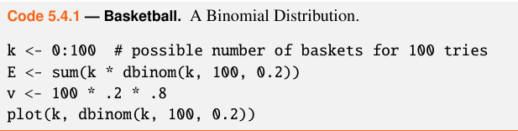
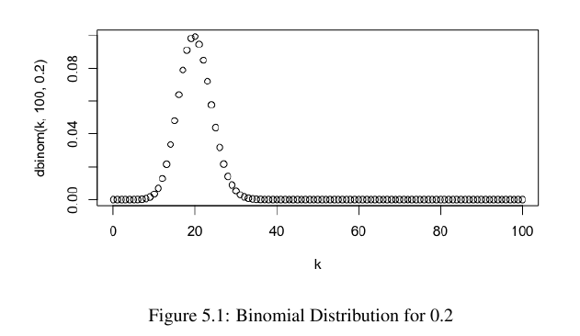
in R

Slide 25
Beta=Binomial factory
suppose newby got lucky and make 3 baskets out of 3 tries
that’s a μ=1.0
it’s unlikely that will continue
small sample sizes are poor estimates of probabilities
what we need is a prior distribution over μ, instead of a single estimate
the beta distribution is a conjugate of the binomial

Slide 26

Beta distribution
the first term with the gammas is a normalizing constant to endure that everything integrates to 1
two new parameters:
a = number of baskets made
b = number of baskets missed

Slide 27
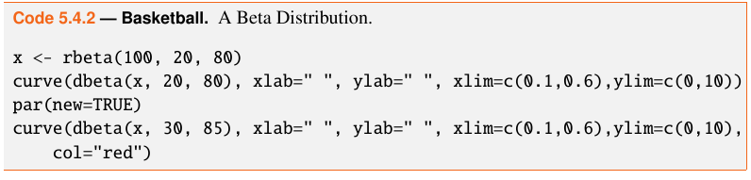
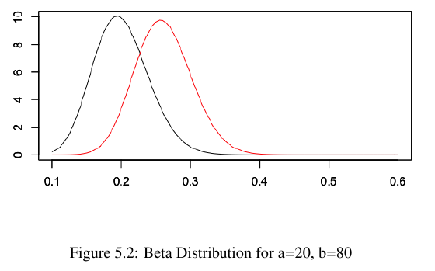
in r
black curve is the original
red curve is updated with

Slide 28
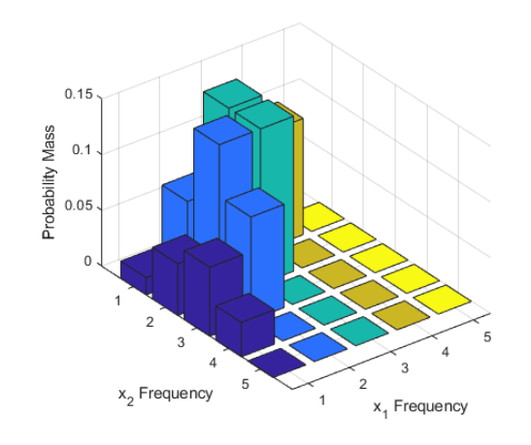
multinomial and Dirichlet
extend the binomial case to variables that can take on more than 2 values

Slide 29

multinomial distribution
k = class
m_k = probability of that class

Slide 30
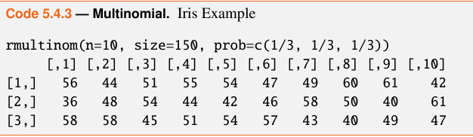
iris data
put 150 observations into 3 classes with even probability of each class
we asked for 10 vectors
each column is a randomly sampled distribution

Slide 31
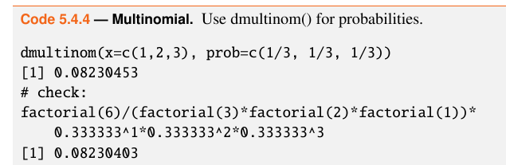
multinomial
if we select 6 iris observations at random, what is the probability that 1 is from class 1, 2 from class 2 and 3 from class 3?

Slide 32

Dirichlet
conjugate prior of multinomial
has k parameters, alphas, one for each class
alpha_0 is the sum of all alphas
Magic bag example: K=3 (red, blue, yellow) balls
for N draws, you place the ball back in the bag with an additional ball of the same color
As N approaches infinity, the bag distribution is

Slide 33
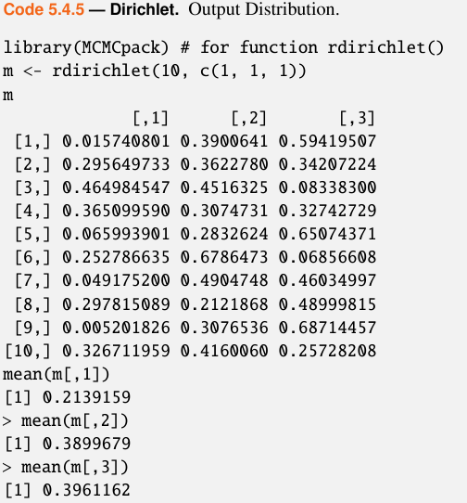
Dirichlet
10 distributions,
all alphas=1
sum of each row=1
with 1000 examples,
the means are each
close to .33

Slide 34

Gaussian
quantitative variables
two parameters, mean and variance
pdf:
let’s plot a few (next slide)
mean shifts graph left or right
variance influences shape of the bell

Slide 35
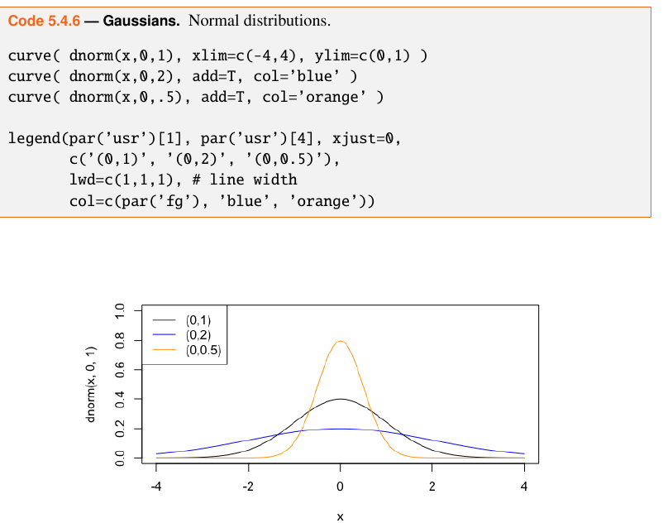

Slide 36

multivariate Gaussian
if we extend the Gaussian from a single variable x to a D-dimensional vector X
we will have a vector of means
|E| is the determinant

Slide 37
probability v. likelihood

Slide 38
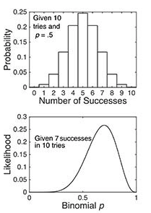
probability v. likelihood
the probability distribution (top) is discrete because there are only 11 possible experimental results of tossing a coin 10 times
the likelihood function (bottom) is continuous because p can take on any value between 0 and 1
the probabilities sum to 1
the integral of the continuous likelihood function is not = 1
Notes:
https://www.psychologicalscience.org/observer/bayes-for-beginners-probability-and-likelihood

Slide 39
probability v. likelihood
p(x | θ) is the p(x) given the class conditional density theta
p(x | θ) can be viewed in two ways:
we can say it is the probability of x, given theta
or the likelihood of theta given that x was observed

Slide 40


likelihood
Suppose we have an observation, x, from a Bernoulli(θ) distribution
the likelihood function is
we see that if we integrate it, it does not sum to 1

Slide 41
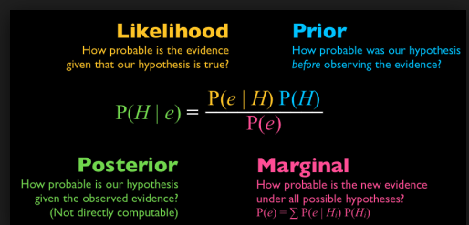
Bayes theorem

Slide 42
Naïve Bayes
estimates from the training data:
discrete variables: counting
continuous variables: finding mean and variance
two ways to get the estimates:
above is the MLE maximum likelihood estimate
choose the theta that maximizes p(x|θ)
MAP (maximum a posteriori) adjusts based on prior distributions
estimate the theta that maximizes p(θ|x)
equivalent to p(θ) p(x|θ)

Slide 43
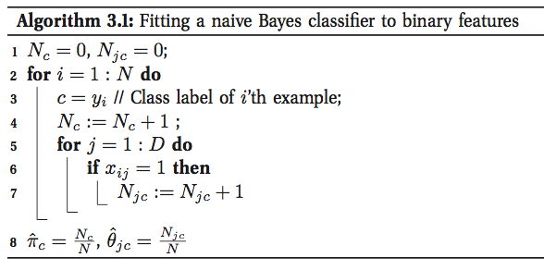
algorithm

Slide 44
overfitting
to guard against overfitting, some variations of the algorithm:
use a Dirichlet prior for the class probability
Beta prior for each theta

Slide 45
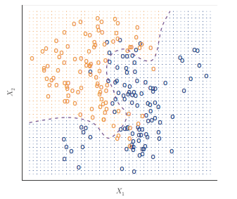
decision boundary
purple line separating 2 classes with 2 predictors

Slide 46

Naïve Bayes
independence of predictors
naïve but it works surprisingly well

Slide 47


estimates
estimate of class priors
for discrete predictor X_i and class c:
this is a model parameter
hence, naïve Bayes is a parametric algorithm

Slide 48

estimates
for predictor X_i and class c:
what if there are 0 examples of X_i in class c?
“smoothing” adds a little to numerator, denominator
Laplace, aka add-one smoothing, if l=1

Slide 49

estimates
for quantitative predictors
need mean, variance for each class

Slide 50
Naïve Bayes on the Tennis data

Slide 51
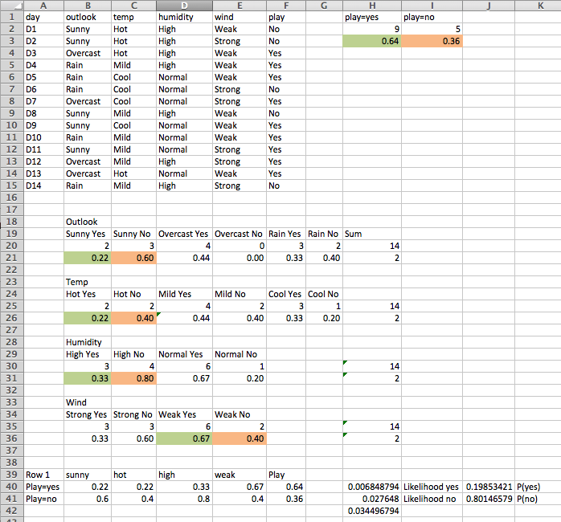
Excel
derive P()
from likelihood
by dividing likelihood
by sum(likelihood)

Slide 52
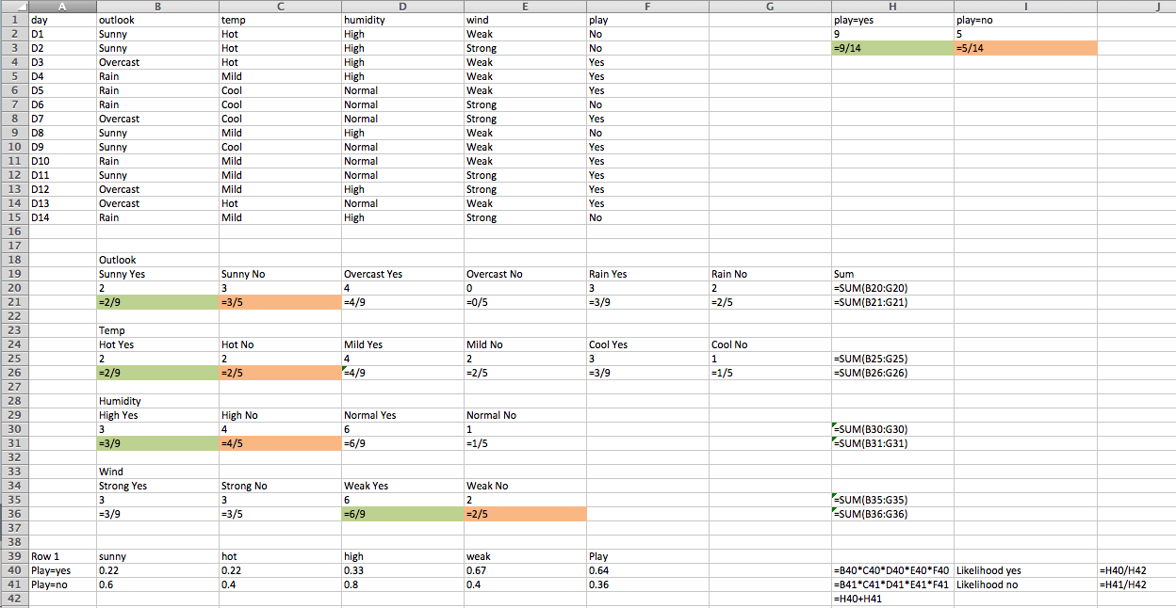
showing formulas

Slide 53
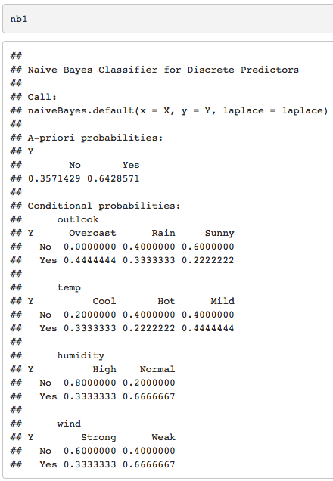
nb numbers

Slide 54
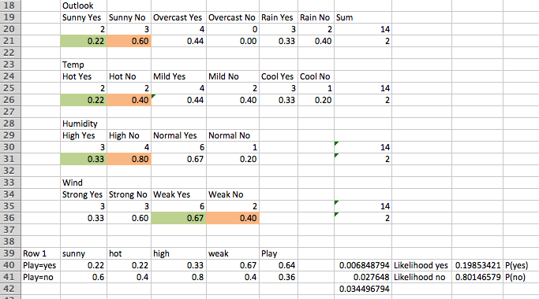
nb numbers

Slide 55
handling text data

Slide 56
text data
previously all of our features were numerical or qualitative
what if we want to learn probabilities about words, like whether an email is ham or spam?

Slide 57
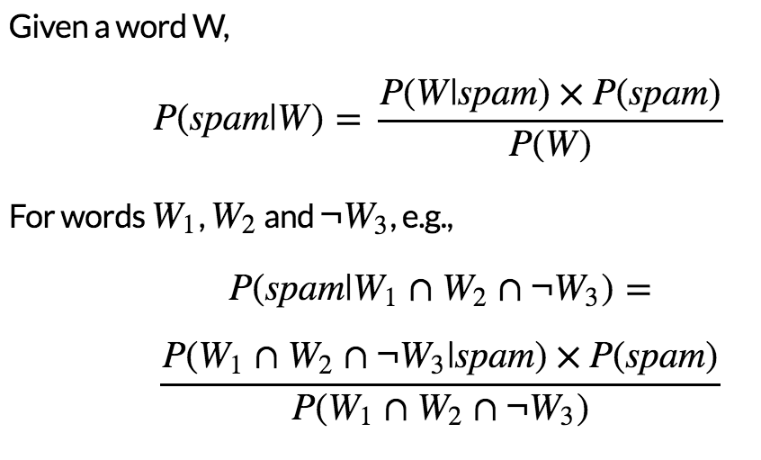
words

Slide 58
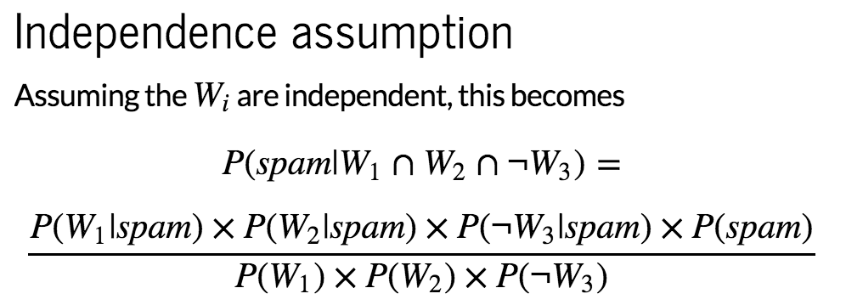
independence assumption

Slide 59
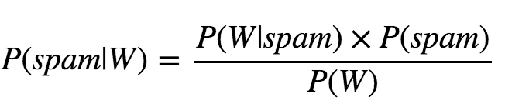
learning the probabilities
prior probabilities are calculated from training data
estimated probability (posterior) on the lhs of the equation is calculated from the prior probabilities

Slide 60
text
the R package tm (text mining) has many useful functions for handling text in machine learning

Slide 61
example
see nb_spam in Piazza

Slide 62

Applying Bayes
a test is positive for cancer
this test has a true positive rate of 80% and a false positive rate of 10%
p(cancer) = 0.004
what is the probability you have cancer, given positive test result?

Slide 63
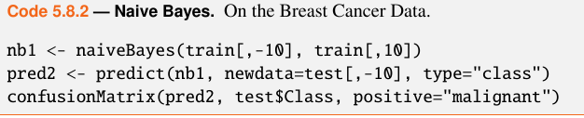
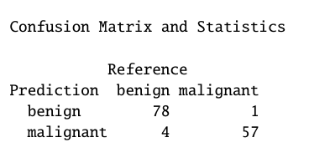
example

Slide 64
NB from scratch
See 5.9 in the book

Slide 65
Comparison of NB and logistic regression

Slide 66
discriminative v. generative
logistic regression directly estimates the parameters of P(Y|X)
we often call this a discriminative classifier
naïve bayes directly estimates parameters for P(Y) and P(X|Y)
we often call this a generative classifier
if the Gaussian NB assumptions hold, and the number of training examples grows towards infinity, the GNB and logistic regression converge toward identical classifiers

Slide 67
comparison
when GNB model assumptions do not hold, logistic regression will often outperform NB as the number of training examples increases
GNB and logistic regression converge towards their asymptotic accuracies at different rates
GNB: log n examples where n is dimension of X
logistic regression: often require n examples
takeaway:
NB may be better for small data
logistic regression may be better if more data is available

