Slide 1
6. Support Vector Machines

Slide 2
history
Vladimir Vapnik developed ideas 1960s in Russia
Emigrated to US to work for Bell Labs
Papers on svm rejected by top ML conferences
180K Google scholar citations
2017 IEEE von Neumann Medal
http://datascience.columbia.edu/vladimir-vapnik

Slide 3
svm
classification or regression
binary classification
multiclass classification

Slide 4
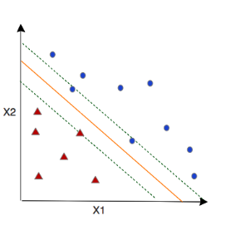
svm
orange line – separating hyperplane
green dashed lines – margins
observations on the margins – support vectors
classification is determining which side an observation falls on: +1 or -1

Slide 5
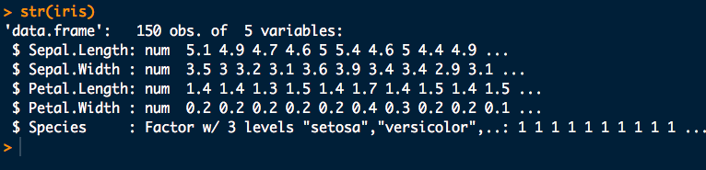
Iris Data
iris data is available in R
Species is our target: 3 classes

Slide 6
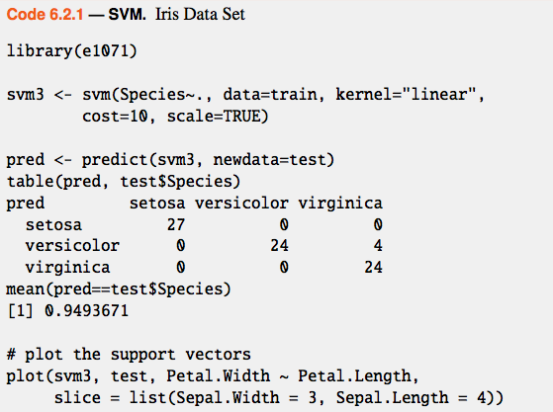
svm in R

Slide 7
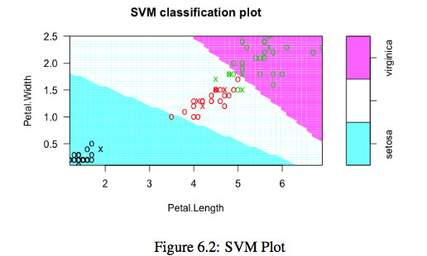

Slide 8


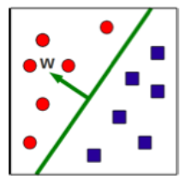
decision boundary
standard svm decision boundary:
w is an orthogonal vector pointing to the + class
new observations classified as +1 or -1

Slide 9

classification rule
will = 0 for support vectors

Slide 10


margin width
margin width is x+ - x-, normalized by unit vector of w
positive support vector has width 1-b, negative support vector has width 1+b
subtracting these gives 2
quantity to optimize:
final step is for
mathematical
convenience

Slide 11

constraint
support vectors are constraints
Lagrangian multipliers (alphas) allow us to put together the optimization expression with the constraints:

Slide 12

find w
take the partial derivative wrt w
we see that w is a linear sum of the samples
alpha=0 for most samples
alpha!=0 for support vectors

Slide 13

optimization
optimization depends on dot products of pairs of samples
the quadratic optimization problem is solved by standard software

Slide 14

slack variables
what if we loosen up the algorithm so that we allow a few observations to fall on the wrong side of the margin?
these are called slack variables
the hyperparameter C controls how much impact slack variables are allowed to have on the optimization
smaller C: lower bias, higher variance
larger C: higher bias, lower variance
larger C: larger margins and more support vectors

Slide 15
hyperparameter
parameters of a model are internal to the model and can be estimated from data
hyperparameters are external to the model and are usually found experimentally
think of hyperparameters as tuning knobs on an old-fashioned radio

Slide 16
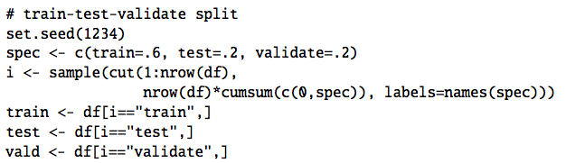
train/test/validation
we need to reserve some training data for tuning hyperparameter C

Slide 17
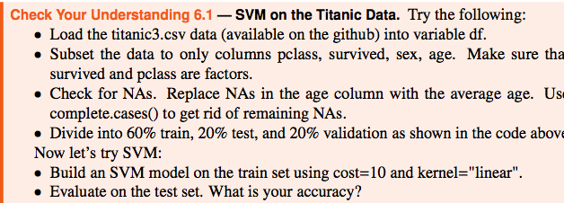
Try this

Slide 18
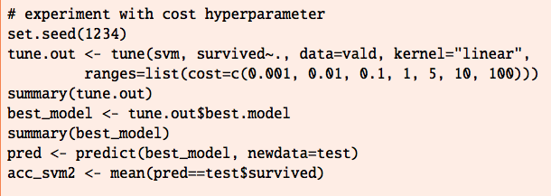
Experiment with C

Slide 19
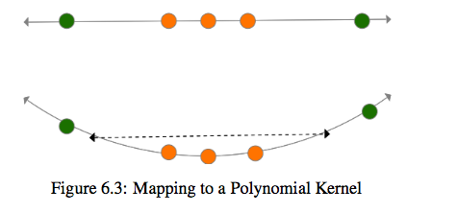
kernel methods
not all data is linearly separable
map it through a kernel function (polynomial)

Slide 20
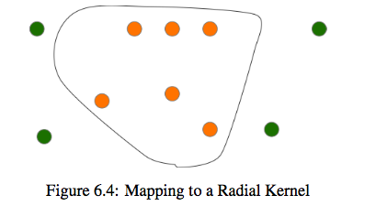
radial kernel

Slide 21
kernel methods
linear svm relied on the inner product of observations
we can apply a kernel function
polynomial:
radial:
radial has an extra hyperparameter gamma
larger gamma can overfit, low bias high variance
smaller gamma could have higher bias, lower variance

Slide 22
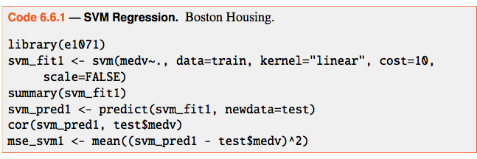
SVM regression

Slide 23
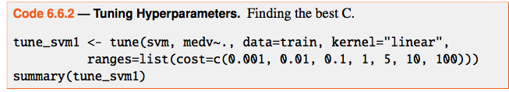
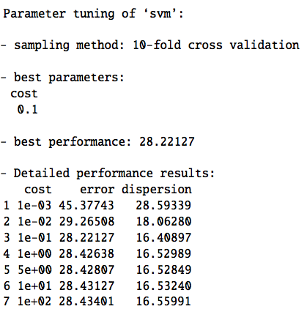
extract best model with
tune_svm1$best.model

Slide 24
svm summary
only a few observations determine the margins
therefore svm is robust to observations far from the hyperplane (as is logistic regression)
svm can be used for:
binary classification
multiclass classification
regression
linear, polynomial, and radial kernels make svm highly versatile

