Slide 1
Neural Networks and Deep Learning
any sufficiently advanced technology
is indistinguishable from magic
- Arthur C. Clark

Slide 2
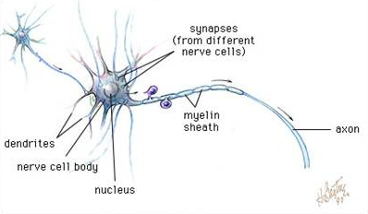
the idea
each neuron is connected to 1000s of other neurons
communicate via electrochemical signals over synapses
when combined inputs reach a certain threshold the neuron fires

Slide 3
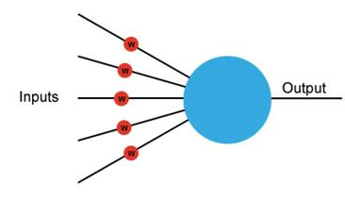
ANN artificial neural network
activation
function
each input has its own weight (+ or -)
the neuron sums these weighted inputs
if > threshold, the outputs 1, else 0

Slide 4
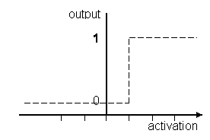

step function
a = x₁w₁ + x₂w₂ + . . . + x_{n}w_{n}

Slide 5
perceptron
invented 1957 by Frank Rosenblatt
originally intended to be a pattern-recognition machine not a program
implemented in hardware: potentiometers for weights, weight updating by electric motors
these single-layer perceptrons could only learn linearly separable patterns

Slide 6
perceptron
1969 book by Minsky and Papert emphasized the limitations of the single-layer perceptron, ex: it could not learn XOR
Although Grossberg published papers 3 years later showing how a multi-layer perceptron network could learn XOR, the negative perception persisted

Slide 7
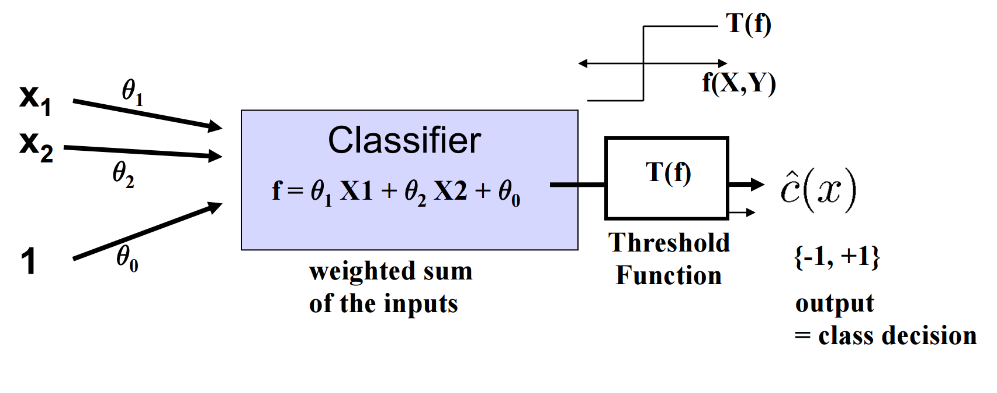
perceptron classifier

Slide 8
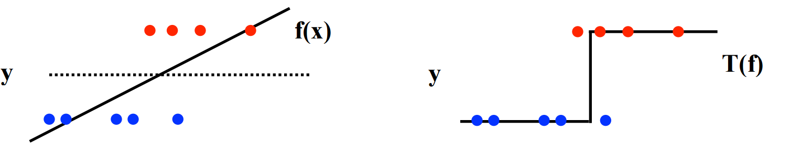
perceptron classifier

Slide 9
perceptron
supervised learning
binary classification
linear function based on features and weights
steps:
represent the features and weights as vectors
calculate the dot product
convert real output to a binary output

Slide 10
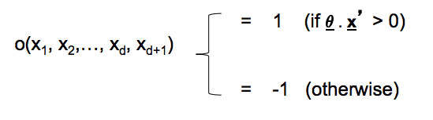
decision boundary
The “sign” function gives us +1 or -1 outputs
therefore the decision boundary will be a hyperplane defined by points where output=0

Slide 11
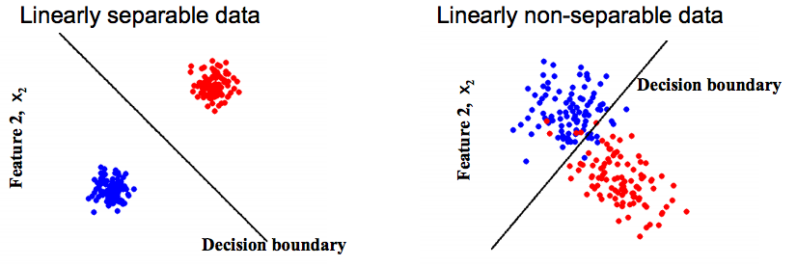
linearly separable

Slide 12
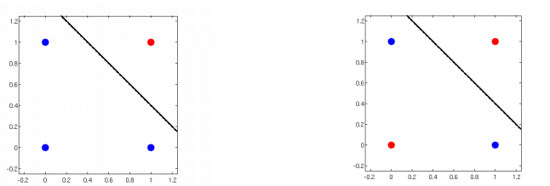
perceptron
can represent AND but not XOR

Slide 13
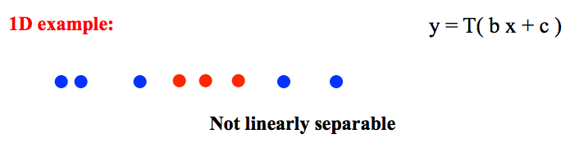
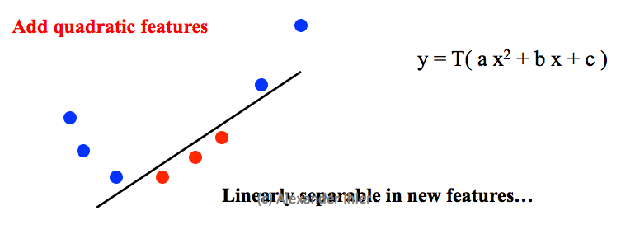
adding features

Slide 14
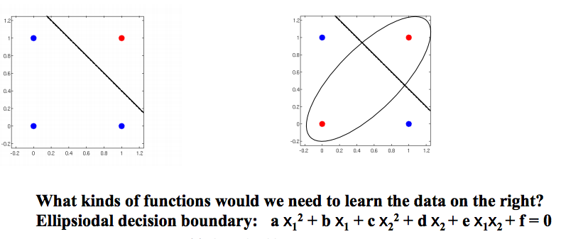
perceptron: AND, XOR

Slide 15
multilayer perceptron
the limitations of the single-layer perceptron led to the development of the multi-layer perceptron
currently called neural networks

Slide 16
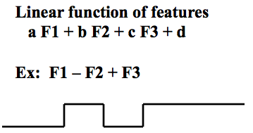
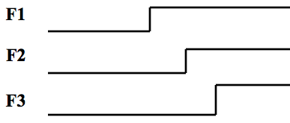
step functions
Earlier we discussed adding polynomial features to the perceptron to create a more flexible decision boundary
What if we used step functions?

Slide 17
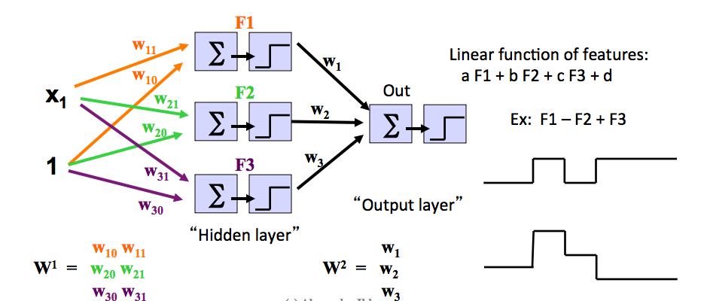
step functions = perceptrons

Slide 18
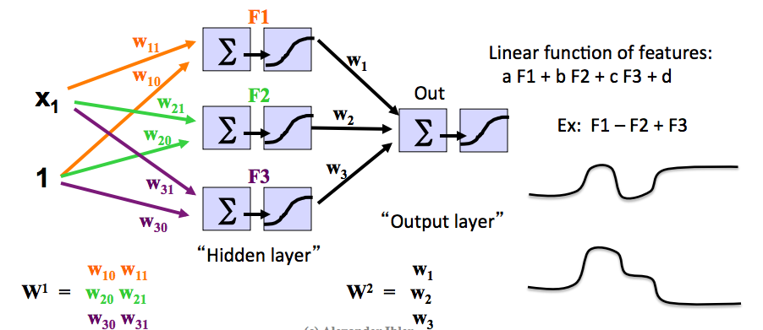
replace threshold with smoother functions such as sigmoid

Slide 19
for regression

Slide 20
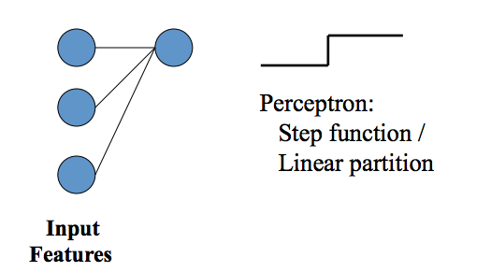
building block: one layer
one layer gets us the standard perceptron with a linear decision boundary

Slide 21
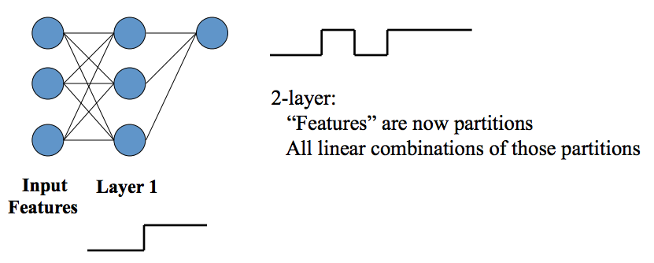
2 layers

Slide 22
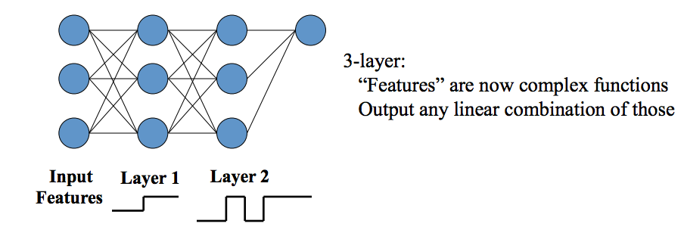
3 layers

Slide 23
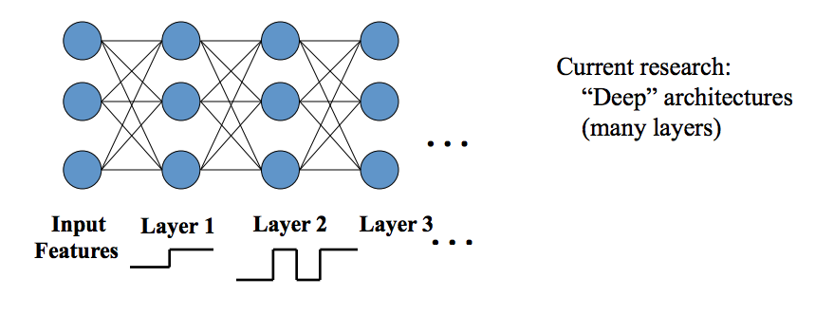
deep networks
Notes:
2006 Geoffrey Hinton published a paper using a deep network for handwriting recognition
revived interest in NN in general, and deep networks in particular

Slide 24
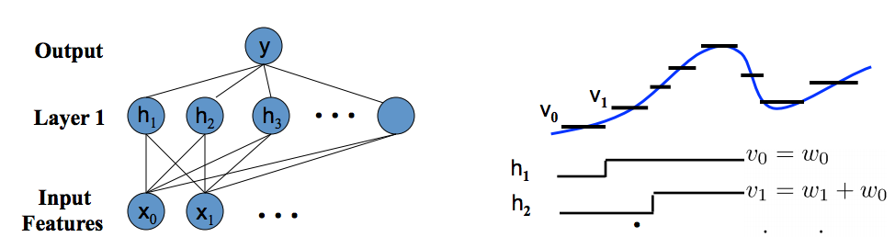
layers -> flexibility
effectively discretizing the function

Slide 25
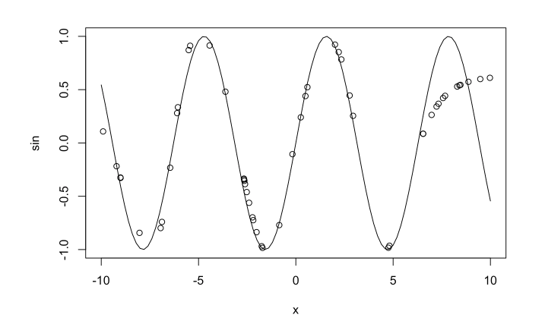
sine example

Slide 26
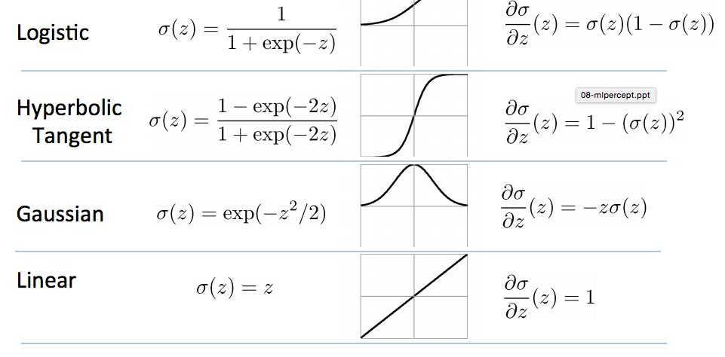
activation functions

Slide 27
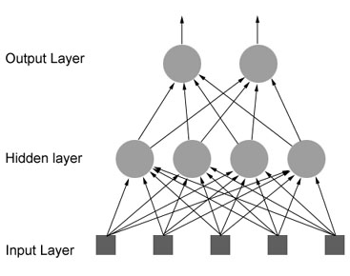
feed-forward network
each input is sent to each neuron in the hidden layer
each output of hidden layer is sent to neuron in output layer

Slide 28
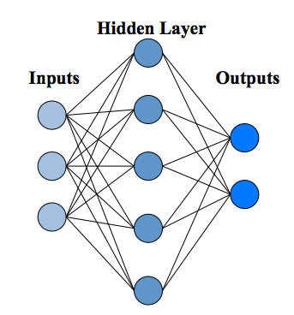
feed-forward NN
multiple outputs could be useful for multi-class classification
or predicting multi-dimensional output for regression

Slide 29
backpropagation
training is done via backpropagation
we observe errors in the outputs
backpropagation applies gradient descent to the cascade of weights
essentially this is applying the chain rule from calculus over and over

Slide 30
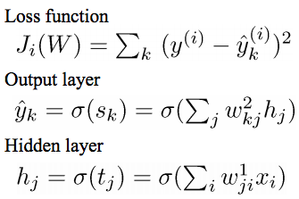
some notation
the loss function quantifies the error
the output layer is a linear combination of the hidden nodes
hidden nodes are activation functions of a linear response t, which is a weighted combination of inputs

Slide 31
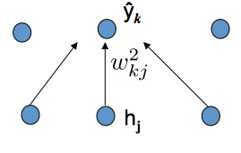
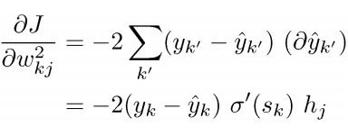
gradient descent
take the derivative of loss J wrt one of the parameters
for example, the weight of the 2nd layer between hidden node j and output node k

Slide 32
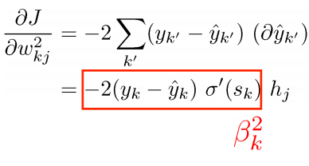
gradient descent

Slide 33
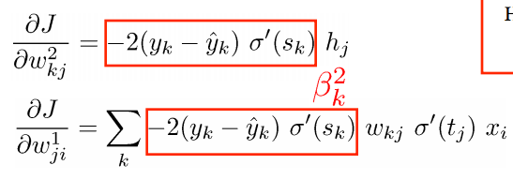
now wrt next layer
notice the similar term for the 2 layers which we will call beta2-k
this allows us to propagate the errors back to an earlier layer
this is simply coded as recursion

Slide 34
backpropagation
the network is trained by backward propagation of errors
used in conjunction with an optimization method such as gradient descent

Slide 35
backpropagation
output of feed-forward NN is compared against the desired output, using the loss function
an error is calculated for each neuron in the output layer
this error is propagated back to neurons at the previous level, essentially adjusting the weights

Slide 36
backpropagation
as the network is trained, the neurons in the intermediate layers get organized such that different neurons learn to recognize different characteristics of the input space
after training, the neurons basically recognize patterns, so that if “noise” is input it will be ignored

Slide 37
summary
Neural networks are defined by:
an activation function which transforms a neuron’s input signals into a single output signal
a network topology (architecture) which describes the number of neurons in the model as well as the number of layers and how they are connected
the training algorithm that specifies how connection weights are set to inhibit or activate neurons in proportion to the input signal

Slide 38
scaling
scaling helps a neural network converge faster

Slide 39
R neuralnet()

Slide 40
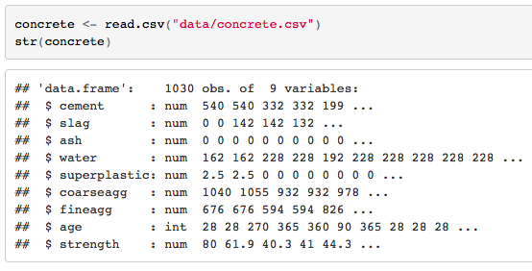
data
concrete data originally from UCI
target: strength
predictors: age in days, plus 7 components in kg per cubic meter

Slide 41
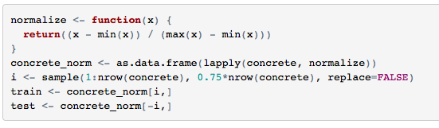
normalize the data
All predictor columns are now normalized to range 0 - 1

Slide 42
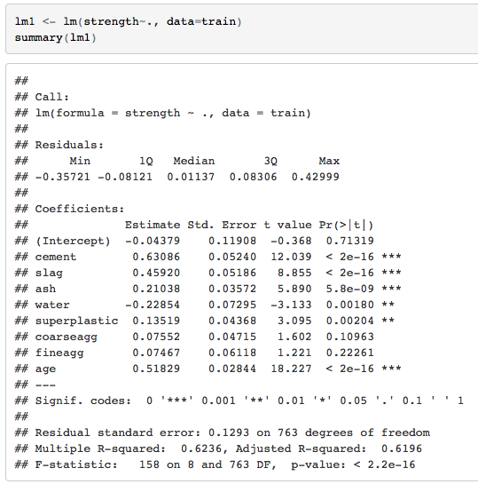
try a linear model

Slide 43
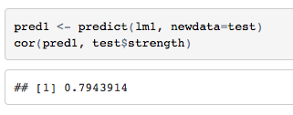
linear model results
correlation between predicted and actual = .79

Slide 44
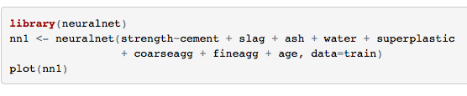
neural net
build a neural network
note that we can’t use the dot operator:
strength~.
instead we have to list each predictor

Slide 45
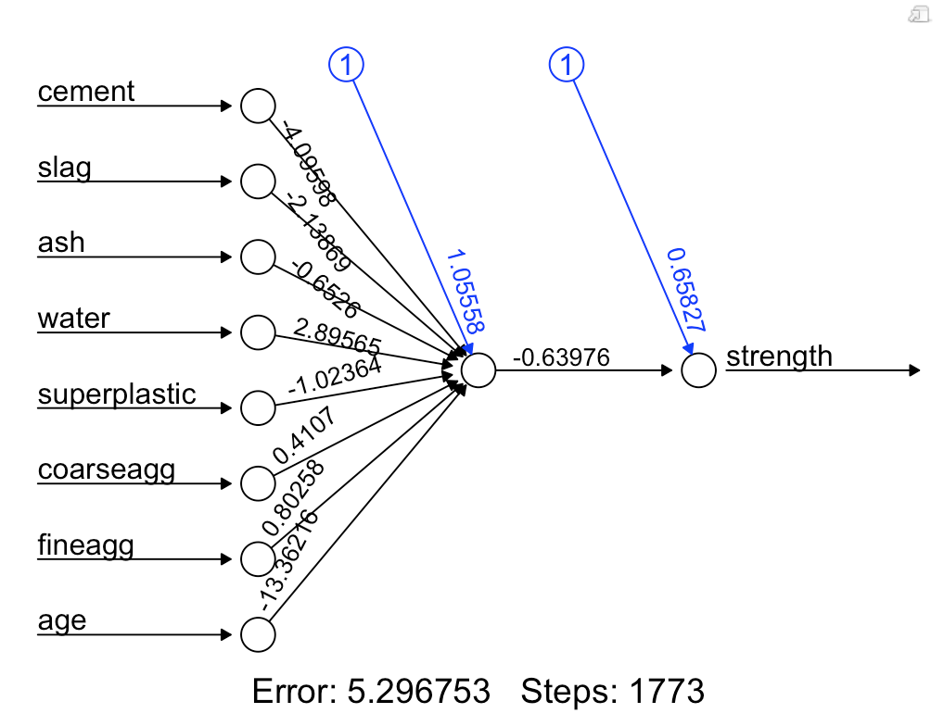
plot() reports the SSE (sum of squared errors) and training steps

Slide 46
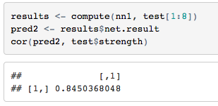
neural model
evaluate the model
the familiar R predict() function does not work with the neural model so we use compute() from the neuralnet package
correlation is higher than linear model
results may vary slightly from run to run because the algorithm
starts with random weights

Slide 47
models
a neural network with a single hidden node bears some similarity to a linear regression model in that the weight of each input mode is somewhat like the coefficients of a linear model and the bias term is somewhat like the intercept
however since the algorithm is completely different mathematically we will get different values

Slide 48
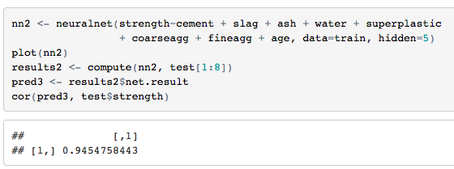
add hidden nodes and evaluate
correlation even higher

Slide 49
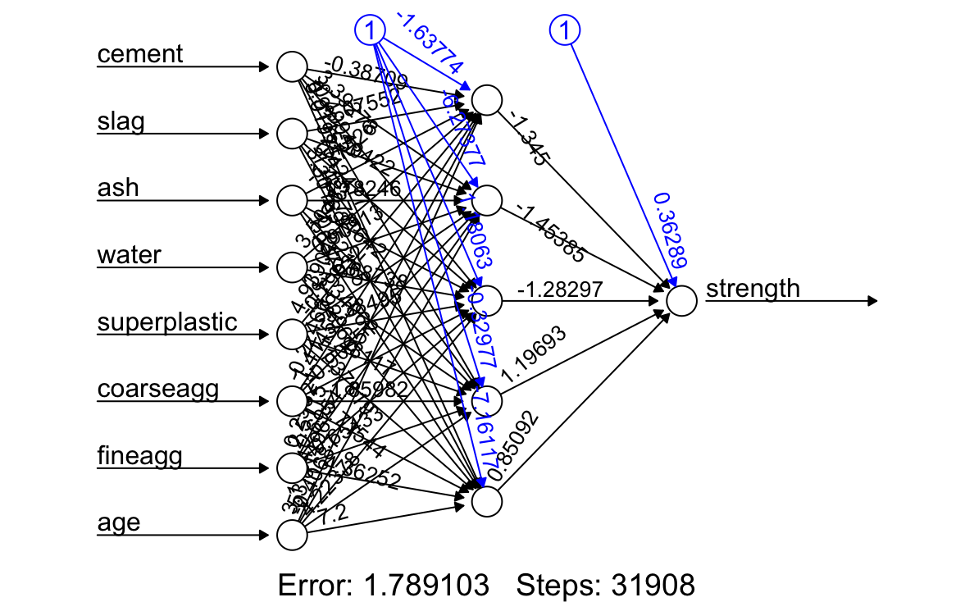

Slide 50
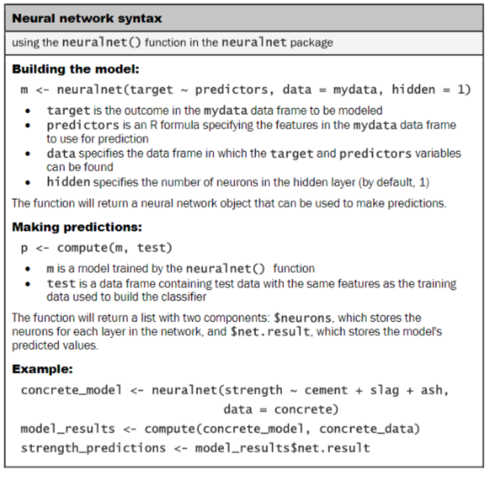

Slide 51
deep learning in R

Slide 52
Andrew Ng Comments
an amazing tool that is helping to build exciting AI applications
currently having a big impact and will continue to grow rapidly
but it has been overhyped
researchers should not say they are building intelligence like the human brain because we have no idea how the brain works
actually, deep learning is advancing using CS and engineering principles, not by trying to copy biology which hasn’t worked
Link to Quora post

Slide 53
many packages
there are several packages for deep learning in R:
MXNet – an R interface to the MXNet deep learning library, which supports several languages, can run on CPUs or GPUs, and on the cloud with AWS, Azure, etc.
darch – (deep architectures) built on basis of code from Hinton and others
Keras – Python API that can run on top of either Tensorflow or Theano (library for multi-dimensional arrays)
Tensorflow – Python library to express computation as a graph of data flows

Slide 54
Keras
Keras is an open source neural network written in Python
It can run on top of Deeplearning4j, Tensorflow, or Theano
It’s primary engineer was Francois Chollet from Google
it was designed to be an interface, providing higher-level more intuitive abstractions that conceal the details of the underlying scientific computing library

Slide 55
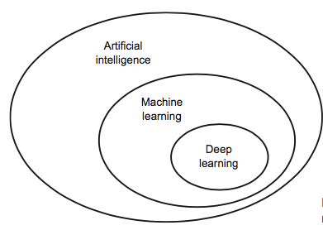
Neural networks with Keras in R
Notes from the book by Francois Chollet (author of Keras)
available here: https://www.manning.com/books/deep-learning-with-r

Slide 56
hardware
deep learning isn’t new by the way, just more accessible with increased computing power and big data
code will run much faster if you have a GPU
you could build your own machine, or use cloud services
http://www.fast.ai/2017/11/16/what-you-need/

Slide 57
why keras?
great tool for starting NN or deep learning
Google’s choice for TensorFlow’s high-level API
allows the same code to run on CPU or GPU
built-in support for convolutional networks (computer vision), recurrent networks (sequence processing) or any combination
supports arbitrary network architectures
MIT license so it can be used in commercial projects
used at Google, Netflix, Uber, CERN, Yelp, Square, and more
recent Kaggle DL winners used Keras

Slide 58
Neural Networks

Slide 59
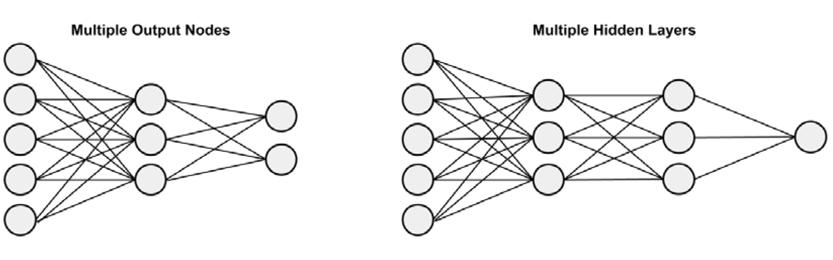
hidden layers

Slide 60
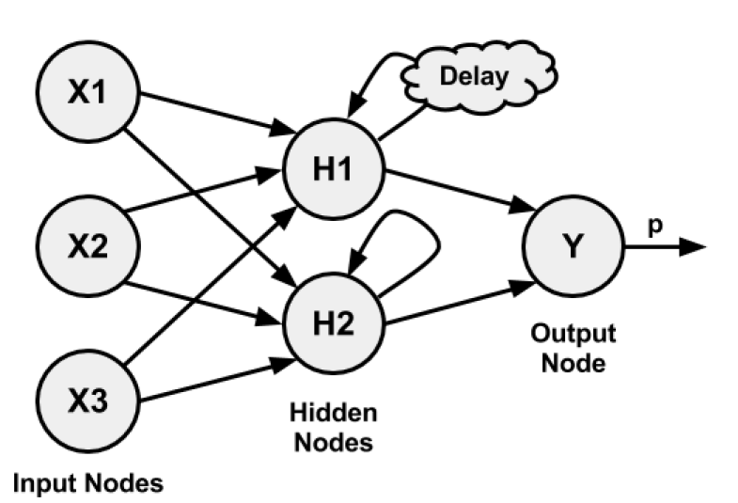
recurrent NN

Slide 61
training
step 1. feedforward – each neuron’s weights are applied moving forward to produce the output signal
step 2. back prop – output is compared to true target in the training data; errors are propagated back to modify the weights
happens over many iterations called epochs
often starts with random weights

Slide 62
topology
more complex topologies can learn more complex functions
simpler architectures may have high bias
to decrease bias, make the architecture more complex
complex architectures may have high variance
to decrease variance, increase the size of data

Slide 63
what is deep learning?

Slide 64
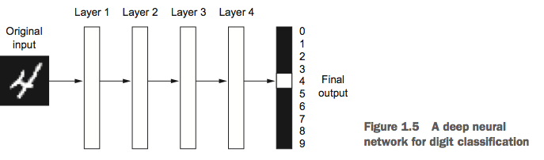
deep learning
learns successive layers of meaningful representations
depth = number of layers (of neural networks)
tens or hundreds of successive layers of representations, learned from training data

Slide 65
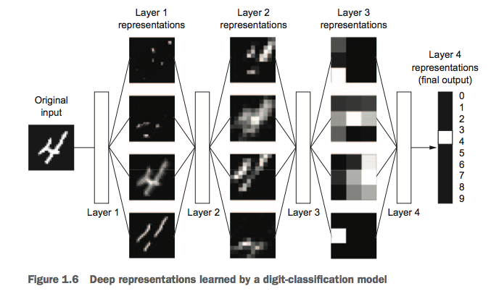
deep layers
each layer is increasingly different from the previous layer

Slide 66
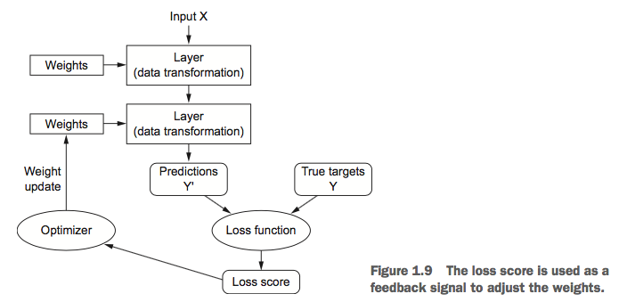
how it works
layers combined into a network (or model)
loss function – defines the feedback signal for learning (back propagation, etc.)
optimizer – uses the loss function to update the weights

Slide 67
advantage
the deep learning algorithm learns the features it needs to learn from the data
there is no feature engineering required
different layers learn different features
weights are updated at all levels jointly without human intervention

Slide 68
recent advances
increasing processing power and access to bigger data help spur advances in deep learning
however, there was a problem: the propagation back through several layers was diminished (vanishing gradients)
2009-2010:
better activation functions
better weight-initialization schemes
better optimization schemes
2014-2016:
further improvements allowed models that are thousands of layers deep

Slide 69
let’s dive in
example from Chapter 2

Slide 70

MNIST data set
NIST (National Institute of Standards) compiled this data set
60K training images and 10K test images
greyscale images of handwritten digits in 28x28 pixel grids
task: classify them into one of 10 categories: digits 0 through 9.

Slide 71
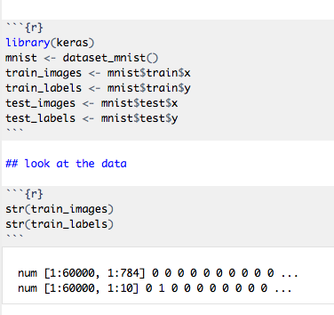
set up
labels are a vector of digits
training data is stored as 3-d array in book but 2-d array here
28x28 = 784

Slide 72
build the network
we will learn details of the parameters later
this is just defining what kind of network we want so we can do training next
read the pipe %>% as “then”
so start with the model, then add a layer, then add another layer

Slide 73
layers
building blocks of neural networks
data goes in and comes out in a more meaningful form
layers extract representations of the data
progressive data distillation
the first layer is densely connected
the second layer is a softmax layer that returns probability scores for 10 classes

Slide 74
units
the units parameter specifies the number of hidden units in the layer
a hidden unit is a dimension in the representation space of the layer
having more hidden units allows the layer to learn more complex representations
at the expense of more computation and it may learn unwanted patterns (patterns that make sense for the training data but don’t generalize to test data)

Slide 75
activation
activation functions determine how the outputs are mapped
the relu (rectified linear unit) function zeros out negative values
the sigmoid function forces the output to [0, 1]
the softmax function is a generalization of the logistic function that squashes the output into K real values [0, 1] that add up to 1

Slide 76
activation
if we didn’t have an activation function, the dense layer could only learn linear transformations (affine transformations)
output = dot(W, input) + b
activation functions give the layers an opportunity to learn non-linear transformations
relu is the most popular activation function in deep learning

Slide 77

compilation step
loss function – how the network will measure its performance on the training data; crossentropy measures the distance between the labels and predictions
optimizer – how the network will update itself (minibatch stochastic gradient descent)
metrics – how the network monitors itself during training and testing
the compile() function modifies the network in place rather than return a new network

Slide 78


preprocessing
shape the image data
originally (60000, 28, 28) int values [0, 255]
make them (60000, 28, 28) double [0, 1]
make the labels categorical

Slide 79
train the network
during training, two values are displayed
loss at each epoch (should decrease)
accuracy at each epoch (should increase)
you also get time information
we are training in minibatches of size 128
5 epochs, an epoch is an iteration over all training examples
5 epochs -> 2345 gradient updates (about 469 per epoch because 60000/128 = 468.75)

Slide 80
test accuracy
the test accuracy was lower than the training accuracy as you would expect

Slide 81
predictions
generate predictions for the first 10 samples

Slide 82
quick picture
that was the quick overview of an example of training a neural network in fewer than 20 lines of R code
next we look at:
tensors
tensor operations
gradient descent

Slide 83
data representations for neural networks

Slide 84
tensors
tensors are high degree generalizations of matrices to an arbitrary number of dimensions
dimension aka axis
in R we use:
vectors of length 1 for 0D tensors (a scalar)
vectors for 1D tensors (one axis)
matrices for 2D vectors (two axes)
arrays for nD vectors (n axes)
the process of turning data into tensors is called vectorization
more about tensors:
http://www.offconvex.org/2015/12/17/tensor-decompositions/

Slide 85
tensors
a tensor has 3 key attributes:
number of axes (rank)
shape – the number of dimensions along each axis, ex: a 3D tensor of shape (2, 3, 2)
data type – integer, double, etc.

Slide 86
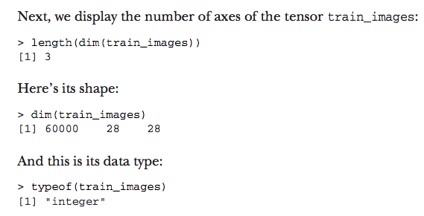
tensor example
from the book:
data seems to now be stored differently

Slide 87

data batches
the first axis is generally the sample axis
rather than train the entire set, it is often trained in batches
in this case the first dimension is the batch axis or batch dimension

Slide 88
tensor examples
vector data – 2D tensors of shape (samples, features)
timeseries or sequence data – 3D tensors of shape (samples, timesteps, features)
images – 4D tensors of shape (samples, height, width, channels) or (samples, channels, height, width)
video – 5D tensors of shape (samples, frames, height, width, channels) etc.

Slide 89
tensor operations
a layer:
layer_dense(units=512, activation=“relu”, …
we can think of this as a function:
output=relu(dot(W, input) + b)
where relu(x) is max(x, 0)
note that element-wise operations lend themselves to parallel implementations
in addition to element-wise operations there are vector operations and reshaping and transpose operations

Slide 90
geometric interpretation
neural networks are chains of tensor operations
tensor operations can be viewed as geometric transformations of the input data
so you can think of a neural network as a very complex geometric transformation in high-dimensional space implemented a step at a time
deep learning works by decomposing a complicated transformation into a long chain of elementary transformations

Slide 91
learning the weights
each layer contains weights (W, b) that are learned from the training data
weights are where the knowledge of the network persists
the weights are initialized with random small values
the weights are gradually adjusted via backpropagation of errors

Slide 92
learning the weights
training loop:
draw a batch of training samples x and targets y
run the network on x (forward pass) to obtain predictions y_pred
compute the loss of the network on the batch
update all weights of the network to reduce the loss on this batch

Slide 93
update the weights
all operations in the network are differentiable
compute the gradient of the loss
adjust the coefficients in the opposite direction of the gradient of the loss

Slide 94
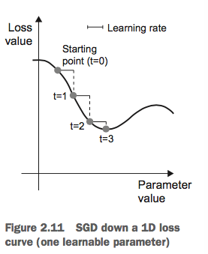
minibatch stochastic gradient descent
1 Draw a batch of training samples x and corresponding targets y.
2 Run the network on x to obtain predictions y_pred.
3 Compute the loss of the network on the batch, a measure of the mismatch between y_pred and y.
4 Compute the gradient of the loss with regard to the network’s parameters (a backward pass).
5 Move the parameters a little in the opposite direction from the gradient—for example, W=W-(step*gradient)—thus reducing the loss on the batch a bit.
“stochastic” because each batch
is drawn at random

Slide 95
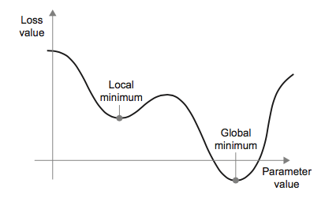
SGD variations
some variations consider momentum
momentum considers not only the current gradient but also the previous parameter update
this can help avoid local minima

Slide 96
backpropagation
backpropagation starts with the final loss value
works backwards through layers, applying the calculus chain rule to compute the contribution that each parameter had in the loss value
this is accomplished with a call to a gradient function

Slide 97
NN summary
learning means finding the parameters that minimize the loss function for the training data
this happens by drawing random batches of samples and computing the gradient of the parameters on the batch and adjusting the weights in the opposite direction
the chain rule for derivatives is used to find the gradient values

Slide 98
key concepts
loss – the quantity to minimize during training
optimizer – the way the gradient of the loss will be used to update parameters

Slide 99
a closer look at network anatomy

Slide 100
layers
some layers are stateless
most layers have weights which contain knowledge
layers are like LEGO bricks put together in a pipeline
different types of layers are appropriate for different types of data processing
type of layers:
fully connected
recurrent layers
convolution layers

Slide 101
dense layers
fully connected aka dense layers
simple vector data in 2D tensors (samples, features)
layer_dense() function in Keras

Slide 102
recurrent layers
sequence data in 3D tensors (samples, timesteps, features)
layer_lstm

Slide 103
convolution layers
image data in 4D tensors
2D convolution layer: layer_conv_2d

Slide 104
connecting layers
this example:
accepts 2D input tensors where the first dimension is 784
returns a tensor where the first dimension has been transformed to 32
layers are dynamically built to match the shape of the incoming layer

Slide 105

connecting layers
in this example:
the second layer didn’t have an input shape argument, it will automatically infer it from the output of the previous layer

Slide 106
models
a deep learning model is a directed, acyclic graph of layers
usually a linear stack of layers mapping a single input to a single output
other topologies in the book:
two-branch networks
multihead networks
inception blocks

Slide 107
topology
the topology of a network defines (constrains) its hypothesis space
designing the right architecture is more art than science
recall the book’s earlier definition of ML:
searching for useful representations of the input data within a predefined space of possibilities using guidance from a feedback signal

Slide 108
learning configurations
after choosing topology, choose:
loss function (objective function) – quantity to be minimized during training
optimizer – how the network is updated based on the loss function, usually some variance of SGD (stochastic gradient descent)
different layers can have different loss functions
there can be only one scalar loss value for SGD, so all losses are averaged into a scalar

Slide 109
loss function
choosing the right objective function is critical
neural networks will take shortcuts to minimize the loss function so selecting the right function influences what it learns
typically:
two-class classification: binary crossentropy
many-class classification: categorical crossentropy
regression: mean squared error
sequence learning: CTC (connectionist temporal classification)
etc.

Slide 110
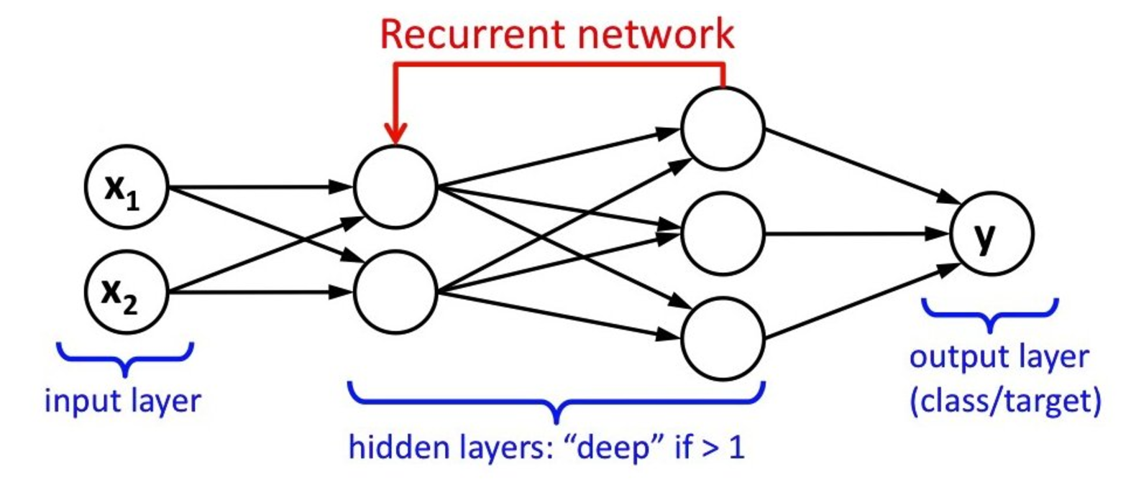
recurrent NN
alternative to feed-forward NN
the output of a layer could be fed to an earlier layer

Slide 111
Keras, TensorFlow, Theano, and CNTK

Slide 112
Keras backend
Keras focuses on the front end leaving low-level operations such as tensor manipulation and differentiation to the backend engine
3 common backend implementations:
TensorFlow – developed by Google
Theano – developed by MILA lab at U. Montreal
MNTK (Microsoft Cognitive Toolkit)
book recommends TensorFlow as the default

Slide 113


Slide 114

software and hardware stack
runs seamlessly on CPU or GPU
CPU: wraps Eigen library for tensor operations
GPU: wraps CUDA

Slide 115
installing
the default CPU-based installation:
install.packages(“keras”)
library(keras)
install_keras()
if you have an NVIDIA CPU and CUDA and cuDNN installed:
install_keras(tensorflow= “gpu”)

Slide 116
workflow
define your training data: input tensors and target tensors
define a network of layers (the model) that maps inputs to targets
configure the learning process by choosing a loss function, an optimizer, and some metrics to monitor
iterate on training data by calling the fit() method

Slide 117
DL workstation
if your computer has an NVIDIA GPU you will see the code run 5-10 times faster
you want to use unix
will work on Windows but is not recommended, consider dual-boot option
another alternative is to use AWS or Google cloud

Slide 118
options
Use the official EC2 Deep Learning AMI (https://aws.amazon.com/amazon- ai/amis), and run Keras experiments within RStudio Server on EC2; details on this and other cloud GPU options at https://tensorflow.rstudio.com/tools/cloud_gpu
Install everything from scratch on a local Unix workstation. Do this if you already have a high-end NVIDIA GPU. You can find details on setting up a local GPU workstation at https://tensorflow.rstudio.com/tools/local_gpu

Slide 119
cloud pros and cons
AWS EC2 a bit easier than other platforms
run Rstudio server just as if it were on your computer
cloud is a good way to get started
but it can be expensive

Slide 120
workstation
it you build your own deep learning machine:
must be an NVIDIA GPU
mid-2017 recommendation:
NVIDIA TITAN Xp
lower budget option: GTX 1060
note that new models come out every year

Slide 121
some practical considerations
for neural networks

Slide 122
data normalization
data is normalized to make learning easier for the network
data should be homogenous: all features should take values is roughly the same range
values should be small: typically most values should be in the 0-1 range
often but not always necessary:
normalize each feature independently to have mean = 0 and sd=1
this can be done with R’s scale() function
important: find mean and sd on training data only and apply to both train and test data

Slide 123
missing values
generally it’s safe to just replace missing values with 0 and the network will learn to ignore those values
if the test data has missing values and the training data does not, that will be a problem
in that case, artificially generate training samples with missing values

Slide 124
feature engineering
modern deep learning removes the need for a lot of feature engineering because the networks can automatically learn useful features from raw data
however, it should not be ignored because:
good features will allow for more efficient learning
good features can allow learning with less data

Slide 125
over- and underfitting
optimization: adjusting a model to get the best performance on the training data
generalization: how well the trained model performs on new data
underfitting: optimization and generalization are both low
overfitting: optimization has gone too far and the system doesn’t generalize well
having lots of training data helps
otherwise use regularization

Slide 126
regularization techniques
reduce the network’s size – number of layers and/or number of units per layer
learnable parameters are the model’s capacity
a model with more parameters has more memorization capacity which can decrease the models ability to generalize
a model with fewer parameters won’t memorize as much but will learn compressed representations and may generalize better
a model with too few parameters will underfit
unfortunately there is no magic formula, so validation sets are used, typically starting small and moving up in size

Slide 127
regularization techniques
weight regularization – put constraints on the complexity of a network by forcing weights to take only small values which makes the distribution of the weight values more regular
L1 regularization – cost added is proportional to the absolute value of the weight coefficients
L2 regularization – uses the square of the weight coefficients
L2 often called weight decay in neural networks

Slide 128

regularization techniques
Keras weight regularization example:
regularizer_12(0.001) means that every coefficient in the weight matrix of the layer will add 0.001*coeff to the total loss
this loss is only during training

Slide 129
regularization techniques
dropout – at each layer, randomly drop out (set to zero) a number of output features
the dropout rate is the percentage of features that are zeroed out, usually 0.2 to 0.5
only done during training not test
at test time, the layer’s output values are scaled down by a factor equal to the dropout rate
Geoff Hinton got the idea from noticing that banks moved tellers around to prevent fraud
randomly removing neurons would prevent conspiracies and reduce overfitting

Slide 130

regularization techniques
Keras dropout example

Slide 131
ML workflow for NN
define the problem and assemble a data set
choose a measure of success
decide on an evaluation protocol for training
prepare the data
develop a model that does better than a baseline
tune the model architecture
regularize the model and tune hyperparameters

