Slide 1
summary: what have we learned?
Machine Learning

Slide 2
major algorithms we studied
linear regression
logistic regression
kNN
naïve Bayes
svm
k-means and clustering
decision trees
random forests
neural networks

Slide 3
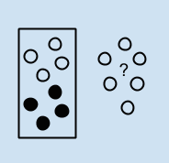

supervised or unsupervised
supervised or unsupervised

Slide 4
regression or classification
regression
classification
linear regression
kNN
decision trees
also:
svm
neural networks
logistic regression
kNN
naïve Bayes
svm
decision trees
neural networks

Slide 5
bias-variance
bias refers to the simplifying assumptions made by the model
variance is the amount that the model would change given different training data
there is a trade-off between the errors introduced by bias and those by variance

Slide 6
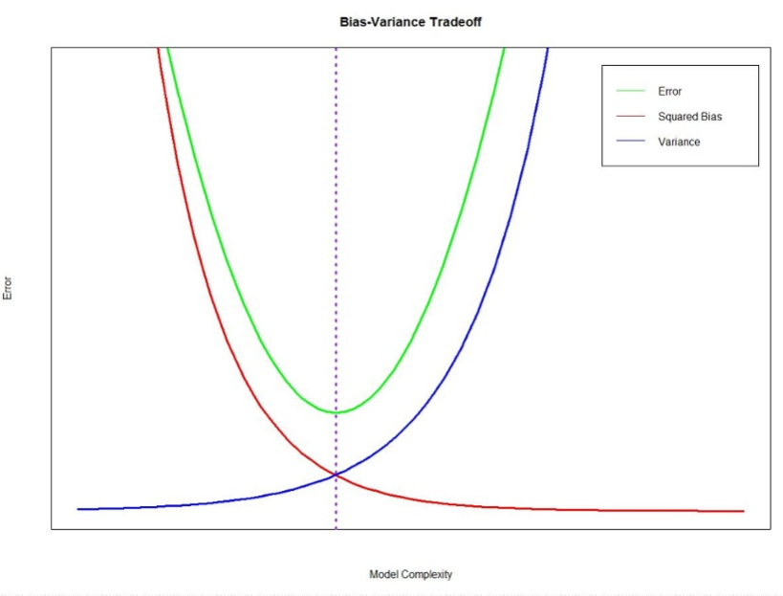

Slide 7
bias-variance
increasing bias decreases variance
increasing variance decreases bias
if the model is simple it will tend toward bias
more complex models have more variance

Slide 8
bias-variance
parametric algorithms tend to have high bias, low variance
non-parametric algorithms tend to have low bias, high variance

Slide 9
size of data set
if you don’t have a lot of data:
high bias/low variance classifiers like Naïve Bayes have an advantage over low bias/high variance classifiers like kNN
if you have lots of data:
the low bias/high variance classifiers have lower asymptotic error

Slide 10
linear regression (degree 1)
high bias, low variance
simple and interpretable
when true function is linear it works well
is sensitive to outliers

Slide 11
logistic regression
somewhat high bias, low variance
robust to outliers

Slide 12
naïve Bayes
high bias, low variance
due to the simplicity of the model
simple and interpretable
can work well with small data sets
doesn’t model feature interactions

Slide 13
svm
low bias, high variance
increasing parameter C increases bias and lowers variance
kernels make it very flexible

Slide 14
kNN
low bias, high variance
increase k for small data sets
no model is created
instance-based learning
can be used for classification or regression

Slide 15
decision trees
low bias, high variance
interpretable
assumes decision boundaries are rectangular
used for regression or classification

Slide 16
neural networks
bias decreases, variance increases with number of hidden units
can model complex relationships between variables
can detect interactions between predictors
not sensitive to outliers
will learn faster if you scale the data
but it’s a black box

Slide 17
feature selection

Slide 18
feature selection
complex subject with many approaches
using a subset of possible predictors
remove predictors that are not helpful

Slide 19
embedded methods
let the model tell you what features were useful as it created the model

Slide 20
filter methods
methods to use before running the model
chi squared test
information gain
correlation scores

Slide 21
wrapper methods
recursive feature elimination methods
forward or backward

Slide 22
things to consider
domain knowledge
are the features independent?
interpretability

Slide 23
feature selection in R
Caret package can be helpful
Caret can remove redundant features, rank features, select a subset of important features

Slide 24
advice from pedro domingos
a few useful things to know about machine learning
The Master Algorithm

Slide 25
learning
learning =
representation +
evaluation +
optimization

Slide 26
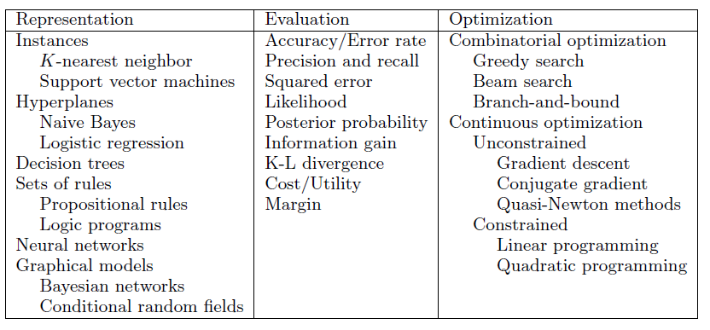

Slide 27
more data
more data beats the best algorithm

Slide 28
advice
try the simplest learners first
naïve Bayes before logistic regression
kNN before SVM
more complex algorithms are harder to use because you have more parameters to tune

Slide 29
5 tribes of ML
each has its own master algorithm

Slide 30
5 tribes
Symbolists – fill in gaps in existing knowledge
Connectionists – emulate the brain
evolutionists – simulate evolution
Bayesians – systematically reduce uncertainty
analogizers – notice similarities between old and new

Slide 31
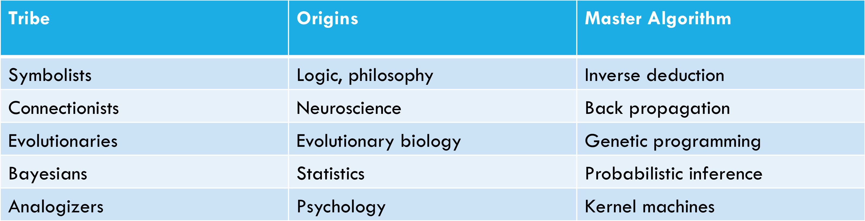
5 tribes

Slide 32
symbolists
believe that all intelligence can be reduced to manipulating symbols
understand that you need to incorporate preexisting knowledge into learning
algorithm: inverse deduction
approach advantages:
flexibility
compositionality
approach criticsm:
logic is too rigid, not the way the world works

Slide 33
connectionists
learning is what the brain does so we need to reverse engineer it
algorithm: back propagation
approach advantage:
has proven to be a powerful learning tool
criticism: all you are doing is adjusting parameters

Slide 34
evolutionaries
believe: that learning is natural selection
key problem is learn structure
algorithm: genetic programming
advantage:
novel inventions have been made by the algorithm
criticism: limited application

Slide 35
bayesians
concerned with uncertainty
learning is a form of uncertain inference
algorithm: probabilistic inference with Bayes’ theorem
advantages:
has proven successful in wide applications from spam filtering to self-driving cars
criticism: too simplistic

Slide 36
analogizers
believe the key to learning is to notice similarities between simulations and inferring other similarities
algorithm: support vector machine, kNN
svm advantage: flexibility
svm criticism: problem of selecting kernel parameters

Slide 37
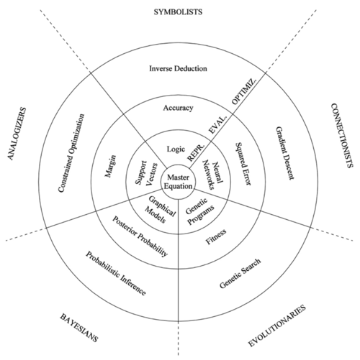
will there be a master algorithm?

Slide 38
summary
for each algorithm you should know:
whether it is supervised or unsupervised
whether you can use it for classification, or regression, or both
advantages and disadvantages
its tendencies towards bias or variance

