Slide 1
Decision Trees and Random Forests
Machine Learning

Slide 2
Decision Trees
can be used for classification or regression
not as accurate as other algorithms
but highly interpretable
tend towards high variance, low bias

Slide 3
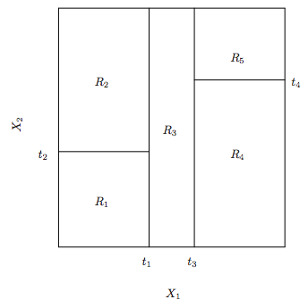
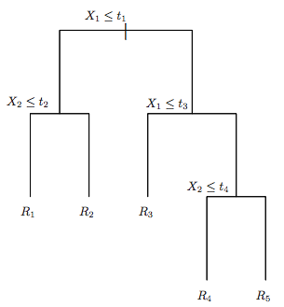
decision trees
a decision tree segments the training data into simple regions by repeatedly selecting an attribute/value that divides the data well

Slide 4
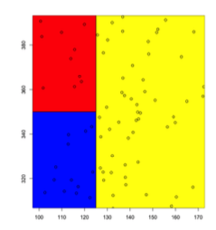
Decision Trees
greedy algorithm
divides data into rectangular dimensions for 2 vectors, cuboid for higher dimensions
decision boundaries are linear
decision boundaries aligned with axes

Slide 5
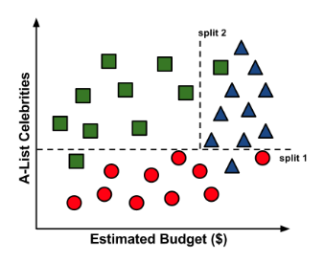
box-shaped regions
the decision tree partitioning makes axis-parallel splits which is one of its limitations
cannot make a
diagonal split
with decision trees

Slide 6
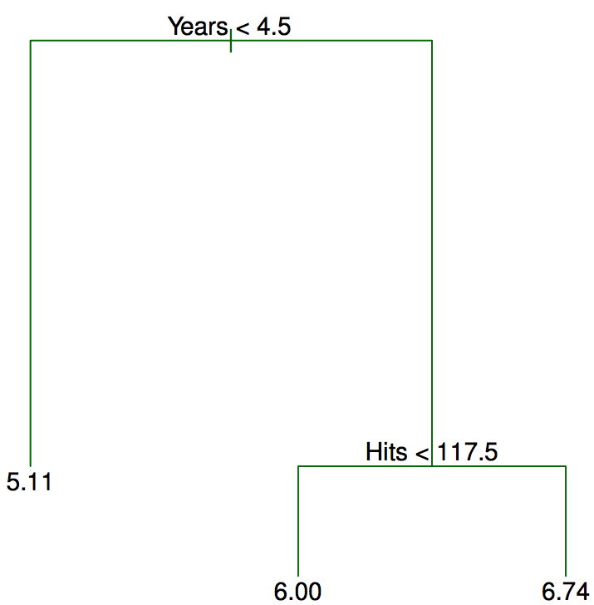
regression example
predict the log salary of a baseball player
labels indicate left branch
first split:
left: Years < 4.5
right: Years >= 4.5
tree has:
2 internal nodes
3 terminal nodes (leaves)
terminal leaves show mean of
log(Salary) in 1000s of $

Slide 7
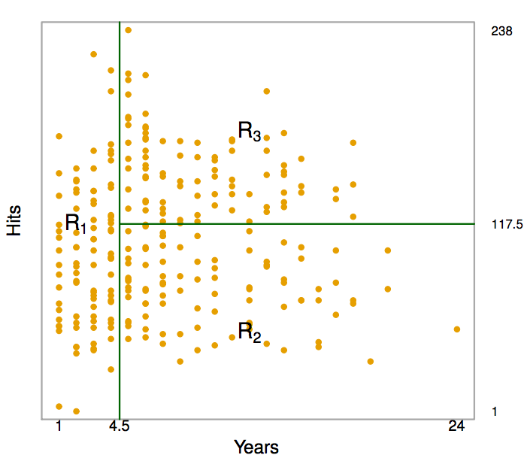
partition
these 3 regions represent the terminal nodes,
or leaves of the tree

Slide 8
rules
if Years < 4.5:
logSalary = 5.107
elif Hits < 117.5:
logSalary = 6.0
else:
logSalary = 6.74

Slide 9
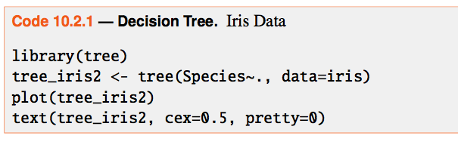
DT in R
several packages for decision trees
rpart and tree both popular

Slide 10
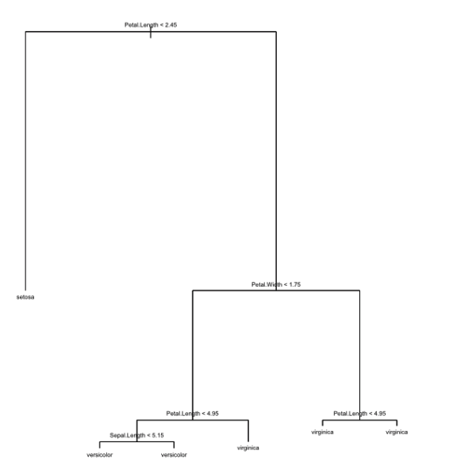

Slide 11

regression
goal: minimize RSS within each region
computationally infeasible
instead: top-down, greedy approach
all predictors are examined to see if they make a good split
splitting is repeated until some threshold is reached

Slide 12
classification
instead of RSS, use counts of classes in regions
splits are made using metrics such as entropy or the Gini index, both of which measure node purity

Slide 13

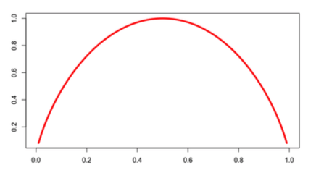
entropy
entropy measure uncertainty in the data

Slide 14


entropy
suppose we had a partition of data with two classes where “red” is 60% and “white” 40%

Slide 15
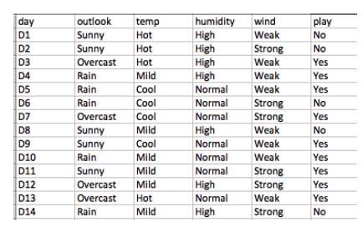
tennis data

Slide 16
split on wind

Slide 17
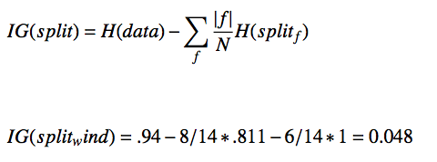
information gain
information gain is the reduction in uncertainty given a split
IG = starting entropy – entropy of the split
ex: entropy of data – entropy of wind
entropy of wind=weak is .811; of wind=strong is 1

Slide 18
try all splits
IG of wind = 0.048
IG of outlook = 0.246
IG of humidity = 0.151
IG of temperature = 0.029
outlook has the highest IG so we would split on outlook

Slide 19
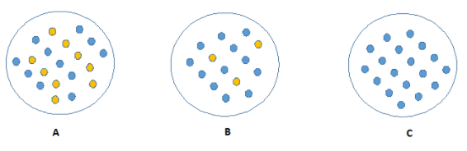
information gain
the 3 nodes below differ in purity
it requires more information to describe nodes that are impure

Slide 20
information gain
steps to calculate for a split:
calculate entropy of parent node
calculate entropy of each individual node of split and weighted average of all sub-nodes
choose the split that results in the lowest

Slide 21
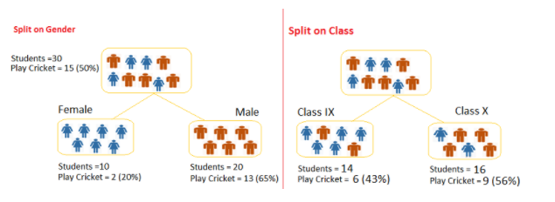
information gain
target variable: play cricket yes/no
Notes:
https://www.analyticsvidhya.com/blog/2016/04/complete-tutorial-tree-based-modeling-scratch-in-python/

Slide 22
information gain
Split on gender:
entropy for parent node:
-(15/30) log2 (15/30) – (15/30) log2 (15/30) = 1
entropy for female node:
-(2/10) log2 (2/10) – (8/10) log2 (8/10) = 0.72
entropy for male mode:
-(13/20) log2 (13/20) – (7/20) log2 (7/20) = 0.93
split on gender:
Weighted entropy of sub-nodes = (10/30)*0.72 + (20/30)*0.93 = 0.86
IG = 1 - 0.86 = .14

Slide 23
information gain
Split on class:
entropy for parent node:
-(15/30) log2 (15/30) – (15/30) log2 (15/30) = 1
entropy for class IX node:
-(6/14) log2 (6/14) – (8/14) log2 (8/14) = 0.99
entropy for class X mode:
-(9/16) log2 (9/16) – (7/16) log2 (7/16) = 0.99
split on class:
Weighted entropy of sub-nodes = (14/30)*0.99 + (16/30)*0.99 = 0.99
IG = 1 - .99 = .01

Slide 24
information gain
the IG for split on gender is higher so gender is chosen as the split

Slide 25
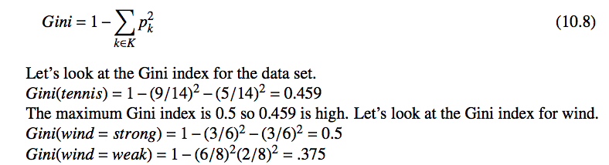
Gini index
comparable to IG but we want a min Gini and a max IG
many variations of the formula

Slide 26
Gini on cricket data

Slide 27
gini index
split on gender:
Gini for subnode female:
1 – [(0.2)*(0.2)+(0.8)*(0.8)]= 1 - 0.68 = 0.32
Gini for subnode male:
1 – [(0.65)*(0.65)+(0.35)*(0.35)] = 1 - 0.55 = 0.45
Weighted Gini for split on gender:
(10/30)*0.32 + (20/30)*0.45 = 0.407

Slide 28
gini index
split on class:
Gini for subnode IX:
1 – [(0.43)*(0.43)+(0.57)*(0.57)] = 1 - 0.51 = 0.49
Gini for subnode IX:
1 – [(0.56)*(0.56)+(0.44)*(0.44)] = 1 - 0.51 = 0.49
Weighted Gini for split on class:
(14/30)*0.49+(16/30)*0.49 = 0.49

Slide 29
gini index
the Gini score for split on Gender is lower than Split on class, so the split will take place on Gender

Slide 30
tree pruning
decision trees are sensitive to variations in the data
if we grow the tree out fully it is likely to overfit
for this reason, trees are often pruned back
optimal subtree can be found by cross validation

Slide 31
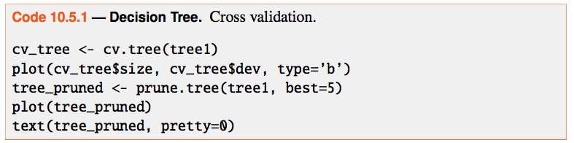
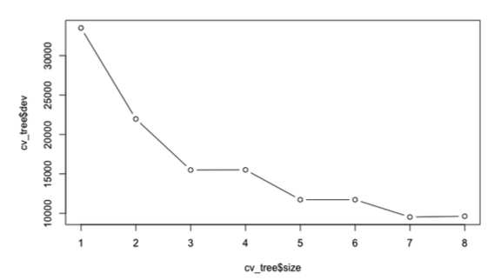
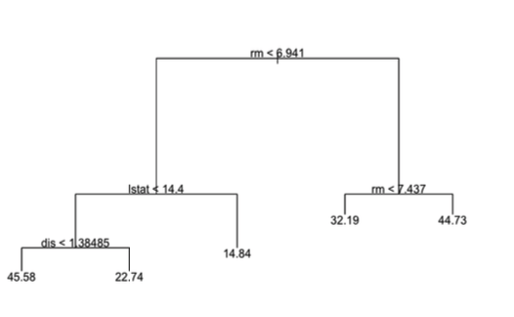

Slide 32
advanced trees
random forests – at each split, a random subset of predictors is selected to choose from
compensates for the greedy approach by letting other trees be created instead of always choosing strongest predictor first
bagging – bootstrap aggregation
repeatedly sample the data to overcome variance
both techniques use the randomForest package
both generate hundreds of trees
importance=TRUE selects bagging

Slide 33
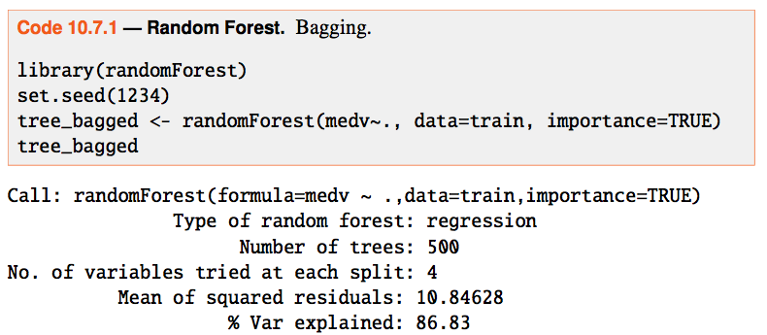
bagging

Slide 34
summary
linear regression or logistic regression will often outperform decision trees
if the underlying relationship between the target and predictors is complex and not linear, decision trees may perform better
random forest or bagging gives very good performance but is less interpretable than a single DT
DT are a non-parametric algorithm

