Slide 1
Link State
Strategy
  send to all nodes (not just neighbors) information about directly connected links (not entire cost table)
Link State Packet (LSP) contents (i.e., bc packet)
  id of the node that created the LSP
  A list of the costs of the links to each directly connected neighbor
  (i.e. the data item d is a list, not just an integer)
  sequence number (SEQNO)
  (i.e. the timestamp ts)
  time-to-live (TTL) for this packet
    Used to deal with sequence number wrap around
    LSP is discarded after TTL seconds of being received.

Slide 2
Link State (cont)
Reliable flooding
  generate new LSP periodically
    increment SEQNO
  forward a received LSP to all neighboring nodes except the neighbor that sent it.
  Store/forward only the most recent LSP of each node.
    all LSP’s combined give a “view” of the topology
  start SEQNO at 0 when reboot
  periodically decrement TTL of each stored LSP
    discard when TTL=0

Slide 3
Spanning “Minimum-Cost Source Tree”
Each node computes a “spanning” “minimum-cost” source tree
  i.e., it contains a minimum cost path from itself to all other nodes.
The tree of node B is shown below.
B
5
3
11
C
A
11
2
D

Slide 4
How do you build the routing table
B
5
3
11
C
A
11
2
D
Tree of B is shown above
At B: RTB[X] is the child on the tree that leads to X on the tree
At B: RTB[A] = A, B:RTB[C] = C, B:RTB[D] = C

Slide 5
Which is more efficient in terms of messages, link-state routing or distance vector routing?

Slide 6
Forward Search algorithm of Dijkstra
We build the tree incrementally
Start from your own node, and grow from there
  In our example, we run the algorithm at D (D is the root node), and build a spanning tree to reach all nodes.
Maintain two sets of edges:
  Confirmed: this set contains the edges already chosen for the tree
  Tentative: this set contains the edges from confirmed nodes to non-confirmed nodes
    I.e. from inside the tree to outside the tree

Slide 7
Edge represented as a triple
Each edge (X, Y), from X to Y, on the tree is actually represented as a triple
  (X, c, Y), where
    c = cost of minimum cost path from the root to X plus cost of edge (X, Y).
D’s Spanning Tree Edges:
(D, 2, C)
(C, 5, B)
(B, 10, A)
B
5
3
11
C
A
11
2
D

Slide 8
Tree construction
tentative
edges
are
from
inside the tree
to outside the tree
At all times:
Confirmed nodes form
a minimum cost tree
Confirmed nodes have
costs smaller (or equal)
than other nodes.
The “largest” (most costly)
confirmed node is known
as “Next”.
Confirmed
edges
are
inside the
tree

Slide 9
Algorithm Details
Let D be the node running the algorithm
First,
  Confirmed = {(-,0,D)}
  set Tentative = {}, and Next = D
Repeat
  Find all the neighbors of Next.
  For each neighbor X of Next
    Let c bet the cost along the tree from D to Next plus cost of edge (Next, X)
    Add triple (Next, c, X) to Tentative if
      X is neither Confirmed nor in Tentative, OR
      X is in Tentative and the cost c’ of the edge in tentative is greater than c.
  Let Next be the node whose edge in Tentative has least cost
  Add Next’s edge to the Confirmed set.
Until Tentative is empty
X
Next
Y
. . .
D
Z

Slide 10
Initial Step
Confirmed = {(-, 0, D)}
Tentative = {}
Next = D
B
5
3
11
C
A
11
2
D

Slide 11
First Iteration
Next = D, so look at neighbors B and C, i.e., edges
  (D,2,C) and (D,11,B)
Add both to Tentative
  Tentative = {(D,2,C), (D,11,B)}
B
5
3
11
C
A
11
2
D
Currently:
Next = D
Confirmed = {(-, 0, D)}
Tentative = {}
Now:
Next = D
Confirmed = {(-, 0, D)}
Tentative = {(D,2,C), (D,11,B)}

Slide 12
First Iteration continued (choose Next)
Least cost in Tentative is (D,2,C)
Thus,
  Next = C
  Move (D,2,C) to Confirmed
B
5
3
11
C
A
11
2
D
Currently:
Next = D
Confirmed = {(-, 0, D)}
Tentative = {(D,2,C), (D,11,B)}
Now:
Next = C
Confirmed = {(-, 0, D), (D,2,C)}
Tentative = {(D,11,B)}

Slide 13
Second Iteration
B
Next = C, so look at A, B, D
  D is confirmed (ignore)
  A and B are not, so look at
    (C,5,B) (Why 5?)
    (C,13,A) (Why 13?)
(C,5,B) replaces (D,11,B) in Tentative, (C,13,A) is added to Tentative.
5
3
11
C
A
11
2
D
Currently:
Next = C
Confirmed = {(-,0,D),
(D,2,C)}
Tentative = {(D,11,B)}
Now:
Next = C
Confirmed = {(-, 0, D), (D,2,C)}
Tentative = {(C,5,B), (C,13,A)}

Slide 14
Second Iteration (continued)
B
Next = B (least element in Tentative)
Move (C,5,B) to Confirmed
5
3
11
C
A
11
2
D
Currently:
Next = C
Confirmed = {(-,0,D),
(D,2,C)}
Tentative = {(C,5,B), (C,13,A)}
Now:
Next = B
Confirmed = {(-,0,D),
(D,2,C)
(C,5,B)}
Tentative = {(C,13,A)}

Slide 15
Third Iteration (complete)
B
Next = B, consider neighbors C,A,D
  C,D confirmed (ignore)
  Consider edge
    (B,10,A) (Why 10?)
(B,10,A) replaces (C,13,A) in Tentative
Next = A (only element in Tentative)
Move (B,10,A) to confirmed
5
3
11
C
A
11
2
D
Currently:
Next = B
Confirmed = {(-,0,D),
(D,2,C)
(C,5,B)}
Tentative = {(C,13,A)}

Slide 16
Fourth Iteration (complete)
B
Next = A
Tentative = {}, so stop.
5
3
11
C
A
11
2
D
Currently:
Next = A
Confirmed = {(-,0,D),
(D,2,C)
(C,5,B)
(B,10,A)}
Tentative = {}

Slide 17
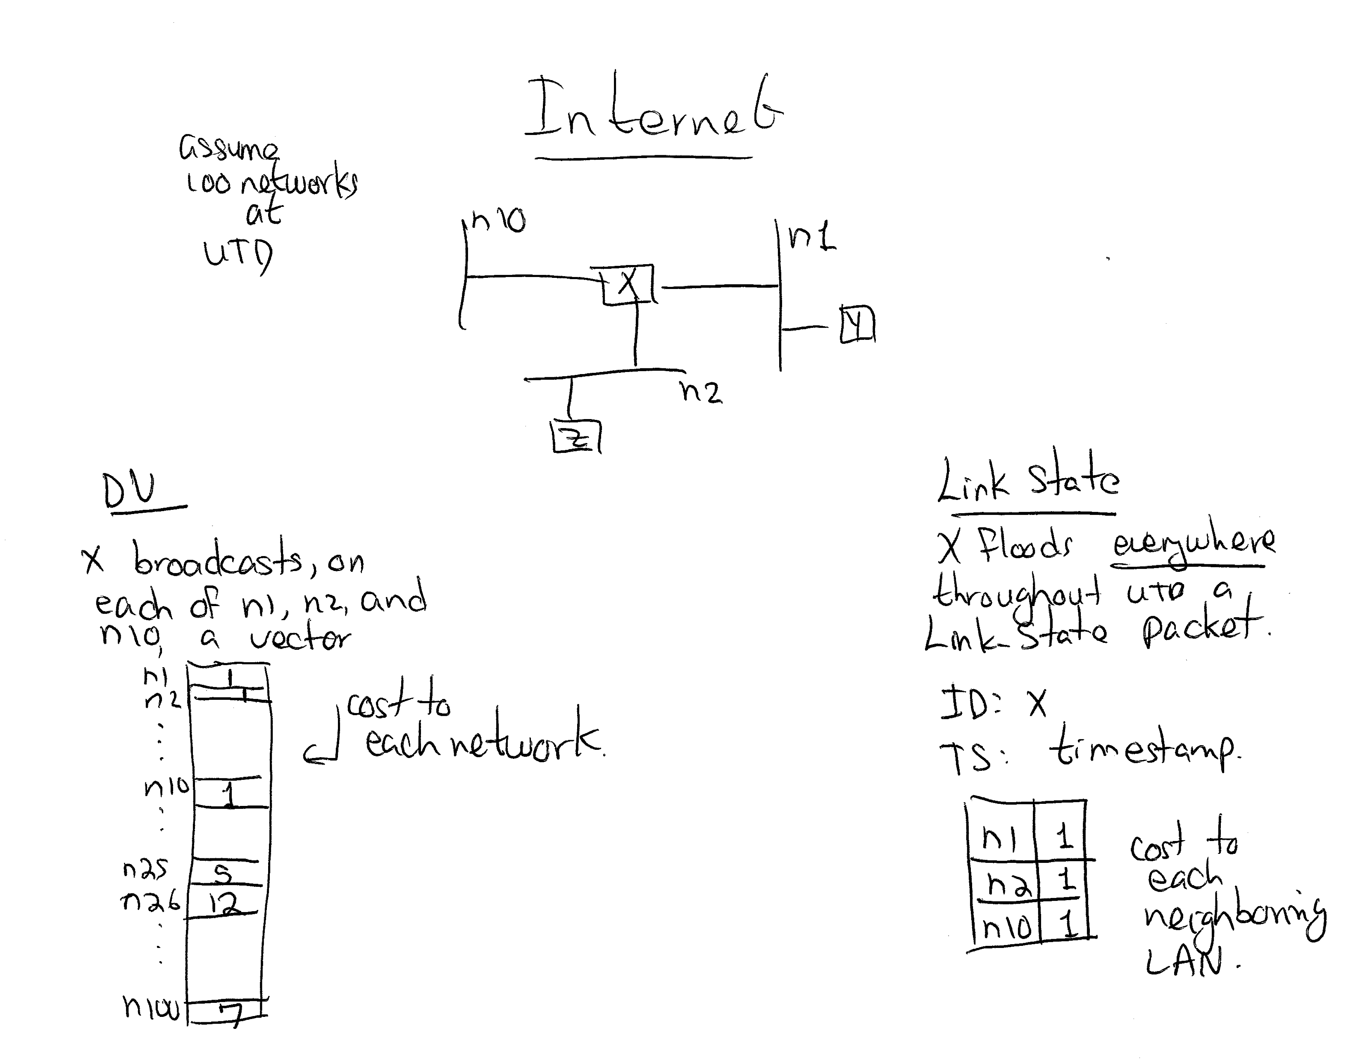

Slide 18
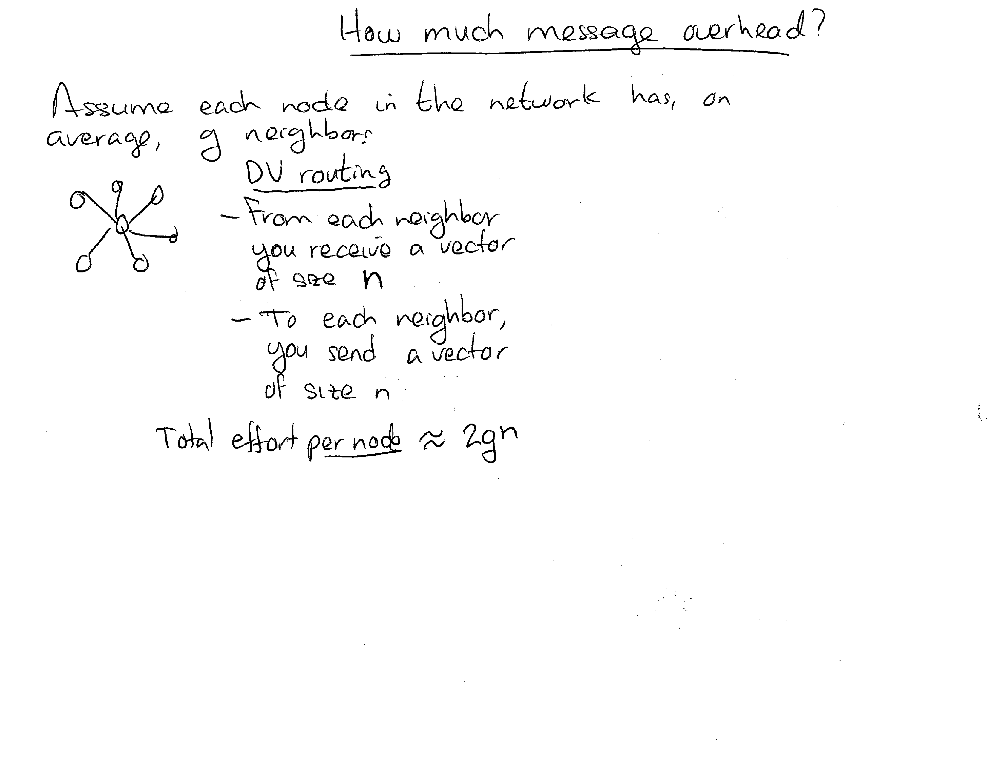

Slide 19
