Slide 1
T07 - Presentation
Overview of ISO/IEC/IEEE 12207
Team 9: Brenden Pace, Daniel Park, Alex Lundin, Jairo Galarza
SE 4381.501
05 April 2018

Slide 2

Introduction
https://www.pinterest.com/pin/496521927652353301/
IEEE 12207, set of international standards
This umbrella includes 3 documents
They define a framework for developing software
Focus on software lifecycle processes
Originally published in 1995
Most recently revised in 2017
12207 - Software life cycle processes
12207.1 - Discussion of Life Cycle Data
12207.2 - Implementation considerations

Slide 3
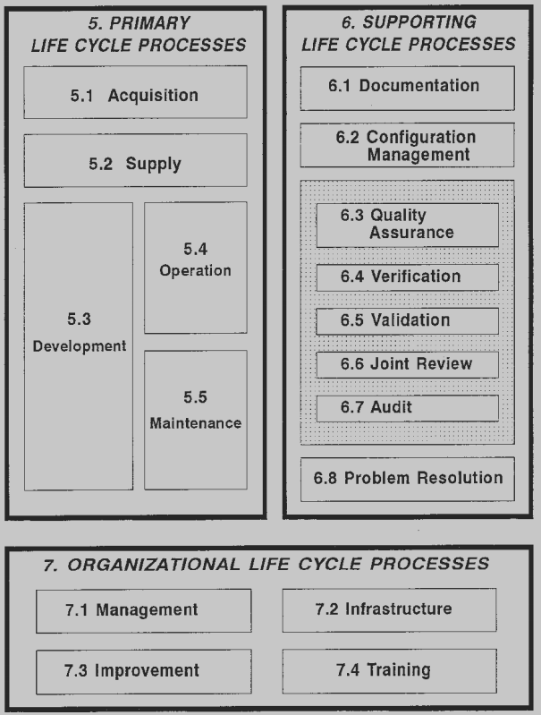
IEEE 12207 Software Life Cycle Processes
3 main life cycles
Primary / Supporting / Organizational
resources, operation and maintenance
documentation, planning
management, infrastructure, training
Annex
Used for tailoring existing processes
Figure 1. Structure of the International Standard [1]

Slide 4
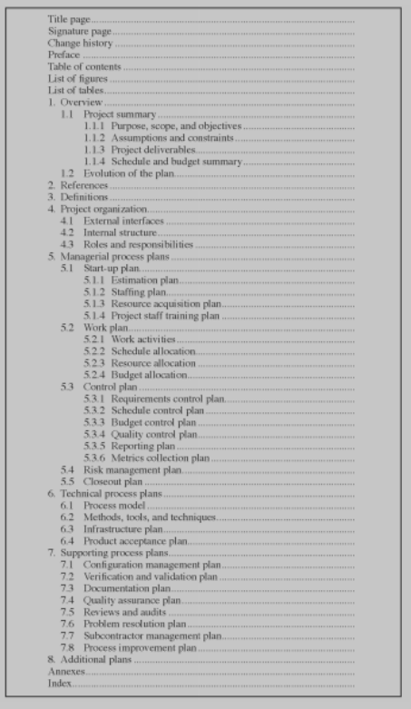
IEEE 1058-1998 Standard for Software Project Management Plans
This is in the Supporting Life Cycle
Areas of coverage for 1058
Compliance - there are two types
Content: what information is included
Format: how the information is conveyed
Example: Managerial process plans
Content: Work Plan, Control Plan
Format: WBS, activity networks
Figure 2. Format of a Software Project Management Plan [3].

Slide 5
IEEE 830 Software Requirements Specifications
Gives recommendations for the specification of requirements
Focus on good characteristics, such as unambiguous requirements
Gives guidelines for formatting this information
Good definition for the purpose and scope of the project
12207 uses a Software Requirements Description (SRD).
SRS is a greater level of detail on what is involved in the preparation of an SRD
Knowing how to format requirements is still useful for tracking progress, estimating, and planning of the project

Slide 6
IEEE 828-1998 Standard for Software Configuration Management Plans
Deals with the task of tracking and controlling changes (a.k.a. configurations) in software
Integrity and traceability of software is recorded, communicated, and controlled.
Mentions status of baselines, change control, tests, releases, and audits
SCM activities
Configuration identification
Configuration control
Status accounting
Configuration audits and reviews

Slide 7
IEEE/EIA 12207.1
Section that focuses on the life cycle data produced during the 12207 process
Many clauses in the IEEE 12207 process require life cycle data
Life cycle data helps describe actions in the process
Record information about a software product during its life cycle
Assist the software logistics planning
Contains characteristics, types, and form of presentation for different types of life cycle data.

Slide 8
SWEBOK Guide V3.0 Chapter 2
Software design provides a blueprint to follow.
There are principles and issues to be aware during development.
Details how important the user experience is.
The software should be intuitive to use and learn about.
Should be forgiving of mistakes that are made.
Issues must be dealt with in advance and prematurely.

Slide 9

Discussion of Estimating
Estimations
Managers pull Life Cycle data
Compliance to 12270.1 is flexible
Format
1 - Flexible, example WBS
Content
1 - Effort estimates
2 - Schedules
3 - Assigning responsibilities
4 - Managing Risks
http://www.lifecyclespinstudio.com/
Organizational Life Cycles
Contribute to companies knowledge
Not typically tied to any one project
Log of lessons learned on projects
This are where estimations appear

Slide 10
Discussion of Planning
Part of the Primary Life Cycle:
5.1 Acquisition and 5.2 Supply
Main roles, acquirer and supplier
Starts with the acquirer realizing a need for the software
Contract developed and sent to a supplier
A software life cycle process will be chosen based on the contract that defines these software requirements
Plans can then start to be developed based on the requirements, these plans can be tracked through to a deliverable product, allowing us to identify risks.

Slide 11
Discussion of Tracking Progress
Allows to give better estimates and plans for project process.
Two main topics to consider:
Data type to track
How data is tracked
Software Configuration Management (SCM) Plans define such requirements.
Having unambiguous requirements allows us to track the project progress easier.

Slide 12
Conclusion
Huge scope
12207 gives high level overview of life cycles
12207.1 focuses on data
12207.2 focuses on implementation
references give exact descriptions of required documents
The main points of 12207 cover:
management
documentation practices
compliance with this International Standard.

Slide 13
References (1/2)
[1] 12207 IEEE Information technology Software life cycle processes. IEEE / Institute of Electrical
And Electronics Engineers Incorporated, 1995.
[2] 830-1998 IEEE Recommended Practice for Software Requirements Specifications. IEEE / Institute of Electrical
And Electronics Engineers Incorporated, 1998.
[3]1058-1098 IEEE Standard for Software Project Management Plans. IEEE / Institute of Electrical And Electronics
Engineers Incorporated, 1998.

Slide 14
References (2/2)
[4] 828-1998 IEEE Standard for Software Configuration Management Plans. IEEE / Institute of Electrical And
Electronics Engineers Incorporated, 1998.
[5] 12207.1 IEEE/EIA Software life cycle processes—Life cycle data. IEEE / Institute of Electrical And
Electronics Engineers Incorporated, 1998.
[6] P. Bourque and R. E. Fairley, Guide to the software engineering body of knowledge: SWEBOK. Los Alamitos,
CA: IEEE Computer Society, 2014.

Slide 15
Lessons Learned
Brenden Pace - “Summarizing a subject may seem easy, but with so much estimating, planning, and tracking progress involved, I lost focus of the main topic. This project has helped show not only just how important documentation can help with identifying risks and planning for due dates, but also how difficult it can be.”
Alex Lundin - “During the project, I learned having a team contract in place doesn’t safeguard against all risks. Careful risk management involves reviewing each risk on a weekly basis and how it might affect progress of future weeks. From the IEEE summaries, I learned how find sources efficiently on the internet. I also learned what IEEE standard documentation practices for Software Management look and feel like.
Daniel Park - “With regards to the IEEE standard, I learned about the importance of preventing issues as soon as possible. Which related to working on the project. As it is important to keep track of everything and to make sure that everyone is on the same track when it comes to projects like this. Clear communication is important.”
Jairo Galarza - “Even though I have researched and learned about planning and tracking, it seems that I keep suffering the plague of student syndrome as I still need to better learn how to apply such knowledge.”

