Slide 1
THERAC-25 CASE STUDY 26 January 2018
se4381t01
TEAM 9
Jairo Galarza Brenden Pace
Alex Lundin Daniel Park

Slide 2
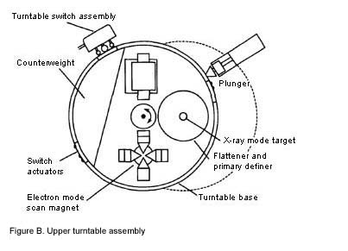
[1]

Slide 3
INTRODUCTION
Background
Classic case study [1]
Software use in medical field
Involved radiation therapy
One of the most well known killer Software bugs [1]
Resulted in
6 massive radiation overdoses [2]
Two deaths
Four lifelong injuries

Slide 4
PROBLEM 1
Value Engineering on Safety interlocks
Originally thought to be solely a hardware problem since AECL believed that was the only way the machine could malfunction was due to the microswitches inside being out of place
Actually found to be a combination of both a software and a hardware error
Race condition definition
Output dependent on event timing
Fails when events don’t follow programmers anticipation
Race condition here
Operator enters radiation level
Magnets start to set
Screen displays safe radiation level
Operator accepts display output
Internal setting flips back to harmful level
Only happened on a specific input set from operator

Slide 5
PROBLEM 2
Lack of Supervision
“The quality assurance manager was apparently unaware that some Therac-20 routines were also used in the Therac-25” [1]
Bug related to one of the Therac-25 accidents was found in the Therac-20 software
“We know that the software for the Therac-25 was developed by a single person, over a period of several years.” [1]
None of AECL employees, questioned under investigation, could provide any information about programmer education or experience. [1]
Modifications in software allow for concurrent access to shared memory [1]
This means that there is no real synchronization aside from data stored in shared variables

Slide 6
PROBLEM 3
Inadequate Testing and Documentation
Background of test cases (if any)
Fault tree used for safety analysis (software excluded) [1]
Assumptions made in analysis [1]
Most testing done as a system under integrated system tests and little done for unit and software testing [1]
Background of documentation
Apparently, very little software documentation was produced during development [1]
“The AECL response also seems to point out an apparent lack of documentation on software specifications and a software test plan.” - 1986 internal FDA memo [1]
Software for Therac-20 and Therac-6 was reused for Therac-25 [1]

Slide 7
Summary
Management Problems
Management Improvements
Relying on Software for Safety
Race condition between keyboard and magnets
Lack of Supervision
Resulted in Software reuse
Inadequate Testing
Assumptions made
Spare documentation
Combine Software and Physical Safety mechanisms
Mechanical failsafe
Monitor development through life cycle
Follow ups with Senior Developers
Test and document to industry standard
Especially for life critical systems

Slide 8
REFERENCES
[1] N. G. Leveson and C. S. Turner, "An investigation of the Therac-25 accidents," in Computer, vol. 26, no. 7, pp. 18-41, July 1993.
[2] ADAM FABIO, "KILLED BY A MACHINE: THE THERAC-25", HACKADAY, 2018. [ONLINE]. AVAILABLE AT: HTTPS://HACKADAY.COM/2015/10/26/KILLED-BY-A-MACHINE-THE-THERAC-25. [ACCESSED: 27- JAN- 2018].​
[3] CLARK TURNER, "AN INVESTIGATION OF THE THERAC-25 ACCIDENTS", HTTP://IEEEXPLORE.IEEE.ORG, 1993. [ONLINE]. AVAILABLE AT: HTTP://IEEEXPLORE.IEEE.ORG/DOCUMENT/274940. [ACCESSED: 27- JAN- 2018].​

Slide 9
CONTACTS
JAIRO GALARZA
JR S.E
JXG152830@UTDALLAS.EDU
ALEX LUNDIN
JR S.E. ​
AML140830@UTDALLAS.EDU
BRENDEN PACE
S.E.
BDP16030@UTDALLAS.EDU
DANIEL PARK
JR S.E.
DXP123230@UTDALLAS.EDU

