Slide 1
Forward kinematics
SURROS, Location, Month dd^{th} - dd^{th} yyyy
Author, co-authors
Univ.-Prof. Dr.-Ing. Prof. h.c. Dr. h.c. Torsten Bertram
Institute of Control Theory and Systems Engineering

Slide 2
Introduction
Coordinate frames
Calculation of forward kinematics

Slide 3










Forward kinematics
Forward kinematics is concerned with the relationship between individual joints and the end-effector pose of a robot
Systematic approach to describe $\{x,y,z,r,p,γ\}=f(θ_{1},θ_{2},…,θ_{n})$
$$θ_{1}$$
$$x$$
Forward kinematics
$$θ_{2}$$
$$y$$
$$z$$
…
Inverse kinematics
$$r$$
$$p$$
$$θ_{n}$$
$$γ$$
Joint space
Cartesian space

Slide 4




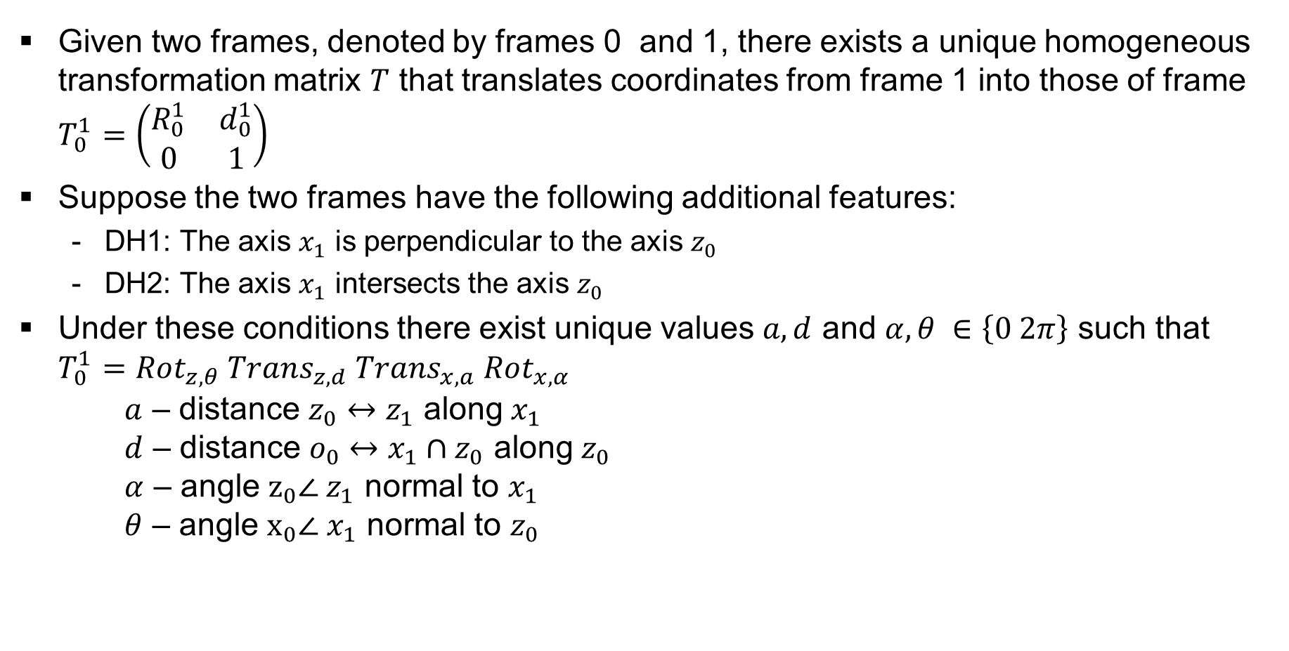






Denavit Hartenberg (DH) principle
Given two frames, denoted by frames 0 and 1, there exists a unique homogeneous transformation matrix $T$ that translates coordinates from frame 1 into those of frame $T_{0}^{1}=\left(\begin{matrix}R_{0}^{1} & d_{0}^{1} \\ 0 & 1\end{matrix}\right)$
Suppose the two frames have the following additional features:
DH1: The axis $x_{1}$ is perpendicular to the axis $z_{0}$
DH2: The axis $x_{1}$ intersects the axis $z_{0}$
Under these conditions there exist unique values $a, d$ and $α, θ ∈\left\{0 2π\right\}$ such that $T_{0}^{1}=Rot_{z,θ} Trans_{z,d} Trans_{x,a} Rot_{x,α}$ $a$ – distance $z_{0}↔z_{1}$ along $x_{1}$ $d$ – distance $o_{0}↔x_{1}∩z_{0}$ along $z_{0}$ $α$ – angle $z_{0}∠ z_{1}$ normal to $x_{1}$ $θ$ – angle $x_{0}∠ x_{1}$ normal to $z_{0}$
$$a$$
$$α$$
$$y_{1}$$
$$z_{1}$$
$$x_{1}$$
$$d$$
$$z_{0}$$
$$x_{0}$$
$$θ$$
$$y_{0}$$

Slide 5
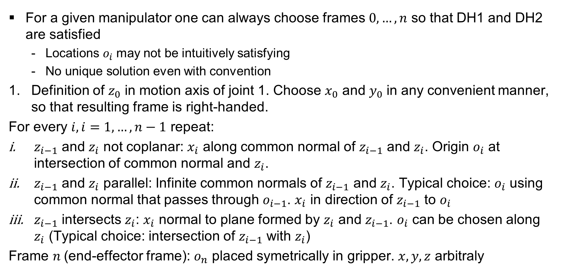
Denavit Hartenberg (DH) procedure
For a given manipulator one can always choose frames $0,…,n$ so that DH1 and DH2 are satisfied
Locations $o_{i}$ may not be intuitively satisfying
No unique solution even with convention
Definition of $z_{0}$ in motion axis of joint 1. Choose $x_{0}$ and $y_{0}$ in any convenient manner, so that resulting frame is right-handed.
For every $i,i=1,…,n−1$ repeat:
$z_{i−1}$ and $z_{i}$ not coplanar: $x_{i}$ along common normal of $z_{i−1}$ and $z_{i}$. Origin $o_{i}$ at intersection of common normal and $z_{i}$.
$z_{i−1}$ and $z_{i}$ parallel: Infinite common normals of $z_{i−1}$ and $z_{i}$. Typical choice: $o_{i}$ using common normal that passes through $o_{i−1}$. $x_{i}$ in direction of $z_{i−1}$ to $o_{i}$
$z_{i−1}$ intersects $z_{i}$: $x_{i}$ normal to plane formed by $z_{i}$ and $z_{i−1}$. $o_{i}$ can be chosen along $z_{i}$ (Typical choice: intersection of $z_{i−1}$ with $z_{i}$)
Frame $n$(end-effector frame): $o_{n}$ placed symetrically in gripper. $x,y,z$ arbitraly

Slide 6
Introduction
Coordinate frames
Calculation of forward kinematics

Slide 7





Coordinate Frames
Definition of $z_{0}$ in motion axis of joint 1. Choose $x_{0}$ and $y_{0}$ in any convenient manner, so that resulting frame is right-handed.
$$z_{0}$$
$$θ_{1}$$
$$y_{0}$$
$$x_{0}$$

Slide 8


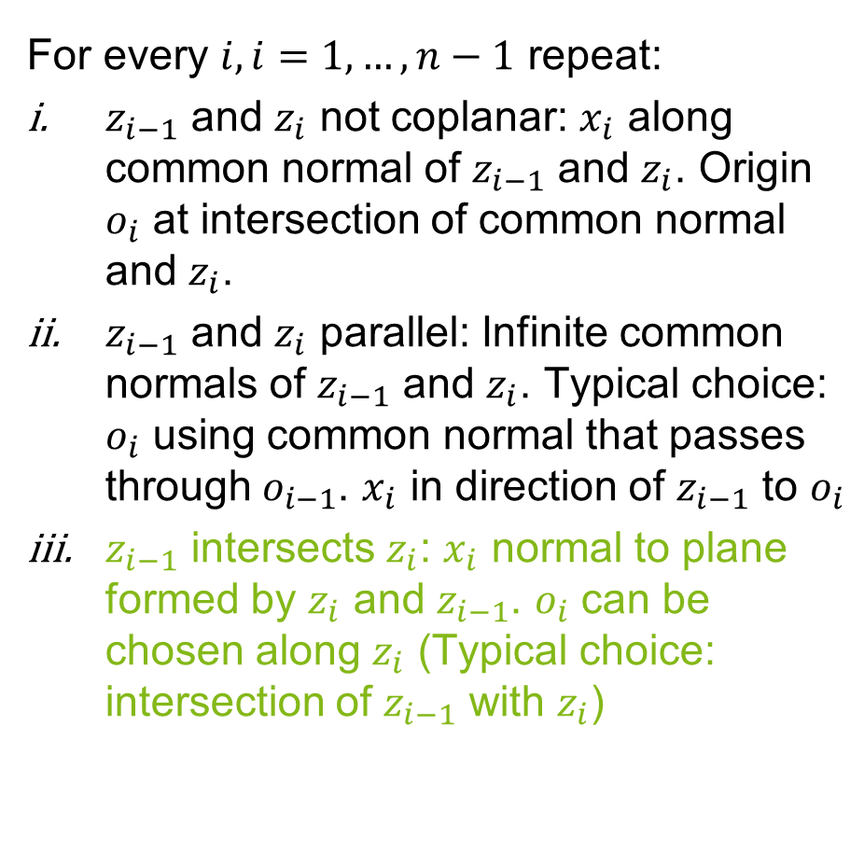



Coordinate Frames
For every $i,i=1,…,n−1$ repeat:
$z_{i−1}$ and $z_{i}$ not coplanar: $x_{i}$ along common normal of $z_{i−1}$ and $z_{i}$. Origin $o_{i}$ at intersection of common normal and $z_{i}$.
$z_{i−1}$ and $z_{i}$ parallel: Infinite common normals of $z_{i−1}$ and $z_{i}$. Typical choice: $o_{i}$ using common normal that passes through $o_{i−1}$. $x_{i}$ in direction of $z_{i−1}$ to $o_{i}$
$z_{i−1}$ intersects $z_{i}$: $x_{i}$ normal to plane formed by $z_{i}$ and $z_{i−1}$. $o_{i}$ can be chosen along $z_{i}$ (Typical choice: intersection of $z_{i−1}$ with $z_{i}$)
$$z_{1}$$
$$θ_{2}$$
$$x_{1}$$
$$z_{0}$$
$$y_{1}$$
$$d_{1}$$
$$z_{0}$$
$$θ_{1}$$
$$y_{0}$$
$$x_{0}$$

Slide 9


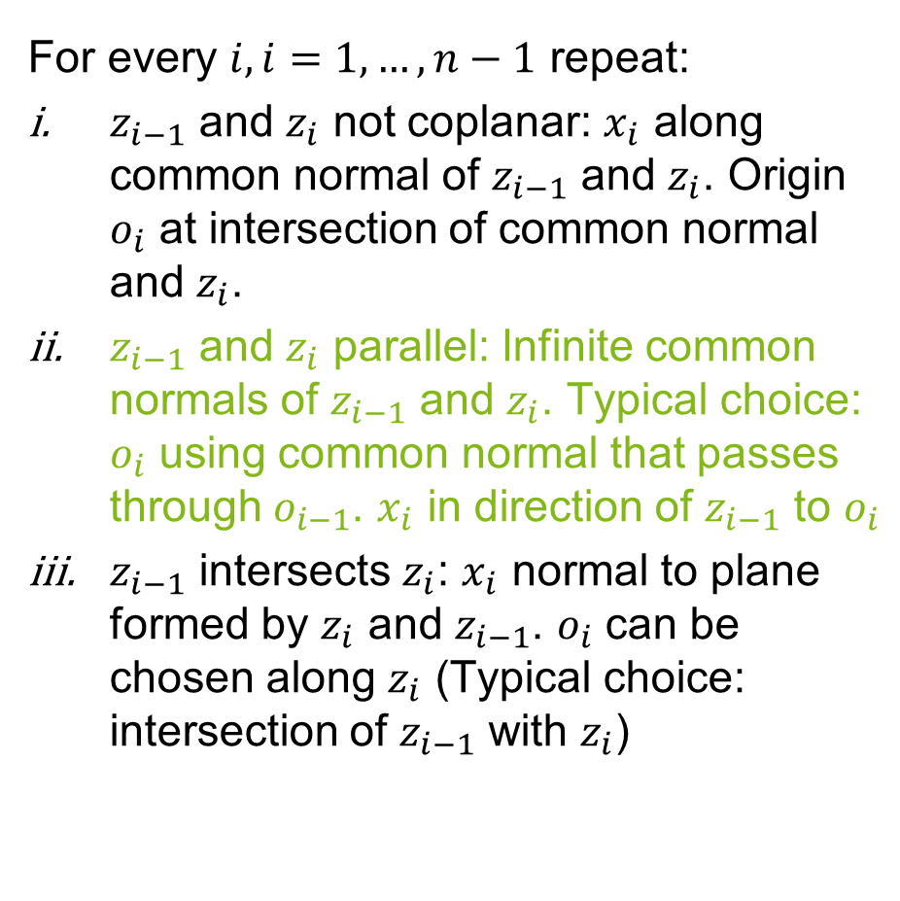


Coordinate Frames
For every $i,i=1,…,n−1$ repeat:
$z_{i−1}$ and $z_{i}$ not coplanar: $x_{i}$ along common normal of $z_{i−1}$ and $z_{i}$. Origin $o_{i}$ at intersection of common normal and $z_{i}$.
$z_{i−1}$ and $z_{i}$ parallel: Infinite common normals of $z_{i−1}$ and $z_{i}$. Typical choice: $o_{i}$ using common normal that passes through $o_{i−1}$. $x_{i}$ in direction of $z_{i−1}$ to $o_{i}$
$z_{i−1}$ intersects $z_{i}$: $x_{i}$ normal to plane formed by $z_{i}$ and $z_{i−1}$. $o_{i}$ can be chosen along $z_{i}$ (Typical choice: intersection of $z_{i−1}$ with $z_{i}$)
$$z_{2}$$
$$θ_{3}$$
$$a_{2}$$
$$y_{2}$$
$$z_{1}$$
$$z_{1}$$
$$θ_{2}$$
$$x_{1}$$
$$z_{0}$$
$$y_{1}$$
$$d_{1}$$
$$z_{0}$$
$$θ_{1}$$
$$y_{0}$$
$$x_{0}$$

Slide 10




Coordinate Frames
For every $i,i=1,…,n−1$ repeat:
$z_{i−1}$ and $z_{i}$ not coplanar: $x_{i}$ along common normal of $z_{i−1}$ and $z_{i}$. Origin $o_{i}$ at intersection of common normal and $z_{i}$.
$z_{i−1}$ and $z_{i}$ parallel: Infinite common normals of $z_{i−1}$ and $z_{i}$. Typical choice: $o_{i}$ using common normal that passes through $o_{i−1}$. $x_{i}$ in direction of $z_{i−1}$ to $o_{i}$
$z_{i−1}$ intersects $z_{i}$: $x_{i}$ normal to plane formed by $z_{i}$ and $z_{i−1}$. $o_{i}$ can be chosen along $z_{i}$ (Typical choice: intersection of $z_{i−1}$ with $z_{i}$)
$$x_{3}$$
$$z_{3}$$
$$θ_{4}$$
$$y_{3}$$
$$z_{2}$$
$$θ_{3}$$
$$a_{2}$$
$$y_{2}$$
$$z_{1}$$
$$z_{1}$$
$$θ_{2}$$
$$x_{1}$$
$$z_{0}$$
$$y_{1}$$
$$d_{1}$$
$$z_{0}$$
$$θ_{1}$$
$$y_{0}$$
$$x_{0}$$

Slide 11


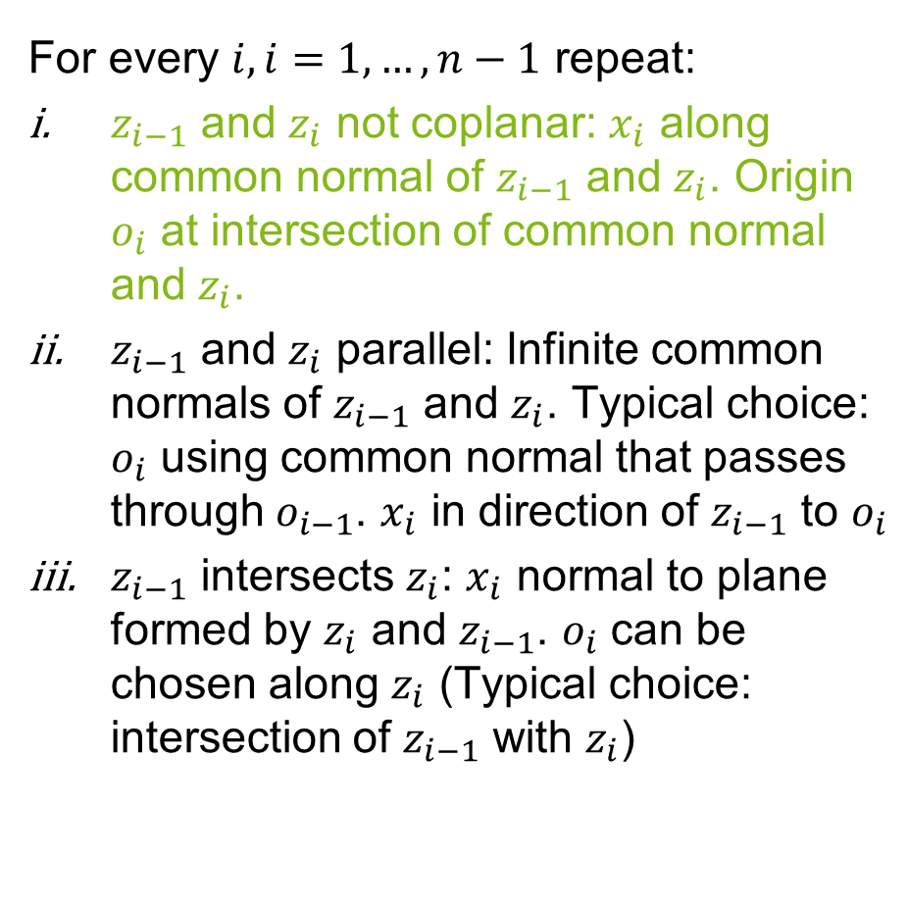




Coordinate Frames
For every $i,i=1,…,n−1$ repeat:
$z_{i−1}$ and $z_{i}$ not coplanar: $x_{i}$ along common normal of $z_{i−1}$ and $z_{i}$. Origin $o_{i}$ at intersection of common normal and $z_{i}$.
$z_{i−1}$ and $z_{i}$ parallel: Infinite common normals of $z_{i−1}$ and $z_{i}$. Typical choice: $o_{i}$ using common normal that passes through $o_{i−1}$. $x_{i}$ in direction of $z_{i−1}$ to $o_{i}$
$z_{i−1}$ intersects $z_{i}$: $x_{i}$ normal to plane formed by $z_{i}$ and $z_{i−1}$. $o_{i}$ can be chosen along $z_{i}$ (Typical choice: intersection of $z_{i−1}$ with $z_{i}$)
$$x_{3}$$
$$z_{3}$$
$$θ_{4}$$
$$d_{4}$$
$$y_{3}$$
$$z_{2}$$
$$z_{4}$$
$$θ_{5}$$
$$θ_{3}$$
$$y_{4}$$
$$a_{2}$$
$$y_{2}$$
$$z_{1}$$
$$x_{4}$$
$$z_{1}$$
$$a_{4}$$
$$θ_{2}$$
$$x_{1}$$
$$z_{0}$$
$$y_{1}$$
$$d_{1}$$
$$z_{0}$$
$$θ_{1}$$
$$y_{0}$$
$$x_{0}$$

Slide 12






Coordinate Frames
Frame $n$(end-effector frame): $o_{n}$ placed symetrically in gripper. $x,y,z$ arbitraly
$z_{tcp}≡a$ approach direction
$y_{tcp}≡s$ sliding direction
$x_{tcp}≡n$ normal direction
$$z_{tcp}$$
$$y_{tcp}$$
$$x_{tcp}$$
$$x_{3}$$
$$z_{3}$$
$$θ_{4}$$
$$a_{3}$$
$$d_{4}$$
$$y_{3}$$
$$x_{2}$$
$$z_{2}$$
$$z_{4}$$
$$θ_{5}$$
$$θ_{3}$$
$$y_{4}$$
$$a_{2}$$
$$y_{2}$$
$$z_{1}$$
$$a_{4}$$
$$x_{4}$$
$$θ_{2}$$
$$x_{1}$$
$$z_{0}$$
$$y_{1}$$
$$d_{1}$$
$$θ_{1}$$
$$y_{0}$$
$$x_{0}$$

Slide 13
Introduction
Coordinate frames
Calculation of forward kinematics

Slide 14

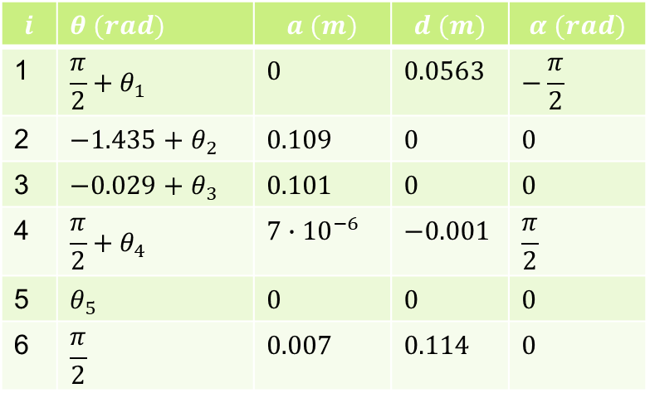




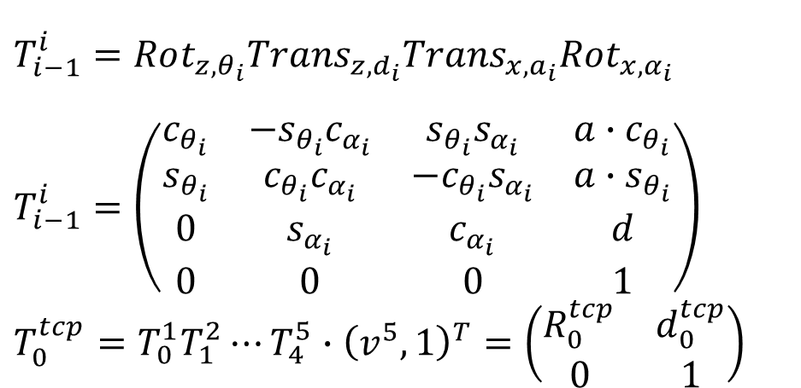










Forward kinematics
$$z_{tcp}$$
$$i$$ | $θ (rad)$ | $$a (m)$$ | $$d (m)$$ | $$α (rad)$$
1 | $$\frac{π}{2}+θ_{1}$$ | $$0$$ | $$0.0563$$ | $$−\frac{π}{2}$$
2 | $$−1.435+θ_{2}$$ | $$0.109$$ | $$0$$ | $$0$$
3 | $$−0.029+θ_{3}$$ | $$0.101$$ | $$0$$ | $$0$$
4 | $$\frac{π}{2}+θ_{4}$$ | $$7∙{10}^{−6}$$ | $$−0.001$$ | $$\frac{π}{2}$$
5 | $$θ_{5}$$ | $$0$$ | $$0$$ | $$0$$
6 | $$\frac{π}{2}$$ | $$0.007$$ | $$0.114$$ | $$0$$
$$y_{tcp}$$
$$x_{tcp}$$
$$x_{2}$$
$$T_{i−1}^{i}=Rot_{z,θ_{i}}Trans_{z,d_{i}}Trans_{x,a_{i}}Rot_{x,α_{i}}$$ $T_{i−1}^{i}=\left(\begin{matrix}c_{θ_{i}} & {−s}_{θ_{i}}c_{α_{i}} & s_{θ_{i}}s_{α_{i}} & a∙c_{θ_{i}} \\ s_{θ_{i}} & c_{θ_{i}}c_{α_{i}} & {−c}_{θ_{i}}s_{α_{i}} & a∙s_{θ_{i}} \\ 0 & s_{α_{i}} & c_{α_{i}} & d \\ 0 & 0 & 0 & 1\end{matrix}\right)$ $T_{0}^{tcp}=T_{0}^{1}T_{1}^{2}⋯T_{4}^{5}∙{\left(v^{5},1\right)}^{T}=\left(\begin{matrix}R_{0}^{tcp} & d_{0}^{tcp} \\ 0 & 1\end{matrix}\right)$
$$z_{2}$$
$$θ_{3}$$
$$y_{2}$$
$$z_{1}$$
$$θ_{2}$$
$$x_{1}$$
$$z_{0}$$
$$y_{1}$$
$$θ_{1}$$
$$y_{0}$$
$$x_{0}$$

Slide 15



Coordinate Frames
$$z_{tcp}$$
$$y_{tcp}$$
$$x_{tcp}$$
$${θ^{5}=\left(x_{0_{5}→tcp}^{5},y_{0_{5}→tcp}^{5},z_{0_{5}→tcp}^{5}\right)}^{T}$$
$$x_{3}$$
$$z_{3}$$
$$θ_{4}$$
$$a_{3}$$
$$d_{4}$$
$$y_{3}$$
$$x_{2}$$
$$z_{2}$$
$$z_{4}$$
$$θ_{5}$$
$$θ_{3}$$
$$y_{4}$$
$$a_{2}$$
$$y_{2}$$
$$z_{1}$$
$$a_{4}$$
$$x_{4}$$
$$θ_{2}$$
$$x_{1}$$
$$z_{0}$$
$$y_{1}$$
$$d_{1}$$
$$θ_{1}$$
$$y_{0}$$
$$x_{0}$$

Slide 16
Titel des Vortrages
Name der Veranstaltung, Ort, TT. - TT. Monat JJJJ
Autor, Koautoren
Univ.-Prof. Dr.-Ing. Prof. h.c. Dr. h.c. Torsten Bertram
Lehrstuhl für Regelungssystemtechnik

Slide 17
Title
Name of event, Location, Month dd^{th} - dd^{th} yyyy
Author, co-authors
Univ.-Prof. Dr.-Ing. Prof. h.c. Dr. h.c. Torsten Bertram
Institute of Control Theory and Systems Engineering

Slide 18
Gliederung
Einleitung
Inaktive Ebene
Aktive Ebene (RGB: 132/184/24)
VERWENDE “Layouts” für die Bearbeitung
Zusammenfassung

Slide 19
Outline
Introduction
Inactive Layer
Active Layer (RGB: 132/184/24)
USE “Layouts” for modifications
Conclusions

Slide 20
Formatierung
erste Ebene: schwarz, normal, Arial, 22 hervorzuhebende Ausdrücke: apfelgrün und fett (RGB: 132 184 24) oder orange und fett (RGB: 255 102 0)
zweite Ebene: schwarz, normal, Arial, 20; apfelgrün orange
dritte Ebene: grau, normal, Arial, 18; apfelgrün orange

Slide 21
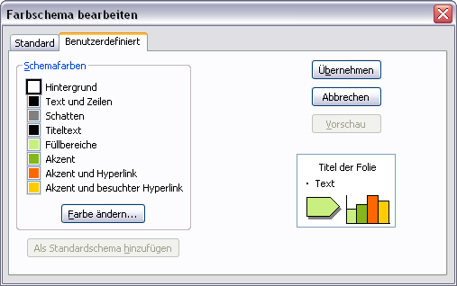
Farbschema
Weitere Farben zum Hervor- heben und Farbighinterlegen (Transparenz = 0%, da sonst teilweise karierte Darstellung möglich)
Farbschema
RGB | Rand | Füllung
 | 132 184 24 | 202 239 129
 | 255 102 0 | 255 173 117
 | 0 102 255 | 139 186 255
 | 255 204 0 | 255 233 139

Slide 22
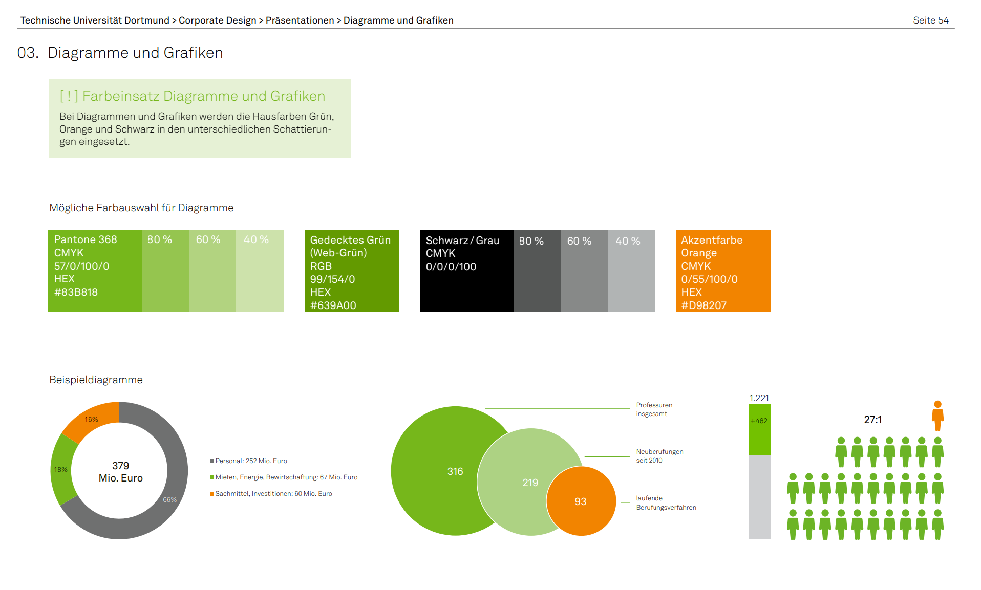
Das Corporate Design der TU Dortmund
https://itmc.tu-dortmund.de/unsere-services/medien-services/grafik/design/corporate-design/
Vorlagen: https://service.tu-dortmund.de/group/intra/corporate-design

Slide 23
TeX Formeln
Formeln im Latex-Stil lassen sich bequem mit Hilfe des IguanaTex Plugins in die Folien einbinden (Windows): http://www.jonathanleroux.org/software/iguanatex/
Nachhaltige, wiederwertbare Foliensätze am Lehrstuhl RST sollten grundsätzlich nur mit Boardmitteln + IguanaTex erstellt werden.
Für Mac OSX Benutzer gibt es eine Alternative, Kompatibilität mit IguanaTex ist ausgeschlossen und daher sollte diese nur in wenigen Fällen Verwendung finden (z.B. in Abschlussarbeiten): http://www.chachatelier.fr/latexit/

Slide 24
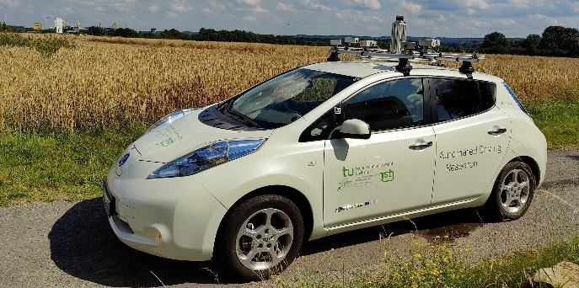
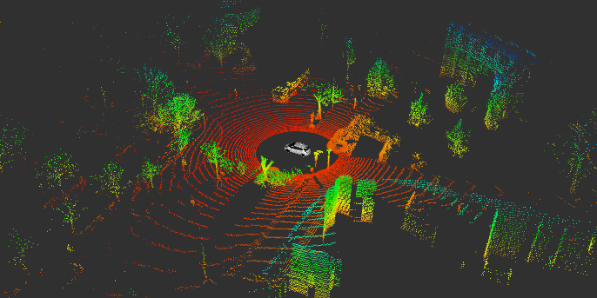
Thank you for your kind attention!
Univ.-Prof. Dr.-Ing. Prof. h.c. Dr. h.c. Torsten Bertram
Institute of Control Theory and Systems Engineering

Slide 25
Vielen Dank für Ihre Aufmerksamkeit!
Univ.-Prof. Dr.-Ing. Prof. h.c. Dr. h.c. Torsten Bertram
Lehrstuhl für Regelungssystemtechnik

Slide 26
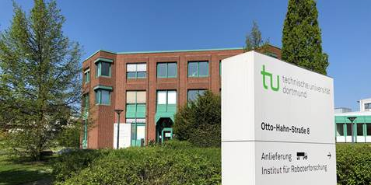
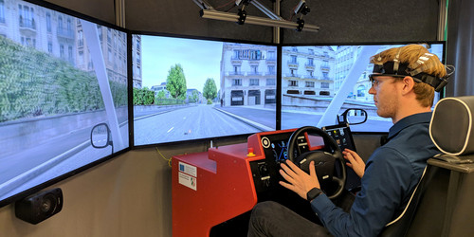
Thank you for your kind attention!
Univ.-Prof. Dr.-Ing. Prof. h.c. Dr. h.c. Torsten Bertram
Institute of Control Theory and Systems Engineering

Slide 27
Vielen Dank für Ihre Aufmerksamkeit!
Univ.-Prof. Dr.-Ing. Prof. h.c. Dr. h.c. Torsten Bertram
Lehrstuhl für Regelungssystemtechnik

Slide 28
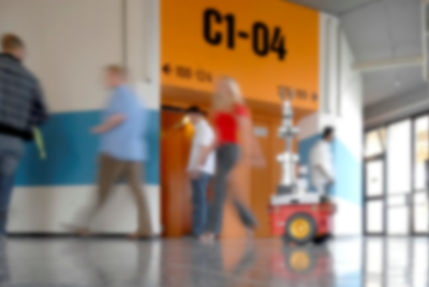
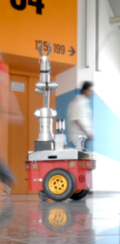

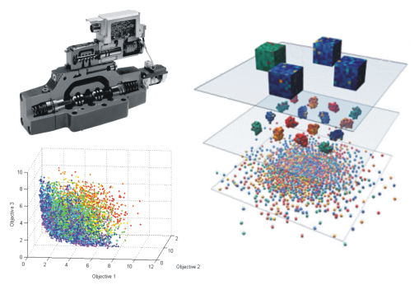
Thank you for your kind attention!
Univ.-Prof. Dr.-Ing. Prof. h.c. Dr. h.c. Torsten Bertram
Institute of Control Theory and Systems Engineering

Slide 29
Vielen Dank für Ihre Aufmerksamkeit!
Univ.-Prof. Dr.-Ing. Prof. h.c. Dr. h.c. Torsten Bertram
Lehrstuhl für Regelungssystemtechnik

