Slide 1
Inverse kinematics
SURROS, Location, Month dd^{th} - dd^{th} yyyy
Author, co-authors
Univ.-Prof. Dr.-Ing. Prof. h.c. Dr. h.c. Torsten Bertram
Institute of Control Theory and Systems Engineering

Slide 2
Introduction
Simplifications and Assumptions
Calculation of inverse kinematics

Slide 3










Inverse kinematics
Forward kinematics is concerned with finding joint variables for a given end-effector pose
Systematic approach to describe $\{θ_{1},θ_{2},…,θ_{n}\}=f(x,y,z,r,p,γ)$
$$θ_{1}$$
$$x$$
Forward kinematics
$$θ_{2}$$
$$y$$
$$z$$
…
Inverse kinematics
$$r$$
$$p$$
$$θ_{n}$$
$$γ$$
Joint space
Cartesian space

Slide 4
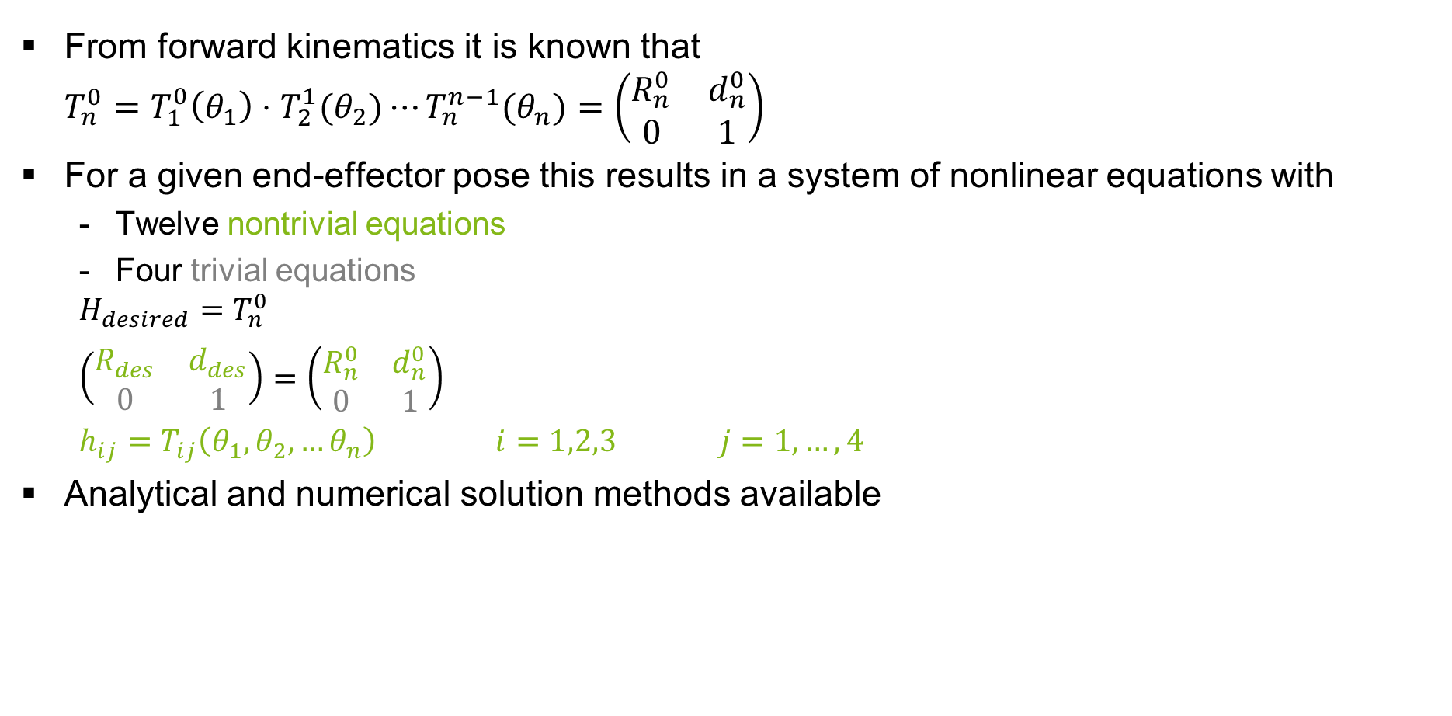
Inverse kinematics
From forward kinematics it is known that $T_{n}^{0}=T_{1}^{0}\left(θ_{1}\right)⋅T_{2}^{1}(θ_{2})⋯T_{n}^{n−1}(θ_{n})=\left(\begin{matrix}R_{n}^{0} & d_{n}^{0} \\ 0 & 1\end{matrix}\right)$
For a given end-effector pose this results in a system of nonlinear equations with
Twelve nontrivial equations
Four trivial equations
$$H_{desired}=T_{n}^{0}$$
$\left(\begin{matrix}R_{des} & d_{des} \\ 0 & 1\end{matrix}\right)=$ $\left(\begin{matrix}R_{n}^{0} & d_{n}^{0} \\ 0 & 1\end{matrix}\right)$
$h_{ij}=T_{ij}\left(θ_{1},θ_{2},…θ_{n}\right)$ $i=1,2,3$ $j=1,…,4$
Analytical and numerical solution methods available

Slide 5
Introduction
Simplifications and Assumptions
Calculation of inverse kinematics

Slide 6






























Simplifications and Assumptions
$$z_{tcp}$$
$$i$$ | $θ (rad)$ | $$a (m)$$ | $$d (m)$$ | $$α (rad)$$
1 | $$\frac{π}{2}+θ_{1}$$ | $$0$$ | $$0.0563$$ | $$−\frac{π}{2}$$
2 | $$−1.435+θ_{2}$$ | $$0.109$$ | $$0$$ | $$0$$
3 | $$−0.029+θ_{3}$$ | $$0.101$$ | $$0$$ | $$0$$
4 | $$\frac{π}{2}+θ_{4}$$ | $$7∙{10}^{−6}$$ | $$−0.001$$ | $$\frac{π}{2}$$
5 | $$θ_{5}$$ | $$0$$ | $$0$$ | $$0$$
6 | $$\frac{π}{2}$$ | $$0.007$$ | $$0.114$$ | $$0$$
$$y_{tcp}$$
$$x_{tcp}$$
$$d_{6}$$
$$x_{3}$$
$$z_{3}$$
$$θ_{4}$$
$$a_{3}$$
$$d_{4}$$
$$y_{3}$$
$$x_{2}$$
$$z_{2}$$
$$z_{4}$$
$$θ_{5}$$
$$θ_{3}$$
$$y_{4}$$
$$a_{2}$$
$$y_{2}$$
$$z_{1}$$
$$a_{4}$$
$$x_{4}$$
$$θ_{2}$$
$$x_{1}$$
$$z_{0}$$
$$y_{1}$$
$$d_{1}$$
$$θ_{1}$$
$$y_{0}$$
$$x_{0}$$

Slide 7







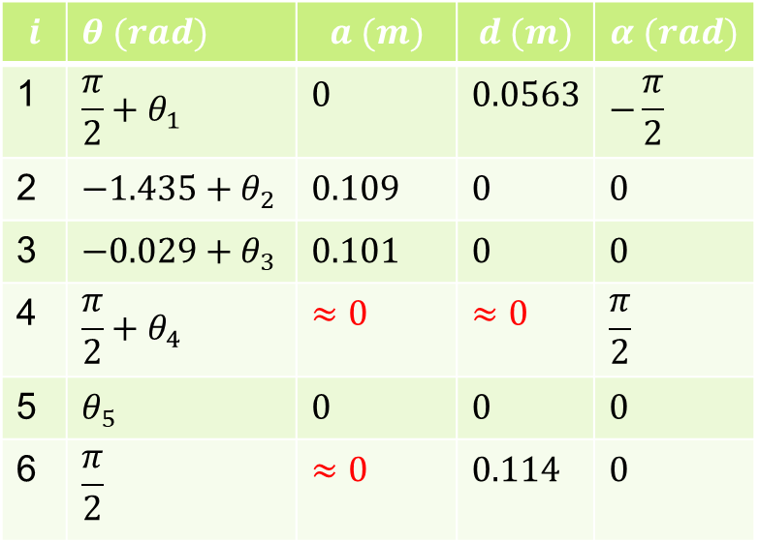












Simplifications and Assumptions
$$z_{tcp}$$
$$i$$ | $θ (rad)$ | $$a (m)$$ | $$d (m)$$ | $$α (rad)$$
1 | $$\frac{π}{2}+θ_{1}$$ | $$0$$ | $$0.0563$$ | $$−\frac{π}{2}$$
2 | $$−1.435+θ_{2}$$ | $$0.109$$ | $$0$$ | $$0$$
3 | $$−0.029+θ_{3}$$ | $$0.101$$ | $$0$$ | $$0$$
4 | $$\frac{π}{2}+θ_{4}$$ | $$≈0$$ | $$≈0$$ | $$\frac{π}{2}$$
5 | $$θ_{5}$$ | $$0$$ | $$0$$ | $$0$$
6 | $$\frac{π}{2}$$ | $$≈0$$ | $$0.114$$ | $$0$$
$$y_{tcp}$$
$$x_{tcp}$$
$$d_{6}$$
$$a_{3}$$
$$x_{2}$$
$$z_{2}$$
$$θ_{3}$$
$$a_{2}$$
$$y_{2}$$
$$z_{1}$$
$$θ_{2}$$
$$x_{1}$$
$$z_{0}$$
$$y_{1}$$
$$d_{1}$$
$$θ_{1}$$
$$y_{0}$$
$$x_{0}$$

Slide 8
Introduction
Simplifications and Assumptions
Calculation of inverse kinematics

Slide 9



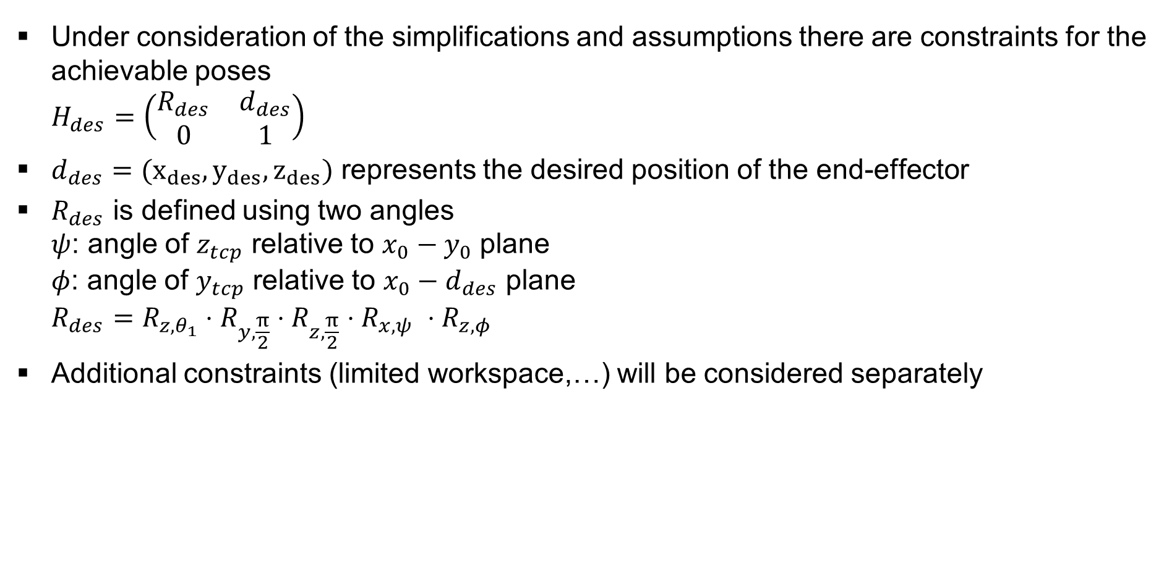






Desired pose
Under consideration of the simplifications and assumptions there are constraints for the achievable poses $H_{des}=\left(\begin{matrix}R_{des} & d_{des} \\ 0 & 1\end{matrix}\right)$
$d_{des}=(x_{des},y_{des},z_{des})$ represents the desired position of the end-effector
$R_{des}$ is defined using two angles $ψ$: angle of $z_{tcp}$ relative to $x_{0}−y_{0}$ plane $φ$: angle of $y_{tcp}$ relative to $x_{0}−d_{des}$ plane $R_{des}=R_{z,θ_{1}}⋅R_{y,\frac{π}{2}}⋅R_{z,\frac{π}{2}}⋅R_{x, ψ }⋅R_{z,φ }$
Additional constraints (limited workspace,…) will be considered separately
$$y_{tcp}$$
$$φ$$
$$z_{tcp}$$
$$ψ$$
$$d_{des}$$
$$x_{tcp}$$
$$z_{0}$$
$$y_{0}$$
$$x_{0}$$

Slide 10

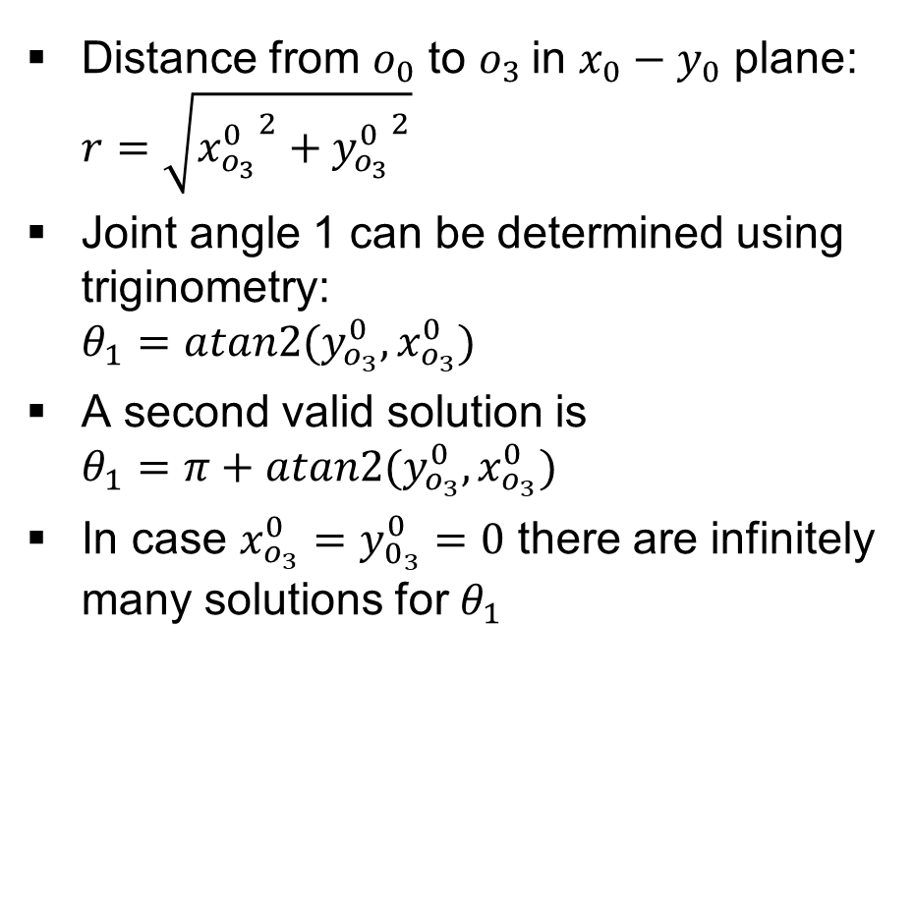






Inverse position: Determination of $θ_{1}$
Distance from $o_{0}$ to $o_{3}$in $x_{0}−y_{0}$ plane: $r=\sqrt{{x_{o_{3}}^{0}}^{2}+{y_{o_{3}}^{0}}^{2}}$
Joint angle 1 can be determined using triginometry: $θ_{1}=atan2(y_{o_{3}}^{0},x_{o_{3}}^{0})$
A second valid solution is $θ_{1}=π+atan2(y_{o_{3}}^{0},x_{o_{3}}^{0})$
In case $x_{o_{3}}^{0}=y_{0_{3}}^{0}=0$ there are infinitely many solutions for $θ_{1}$
Projection of $o_{3}$onto $x_{0}−y_{0}$plane:
$$z_{0}$$
$$y_{0}$$
$$θ_{1}$$
$$r$$
$$x_{0}$$
$$(x_{o_{3}}^{0},y_{0_{3}}^{0})$$

Slide 11


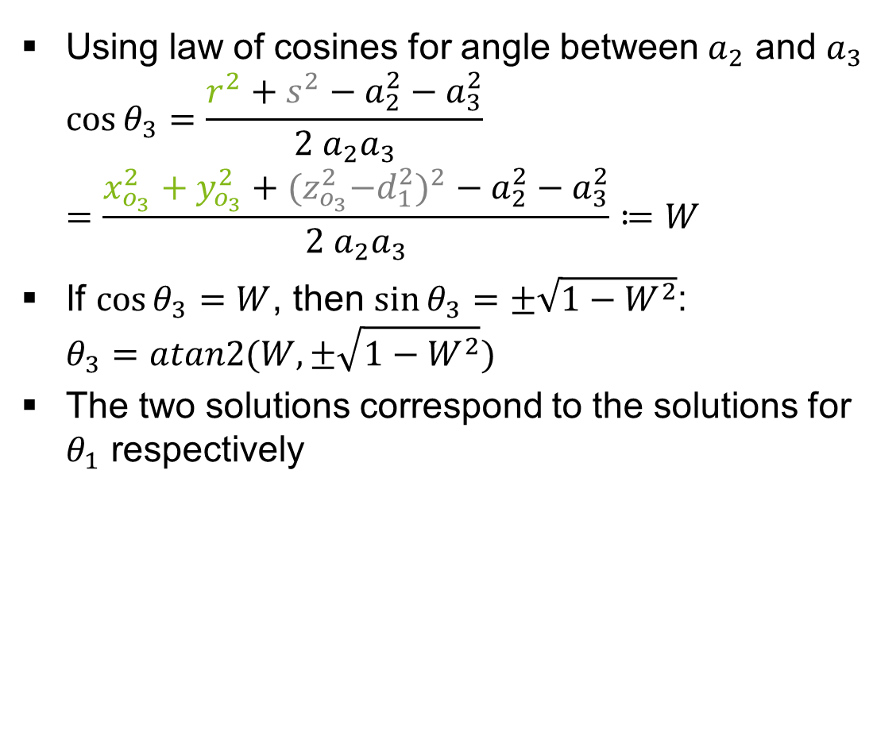













Inverse position: Determination of $θ_{2}$ and $θ_{3}$
Using law of cosines for angle between $a_{2}$ and $a_{3}$ $\cos{θ_{3}}=\frac{r^{2}+s^{2}−a_{2}^{2}−a_{3}^{2}}{2 a_{2}a_{3}}$ $=\frac{x_{o_{3}}^{2}+y_{o_{3}}^{2}+{{(z}_{o_{3}}^{2}−d_{1}^{2})}^{2}−a_{2}^{2}−a_{3}^{2}}{2 a_{2}a_{3}}≔W$
If $\cos{θ_{3}}=W$, then $\sin{θ_{3}}=±\sqrt{1−W^{2}}$: $θ_{3}=atan2(W,±\sqrt{1−W^{2}})$
The two solutions correspond to the solutions for $θ_{1}$ respectively
Projection onto ${o_{1}−o}_{2}−o_{3}$ plane:
$$z_{0}$$
$$d_{6}$$
$$s$$
$$a_{3}$$
$$θ_{3}$$
$$a_{2}$$
$$θ_{2}$$
$$r$$
$$d_{1}$$
$$z_{0}$$
$$y_{0}$$
$$θ_{1}$$
$$x_{0}$$
Note: w.r.t Spong, the signum for $θ_{2}$ and $θ_{3}$ is inverted due to the orientation of the $z_{2}$ and $z_{3}$ axes!

Slide 12



Inverse position: Determination of $θ_{2}$ and $θ_{3}$
With known $θ_{3}$, $θ_{2}$ can be determined as $θ_{2}=−atan2\left(r,s\right)+atan2\left(a_{2}+a_{3}c_{−θ_{3}},a_{3}s_{{−θ}_{3}}\right)$ $=−atan2\left(\sqrt{x_{o_{3}}^{2}+y_{o_{3}}^{2}},z_{o_{3}}−d_{1}\right)+atan2\left(a_{2}+a_{3}c_{{−θ}_{3}},a_{3}s_{{−θ}_{3}}\right)$
Projection onto $o_{2}−o_{3}$ plane:
$$z_{0}$$
$$d_{6}$$
$$s$$
$$a_{3}$$
$$θ_{3}$$
$$a_{2}$$
$$θ_{2}$$
$$r$$
$$d_{1}$$
$$z_{0}$$
$$y_{0}$$
$$θ_{1}$$
$$x_{0}$$
Note: w.r.t Spong, the signum for $θ_{2}$ and $θ_{3}$ is inverted due to the orientation of the $z_{2}$ and $z_{3}$ axes!

Slide 13

Inverse position
$$θ_{1}=\left\{\begin{aligned}atan2(y_{o_{3}}^{0},x_{o_{3}}^{0}) \\ π+atan2(y_{o_{3}}^{0},x_{o_{3}}^{0}) \end{aligned}\right.$$
$θ_{3}=−atan2(±\sqrt{1−W},W)$,
$W=\frac{x_{o_{3}}^{2}+y_{o_{3}}^{2}+{{(z}_{o_{3}}^{2}−d_{1}^{2})}^{2}−a_{2}^{2}−a_{3}^{2}}{2 a_{2}a_{3}}$
$$θ_{2}=−atan2\left(r,s\right)+atan2\left(a_{2}+a_{3}c_{{−θ}_{3}},a_{3}s_{{−θ}_{3}}\right)$$
Projection onto $o_{2}−o_{3}$ plane:
$$z_{0}$$
$$d_{6}$$
$$s$$
$$a_{3}$$
$$θ_{3}$$
$$a_{2}$$
$$θ_{2}$$
$$r$$
$$d_{1}$$
$$z_{0}$$
$$y_{0}$$
$$θ_{1}$$
$$x_{0}$$
Note: w.r.t Spong, the signum for $θ_{2}$ and $θ_{3}$ is inverted due to the orientation of the $z_{2}$ and $z_{3}$ axes!

Slide 14
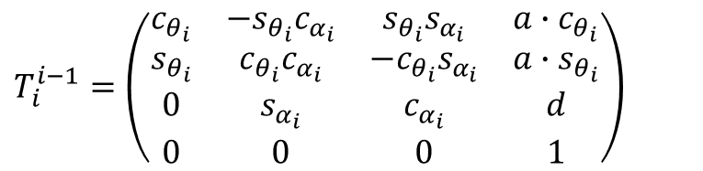
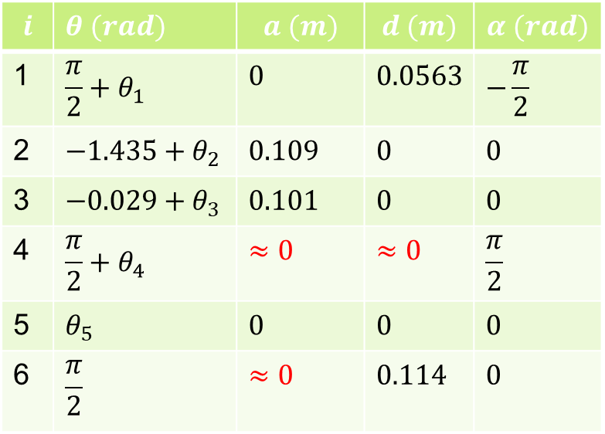
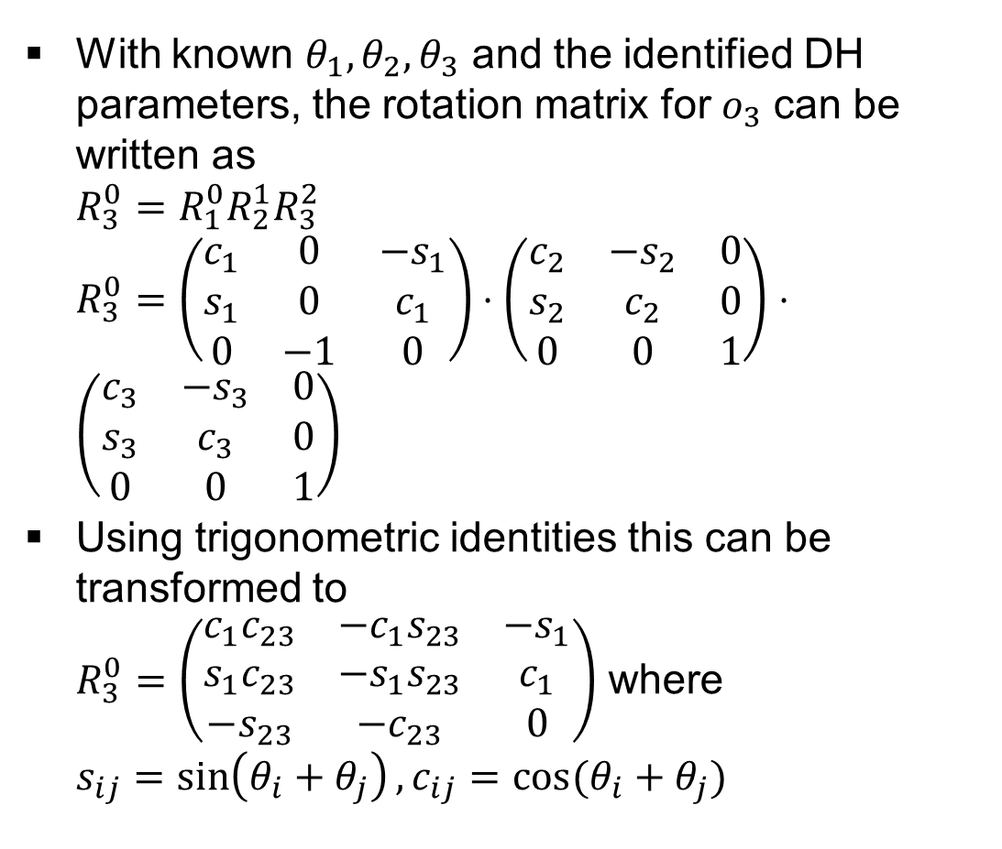



Inverse Orientation
With known $θ_{1},θ_{2},θ_{3}$ and the identified DH parameters, the rotation matrix for $o_{3}$ can be written as $R_{3}^{0}=$ $R_{1}^{0}R_{2}^{1}R_{3}^{2}$ $R_{3}^{0}=\left(\begin{matrix}c_{1} & 0 & {−s}_{1} \\ s_{1} & 0 & c_{1} \\ 0 & −1 & 0\end{matrix}\right)⋅\left(\begin{matrix}c_{2} & −s_{2} & 0 \\ s_{2} & c_{2} & 0 \\ 0 & 0 & 1\end{matrix}\right)⋅$ $\left(\begin{matrix}c_{3} & −s_{3} & 0 \\ s_{3} & c_{3} & 0 \\ 0 & 0 & 1\end{matrix}\right)$
Using trigonometric identities this can be transformed to $R_{3}^{0}=\left(\begin{matrix}c_{1}c_{23} & −c_{1}s_{23} & −s_{1} \\ s_{1}c_{23} & −s_{1}s_{23} & c_{1} \\ −s_{23} & −c_{23} & 0\end{matrix}\right)$ where $s_{ij}=\sin\left(θ_{i}+θ_{j}\right),c_{ij}=cos⁡(θ_{i}+θ_{j})$
$$i$$ | $θ (rad)$ | $$a (m)$$ | $$d (m)$$ | $$α (rad)$$
1 | $$\frac{π}{2}+θ_{1}$$ | $$0$$ | $$0.0563$$ | $$−\frac{π}{2}$$
2 | $$−1.435+θ_{2}$$ | $$0.109$$ | $$0$$ | $$0$$
3 | $$−0.029+θ_{3}$$ | $$0.101$$ | $$0$$ | $$0$$
4 | $$\frac{π}{2}+θ_{4}$$ | $$≈0$$ | $$≈0$$ | $$\frac{π}{2}$$
5 | $$θ_{5}$$ | $$0$$ | $$0$$ | $$0$$
6 | $$\frac{π}{2}$$ | $$≈0$$ | $$0.114$$ | $$0$$
$$R_{i}^{i−1}$$
$$d_{i}^{i−1}$$
$T_{i}^{i−1}=\left(\begin{matrix}c_{θ_{i}} & {−s}_{θ_{i}}c_{α_{i}} & s_{θ_{i}}s_{α_{i}} & a∙c_{θ_{i}} \\ s_{θ_{i}} & c_{θ_{i}}c_{α_{i}} & {−c}_{θ_{i}}s_{α_{i}} & a∙s_{θ_{i}} \\ 0 & s_{α_{i}} & c_{α_{i}} & d \\ 0 & 0 & 0 & 1\end{matrix}\right)$
Note: w.r.t Spong, the signum for $θ_{2}$ and $θ_{3}$ is inverted due to the orientation of the $z_{2}$ and $z_{3}$ axes!

Slide 15

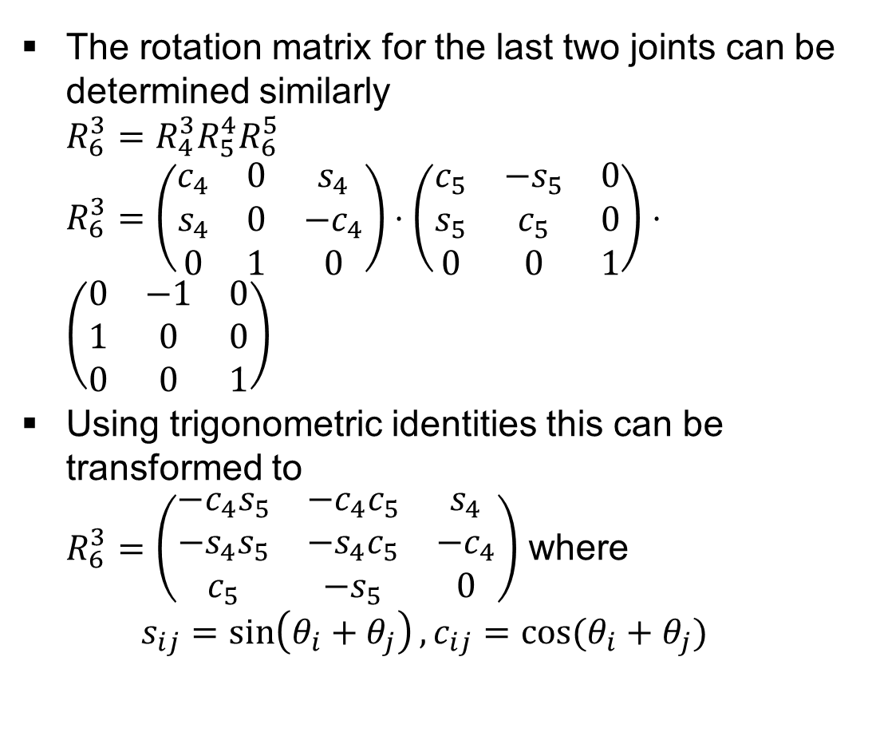
Inverse Orientation
The rotation matrix for the last two joints can be determined similarly $R_{6}^{3}=$ $R_{4}^{3}R_{5}^{4}R_{6}^{5}$ $R_{6}^{3}=\left(\begin{matrix}c_{4} & 0 & s_{4} \\ s_{4} & 0 & −c_{4} \\ 0 & 1 & 0\end{matrix}\right)⋅\left(\begin{matrix}c_{5} & −s_{5} & 0 \\ s_{5} & c_{5} & 0 \\ 0 & 0 & 1\end{matrix}\right)⋅$ $\left(\begin{matrix}0 & −1 & 0 \\ 1 & 0 & 0 \\ 0 & 0 & 1\end{matrix}\right)$
Using trigonometric identities this can be transformed to $R_{6}^{3}=\left(\begin{matrix}−c_{4}s_{5} & −c_{4}c_{5} & s_{4} \\ −s_{4}s_{5} & −s_{4}c_{5} & −c_{4} \\ c_{5} & −s_{5} & 0\end{matrix}\right)$ where $s_{ij}=\sin\left(θ_{i}+θ_{j}\right),c_{ij}=cos⁡(θ_{i}+θ_{j})$
$$i$$ | $θ (rad)$ | $$a (m)$$ | $$d (m)$$ | $$α (rad)$$
1 | $$\frac{π}{2}+θ_{1}$$ | $$0$$ | $$0.0563$$ | $$−\frac{π}{2}$$
2 | $$−1.435+θ_{2}$$ | $$0.109$$ | $$0$$ | $$0$$
3 | $$−0.029+θ_{3}$$ | $$0.101$$ | $$0$$ | $$0$$
4 | $$\frac{π}{2}+θ_{4}$$ | $$≈0$$ | $$≈0$$ | $$\frac{π}{2}$$
5 | $$θ_{5}$$ | $$0$$ | $$0$$ | $$0$$
6 | $$\frac{π}{2}$$ | $$≈0$$ | $$0.114$$ | $$0$$
$$R_{i}^{i−1}$$
$$d_{i}^{i−1}$$
$T_{i}^{i−1}=\left(\begin{matrix}c_{θ_{i}} & {−s}_{θ_{i}}c_{α_{i}} & s_{θ_{i}}s_{α_{i}} & a∙c_{θ_{i}} \\ s_{θ_{i}} & c_{θ_{i}}c_{α_{i}} & {−c}_{θ_{i}}s_{α_{i}} & a∙s_{θ_{i}} \\ 0 & s_{α_{i}} & c_{α_{i}} & d \\ 0 & 0 & 0 & 1\end{matrix}\right)$
Note: w.r.t Spong, the signum for $θ_{2}$ and $θ_{3}$ is inverted due to the orientation of the $z_{2}$ and $z_{3}$ axes!

Slide 16
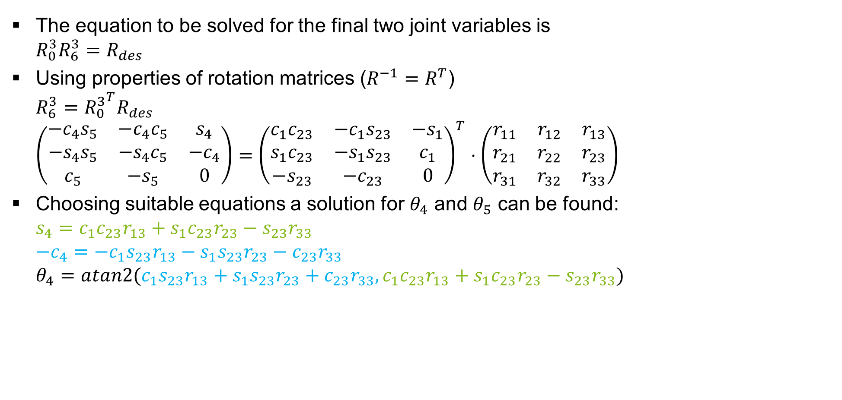
Inverse Orientation
The equation to be solved for the final two joint variables is $R_{0}^{3}R_{6}^{3}=R_{des}$
Using properties of rotation matrices ($R^{−1}=R^{T}$) $R_{6}^{3}={R_{0}^{3}}^{T}R_{des}$ $\left(\begin{matrix}−c_{4}s_{5} & −c_{4}c_{5} & s_{4} \\ −s_{4}s_{5} & −s_{4}c_{5} & −c_{4} \\ c_{5} & −s_{5} & 0\end{matrix}\right)={\left(\begin{matrix}c_{1}c_{23} & −c_{1}s_{23} & −s_{1} \\ s_{1}c_{23} & −s_{1}s_{23} & c_{1} \\ −s_{23} & −c_{23} & 0\end{matrix}\right)}^{T}⋅\left(\begin{matrix}r_{11} & r_{12} & r_{13} \\ r_{21} & r_{22} & r_{23} \\ r_{31} & r_{32} & r_{33}\end{matrix}\right)$
Choosing suitable equations a solution for $θ_{4}$ and $θ_{5}$ can be found: $s_{4}=c_{1}c_{23}r_{13}+s_{1}c_{23}r_{23}−s_{23}r_{33}$ $−c_{4}=−c_{1}s_{23}r_{13}−s_{1}s_{23}r_{23}−c_{23}r_{33}$ $θ_{4}=atan2(c_{1}s_{23}r_{13}+s_{1}s_{23}r_{23}+c_{23}r_{33},c_{1}c_{23}r_{13}+s_{1}c_{23}r_{23}−s_{23}r_{33})$
Note: w.r.t Spong, the signum for $θ_{2}$ and $θ_{3}$ is inverted due to the orientation of the $z_{2}$ and $z_{3}$ axes!

Slide 17

Inverse Orientation
Under consideration of the assumptions and simplifications, there is no need to calculate the inverse kinematics for $θ_{5}$, as it will solely influence the end-effector orientation $θ_{5}=φ$
Alternatively the joint angle $θ_{5}$ can be derived from the preceding joint angles under consideration of the forward kinematics. $T_{4}^{0}=T_{1}^{0}⋅…⋅T_{4}^{3}$ $θ_{5}=φ=\operatorname{acos}\left(T_{4}^{0}{\left(:,2\right)}^{T}⋅H_{des}\left(:,2\right)\right)−θ_{6}$
Note: w.r.t Spong, the signum for $θ_{2}$ and $θ_{3}$ is inverted due to the orientation of the $z_{2}$ and $z_{3}$ axes!

Slide 18
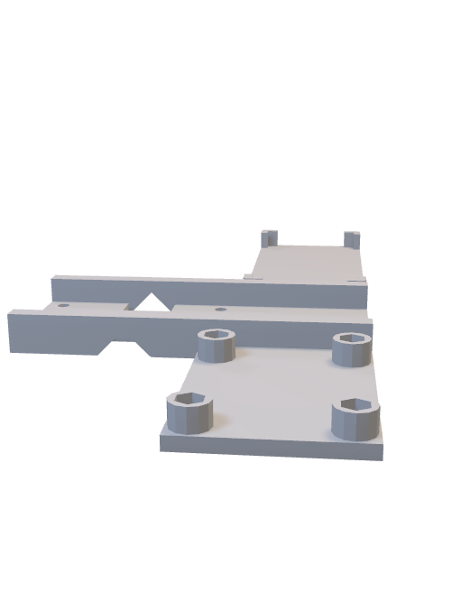

Slide 19





























Coordinate Frames
$$z_{tcp}$$
$$y_{tcp}$$
$$x_{tcp}$$
$${θ^{5}=\left(x_{0_{5}→tcp}^{5},y_{0_{5}→tcp}^{5},z_{0_{5}→tcp}^{5}\right)}^{T}$$
$$x_{3}$$
$$z_{3}$$
$$θ_{4}$$
$$a_{3}$$
$$d_{4}$$
$$y_{3}$$
$$x_{2}$$
$$z_{2}$$
$$z_{4}$$
$$θ_{5}$$
$$θ_{3}$$
$$y_{4}$$
$$a_{2}$$
$$y_{2}$$
$$z_{1}$$
$$a_{4}$$
$$x_{4}$$
$$θ_{2}$$
$$x_{1}$$
$$z_{0}$$
$$y_{1}$$
$$d_{1}$$
$$θ_{1}$$
$$y_{0}$$
$$x_{0}$$

Slide 20
Titel des Vortrages
Name der Veranstaltung, Ort, TT. - TT. Monat JJJJ
Autor, Koautoren
Univ.-Prof. Dr.-Ing. Prof. h.c. Dr. h.c. Torsten Bertram
Lehrstuhl für Regelungssystemtechnik

Slide 21
Title
Name of event, Location, Month dd^{th} - dd^{th} yyyy
Author, co-authors
Univ.-Prof. Dr.-Ing. Prof. h.c. Dr. h.c. Torsten Bertram
Institute of Control Theory and Systems Engineering

Slide 22
Gliederung
Einleitung
Inaktive Ebene
Aktive Ebene (RGB: 132/184/24)
VERWENDE “Layouts” für die Bearbeitung
Zusammenfassung

Slide 23
Outline
Introduction
Inactive Layer
Active Layer (RGB: 132/184/24)
USE “Layouts” for modifications
Conclusions

Slide 24
Formatierung
erste Ebene: schwarz, normal, Arial, 22 hervorzuhebende Ausdrücke: apfelgrün und fett (RGB: 132 184 24) oder orange und fett (RGB: 255 102 0)
zweite Ebene: schwarz, normal, Arial, 20; apfelgrün orange
dritte Ebene: grau, normal, Arial, 18; apfelgrün orange

Slide 25
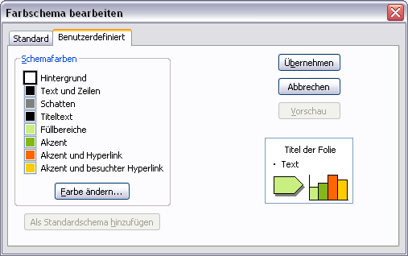
Farbschema
Weitere Farben zum Hervor- heben und Farbighinterlegen (Transparenz = 0%, da sonst teilweise karierte Darstellung möglich)
Farbschema
RGB | Rand | Füllung
 | 132 184 24 | 202 239 129
 | 255 102 0 | 255 173 117
 | 0 102 255 | 139 186 255
 | 255 204 0 | 255 233 139

Slide 26
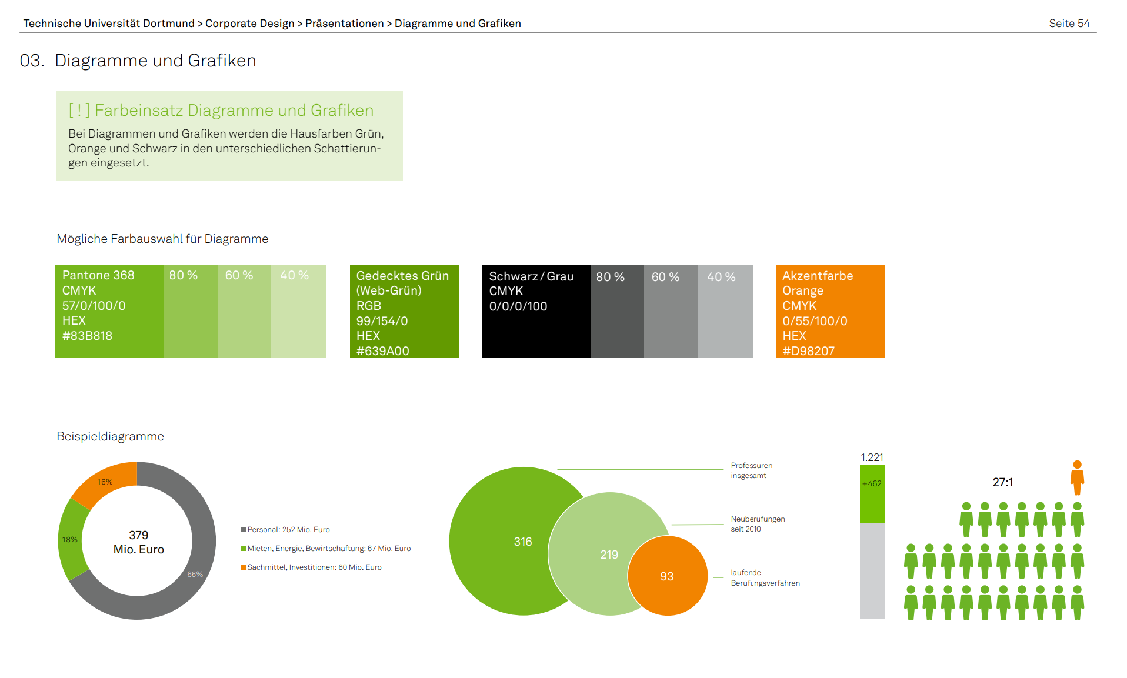
Das Corporate Design der TU Dortmund
https://itmc.tu-dortmund.de/unsere-services/medien-services/grafik/design/corporate-design/
Vorlagen: https://service.tu-dortmund.de/group/intra/corporate-design

Slide 27
TeX Formeln
Formeln im Latex-Stil lassen sich bequem mit Hilfe des IguanaTex Plugins in die Folien einbinden (Windows): http://www.jonathanleroux.org/software/iguanatex/
Nachhaltige, wiederwertbare Foliensätze am Lehrstuhl RST sollten grundsätzlich nur mit Boardmitteln + IguanaTex erstellt werden.
Für Mac OSX Benutzer gibt es eine Alternative, Kompatibilität mit IguanaTex ist ausgeschlossen und daher sollte diese nur in wenigen Fällen Verwendung finden (z.B. in Abschlussarbeiten): http://www.chachatelier.fr/latexit/

Slide 28
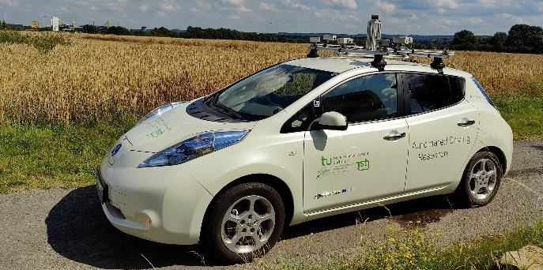
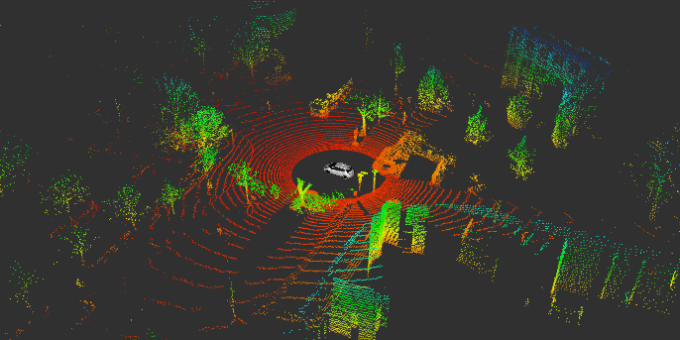
Thank you for your kind attention!
Univ.-Prof. Dr.-Ing. Prof. h.c. Dr. h.c. Torsten Bertram
Institute of Control Theory and Systems Engineering

Slide 29
Vielen Dank für Ihre Aufmerksamkeit!
Univ.-Prof. Dr.-Ing. Prof. h.c. Dr. h.c. Torsten Bertram
Lehrstuhl für Regelungssystemtechnik

Slide 30
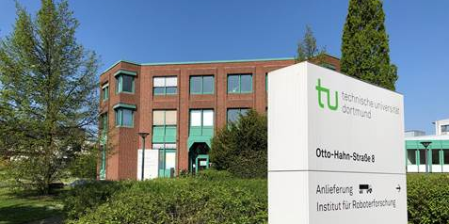
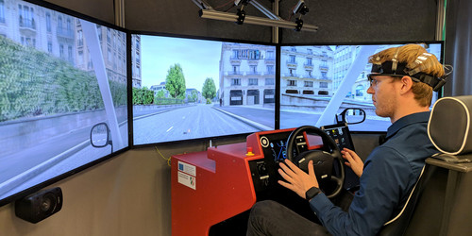
Thank you for your kind attention!
Univ.-Prof. Dr.-Ing. Prof. h.c. Dr. h.c. Torsten Bertram
Institute of Control Theory and Systems Engineering

Slide 31
Vielen Dank für Ihre Aufmerksamkeit!
Univ.-Prof. Dr.-Ing. Prof. h.c. Dr. h.c. Torsten Bertram
Lehrstuhl für Regelungssystemtechnik

Slide 32
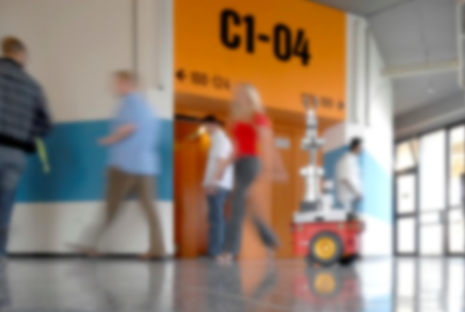
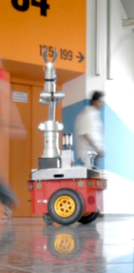

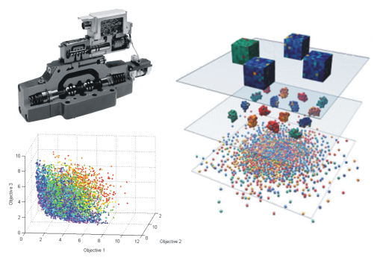
Thank you for your kind attention!
Univ.-Prof. Dr.-Ing. Prof. h.c. Dr. h.c. Torsten Bertram
Institute of Control Theory and Systems Engineering

Slide 33
Vielen Dank für Ihre Aufmerksamkeit!
Univ.-Prof. Dr.-Ing. Prof. h.c. Dr. h.c. Torsten Bertram
Lehrstuhl für Regelungssystemtechnik

