Slide 1

ET4394 Wireless Networking
Wireshark Project: Distribution of Frame Types
Group: ALGG1
Alexios Lyrakis
Georgios Giannakaras

Slide 2
Methodology of Work and Plan of Action
Locations inside TUDelft campus: 3mE, EWI, Library
Scanned all channels for all the available APs
Captured in the channel in which ‘eudoram’ had the strongest signal
Other Locations: Dorms, Café
Scanned all channels for all the available APs
Captured in the channel accommodating the most APs with strong signals
1 hour per recording session
25 hours recorded in total

Slide 3
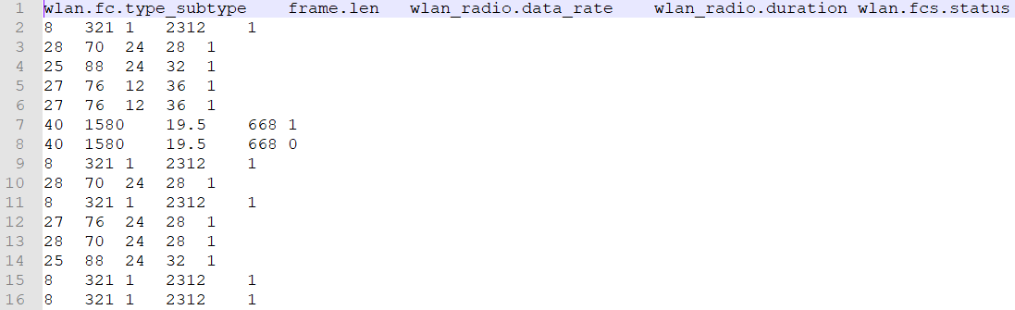
OS: Kali Linux
Network Protocol Analyzer: TShark
Recorded information: Frame Subtype, Length, Data Rate, Duration, FCS Status
1 hour recording session approximately 50mB / file
Indicative exported file with the desired information:
Script Programming Language: Python
Exported info: min, max, average per field

Slide 4
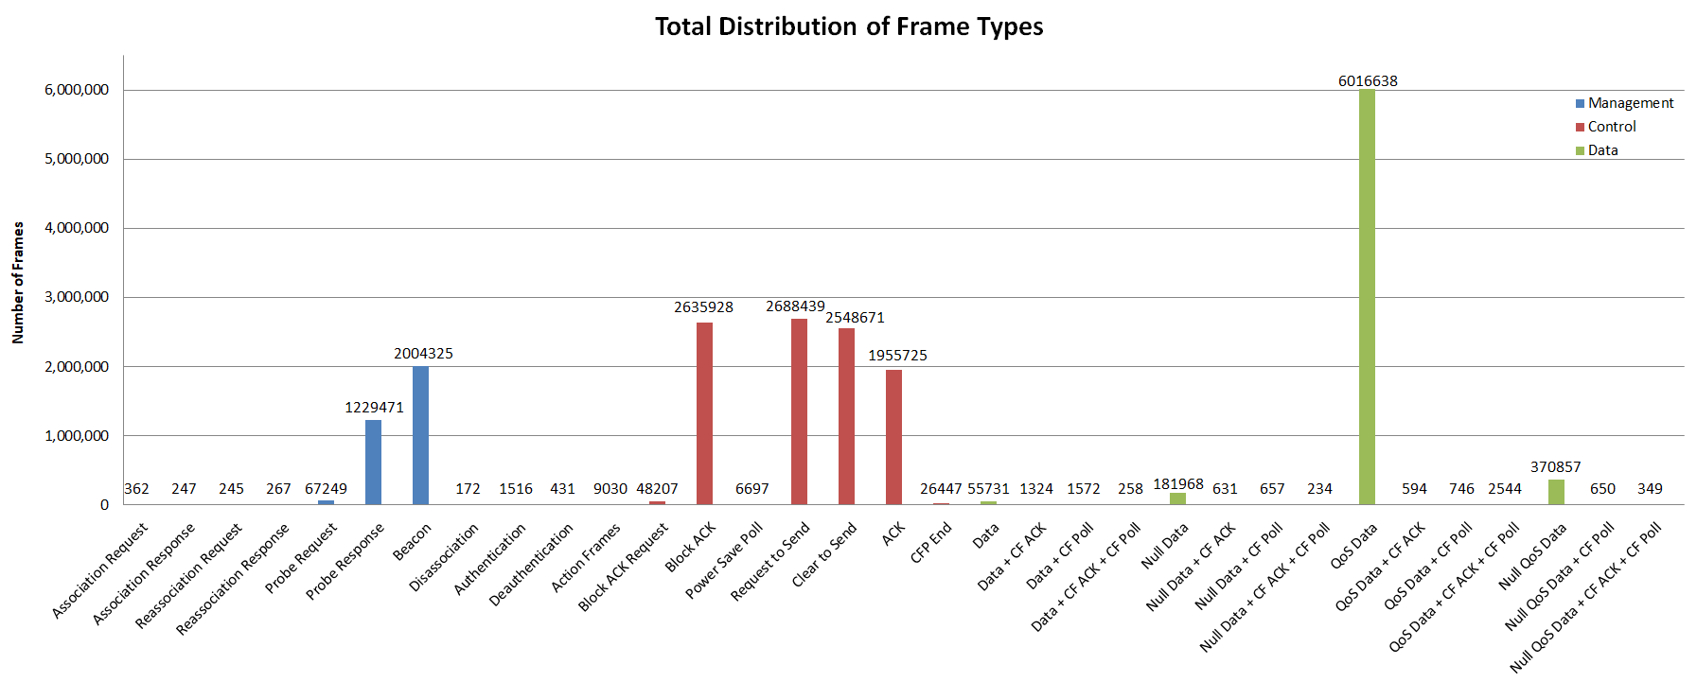
Experimental Results

Slide 5
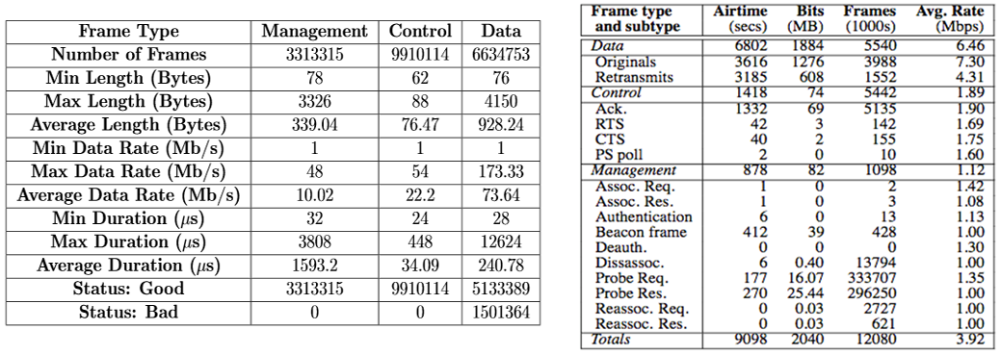
[1]
[1] Rodrig et al. Measurement-based Characterization of 802.11 in a Hotspot Setting, ACM SIGCOMM’05 Workshop, Aug. 22–26, 2005, Philadelphia, PA, USA
http://citeseerx.ist.psu.edu/viewdoc/download?doi=10.1.1.80.6621&rep=rep1&type=pdf

Slide 6
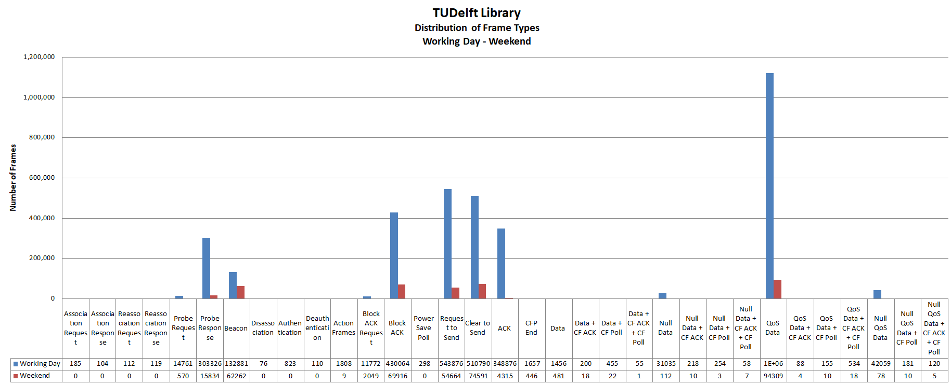

Slide 7
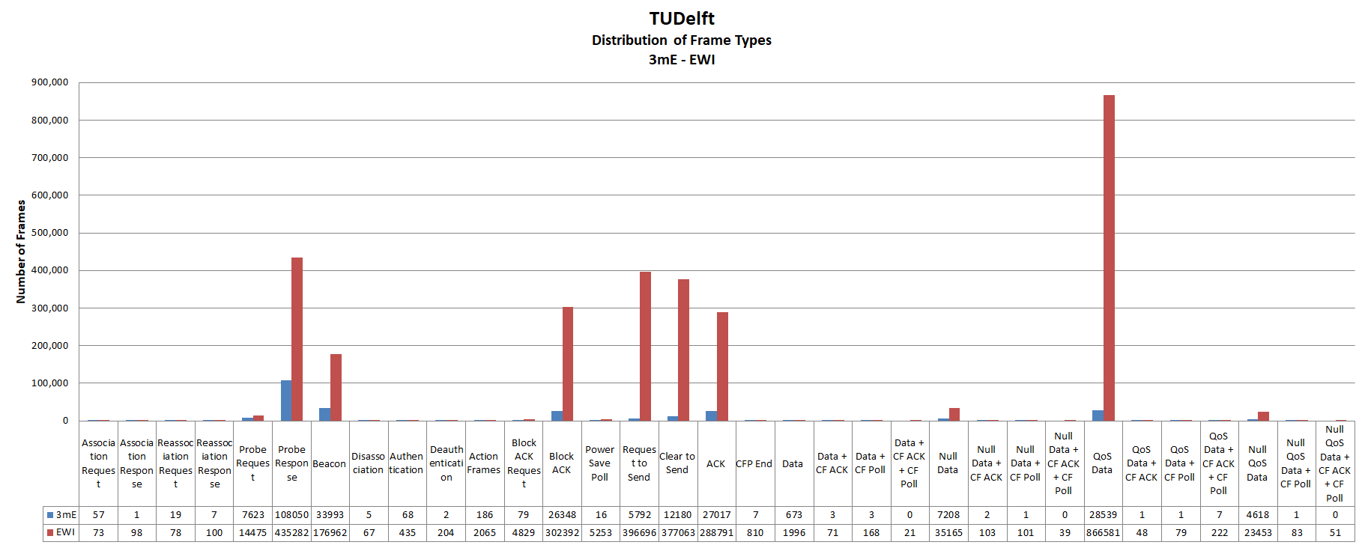

Slide 8
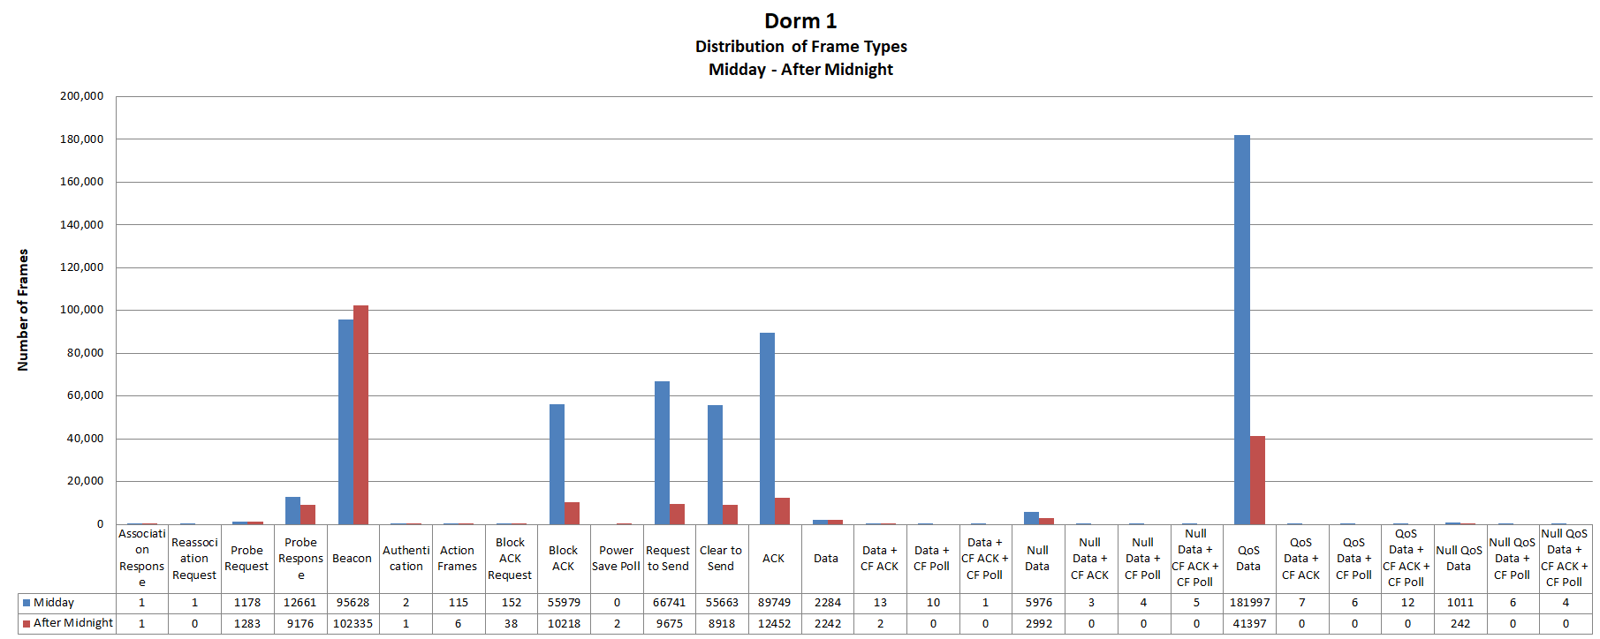

Slide 9
Conclusions
Approximately same distribution in all the experiments
Amount of frames:
Control Data Management
Majority of bits:
Data Management Control
QoS feature utilized by most STAs
RTS/CTS mechanism enabled in most STAs
Both active and passive scanning are used
Resulting graphs verified the theoretical expectations

