Slide 1


Friedrich-Alexander-Universität
Technische Fakultät
Gait Analysis for Parkinson's Disease Detection
Using Mamba and Selective State Space Models
Alex Martinelli
alex.martinelli@fau.de | Matriculation: 23699064
Data Science M.Sc. — Pattern Recognition Lab, FAU Erlangen-Nürnberg

Slide 2
Friedrich-Alexander-Universität
Technische Fakultät
Introduction
Parkinson's Disease (PD)
Progressive neurodegenerative disorder affecting motor control, balance, and gait.
Clinical Challenge
Diagnosis relies on UPDRS & Hoehn-Yahr scales — subjective, clinician-dependent.
Objective Gait Analysis
vGRF signals from force-sensitive insoles provide rich time-series data for automated, non-invasive PD detection.
This Study
We apply Mamba (Selective SSM) to PD detection from vGRF signals, comparing against SVM, LSTM, and GRU baselines.
88.9%
Best prior accuracy
(1D-LBP + MLP)
>95%
Transformers
(high compute cost)
Linear
Mamba complexity
vs quadratic attention
Technische Fakultät
9. März 2026
2

Slide 3
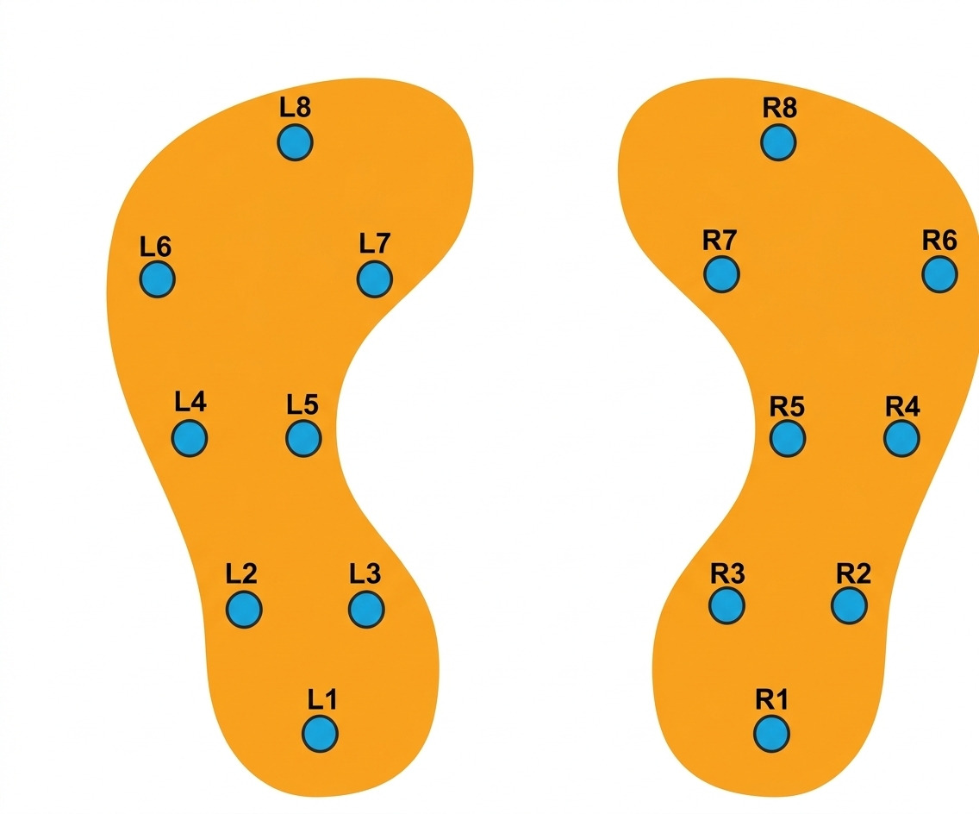
Friedrich-Alexander-Universität
Technische Fakultät
Dataset: PhysioNet Gait in Parkinson's Disease
166 subjects
93 PD patients + 73 healthy controls
Data collection
~2 min comfortable pace on level ground. Three studies: normal walk, dual-task, rhythmic auditory stimulation.
Sensor setup
Force-sensitive insoles — 8 sensors/foot, 100 Hz. 18 signals per subject (L1–L8, R1–R8 + 2 totals).
Disease severity (HY scale)
Stage 2 (mild bilateral) • 2.5 (moderate) • 3 (postural instability)
Group | N | HY
Healthy Controls | 73 (44%) | —
PD Mild | 55 (33%) | 2.0
PD Medium | 28 (17%) | 2.5
PD High | 10 (6%) | 3.0
Fig. 1 — Sensor placement under foot insole
Technische Fakultät
9. März 2026
3

Slide 4
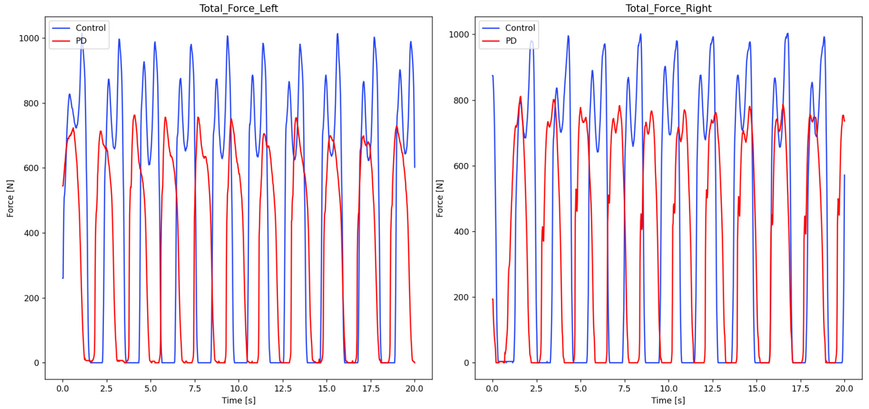
Friedrich-Alexander-Universität
Technische Fakultät
vGRF Signal Characteristics
Fig. 2 — Total VGRF: Healthy Control (blue) vs PD Patient (red) — Left & Right foot
Key observations: PD patients show reduced peak force amplitudes, increased stride-to-stride variability, and irregular temporal spacing — reflecting bradykinesia and impaired rhythm generation.
Technische Fakultät
9. März 2026
4

Slide 5
Friedrich-Alexander-Universität
Technische Fakultät
Proposed Approach: Two Modeling Paradigms
Feature-Based ML
End-to-End Sequence Modeling
TSFRESH automated extraction:
Statistics, extrema, temporal descriptors from 16 sensors.
Handcrafted biomechanical features:
Stride-level descriptors (impulse CV, stance phase CV). 229 features total.
Feature selection:
MI + F-score + Cohen's d. Top 9 features → SVM (linear & RBF).
PCA analysis:
35 components for 95% variance → substantial redundancy.
Raw vGRF signals as direct input:
No manual feature engineering.
Models evaluated:
LSTM • GRU • Mamba (Selective SSM)
Preprocessing:
Chunks of 2,000 timesteps. Per-channel z-score normalization. Subject-level 80/20 split (no leakage).
Hyperparameter search:
Random search: batch size, hidden dim, layers, LR, dropout, d_state, d_conv.
Technische Fakultät
9. März 2026
5

Slide 6
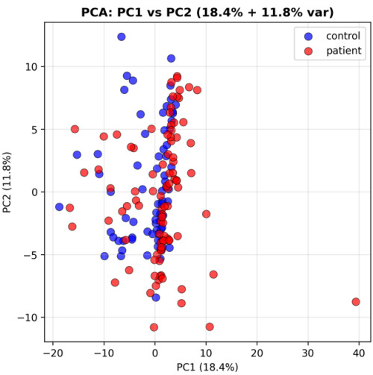
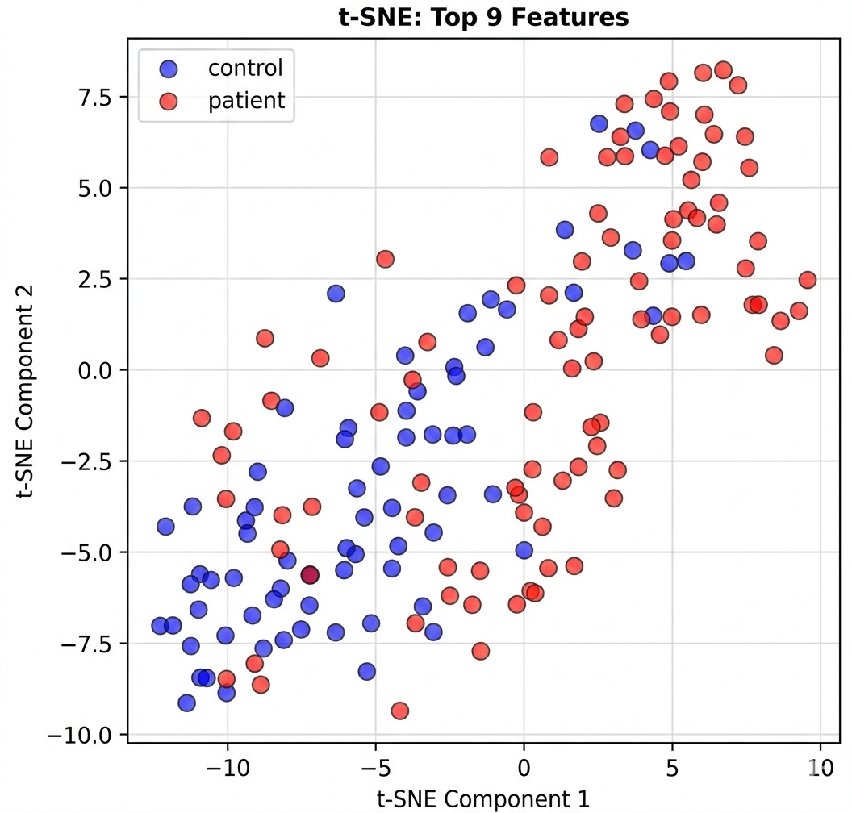
Friedrich-Alexander-Universität
Technische Fakultät
Feature Engineering & Selection
Fig. 3 — PCA (PC1+PC2 = 29.8% variance)
Fig. 4 — t-SNE of top 9 features (improved clustering)
Top 9 features (TSFRESH): L2_max, L2_abs_max, R2_max, R2_abs_max, R6_median, L6_median, R5_median, L8_median, L2_std — Ranking: Cohen's d (0.5) + F-score (0.5)
Technische Fakultät
9. März 2026
6

Slide 7
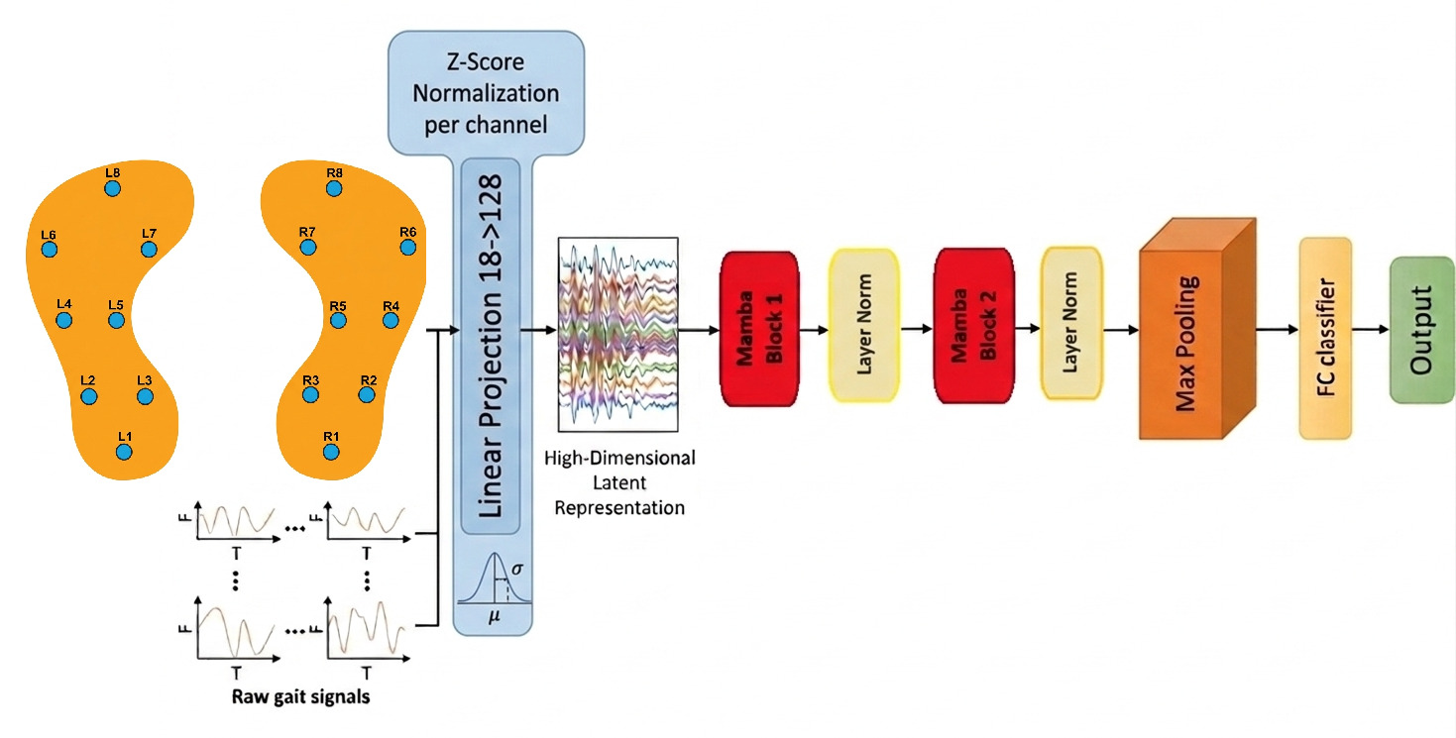
Friedrich-Alexander-Universität
Technische Fakultät
Mamba: Selective State Space Model
Fig. 5 — Mamba pipeline: Z-score norm → Linear embedding → Stacked Mamba blocks → Max pooling → FC classifier
Mamba Block
State Space Model
Selective Mechanism
Projection → Conv → Selective SSM → Residual + LayerNorm. Stackable.
Hidden state summarizes sequence history with linear O(n) complexity.
Unlike S4, Mamba makes state-update matrices input-dependent.
Technische Fakultät
9. März 2026
7

Slide 8
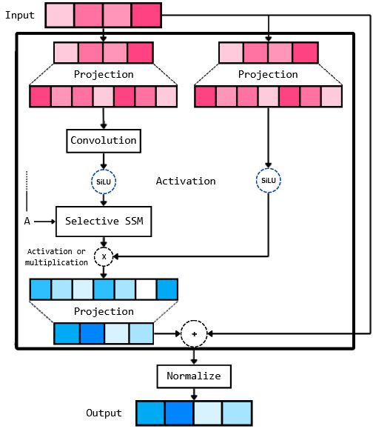
Friedrich-Alexander-Universität
Technische Fakultät
Mamba Block Architecture
How a Mamba block works:
1. Input projection:
Projected to higher-dim space, split into two branches.
2. Convolution:
1D convolution captures local temporal dependencies.
3. Selective SSM:
Dynamic matrices (A,B,C) per-timestep — relevant info retained, noise discarded.
4. Output + residual:
Outputs combined, projected back, residual added, normalized.
Advantage vs LSTM/GRU:
No sequential bottleneck. Linear complexity. Better long-range modeling.
Fig. 6 — Mamba block with Selective SSM
Technische Fakultät
9. März 2026
8

Slide 9
Friedrich-Alexander-Universität
Technische Fakultät
Training Setup & Hyperparameters
Parameter | LSTM | GRU | Mamba
Channels | [2,5,6,8,10,13,14,16,17,18] | all | all
Batch size | 32 | 32 | 64
Hidden dim | 64 | 96 | 128
Layers | 2 | 3 | 2
Dropout | 0.3 | 0.3 | —
Learning rate | 5e-3 | 2.5e-4 | 5e-5
Optimizer | Adam | Adam | Adam
Loss | BCE | BCE | CE (1.1/1.0)
ES patience | 10 | 10 | 10
LR sched. pat. | 5 | 5 | 5
d_state | — | — | 32
d_conv | — | — | 32
Technische Fakultät
9. März 2026
10

Slide 10
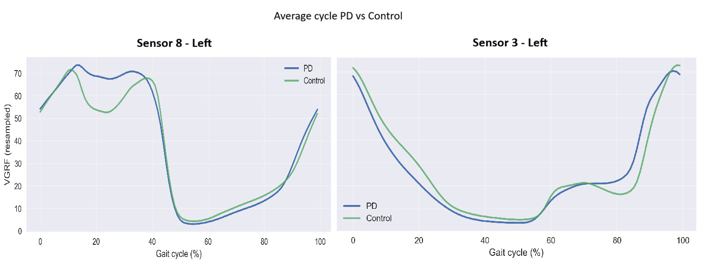
Friedrich-Alexander-Universität
Technische Fakultät
Average Gait Cycle: PD vs Control
Fig. 7 — Mean normalized gait cycles per group. Signals segmented, resampled, and averaged per sensor.
Interpretation: Average gait cycle plots for each sensor (left and right foot) to visually compare PD dynamics vs healthy control pressure throughout the full stride.
Technische Fakultät
9. März 2026
9

Slide 11
Friedrich-Alexander-Universität
Technische Fakultät
Classification Results
88.6%
0.897
0.885
+1.4%
Mamba Accuracy
Mamba Precision
Mamba F1-Score
vs LSTM
Model | Accuracy | Precision | Recall | F1-Score
Mamba | 0.886 | 0.897 | 0.886 | 0.885
LSTM | 0.872 | 0.875 | 0.872 | 0.872
GRU | 0.844 | 0.846 | 0.844 | 0.843
RBF SVM | 0.806 | 0.803 | 0.803 | 0.803
Linear SVM | 0.794 | 0.791 | 0.791 | 0.791
Key finding: Mamba outperforms all baselines in every metric. Deep learning models substantially outperform feature-based SVMs, confirming end-to-end temporal representation learning.
Technische Fakultät
9. März 2026
11

Slide 12
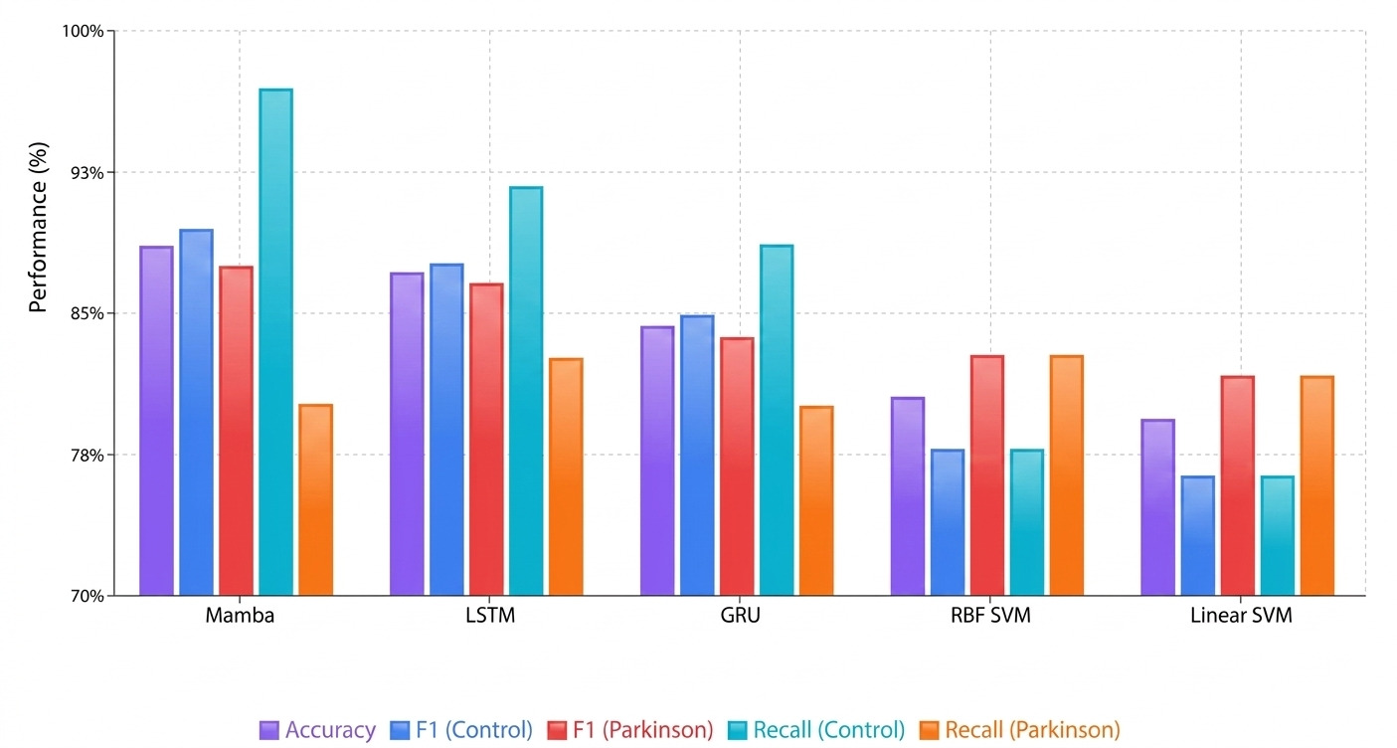
Friedrich-Alexander-Universität
Technische Fakultät
Model Performance Comparison
Fig. 8 — Accuracy, F1 (Control), F1 (Parkinson), Recall (Control), Recall (Parkinson) across all models
Technische Fakultät
9. März 2026
12

Slide 13
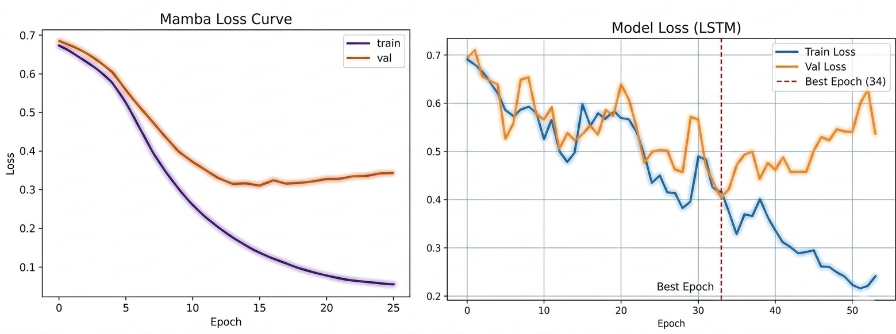
Friedrich-Alexander-Universität
Technische Fakultät
Training Dynamics: Mamba vs LSTM
Fig. 9 — Mamba (left): smooth convergence. LSTM (right): unstable validation after epoch 30.
Mamba: Smooth monotonic decrease in both train/val loss. Small gap — no significant overfitting. LSTM: Irregular validation fluctuations after ~epoch 30, indicating overfitting on long biomedical sequences.
Technische Fakultät
9. März 2026
13

Slide 14
Friedrich-Alexander-Universität
Technische Fakultät
Discussion
Mamba advantages for biomedical time-series
Selective SSM effectively captures long-range temporal dependencies. Linear complexity enables scaling without Transformer overhead.
End-to-end vs. feature engineering
Deep learning models outperformed SVM-based pipelines, confirming learned temporal representations are more discriminative.
Comparison with Transformers
Transformers achieve >95% accuracy but require quadratic attention. Mamba provides 88.6% with far lower computational resources.
Limitations
Small dataset (166 subjects), class imbalance (70% PD). Chunk-based segmentation necessary. Single sensor modality may limit generalization.
Technische Fakultät
9. März 2026
14

Slide 15
Friedrich-Alexander-Universität
Technische Fakultät
Conclusion
Best classification: 88.61% accuracy, 0.897 precision, 0.885 F1 — outperforming LSTM, GRU, RBF SVM, Linear SVM.
Stable, efficient training: Smooth convergence and low overfitting vs recurrent architectures — critical for small biomedical datasets.
Efficient vs Transformers: Linear complexity enables scalable application to long physiological time-series.
Future work: Additional modalities • Larger clinical cohorts • PD severity regression
Technische Fakultät
9. März 2026
15

