Slide 1
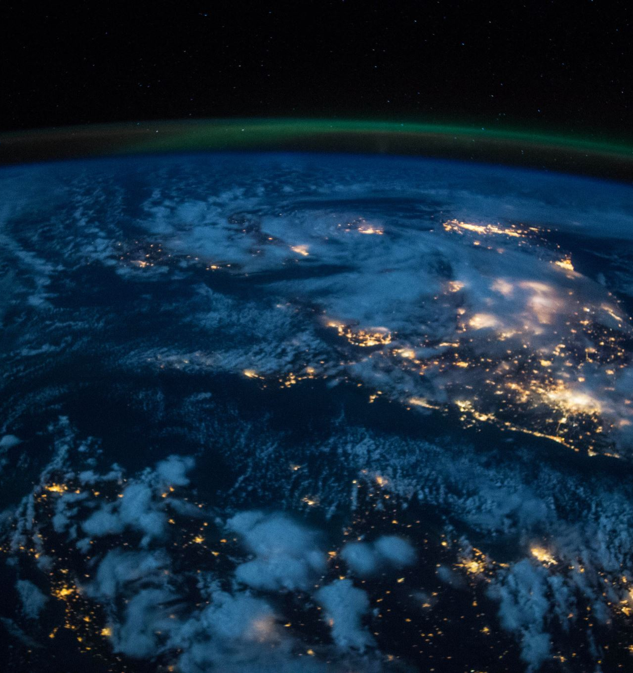
AlGa
Design and Implementation of
Mobile Applications
2019/2020
Alessandro Falcetta
Gabriele Guelfi

Slide 2
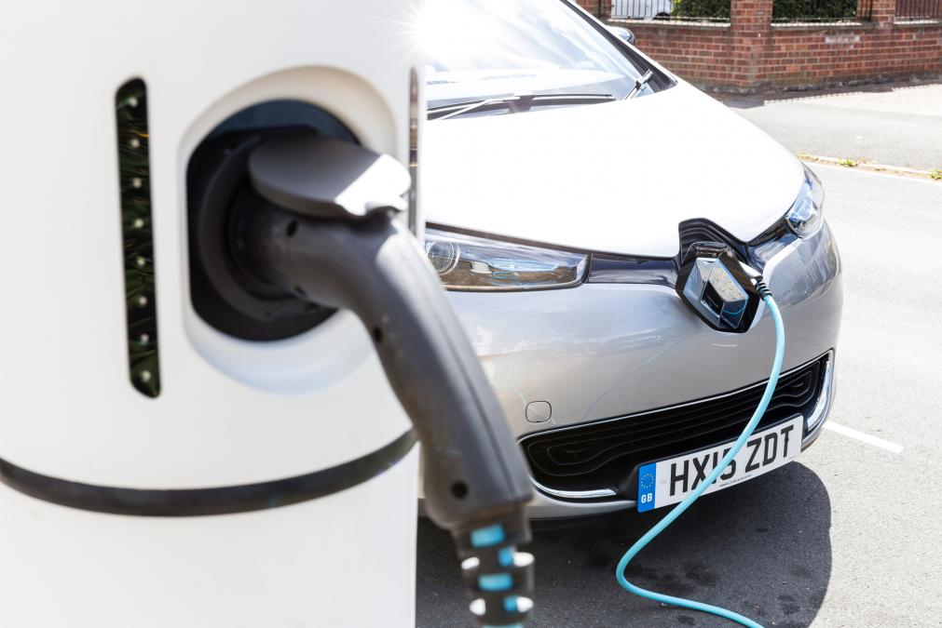
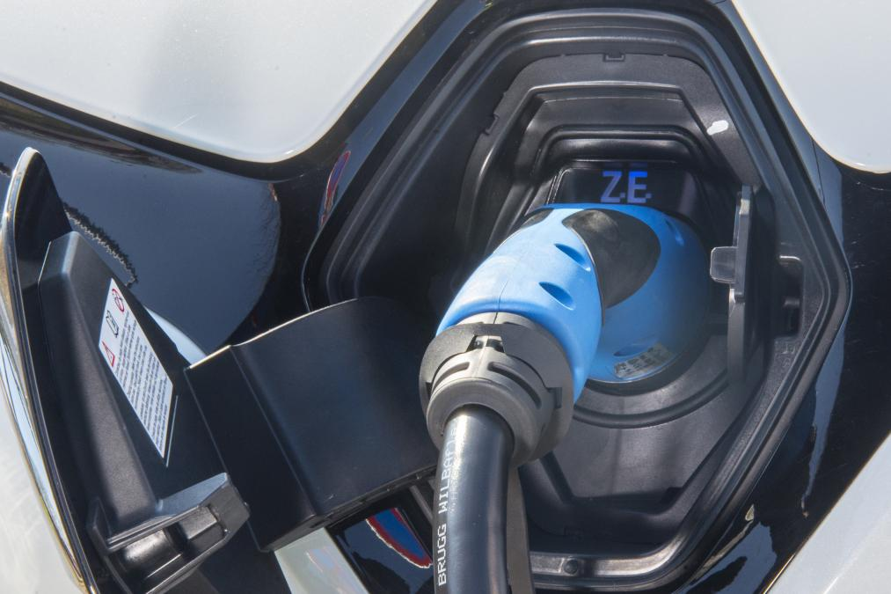
Overview
AlGa is a mobile application developed using Flutter whose goal is to assist electric cars' owners.
AlGa supports profile management with a focus on user's car, a screen to look for research stations, and a screen to check useful statistics automatically collected.
Moreover, the recharge process is eased thanks to automatic notifications which inform user when the car is fully charged.

Slide 3
Outline
Motivations
Product description
External services
Design
Testing
Conclusions

Slide 4

Motivations
We decided to go with Flutter.
The main reasons are:
Portability: one code-base can work for both Android and iOs (soon also Web)
Modern approach, well supported by Google
High amount of useful packages
Easy to learn

Slide 5
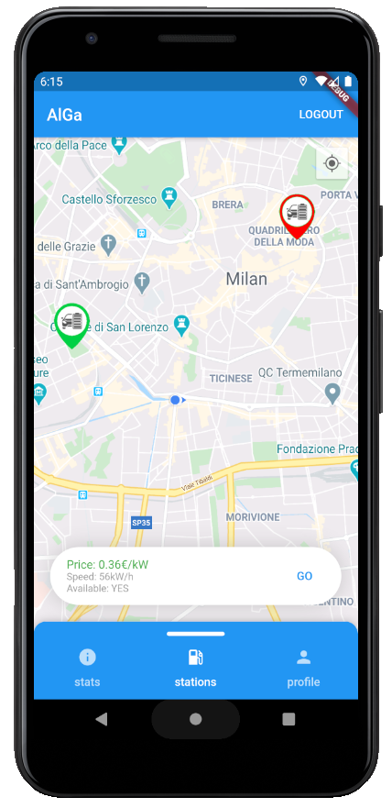
Product Description: Recharge stations finder
The core of the application: a screen which shows recharge stations on a Google Maps background.
Green stations are available, red ones are not.
The stations are fetched from a database (Firebase)

Slide 6
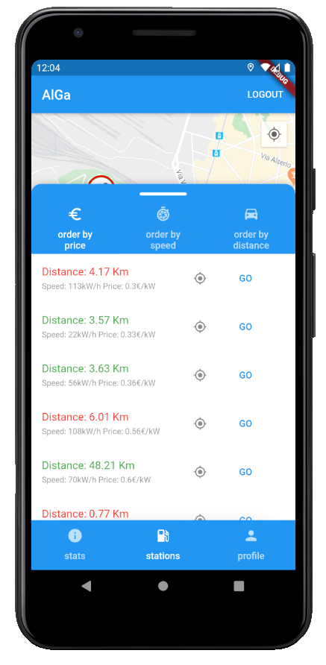
Product Description: Recharge stations finder
Users can use a slider to order the stations according to price, recharge speed or distance.
When the user presses "GO" either on the slide or on a station on the map, the app launches a navigation on Maps towards the station.

Slide 7
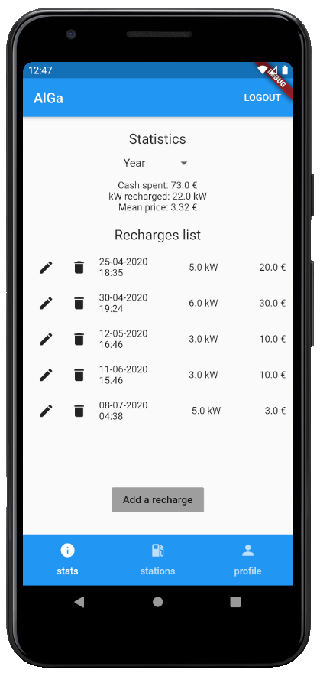
Product Description: Stats
Users can consult a series of statistics related to their recharges.
Option to select between Week, Month and Year
Aggregated information like Total spent, total kW recharged and Mean price for kW...

Slide 8
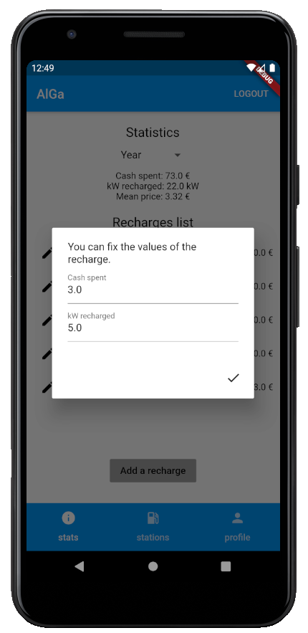
Product Description: Stats
Recharges can be deleted, modified or added.
They are saved on a Firestore database.
Recharges are also automatically collected with through the help of notifications and geolocalization.

Slide 9
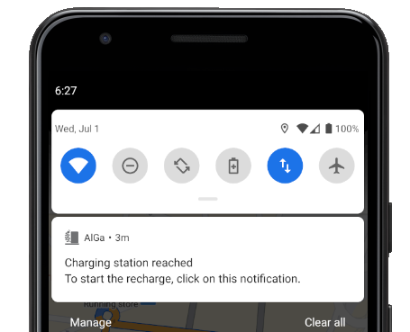
Product Description: Recharges
When the user starts the navigation to a station, AlGa starts monitoring the user's position (and only for this occasion...)
As soon as the station is reached, a notification is shown.

Slide 10
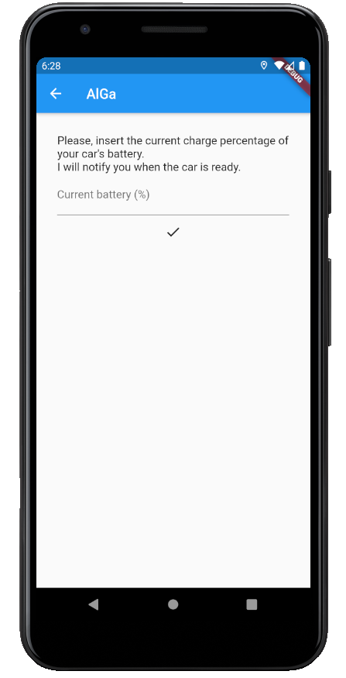
Product Description: Recharges
Clicking on it, the user can start the recharge.
According to the current battery % and the data related to user's car, AlGa will calculate the time needed and the price.
A notification is scheduled to be sent when the recharge is terminated.

Slide 11
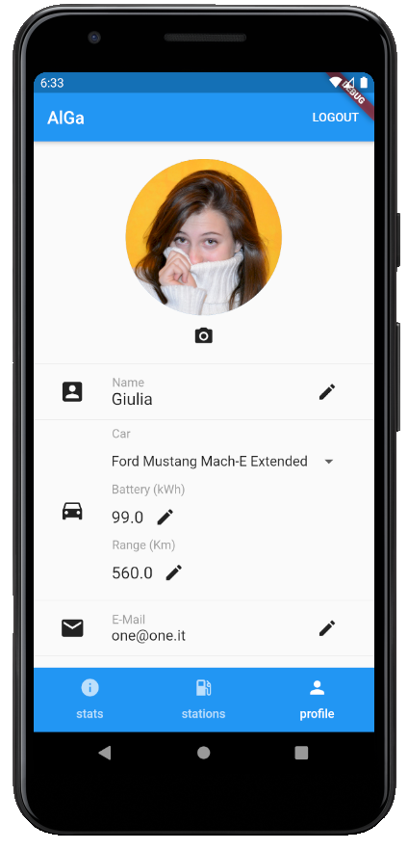
Product Description: Profile
User can personalize her/his own experience with their profile.
Registration can be done in two ways:
Classic e-mail and password
Through GitHub OAuth

Slide 12
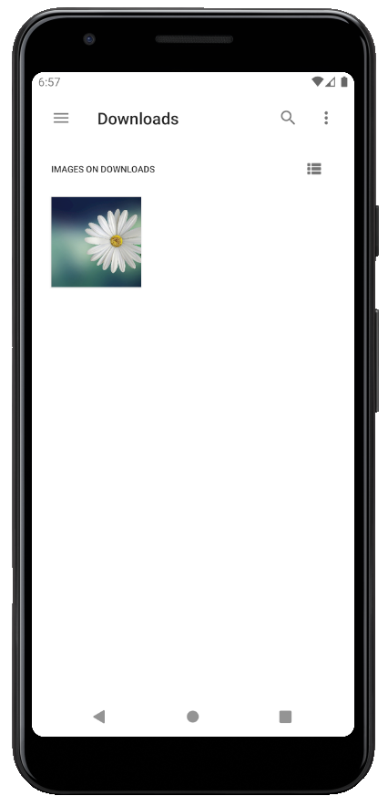
Product Description: Profile
Users can:
choose a profile pic;
modify name, e-mail and password;
modify their car, even with custom values;
delete their account

Slide 13

External services: Firebase
Firebase is used to:
Manage users login/registration
Supports GitHub OAuth
Database for recharges, stations, cars
Save users' profile pics
Official Google product, fully compatible with Flutter

Slide 14
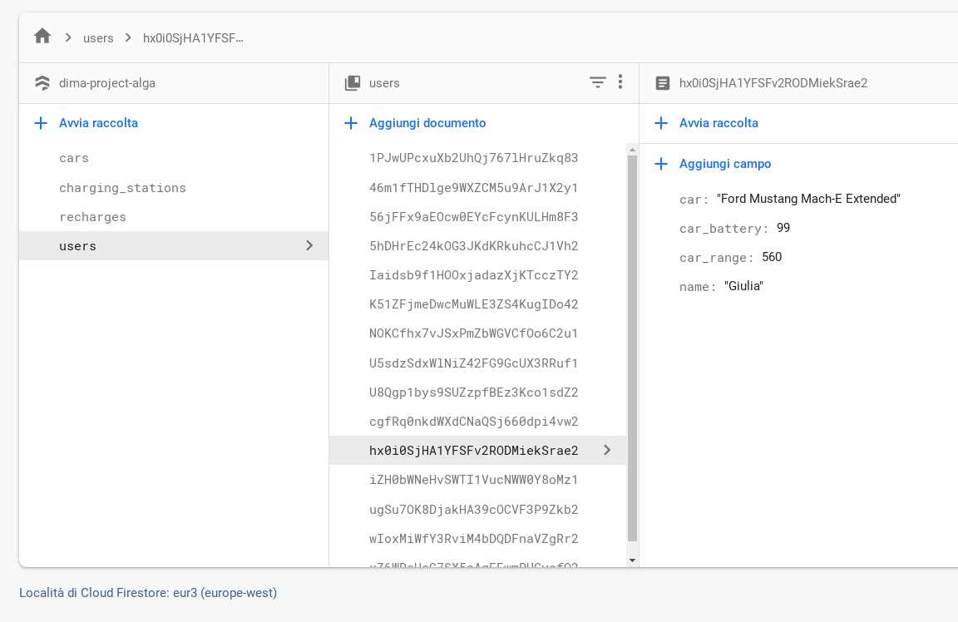
External services: Firebase
Convenient way to store data in a NoSQL database
Data can be updated using the Console or programmatically (we used a Python script)

Slide 15
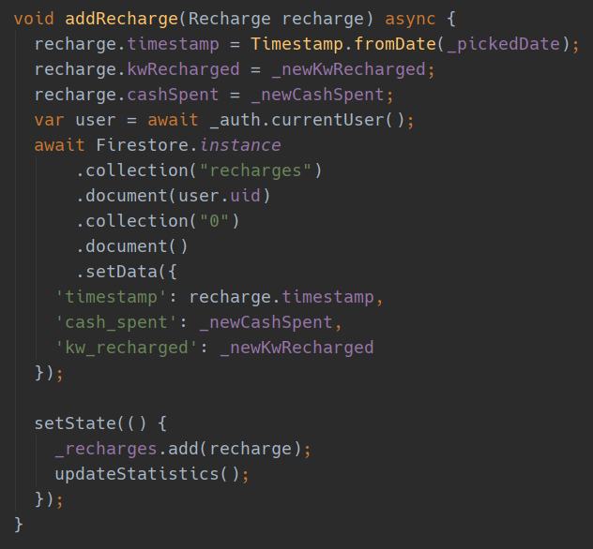
External services: Firebase
In the app, Flutter provides a convenient way to asynchronously fetch/update/add data from/to the database

Slide 16
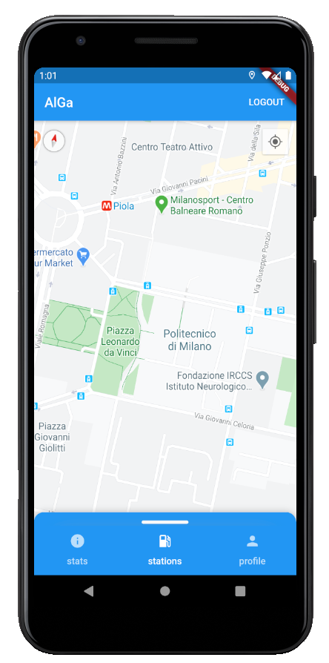
External services: GMaps
GMaps can be included in a Flutter app through a package
Possibility to set custom map pins (we did it for the stations)

Slide 17

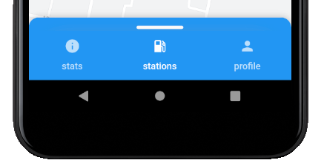
Design
In general, we tried to stick to Material Design Principles¹
Icon made together with a friend
Tabs navigation
1. https://material.io/design/iconography/product-icons.html#design-principles

Slide 18
Testing
Both on emulators and real devices (Sony, Xiaomi)
Geolocalization tested both using fake locations and in real conditions (i.e. navigation towards a station, check for notification correctness, etc.)
Check validity of use-cases

Slide 19
Conclusions
Mobile-applications development is different
Great focus on users and usability
Possibility to test on real-use cases and real devices
Main difficulties we faced:
Flutter is still young (some bugs...)
Sometimes, documentation is missing

Slide 20
Conclusions
Future works include:
Better integration with cars, in order to automatically fetch characteristics and battery %
Better integration with recharges stations
Code is available at: https://github.com/GabrieleGuelfi/Project_DIMA

Slide 21
Thank you

