Slide 1
Section 05
Xiang Pan
10/10/2023

Slide 2
Beam Search
P A R T 0 1

Slide 3
Beam Search
P A R T 0 1
V: vocabulary size
B: Beam Width/Size
L: Sequence Length
Assume V=6, B=2:
1. When generating the first word, select the 2 words with the highest probability (assumed to be A, C), that is, select the top 2 words out of 6;
2. When generating the second word, combine the current sequence A/C with the 6 words in the vocabulary list to obtain 2*6 sequences, and select the 2 with the highest probability as the current sequence (assuming it is now AB, AE);
3. Continue the above process until the end. The 2 highest scoring ones are finally output.

Slide 4
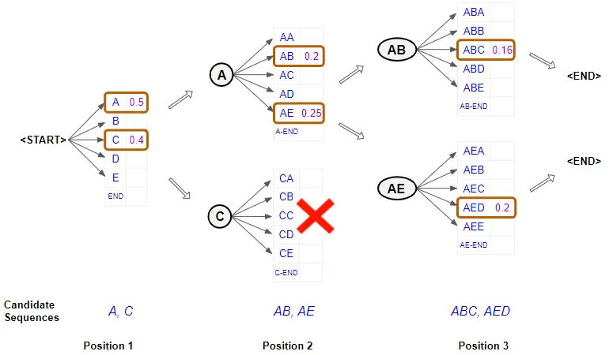
Beam Search
P A R T 0 1
https://towardsdatascience.com/foundations-of-nlp-explained-visually-beam-search-how-it-works-1586b9849a24

Slide 5
Beam Search
P A R T 0 1
Complexity: O(B * V * L)
The bigger B
Pros: The more options we have to consider, the better sentences we can find.
Cons: The calculation cost is higher, the slower the speed, the greater the memory consumption
The smaller B
Pros: low computational cost, fast speed, smaller memory footprint
Cons: fewer options to consider, less good results

Slide 6
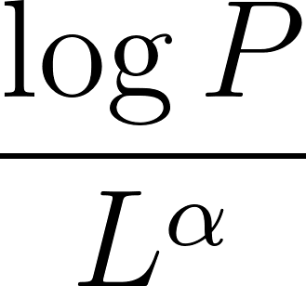
Beam Search
P A R T 0 1
Possible Issue:
Data underflow
Log P
Tend to generate short sequences
Normalized Prob:
α = 1, full normalization
α = 0, no normalization
Less Diverse Decoding Results:
Regularizing the Diversity
Diverse Beam Search
https://towardsdatascience.com/foundations-of-nlp-explained-visually-beam-search-how-it-works-1586b9849a24

Slide 7
Tasks and Datasets
P A R T 0 2
Adopted from Spring2023 Section03 Slides by Nitish

Slide 8
NLP Datasets
P A R T 02
•Datasets in NLP, and useful resources to use them.
•Considerations when choosing a dataset.
•Challenges in data collection.

Slide 9
Individual Task Benchmarks
P A R T 02
•Tasks: Machine Translation,Question Answering, Sentiment Analysis, Common Sense Reasoning, Summarization etc.
•http://nlpprogress.com - Useful resource to track datasets for different tasks in NLP

Slide 10
Individual Task Benchmarks
P A R T 02
What is different in all the benchmarks for the same task (say QA)?
Domain (e.g. sports domain vs legal domain)
Fine-grained phenomena (e.g. short answers vs long answers)
Language
Evaluation Metric (e.g. exact span match vs multiple-choice)
etc.

Slide 11
Individual Task Benchmarks
P A R T 02
GLUE and SuperGLUE include a suite a tasks designed to test natural language understanding
Tasks: Sentiment analysis, paraphrase detection, natural language inference etc.
Highly influential in recent developments in NLP (BERT, GPT-2 etc) and developed at NYU!!

Slide 12
Multi-Task Benchmarks
P A R T 02
BigBench: create a collaborative benchmark.
Spans 204 diverse tasks including linguistics, common-sense reasoning, social bias, math etc.
Influential in recent developments in large language models like GPT-3. (More later in the course!)

Slide 13
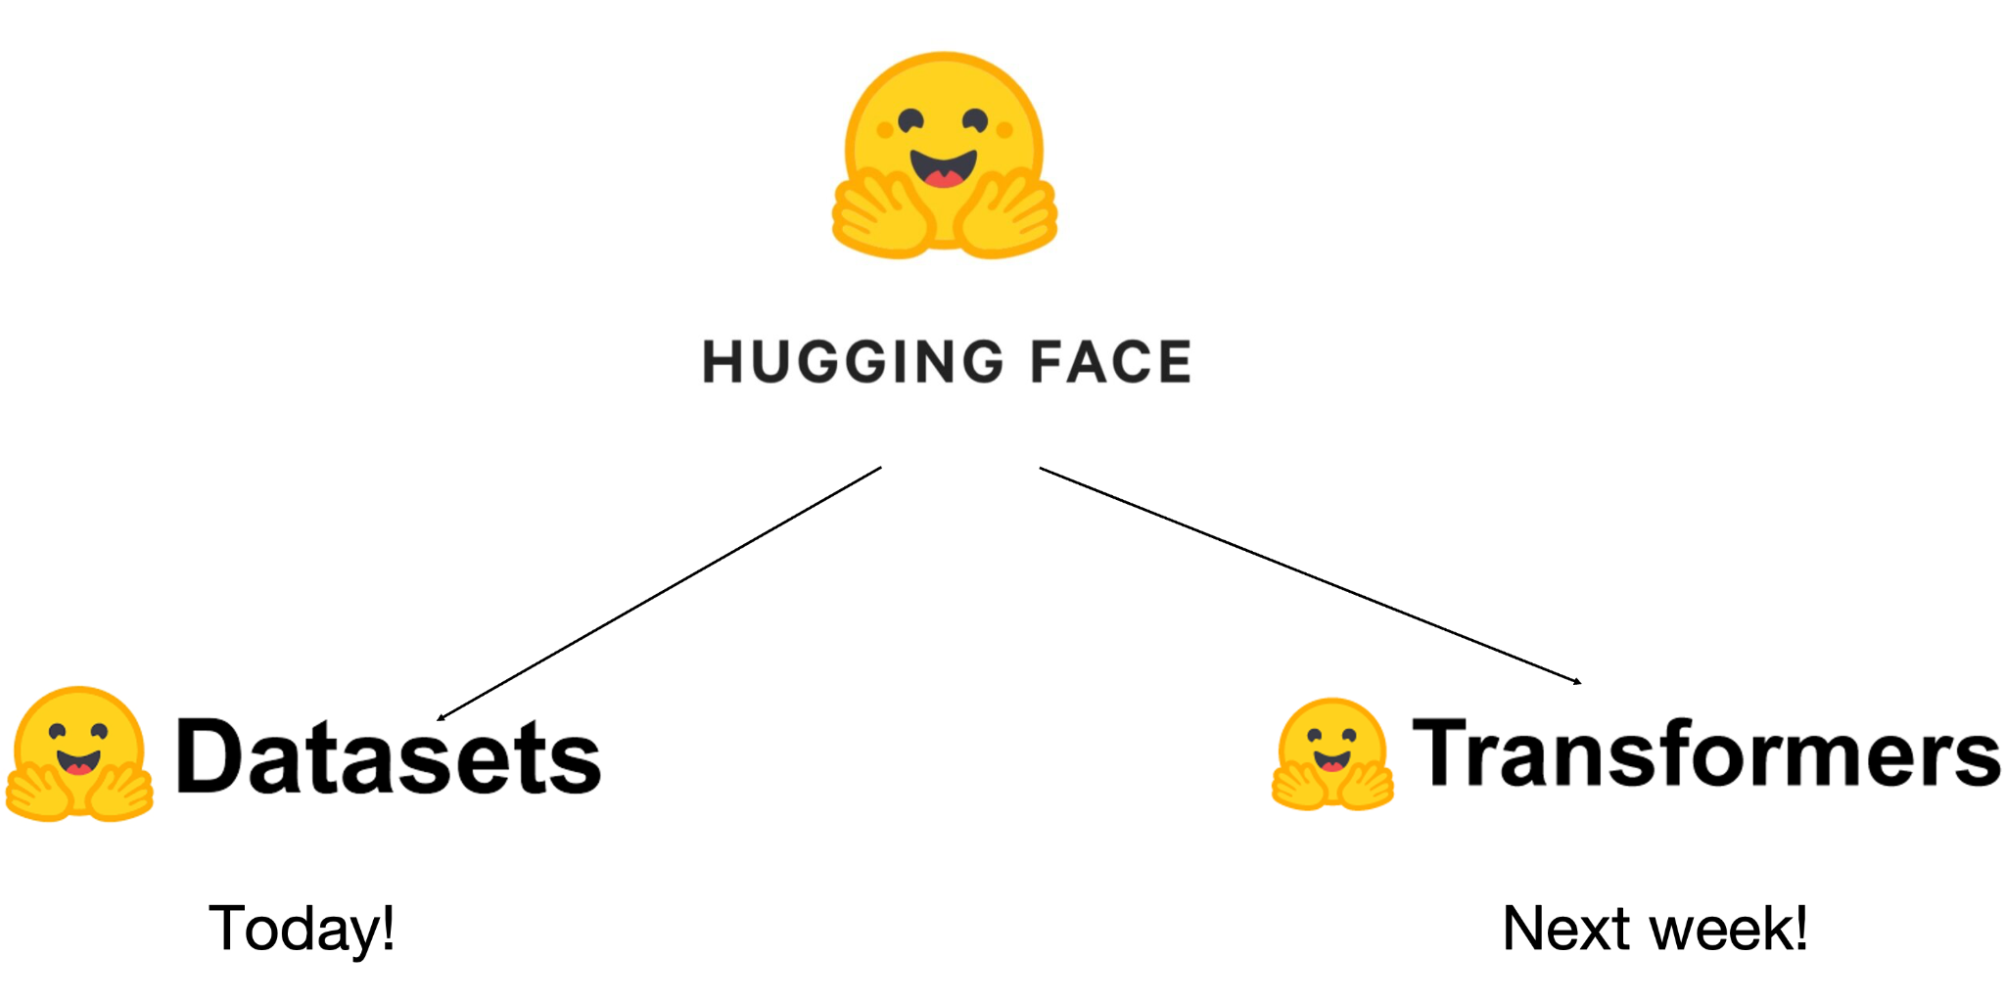
Useful Resources
P A R T 02

Slide 14
Datasheets for Datasets
P A R T 02
Analogous to the datasheets common in electronic components (e.g. operating characteristics, usage etc.)
Why? Increases transparency and accountability.
Standardizes dataset documentation along: Creation Composition Intended uses Maintenance

Slide 15
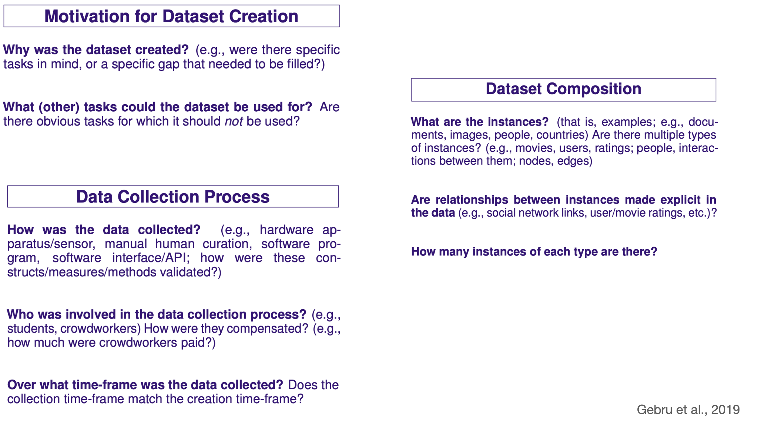
Datasheets for Datasets
P A R T 02

Slide 16
Datasheets for Datasets
P A R T 02

Slide 17
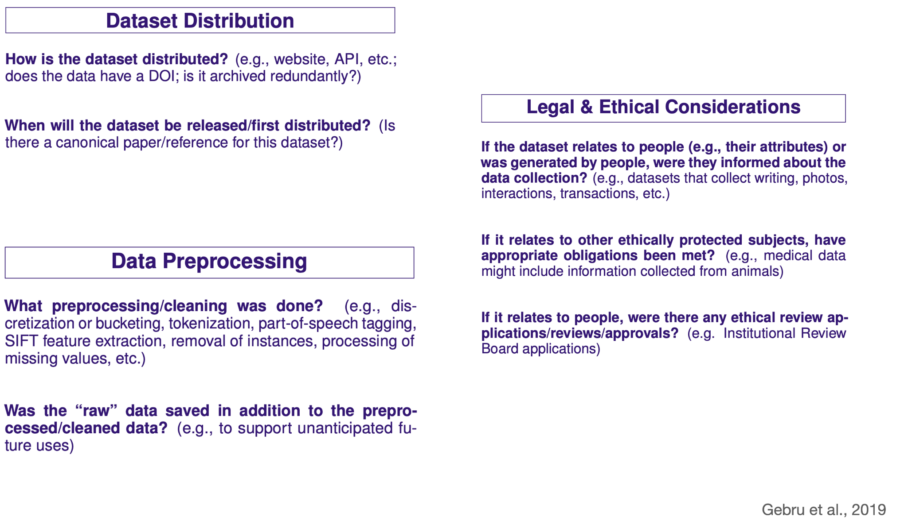
Datasheets for Datasets
P A R T 02

Slide 18
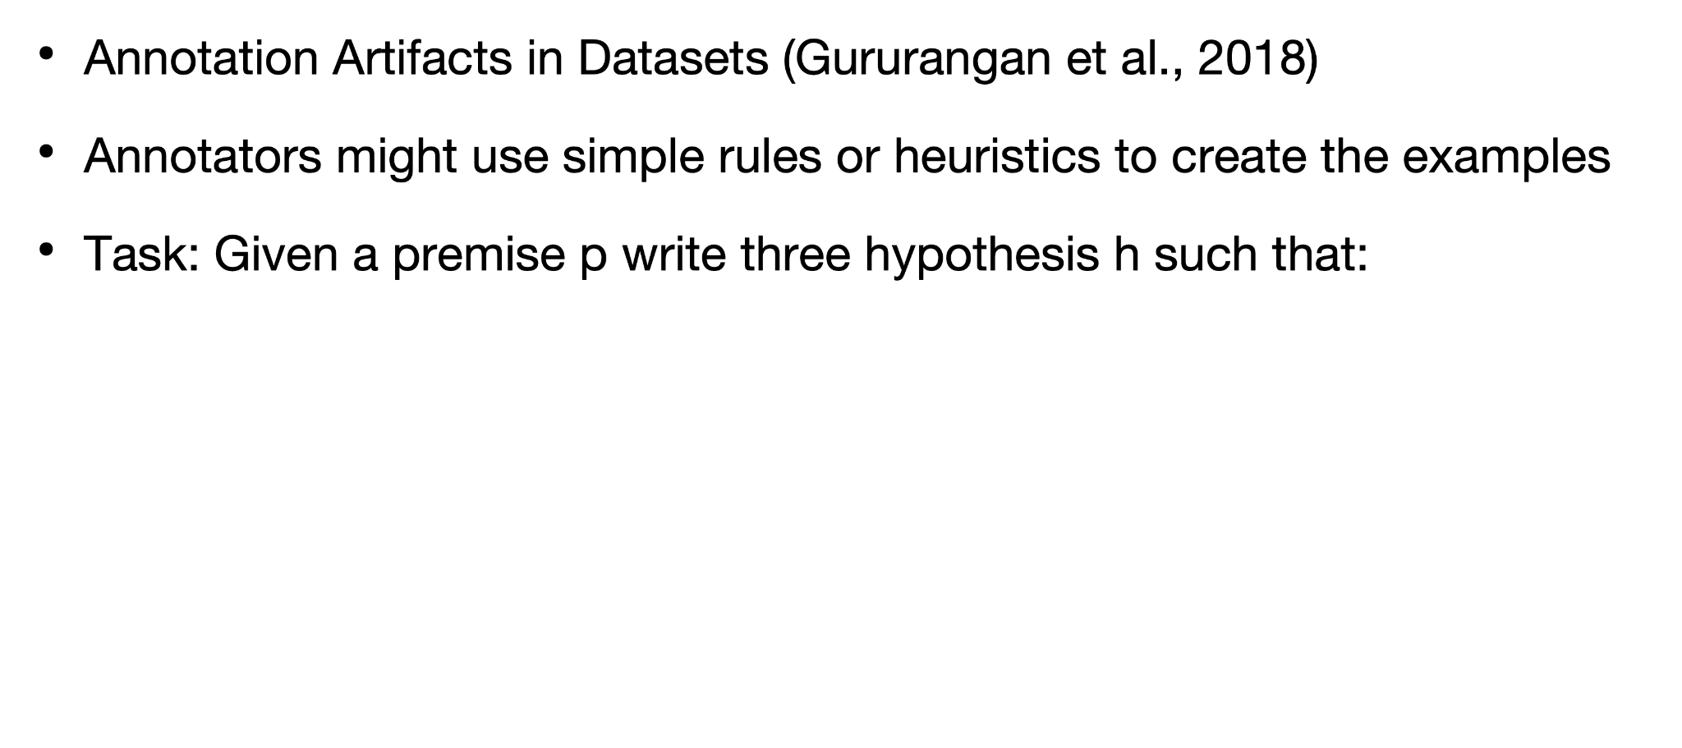
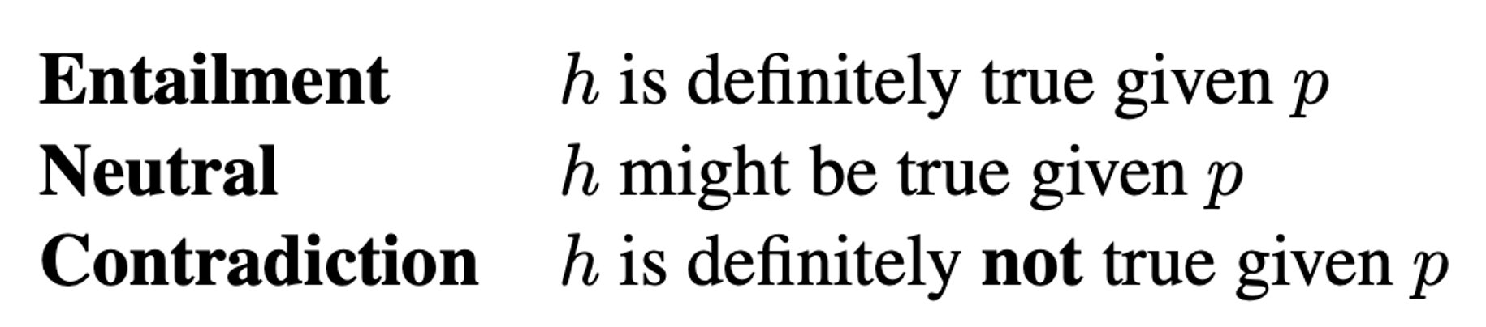
Challenges in Dataset Construction
P A R T 02

Slide 19
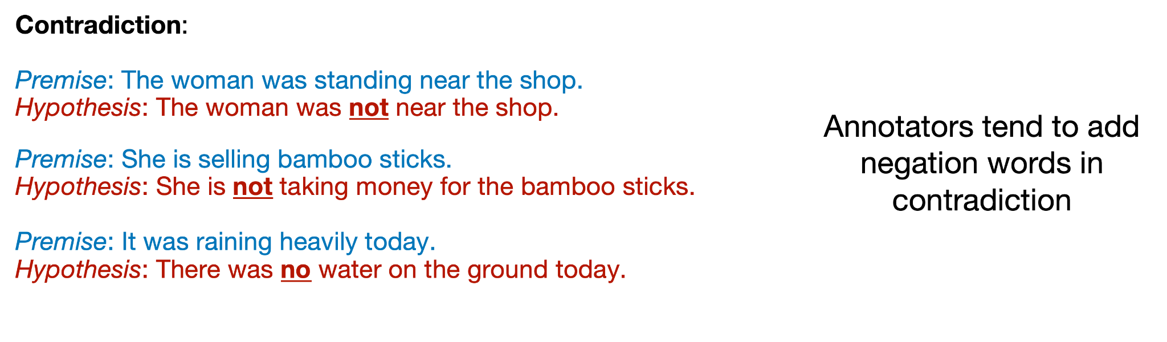
Challenges in Dataset Construction
P A R T 02

Slide 20
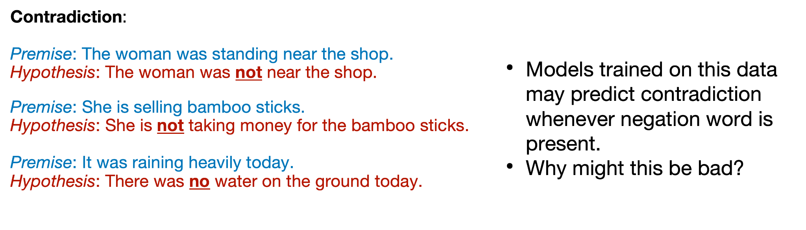
Challenges in Dataset Construction
P A R T 02

Slide 21
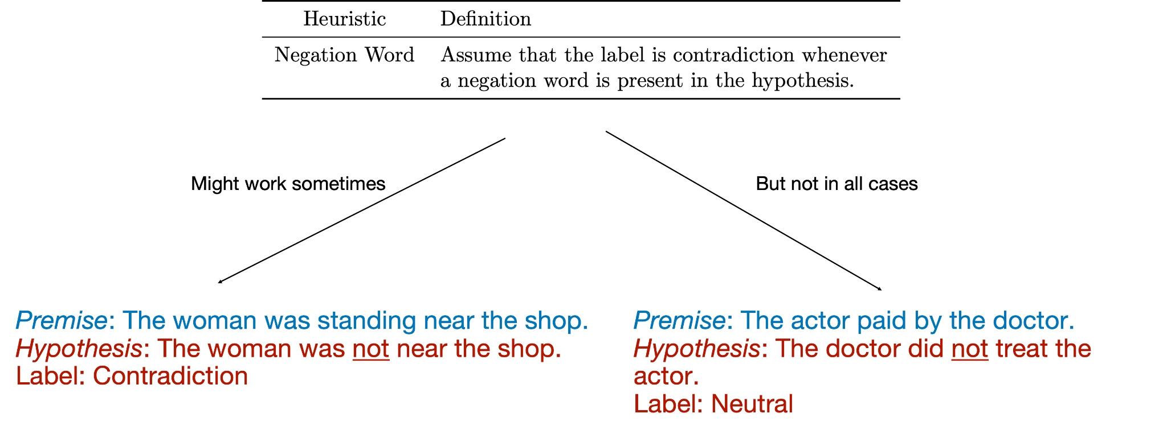
Challenges in Dataset Construction
P A R T 02

Slide 22
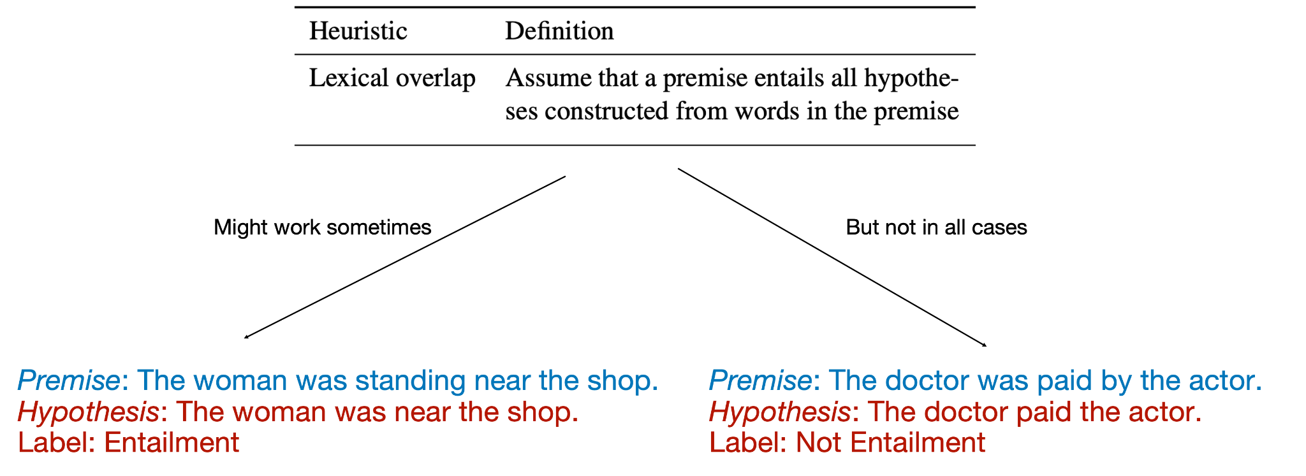
Challenges in Dataset Construction
P A R T 02

Slide 23
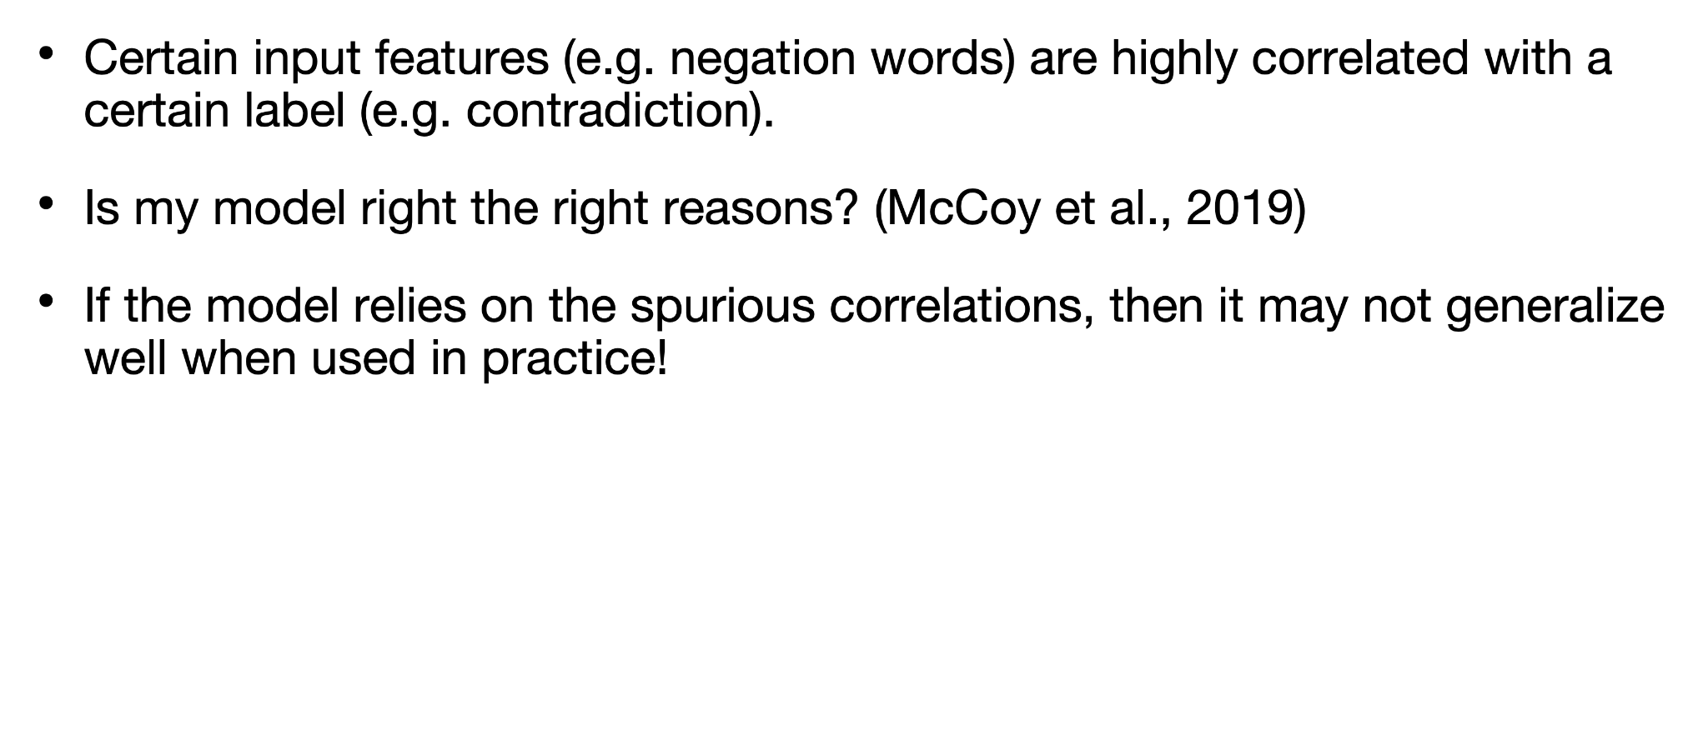
Spurious Correlations in Datasets
P A R T 02

Slide 24
Summary
P A R T 02
Single-task vs Multi-task benchmarks
Huggingface Datasets Library
Datasheets for Datasets
Challenges in data collection — annotator artifacts.

