Slide 1
Flooduino
Members: Frédéric Weyssow, Istref Uka, Alexander Marggraf, Pascal von Fellenberg
University of Basel, Computer Architecture
22.01.2025

Slide 2
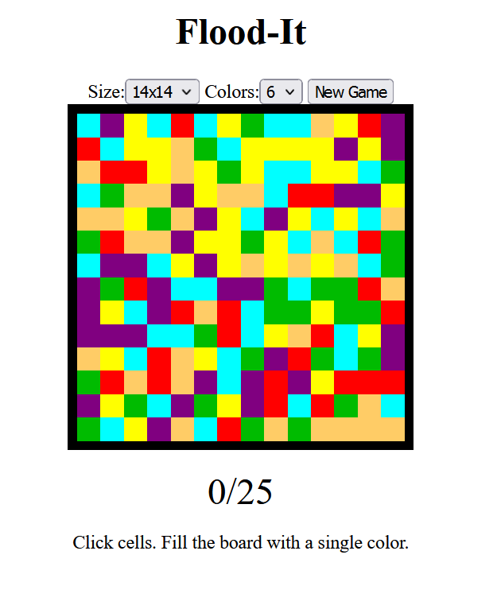
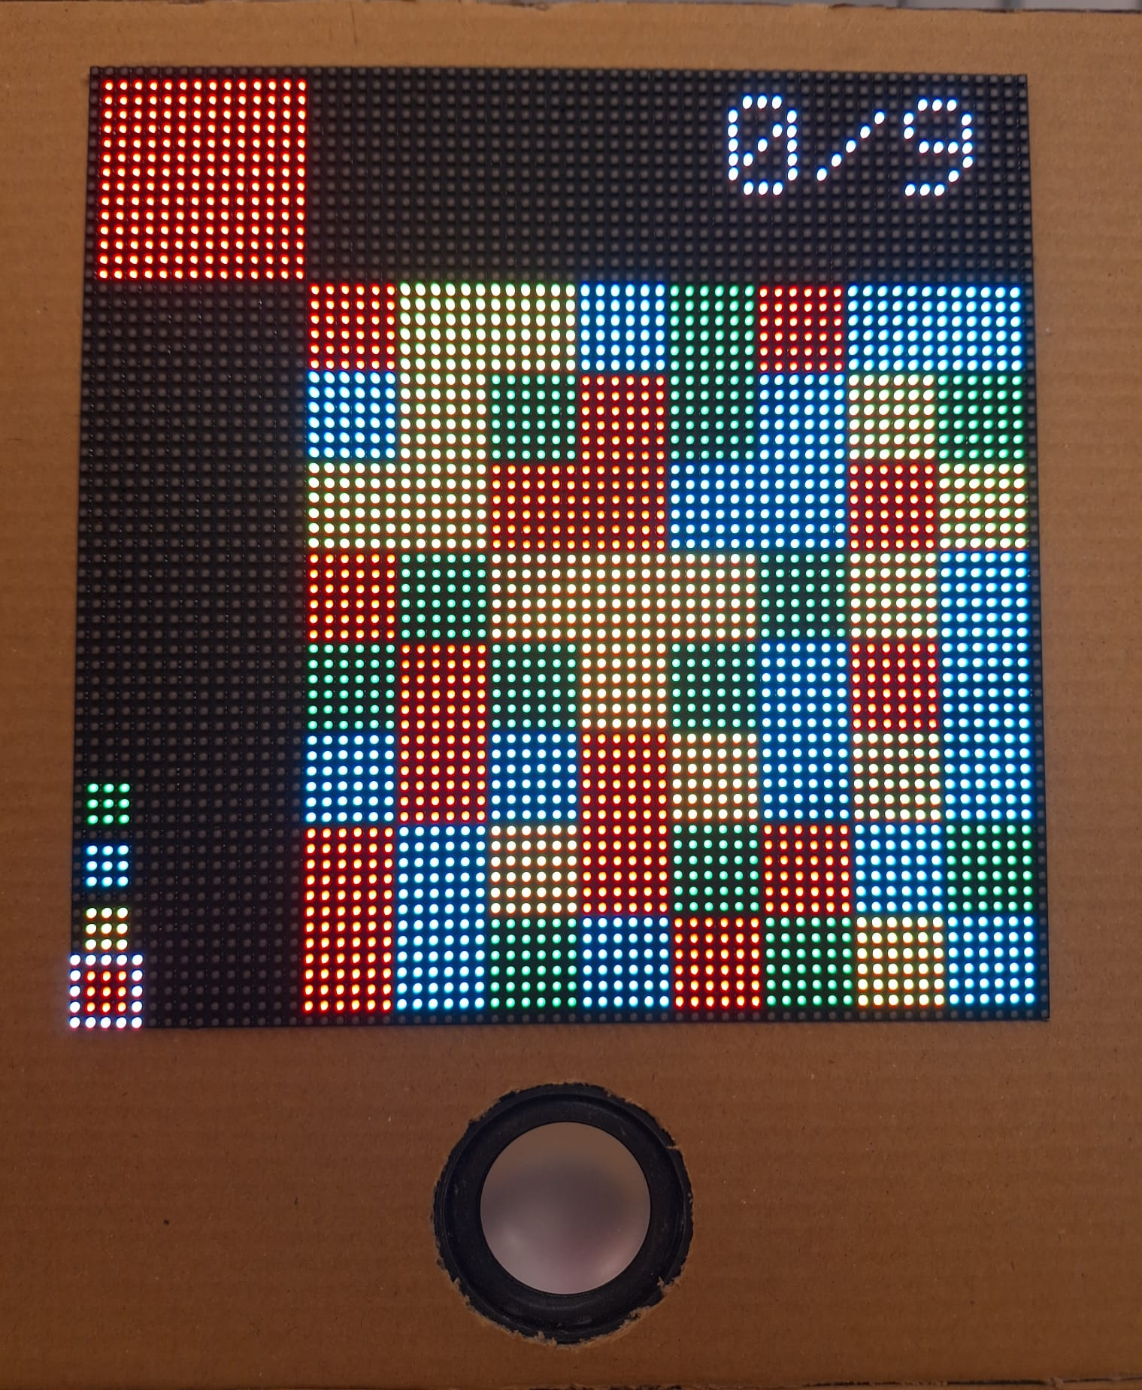
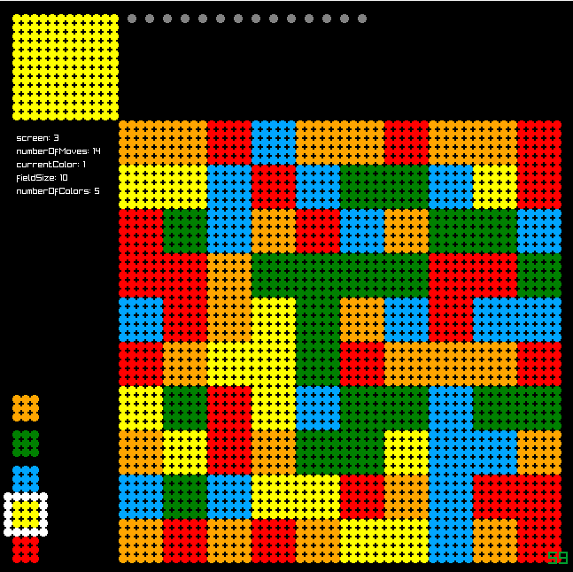
Methodology
Implement Flood-it Game on an Arduino, using an RGB-LED-matrix
Prototype
Final Product

Slide 3
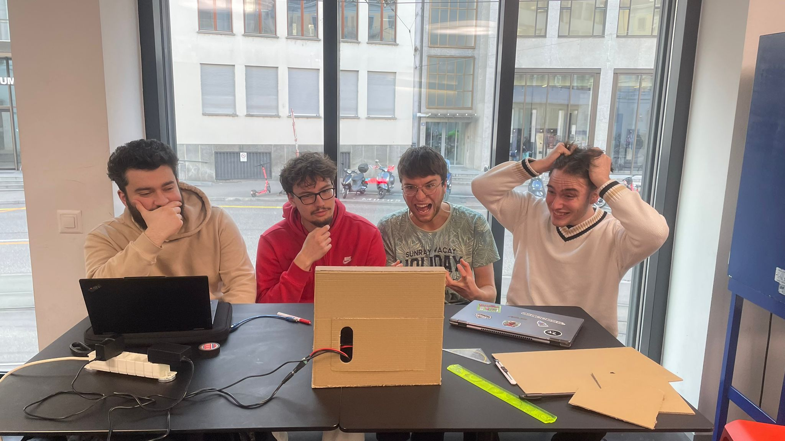
Challenges
Build Systems (CMake)
Buttons
Displaying bitmaps
Music

Slide 4
Division of Labor
Who did what?:
Alex: Input, visual design and displaying images.
Pascal: Visual output and porting.
Frederic and Istref: Game logic and audio.
The rest was worked on by the whole team.

Slide 5
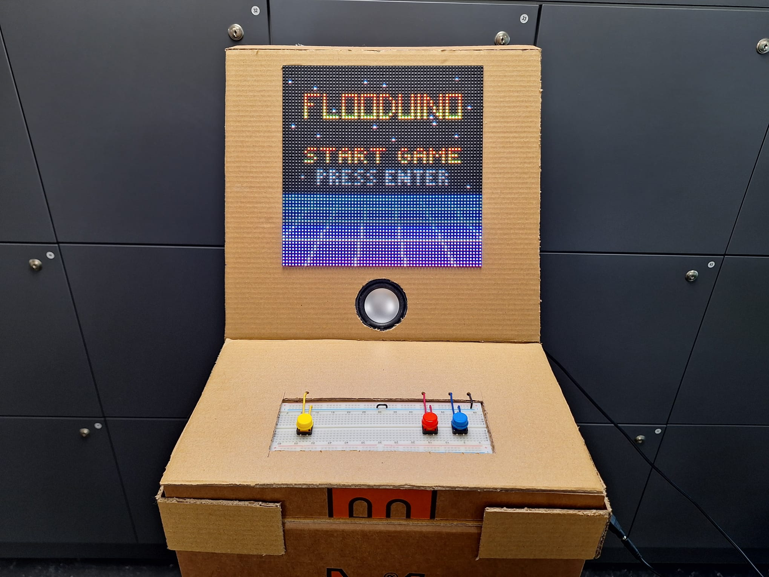
Demonstration

Slide 6


