Slide 1
Flooduino
Members: Frédéric Weyssow, Istref Uka, Alexander Marggraf, Pascal von Fellenberg
University of Basel, Computer Architecture
22.01.2025

Slide 2
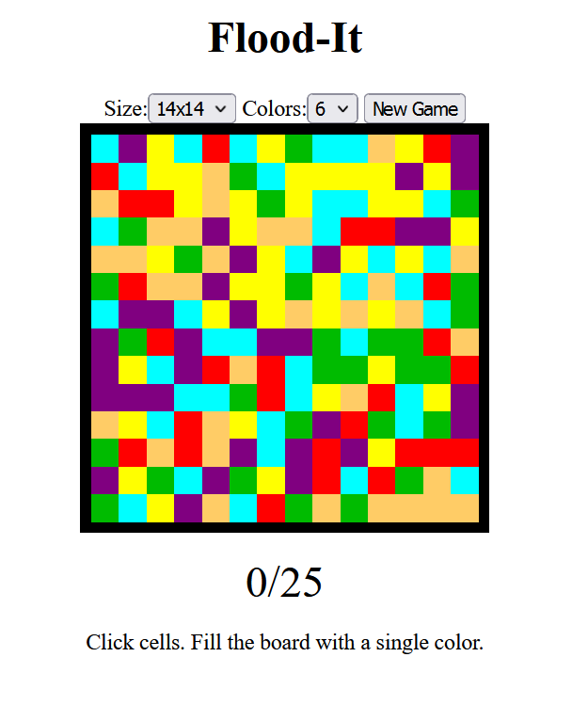
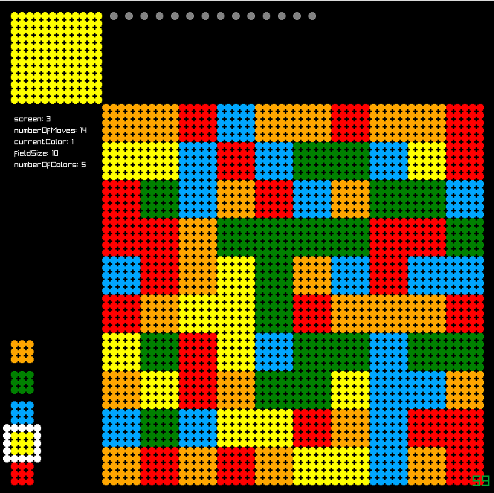

Recap: Vision
Implement Flood-it Game on an Arduino, using an RGB-LED-matrix
Prototype

Slide 3
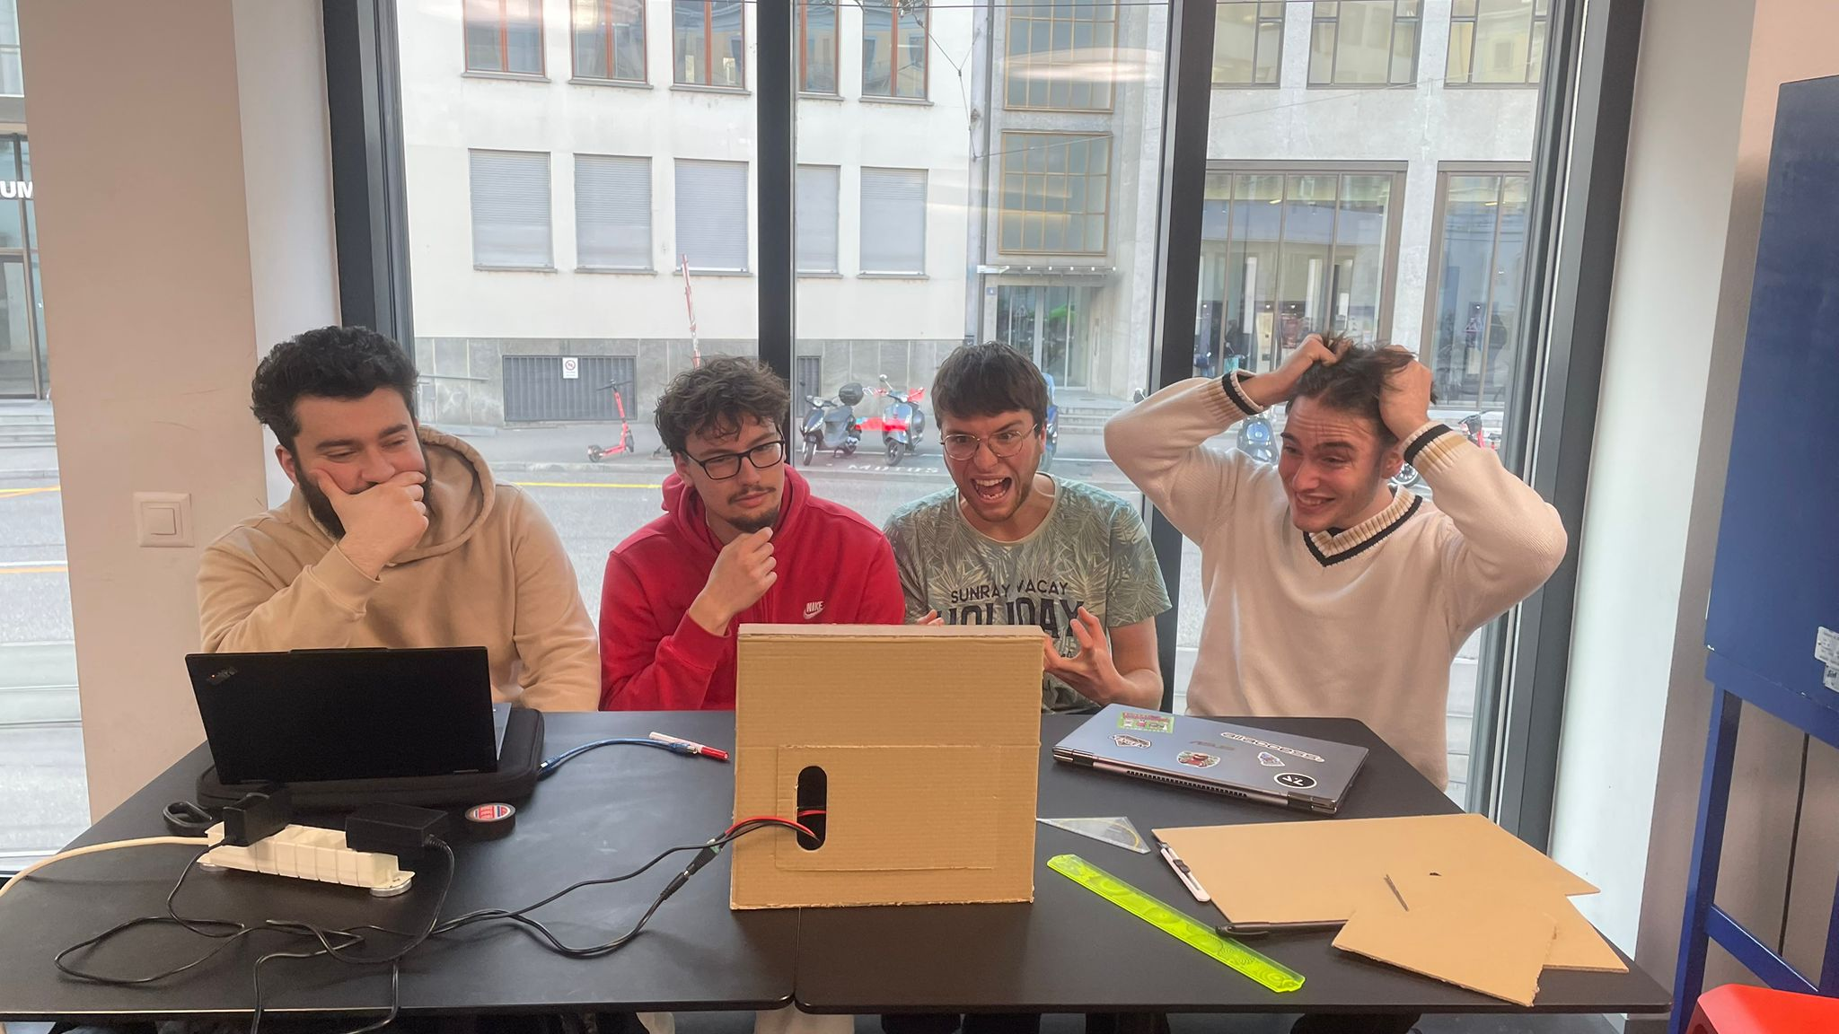
Challenges
Input
Libraries
Music

Slide 4
Division of Labor
Who did what?:
Input and visual design: Alex
Visual output on prototype and porting: Pascal
Game Logic: Frederic and Istref
Hardware, housing and music choice: Everyone

Slide 5
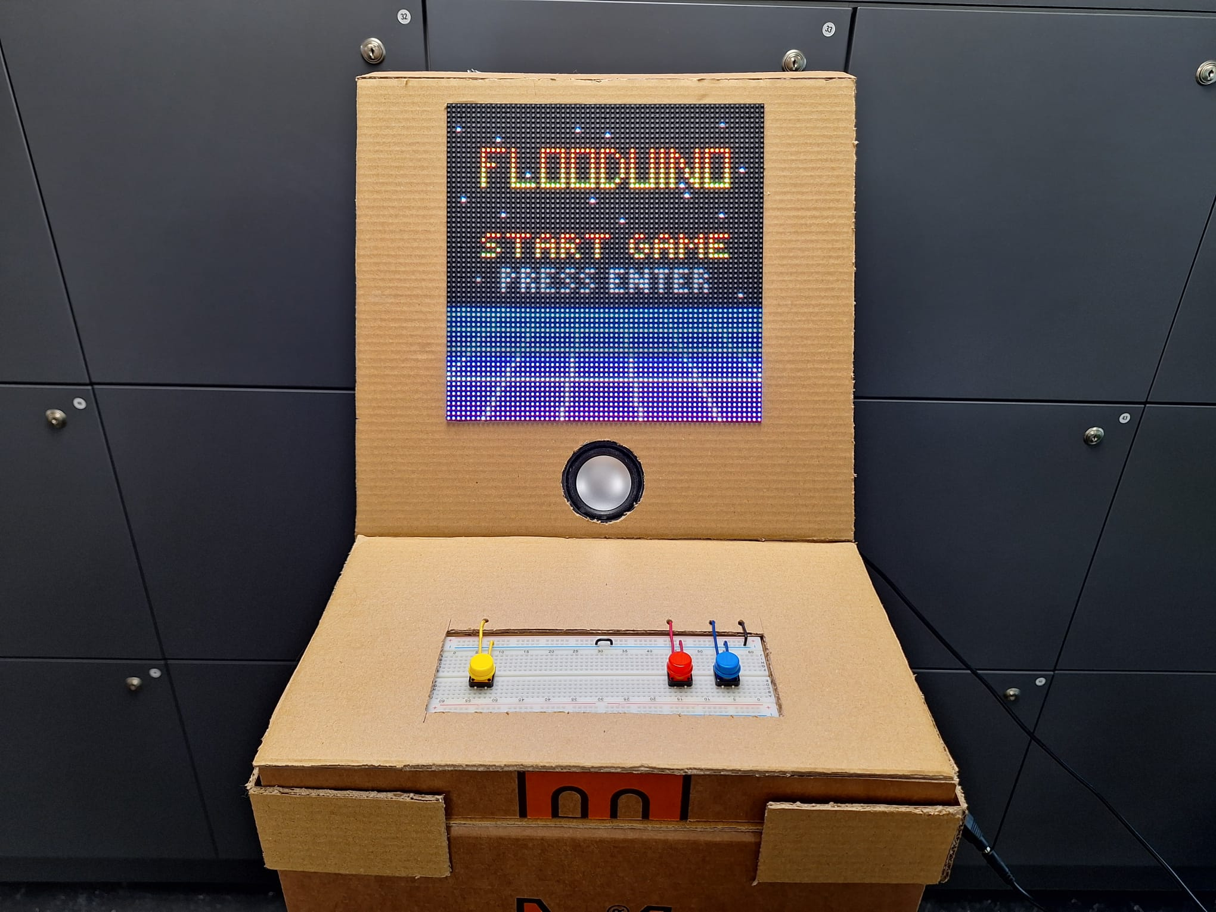
Demonstration

Slide 6
Thank you for your attention Questions?

