Slide 1
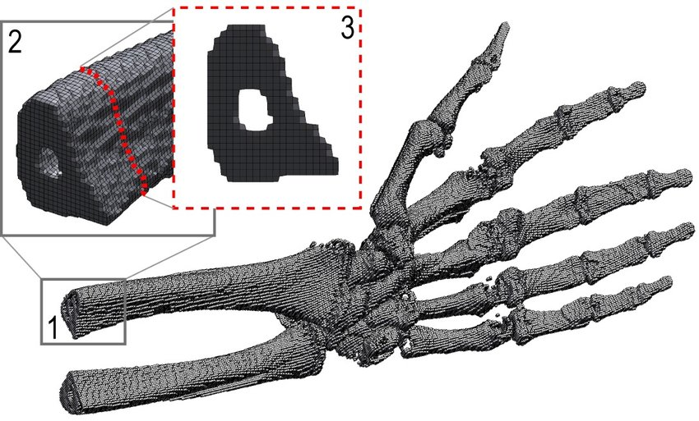
Creating a Voxel Rendering Engine
Alex McDermott (N10494367)
Supervised By Professor Clinton Fookes

Slide 2

Circumstances
Topic was changed in Week 10
Previous arrangement fell through
Airbus was unable to find a supervisor
New project is student-led
Timeframe greatly shortened

Slide 3
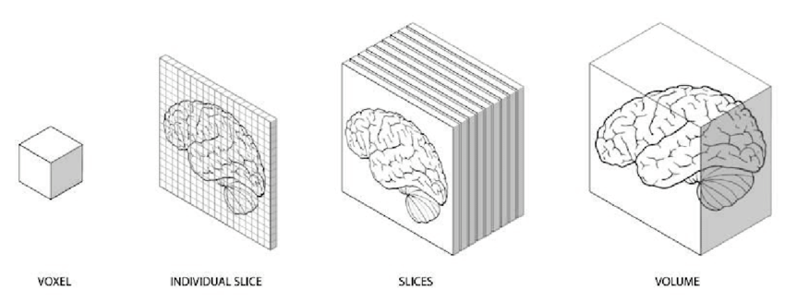
Outline
A voxel is a cell of a 3D grid
Often stores density data
Used for MRI and CT scans
Can also be used in games

Slide 4

Language Choice
Rendering is computationally expensive
2 million colour calculations, 30 times per second
Rust was chosen because its fast and safe
Very active community with lots of recourses

Slide 5
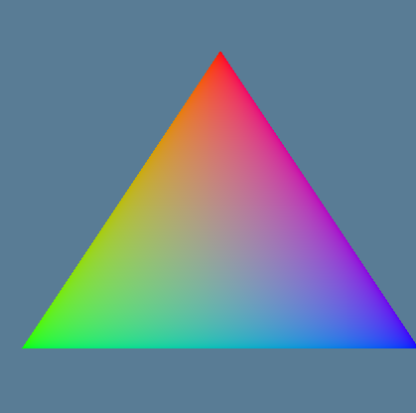
WGPU
Need to take advantage of the GPU
WGPU was used for multiplatform support
Provides abstraction over other API’s
Still quite verbose and cumbersome

Slide 6
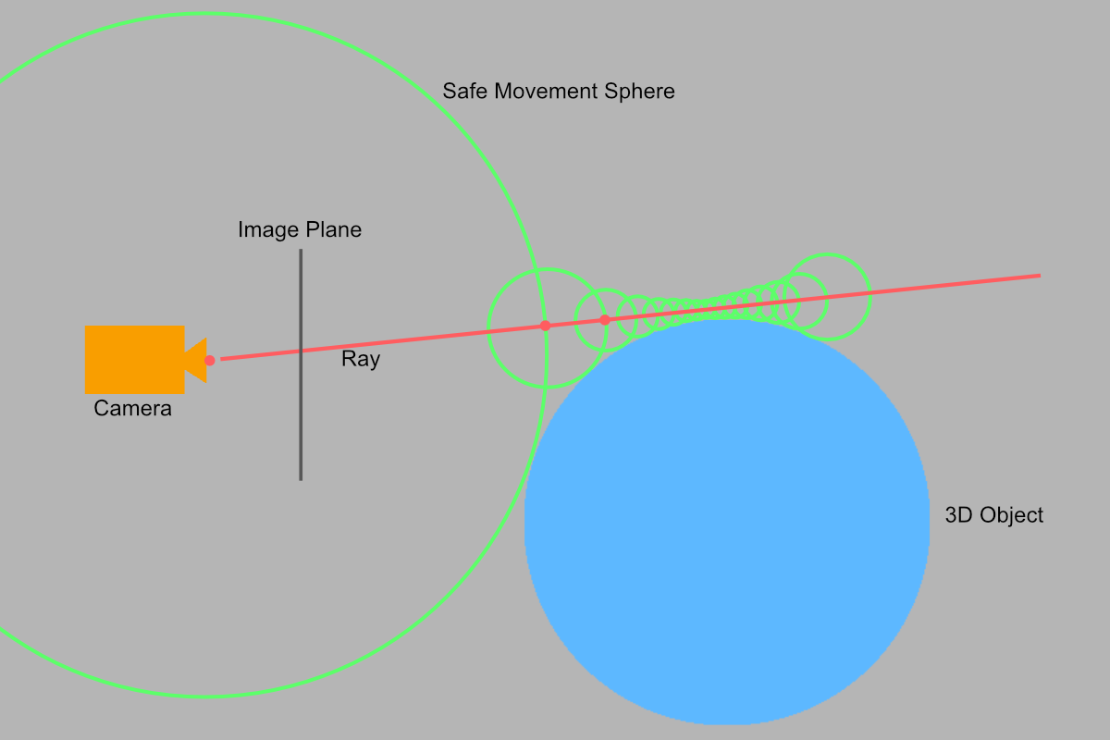
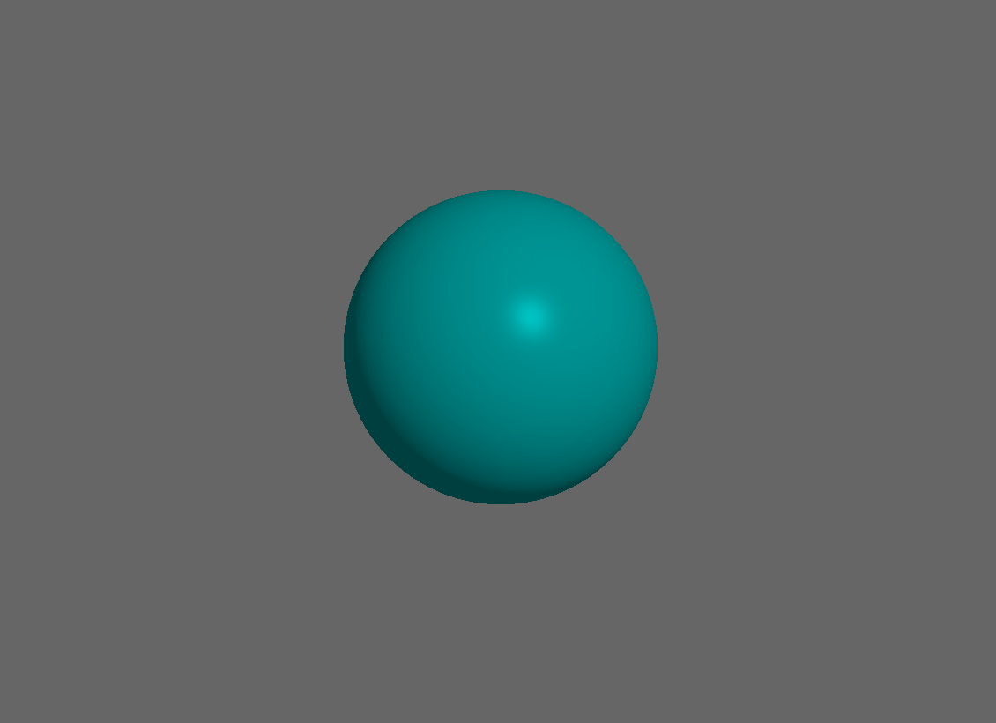
Ray Marching
Need to become familiar with WGSL
Started with something familiar
Process is similar and carries over to voxels
Process is based on Signed Distance Fields
Phong shading was used to shade hits based on gradient

Slide 7
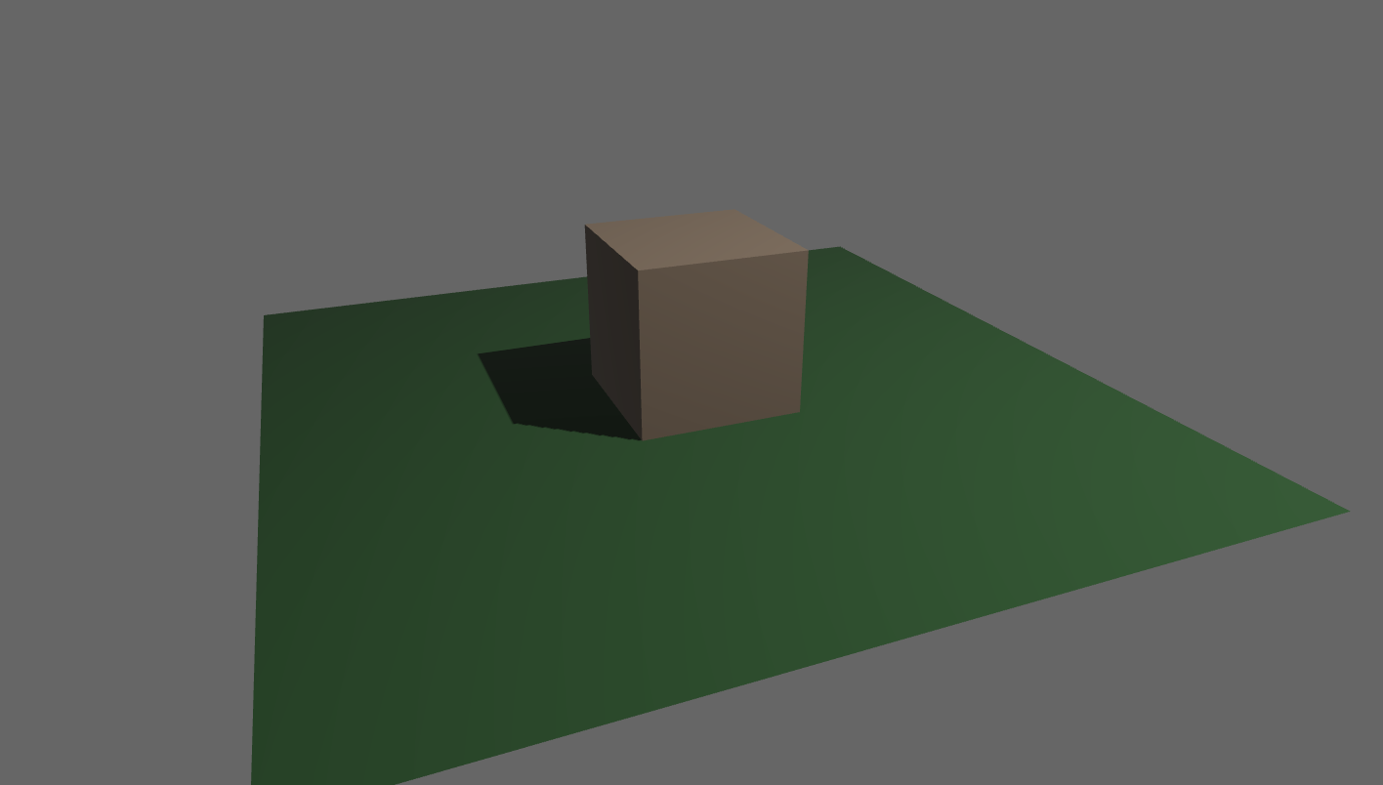
Bevy
Switch to Bevy to reduce boilerplate code
Comes with many useful features out of the box
Code is now much more concise

Slide 8
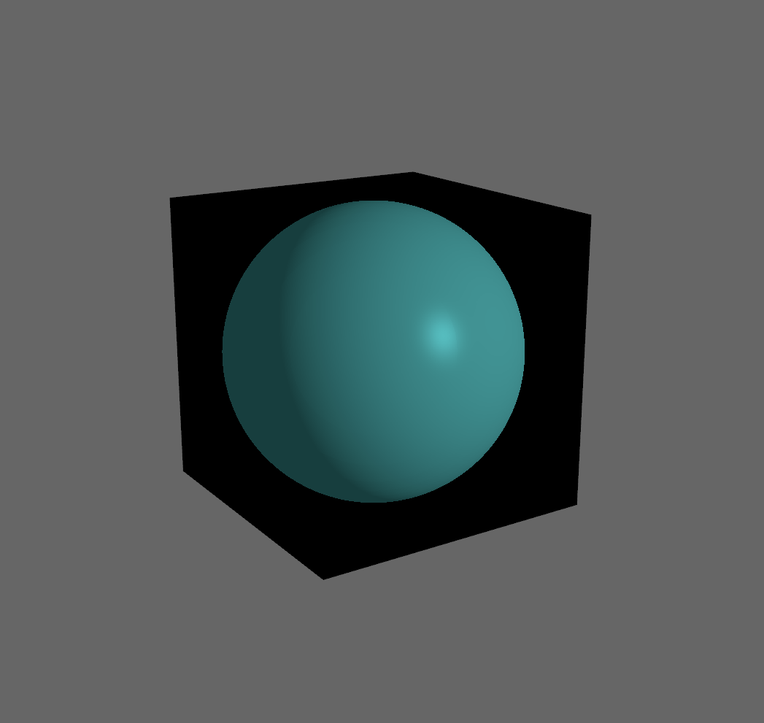
Bevy
Updated the previous code to work with Bevy
Needed to recalculate ray direction to project volume onto cube
Could allow for scenes with multiple volumes

Slide 9

Risk Management
Negligible chance of physical risk
Biggest risk is data loss
Mitigated through Git version control
Stored in the cloud on GitHub

Slide 10
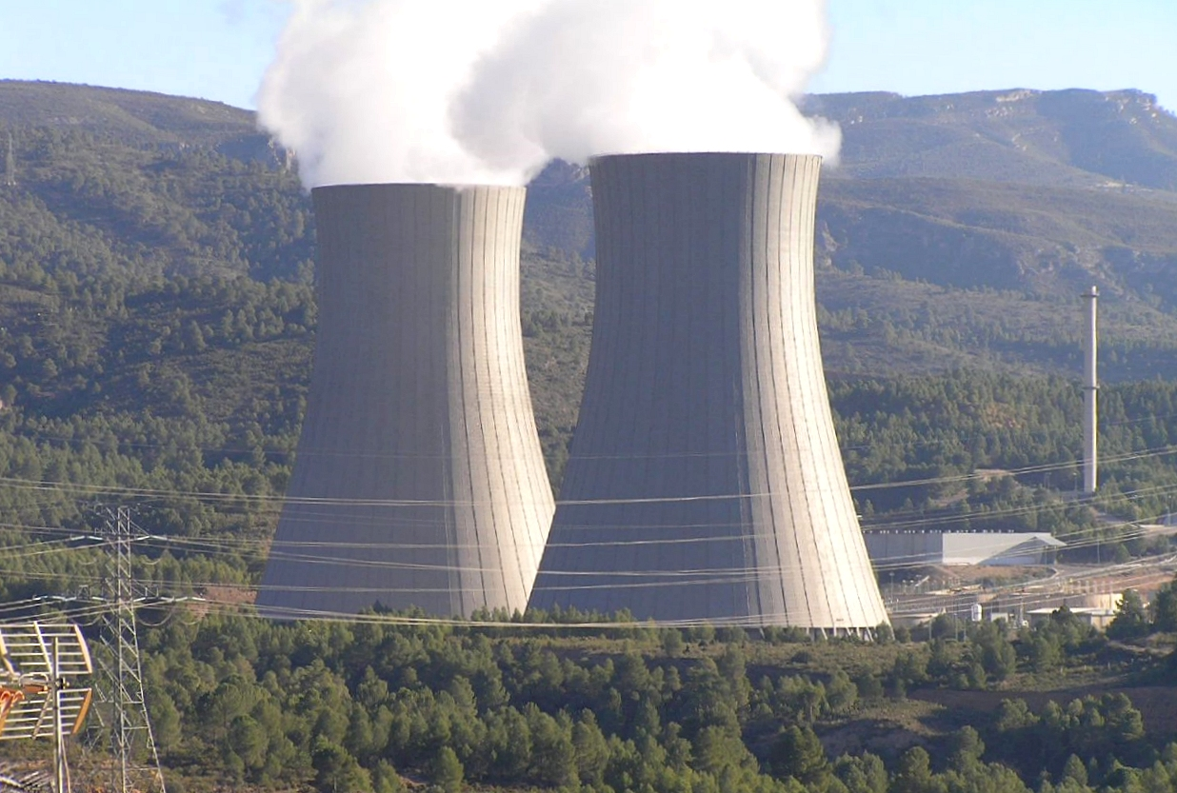

Sustainability
Limited environment impact
Need to consider electricity usage
Efficient code must be written to minimise electricity use
Motivational and development sustainability must be considered

Slide 11

Questions?

