Slide 1
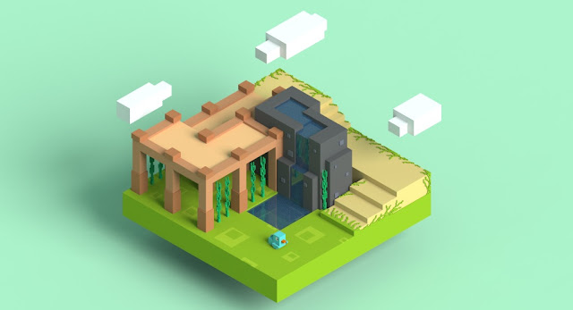
Creating a Voxel Rendering Engine
Alex McDermott (N10494367)

Slide 2
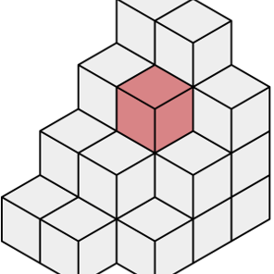
Aim and Research Question
Generate a voxel object
Directly render without intermediary representation
Assess feasibility for web platforms.
Identify future improvements

Slide 3

Context – What is a Voxel?
Essentially a 3D pixel
Used to represent volumetric data
E.g., medical scans like MRI's, clouds, terrain in games etc.
Traditional 3D models use triangles to represent surface geometry
Voxels use a fixed size grid to store data about points in space
Whether an object is transparent or opaque

Slide 4
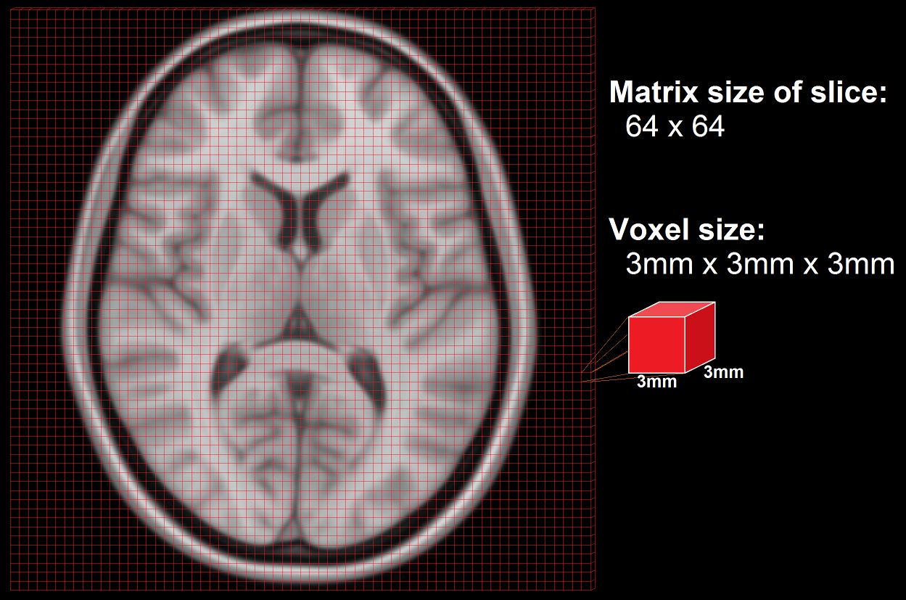
Context – Why use Voxels?
Provide an alternative representation
They have unique use cases
Intuitive representation
Easy manipulation

Slide 5
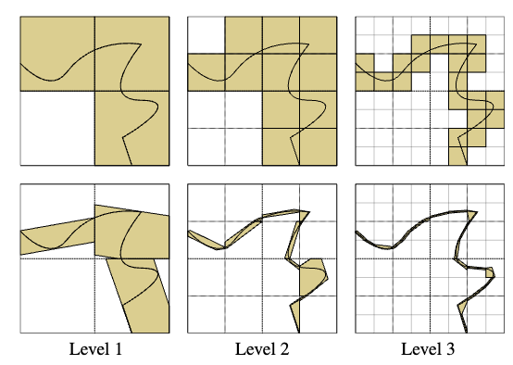
Existing Work – SVO's
Stands for Sparse Voxel Octree
Tree like data structure
Efficiently represent a voxel volume
Iterative division into octants
Subdivision doesn't need to be uniform
Provides memory and computation savings

Slide 6
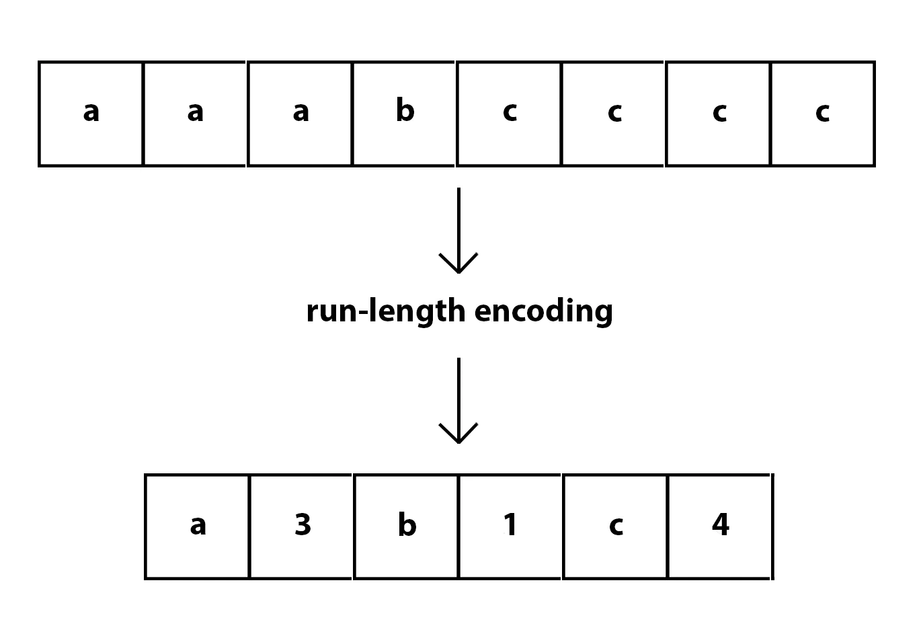
Existing Work – Compression
Voxels can require large amounts of memory
Leaf nodes in an SVO implementation can be compressed
Lossless compression using run length encoding is common
Count number of repeat occurrences and store it with the value

Slide 7
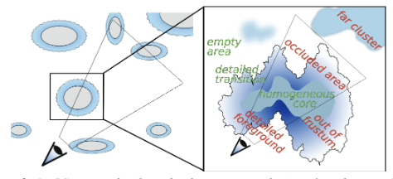
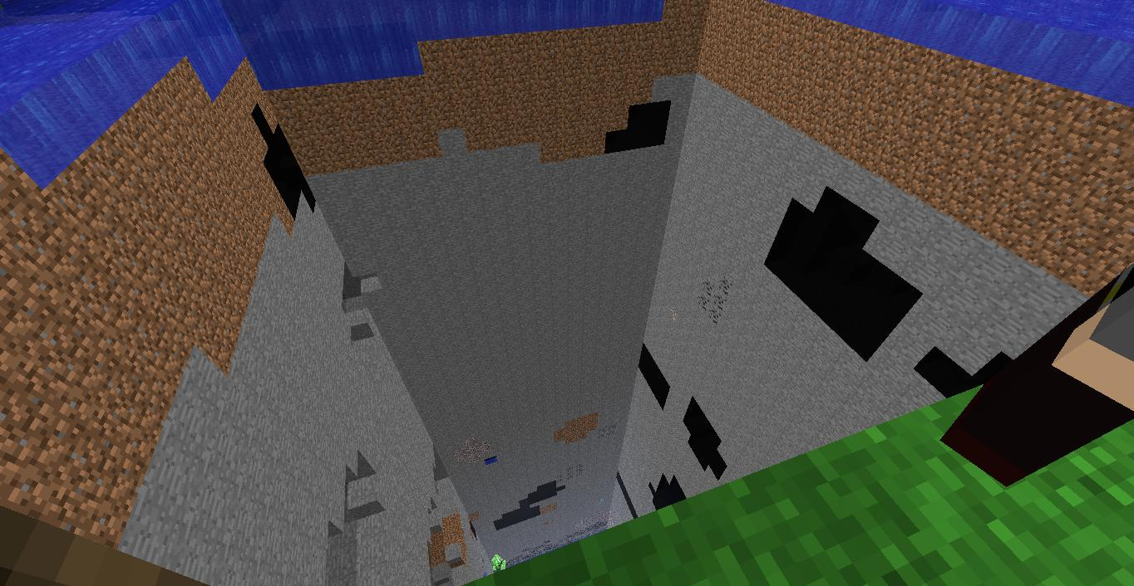
Existing Work – Streaming
Third technique to reduce memory footprint
Loads only data that Is need at a given time
Implement with chunking in voxel applications
Only load in nodes of the SVO that are visible to the camera
Similar to what's used in Minecraft

Slide 8
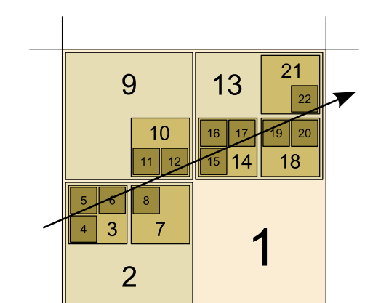
Existing Work – DDA Algorithm
Short for Digital Differential Analysis
Line drawing algorithm in computer graphics
Can be extended to three dimensions
Allows optimal traversal of grid aligned spaces
Each step moves exactly one unit in only one cardinal direction
Avoids overstepping edges
Avoids oversampling

Slide 9


Approach – Language and Framework
Uses native language of the web (JavaScript)
Specifically, the TypeScript superset
NextJS included for easy development

Slide 10

Approach – ThreeJS and React Three Fiber
Uses ThreeJS graphics library
Wrapper around WebGL API
Allows use of the GPU to write shaders
React Three Fiber helps integrate with NextJS

Slide 11
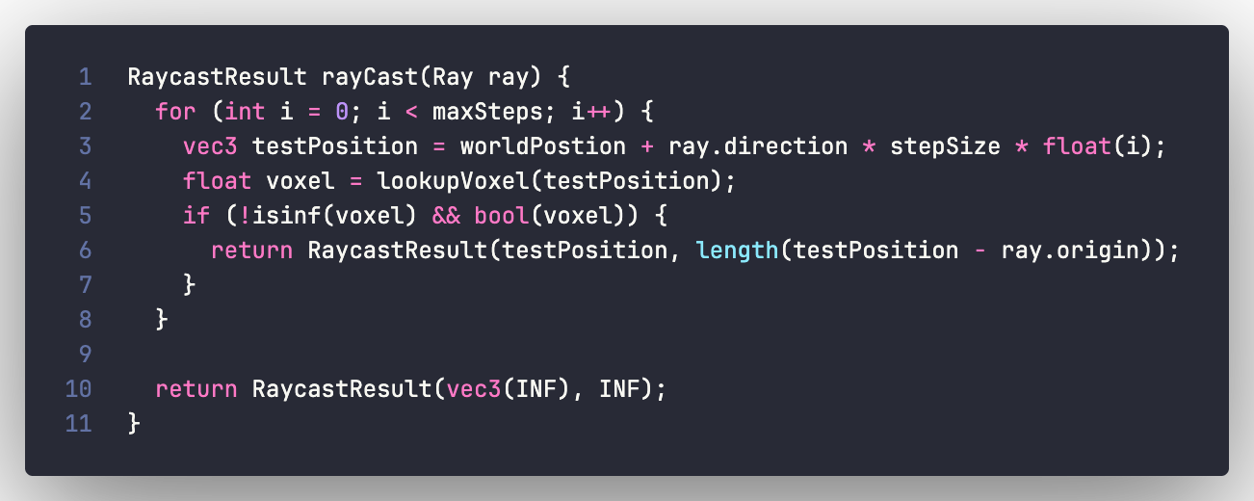
Approach – GLSL
Stands for OpenGL Shading Language
The language that shaders are written in
Runs on the GPU in parallel

Slide 12
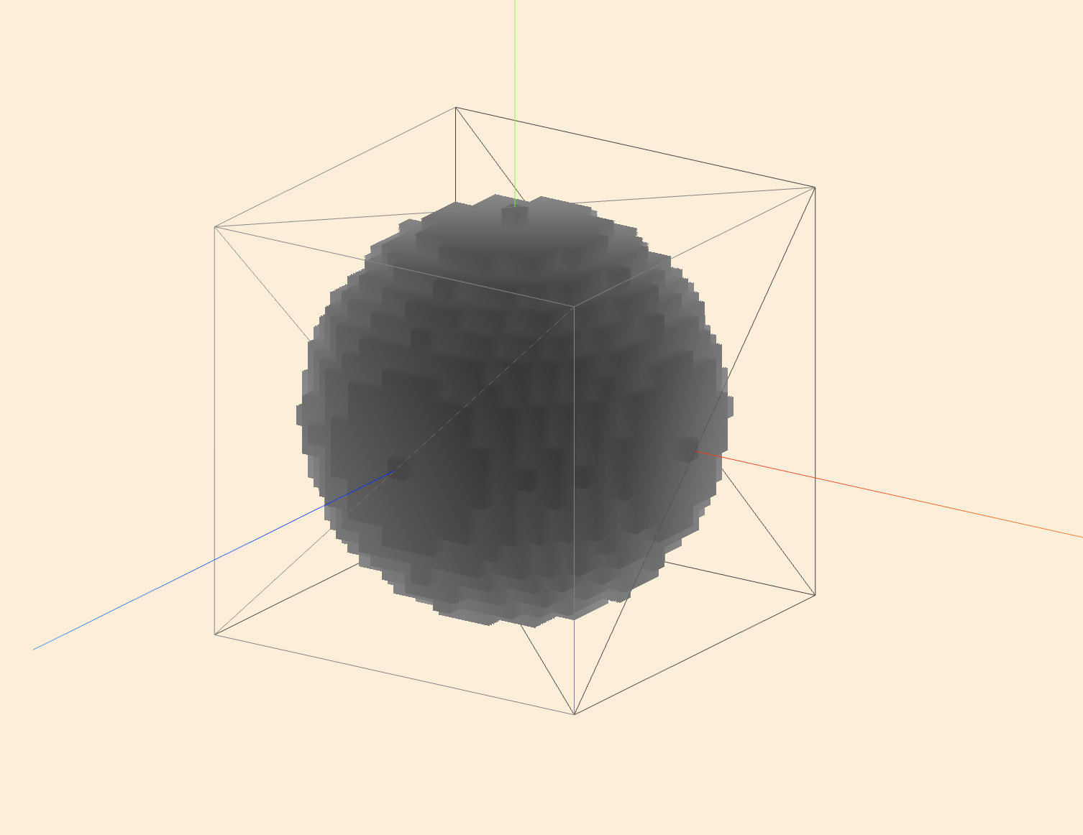
Results – Normalised Depth
Ray could potentially travel infinity far
Depth is mapped to range of proxy geometry

Slide 13
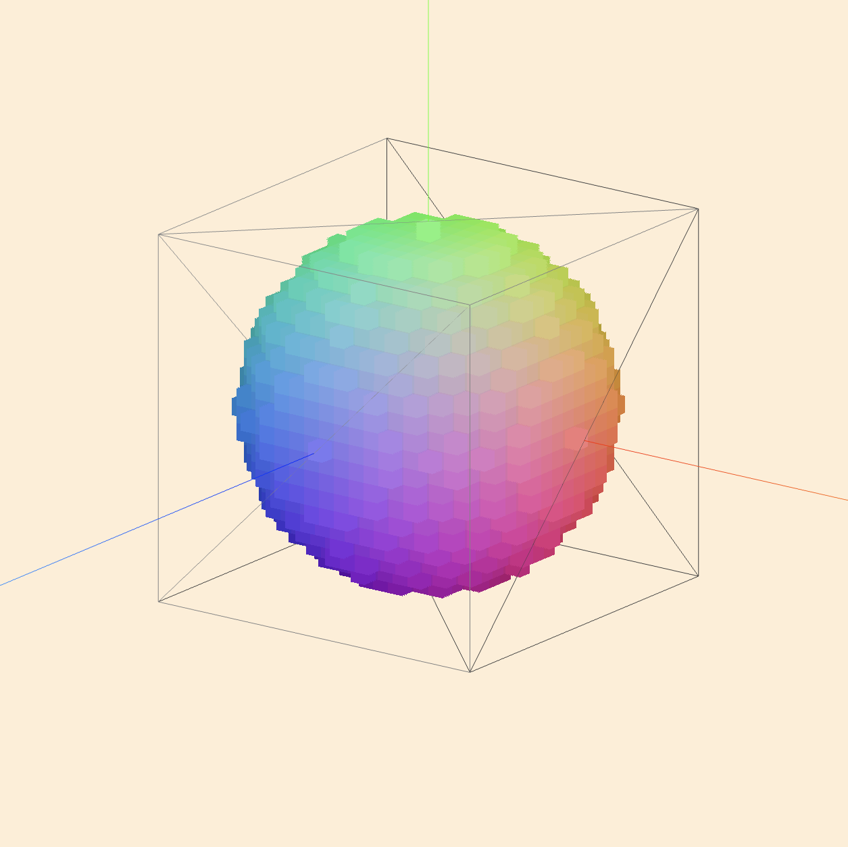
Results – World Space Position
XYZ coordinates are mapped to RGB colors
Darker colors near the origin
Brighter colors going outwards

Slide 14
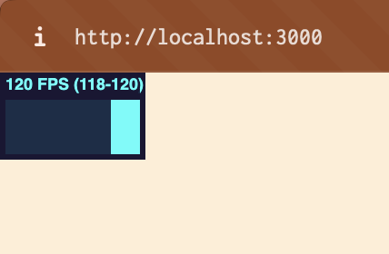
Results – Performance
Runs at 1080p resolution
Hits monitor refresh rate at 120fps
4 times faster than 30fps target on test hardware

Slide 15

Significance and Future Work
The project was significant as it achieved the aim
Achieved despite lack of optimizations
Still large performance gains to be had
Development will continue

Slide 16

Challenges
Multitude of challenges faces
Primarily change of project at end of 400-1
Airbus backed out of previous agreement
Halved time spent on this project
Literature review had to be recompleted
Cut into development time

Slide 17

Conclusion
The project was a success
Despite setbacks the goal was achieved
Real time voxel rendering is feasibly in the browser

