Slide 1
Route Reservation in
Ad Hoc Wireless Networks
By

Slide 2
Abstract:
Route Reservation in ad hoc wireless networks reduces the network traffic, increases the performance. Without route reservation network traffic increases and time delay increases. Same message may be transmitted to other unnecessary destinations also. Sometimes data may be lost,when packets arrived in reverse order.
In this project the N/W performance (in terms of throughput, delay, good put, and max tolerable speed) is analyzed under the RB and NRB switching schemes.

Slide 3
Introduction:
The two principal switching techniques are used in wired networks are
- Circuit switching.
- packet switching.
- Difference between them is the way resources are shared.
Circuit switching :
-Provides exclusive access to the resources by means of reservation.
-min datalost,errors but lot of B.W is wasted if path not used by source
Packet switching :
-Resources are shared on demand, without prior reservation.
- It is suitable for a wired data network such as the Internet.

Slide 4
Existing System : (NRB)
In an NRB (Non Reservation Based) scheme:
An intermediate node can simultaneously serve as relay for more than
one source.
Resources (in terms of relaying nodes) are shared on-demand fashion.
Each node has its own queue & multihop routes are not necessarily
disjoint(two multihop routes between S1&D1).
Same source can transmit successive messages to different
destination(sourse S3 transmitting to D3&D3’)
Relay & destination nodes are involve in new queues.
This is typical for most of the routing protocols in ad hoc wireless
n/w’s.

Slide 5
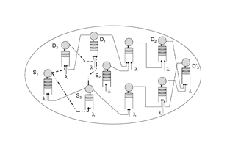
NRB ad hoc wireless n/w model

Slide 6
Proposed System :(RB)
In an RB (Reservation Based) scheme, a source first reserves a multi-hop route to its destination, i.e., it reserves intermediate nodes before the actual transmission begins.
-The reserved intermediate nodes are required to relay only the message
generated by the specific source.
Relay & destination nodes do not involve in new queues(multihop routes are
disjoint)
RB communication can yield better delay performance than NRB communication in ad hoc wireless networks.

Slide 7
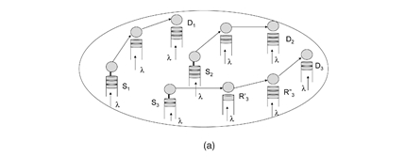
RB ad hoc wireless n/w model

Slide 8
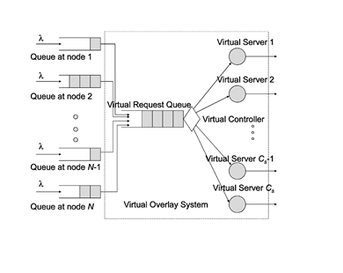
Conceptual queuing model for RB

Slide 9
Requrements:
    Hardware Interface
Hard disk : 40 GB
RAM : 512 MB
Processor Speed : 3.00GHz
Processor : Pentium IV Processor
Software Interface
JDK 1.5
Swing Builder
MySQL Server

Slide 10
Modules:
Non Reservation Based Routing:
In this module, here we transferring the file from source to destination through intermediate node, after transmission we are going to find route path for corresponding destination and the transfer the file to the destination, then calculate the delay
Reservation Based Routing:
In this module, we are going to transfer the same file from source to destination through intermediate node, before transmission we going give route request to all the node and find the corresponding route path for all the node and store it into database, then transfer the file from source to destination through the corresponding route path present in a table and calculate the delay
Comparison Chart:
In this module, going to show performance chart for two different types of routing and this will prove reservation based is better performance than non-reservation based routing

Slide 11
System architecture
.
Source
Non-Reservation Based
Reservation Based
Transmit and Find Delay
Transmit and Find Delay
Performance of Chart

Slide 12
Information flow
DFD (Data Flow Diagram):
The DFD is also called as bubble chart. It is a simple graphical formalism that can be used to represent a system in terms of the input data to the system, various processing carried out on these data, and the output data is generated by the system.

Slide 13
Reservation Based
Non-Reservation Based
Source
Route Nodes
Destination
Latency
Compar
ison
Output
Chart

Slide 14
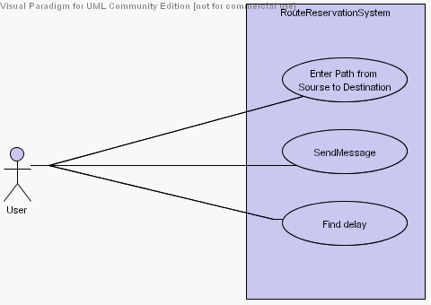
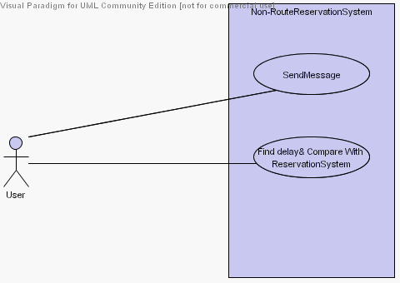
UML Diagrams:
UseCase Diagram

Slide 15
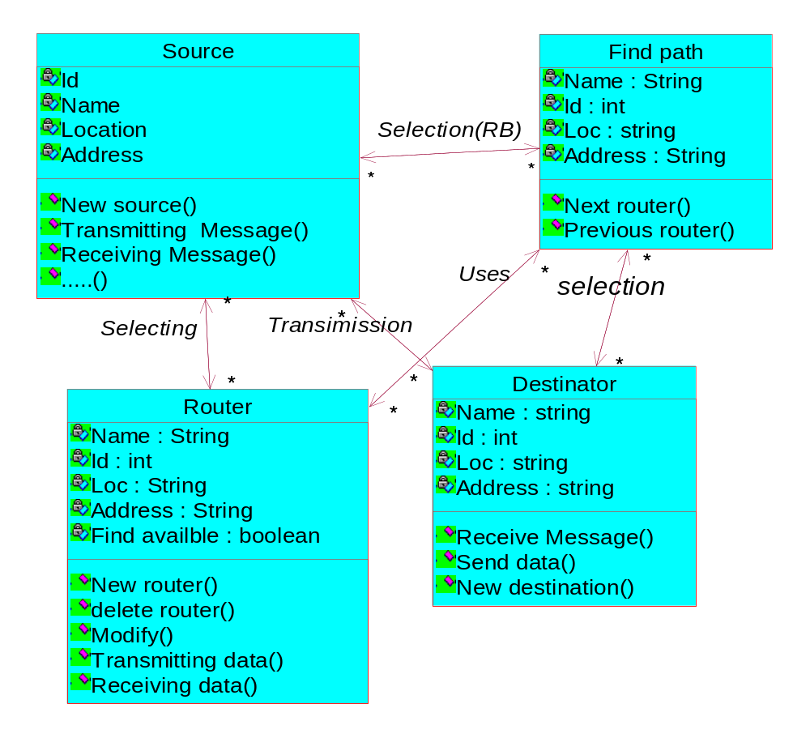
Class Diagram

Slide 16
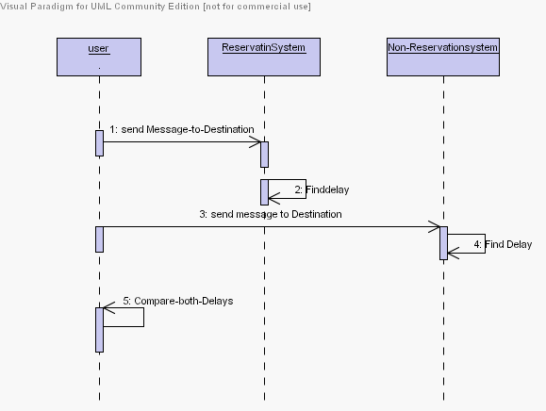
Sequence diagram

Slide 17
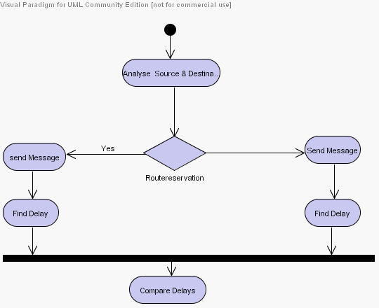
Activity Diagram

Slide 18
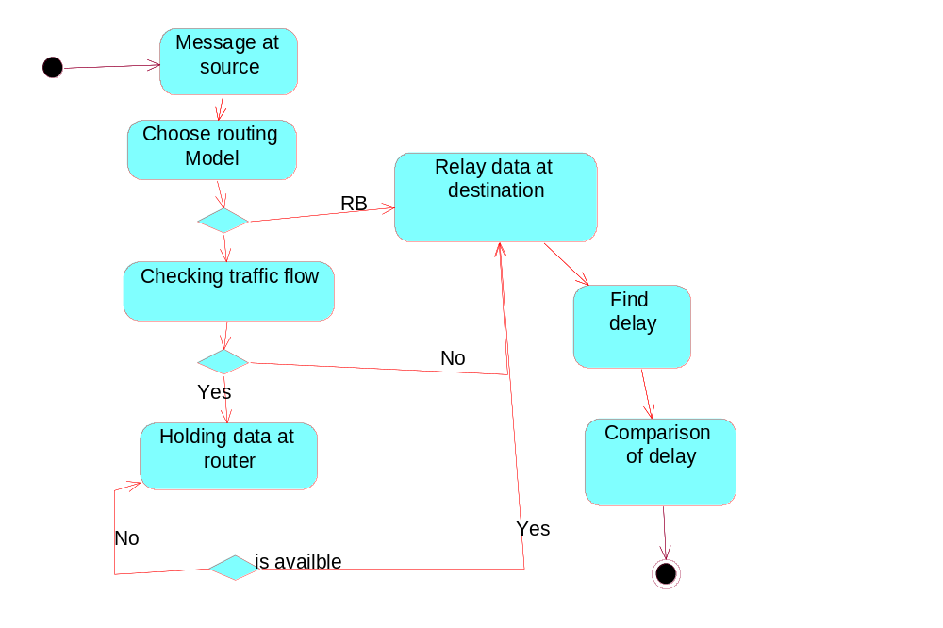
State Chart Diagram

Slide 19
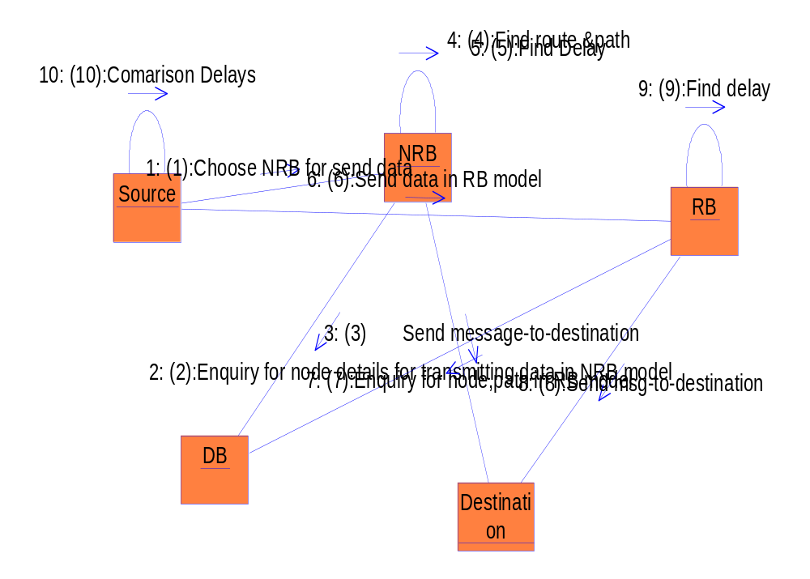
Collaboration Diagram

Slide 20
OUTPUT SCREENSHOTS

Slide 21
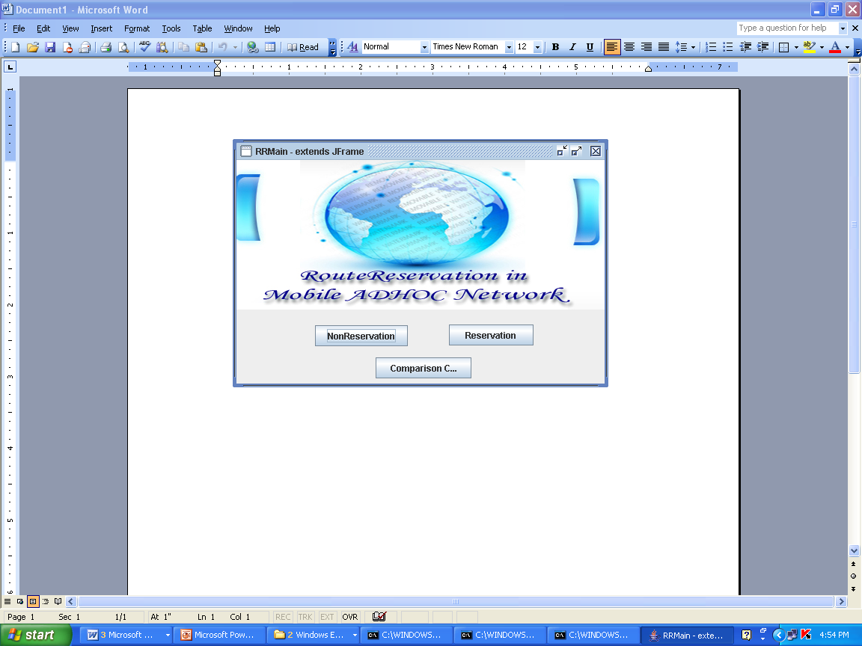

Slide 22
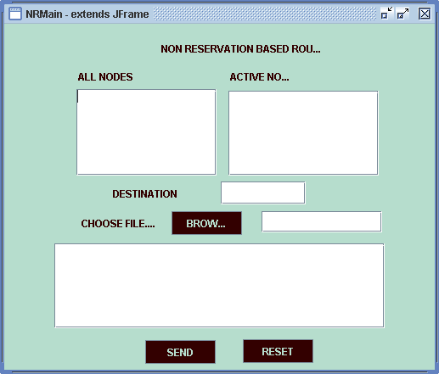
Non-Reservation based

Slide 23
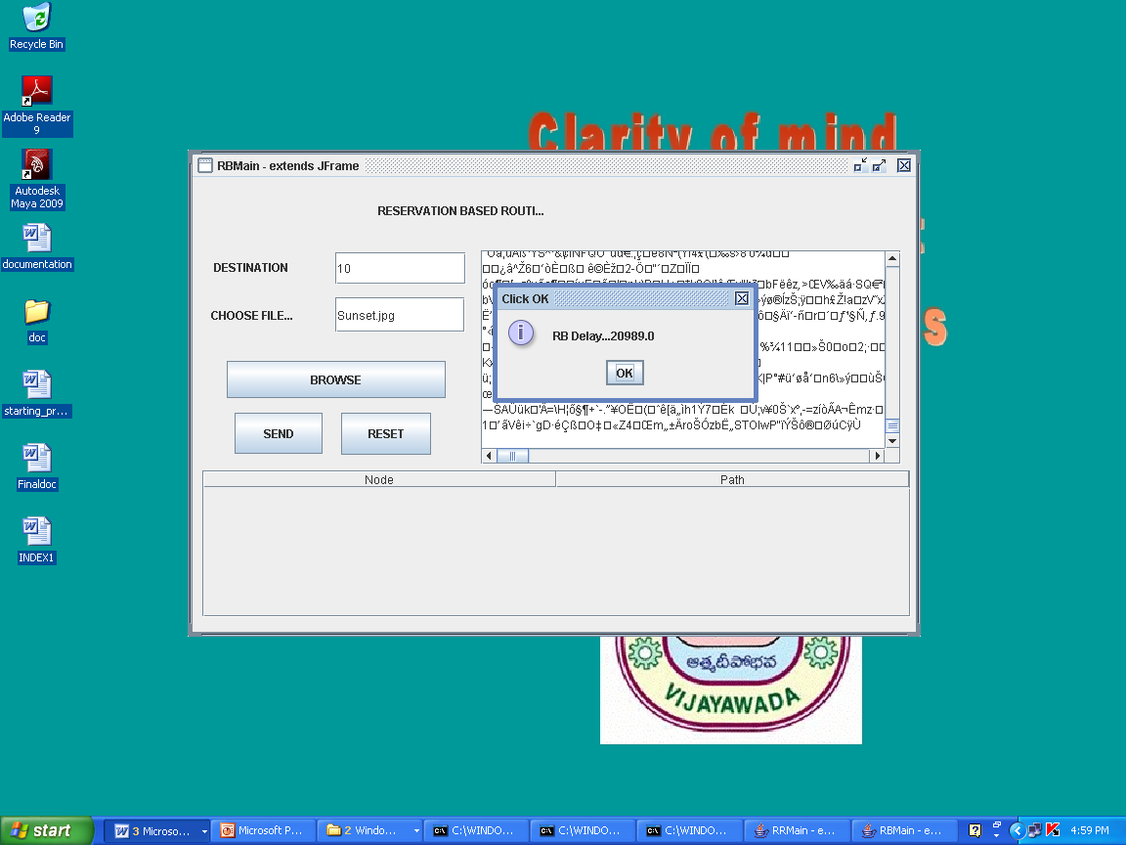
Reservation based

Slide 24
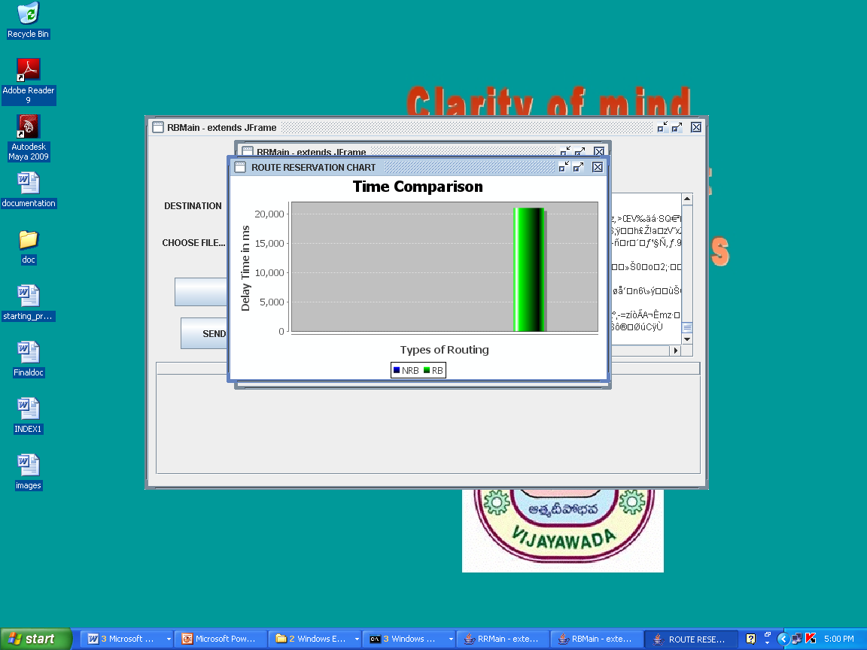

Slide 25
References
D. Bertsekas and R. Gallager, Data Networks. Prentice Hall, 1992.
E.M. Royer and C.-K. Toh, “A Review of Current Routing Protocols for Ad Hoc Mobile Wireless Networks,” IEEE Personal Comm. Magazine, vol. 6, no. 2, pp. 46-55, Apr. 1999.
G. Ferrari and O.K. Tonguz, “Performance of Ad Hoc Wireless Networks with Aloha and PR-CSMA MAC Protocols,” Proc. IEEE GLOBECOM, pp. 2824-2829, Dec. 2003.
C.E. Perkins and E.M. Royer, “Ad-Hoc On-Demand Distance Vector Routing,” Proc. IEEE Workshop Mobile Computing Systems and Applications, pp. 90-100, Feb. 1999.

Slide 26
Queries?

Slide 27
Thank Q

