Slide 1




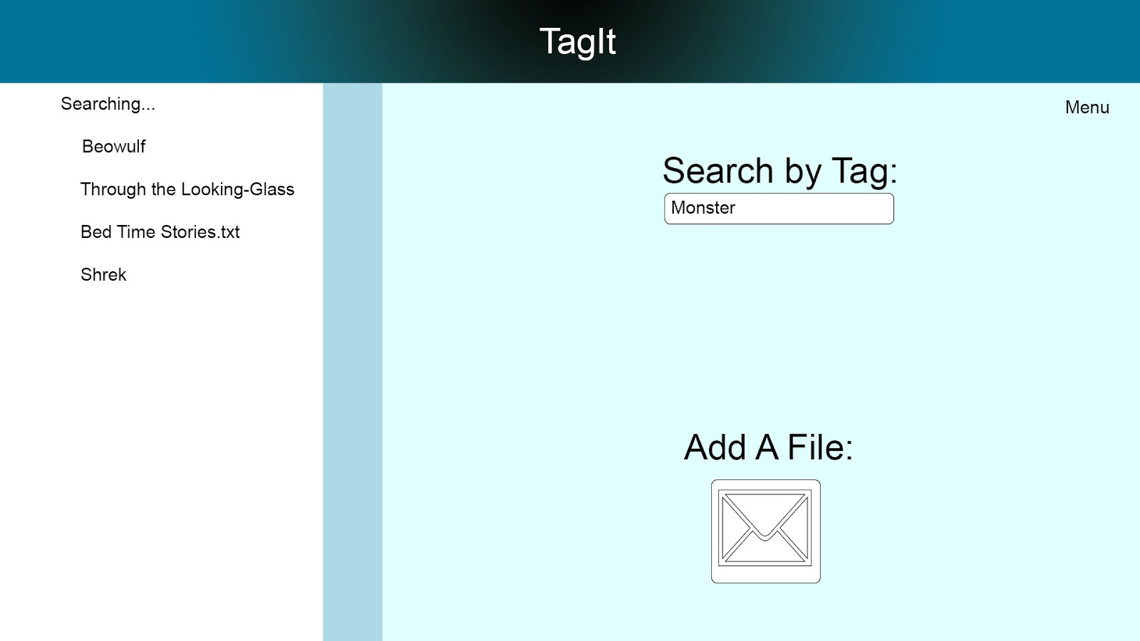
Tag You’re [Storing] It
Fall 2016
Gauge Pendergrass Alex Molbert
Advisor: Bob Bradley
Goal
Requirements
Searching for files must be quick and accurate
Generating the Tags for each file needs to take a reasonable amount of time, and limiting the number of tags generated saves time and space
Security and authentication of users and their files is important
Out goal with this project was to create a cloud bases program, with easy searching. The idea would be to use Tags to be able to search for your files using simple keywords. This would set it apart from other storage programs because you would only need simple keywords, not full titles. The keywords are both created by the user, and also generated by the system itself.
Design Process
The application’s database is hosted on Google’s Firebase
Using a programming language called R, we created scripts that run over user files, using text analysis, to create computer generated Tags
Send a request to OpenCPU, using their API to run scripts for generating Tags that are returned by the server, and stored with the file in database for the user.
Software
Rstudio – A programming environment for the R language
Firebase- A realtime database, owned by google, used for storage of user files and metadata
OpenCPU – A web hosted server, that we use to host our scripts to create computer generated Tags
Conclusion
Accomplished Work:
Allow user to upload a file and create metadata and specific tags
Ability to search for user files using Tags
Able to take user inputted files and create computer generated tags for them
Future Work:
Image analysis
Better algorithm s for better auto generated tags

