Slide 1
Intro CS360
Dr. becka morgan

Slide 2
Why Study Programming languages
The study of programming languages is valuable for a number of reasons:
Increase our capacity to use different constructs
Enable us to choose languages more intelligently
Makes learning new languages easier

Slide 3
Programming Methodologies Influences
1950s and early 1960s: Simple applications; worry about machine efficiency
Late 1960s: People efficiency became important; readability, better control structures
structured programming
top-down design and step-wise refinement
Late 1970s: Process-oriented to data-oriented
data abstraction
Middle 1980s: Object-oriented programming
Data abstraction + inheritance + polymorphism

Slide 4
Language Categories
Imperative
Central features are variables, assignment statements, and iteration
Include languages that support object-oriented programming
Include scripting languages
Include the visual languages
Examples: C, Java, Perl, JavaScript, Visual BASIC .NET, C++
Functional
Main means of making computations is by applying functions to given parameters
Examples: LISP, Scheme, ML, F#
Logic
Rule-based (rules are specified in no particular order)
Example: Prolog
Markup/programming hybrid
Markup languages extended to support some programming
Examples: JSTL, XSLT

Slide 5
Language Design Trade-Offs
Reliability vs. cost of execution
Example: Java demands all references to array elements be checked for proper indexing, which leads to increased execution costs
Readability vs. writability
Example: APL provides many powerful operators (and a large number of new symbols), allowing complex computations to be written in a compact program but at the cost of poor readability
Writability (flexibility) vs. reliability
Example: C++ pointers are powerful and very flexible but are unreliable

Slide 6
Implementation Methods
Compilation
Programs are translated into machine language; includes JIT systems
Use: Large commercial applications
Pure Interpretation
Programs are interpreted by another program known as an interpreter
Use: Small programs or when efficiency is not an issue
Hybrid Implementation Systems
A compromise between compilers and pure interpreters
Use: Small and medium systems when efficiency is not the first concern

Slide 7
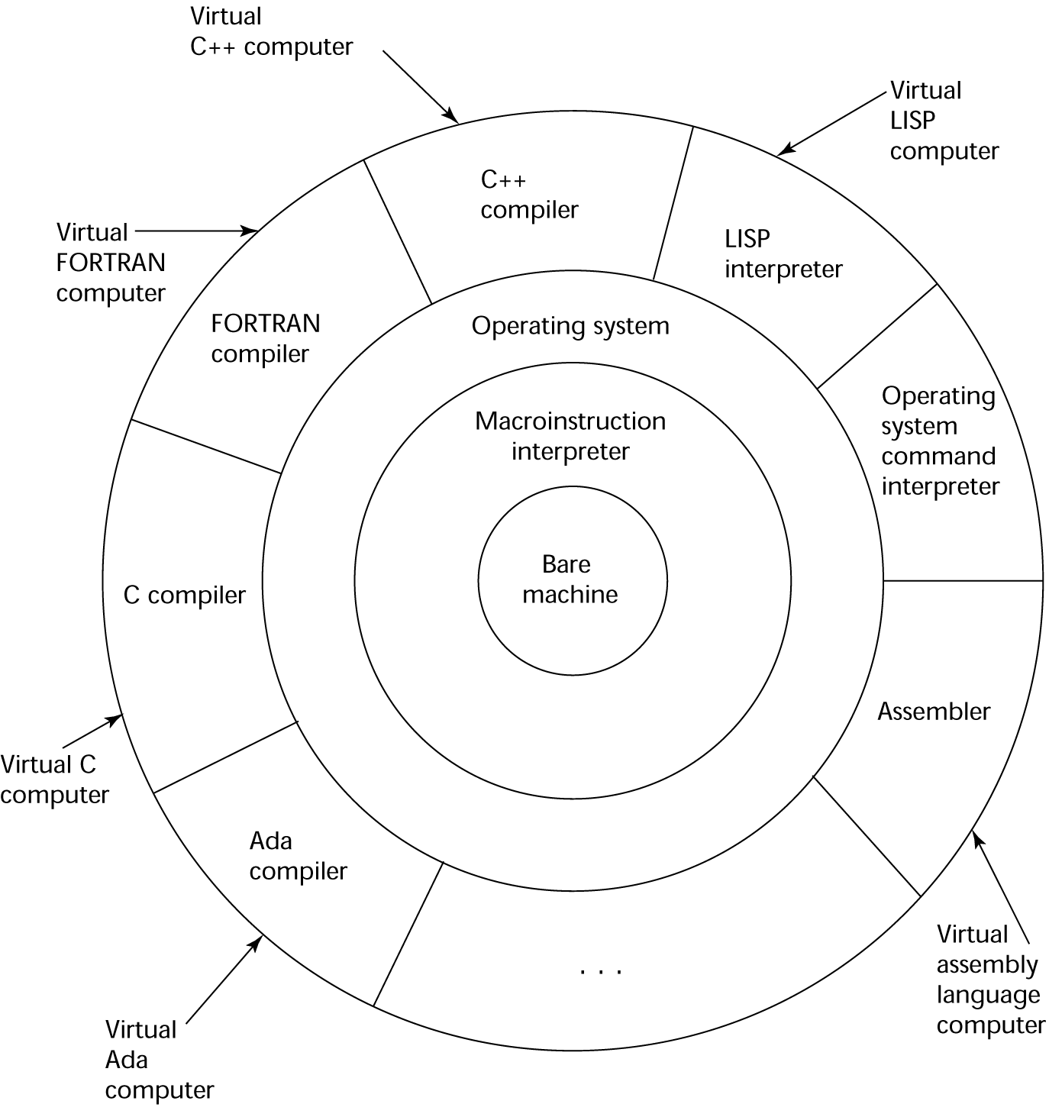
Layered View of Computer
The operating system and language implementation are layered over
machine interface of a computer

Slide 8
Compilation
Translate high-level program (source language) into machine code (machine language)
Slow translation, fast execution
Compilation process has several phases:
lexical analysis: converts characters in the source program into lexical units
syntax analysis: transforms lexical units into parse trees which represent the syntactic structure of program
Semantics analysis: generate intermediate code
code generation: machine code is generated

Slide 9
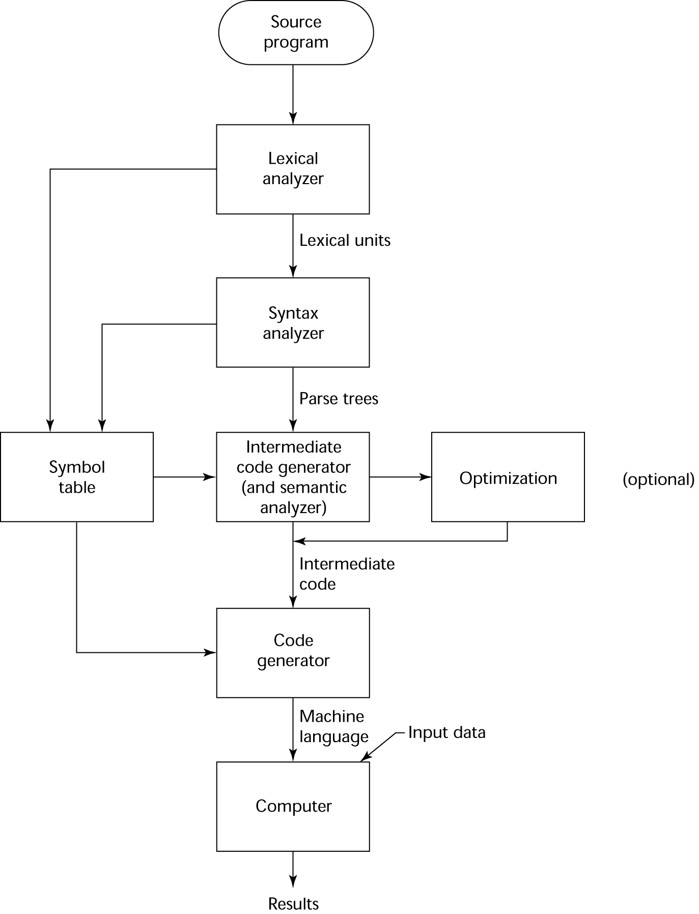
The Compilation Process

Slide 10
Programming paradigms
Main programming paradigms
The imperative paradigm
The functional paradigm
The logical paradigm
The object-oriented paradigm

Slide 11
The imperative paradigm First do this and next do that
Characteristics:
Discipline and idea
Digital hardware technology and the ideas of Von Neumann
Incremental change of the program state as a function of time.
Execution of computational steps in an order governed by control structures
We call the steps for commands
Straightforward abstractions of the way a traditional Von Neumann computer works
Similar to descriptions of everyday routines, such as food recipes and car repair
Typical commands offered by imperative languages
Assignment, IO, procedure calls
Language representations
Fortran, Algol, Pascal, Basic, C
The natural abstraction is the procedure
Abstracts one or more actions to a procedure, which can be called as a single command.
"Procedural programming"
Notes:
Control flow in imperative programming is explicit: commands show how the computation takes place, step by step. Each step affects the global state of the computation.

Slide 12
The Functional paradigm Evaluate an expression and use the resulting value for something
Characteristics:
Discipline and idea
Mathematics and the theory of functions
The values produced are non-mutable
Impossible to change any constituent of a composite value
As a remedy, it is possible to make a revised copy of composite value
Atemporal
Time only plays a minor role compared to the imperative paradigm
Applicative
All computations are done by applying (calling) functions
The natural abstraction is the function
Abstracts a single expression to a function which can be evaluated as an expression
Functions are first class values
Functions are full-fledged data just like numbers, lists, ...
Fits well with computations driven by needs
Opens a new world of possibilities
Notes:
Functional — Computation proceeds by (nested) function calls that avoid any global state. Programs have no variables. No kidding.
In functional programming control flow is expressed by combining function calls, rather than by assigning values to variables.
With functional programming
There are no commands, only side-effect free expressions
Code is much shorter, less error-prone, and much easier to prove correct
There is more inherent parallelism, so good compilers can produce faster code

Slide 13
The logic paradigm Answer a question via search for a solution
Characteristics:
Discipline and idea
Automatic proofs within artificial intelligence
Based on axioms, inference rules, and queries.
Program execution becomes a systematic search in a set of facts, making use of a set of inference rules
Notes:
Logic (Rule-based) — Programmer specifies a set of facts and rules, and an engine infers the answers to questions.

Slide 14
The object oriented Paradigm Send messages between objects to simulate the temporal evolution of a set of real world phenomena
Characteristics:
Discipline and idea
The theory of concepts, and models of human interaction with real world phenomena
Data as well as operations are encapsulated in objects
Information hiding is used to protect internal properties of an object
Objects interact by means of message passing
A metaphor for applying an operation on an object
In most object-oriented languages objects are grouped in classes
Objects in classes are similar enough to allow programming of the classes, as opposed to programming of the individual objects
Classes represent concepts whereas objects represent phenomena
Classes are organized in inheritance hierarchies
Provides for class extension or specialization
Notes:
Object-Oriented — Computation is effected by sending messages to objects; objects have state and behavior.
OOP is based on the sending of messages to objects. Objects respond to messages by performing operations. Messages can have arguments, so "sending messages" looks a lot like calling subroutines. A society of objects, each with their own "local memory" and own set of operations has a different feel than the "monolithic processor and single shared memory" feel of non object oriented languages.

Slide 15
Readings and videos
On Moodle
Also optional books
Google
Questions?

