Slide 1
Chapter 4 - Syntax
Programming Languages:
Principles and Practice, 2nd Ed.
Kenneth C. Louden
© Kenneth C. Louden, 2003

Slide 2
Introduction
Syntax is the structure of a language, i.e., the form that each program or source code file must take.
Since the early 1960s, syntax has been given as a set of grammar rules in a form developed by Noam Chomsky, John Backus, and Peter Naur. (Context-free grammar, Backus Naur Form [BNF].)
Syntax includes the definition of the words, or tokens, of the language, which can be called its lexical structure.
Both lexical and syntactic structure have precise mathematical definitions that every computer scientist should know.
Chapter 4
K. Louden, Programming Languages

Slide 3
Lexical Structure
Tokens are the building blocks of syntax: the “words” of the language.
Tokens are recognized by the first phase of a translator -- the scanner -- which is the only part of the translator that deals directly with the input. The scanner groups the input characters into tokens. (Scanners are sometimes called lexers.)
Tokens can be defined using either grammar rules or regular expressions.
Regular expressions are used in many areas of computer science to describe text patterns. One example: grep (“global regular expression print”).
Sample regular expression: [0-9]+(\.[0-9]+)?
Chapter 4
K. Louden, Programming Languages

Slide 4
Standard Token Categories
Reserved words, sometimes called keywords, such as if and while
Literals or constants, such as 42 (a numeric literal) or "hello" (a string literal)
Special symbols, such as “;”, “<=”, or “+”
Identifiers, such as x24, monthly_balance, or putchar
Chapter 4
K. Louden, Programming Languages

Slide 5
White space and comments
“Internal” tokens of the scanner that are matched and discarded
Typical white space: newlines, tabs, spaces
Comments:
    /* … */, // … \n (C, C++, Java)
    -- … \n (Ada, Haskell)
    (* … *) (Pascal, ML)
    ; … \n (Scheme)
Comments generally not nested.
Comments & white space ignored except they function as delimiters (or separators).
Chapter 4
K. Louden, Programming Languages

Slide 6
Reserved words versus predefined identifiers
Reserved words cannot be used as the name of anything in a definition (i.e., as an identifier).
Predefined identifiers have special meanings, but can be redefined (although they probably shouldn’t).
Examples of predefined identifiers in Java:
anything in java.lang package, such as String, Object, System, Integer.
Chapter 4
K. Louden, Programming Languages

Slide 7
Java reserved words
abstract default if private this
boolean do implements protected throw
break double import public throws
byte else instanceof return transient
case extends int short try
catch final interface static void
char finally long strictfp volatile
class float native super while
const for new switch
continue goto package synchronized
Chapter 4
K. Louden, Programming Languages

Slide 8
Java reserved words (cont.)
The keywords const and goto are reserved, even though they are not currently used. This may allow a Java compiler to produce better error messages if these C++ keywords incorrectly appear in programs.
While true and false might appear to be keywords, they are technically boolean literals (§3.10.3). Similarly, while null might appear to be a keyword, it is technically the null literal (§3.10.7).
Chapter 4
K. Louden, Programming Languages

Slide 9
C tokens
“There are six classes of tokens: identifiers, keywords, constants, string literals, operators, and other separators. Blanks, horizontal and vertical tabs, newlines, formfeeds, and comments as described below (collectively, "white space") are ignored except as they separate tokens. Some white space is required to separate otherwise adjacent identifiers, keywords, and constants. If the input stream has been separated into tokens up to a given character, the next token is the longest string of characters that could constitute a token.” [Kernighan and Ritchie, The C Programming Language, 2nd Ed., pp. 191-192.]
Note principle of longest substring (true for virtually every language except FORTRAN): ifelse is an identifier, not two keywords.
Chapter 4
K. Louden, Programming Languages

Slide 10
Scanners
Recognizers of regular expressions
Implemented as finite automata, a.k.a. finite state machines
Typically contain a loop that cycles through characters, building tokens and associated values by repeated operations
This process is repeated for each token
A single token recognition is encapsulated in a getToken() (or similarly named) procedure
Chapter 4
K. Louden, Programming Languages

Slide 11
Simple scanner example
Tokens from integer arithmetic:
+ - * / Number ([0-9]+), left & right parens, and white space, all on a single line of input
EOL token also needed (to end input)
Error token also needed (for illegal characters)
C code is in Figure 4.1, pages 82-83
(only + and * are implemented in that code)
Input taken from standard input (keyboard or redirected file)
End of file check not implemented
Chapter 4
K. Louden, Programming Languages

Slide 12
Context-free grammars
Figure 4.2, page 83:
  (1) sentence → noun-phrase verb-phrase .
  (2) noun-phrase → article noun
  (3) article → a | the
  (4) noun → girl | dog
  (5) verb-phrase → verb noun-phrase
  (6) verb → sees | pets
Chapter 4
K. Louden, Programming Languages

Slide 13
Terminology
Left-hand sides (before the →) are called nonterminals or structure names.
Right-hand sides (after the →) are strings of tokens and nonterminals, sometimes called symbols. (Metasymbols with special meanings can also sometimes appear.)
Tokens are sometimes called terminals.
Grammar rules themselves are sometimes called productions, since they "produce" the language.
Metasymbols are the arrow → (“consists of”) and the vertical bar | (choice).
One nonterminal is singled out as the start symbol: it stands for a complete unit in the language (sentence, program).
Chapter 4
K. Louden, Programming Languages

Slide 14
CFGs generate “languages”:
The language of a CFG is the set of strings of terminals that can be generated from the start symbol by a derivation:
    sentence ⇒ noun-phrase verb-phrase . (rule 1)
    ⇒ article noun verb-phrase . (rule 2)
    ⇒ the noun verb-phrase . (rule 3)
    ⇒ the girl verb-phrase . (rule 4)
    ⇒ the girl verb noun-phrase . (rule 5)
    ⇒ the girl sees noun-phrase . (rule 6)
    ⇒ the girl sees article noun . (rule 2)
    ⇒ the girl sees a noun . (rule 3)
    ⇒ the girl sees a dog . (rule 4)
Chapter 4
K. Louden, Programming Languages

Slide 15
CFGs can be recursive:
  expr → expr + expr | expr ∗ expr
  | ( expr ) | number
  number → number digit | digit
  digit → 0 | 1 | 2 | 3 | 4 | 5 | 6 | 7 | 8 | 9
or
  expr → expr + expr | expr ∗ expr
  | ( expr ) | NUMBER
  NUMBER = [0-9]+
Chapter 4
K. Louden, Programming Languages

Slide 16
Notes:
Recursion can be used to get simple repetition (Example 1):
    number ⇒ number digit ⇒ number digit digit
    ⇒ digit digit digit ⇒ 2 digit digit
    ⇒ 23 digit ⇒ 234
Recursion is more powerful than just simple repetition (Example 2):
    expr ⇒ expr * expr ⇒ ( expr ) * expr
    ⇒ ( expr + expr ) * expr ⇒ ...
    ⇒ (2 + 3) * 4
Chapter 4
K. Louden, Programming Languages

Slide 17
Parse Trees
Derivations express the structure of syntax, but not very well: there can be lots of different derivations for the same structure, e.g. Example 1 could have been:
    number ⇒ number digit ⇒ number 4
    ⇒ number digit 4 ⇒ number 34
    ⇒ digit 34 ⇒ 234
A parse tree better expresses the structure inherent in a derivation.
Two sample parse trees on next slide.
Chapter 4
K. Louden, Programming Languages

Slide 18
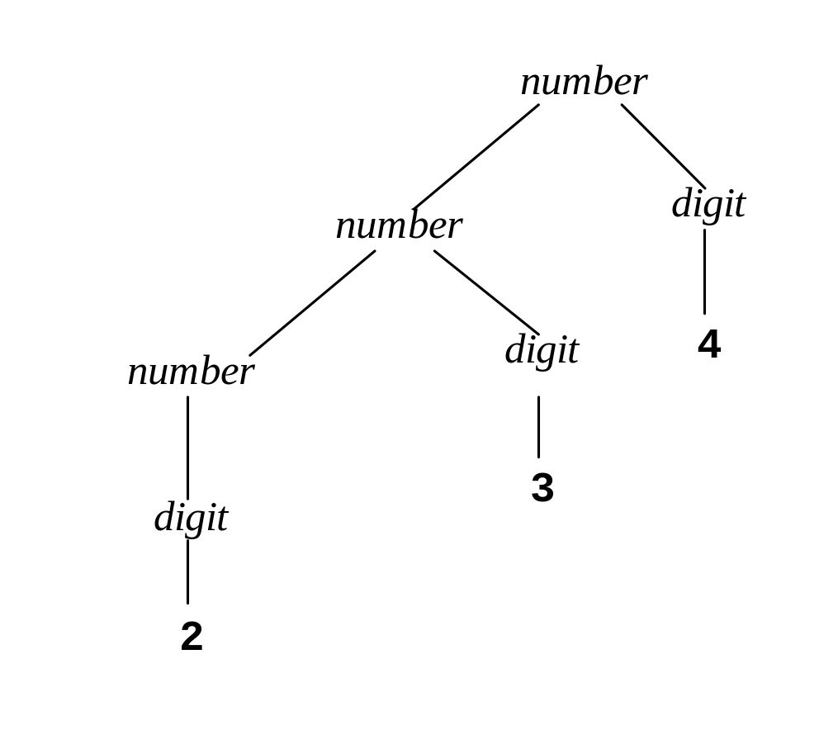
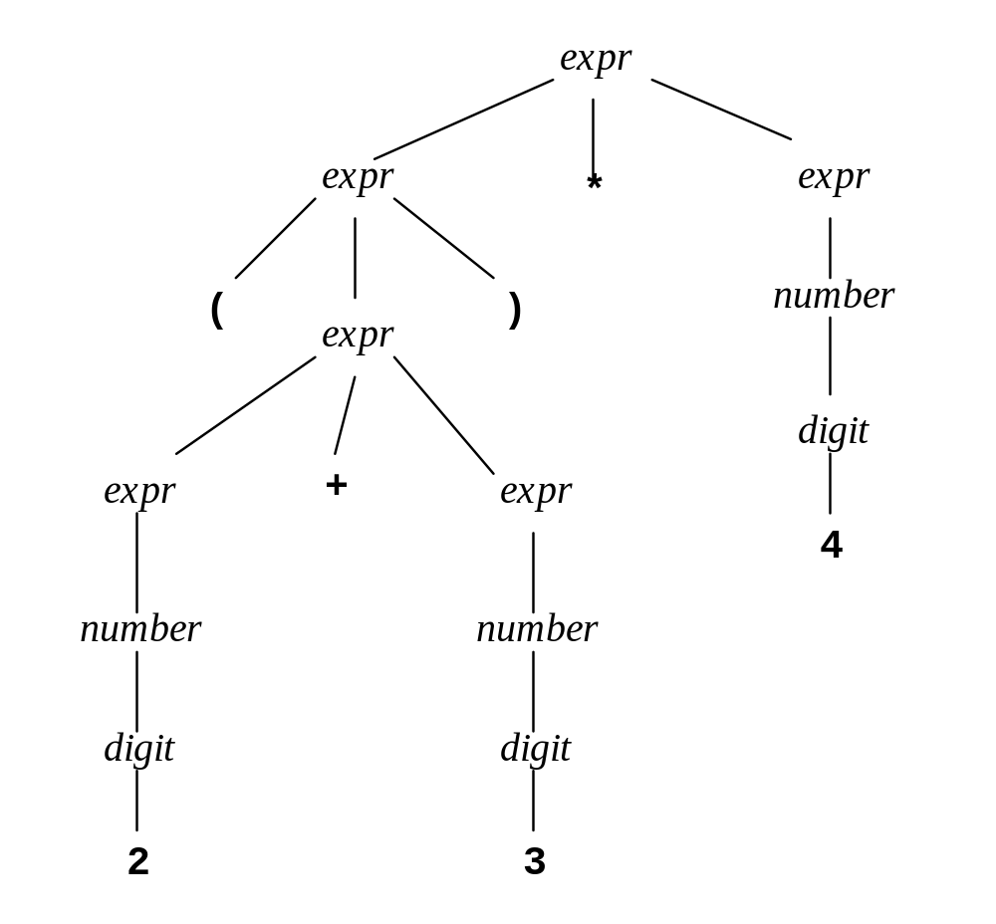
Example 1:
Example 2:
Chapter 4
K. Louden, Programming Languages

Slide 19
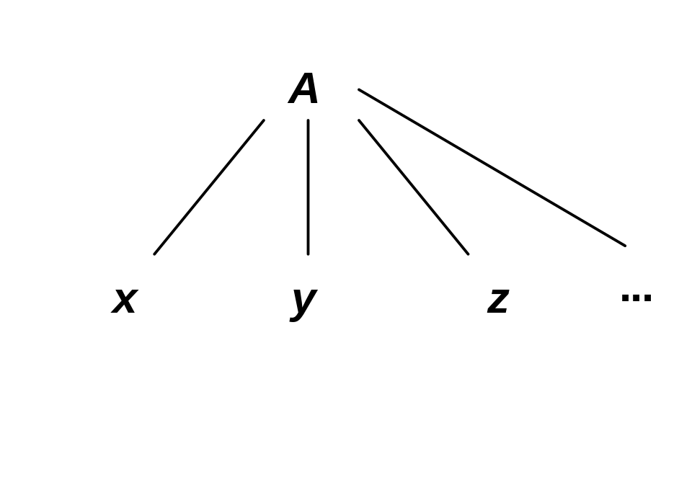
Notes on Parse Trees
Leaves are tokens, interior nodes are nonterminals, the root node is the start symbol.
Every replacement in a derivation using a grammar rule A → xyz… corresponds to the creation of children at the node labeled A:
Chapter 4
K. Louden, Programming Languages

Slide 20
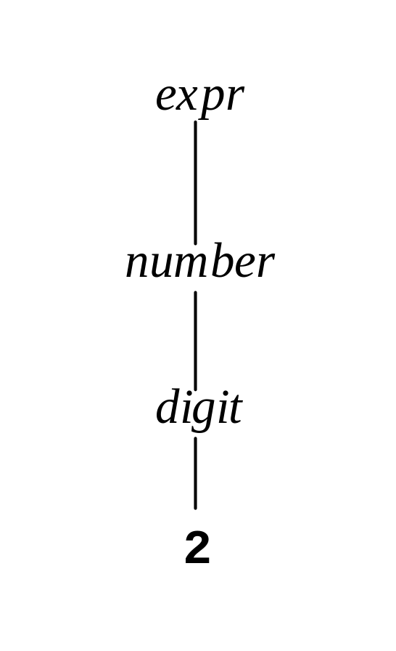
Abstract Syntax Trees
Parse trees are still too detailed in their structure, since every step in a derivation is expressed as nodes:
We would really like this
to be just a “2” node.
An (abstract) syntax tree
condenses a parse tree
to its essential structure,
removing such “cascades.”
Chapter 4
K. Louden, Programming Languages

Slide 21
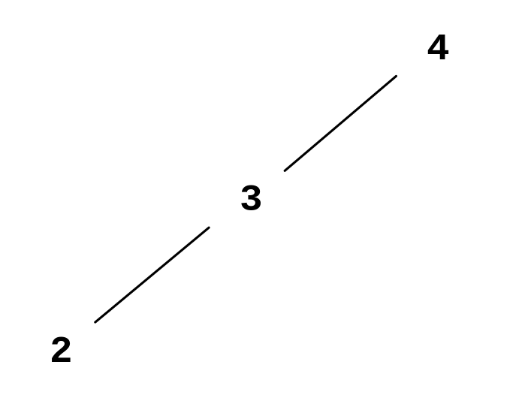
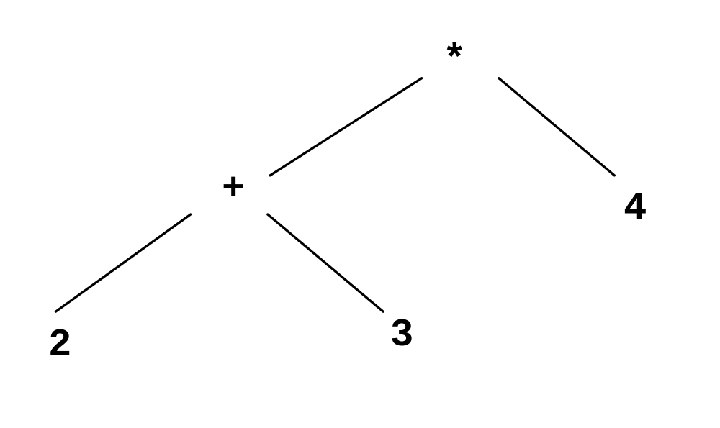
Example 1:
Example 2:
Note how much more compact -- even parentheses have disappeared!
Chapter 4
K. Louden, Programming Languages

Slide 22
Principle of syntax-directed semantics (or semantics-based syntax):
The parse tree and the abstract syntax tree must have a structure that corresponds to the computation to be performed.
Chapter 4
K. Louden, Programming Languages

Slide 23
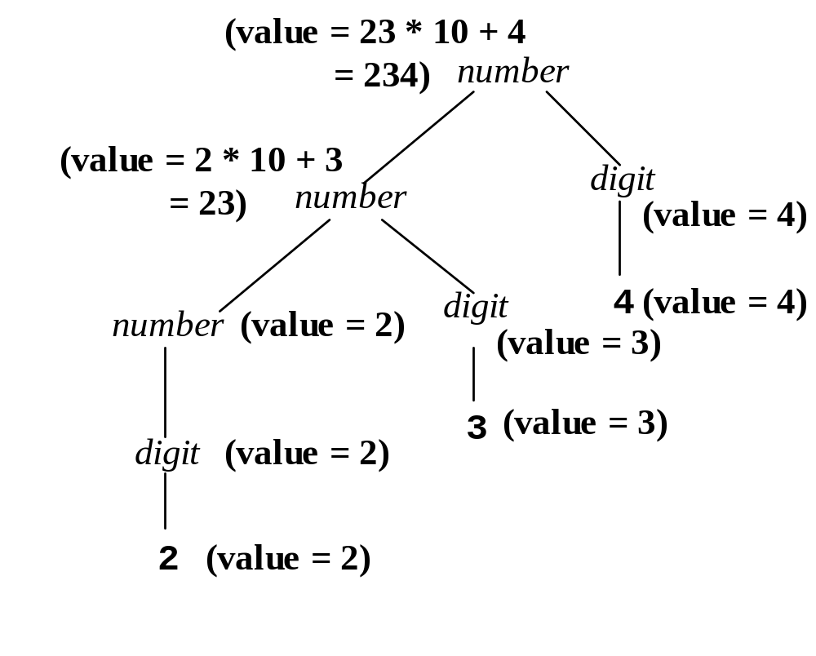
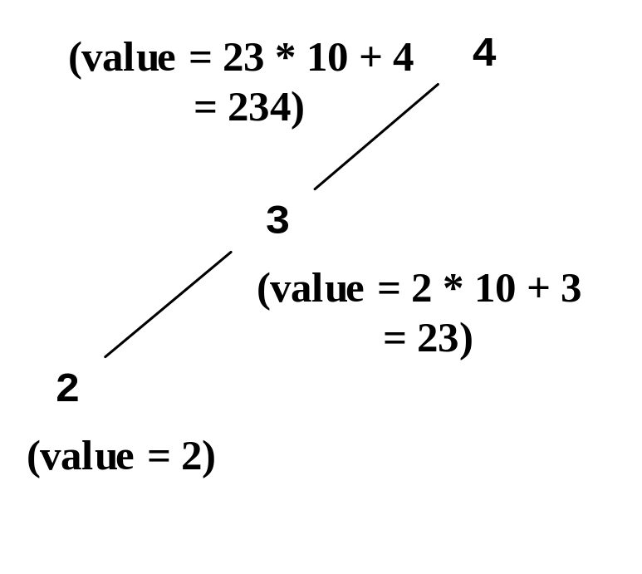
Example 1:
Parse tree
Abstract syntax tree
Chapter 4
K. Louden, Programming Languages

Slide 24
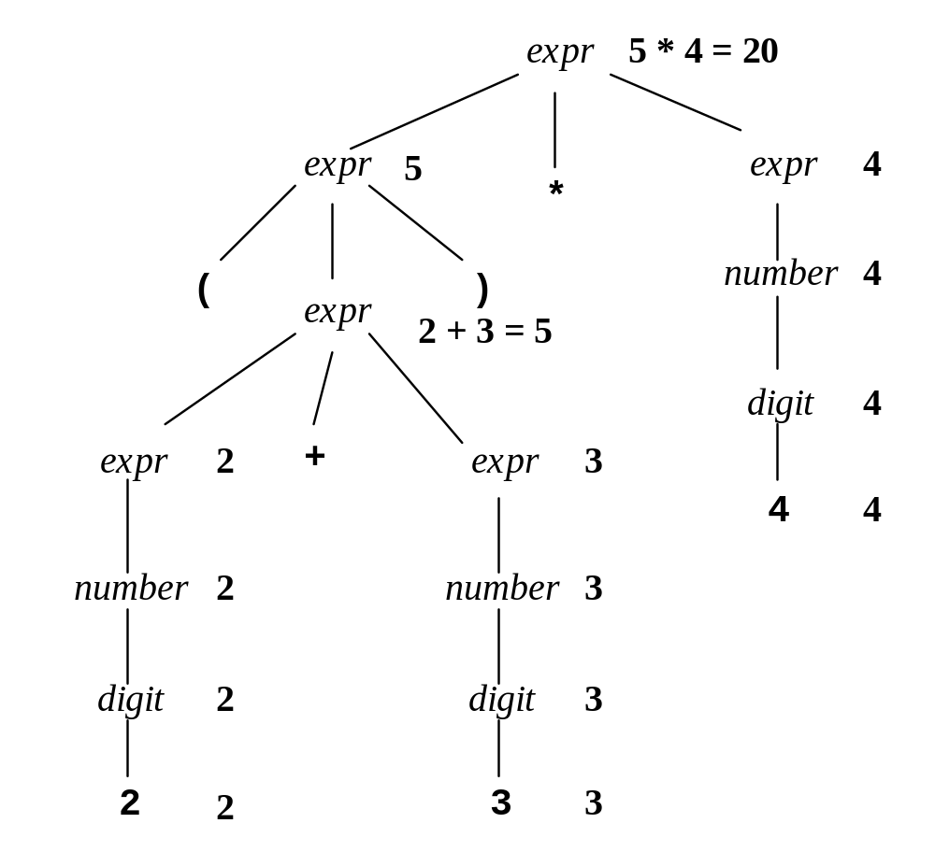
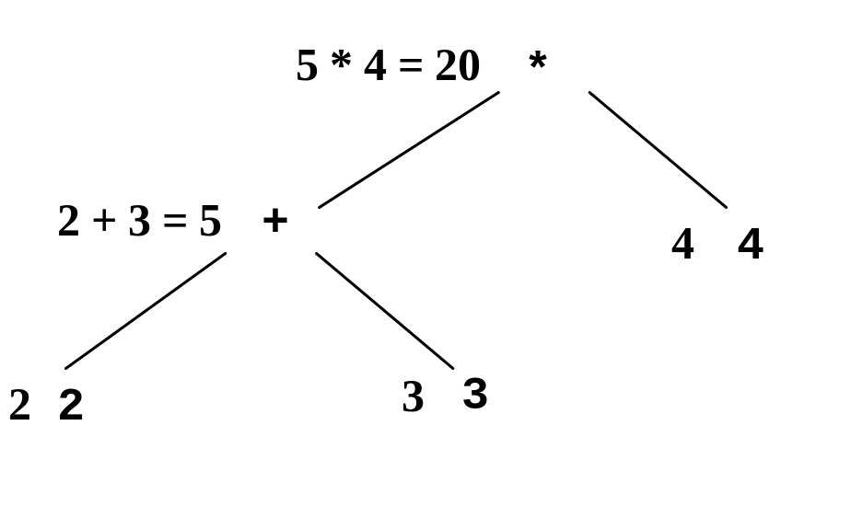
Example 2:
Parse tree
Abstract syntax tree
Chapter 4
K. Louden, Programming Languages

Slide 25
Ambiguity
Grammars don’t always specify unique parse trees for every string in the language: a grammar is ambiguous if some string has two distinct parse (or abstract syntax) trees (not just two distinct derivations).
Ambiguity is usually bad and must be removed.
Semantics help in determining which parse tree is correct.
Often the grammar can be rewritten to make the correct choice.
Chapter 4
K. Louden, Programming Languages

Slide 26
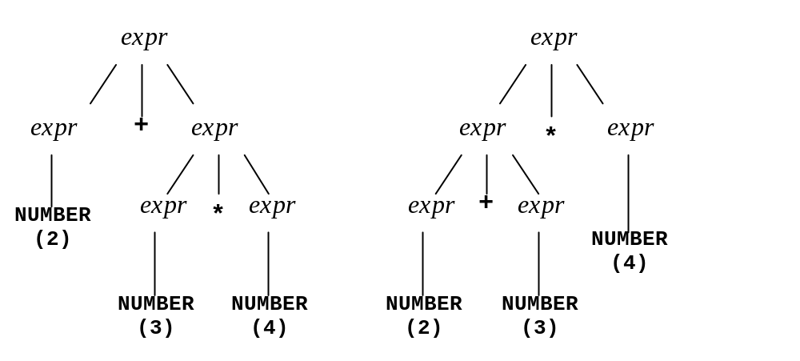
Example of Ambiguity
Grammar:
  expr → expr + expr | expr ∗ expr
  | ( expr ) | NUMBER
Expression: 2 + 3 * 4
Parse trees:
Chapter 4
K. Louden, Programming Languages

Slide 27

Another Example of Ambiguity
Grammar (with subtraction):
  expr → expr + expr | expr - expr
  | ( expr ) | NUMBER
Expression: 2 - 3 - 4
Parse trees:
Chapter 4
K. Louden, Programming Languages

Slide 28
Resolving these ambiguities
The first example is a precedence issue, the second is an associativity issue.
Use recursion to specify associativity, new rules (a “precedence cascade”) to specify precedence:
    expr → expr + term | term
    term → term * factor | factor
    factor→ ( expr ) | NUMBER
Note how left recursion expresses left associativity, and higher precedence means “lower” in the cascade.
Chapter 4
K. Louden, Programming Languages

Slide 29
Is there an alternative? Yes, but they both change the language:
Fully-parenthesized expressions:
expr → ( expr + expr ) | ( expr * expr )
| NUMBER
so: ((2 + 3) * 4)
and: (2 + (3 * 4))
Prefix expressions:
expr → + expr expr | * expr expr
| NUMBER
so: + + 2 3 4
and: + 2 * 3 4
Chapter 4
K. Louden, Programming Languages

Slide 30
Scheme uses prefix form, but keeps the parentheses. Why?
Scheme allows any number of arguments to the arithmetic operators:
expr → (op exprlist )| NUMBER
exprlist → exprlist expr | empty
empty →
so: (+), (+ 1), (+ 1 2 3 4), etc.
[- and / require at least one argument]
Chapter 4
K. Louden, Programming Languages

Slide 31
Unary Minus (Ex. 4.13(a), p.116)
Add unary - (negation) so that at most one unary minus is allowed in each expression, and it must come at the beginning of an expression:
  -2 + 3 is legal (and equals 1)
  -2 + (-3) is legal
  -2 + -3 is not legal
Answer:
expr → expr + term | term | - term
Chapter 4
K. Louden, Programming Languages

Slide 32
Extended BNF Notation
Notation for repetition and optional features.
{…} expresses repetition:
expr → expr + term | term becomes
expr → term { + term }
[…] expresses optional features:
if-stmt → if( expr ) stmt
| if( expr ) stmt else stmt
becomes
if-stmt → if( expr ) stmt [ else stmt ]
Chapter 4
K. Louden, Programming Languages

Slide 33
Notes on use of EBNF
Use {…} only for left recursive rules:
expr → term + expr | term
should become expr → term [ + expr ]
Do not start a rule with {…}: write
expr → term { + term }, not
expr → { term + } term
Exception to previous rule: simple token repetition, e.g. expr → { - } term …
Square brackets can be used anywhere, however:
expr → expr + term | term | unaryop term
should be written as
expr → [ unaryop ] term { + term }
Chapter 4
K. Louden, Programming Languages

Slide 34
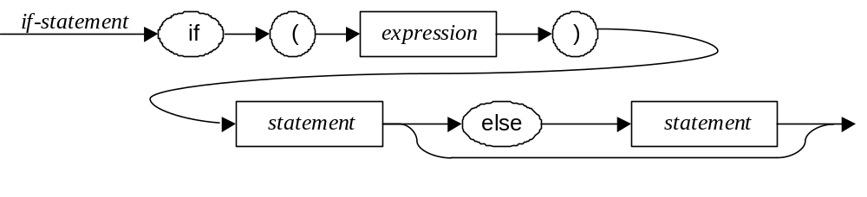
Syntax Diagrams
An alternative to EBNF.
Rarely seen any more: EBNF is much more compact.
Example (if-statement, p. 101):
Chapter 4
K. Louden, Programming Languages

Slide 35
Standard Grammar Categories
Declarations, sometimes called definitions. Java example:
  ClassDeclaration: class Identifier [ extends Type]
  [ implements TypeList ] ClassBody
Statements. Java example:
  Statement: throw Expression ; | … (other options)
Expressions, such as the running expression grammar example in this chapter.
Sequences of things (expressions, statements, declarations). Java example:
  Block: { BlockStatements }
  BlockStatements: { BlockStatement }
Chapter 4
K. Louden, Programming Languages

Slide 36
Parsing
Only an overview here - see a compiler course: there are many algorithms and tools.
Hand-written parsers almost always use an algorithm called recursive-descent that every computer professional should know.
Based on EBNF, it models the grammar with a function for every nonterminal: the body of the function is given by the right-hand side of the grammar rule(s) for that nonterminal: tokens are matched from the input, and nonterminals are “called.”
Chapter 4
K. Louden, Programming Languages

Slide 37
Recursive-descent example
Grammar:
expr → term { + term }
term → factor { ∗ factor }
factor → ( expr ) | number
Code sketch (see Fig. 4.12, pp. 105-107 for a complete example):
factor()
{ if (token == ‘(‘)
{ match(token);
expr();
match(‘)’);
}
else number();
}
expr()
{ term();
while (token == ‘+’)
{ match(token);
term();
}
}
Chapter 4
K. Louden, Programming Languages

Slide 38
The Parsing Problem
Making decisions on what to expect next in a parse based on the next input token can be tricky.
In difficult situations, we must compute the First symbols of grammar rule choices: given A → α₁ | α₂ we can decide which α_{i} to use only if First(α₁) ∩ First(α₂) is empty.
Example: First(expr) = { ( NUMBER }
Chapter 4
K. Louden, Programming Languages

Slide 39
Example for A → α₁ | α₂
A → ab | db (case 1)
A → ab | ac (case 2)
We need to have First(α₁) ∩ First(α₂) is empty.
Case 1 is OK and Case 2 is not
Chapter 4
K. Louden, Programming Languages

Slide 40
The Parsing Problem (cont.)
Additional problem: trying to decide whether an optional construct is actually present. B → AC or B → C can be written in EBNF as B → [A]C).
May have to compute Follow sets of nonterminals: if A is optional, then First(A) ∩ Follow(A) should be empty.
Example: Exercise 4.49, p. 121, where list is optional: list → expr [ list ] . (See solution in posted answers.)
Chapter 4
K. Louden, Programming Languages

Slide 41
Scanning/parsing tools
Scanners and parsers can be automatically generated from regular expressions and grammars.
Unix tools Lex (Lesk, 1975) and Yacc (Johnson, 1975) are the most popular.
Modern free versions are Gnu Bison and Flex ("Fast lex").
Compiler courses cover these.
Context-free grammars that meet the requirements for Yacc are called LALR(1) grammars (see a compiler course).
Chapter 4
K. Louden, Programming Languages

Slide 42
Lexics vs. Syntax vs. Semantics
Division between lexical and syntactic structure is not fixed: a number can be a token or defined by a grammar rule.
Implementation can often decide (scanners are faster, but parsers are more flexible).
Division between syntax and semantics is in some ways similar: some authors call all static structure "syntax".
Our view: if it isn't in the grammar (or the disambiguating rules), it's semantics.
Chapter 4
K. Louden, Programming Languages

