Slide 1
Endianness

Slide 2
Memory
One large array of bytes
Address refers to location (similar to index)
Each address stores one element of the array, typically one byte
Thus memory is said to be byte-addressable
Often things are stored in words, defined as 32 bits or 4 bytes (ex. Integers, single-precision floating point numbers, and MIPS instuctions)
Since memory is byte addressable each word is broken down into 4 bytes.

Slide 3
So what does that have to do with endian…
Our example-
Suppose we have a 32 bit quantity, written as 90AB12CD₁₆
Our 4 bytes are then 90, AB, 12 ,CD
There are two ways to store this in memory…

Slide 4
Big Endian
In big endian, you store the most significant byte in the smallest address. Here's how it would look:
Address | Value
1000 | 90
1001 | AB
1002 | 12
1003 | CD

Slide 5
Little Endian
In little endian, you store the least significant byte in the smallest address. Here's how it would look:
Notice that this is in the reverse order compared to big endian.
Address | Value
1000 | CD
1001 | 12
1002 | AB
1003 | 90

Slide 6
Why is endianness so important? Suppose you are storing int values to a file, then you send the file to a machine which uses the opposite endianness and read in the value. You'll run into problems because of endianness. You'll read in reversed values that won't make sense.

Slide 7
History of Endian-ness
Where does this term "endian" come from? Jonathan Swift was a satirist (he poked fun at society through his writings). His most famous book is "Gulliver's Travels", and he talks about how certain people prefer to eat their hard boiled eggs from the little end first (thus, little endian), while others prefer to eat from the big end (thus, big endians) and how this lead to various wars. Of course, the point was to say that it was a silly thing to debate over, and yet, people argue over such trivialities all the time (for example, should braces line in parallel or not? vi or emacs? UNIX or Windows).

Slide 8
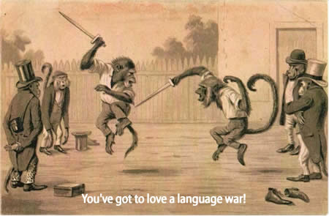
AKA Monkey Knife Fight! (Java VS Rub)

