Slide 1
Network Security Protocols and Defensive Mechanisms
Based on John Mitchell

Slide 2

Outline
Network protocol security
  IPSEC
  BGP instability and S-BGP
  DNS rebinding and DNSSEC
  Wireless security – 802.11i/WPA2
Standard network perimeter defenses
  Firewall
    Packet filter (stateless, stateful), Application layer proxies
  Traffic shaping
  Intrusion detection
    Anomaly and misuse detection

Slide 3
Review
Basic network protocols
  IP, TCP, UDP, BGP, DNS
Problems with them
  No SRC authentication: can’t tell where from
  Packet sniffing
  Connection spoofing, sequence numbers
  BGP: advertise bad routes or close good ones
  DNS: cache poisoning, rebinding

Slide 4
IPSEC
Security extensions for IPv4 and IPv6
IP Authentication Header (AH)
  Authentication and integrity of payload and header
IP Encapsulating Security Protocol (ESP)
  Confidentiality of payload
Security Associations(SA): Provide the bundle of algorithms and data as parameters necessary to operate the AH and/or ESP.
ESP with optional ICV (integrity check value)
  Confidentiality, authentication and integrity of payload

Slide 5
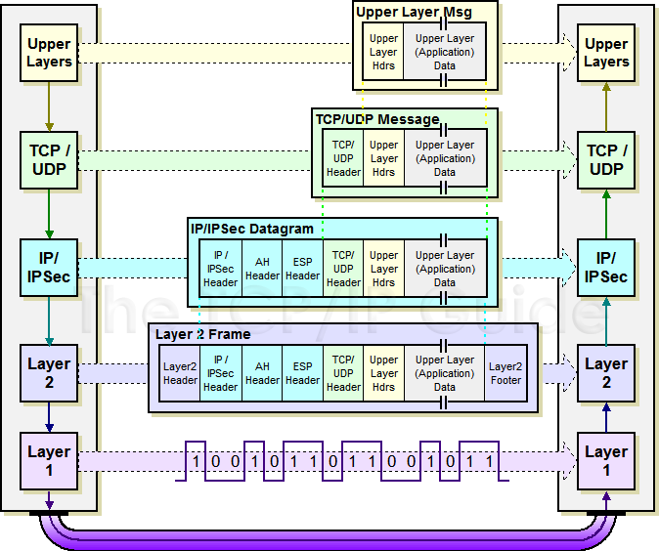
IPSec Transport Mode Operation
http://www.tcpipguide.com/free/t_IPSecModesTransportandTunnel.htm

Slide 6
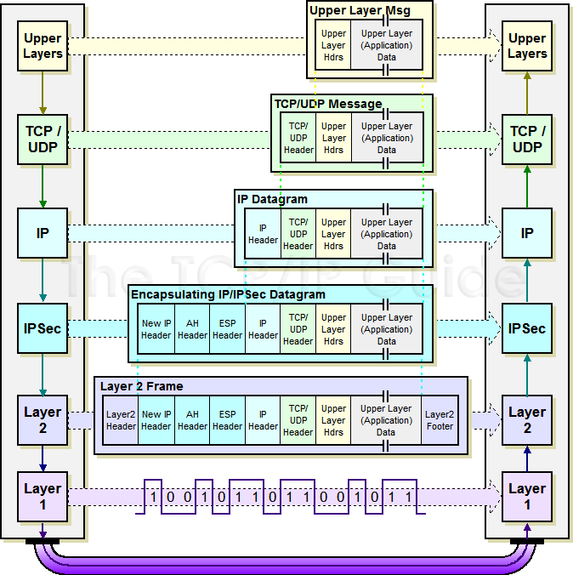
IPSec Tunnel Mode Operation
Notes:
Transport mode
In transport mode, only the payload of the IP packet is usually encrypted and/or authenticated. The routing is intact, since the IP header is neither modified nor encrypted; however, when the authentication header is used, the IP addresses cannot be translated, as this will invalidate the hash value. The transport and application layers are always secured by hash, so they cannot be modified in any way (for example by translating the port numbers).
Tunnel mode
Main article: Tunneling protocol
In tunnel mode, the entire IP packet is encrypted and/or authenticated. It is then encapsulated into a new IP packet with a new IP header. Tunnel mode is used to create virtual private networks for network-to-network communications (e.g. between routers to link sites), host-to-network communications (e.g. remote user access), and host-to-host communications (e.g. private chat).

Slide 7
VPN
Three different modes of use:
  Remote access client connections
  LAN-to-LAN internetworking
  Controlled access within an intranet
Several different protocols
  PPTP – Point-to-point tunneling protocol
  L2TP – Layer-2 tunneling protocol
  IPsec (Layer-3: network layer)
Data layer

Slide 8
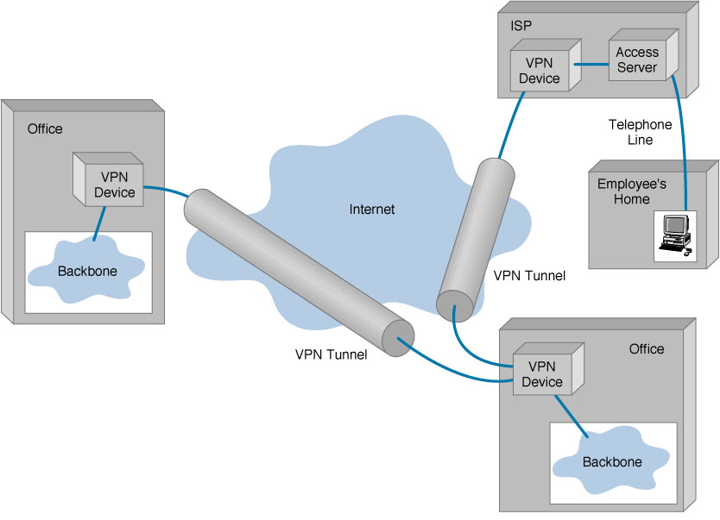
Generic diagram

Slide 9
BGP example [D. Wetherall]
1
3
3 2 7
4
2 7
2 6 5
2 6 5
3 2 6 5
5
8
2
2 7
6 5
7 2 6 5
7
2 7
7
6
6 2 7
5
7
2 6 5
5
Transit: 2 provides transit for 7
Algorithm seems to work OK in practice
  BGP is does not respond well to frequent node outages

Slide 10
BGP Security Issues
BGP is the critical infrastructure for Internet, the basis for all inter-ISP routing
Benign configuration errors affect about 1% of all routing table entries at any time
The current system is highly vulnerable to human errors, and a wide range of malicious attacks
  links
  routers
  management stations
MD5 MAC is rarely used, perhaps due to lack of automated key management
Slide: Steve Kent

Slide 11
S-BGP Design Overview
IPsec: secure point-to-point router communication
Public Key Infrastructure: an authorization framework for all S-BGP entities
Attestations: digitally-signed authorizations to advertise specified address blocks
Validation of UPDATEs based on a new path attribute, using PKI certificates and attestations
Repositories for distribution of certificates, CRLs, and address attestations
Tools for ISPs to manage address attestations, process certificates & CRLs, etc.
Slide: Steve Kent

Slide 12
DNS Lookup Example
root & edu
DNS server
www.cs.stanford.edu
www.cs.stanford.edu
NS stanford.edu
stanford.edu
DNS server
Local DNS resolver
NS cs.stanford.edu
Client
A www=IPaddr
cs.stanford.edu
DNS server
DNS record types (partial list):
- NS: name server (points to other server)
- A: address record (contains IP address)
- MX: address in charge of handling email
- TXT: generic text (e.g. used to distribute site public keys (DKIM) )

Slide 13
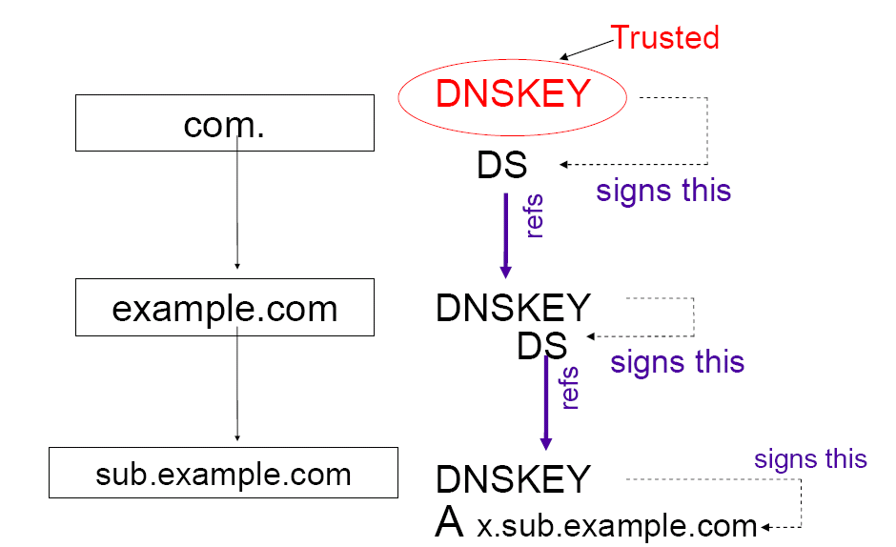

DNSSEC
http://www.nanog.org/mtg-0410/pdf/crocker.pdf
Protocol Extensions to DNS provide
  Data Integrity
  Origin Authentication of DNS data
  Authenticated Denial of Existence

Slide 14
Some DNSSEC Issues
Root zone key rollover
  Trust in key is established by DS Resource Record (RR)
    DS RR of a child zone is stored in its parent zone
    Carries a "digest" that can uniquely authenticate that DNSKEY
  Root public key relies on communication "out-of-band" to DNS
  Lots of politics about who gets to operate DNS root
What about host names that don't exist in a zone?
  Simple "does not exist" message would allow replay
  Better: if name is not in zone, return a "gap-spanning" NSEC RR that gives nearest names before and after the queried name

Slide 15

DNS Rebinding Attack
[DWF’96, R’01]
<iframe src="http://www.evil.com">
DNS-SEC cannot
stop this attack
Firewall
www.evil.com?
ns.evil.com
DNS server
171.64.7.115 TTL = 0
192.168.0.100
www.evil.com
web server
corporate
web server
171.64.7.115
192.168.0.100
Read permitted: it’s the “same origin”

Slide 16
DNS Rebinding Defenses
Browser mitigation: DNS Pinning
  Refuse to switch to a new IP
  Interacts poorly with proxies, VPN, dynamic DNS, …
  Not consistently implemented in any browser
Server-side defenses
  Check Host header for unrecognized domains
  Authenticate users with something other than IP
Firewall defenses
  External names can’t resolve to internal addresses
  Protects browsers inside the organization

Slide 17
Wireless Access Evolution
802.11 (Wired Equivalent Protocol)
  Authentication: Open system (SSID) and Shared Key
  Authorization: some vendor use MAC address filtering
  Confidentiality/Integrity: Completely insecure
WPA: Wi-Fi Protected Access
  Authentication: PSK, 802.1X/EAP (enterprise)
  Confidentiality/Integrity: TKIP (improved using RC4)
  Reuse legacy hardware, still problematic
IEEE 802.11i (Ratified 2004 ): WPA2
  Mutual authentication: PSK, 802.1X/EAP (enterprise)
  Data confidentiality and integrity: AES-CCMP
  Key management
  Availability
  CCMP: AES-based authenticated encryption (integrity,confidentiality)
Notes:
In Open System authentication, the WLAN client need not provide its credentials to the Access Point during authentication. Any client can authenticate with the Access Point and then attempt to associate. In effect, no authentication occurs. Subsequently WEP keys can be used for encrypting data frames. At this point, the client must have the correct keys.
In Shared Key authentication, the WEP key is used for authentication in a four step challenge-response handshake:
The client sends an authentication request to the Access Point.
The Access Point replies with a clear-text challenge.
The client encrypts the challenge-text using the configured WEP key, and sends it back in another authentication request.
The Access Point decrypts the response. If this matches the challenge-text the Access Point sends back a positive reply.

Slide 18
What Went Wrong With WEP
No Key Management
  Long Lived keys
  Fix: Use 802.1X ( Standard for user, device authentication )
Crypto Issues RC4 cipher stream
  Key size: 40 bit keys
  Initialization Vector too small:24 bit
  Integrity Check Value based on CRC-32
  Authentication messages can be forged
Crack WEP using KALI linux

Slide 19
Perimeter and Internal Defenses
Commonly deployed defenses
  Perimeter defenses – Firewall, IDS
    Protect local area network and hosts
    Keep external threats from internal network
  Internal defenses – Virus scanning
    Protect hosts from threats that get through the perimeter defenses
  Extend the “perimeter” – VPN
Common practices, but could be improved
  Internal threats are significant
    Unhappy employees
    Compromised hosts

Slide 20


Basic Firewall Concept
Separate local area net from internet
Firewall
Local network
Internet
Router
All packets between LAN and internet routed through firewall

Slide 21
Packet Filtering
Uses transport-layer information only
  IP Source Address, Destination Address
  Protocol (TCP, UDP, ICMP, etc)
  TCP or UDP source & destination ports
  TCP Flags (SYN, ACK, FIN, RST, PSH, etc)
  ICMP message type
Examples
  DNS uses port 53
    Block incoming port 53 packets except known trusted servers
Issues
  Stateful filtering
  Encapsulation: address translation, other complications
  Fragmentation

Slide 22
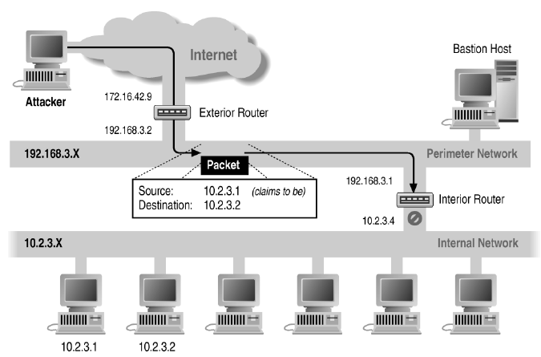
Source/Destination Address Forgery

Slide 23
More about networking: port numbering
TCP connection
  Server port uses number less than 1024
  Client port uses number between 1024 and 16383
Permanent assignment
  Ports <1024 assigned permanently
    20,21 for FTP 23 for Telnet
    25 for server SMTP 80 for HTTP
Variable use
  Ports >1024 must be available for client to make connection
  Limitation for stateless packet filtering
    If client wants port 2048, firewall must allow incoming traffic
  Better: stateful filtering knows outgoing requests
    Only allow incoming traffic on high port to a machine that has initiated an outgoing request on low port

Slide 24
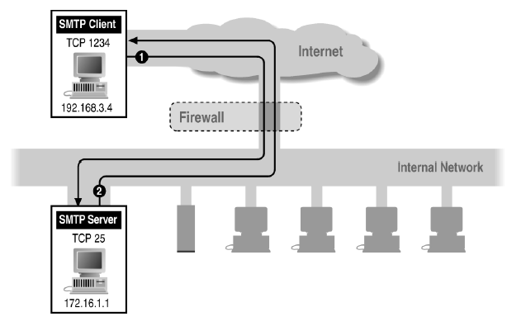
Filtering Example: Inbound SMTP
Can block external request to internal server based on port number

Slide 25
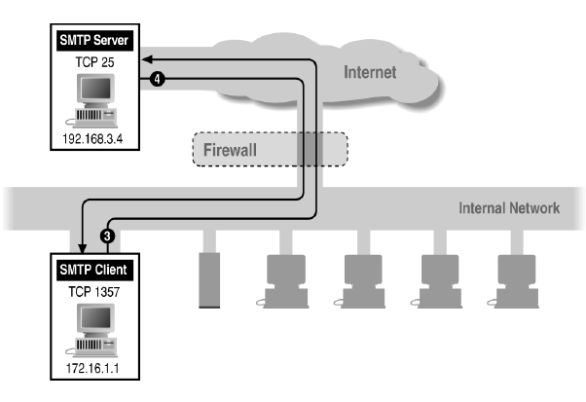
Filtering Example: Outbound SMTP
Known low port out, arbitrary high port in
If firewall blocks incoming port 1357 traffic then connection fails

Slide 26
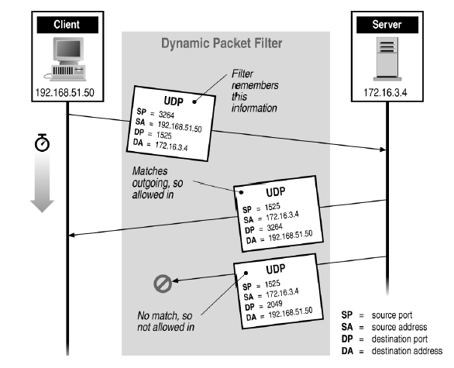
Stateful or Dynamic Packet Filtering

Slide 27

Telnet
Telnet Server
Telnet Client
23
1234
◆ Client opens channel to server; tells server its port number. The ACK bit is not set while establishing the connection but will be set on the remaining packets
◆
“PORT 1234”
❖
“ACK”
❖ Server acknowledges
Stateful filtering can use this pattern to identify legitimate sessions

Slide 28
FTP
FTP Server
FTP Client
20
Data
21
Command
5150
5151
◆ Client opens command channel to server; tells server second port number
◆
“PORT 5151”
❖ Server acknowledges
❖
⬥
“OK”
⬥ Server opens data channel to client’s second port
DATA CHANNEL
 Client acknowledges

TCP ACK
Notes:
From Zwicky, Building Internet Firewalls, second edition page 456

Slide 29
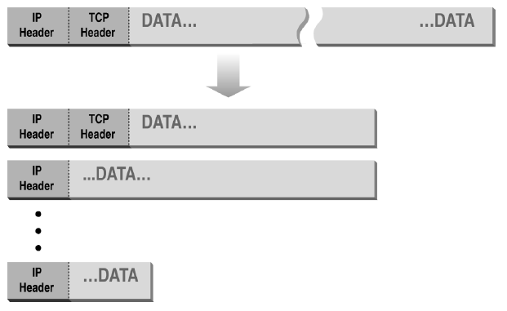
Normal IP Fragmentation
Complication for firewalls
Flags and offset inside IP header indicate packet fragmentation

Slide 30
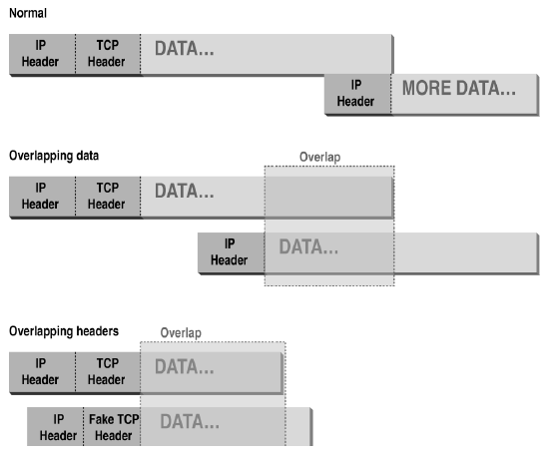
Abnormal Fragmentation
Low offset allows second packet to overwrite TCP header at receiving host

Slide 31
Packet Fragmentation Attack
Firewall configuration
  TCP port 23 is blocked but SMTP port 25 is allowed
First packet
  Fragmentation Offset = 0.
  DF bit = 0 : "May Fragment"
  MF bit = 1 : "More Fragments"
  Destination Port = 25. TCP port 25 is allowed, so firewall allows packet
Second packet
  Fragmentation Offset = 1: second packet overwrites all but first 8 bits of the first packet
  DF bit = 0 : "May Fragment"
  MF bit = 0 : "Last Fragment."
  Destination Port = 23. Normally be blocked, but sneaks by!
What happens
  Firewall ignores second packet “TCP header” because it is fragment of first
  At host, packet reassembled and received at port 23

Slide 32
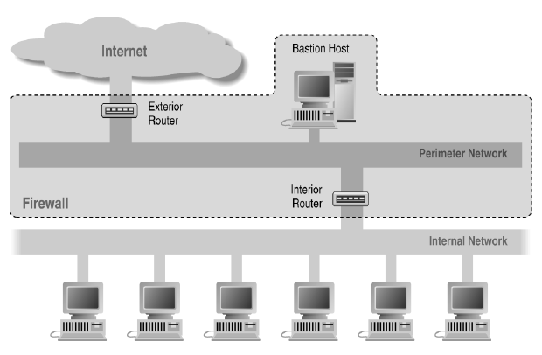
Screened Subnet Using Two Routers

Slide 33
Traffic Shaping
Traditional firewall
  Allow traffic or not
Traffic shaping
  Limit certain kinds of traffic
  Can differentiate by host addr, protocol, etc
  Multi-Protocol Label Switching (MPLS)
    Label traffic flows at the edge of the network and let core routers identify the required class of service
A real traffic scenario:
  P2P file sharing takes a lot of bandwidth
  1/3 of network bandwidth consumed by BitTorrent
    what are BitTorrent, Gnutella, Kazaa, … used for?

Slide 34
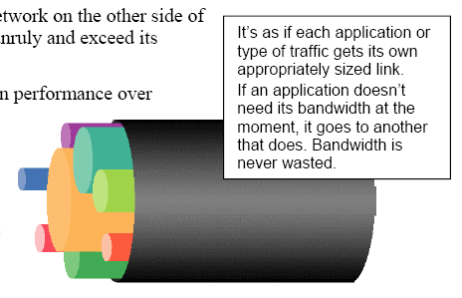
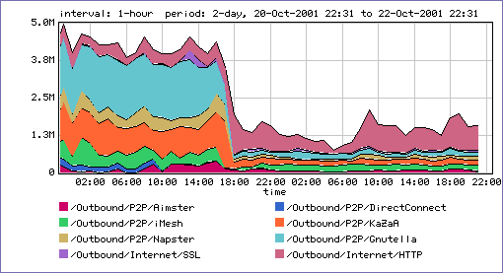
PacketShaper Controls
A partition:
  Creates a virtual pipe within a link for each traffic class
  Provides a min, max bandwidth
  Enables efficient bandwidth use
Rate shaped P2P capped ➢ at 300kbps
Rate shaped HTTP/SSL ➢
to give better performance

Slide 35
Host and network intrusion detection
Intrusion prevention
  Network firewall
    Restrict flow of packets
  System security
    Find buffer overflow vulnerabilities and remove them!
Intrusion detection
  Discover system modifications
    Tripwire
  Look for attack in progress
    Network traffic patterns
    System calls, other system events

Slide 36

General intrusion detection
http://www.snort.org/
Many intrusion detection systems
  Close to 100 systems with current web pages
  Network-based, host-based, or combination
Two basic models
  Misuse detection model
    Maintain data on known attacks
    Look for activity with corresponding signatures
  Anomaly detection model
    Try to figure out what is “normal”
    Report anomalous behavior
Fundamental problem: too many false alarms

Slide 37
Difficulties in intrusion detection
Lack of training data
  Lots of “normal” network, system call data
  Little data containing realistic attacks, anomalies
Data drift
  Statistical methods detect changes in behavior
  Attacker can attack gradually and incrementally
Main characteristics not well understood
  By many measures, attack may be within bounds of “normal” range of activities
False identifications are very costly
  Sys Admin spend many hours examining evidence

