Slide 1
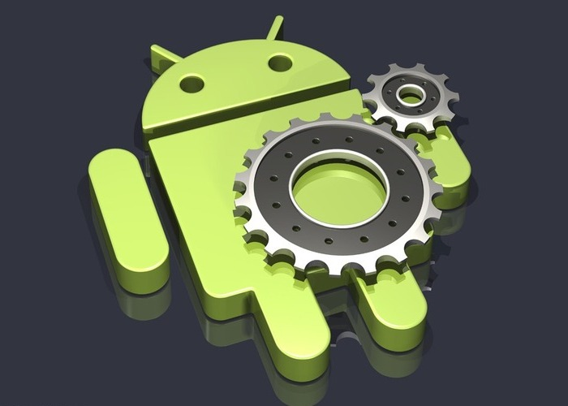
Android Architecture

Slide 2
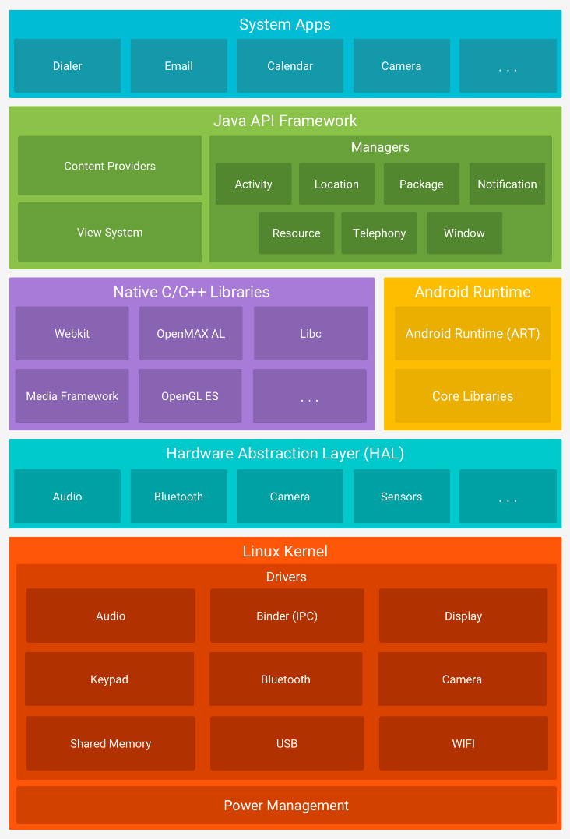
Architecture Diagram
Components Layout
Linux Kernel versions 3.18 or 4.4 versions depend on device
Hardware Abstraction Layer (HAL)
Native C/C++ Libraries Layer
Android Runtime Layer
Java API Framework Layer
System Apps Layer

Slide 3
Linux Kernel Layer
System and Kernel security
Linux Security for mobile computing environment contains:
A user-based permissions model
Process isolation
Extensible mechanism for secure Inter-Process Communication (IPC)
The ability to remove unnecessary and potentially insecure parts of the kernel
Linux Security as a multiuser operating system:
Prevents user A from reading user B's files
Ensures User A does not exhaust user B's memory
Ensures that user A does not exhaust user B's CPU resources
Ensures that user A does not exhaust user B's devices (e.g. telephony, GPS, Bluetooth)
Notes:
As a multiuser operating system, a fundamental security objective of the Linux kernel is to isolate user resources from one another

Slide 4
Linux Kernel Layer
Application Sandboxing
Linux user-based protection for identifying and isolating application resources.
Android system assigns a unique user ID (UID) to each Android application and runs it as that user in a separate process.
This sets up a Kernel-level Sandbox.
Process level security enforced by the kernel for applications and the system using user and group IDs that are assigned to applications.
Since the Application Sandbox is in the kernel, this security model extends to native code and to operating system applications.

Slide 5
Linux Kernel Layer
Rooting of Devices
By default, only the kernel and a small subset of the core applications run with root permissions.
Android does not prevent a user or application with root permissions from modifying the operating system, kernel, or any other application.
The ability to modify an Android device is important to developers working with the Android platform for debugging lower system or kernel level components.
On some devices, a person with physical control of a device and a USB cable is able to install a new operating system that provides root privileges to the user.

Slide 6
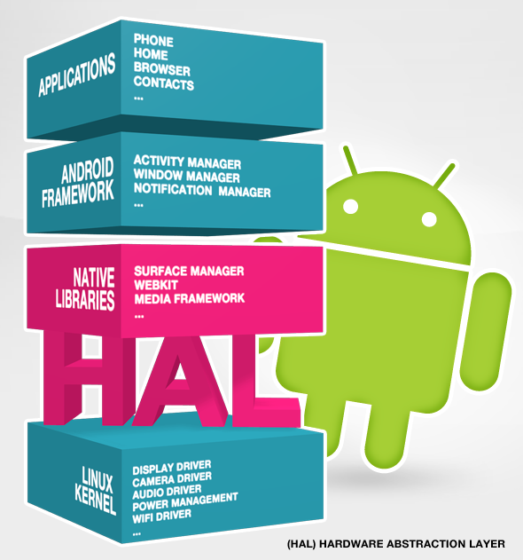
Hardware Abstraction Layer (HAL)
Hardware Abstraction Layer
Android gives you the freedom to implement your own device specifications and drivers.
The hardware abstraction layer (HAL) provides a standard method for creating software hooks between the Android platform stack and your hardware.

Slide 7
Android Runtime (ART) Layer
Android Runtime
As of Android version 5.0 or higher, each app runs in its own process and with its own instance of the Android Runtime (ART).
ART is written to run multiple VM’s on low-memory devices by executing DEX files (bytecode for Android) for minimal memory footprint.
Ahead-of-time (AOT) and just-in-time (JIT) compilation
Optimized garbage collection (GC)
Prior to Android version 5.0, “Dalvik” was the Android runtime. If your app runs well on ART, then it should work on Dalvik as well, but the reverse may not be true.

Slide 8

Native C/C++ Libraries Layer
Native C/C++ Libraries
Components like ART and HAL are built in native code and require libraries written in C and C++.
Android provides Java framework API’s to expose the functionality of some of these native libraries.
You can use the Java OpenGL API to draw 2D or 3D graphics.
When developing an app that requires C or C++ code, one can use the Android Native Development Kit (NDK).

Slide 9
Java API Framework Layer
Java API Framework
Rich and extensible View System you can use to build an app’s UI.
Resource Manager provides access to resources such as localized strings, graphics, and layout files.
Notification Manager that enables all apps to display custom alerts in the status bar.
Activity Manager that manages the lifecycle of apps and provides a common navigation back stack.
Content Providers that enable apps to access data from other apps, such as the Contacts app, SMS app, Telephony app or to share their own data.
Developers have full access to the same framework APIs that Android system apps use.

Slide 10
System Apps Layer
System Apps
Android comes with a set of core apps such as
Email
SMS messaging
Calendars
Internet browsing
Contacts etc..
Apps included with the platform have no special status among the apps the user chooses to install.
An app downloaded from the Play store can become a default app to whatever the user desires such as a third-party messaging app can become the default and replace the system SMS messanger.

Slide 11
Thank you!
Alexander Molodyh

