Slide 1

Android Architecture

Slide 2
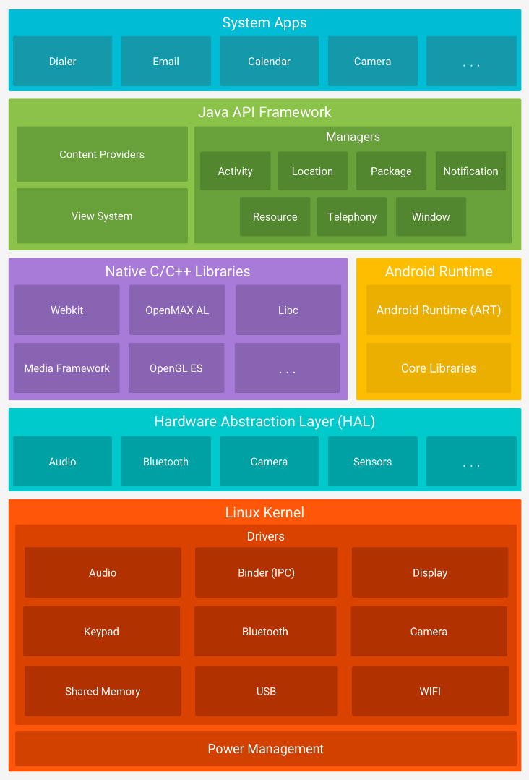
Architecture Diagram
Components Layout
Linux Kernel versions 3.18 or 4.4 versions depend on device
Hardware Abstraction Layer (HAL)
Native C/C++ Libraries Layer
Android Runtime Layer
Java API Framework Layer
System Apps Layer

Slide 3
Linux Kernel Layer
System and Kernel security
Linux Security for mobile computing environment contains:
A user-based permissions model
Process isolation
Extensible mechanism for secure Inter-Process Communication (IPC)
The ability to remove unnecessary and potentially insecure parts of the kernel
Linux Security as a multiuser operating system:
Prevents user A from reading user B's files
Ensures User A does not exhaust user B's memory
Ensures that user A does not exhaust user B's CPU resources
Ensures that user A does not exhaust user B's devices (e.g. telephony, GPS, Bluetooth)
Notes:
As a multiuser operating system, a fundamental security objective of the Linux kernel is to isolate user resources from one another

Slide 4
Linux Kernel Layer
Application Sandboxing
Linux user-based protection for identifying and isolating application resources.
Android system assigns a unique user ID (UID) to each Android application and runs it as that user in a separate process.
This sets up a Kernel-level Sandbox.
Process level security enforced by the kernel for applications and the system using user and group IDs that are assigned to applications.
Since the Application Sandbox is in the kernel, this security model extends to native code and to operating system applications.

Slide 5

Hardware Abstraction Layer (HAL)
Android gives you the freedom to implement your own device specifications and drivers.
The hardware abstraction layer (HAL) provides a standard method for creating software hooks between the Android platform stack and your hardware.

Slide 6
Android Runtime (ART) Layer
Android Runtime:
As of Android version 5.0 or higher, each app runs in its own process and with its own instance of the Android Runtime (ART).
ART is written to run multiple VM’s on low-memory devices by executing DEX files (bytecode for Android) for minimal memory footprint.
Ahead-of-time (AOT) and just-in-time (JIT) compilation
Optimized garbage collection (GC)
Prior to Android version 5.0, “Dalvik” was the Android runtime. If your app runs well on ART, then it should work on Dalvik as well, but the reverse may not be true.

Slide 7

Native C/C++ Libraries Layer
Native C/C++ Libraries:
Components like ART and HAL are built in native code and require libraries written in C and C++.
Android provides Java framework API’s to expose the functionality of some of these native libraries.
You can use the Java OpenGL API to draw 2D or 3D graphics.
When developing an app that requires C or C++ code, one can use the Android Native Development Kit (NDK).

Slide 8
Android Runtime (ART) Layer
Android Runtime:
As of Android version 5.0 or higher, each app runs in its own process and with its own instance of the Android Runtime (ART).
ART is written to run multiple VM’s on low-memory devices by executing DEX files (bytecode for Android) for minimal memory footprint.
Ahead-of-time (AOT) and just-in-time (JIT) compilation
Optimized garbage collection (GC)
Prior to Android version 5.0, “Dalvik” was the Android runtime. If your app runs well on ART, then it should work on Dalvik as well, but the reverse may not be true.

Slide 9
So,
From somewhere, to somewhere
… is a clearer way to show the user “what is going on”.

Slide 10

Floating Action Button
Is the most eye-attracting element on the screen.
Should have the most frequently-used function in the current activity.

Slide 11
Thank you!
Lyndon Pan, 12/2014

