Slide 1
HSR Human Point Follower
By: Alex Morrow

Slide 2
Problem Statement
How can a robot understand where a person is pointing and navigate there?
Human detection and tracking
Pose detection & Accuracy
Goal:
Robot should attempt to detect a human in its field of vision
Robot should successfully identify humans only.
Robot should track human as long as it remains in sight
Robot should recognize pointing gesture
Robot should compute waypoint with relative accuracy
Robot should navigate to waypoint

Slide 3
Introduction to OpenPose
What is OpenPose?
Open-source real-time multi-person keypoint detection library developed by CMU's Perceptual Computing Lab (Cao et al., 2017)
Detects body, hand, facial, and foot keypoints from RGB images
First real-time multi-person 2D pose estimation system
Why OpenPose for this project?
Real-time performance (~15-30 FPS depending on resolution)
Well-documented with pre-trained models
Provides confidence scores per keypoint (critical for filtering noise)

Slide 4
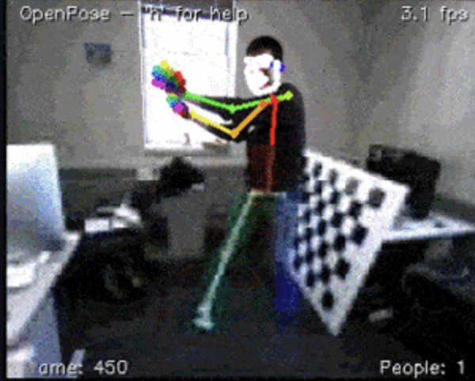
Technical Details
Primary data used is the BODY_25 array which gives the positions of anchor points on the skeleton
Parameter | Value | Reason
Model | BODY_25 | Full Body With Feet
Resolution | 320x176 | Faster Processing
Min confidence | 0.3 | Filter noise
Min Keypoints | 10 | Confirm Human Presence

Slide 5
Computing the Waypoint
"Commodifying Pointing in HRI: Simple and Fast Pointing Gesture Detection from RGB-D Images", Bita Azari, Angelica Lim, Richard T. Vaughan, arXiv:1902.02636 (Feb 2019)
The paper compares several methods for computing pointing direction and finds that the face-to-hand vector best captures human pointing intention
Similarities | Differences
Both use combination of RGB and Depth data | Uses CNN-based detector, I used openpose BODY_25
Sample for depth, draw a ray to through the ground to estimate pointing location | Uses nose as facial anchor, I did not have nose available

Slide 6
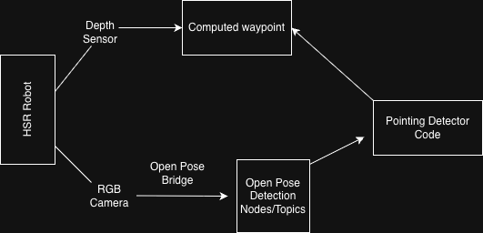
System Overview

Slide 7
How My Code Works
State | Behavior | Exit Condition
IDLE | Wait for start signal | /human_point_follower/start = True
SEARCHING | Rotate base 36o degrees | Human detected 5 consecutive frames
TRACKING | Keep human centered in frame | Pointing gesture detected
DETECTED | Validate 3-second hold | Hold Confirmed -> Compute waypoint
NAVIGATING | Dead-reckoning to target | Reached Destination
COMPLETED | Wait for reset | Any message on start topic

Slide 8
Human Detection
ROS Topic Inputs:
/hsrb/head_rgbd_sensor/rgb/image_rect_color
Outputs
/openpose/human_detected (Bool)
/openpose/keypoints (PoseArray)
Parameter | Value | Purpose
min_keypoints | 10 | Ensure sufficient body visibility
min_confidence | 0.3 | Filter noise
detection_threshold | 5 frames | consistency

Slide 9
Pointing Gesture Recognition
Three-Stage Validation:
Arm Straightness Check
Calculate angle between upper arm (shoulder→elbow) and forearm (elbow→wrist)
Threshold: < 25° deviation from straight line
Arm Extension Check
Wrist must be > 50% of full arm length from shoulder
Ensures arm is actually extended, not bent at side
Neutral Arm Filter
Reject if wrist is significantly below elbow (> 30 pixels)
Prevents detecting hanging arms as pointing

Slide 10
Limitations & Future Directions
Limitations:
Omniverse simulations do not have good human model support
Unable to use detailed face model
Openpose installation and configuration
Future Directions:
Using ensemble ML model for task instead.
Use current project simulation as foundation for reinforcement learning environment.
Classification for point detection

Slide 11
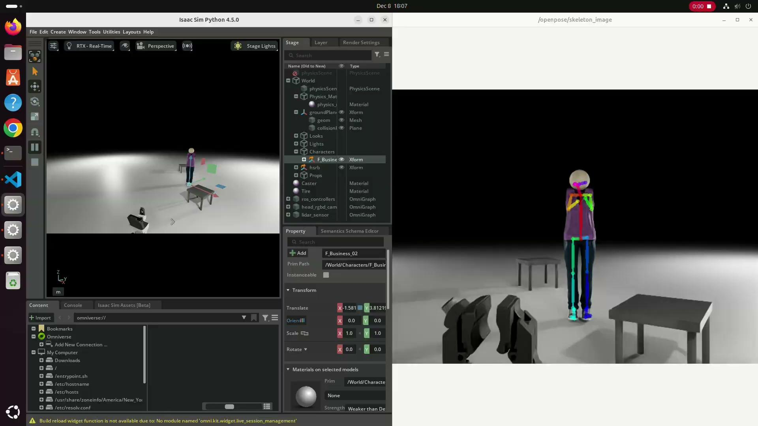

Slide 12
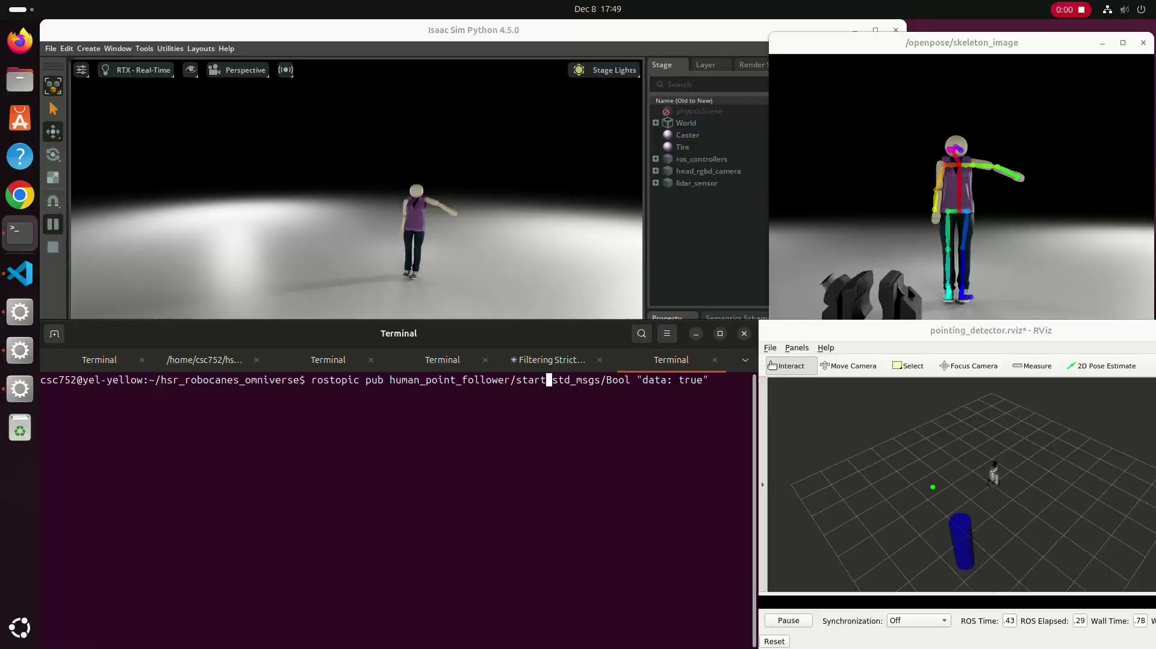

Slide 13


