Slide 1
How to save the Plan Cache
by Alessandro Mortola

Slide 3



I have worked with all versions from Sql Server 7.0 to Sql Server 2022
I spoke several times at Sql Saturday, Data
Saturday and SqlStart! editions
I am an author for sqlservercentral.com
I am certified Sql Server 2016 Dev
I currently work for a well-known Italian company as
  Sql Server DBA
  Analyst
@AlexMortola
alessandro.mortola@gmail.com
https://www.linkedin.com/in/alessandromortola

Slide 4
The Plan Cache and its limits
How to use the Plan Cache properly
  Ad hoc queries vs Parameterized
Parameterization
What if your queries are not parameterized?
  Simple Parameterization
  Forced Parameterization
Other options for Ad hoc queries
  Optimize for Ad hoc Workloads
  TF 253
Agenda

Slide 5
Sql Server Cache
Plan Cache
Reserved for execution plans
Data Cache
Reserved for Indexes and Data
Other Small Caches
Plan Cache
Object Plans (stored procedures, triggers, functions)
Sql Plans (Ad hoc, autoparameterized, dynamic, prepared queries)
S T O R E S
Bound Trees (data structure used during compilation for views, constraints and defaults)
Extended Stored Procedures (system procedures. E.g. sp_executesql, xp_cmdshell)

Slide 6

The Plan Cache
Each Store (Object Plans, Sql Plans, Bound Trees and Extended Stored Procedures) contains a hash table to keep track of all the plans in that particular store. Each bucket in the hash table contains zero, one, or more cached plans.
The DMV sys.dm_os_memory_cache_hash_tables gives us information about each hash table.
Hash table
Bucket #1
Bucket #2
…
Bucket #N
Plan 1
Plan 2
Plan X
Name | Plan cache store | Buckets_count | Buckets_max_length | Buckets_avg_length
Object Plans | CACHESTORE_OBJCP | 40009 | … | …
SQL Plans | CACHESTORE_SQLCP | 40009 | … | …
Bound Trees | CACHESTORE_PHDR | 4001 | … | …
Extended Stored Procedures | CACHESTORE_XPROC | 127 | … | …

Slide 7
The Plan Cache
The DMV sys.dm_os_memory_cache_counters provides information about the cache entries allocated.
Name | Plan cache store | Pages_kb | Entries_count
Object Plans | CACHESTORE_OBJCP | … | …
SQL Plans | CACHESTORE_SQLCP | … | …
Bound Trees | CACHESTORE_PHDR | … | …
Extended Stored Procedures | CACHESTORE_XPROC | … | …

Slide 8
The Plan Cache Pressure Limit
Starting from Sql Server 2005 SP2, there are two limitations related to the plan cache:
Total size (depending on the server memory)
75% of visible target memory from 0 to 4 GB
+ 10% of visible target memory from 4 GB to 64 GB
+ 5% of visible target memory > 64 GB
Number of entries
SQL Server also indicates memory pressure when the number of plans in a store exceeds four times the hash table size for that store, regardless of the actual size of the plans.
e.g.
Sql Server Memory: 64 GB
Plan Cache: 3 GB + 6 GB
These limits can be raised with the documented 8032 (total size) and trace flag 174 (number of entries).

Slide 9
Two query types to deal with
Adhoc vs Parameterized
The Cache
objtype | usecounts | text
Adhoc | 1 | select SalesOrderID, OrderQty, ProductID from Sales.SalesOrderDetailEnlarged where ProductID = 777;
select SalesOrderID, OrderQty, ProductID
from Sales.SalesOrderDetailEnlarged
where ProductID = 777;
Compiled
Ad hoc
select SalesOrderID, OrderQty, ProductID
from Sales.SalesOrderDetailEnlarged
where ProductID = 778;
objtype | usecounts | text
Adhoc | 1 | select SalesOrderID, OrderQty, ProductID from Sales.SalesOrderDetailEnlarged where ProductID = 778;
Compiled
exec sp_executesql
@stmt = N'select SalesOrderID,
OrderQty, ProductID
from Sales.SalesOrderDetailEnlarged
where ProductID = @pid;',
@params = N'@pid int', @pid = 777;
objtype | usecounts | text
Prepared |  | (@pid int)select SalesOrderID, OrderQty, ProductID from Sales.SalesOrderDetailEnlarged where ProductID = @pid;
1
Compiled
2
Parameterized
exec sp_executesql
@stmt = N'select SalesOrderID,
OrderQty, ProductID
from Sales.SalesOrderDetailEnlarged
where ProductID = @pid;',
@params = N'@pid int', @pid = 778;
Uses the plan in the cache

Slide 10

To keep in mind
#1
#2
#3
Compiling a query has a cost in terms of time and resources (e.g. CPU, RAM)
SQL Server has an efficient algorithm to find an existing plan related to a specific statement. The minimal resources that are used by this scan are less than the resources that should be used for compiling every statement
The way SQL Server looks at the plan in cache is by calculating a hash value of the query text
#4
#5
Ad hoc queries are the main responsible for plan pollution
Execution plans remain in the cache as long as there is enough memory to store them. When memory pressure exists, the SQL Server uses a cost-based approach to determine which plans to remove from the cache
02_PlanPollution.sql

Slide 11
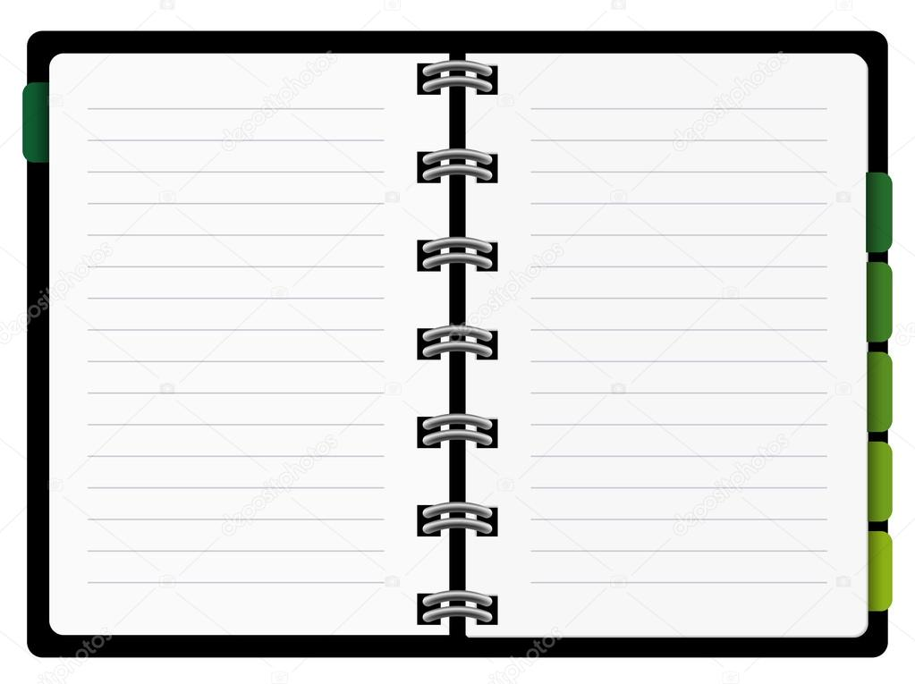
How to use the Plan Cache properly
Parameterization

Slide 12
PARAMETERIZATION
#1 – Stored procedures
CacheObjType | ObjType | Estimated number of rows based on
Compiled Plan | Proc | Statistics Histogram
create procedure dbo.spGetOrderDetailsFromProductID @productID int
as
  select SalesOrderID, CarrierTrackingNumber
  from Sales.SalesOrderDetailEnlarged
  where ProductID = @productID
  order by rowguid;
go
exec dbo.spGetOrderDetailsFromProductID @productID = 870;
go
03_Parameterization
Notes:
In questa casistica ricadono anche scalar udf e multistatement TVFs
Questa forma di parametrizzazione è distinta dalle prossime due in quanto questa ha come ObjType “Proc” mentre le successive hanno “Prepared”

Slide 13
PARAMETERIZATION
#2 – Dynamic Sql with sp_executesql
CacheObjType | ObjType | Estimated number of rows based on
Compiled Plan | Prepared | Statistics Histogram
declare @stmt nvarchar(max),
@params nvarchar(max);
set @stmt = N'select SalesOrderID, CarrierTrackingNumber
      from Sales.SalesOrderDetailEnlarged
      where ProductID = @productID
      order by rowguid;';
set @params = N'@productID int';
exec sp_executesql @stmt, @params, 870;

Slide 14
PARAMETERIZATION
#3 – Using sp_prepare and sp_execute
CacheObjType | ObjType | Estimated number of rows based on
Compiled Plan | Prepared | Statistics Header & Density Vector
DECLARE @PreparedStatementNumber INT;
EXEC sp_prepare @PreparedStatementNumber OUTPUT,
N'@productID int',
N'select SalesOrderID, CarrierTrackingNumber
  from Sales.SalesOrderDetailEnlarged
  where ProductID = @productID
  order by rowguid;';
exec sp_execute @PreparedStatementNumber, 870;
exec sp_unprepare @PreparedStatementNumber;
03_Parameterization
Notes:
It compiles during the execution of sp_prepare and it used the Density Vector, Not the Histogram
Finding an execution plan by an identifying handle is more efficient than the algorithms used to match an Transact-SQL statement to existing execution plans
The application can control when the execution plan is created and when it is reused.
The prepare/execute model is portable to other databases, including earlier versions of SQL Server

Slide 15
Pay attention: Variables are NOT parameters
Queries that filter by literals or parameters (with the exception of sp_prepare) use statistics HISTOGRAM
Queries that filter by variables use statistics DENSITY_VECTOR
declare @pid int = 870;
select SalesOrderID, CarrierTrackingNumber
from Sales.SalesOrderDetailEnlarged
where ProductID = @pid
order by rowguid;
CacheObjType | ObjType
Compiled Plan | Adhoc
create procedure [dbo].[spTest] (@prodid int)
as
declare @pid int = @prodid;
select SalesOrderID, CarrierTrackingNumber
from Sales.SalesOrderDetailEnlarged
where ProductID = @pid
order by rowguid;
go
CacheObjType | ObjType
Compiled Plan | Proc
03_Parameterization

Slide 16
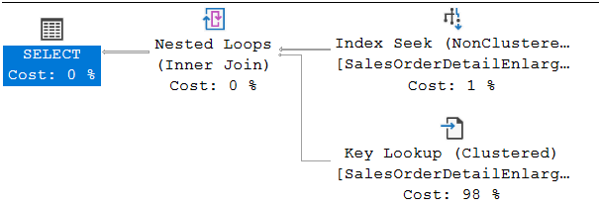
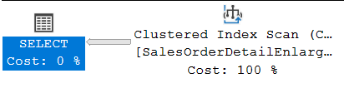
Parameter Sniffing (aka Parameter Sensitivity)
It is a performance optimization. The first time a user runs a parameterized query, Sql Server chooses a “good enough” plan basing the decision on the parameter values. That plan is used for the next executions.
What can go wrong? If the data distribution is unevenly distributed, the compiled plan may not fit all possible parameter values and performance problems may occur.
--@pid = 897 → 78 rows
select en.SalesOrderID, en.CarrierTrackingNumber
from Sales.SalesOrderDetailEnlarged en
where en.ProductID = @pid;
--@pid = 870 → 182832 rows
select en.SalesOrderID, en.CarrierTrackingNumber
from Sales.SalesOrderDetailEnlarged en
where en.ProductID = @pid;
04_ParameterSniffing

Slide 17




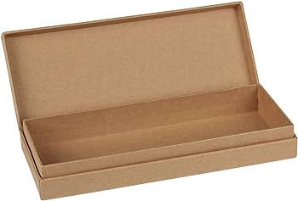
Parameter Sniffing – An interesting metaphor
By Guy Glanster

Slide 18
Parameter Sniffing – How to deal with it
select SalesOrderID, CarrierTrackingNumber
from Sales.SalesOrderDetailEnlarged
where ProductID = @pid
Optimizing for a typical parameter
option (optimize for (@pid = 123));
Optimizing on every execution
option (recompile);
Optimizing for UNKNOWN
option (optimize for unknown);
declare @lpid int = @pid;
select SalesOrderID, CarrierTrackingNumber
from Sales.SalesOrderDetailEnlarged
where ProductID = @lpid;
Using local variables
Disabling PS at Query level
option (use hint ('DISABLE_PARAMETER_SNIFFING'));
Disabling PS at Database level
alter database scoped configuration set parameter_sniffing = off
Disabling PS at Instance level
Trace Flag 4136
Notes:
Disabilitare Parameter Sniffing significa lavorare col Density Vector
Option (recompile) permette anche a query che filtrano per variabili locali di utilizzare l’histogram

Slide 19
Parameter Sensitive Plan Optimization
New in Sql Server 2022 !!!
It is part of the Intelligent Query Processing family of features
It is available for each edition
It addresses the scenario where a single cached plan for a parameterized query isn't optimal for all possible incoming parameter values. This is the case with non-uniform data distributions
The dispatcher plan contains the optimization logic called a dispatcher expression. The dispatcher plan maps to query variants based on the cardinality range boundary values predicates
Notes:
During the initial compilation, column statistics histograms identify non-uniform distributions and evaluate the most at-risk parameterized predicates, up to three out of all available predicates. In other words, if multiple predicates within the same query meet the criteria, PSP optimization chooses the top three. The PSP feature limits the number of predicates that are evaluated, in order to avoid bloating the plan cache.
Non uniform distribution are identified using the Histogram
PSPO not used:
OPTION recompile
OPTIMIZE FOR
Parameter sniffing disabled

Slide 20
Parameter Sensitive Plan Optimization
New in Sql Server 2022 !!!
select *
from t1
where id = @pid;
It checks if PSPO requirements are met
It sets the high and low boundary values looking at the statistics
Query Variant 1
Query Variant 2
Query Variant 3
Cardinality
Low
boundary
High
boundary
Seek + Lookup + small memory grant
Scan + medium memory grant
Scan + large memory grant
Notes:
The PSP optimization feature generates a shell plan known as a dispatcher plan. The dispatcher expression has the logic that bucketizes queries into query variants based on the runtime values of parameters.
Query variant plans are placed in the plan cache object store (CACHESTORE_OBJCP) while dispatcher plans are placed in the SQL Plans cache store (CACHESTORE_SQLCP)
(from Parameter Sensitive Plan optimization - SQL Server | Microsoft Learn)

Slide 21
PSP optimization skipped reasons
There are 40 possible reasons why PSP optimization can be skipped and they are returned from the following query:
NoParameter
CompatLevelBelow160
UnsupportedComparisonType
SkewnessThresholdNotMet
HasLocalVar
SystemDB
…
SELECT map_key, map_value
FROM sys.dm_xe_map_values
WHERE name ='psp_skipped_reason_enum';
The Extended Event parameter_sensitive_plan_optimization_skipped_reason occurs when the PSP optimization feature is skipped.

Slide 22

PSP optimization is not perfect yet
We have more possible execution plans in cache, each of which can be sniffed and the medium plans are the more vulnerable
PSP optimization currently only works with equality predicates
It is a young technology. It will be better in future releases
05_PSPOptimization

Slide 23
#1. What if your queries are not parameterized ?
Simple
Parameterization

Slide 24
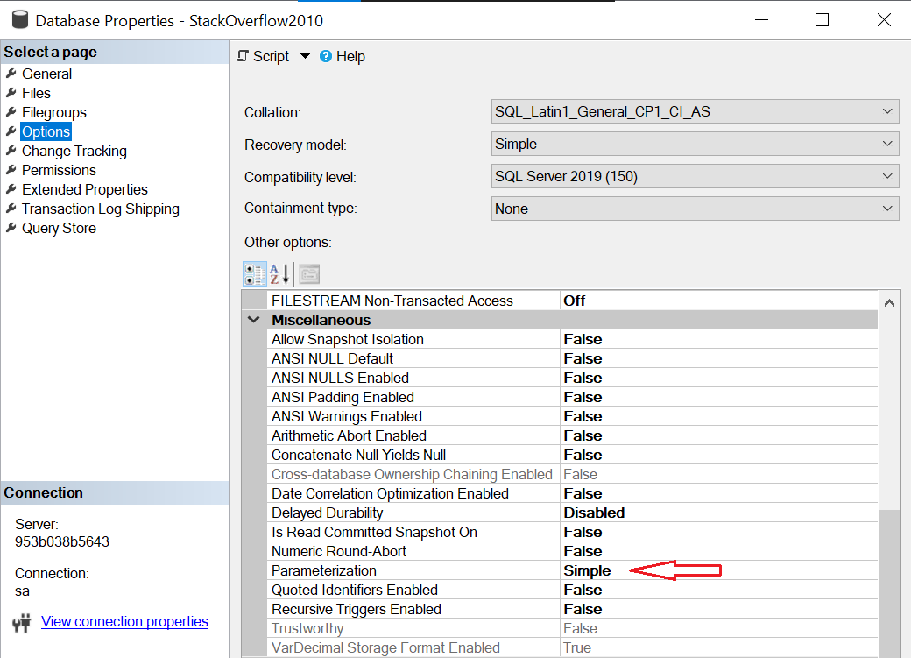
How Sql Server protects itself against “single use plans”:
Simple Parameterization
With Simple Parameterization, before Sql Server 2005 known as auto-parameterization, Sql Server attempts to replace constant literal values with parameter markers
It is set at database level and Simple is the default value

Slide 25
Simple Parameterization – When it is applied
The Simple Parameterization is applied to “simple and safe” queries
Simple Parameterization will NOT happen if the statement contains any of these:
JOIN | TOP | BULK INSERT | UNION
INTO | DISTINCT | GROUP BY | HAVING
Sub queries | Query hint | Constant comparison | …
Safe Execution Plan: regardless of the provided input parameter values, the query must always lead to the same execution plan [Klaus Aschenbrenner]

Slide 26
What is supported and not supported by
the Simple Parameterization
 | Supported | Not Supported
Functions | CAST & CONVERT ABS FLOOR … | LOWER UPPER CEILING …
Global Variables | @@SPID @@TRANCOUNT … | @@ROWCOUNT @@IDENTITY …
The list of intrinsic functions compatible with simple parameterization is quite limited and undocumented. [Paul White]

Slide 27
Simple Parameterization – How it works
Starting from an Ad hoc, Simple and Safe query, Sql Server substitutes literal values with parameters obtaining a parameterized plan
Sql Server tries guessing the data type using the smallest compatible subtype.
E.g.: with “WHERE BusinessEntityId = 1” the parameter will be defined as tinyint
In the plan cache we have one Compiled Plan / Prepared statement with the full plan and N Adhoc shells (smaller than a full plan) that are really pointers to the Prepared
Shell plans allow to bypass the parsing, parameter replacement, normalization and decoding stages
The original text is manipulated and standardized (more details later)
Notes:
Al contrario di quanto avviene con FORCED, una query SIMPLE parameterized NON può usare il plan di una parameterized, anche se hash e handle coincidono.

Slide 28
Simple Parameterization – Data Type Inference
Numbers
For strings of numbers without decimal points, Sql Server chooses from tinyint, smallint and int. For numbers beyond the range of integer, Sql Server uses numeric with the smallest possible precision
Strings of numbers with decimal precision are interpreted as numeric with a precision and scale just large enough to contain the value provided
Strings prefixed with a currency symbol are interpreted as money
Strings in scientific notation translate to float

Slide 29
Simple Parameterization – Data Type Inference
Datetime and Uniqueidentifier
The literal value must be provided in ODBC escape format. e.g:
{d '1901-01-01’}
{ts '1900-01-01 12:34:56.790’}
{guid 'F85C72AB-15F7-49E9-A949-273C55A6C393’}
General string and Binary
They are typed as varchar(8000), nvarchar(4000) or varbinary(8000). MAX is used if the literal exceeds 8000 bytes
[Ref. Paul White]
Notes:
Date and time types other than datetime aren’t used.

Slide 30

Simple Parameterization – Text manipulation
Original query text
select @@SPID,
CAST(ProductId as VARCHAR(10)) as ProdId,
FLOOR(StandardCost) as IntStdCost --Comment!!!
from Production.Product
where ProductID = 1 and Name != 'X'
order by ProductID
Text Manipulation
Query text manipulated by the Simple Parameterization
(@1 tinyint,@2 varchar(8000))
SELECT @@spid,
CONVERT([varchar](10),[ProductId]) [ProdId],
floor([StandardCost]) [IntStdCost]
FROM [Production].[Product]
WHERE [ProductID]=@1 AND [Name]<>@2
ORDER BY [ProductID] ASC

Slide 31
Simple Parameterization – Text manipulation
Original query text
select @@SPID,
CAST(ProductId as VARCHAR(10)) as ProdId,
FLOOR(StandardCost) as IntStdCost --Comment!!!
from Production.Product
where ProductID = 1 and Name != 'X'
order by ProductID
Keywords: UPPERCASE
Data types: lowercase
ASC is added in ORDER BY clause
Query text manipulated by the Simple Parameterization
(@1 tinyint,@2 varchar(8000))
SELECT @@spid,
CONVERT([varchar](10),[ProductId]) [ProdId],
floor([StandardCost]) [IntStdCost]
FROM [Production].[Product]
WHERE [ProductID]=@1 AND [Name]<>@2
ORDER BY [ProductID] ASC

Slide 32
Simple Parameterization – Text manipulation
Original query text
select @@SPID,
CAST(ProductId as VARCHAR(10)) as ProdId,
FLOOR(StandardCost) as IntStdCost --Comment!!!
from Production.Product
where ProductID = 1 and Name != 'X'
order by ProductID
Global variables: lowercase
Objects are delimited by square brackets
Query text manipulated by the Simple Parameterization
(@1 tinyint,@2 varchar(8000))
SELECT @@spid,
CONVERT([varchar](10),[ProductId]) [ProdId],
floor([StandardCost]) [IntStdCost]
FROM [Production].[Product]
WHERE [ProductID]=@1 AND [Name]<>@2
ORDER BY [ProductID] ASC

Slide 33
Simple Parameterization – Text manipulation
Original query text
select @@SPID,
CAST(ProductId as VARCHAR(10)) as ProdId,
FLOOR(StandardCost) as IntStdCost --Comment!!!
from Production.Product
where ProductID = 1 and Name != 'X'
order by ProductID
Unnecessary spaces and comments are removed
CAST is replaced by CONVERT
Query text manipulated by the Simple Parameterization
(@1 tinyint,@2 varchar(8000))
SELECT @@spid,
CONVERT([varchar](10),[ProductId]) [ProdId],
floor([StandardCost]) [IntStdCost]
FROM [Production].[Product]
WHERE [ProductID]=@1 AND [Name]<>@2
ORDER BY [ProductID] ASC

Slide 34
Simple Parameterization – Text manipulation
Original query text
select @@SPID,
CAST(ProductId as VARCHAR(10)) as ProdId,
FLOOR(StandardCost) as IntStdCost --Comment!!!
from Production.Product
where ProductID = 1 and Name != 'X'
order by ProductID
Parameter enumeration starts from @1
Intrinsic functions: lowercase (but not CONVERT!)
Query text manipulated by the Simple Parameterization
(@1 tinyint,@2 varchar(8000))
SELECT @@spid,
CONVERT([varchar](10),[ProductId]) [ProdId],
floor([StandardCost]) [IntStdCost]
FROM [Production].[Product]
WHERE [ProductID]=@1 AND [Name]<>@2
ORDER BY [ProductID] ASC

Slide 35
Simple Parameterization – Text manipulation
Original query text
select @@SPID,
CAST(ProductId as VARCHAR(10)) as ProdId,
FLOOR(StandardCost) as IntStdCost --Comment!!!
from Production.Product
where ProductID = 1 and Name != 'X'
order by ProductID
AS used for aliases are removed
!= is substituted by <>
…
Query text manipulated by the Simple Parameterization
(@1 tinyint,@2 varchar(8000))
SELECT @@spid,
CONVERT([varchar](10),[ProductId]) [ProdId],
floor([StandardCost]) [IntStdCost]
FROM [Production].[Product]
WHERE [ProductID]=@1 AND [Name]<>@2
ORDER BY [ProductID] ASC
Notes:
BETWEEN transformed into >= AND <=

Slide 36
Simple Parameterization – Final notes
It is set at database level
The main drawback is due to the Data Type inference. E.g.:
select Name from Production.Product where ProductID = 1;
go
select Name from Production.Product where ProductID = 256;
go
select Name from Production.Product where ProductID = 32768;
go
tinyint
smallint
int
06_SimpleParameterization

Slide 37
#2. What if your queries are not parameterized?
Forced
Parameterization
Notes:
.

Slide 38
Forced Parameterization
It was introduced in Sql Server 2005
It tells SQL Server to parameterize all DML queries
When the PARAMETERIZATION option is set to FORCED, any literal value that appears in a SELECT, INSERT, UPDATE, or DELETE statement, submitted in any form, is converted to a parameter during query compilation
In the plan cache we have one Compiled Plan / Prepared statement with the full plan and N Compiled Plan / Adhoc shells (smaller than a full plan) that are really pointers to the Prepared statement
Notes:
Forced parameteriation force the QO to consider paramerizing all queries in the database
When forced parm is enabled, SIMPLE param. can still occur.
(!) Compatibile con la “user parameterization” purchè testo e parametri siano perfettamente coincidenti

Slide 39
Forced Parameterization – When it is not applied
Statements inside the bodies of stored procedures, triggers, or user-defined functions
Statements inside a T-SQL cursor
Statements that reference variables, such as WHERE T.col2 >= @bb
Statements that contain more than 2,097 literals that are eligible for parameterization
Statements that contain the RECOMPILE query hint
The <select_list> of any SELECT statement
Constant-foldable expressions that are arguments of the +, -, *, /, and % operators. E.g.: WHERE T.col2 = 1 + 2
https://learn.microsoft.com/en-us/sql/relational-databases/query-processing-architecture-guide?view=sql-server-ver16#data-types-of-parameters

Slide 40
Forced Parameterization – Data Type Inference
Numbers
Integer literals that fit within int data type parameterize to int
Larger integer literals that are part of predicates that involve comparison operators, parameterize to numeric (38,0)
Larger literals that aren't parts of predicates that involve comparison operators parameterize to numeric whose precision is just large enough to support its size and whose scale is 0
Fixed-point numeric literals parameterize to numeric
Floating point numeric literals parameterize to float
Money type literals parameterize to money
Notes:
(*) numeric(38,0) If part of predicates with comparison operator; numeric (x,0) with x large enough to support the literal otherwise
(**) numeric(38, y) If part of predicates with comparison operator; numeric (x,y) with x and y large enough to support the literal otherwise
Esempio Floating point: 2E3

Slide 41
Forced Parameterization – Data Type Inference
NON parameterizable data types: Datetime and Uniqueidentifier
Constants specified by using ODBC extension syntax are NOT parameterized
General string and Binary
Non-Unicode string literals parameterize to varchar(8000) or varchar(MAX)
Unicode string literals parameterize to nvarchar(4000) or nvarchar(MAX)
Binary literals parameterize to varbinary(8000) or varbinary(MAX)

Slide 42
Forced Parameterization – Text manipulation
Original query text
SELECT p.ProductId as ProductIdentifier, --Comment!!!
sc.Name AS SubCatName
FROM Production.Product p
INNER JOIN Production.ProductSubcategory sc
ON p.ProductSubcategoryID = sc.ProductSubcategoryID
WHERE p.ProductID = 1
ORDER BY p.ProductID
Text Manipulation
Query text manipulated by the Forced Parameterization
(@0 int)
select p . ProductId as ProductIdentifier ,
sc . Name as SubCatName
from Production . Product p
inner join Production . ProductSubcategory sc
on p . ProductSubcategoryID = sc . ProductSubcategoryID
where p . ProductID = @0
order by p . ProductID

Slide 43
Forced Parameterization – Text manipulation
Original query text
SELECT p.ProductId as ProductIdentifier, --Comment!!!
sc.Name AS SubCatName
FROM Production.Product p
INNER JOIN Production.ProductSubcategory sc
ON p.ProductSubcategoryID = sc.ProductSubcategoryID
WHERE p.ProductID = 1
ORDER BY p.ProductID
Keywords: lowercase
Data type: lowercase
Parameter enumeration starts from @0
Query text manipulated by the Forced Parameterization
(@0 int)
select p . ProductId as ProductIdentifier ,
sc . Name as SubCatName
from Production . Product p
inner join Production . ProductSubcategory sc
on p . ProductSubcategoryID = sc . ProductSubcategoryID
where p . ProductID = @0
order by p . ProductID

Slide 44
Forced Parameterization – Text manipulation
Original query text
SELECT p.ProductId as ProductIdentifier, --Comment!!!
sc.Name AS SubCatName
FROM Production.Product p
INNER JOIN Production.ProductSubcategory sc
ON p.ProductSubcategoryID = sc.ProductSubcategoryID
WHERE p.ProductID = 1
ORDER BY p.ProductID
Unnecessary spaces and comments are removed
There is a space either side of the 'dot' between schema and object names
Query text manipulated by the Forced Parameterization
(@0 int)
select p . ProductId as ProductIdentifier ,
sc . Name as SubCatName
from Production . Product p
inner join Production . ProductSubcategory sc
on p . ProductSubcategoryID = sc . ProductSubcategoryID
where p . ProductID = @0
order by p . ProductID

Slide 45
Forced Parameterization – Final notes
It is set at database level
It can be set at query level with OPTION (PARAMETERIZATION FORCED)
It doesn’t have any particular drawbacks, even if it may cause a sub-optimal plan usage mainly in environments that rely heavily on indexed views and indexes on computed columns
07_ForcedParameterization

Slide 46
Another option for Ad hoc queries
Optimize
for
Ad hoc Workloads

Slide 47
Optimize for Ad hoc Workloads
It is set at instance level
It has been available since Sql Server 2008
The behaviour
When the Ad hoc query is compiled for the first time the Engine does not store the full plan, but only a small stub
The compiled plan stub doesn't have an execution plan associated with it
If the query is executed again, the stub is removed from the cache, the query is compiled again and the full execution plan is cached, ready for further reuse
08_OptimizeForAdHocWorkload

Slide 48

Optimize for Ad hoc Workloads
Let’s look at this setting from another point of view…

Slide 49
Optimize for Ad hoc Workloads
#1
The stubs are very small (generally < 1 Kb) but they still count for the total number of plans in the cache.
The only advantage is space saving.

Slide 50
Optimize for Ad hoc Workloads
#2
There aren't plans in the cache to analyse for the stubs.
Do you capture query plans in a different way? (Query Store, monitoring tool, etc.)

Slide 51
Optimize for Ad hoc Workloads
#3
A second execution of an Ad hoc query needs recompiling, that means time and usage of resources.

Slide 52
Optimize for Ad hoc Workloads
#4
Is there memory pressure related to space usage?

Slide 53
Optimize for Ad hoc Workloads
#5
How many queries are in the cache with execution_count = 1? And how many with execution_count > 1?

Slide 54
Another option for Ad hoc queries
TF 253

Slide 55
The Trace Flag 253
It prevents the caching of Adhoc plans
If enabled at query level, it prevents simple parameterization
It is undocumented

Slide 56

Resources

Slide 57
Resources
Official documentation – Query processing architecture guide
https://learn.microsoft.com/en-us/sql/relational-databases/query-processing-architecture-guide?view=sql-server-ver16
Erin Stellato – SQL Server Plan Cache Limits
https://www.sqlskills.com/blogs/erin/sql-server-plan-cache-limits/
Guy Glantser - How to Use Parameters Like a Pro and Boost Performance
https://www.youtube.com/watch?v=PR39RcJV1K8
Sergio Govoni – SQL Server 2022 Parameter Sensitive Plan Optimization
https://t.ly/Pk2bM

Slide 58
Resources
Paul White – Simple Parameterization and Trivial Plans
https://sqlperformance.com/2022/03/sql-performance/simple-param-trivial-plans-1
Erik Darling – No, Really: Don’t Optimize For Ad Hoc Workloads As A Best Practice
https://erikdarlingdata.com/no-really-dont-optimize-for-ad-hoc-workloads-as-a-best-practice/
Randolph West – Don’t optimize for ad hoc workloads as a best practice
https://bornsql.ca/blog/dont-optimize-for-ad-hoc-workloads-as-a-best-practice/
Jonathan Kehayias – Enlarging the AdventureWorks Sample Databases
https://www.sqlskills.com/blogs/jonathan/enlarging-the-adventureworks-sample-databases/

Slide 59

Are there any questions?

Slide 60



