Slide 1
PUCKFish
Critical Design Review
Will Aracri, Peter Ha, Ammar Hussain, Alex Necakov, Victoria Thomas

Slide 2
Introduction
Fisheries have a regulatory cap on how many traps they can place, and where they can be placed
Trappers are forced to guess at lobster clusters
There is no effective way to optimise trap placement without up to date data
Trappers currently make heavy use of incomplete, unreliable historical data
No solution to trappers’ data needs exists
Notes:
Will

Slide 3
Problem Statement
In order to preserve the North American right whale population, trappers are limited by the amount of traps that they can deploy by regulation which limits their ability to achieve high catch yields
There is little data to support where trappers should drop traps, wasting time through trial and error
Mounted onto lobster traps, PUCKFish will house sensors that collect vital data on lobster ecosystems which then can be fed to a model provided by our clients in order to provide the optimal fishing locations, thus increasing catch yield
Notes:
Victoria

Slide 4
Requirements
Collect information about water in area around trap
Dissolved Oxygen
Depth
Salinity
Temperature
Water Current Velocity
Ambient Light
Poll sensors at least once per hour
Last 10 days off of a single charge
Compact form factor
Rechargeable with shipboard marine batteries
Be robust enough to withstand constant marine conditions
Automatically detect when the trap surfaces/descends
Transmits data to shipboard base station when trap surfaces, stored in common devices and formats.
Unit cost < $50 at scale, $150 for prototype
Notes:
Victoria

Slide 5
Deliverables
Three PUCKFish underwater sensing devices
Easy charging solution
Accompanying documentation
Notes:
Victoria

Slide 6
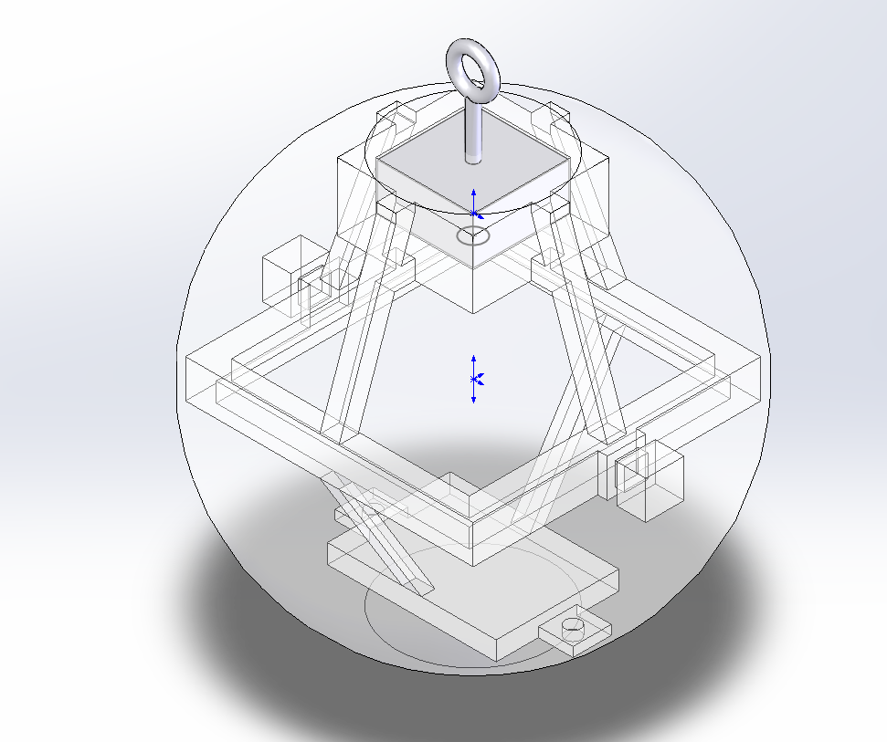
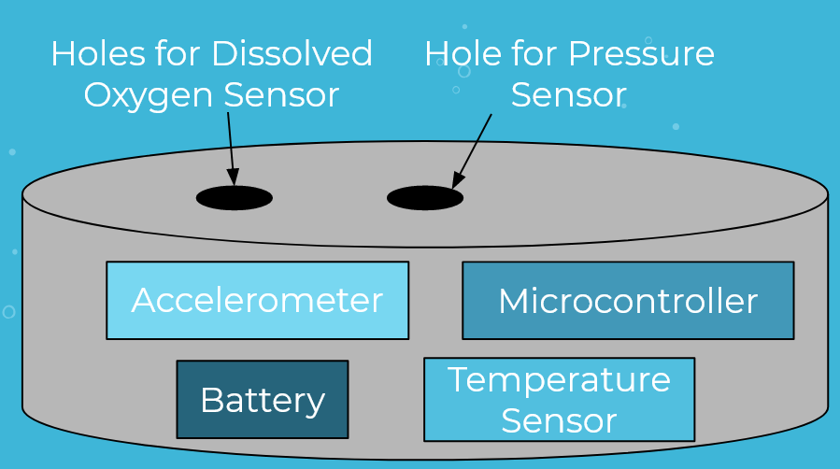
Visualization
Overview of Puck Systems
Overview of Puck CAD

Slide 7
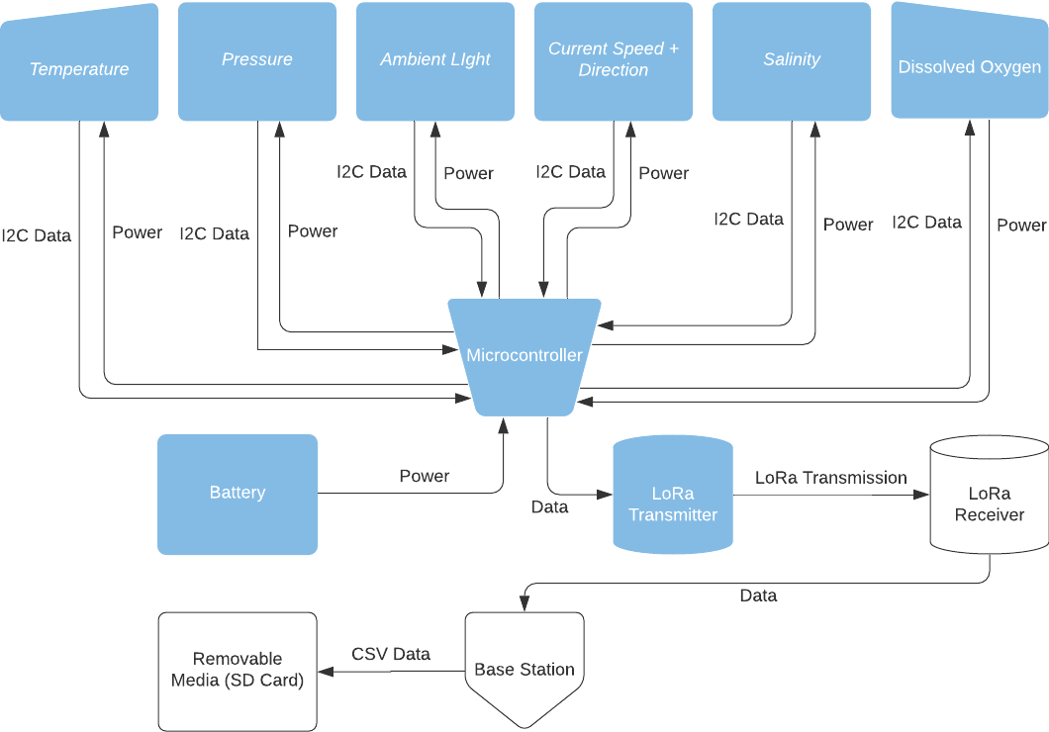

Slide 8
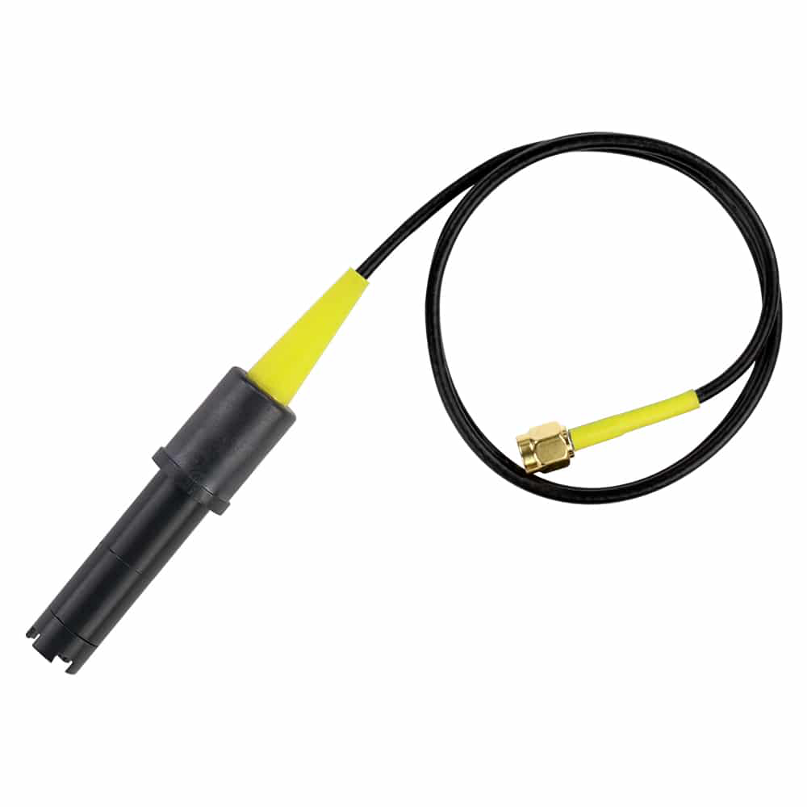
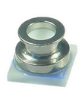
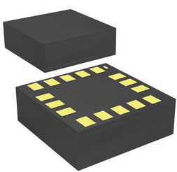
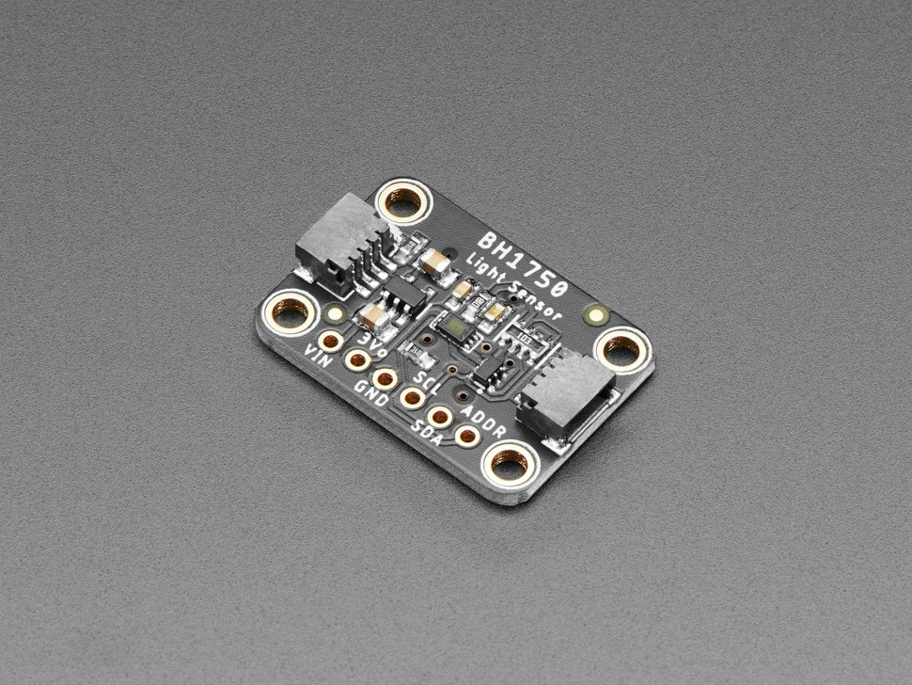
Technical Progress - Sensors
Dissolved Oxygen - Atlas Scientific DO2 Sensor
Reads data in percent saturation - good enough for our needs
Probe will be exposed to exterior
Salinity - Current sensing diode
Exposed to exterior
Able to calculate salinity from conductivity calculations
Water Current Velocity - ICM-20608-G (IMU)
Give reasonable data underwater
Operate while in liquid and tethered to buoy line/lobster trap
Depth - MS583730BA01-50 (Also Temp sensor)
Exposed to exterior (water proof)
Operate at 30 bar pressure and low temp
Temperature - MS583730BA01-50 (same)
Avoid temperature bleed from rest of unit
Bottom of PCB
Operate at range expected underwater (-55C)
Ambient Light -Adafruit BH1750
Avoid light bleed from other sensors
Behind waterproof cover to get reading

Slide 9
Technical Progress - Software
Software development done in Arduino framework
Using premade libraries for most sensors, radio
Need to finish developing drivers for salinity, dissolved oxygen sensors
Salinity is simple analog reading
Pressure will require a custom I2C driver
Currently able to send data from IMU, Ambient Light, Temperature, Dissolved Oxygen over LoRa in JSON format
Need to work on data storage, drivers, and logic for when to transmit data
"timeStamp": 50454,
"accelerationX": -1.213860273,
"accelerationY": -8.346187592,
"accelerationZ": 3.110068083,
"orientationX": -0.321353763,
"orientationY": 0.258601815,
"orientationZ": 0.092196018,
"temperature": 32.24764633,
"ambientLight": 23.33333206
}{
"timeStamp": 55522,
"accelerationX": 0.117315881,
"accelerationY": -9.56004715,
"accelerationZ": 0,
"orientationX": 0.027712099,
"orientationY": -0.009059724,
"orientationZ": -0.043966308,
"temperature": 31.63588142,
"ambientLight": 0

Slide 10
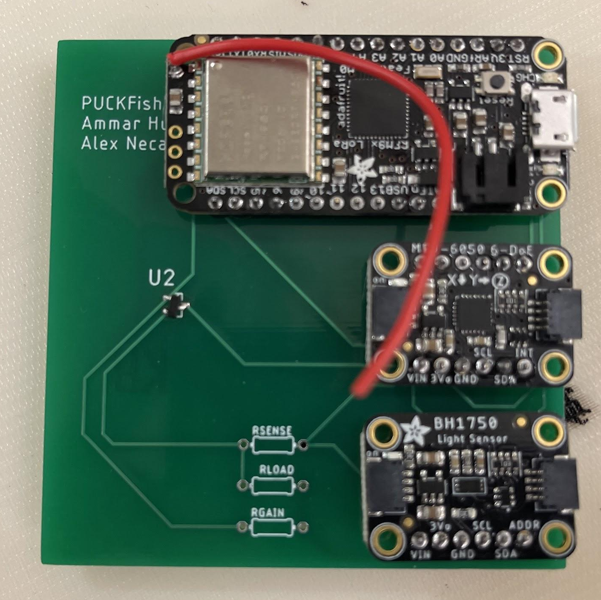
Technology Overview - Electronics
PCB developed and partially populated
Will be placed on rigid skeleton to position in mold
Some sensors require external access
Pressure sensor - will have routing to outside
Salinity - probes will extend from board
Dissolved oxygen - single probe extending from board
Storage, wireless charger, and battery not pictured
Wireless charger not on PCB, needs to be close to surface
Three boards, one for each unit
Each partially populated, completing will be simple
Need to figure out how to arrange probes, charger, battery

Slide 11
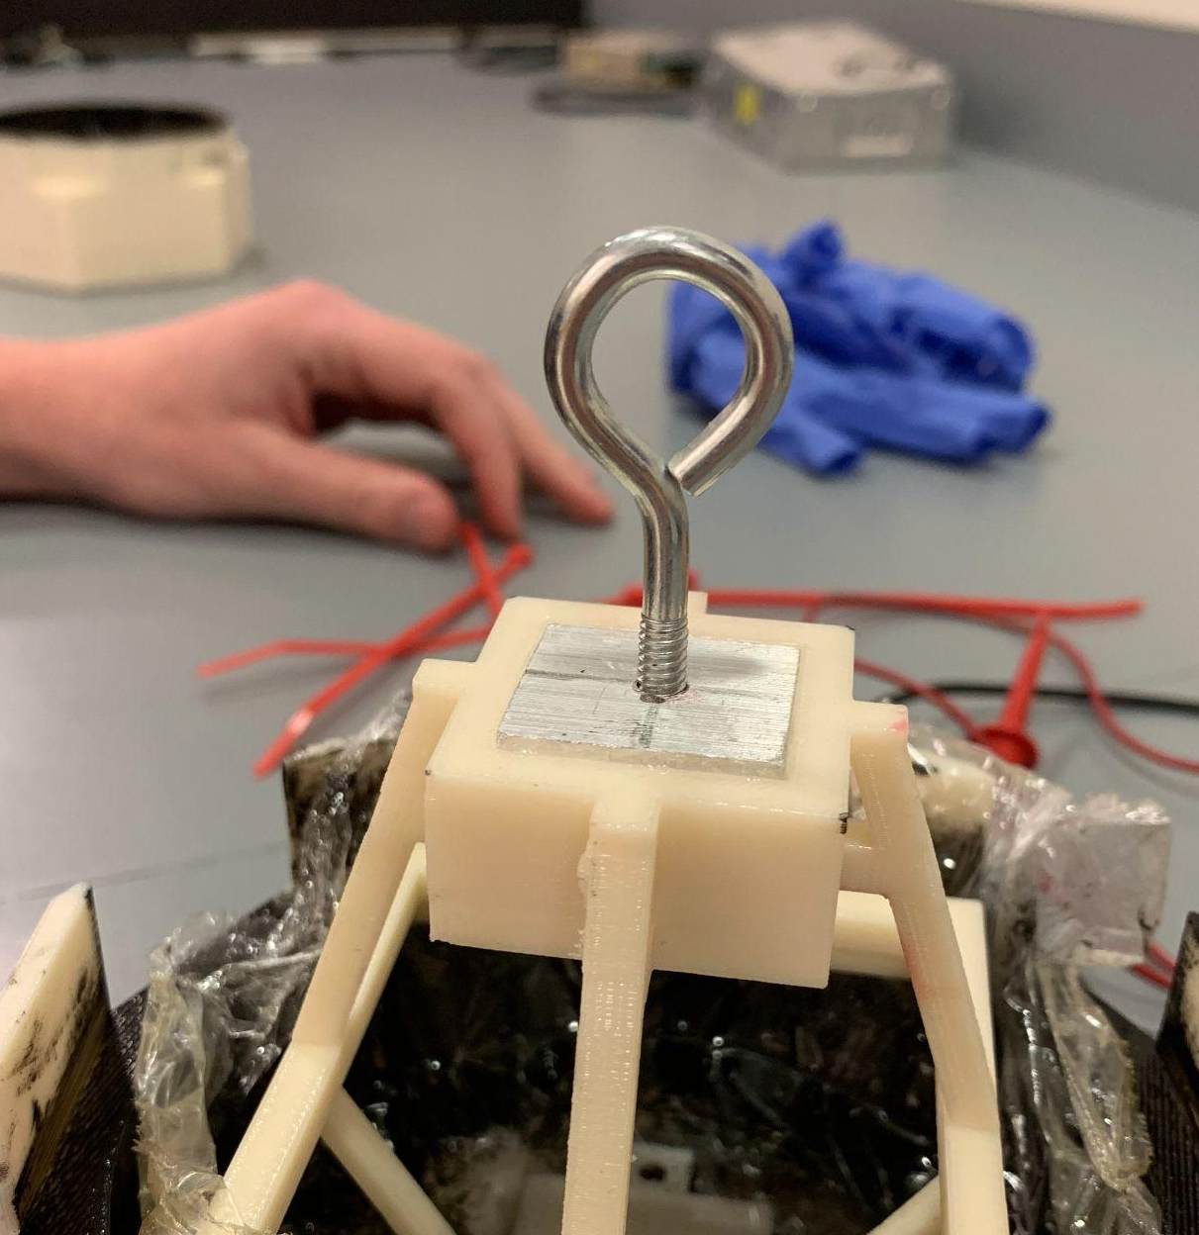
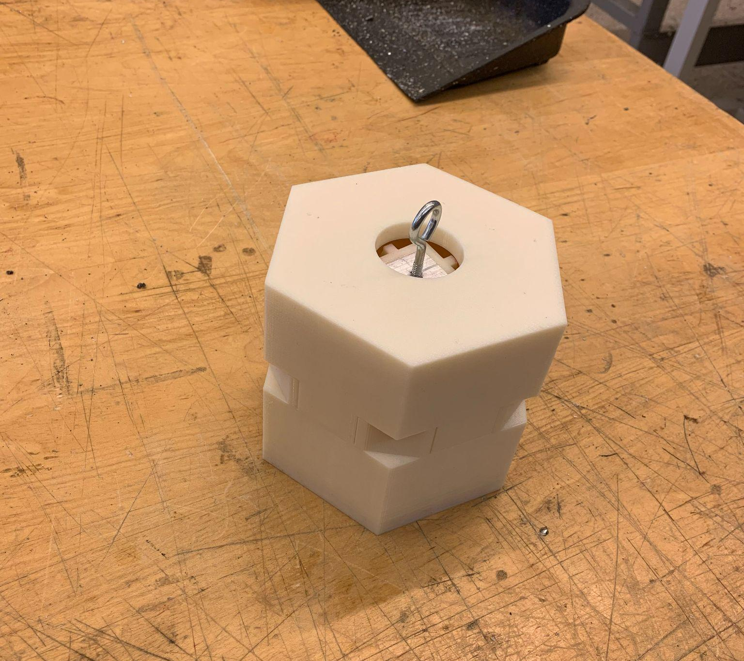
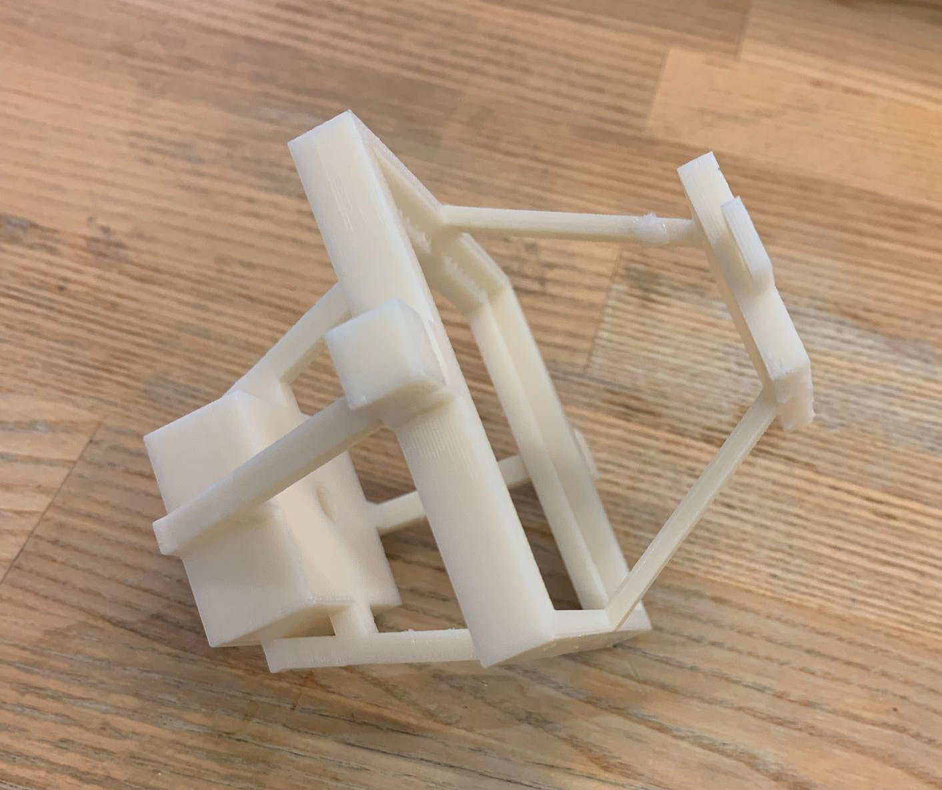
Technology Overview - Skeleton and Body Design
Inside the body of the PUCKFish, we created a skeleton out of ABS to hold our electronics in place
This form also allows us to add mounts for the buoy and attachment to the lobster trap
The skeleton of the PUCKFish will then be cast in epoxy to create a clear sphere
Eyebolt for cage connection
Skeleton
Skeleton in ABS mold
Notes:
Victoria

Slide 12
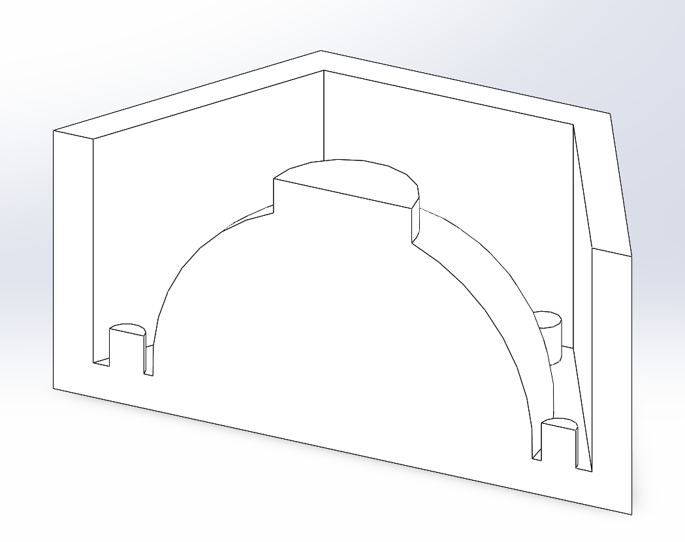
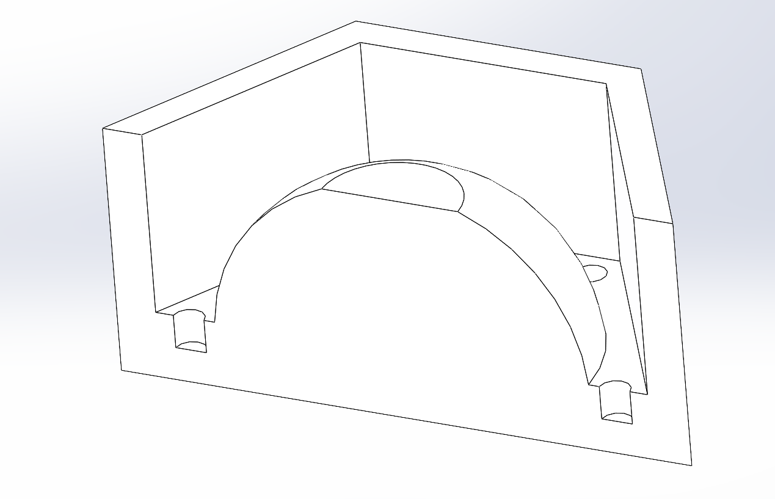
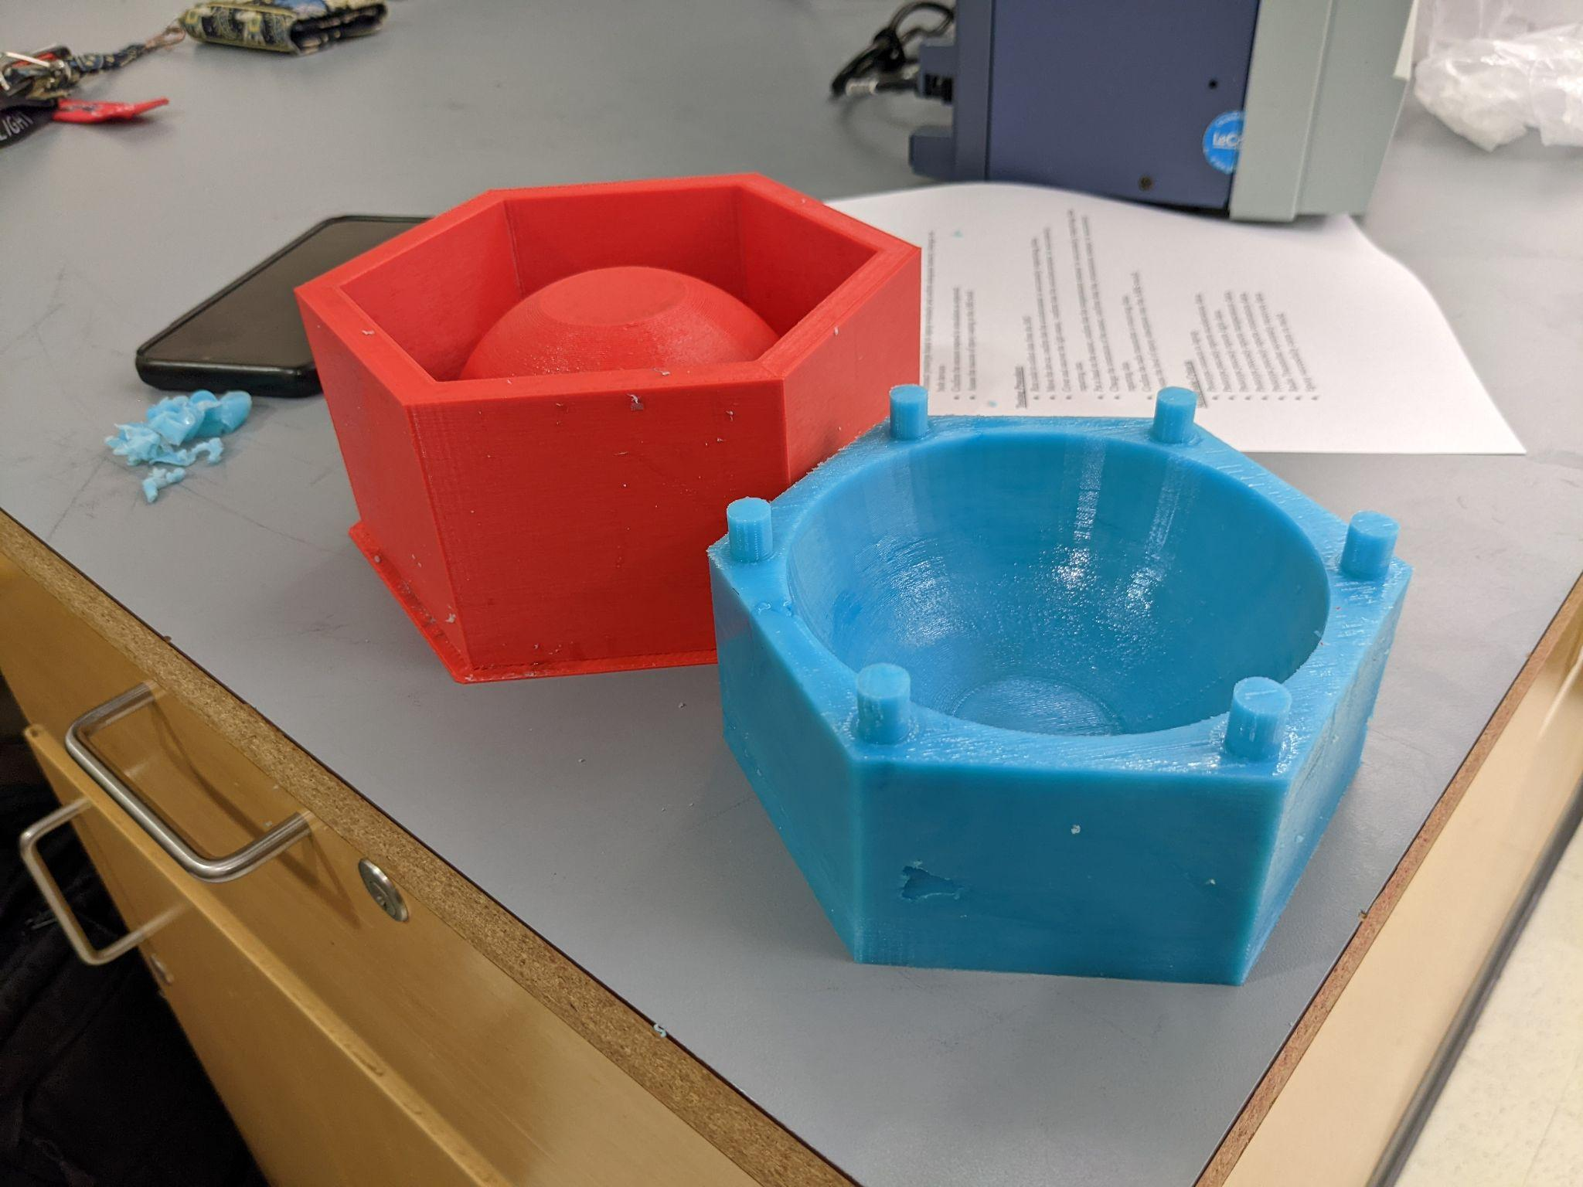
Technology Overview - Blanks and Molds
Originally planned to cast epoxy body in 3D printed ABS mold
ABS was too porous and absorbed the epoxy
Attempted to treat epoxy with enamel waterproof paint, but that was also absorbed
Used a 3D printed ABS blank to cast our mold in silicone
Following application of a mold release spray, the epoxy body can then be cast in the silicone mold, with no risk of seepage
This methodology is more standard, rugged, and effective
Final molds are cast
Epoxy pour with electronics pending finalized code
From left to right: top blank, lower blank, mold and skeleton assembly, and lower mold and blank

Slide 13
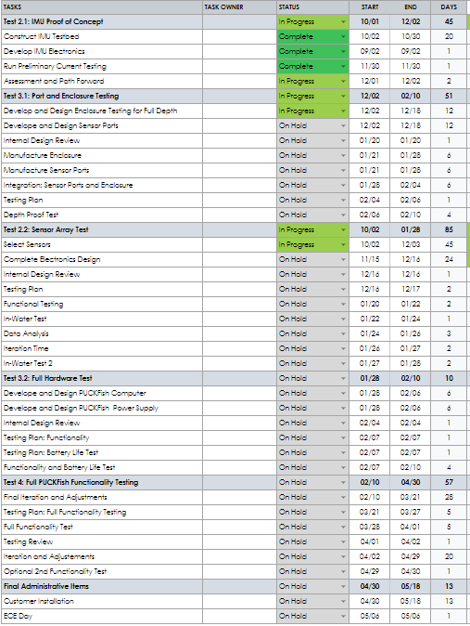
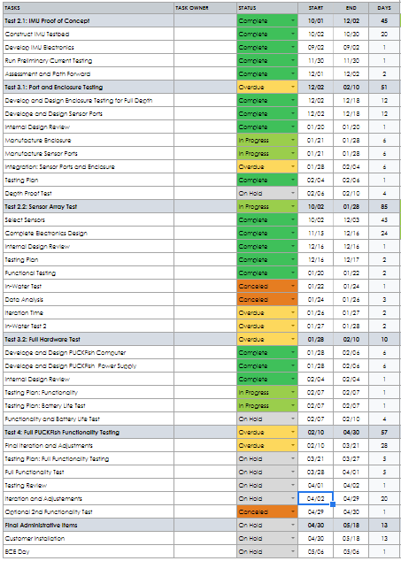
Schedule: Task List
PDR Stage
Updated
Notes:
Will

Slide 14
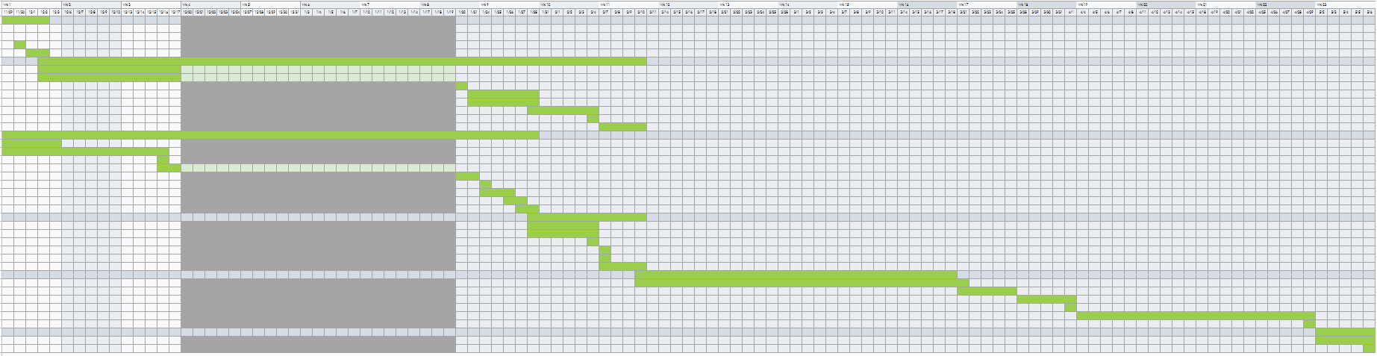
Schedule: Gantt Chart, PDR
Notes:
Will

Slide 15
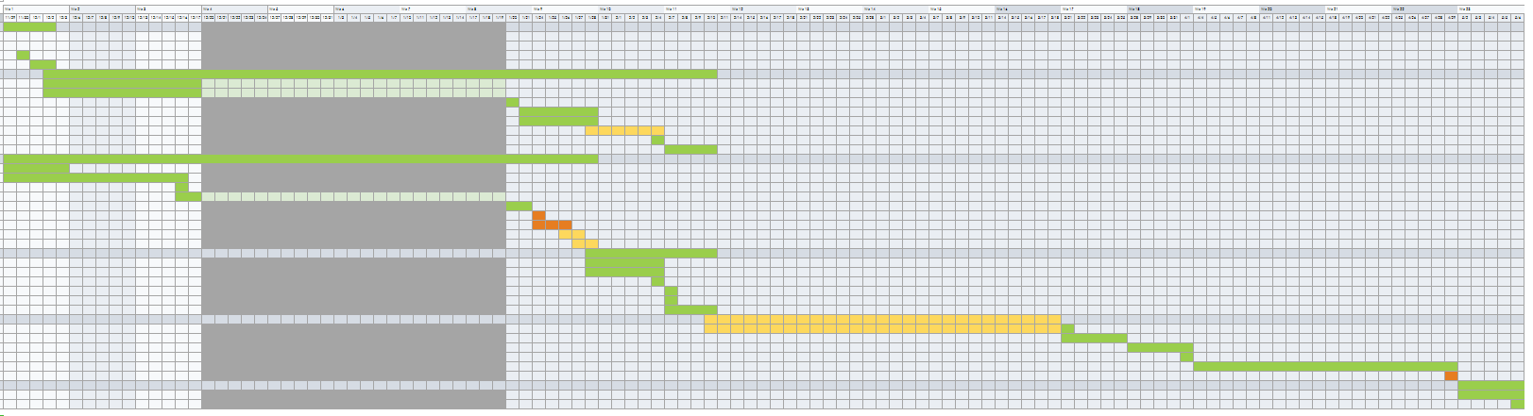
Schedule: Gantt Chart Current

Slide 16
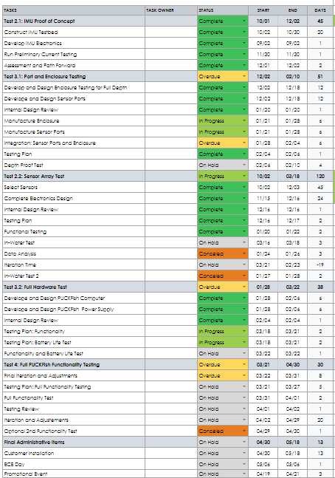
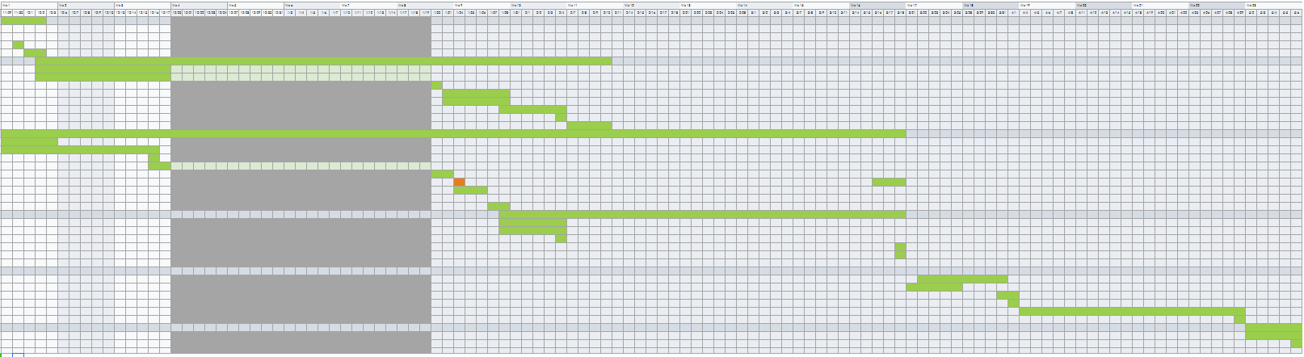
Schedule: Gantt Chart Updated

Slide 17
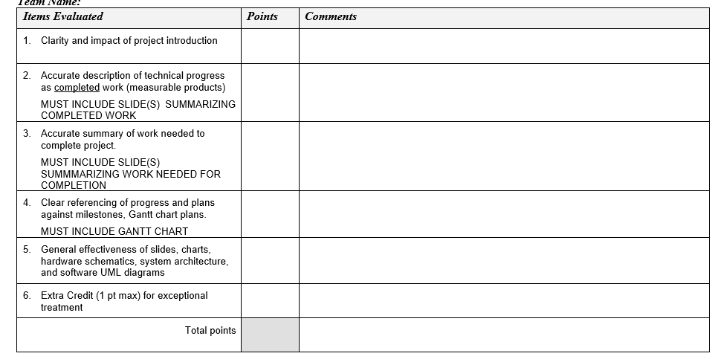
REQUIREMENTS!

