Slide 1
Puck Fish PDRR
Bill Aracri, Peter Ha, Ammar Hussain, Alexander Necakov, Victoria Thomas

Slide 2
Product Statement
Current lobster traps suffer from a lack of data necessary to lobster-catchers, and present significant environmental hazards to oceanic wildlife.
Today, only 400 North American Right Whales remain in the wild. Of these, 34 have died since 2017 to fishing-related accidents such as entanglement with fishing and buoy lines and boat collision.
Marine Mammal Protection Act and Atlantic Large Whale Take Reduction Plan limits where people can place traps, and the quantity, to prevent entanglement.
These can simultaneously be solved by the introduction of sensing devices to lobster traps, which then return data to a central, near real-time database. Lobster-catchers can track and recover each trap, while additionally collecting data on the most effective locations for traps and generating more complete data for several variables useful to fisheries and the scientific community, removing the need for extremely high volume trapping.
Notes:
Peter

Slide 3
Product Visualization
Hole for Dissolved Oxygen Sensor
Hole for Pressure Sensor
Microcontroller
Accelerometer
Microcontroller
SD Card
Battery
Temperature Sensor
Puck
Base Station

Slide 4
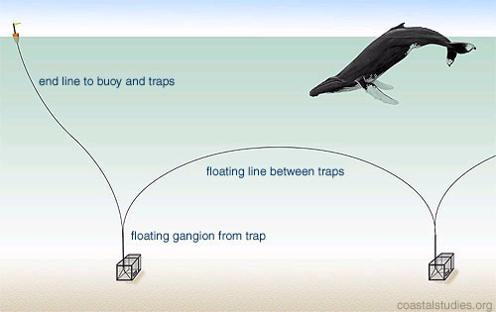

System Visualization
Current System
Our Solution
Gathers data about dissolved oxygen, pressure and floor conditions
Many, potentially inefficient traps, no data
Fewer, better placed traps informed by data
This product can be used with lineless or lined buoys
Notes:
Our device will be compatible with lineless buoys or reduce line waste for lined buoys

Slide 5
Deliverables
Prototype Stage
A functional sensing device that successfully collects data while submerged
Final Stage
Three PUCKFish underwater sensing devices
Base station for data transmission
Easy charging solution
Accompanying documentation

Slide 6
Requirements
Functions
Collect information about water in area around trap
Temp
Depth
Ambient Light
Dissolved Oxygen
Ambient Water Current Speed/Direction
Salinity
Automatically detect when the trap surfaces/submerges
Transmit data to shipboard base station when trap surfaces
Data must be transferable to removable media (SD Card)
Be in commonly readable format (CSV)
Support easy charging solution

Slide 7
Requirements
Objectives
Should be small in form factor (hockey puck size)
Should be easy to manufacture
Be chargeable with shipboard Marine Batteries (waterproofed lead acid batteries)
Withstand marine weather conditions (heavy rain, frequent splashes of saltwater)

Slide 8
Requirements
Constraints
Unit cost < $50 at scale, $150 for prototype
Last 10 days off of a single charge (2-3 days during normal use)
Time window to transmit data when trap surfaces (1MB at 50kb/s from 50ft away
Must operate at 1100 ft below sea level (34.4 atm)
Electronics must be waterproofed, but sensors have to be exposed to water
Collect data at least once per hour, but target once per minute if power budget allows for it

Slide 9
Competitors
Competitors were found and grouped into the following categories
Non-Competitors
These projects displayed similar goals to PUCKFish but approached the problem from a different perspective. As such, requirements for each system did not necessarily overlap and niches were not shared
Minor Competitors
These projects had the same goals and approached the problem in the same way as PUCKFish, however they exhibited fewer performance requirements and/or are inoperable or off-the-grid
Major Competitors
These projects had the same goals and approached the problem in the same way as PUCKFish, in order to compete in the same niche as these projects, more performance specifications were considered and adapted.

Slide 10
Competitors
Product | Dev Time (Months) | Temp | Oxygen | Depth | Salinity | Current Values | Ambient Light
PUCKFish | 6 | 1 | 1 | 1 | 1 | 1 | 1
Major
TimeZero | 6 | 1 | 1 | 1 | 1 | 1 | 0
eMOLT | 0 | 1 | 0 | 0 | 1 | 1 | 0
Minor
LobsterNet | 14 | 1 | 1 | 1 | 0 | 0 | 0
Oregon State U | 0 | 1 | 1 | 0 | 0 | 0 | 0
Non
LasTrap | 0 | 0 | 0 | 0 | 0 | 0 | 0
LobsterLift | 8 | 0 | 0 | 0 | 0 | 0 | 0
Notes:
Will

Slide 11
Questions?

