Slide 1
Veridion Insurance Taxonomy Classifier
Summary, architecture, and key decisions
Alex NEGULESCU

Slide 2
Problem & Goal
Assign one or more insurance taxonomy labels to each company
Export a clean, human‑readable list with label(s) and confidence
Provide simple manual validation and clear metrics

Slide 3
Inputs & Outputs
Inputs: data/ml_insurance_challenge.csv, data/insurance_taxonomy.csv
Intermediate: companies_lab_* (top‑k per pipeline)
Manual set: manual_validation_sample.csv (requires 'manual_lab')
Metrics: data/metrics.csv (overall + by confidence bands)
Final: company_list_solution.csv (insurance_label, confidence)

Slide 4
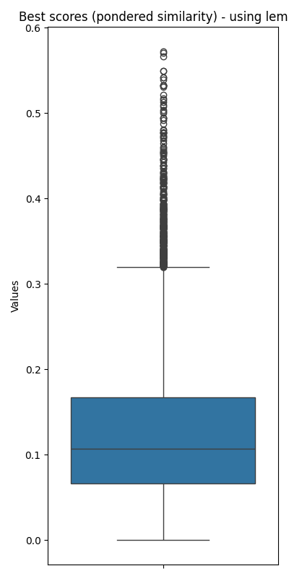

Baseline vs. Alternatives
Baseline: TF‑IDF + Cosine
Concatenate company text fields; vectorize with TF‑IDF
Cosine similarity to taxonomy labels; take top‑k
Ablations (Optional)
Split‑Tax: split labels into field/what
Lemma: lemmatization on text/taxonomy
Kept for analysis; baseline generally performed best

Slide 5
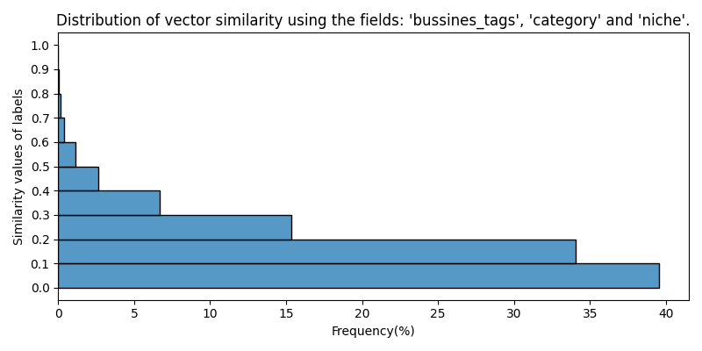
Decision Rationale — Why TF‑IDF Baseline
Strong performance in trials vs. split/lemma variants
Transparent and explainable (easy to audit per term/weight)
Fast and deterministic; minimal dependencies, easy to reproduce
Great fit for sparse, tag‑like data common in taxonomies

Slide 6
Unified Step — What It Does
Generates a manual validation sample (to label 'manual_lab')
Computes metrics overall and for bands: <0.3, 0.3–0.4, >0.4
Exports final list by joining non‑empty top‑k labels
Maps confidence from sim_val_1 to 50% / 75% / 90%

Slide 7
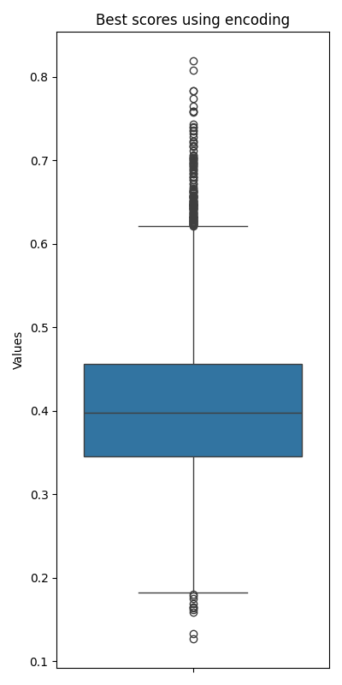
Thresholds & Confidence
Policy
Drop labels where sim_val_k < 0.3
Confidence from sim_val_1: <0.3→50%, 0.3–0.4→75%, >0.4→90%
Rationale
Based on data distribution and metrics
name | accuracy | precision | recall | f1
total | 0.75 | 0.83 | 0.75 | 0.77
under_0.3 | 0.4 | 0.65 | 0.4 | 0.48
0.3-0.4 | 0.75 | 0.78 | 0.75 | 0.75
over_0.4 | 0.895 | 0.916 | 0.895 | 0.904

Slide 8
Optional SBERT Fallback (Low‑Confidence Only)
How
Compute embeddings only when TF‑IDF similarity is below threshold
Cache taxonomy embeddings to keep it fast
Why
Improves recall on hard cases without slowing the baseline
Avoids full‑scale embedding of all companies (cost/latency)
Keeps reproducibility and transparency as defaults

Slide 9
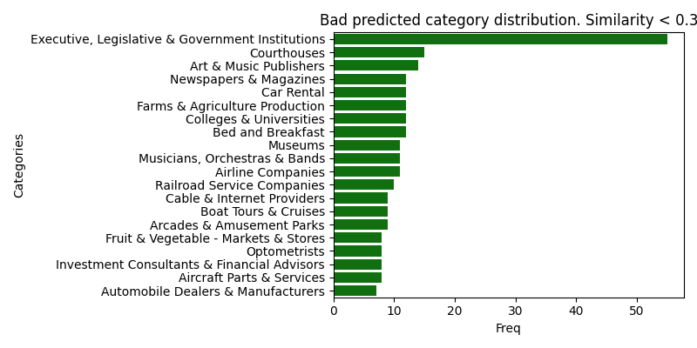
Bad predicted categories
Many items (e.g., government institutions, venues, arts) aren’t insurance concepts, so the model latches onto broad industry words rather than true insurance labels.
Generic-token dominance on short/noisy text

Slide 10
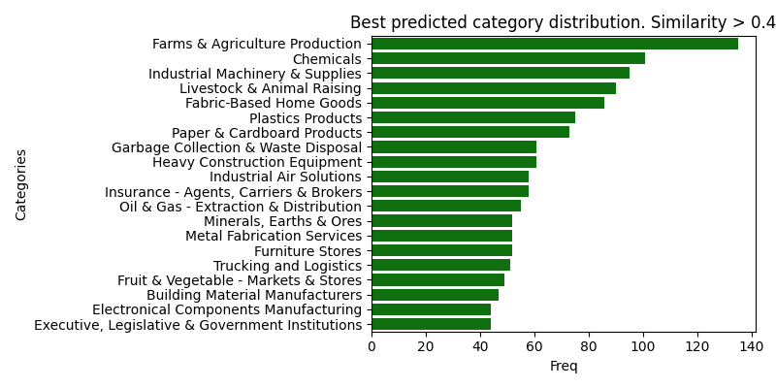
Well predicted categories
Distinctive domain vocabulary – they use rare, specific terms/bigrams that separate cleanly in TF-IDF (e.g., fertilizer, livestock, extrusion, corrugated, PCB, trucking, waste disposal, heavy construction, chemicals
Richer, on-topic descriptions – company blurbs list products/processes (materials, machinery, operations), so the signal-to-noise is high and cosine aligns strongly with the taxonomy entries.

Slide 11
Reproducibility & Structure
Single entry for unification; separate pipelines for ablations
Deterministic outputs and pinned versions recommended
Clear folder structure and standardized CSV artifacts

Slide 12
Quick Start (Commands)
python pipeline_tf_idf_simple.py
python pipeline_split_tax.py # optional
python pipeline_split_lemma.py # optional
python pipeline_unified.py # evaluate + export final list

Slide 13
Limitations & Next Steps
Distinctive domain vocabulary – they use rare, specific terms/bigrams that separate cleanly in TF-IDF (e.g., fertilizer, livestock, extrusion, corrugated, PCB, trucking, waste disposal, heavy construction, chemicals
Consider adding a more powerful pre-trained model as fallback for low confidence scores

