Slide 1
CAPx Release 0.1
Contributors:
Steven Truong - Jose Recendez - Alex Neumann
Sneha Patel - Tom Rullestad

Slide 2
Overview – CIS 440 Class Website
Goal: Create a website for the CIS 440 capstone class which allows companies to post project opportunities and students to sign up for projects
Core Functionality:
Allow companies and students to post projects
Rate projects (up/downvote similar to Reddit.com)
Signup for projects
View Dr. Clark’s comments on each project
View completed projects from previous semesters

Slide 3
Additional Functionality
Additional Features:
Allow students to login with GitHub account
Project expiration (automatically remove old projects for next semester)
Tags for projects
Example (for our project): Python, Heroku, Flask, CSS, HTML
Tags for students
Example: Front-End, Back-End

Slide 4
Technology
Technology Used:
Hosting service: Heroku
Database: PostgreSQL
Coding language: Python with the Flask framework
HTML / CSS (with bootstrap)
Live “Hello World” site
http://arcane-crag-8303.herokuapp.com/

Slide 5
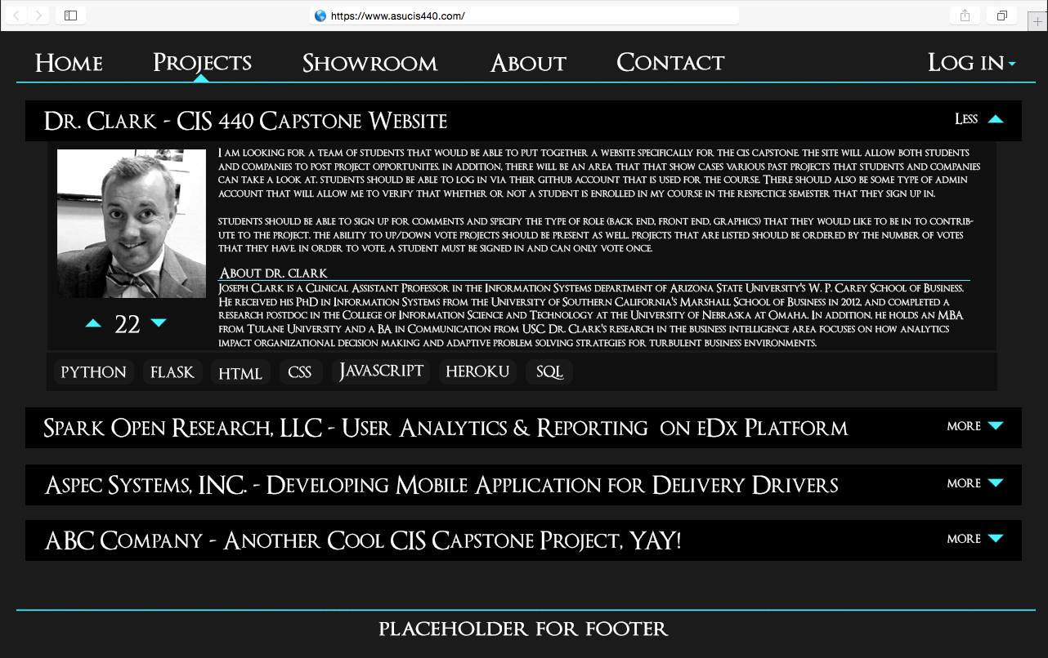
Mockups

Slide 6
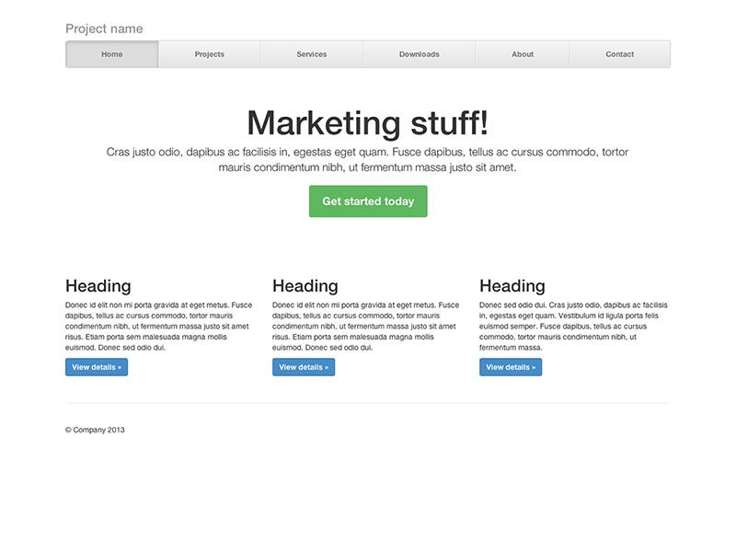
Mockups

Slide 7
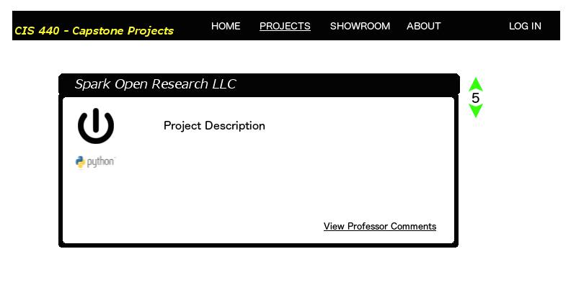
Mockups

Slide 8
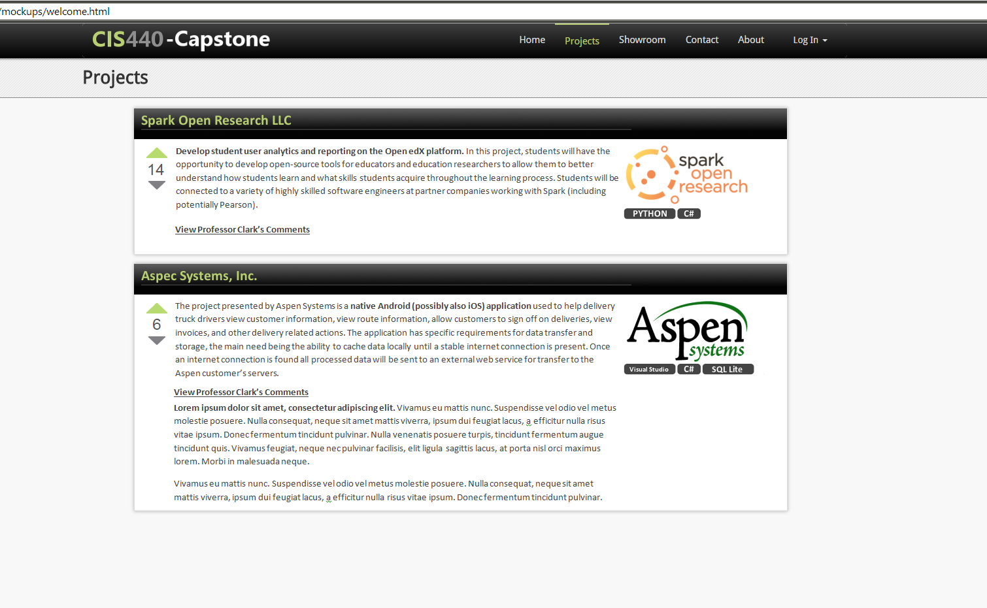
Mockups

Slide 9
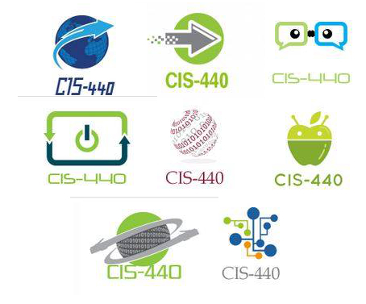
Mockup Logos

Slide 10
Task Board – Waffle.io
Task Board:
https://waffle.io/asu-cis-capstone/capx
GitHub Repo:
https://github.com/asu-cis-capstone/capx

Slide 11
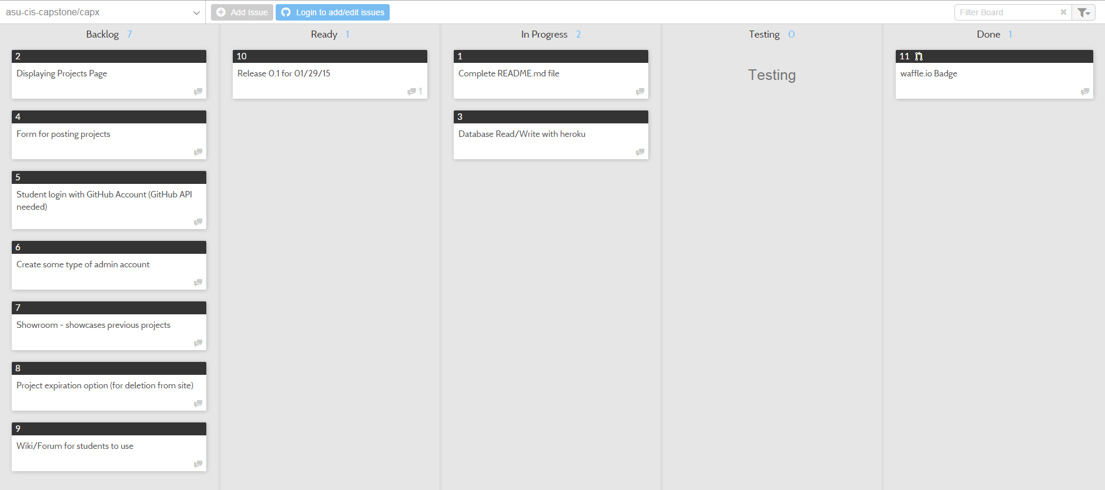
Backup – Task Board screenshot

